Slide 1

Home System
Architecture:
Opening the Door

Slide 2
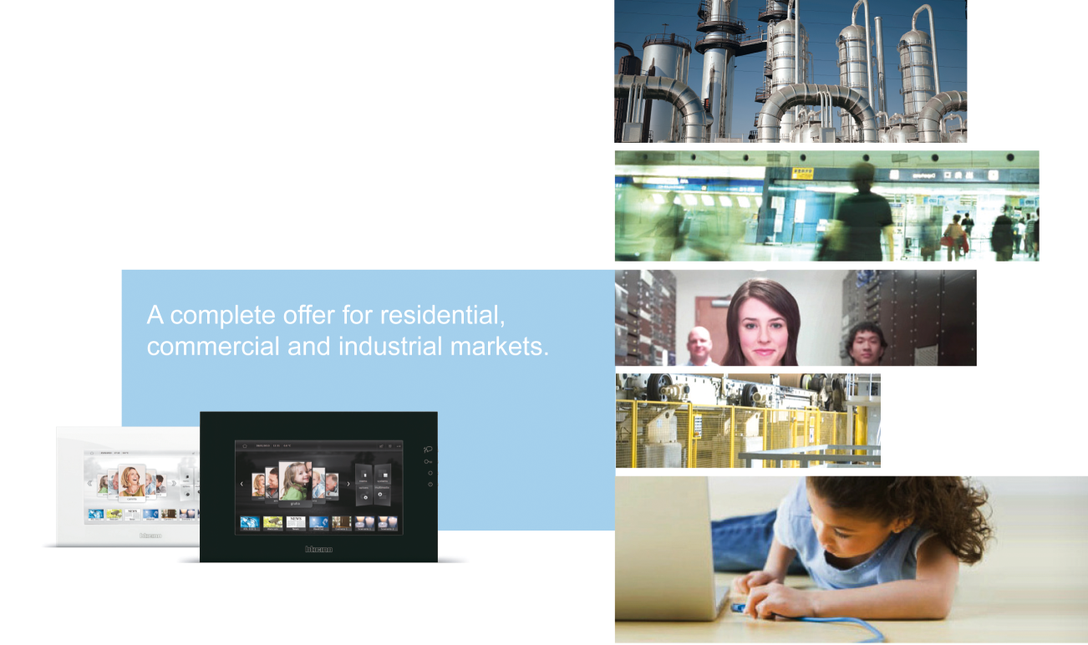
THE GROUP
Legrand Company
The global specialist in electrical
and digital building infrastructures

Slide 3
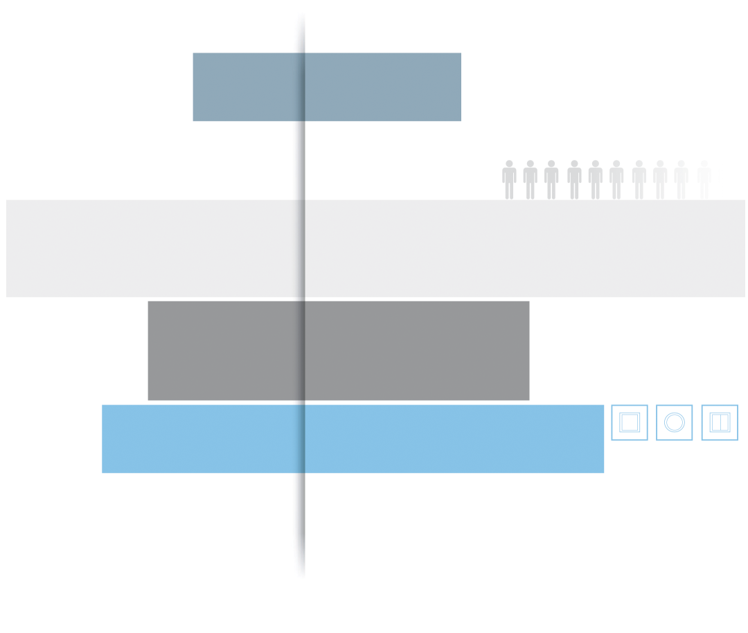
THE GROUP
Legrand Company
180
Active in
180 markets
Over 70 branches
70
More than
33.000 employees
throughtout the world
33.000
8%
+8% average yarly
incrase in revenue
in the 5 years
190.000
Over 190.000 product in the revenue in the 5 years
Market leadership -
in at least one product series -
in more than 20 countries
20

Slide 4
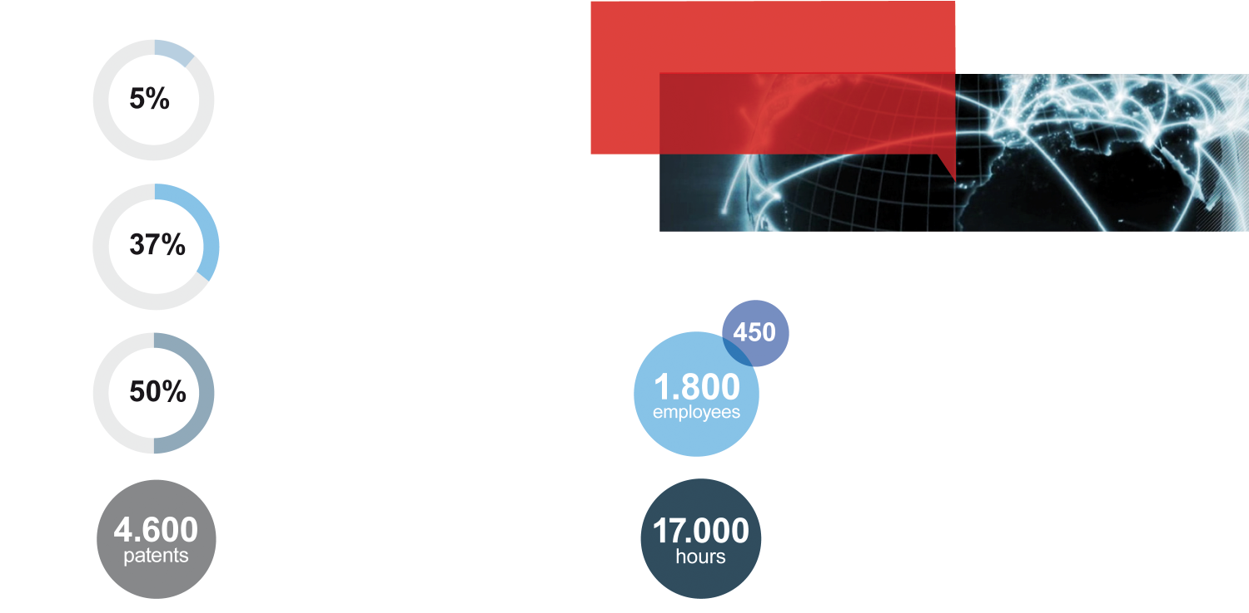
RESEARCH AND DEVELOPMENT
Legrand Company
Over 4 billion
electrical devices
installed throughout
the world.
5% of revenue
invested in R&D.
37% of total investments dedicated to the development of new products and solutions.
50% of sales generated with products added to the catalog
less than 5 years ago.
Over 1.800 employees dedicated to Research & Development, including 450 in Italy.
Over 17.000 hours/year dedicated to training employeeson enviropmental issues.
Over 4.600 active patents.

Slide 5
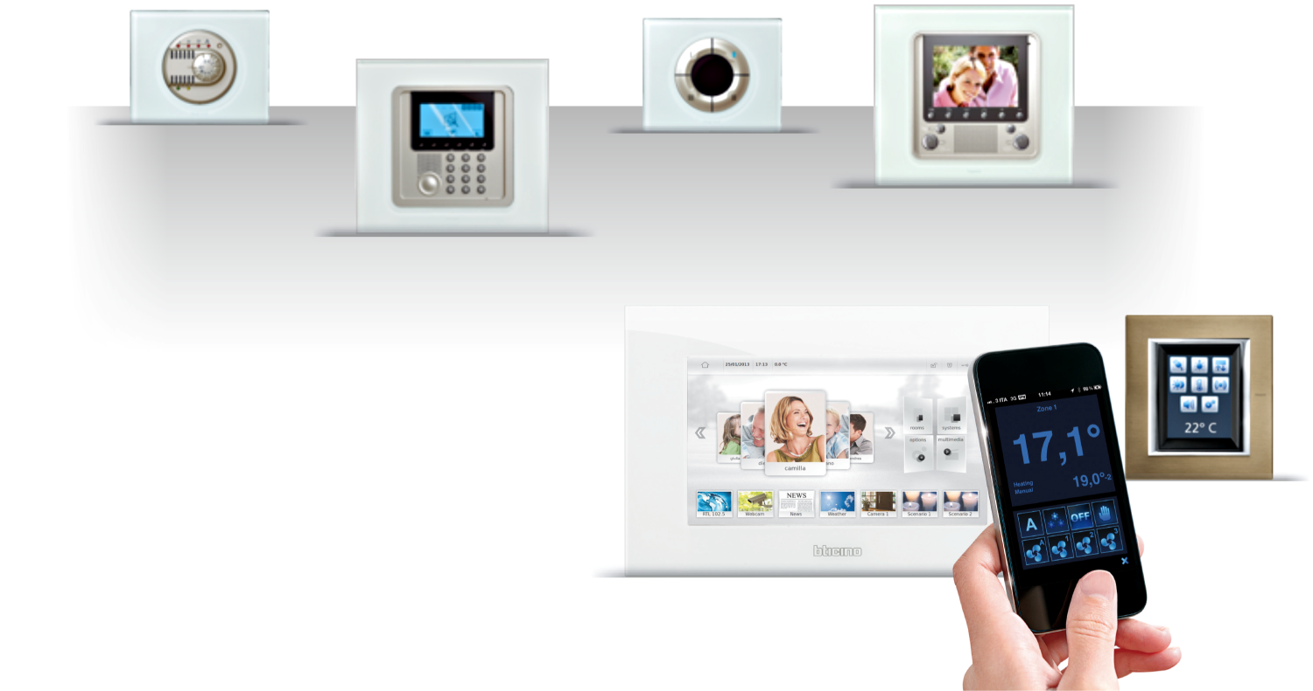

MyHOME
Home Automation System
ENERGY MANAGEMENT
VIDEO DOOR ENTRY
COMFORT
SAFETY & SECURITY
LOCAL AND REMOTE CONTROL
MyHome offer is the home automation
solution of Legrand group
Commercialize since 1992 and
continuously improved

Slide 6
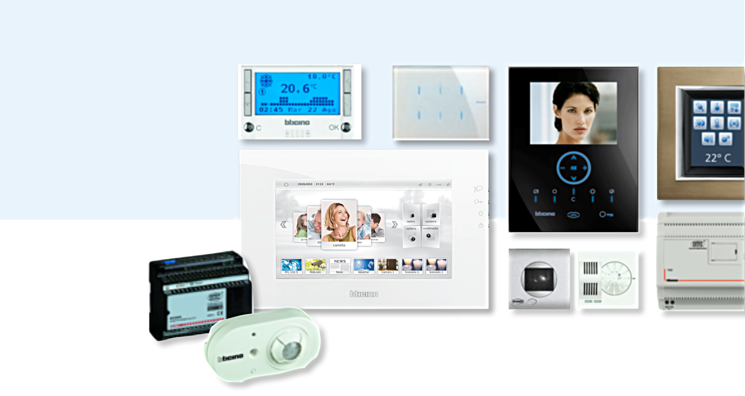

FEW DEVICES OF MyHOME
Home Automation System
MyHome is a network
of devices/systems connected each other; the “status of the house” is always available and shared among all the devices

Slide 7



MyHOME IS OPEN
Home Automation System
The main
pillars to let
MyHome
open are:
OpenWebNet a public language for home automation
MyOpen community
www.myopen-legrandgroup.com
OpenWebNet a language
developed since 2000
MyOpen community a web
community online since 2006

Slide 8

INTEROPERABILITY PROJECT -
VISION AND OBJECTIVES
Trends
CURRET TRENDS
Evolution of Energy scenarios (smart grid, renewable energy)
Social-demographic evolution (active ageing)
Evolution of connectivity and user interface (Internet of Things, M2M…
Social evolution (smart city, smart communities, social networking)
Everyone is driving for a common and systemized approach.
Even the home (in fact especially the home) must evolve
in accordance with the change.
Some studies predict that in 2020 (in 8 years)
more than 50% of homes will be Smart
(Source: Deutsche Telecom)
[
]
Legrand facilitates debade between different stakeholders
The interoperability project establishes the bases for the change

Slide 9
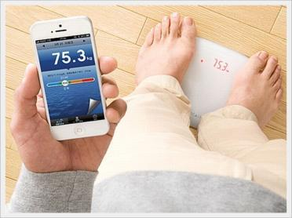
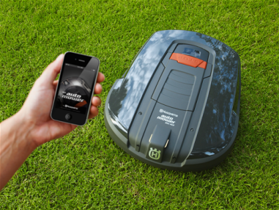
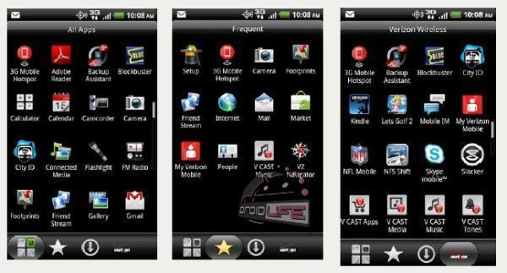
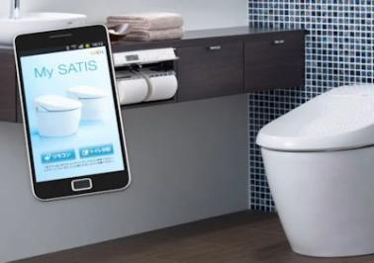
IoT means Interoperability
Trends
CURRET TRENDS
Everyone is proposing smart objects or smart functions.
Control by Smartphones and Tablets are always proposed.
Cloud connection is increasing rapidly.
The solutions proposed by manufacturers are almost ever vertical and proprietary.
THREE MAIN RISKS
The “Salami Slice” Syndrome. Vertical non-communicating solutions.
The Apps Babel and the “bloatware” infestation.
The privacy at stake.

Slide 10

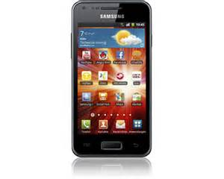






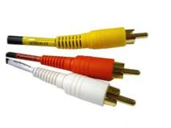
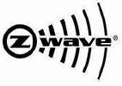


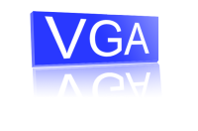







A strategy for interoperability
Interoperability works here
English Spoken Language
Protocol: Meucci
Plain Old Analog
Wired (2 wires)
Fixed
Voice only
Protocol: GSM / 4G
Digital
Wireless
Mobile
Smart contents
Network physical translations
Ethernet

Slide 11




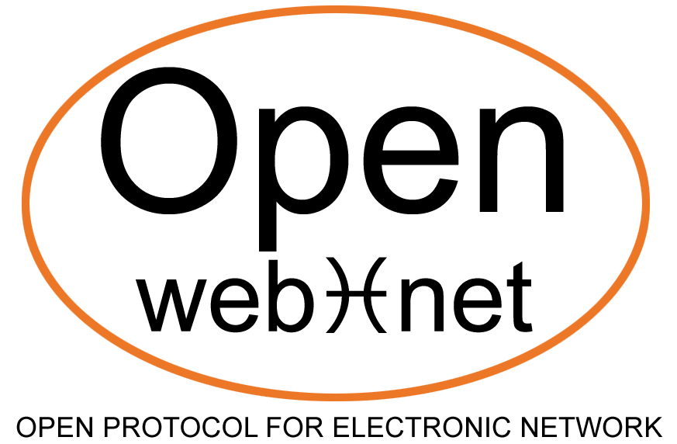

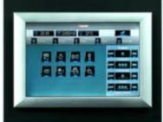
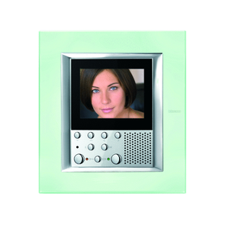
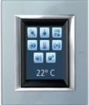

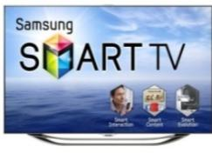
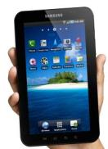
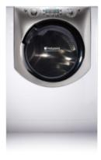


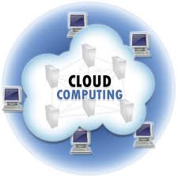
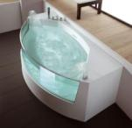
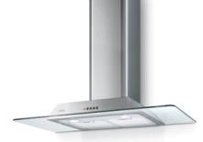
Interoperability: the importance of SCENARIOS
The home architecture
Loads
I’m going to sleep!
Ethernet /WiFi→OverIP
Got an alarm!
Reduce energy consumption by 50%
Washing machine has finished!

Slide 12
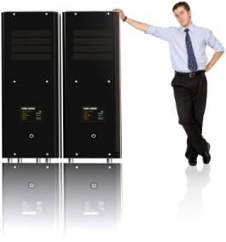

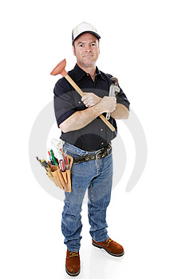
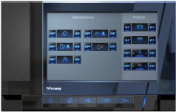
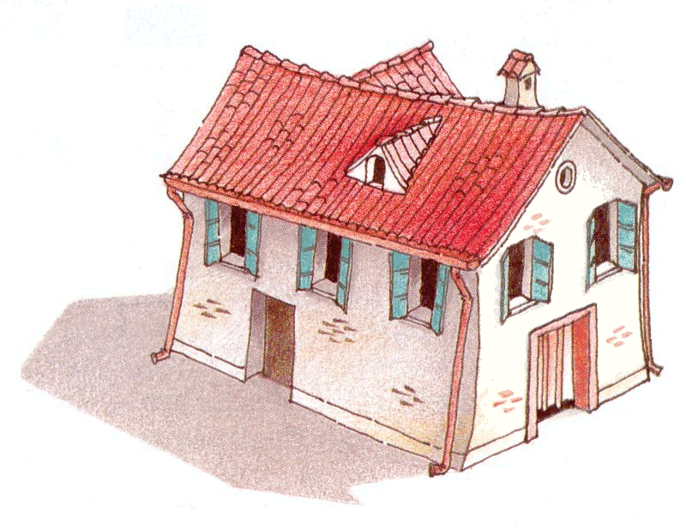
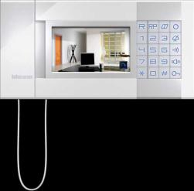
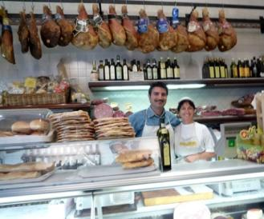

HOME LIFE
The public architecture
Real time data.
Real time data.
web
Real time data.
Service to people and homes.

Slide 13
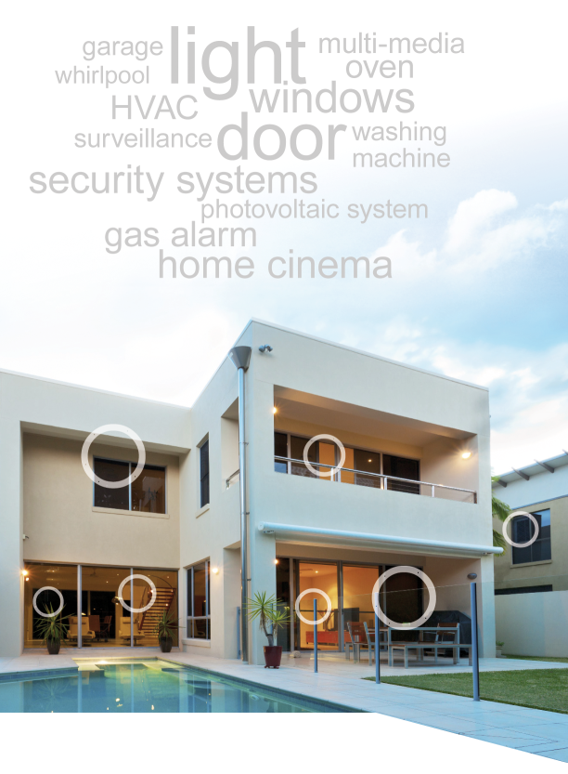
INTEROPERABILITY PROJECT -
VISION AND OBJECTIVES
A COMMON AND OPEN PLATFORM FOR THE MARKET OF DOMESTIC AUTOMATION
Creation of an open, simple, economical interoperable language with the aim of allowing the object to communicate between themselves therby opening up the possibility to create even complex relations and reaction
Such a language is not intended to substitute
complex management systems of proprietary protocls with specific purposes, but to coexist and integrate with them enabling interoperability
The Open Source nature of the project will facilitate
the adoption by a large number of operators - even small producers - and its development will benfit from the contribution of all

Slide 14
INTEROPERABILITY PROJECT
Smart objects, smart home, smart building, smart cities, smart countryes…
Energy management
Awareness
Peak management
Sources management
Smart grid
INTEROPERABILITY
IS A KEYWORD FOR THE CURRENT
MAIN WORLDWIDE TRENDS
Internet of Things:
a connected world
In 2015 more than 25 billions of “things”
will be connected. Almost all market segment
is adopting IP technology.
AAL,
Digital Divide,
active aging

Slide 15

INTEROPERABILITY PROJECT
To introduce the two basic pillars of “DEVICES INTEROPERABILITY”,
start speaking about “PEOPLE INTEROPERABILITY”
DEVICES can “interoperate” if
They can get
in touch each other =
they have to share a
“technological solution”
to get in contact
They can exchange
information each other =
they have to share
the same language

Slide 16
KEY FACTOR
Open and free language
Contribution of the Community
Open App
OPEN SOURCE
DEMOCRATIC
SCALABLE
FLEXIBLE
ECONOMICAL
Autocertification of compatibility
Possibility for all to add missing User Cases
Maximum freedom in product functionality
Minimum requisites to be compliant are very low
From simple solutions to complex algorythms
No limit to the number of integrable objects
Vertical & horizontal solutions
Diversity in the solutions
User case and shared or reserved solutions
Marginal investments to adapt products
Light software
HW: current power on electronic board already suitable

Slide 17
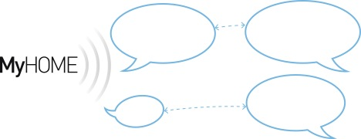


OPEN WEB NET
Public language for Home Automation
The
Temperature
is of 20 degree
Let me know
the temperature of the bedroom
Over IP
Switch off
all the lamps
Done!
Any IP devices
Born in 2000 and freely available since 2006
Introduce an abstraction level that allows the supervision and control of any
home automation system (not only MyHome) by concentrating on the functions
OpenWebNet is a “standard de-facto”
In a connected world OpenWebNet is playing a very important role
- Able to make the “Home Automation” a “thing” of the “Internet of things”
  - It generates business enabling interoperability (plenty of devices are able
to “speak openwebnet” and has been developed and sold)

Slide 18


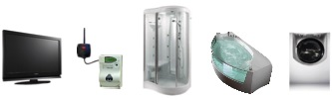
OPEN WEB NET
Public language for Home Automation
Simple… very
simple language
to learn and to use
Designed to be
used on any
operative system
Designed to be
simply improved
Designed
to be used on
any HW platform
Designed to be used also for devices / systems different from “home automation”
(i.e. household appliances, energy metering, etc..)

Slide 19
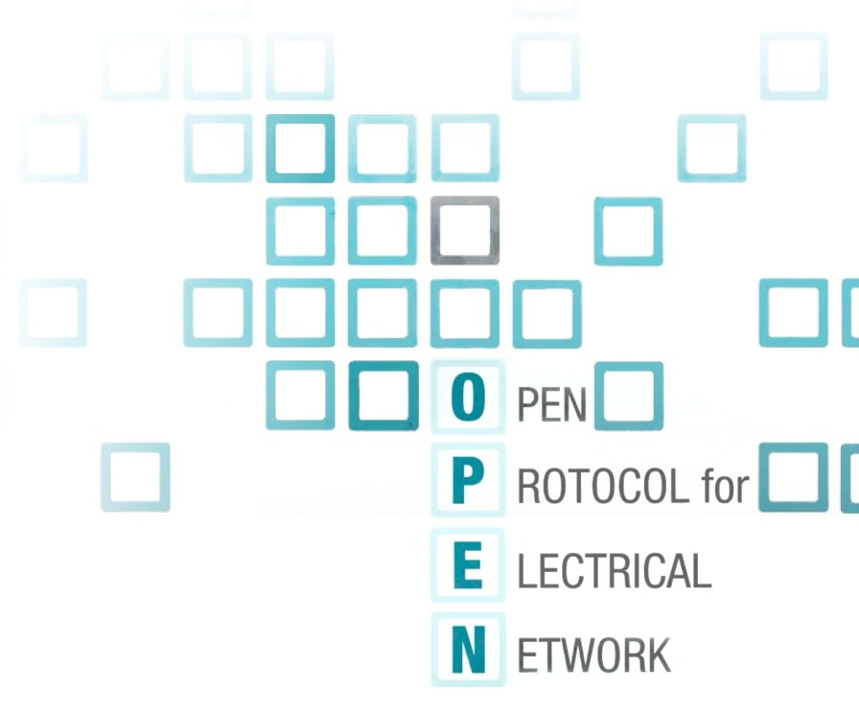
OPEN WEB NET is open
Public language for Home Automation
Grammars and vocabulary
are freely available here:
www.myopen-legrandgroup.com
MyOpen went on line the 2006; since then
(thanks to the so “openess” approach),
everyone could, can and will be able to:
improve the “words” of openwebnet language
to describe functionalities not covered till now
develop and promote their own solutions
(device, software, etc) openwebnet compliant

Slide 20
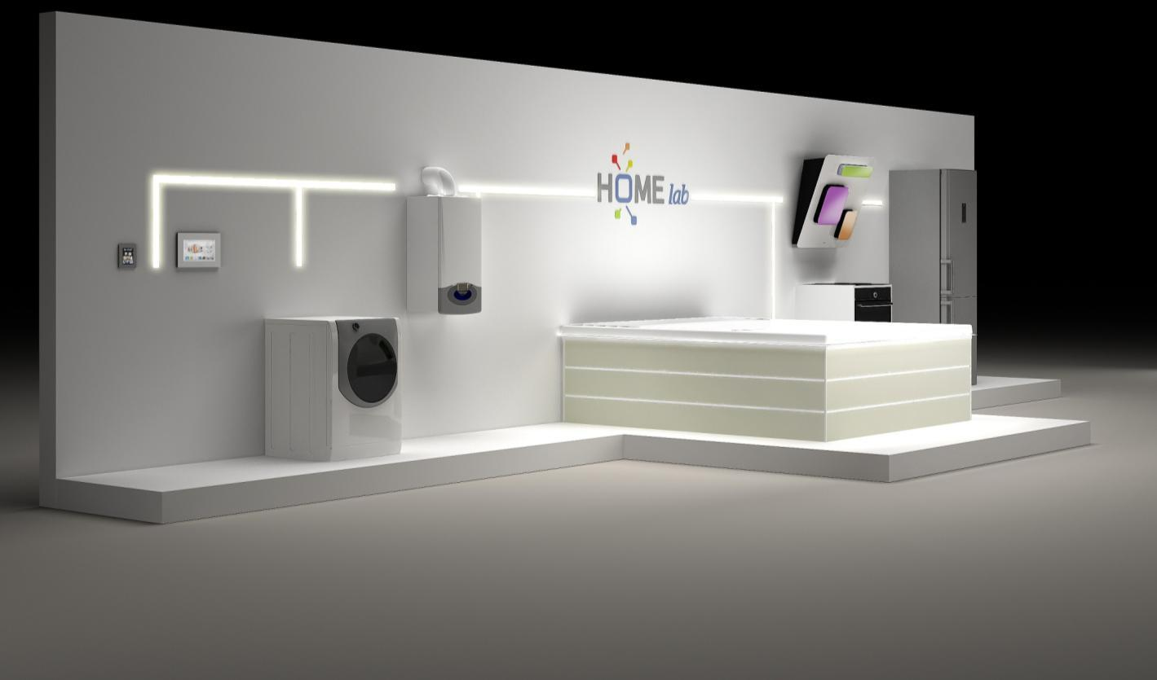
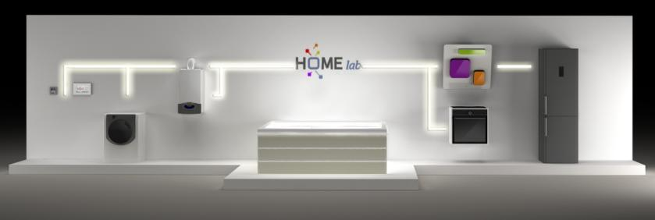
The connected objects via Open Web Net

Slide 21
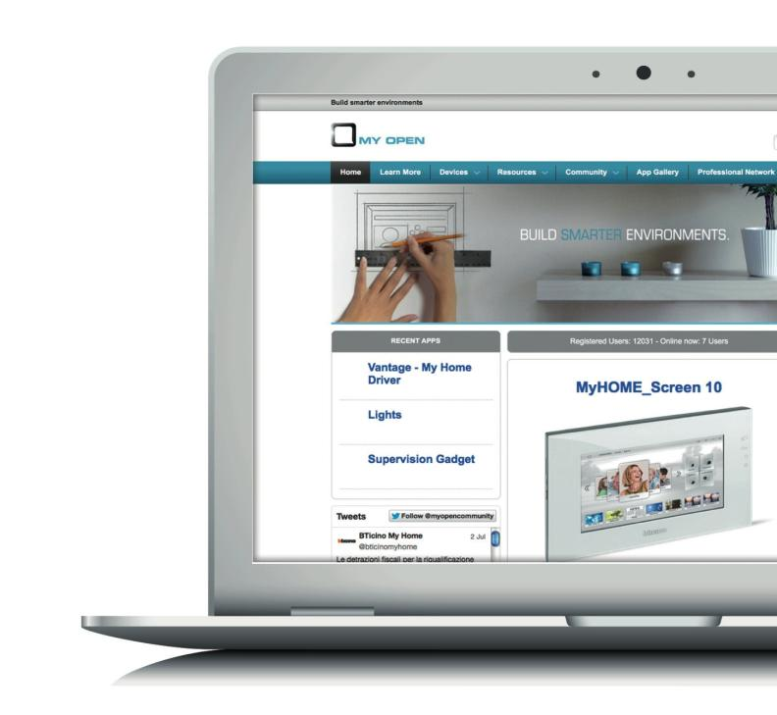
MY OPEN
Community
www.myopen-legrandgroup.com
+ 14’000 users
See the following preliminary videos
http://www.youtube.com/watch?v=pKiWFZwD7xg
http://www.youtube.com/watch?feature=player_embedded&v=QrggqHmbn8o

Slide 22
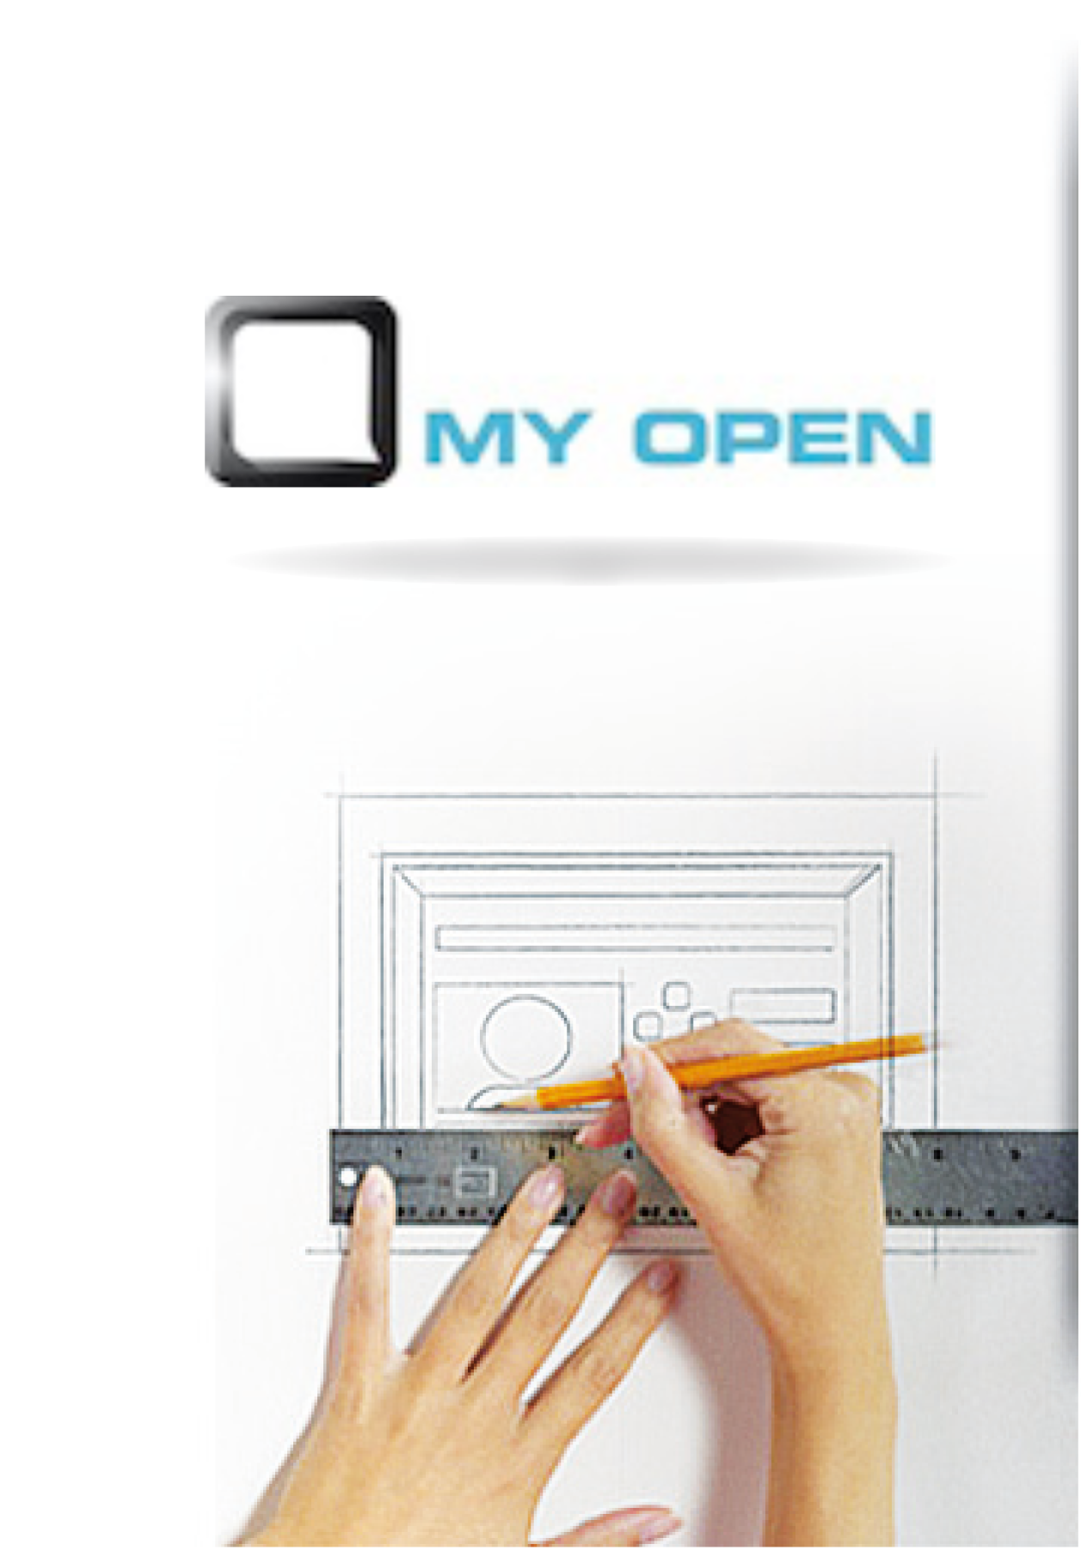
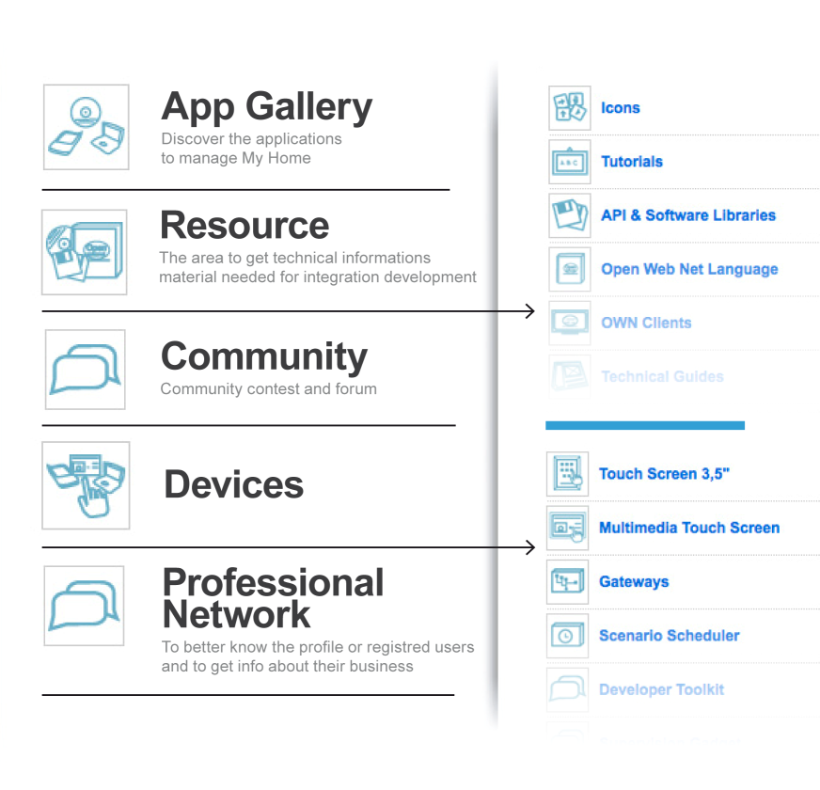
MY OPEN the main area
Community

Slide 23
Conclusions
As seen in the previous slides, a correct approach to smart homes needs a multidisciplinary set of skills about:
System architecture
Digital Hardware platforms
System and application Software
Networking

