Slide 1
My English Class

Slide 2
Objectifs
Dans ce cours vous allez:
découvrir le genre du roman policier,
apprendre à déceler des indices et étudier un extrait d’un roman policier,
jouer au détective afin de résoudre une énigme,
parler, lire et comprendre en anglais.

Slide 3
Recommandations
Parler en anglais
Participer activement
Recopier les parties indiquées COPY
Retrouver le cours et l’émission en Replay sur le site Lumni (France 4)

Slide 4
The Guessing Game

Slide 5
Guess who ?
3. Queen Victoria was a huge fan of this character.
4. His best friend was a doctor.
This famous detective is a fictional character who has appeared in 226 films.
5. He lived at 221b Baker Street, London.
2. He was created by a Scottish writer but the character is British.

Slide 6
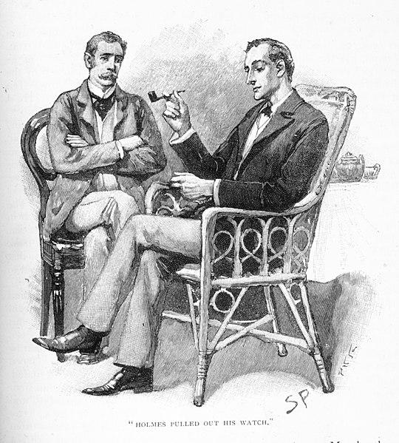
Sherlock Holmes
(a fictional character)

Slide 7
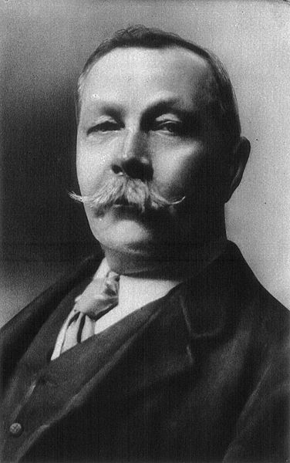
Arthur Conan Doyle (novelist)
(1859-1930)
Edinburgh,
Scotland
Began writing in 1880 while studying medicine
Studied medicine and developed his power of observation
Wrote 60 detective novels featuring Sherlock Holmes
Became a doctor

Slide 8
Whodunnit ?
Dictionary definition (vocabulary.com)
A Whodunnit (= who did it ) is a mystery story that keeps the criminal’s identity a secret until the very end.
Arthur Conan Doyle excelled in the art of Whodunnits ( aka detective fiction).

Slide 9
Reading Comprehension

Slide 10
The Hound of the Baskervilles (1902)
Summary
Sherlock Holmes and Dr. Watson use their detective skills to deduce the characteristics of the man whose walking stick is left in their possession. The owner of the stick, Dr. Mortimer arrives and tells them that he has discovered the body of Sir Charles Baskerville in the grounds of his Devon home with the footprint of a gigantic hound next to him.
Title
Who?
Illustration
What?
Where?
Novelist

Slide 11
Read and act like a detective
COPY
Concentrate and Read the text ( out loud)
Look for the Clues (= transparent words / the words you know) to help you understand, write down the words that are new. Develop your sense of observation
Ask questions and examine the text.
Look at the evidence and justify by quoting from the text.
Never be discouraged.

Slide 12
Part 1- The opening scene

Slide 13
Chapter 1
The Incipit
Mr. Sherlock Holmes, who was usually very late in the mornings, save upon those not infrequent occasions when he was up all night, was seated at the breakfast table. I stood upon the hearth-rug and picked up the stick which our visitor had left behind him the night before. It was a fine, thick piece of wood, bulbous-headed, of the sort which is known as a ‘Penang lawyer.’ Just under the head was a broad silver band nearly an inch across. ‘To James Mortimer, M.R.C.S., from his friends of the C.C.H.,’ was engraved upon it, with the date ‘1884.’ It was just such a stick as the old-fashioned family practitioner used to carry dignified, solid, and reassuring.
Questions
Evidence in the text
Mr. Sherlock Holmes
‘I’
James Mortimer
Who ?
seated at the breakfast table
stood upon the hearth rug
Where ?
a stick / a thick piece of wood /bulbous-headed/ Penang lawyer/ silver/ dignified/ solid
What ?

Slide 14
Which walking stick are they talking about?
The Penang
Lawyer
To James Mortimer, M.C.R.S., from
his friends of the C.C.H.
1884

Slide 15
‘Well, Watson, what do you make of it?’
Holmes was sitting with his back to me, and I had given him no sign of my occupation.
‘How did you know what I was doing? I believe you have eyes in the back of your head.’
‘I have, at least, a well-polished, silver-plated coffee-pot in front of me,’ said he. ‘But, tell me, Watson, what do you make of our visitor’s stick?’
(Extract - Chapter 1 p. 4-6 -
The Hound of Baskervilles, Sir Arthur Conan Doyle)
https://www.planetebook.com/free-ebooks/the-hound-of-the-baskervilles.pdf )
Holmes :
was sitting with his back against Dr. Watson
was observing the reflection of Dr. Watson in a silver-plated coffee-pot.
Watson was standing.
What were they doing?
Holmes’
great sense of
observation
Past BE +ING ( past actions)
Why is “I” repeated?
1st person narrative
Dr.Watson
(= narrator)

Slide 16
Part 2 - Doctor Watson's opinion

Slide 17
‘I think,’ said I, following as far as I could the methods of my companion, ‘that Dr. Mortimer is a successful elderly medical man, well-esteemed since those who know him give him this mark of their appreciation.’
‘Good!’ said Holmes. ‘Excellent!’
‘I think also that the probability is in favour of his being a country practitioner who does a great deal of his visiting on foot.’
‘Why so?’ asked Holmes. (..)
“There is the ‘friends of the C.C.H.’ I should guess that to be the Something Hunt, the local hunt to whose members he has possibly given some surgical as- sistance, and which has made him a small presentation in return.’
Holmes
I = Dr. Watson
(Mortimer)
(Friends of the CCH)
Who ?
What is Dr. Watson doing?
He is speaking to Holmes.
He is describing Mortimer.
Watson thinks Mortimer :
is a doctor / a teacher
works in town / in the country
likes walking/ running / hunting
What presentation was Dr. Mortimer given?
present
A walking stick

Slide 18
Direct Speech
COPY
Direct speech (or reported speech) is a report of the exact words used by a speaker or a writer. It contrasts with indirect speech.
What ?
Direct speech is usually placed inside quotation marks ( “) or (‘) and accompanied by a reporting verb, that is preceded by a comma(,)
How ?
Ex : ‘ I think,’ said I, (..) ‘ that Dr. Mortimer is a successful elderly medical man.’

Slide 19
Look at these adjectives and qualify
Doctor Mortimer
COPY
Remark:
The adjectifs are not separated by a comma because they are not coordinated.
elderly
An elderly man
adjectif + noun
medical
An elderly medical man
age / purpose or role + noun
successful
A successful elderly medical man
opinion/ age/ purpose + noun
A successful elderly practitioner

Slide 20
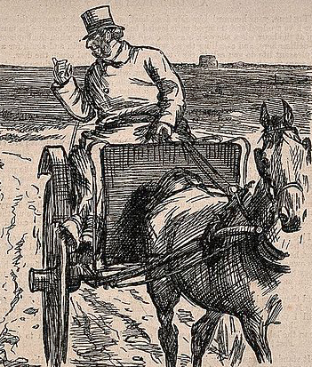
Does this picture correspond to Doctor Watson’s description of Doctor Mortimer?
Yes, it does
Explain why or why not ?
No, it doesn’t
No, it doesn’t because Doctor Watson said Dr. Mortimer did a great deal of ‘visiting on foot.’

Slide 21
Part 3 - Sherlock's opinion

Slide 22
Holmes explained, “I would suggest, for example, that a presentation to a doctor is more likely to come from a hospital than from a hunt, and that when the initials ‘C.C.’ are placed before that hospital the words ‘Charing Cross’ very naturally suggest themselves.’
‘You may be right,’I replied.
Holmes continued, ‘The probability lies in that direction. And if we take this as a working hypothesis we have a fresh basis from which to start our construction of this unknown visitor.’
‘Well, then, supposing that ‘C.C.H.’ does stand for ‘Charing Cross Hospital,’ what further inferences may we draw?’ I asked (..)
True ( T ) or False (F) ?
justify and quote the text
Holmes suggests that Dr. Mortimer works in a hospital.
CCH are the initials for Charing Cross
Hunt.
“More likely” is “more probably “
deductions

Slide 23
NEGATIVE words
Holmes replied, ‘Now, you will observe that he could not have been on the staff of the hospital, since only a man well-established in a London practice could hold such a position, and such a one would not drift into the country.’
Holmes continued, ‘What was he then? If he was in the hospital and yet not on the staff he could only have been a house-surgeon or a house-physician—little more than a senior student. And he left five years ago—the date is on the stick. So your grave, middle-aged family practitioner vanishes into thin air, my dear Watson, and there emerges a young fellow under thirty, amiable, unambitious, absent-minded.’
“He could not have been on the staff of the hospital.”
“ would not drift into the country.”
compound words
Holmes proves Dr. Mortimer is :
a young/ old doctor
nice/ not nice
ambitious/ unambitious
alert/ absent-minded
a man

Slide 24
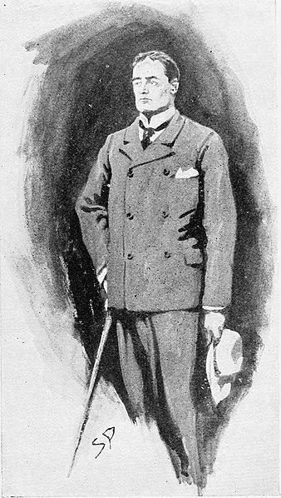
The portrait of Dr. Mortimer
Doctor Watson
Sherlock Holmes
“ A successful elderly country practitioner’ who likes walking and hunting.
“a young,
amiable, unambitious, absent-minded house - surgeon or house physician”
an incorrect portrait
a correct portrait

Slide 25
Who’s who?
(is)
Doctor
Watson
a pupil
Sherlock
Holmes
a teacher
docile
the know-it-all
Doctor Watson plays the part of pupil or the docile
reader who doesn’t understand and makes errors whereas Sherlock Holmes is the know-it-all teacher who uses his sense of observation to reveal the truth.
COPY

Slide 26
Stages of Sherlock’s reasoning
Observes
2. Suggests a problem
3. Forms a hypothesis : “If … then…. so….”
4. Applies a method
Elementary…
Doctor Watson !
5. Asks questions
6. Concludes

Slide 27
Match the elements
Obviously
May
Certainly
Will
Possibly
Could
Eventually
Auxiliaires Modaux
Adverbes

Slide 28
What could happen next ?
Holmes
may
could
will
discover the murderer
die
be the suspect
become a victim
Dr. Mortimer
Dr.
Watson

Slide 29
Let’s Recap
COPY
Sherlock Holmes and Doctor Watson are in the living room and are examining a walking stick that has been left by Doctor James Mortimer
Doctor Watson thinks Dr. Mortimer is a successful elderly country practitioner.
However, Sherlock Holmes proves that Dr. Mortimer is in reality a young, unambitious, absent- minded, house - surgeon or house - physician.
Doctor Watson plays the part of a docile pupil whereas Holmes is the know-it-all teacher.

Slide 30
On récapitule...
COPY
Vocabulary:
an incipit
a fellow
a practitioner
a house-surgeon
a house-physician
a presentation
absent-minded
amiable
to be likely
to quote
Grammar :
May
Could
Would + verb
Past /present Be+ ing
Order of adjectives
Direct speech
Let’s reason
Observe
Find a problem
Form a hypothesis
If...then ...so...
Apply a method
Ask a question
Conclude

Slide 31
On fait le bilan et on s’auto-évalue
Nous avons :
étudié un extrait de The Hound of the Baskervilles.
appris à analyser un texte littéraire.
enrichi notre vocabulaire.
revu comment
travailler la modalité,
mettre les adjectifs dans l’ordre
employer le prétérit Be+ing

Slide 32
Pour aller plus loin
Read The Hound of the Baskervilles
https://www.planetebook.com/free-ebooks/the-hound-of-the-baskervilles.pdf
Invent your own detective fiction / or invent what happens next.
https://alyssamackay.com/2017/10/16/10-tips-for-writing-your-whodunit/
Grammar
https://www.englisch-hilfen.de/en/
Fun and games : https://learningapps.org/4987127

Slide 33
“Stay Safe
Practice your English
Remember the protective measures!”

Slide 34
Goodbye

Slide 35
Ressources
The hearth rug - https://pixabay.com/fr/images/search/hearth%20rug/
The Hound of the Baskervilles (cover) https://en.wikipedia.org/wiki/The_Hound_of_the_Baskervilles
Sherlock Holmes https://fr.m.wikipedia.org/wiki/Fichier:Sherlock_Holmes_%26_Watson_-_The_Greek_Interpreter_-_Sidney_Paget.jpg
https://pixabay.com/fr/vectors/sherlock-sherlock-holmes-holmes-3828991/
Arthur Conan Doyle https://commons.wikimedia.org/wiki/File:Conan_doyle.jpg
Extract - Chapter 1 p. 4-6 The Hound of Baskervilles, Sir Arthur Conan Doyle
https://www.planetebook.com/free-ebooks/the-hound-of-the-baskervilles.pdf
Walking stick https://pixabay.com/fr/vectors/bâton-de-marche-bâton-à-pied-159542/
Penang Lawyer http://sherlockholmesdiesse.blogspot.com/2018/02/ready-for-first-challenge.html
Country practioner https://commons.wikimedia.org/wiki/File:One_country_doctor_asks_another_to_assist_him_in_a_post_mort_Wellcome_V0011415.jpg
Doctor Mortimer
https://commons.wikimedia.org/wiki/File:Houn-11_-_Sir_Henry_Baskerville_(Hound_of_Baskervilles,_page_58).jpg
Magnifying glass https://pixabay.com/fr/illustrations/loupe-verre-recherche-4186151/

