Slide 1
KEEP CALM AND SPEAK ENGLISH

Slide 2
Likes , dislikes
and frequency

Slide 3
Dans ce cours,
tu vas revoir:
Du vocabulaire sur les réseaux sociaux
Les adverbes de fréquences
Du vocabulaire sur les activités d’intérieur
Comment exprimer tes goûts

Slide 4
Social networks activities

Slide 5
Social networks activities
upload
download
share
chat
send

Slide 6
Let’s check your vocabulary
chat
download
share
upload
send
follow

Slide 7
Discover Sandra’s habits on social networks
Sandra never uploads personal photos but she sometimes shares pictures of horses because she loves horse riding. She rarely downloads series on her phone. She always chats with her friends. She usually follows her favourite stars on social networks and she often sends funny pictures to her friends.
+
-
NEVER
RARELY
SOMETIMES
OFTEN
USUALLY
ALWAYS

Slide 8
Let’s practise!
NEVER
RARELY
USUALLY
OFTEN
ALWAYS
SOMETIMES
+
-

Slide 9
Let’s observe
She never uploads personal photos.
I sometimes share my pictures.
He usually sends a lot of messages.
s
s
En anglais, l’adverbe de fréquence se place
 avant  après le verbe.
Au présent, on utilise  le présent simple
 le présent en be + V-ing avec un adverbe de fréquence.
Rappel: pense à mettre le « s » au verbe à la 3ème personne du singulier!

Slide 10
Social networks can be dangerous!

Slide 11
Dangers : correct the problems!
always
Your photos are never on the net for a long time
often
Young people are never addicted to social networks
rarely
Your pictures usually disappear
often / sometimes
People rarely steal your photos
rarely
You are always safe on the net

Slide 12
Let’s observe
You are rarely safe on the net.
Young people are often addicted to social networks. People sometimes steal your photos.
steal
En anglais l’adverbe de fréquence se place avant le verbe.
Toujours vrai?  oui  non.
En anglais l’adverbe de fréquence se place
le verbe « be »
les autres verbes.
après
avant

Slide 13
Let’s practise
Add the adverbs in the sentences!
She is online. (never)
They chat on the Internet with their friends. (rarely)
I’m bored at the week-end. (always)
I don’t upload personal photos. (often)
We download some series. (sometimes)
What do you do at the week-end? (usually)
She is never online.
They rarely chat on the Internet with their friends.
I am always bored at the week-end.
I don’t often upload personal photos
We sometimes download some series.
What do you usually do at the week-end?

Slide 14
Social networks aren’t the only solution! What else can you do at home?

Slide 15
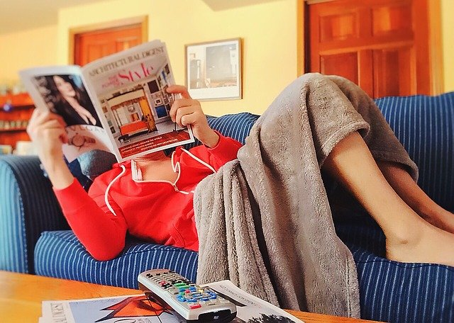
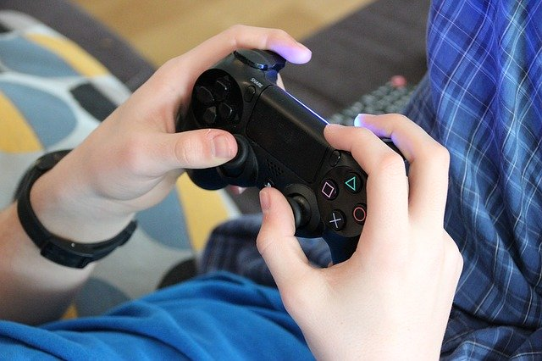
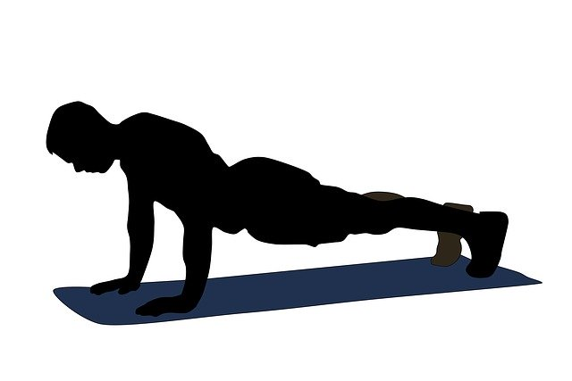
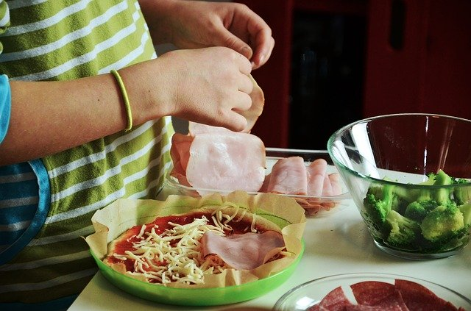
Indoor activities
play videogames
do some sport
rest
listen to music
watch series on TV
relax
cook
read
lie on my sofa

Slide 16
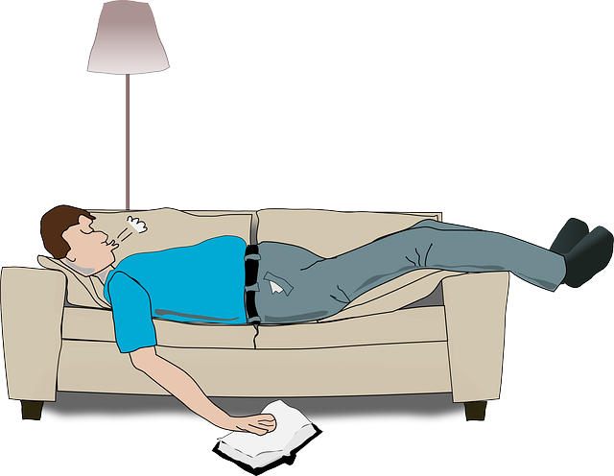
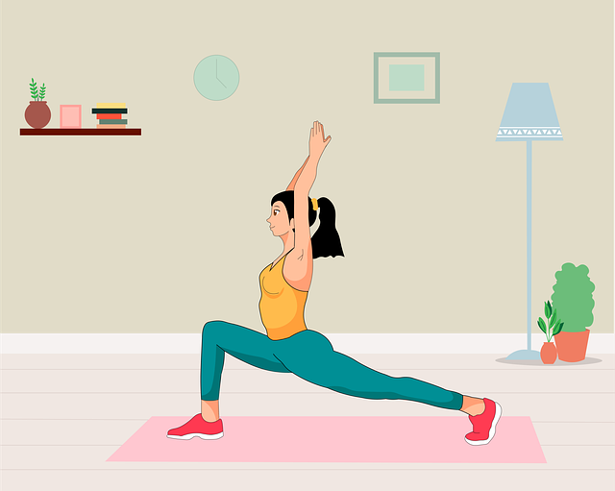
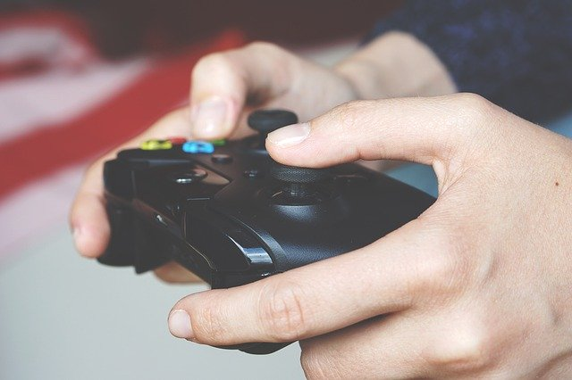
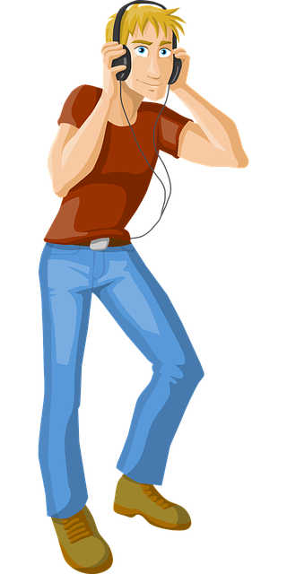
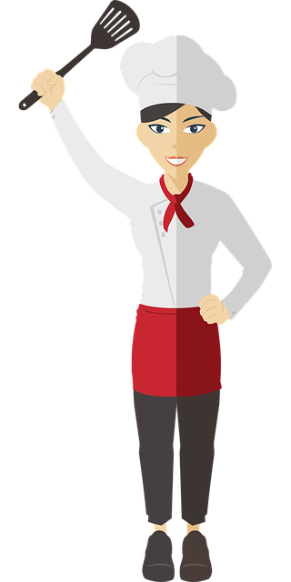
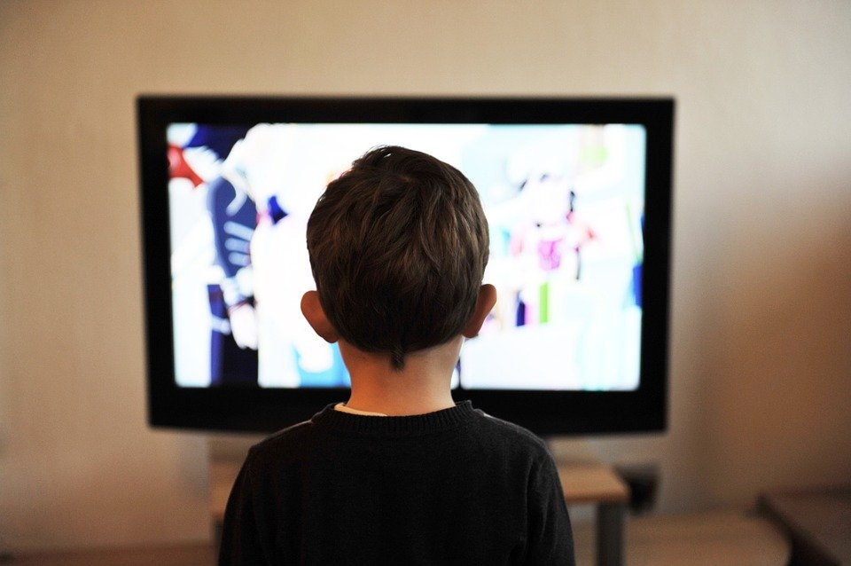
Check your vocabulary
read
rest
relax
lie on my sofa
play videogames
do some sport
watch series on TV
cook
listen to music

Slide 17
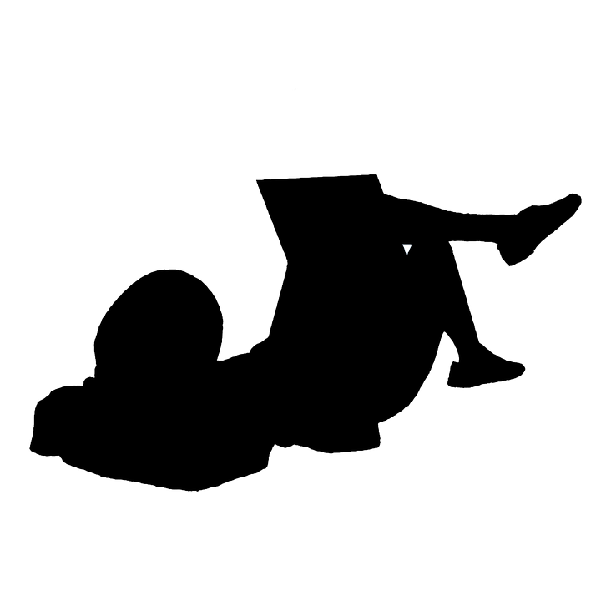
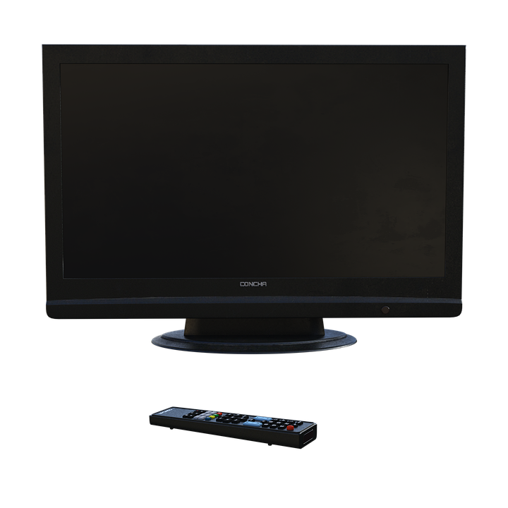
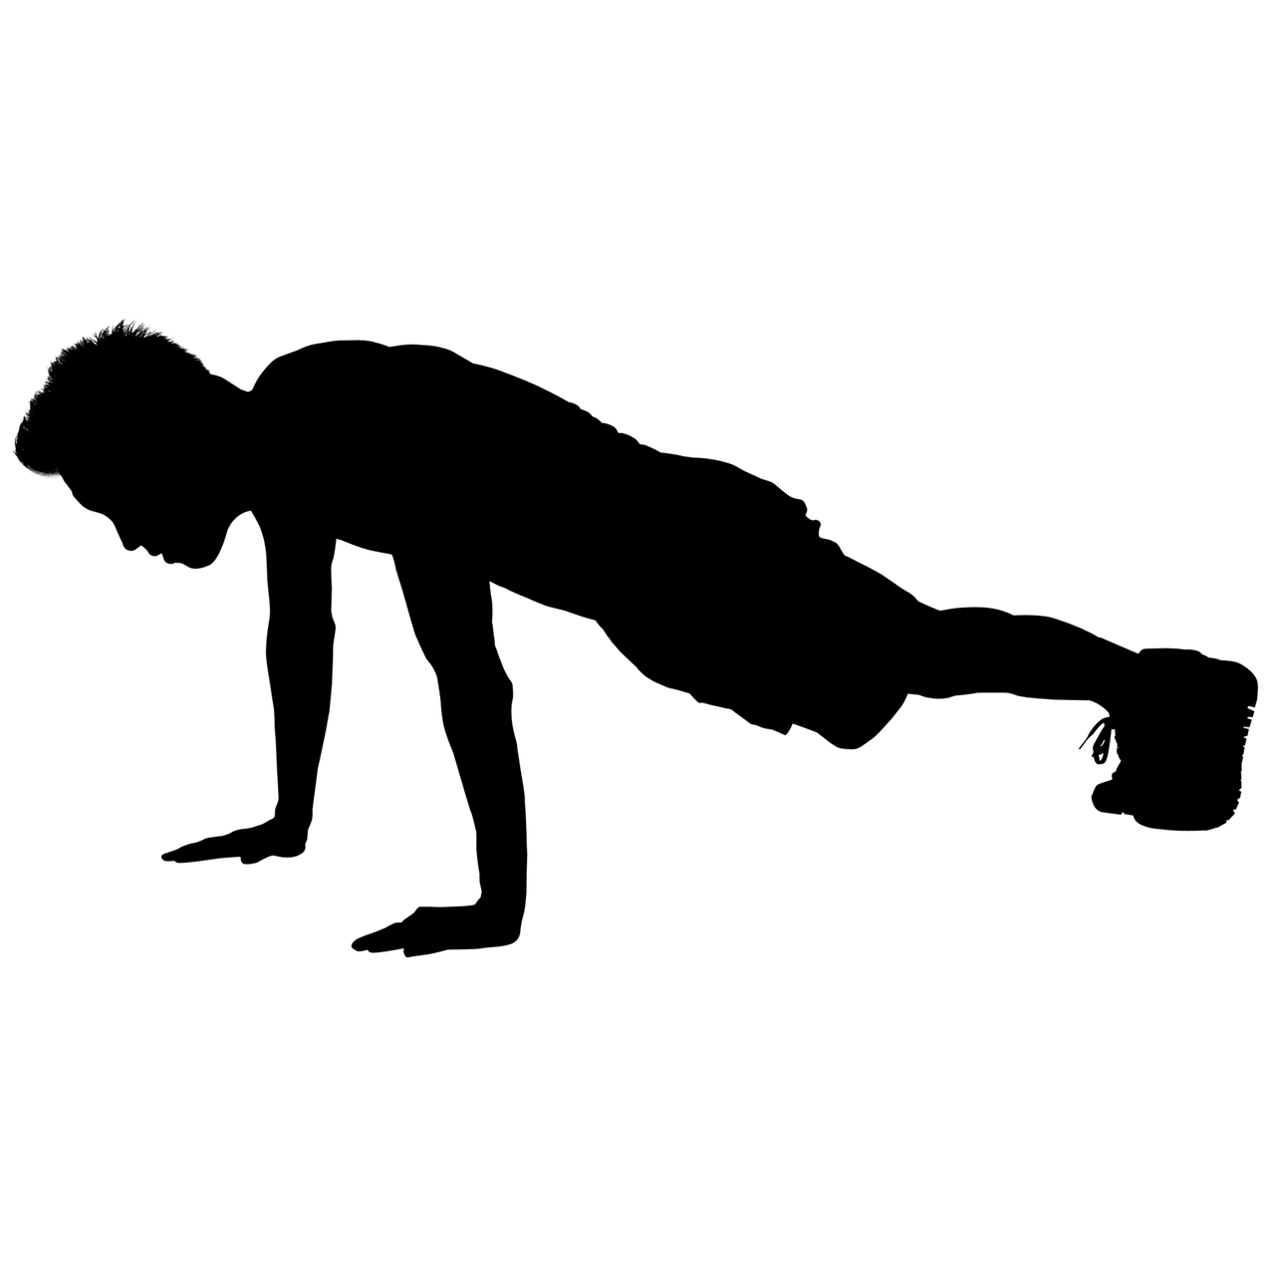
Discover Kevin’s and Sandra’s likes and dislikes
What activities are mentionned?

Slide 18
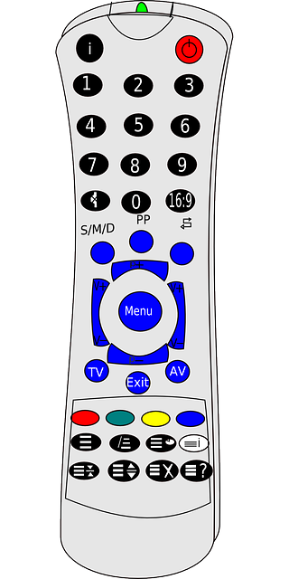
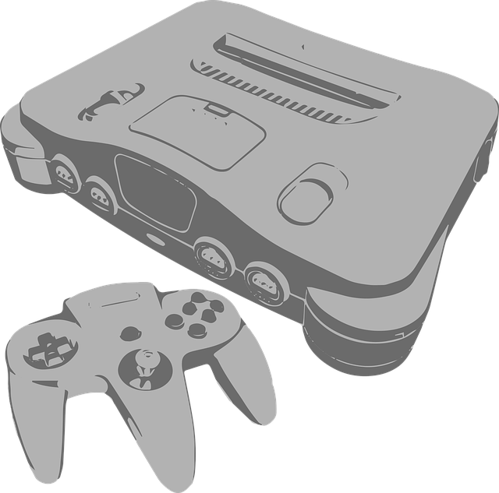
Whose objects are they? Why?
Kevin’s remote control
Kevin’s console
Sandra’s mobile
Sandra’s computer
She hates watching TV
He prefers. watching matches on TV.
He loves playing videogames.
Kevin doesn’t like playing football.
Sandra never practises sports.
She loves chatting / sharing photos with her friends.

Slide 19
Let’s recap some basic vocabulary
+
I love
I like
I prefer
I hate
I don’t like

Slide 20
Let’s check!
+
I hate
I prefer
I like
I love
I don’t like

Slide 21
He likes football.
He doesn’t like playing football.
She loves her friends.
She hates watching TV.
She loves chatting with her friends.
He prefers watching football.
+ nom
+ V-ing

Slide 22
Talk about John’s likes and dislikes
+
John doesn’t like reading / resting / relaxing or lying on the sofa.
He loves cooking,
but he hates watching series on TV or
playing videogames.
He likes chatting with his friends but
he prefers listening to music.

Slide 23
Discover Amy’s likes and dislikes

Slide 24
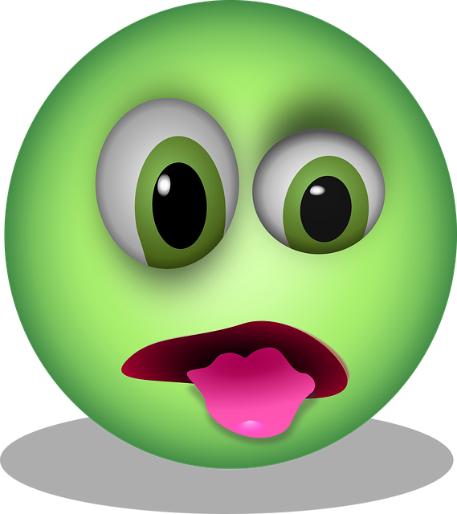
1. Spot the activities!
2. Put them into the chart below
I’m keen on listening to music and I am fond of reading magazines about horses. I fancy resting on my bed, I enjoy decorating my room and I’m crazy about chatting with my friends!
On the other hand, I don’t like running and I dislike doing sport in general. I can’t bear doing nothing. I can’t stand working in the garden and I hate going into the garage, it’s so scary!
listening to music
running
doing nothing
chatting
reading
working in the garden
doing sports
resting
going into the garage
decorating

Slide 25
Expressing likes and dislikes
I’m keen on listening to music and I am fond of reading magazines about horses. I fancy resting on my bed, I enjoy decorating my room and I’m crazy about chatting with my friends!
On the other hand, I don’t like running and I dislike doing sports in general. I can’t bear doing nothing. I can’t stand working in the garden and I hate going into the garage, it’s so scary!
be keen on
don’t like
can’t bear
be fond of
be crazy about
can’t stand
fancy
dislike
= love
enjoy
= hate
= like

Slide 26
Rappels conjugaison
be keen on
Be :
I am, you are, he is…
fancy
be fond of
enjoy
Présent simple:
I enjoy, he fancies, she likes, they hate…
like
be crazy about
can’t bear
love
invariable
dislike
can’t stand
hate

Slide 27
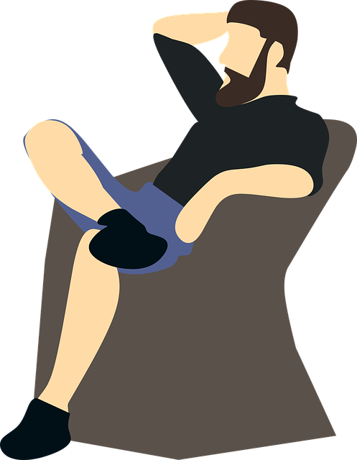
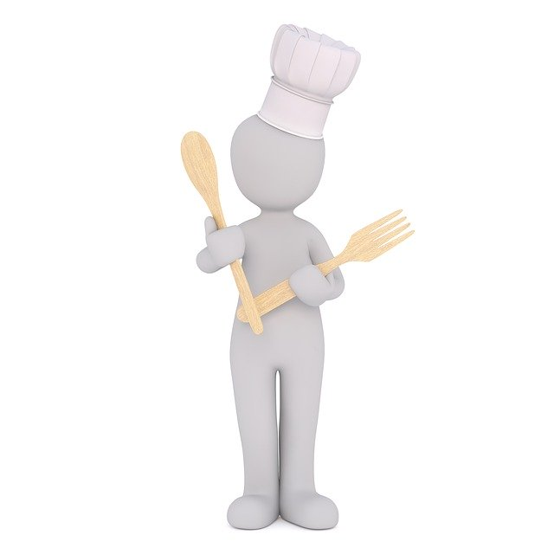
Now it’s your turn to talk about Mr Jenkins
often
never
usually
rarely

Slide 28
Now it’s your turn to talk about Mr Jenkins
Mr Jenkins can’t stand doing sport (He can’t bear / he hates doing sport.) He never does sport at home.
never
sometimes
But, he is keen on (= he is fond of, he enjoys, he fancies) resting / relaxing in his armchair. He sometimes rests / relaxes in his armchair after dinner.
And, he is crazy about (= he loves) cooking so he usually cooks at home!
usually
He dislikes ( = he doesn’t like) watching TV so he rarely watches TV at home.
rarely

Slide 29
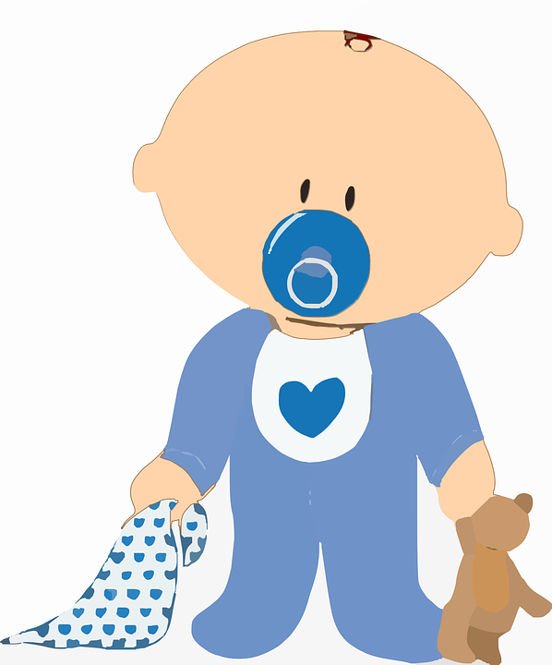
Who am I?
I never run because I can’t!
I sometimes sing but it isn’t always nice!
I usually wear pyjamas.
I often eat many times a day and at night.
I usually lie on my back.
I’m crazy about sleeping.
I fancy eating everything around me!
And I can’t stand being hungry!
I always cry when I’m hungry

Slide 30
Dans ce cours tu as appris :
Du vocabulaire pour parler d’activités en ligne ou à la maison
Les adverbes de fréquence
À exprimer des goûts de façon variée

Slide 31
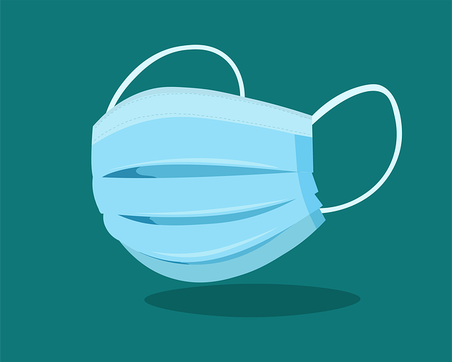
Thank you very much, see you soon!
STAY SAFE
AND
Practise your English

