Slide 1
KEEP CALM AND SPEAK ENGLISH

Slide 2
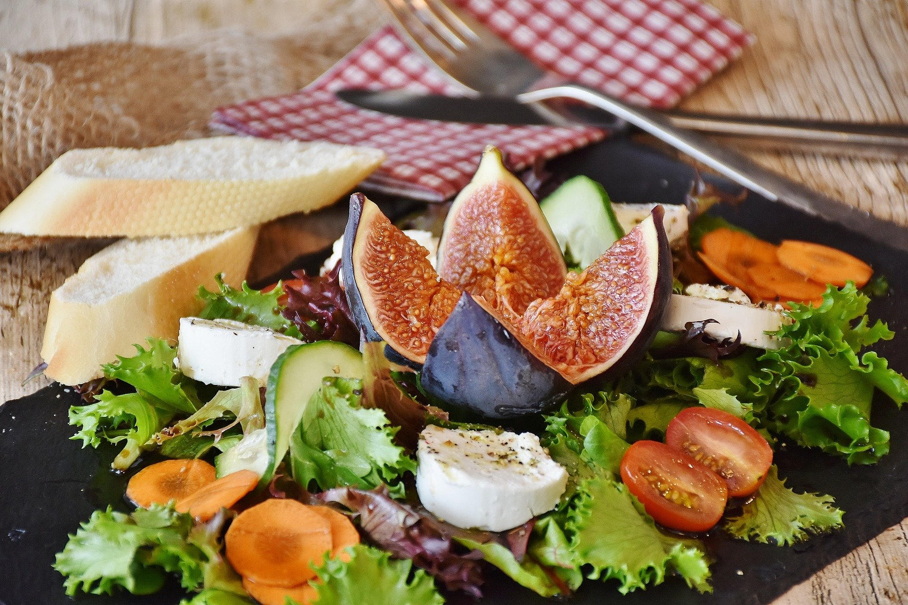
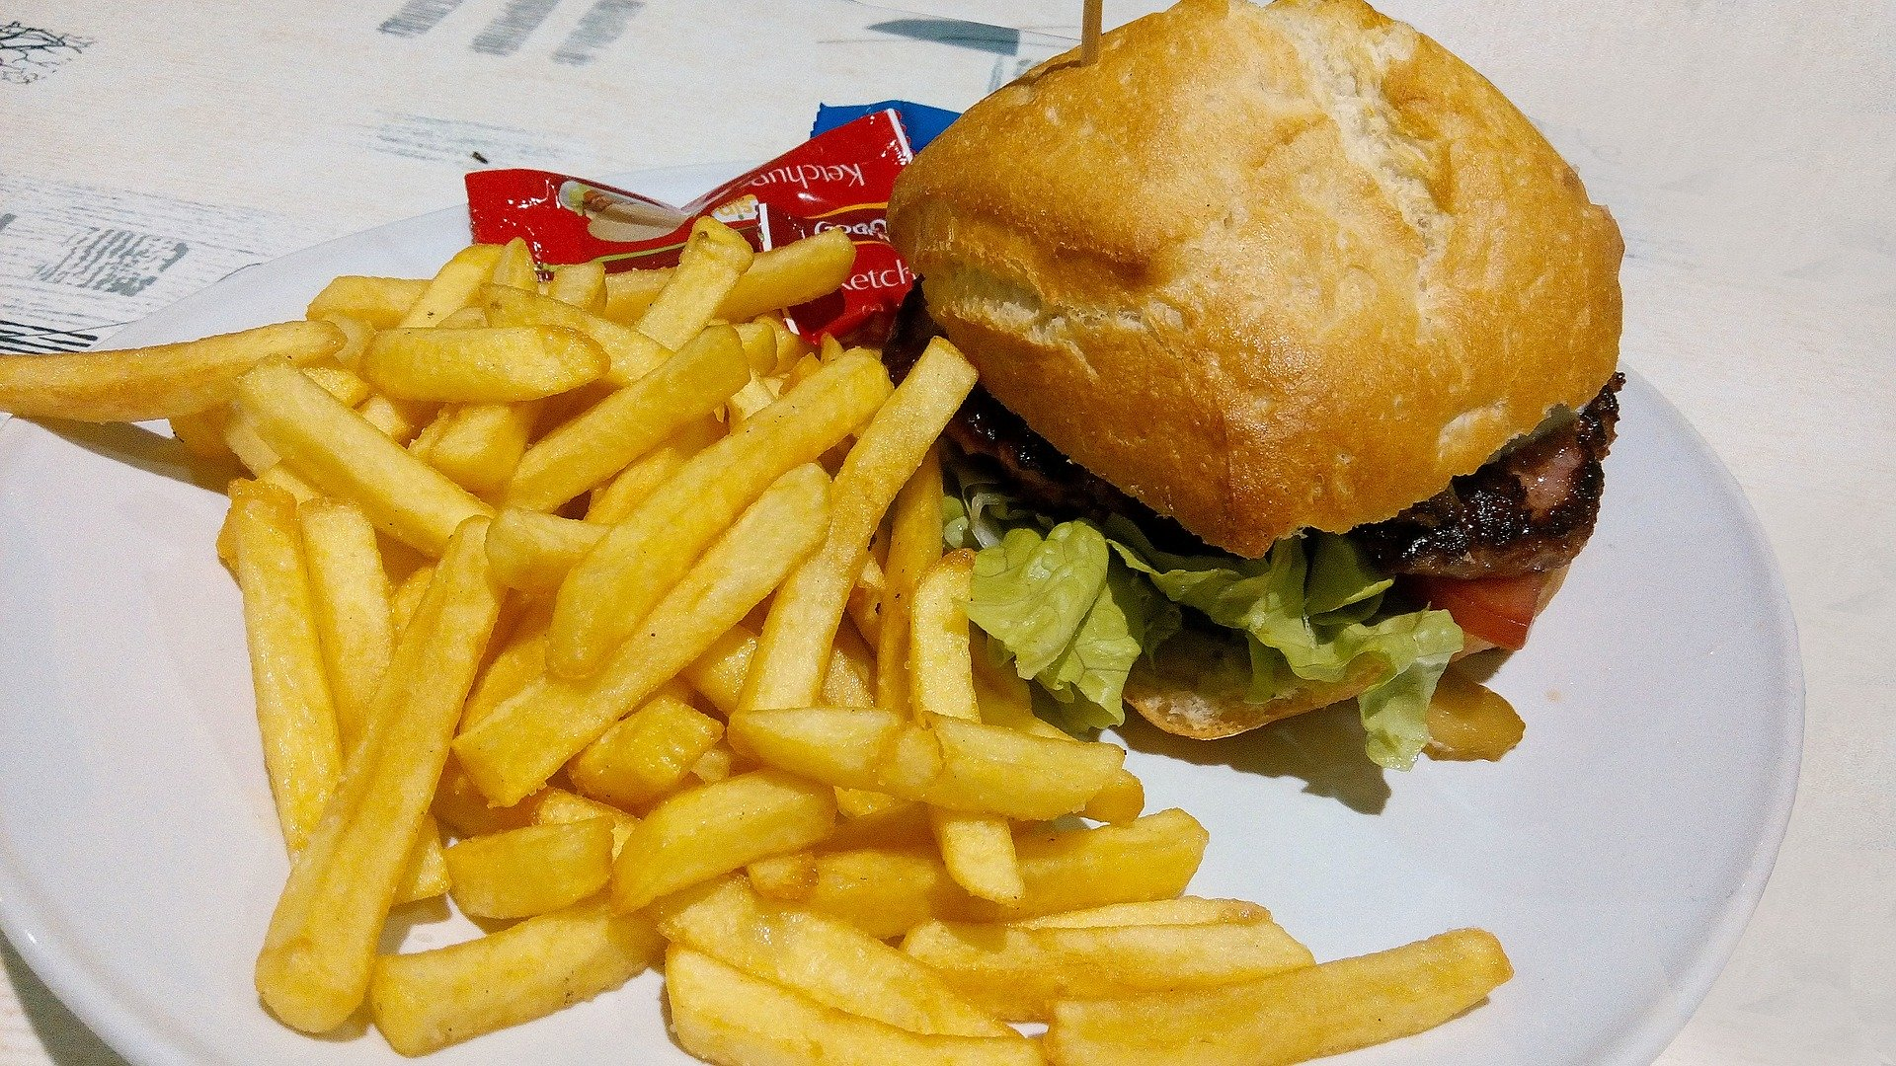
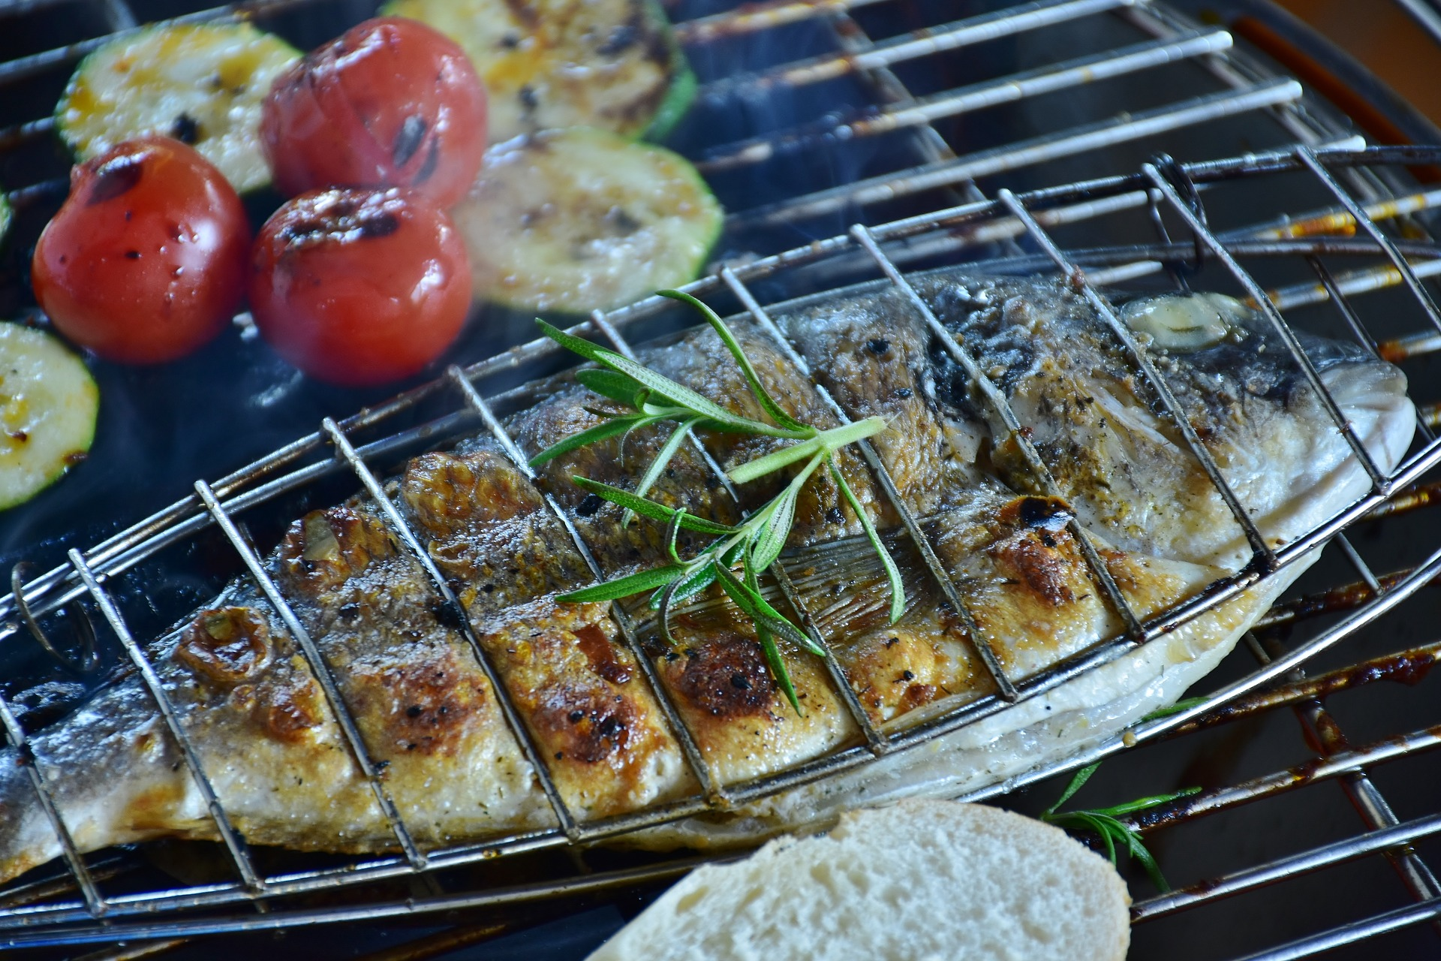
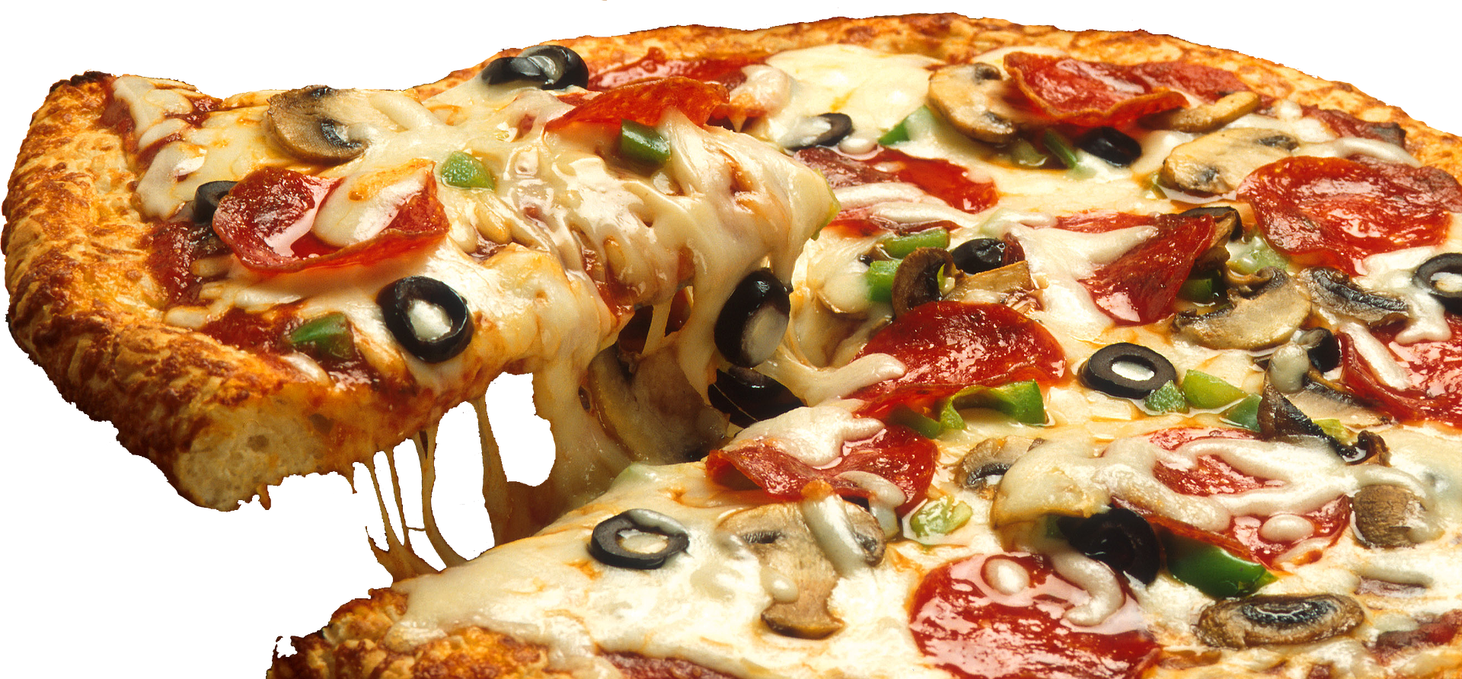
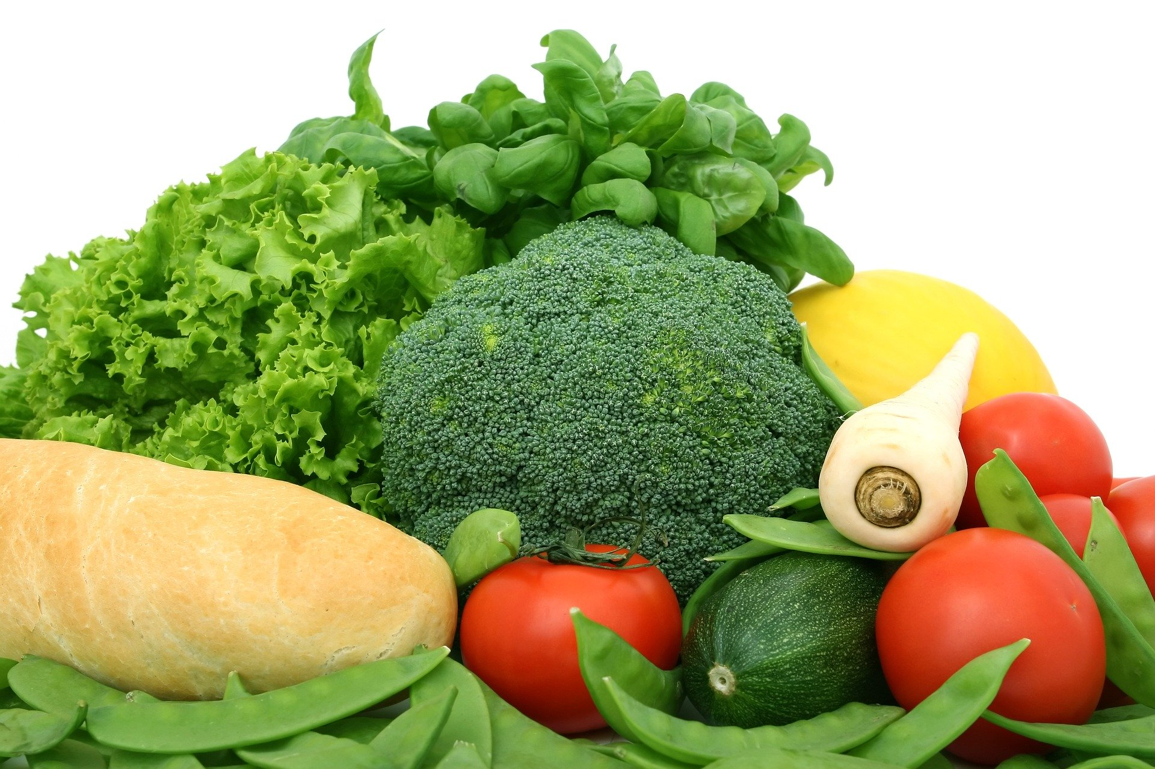
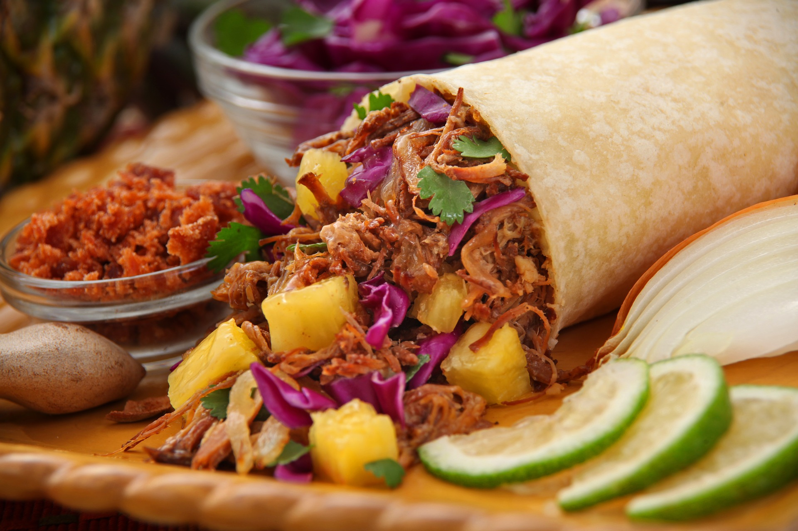
Food and health:
junk food vs healthy food

Slide 3
Dans ce cours tu vas revoir:
Du vocabulaire sur la nourriture.
Comment donner des conseils
Comment dire les grands nombres
Comment exprimer des quantités
Comment répondre à un courrier

Slide 4
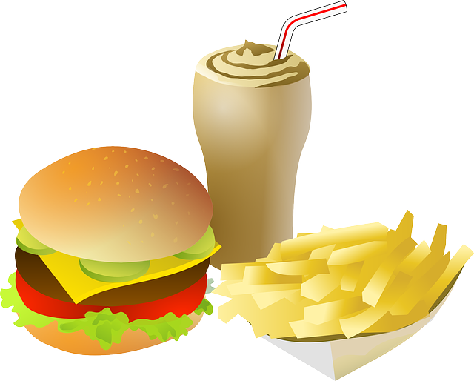
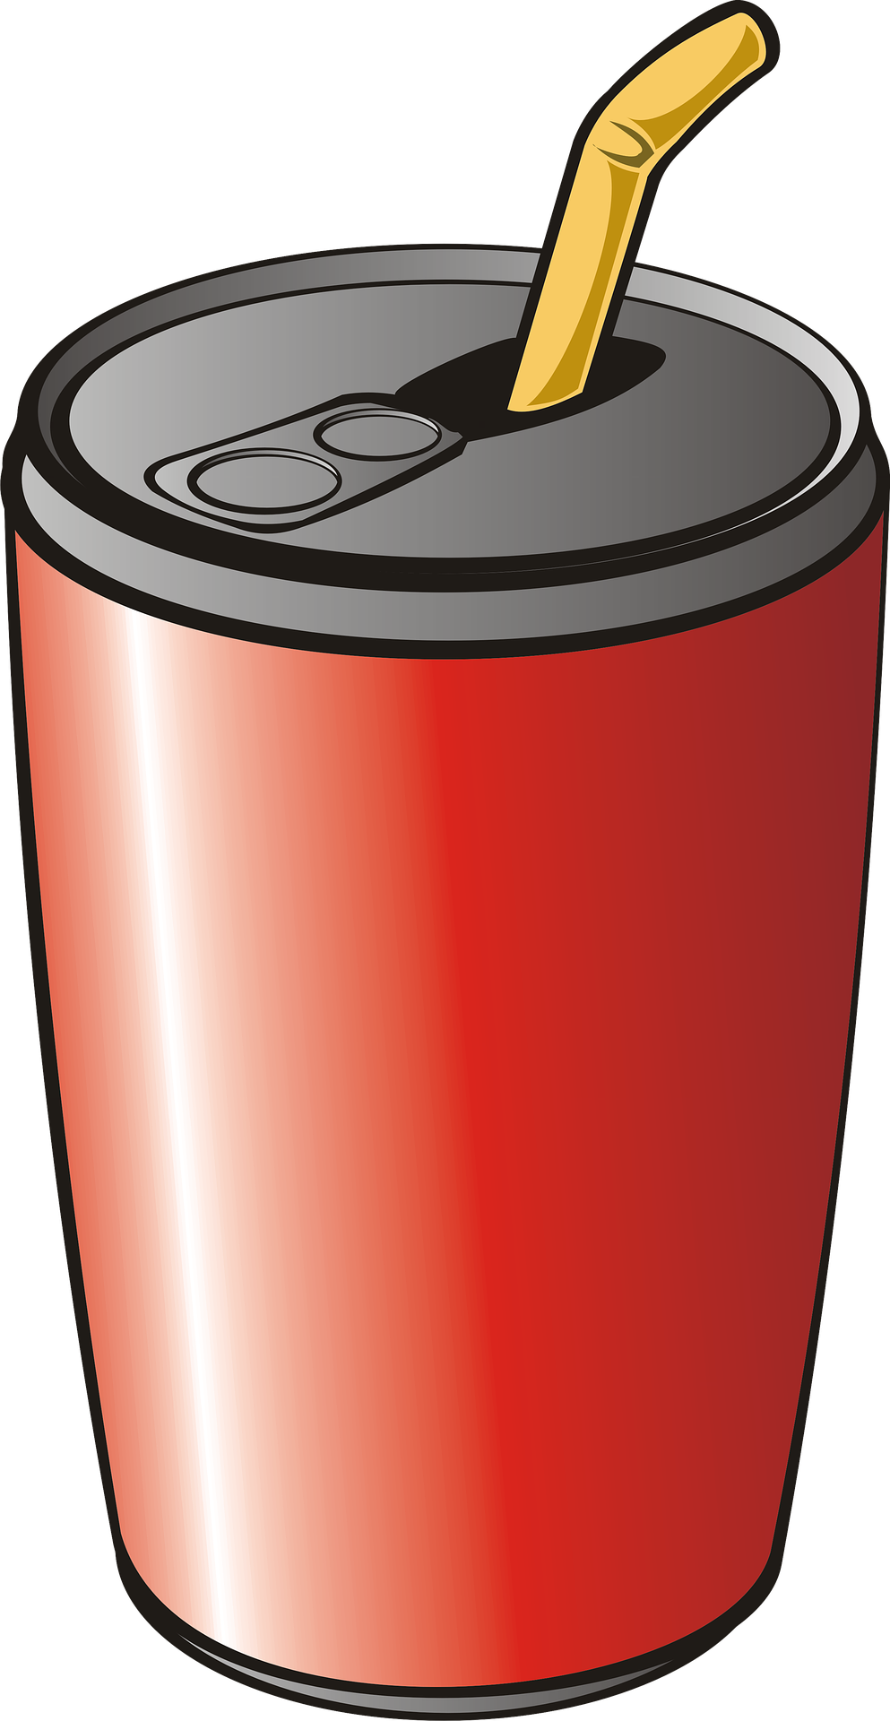
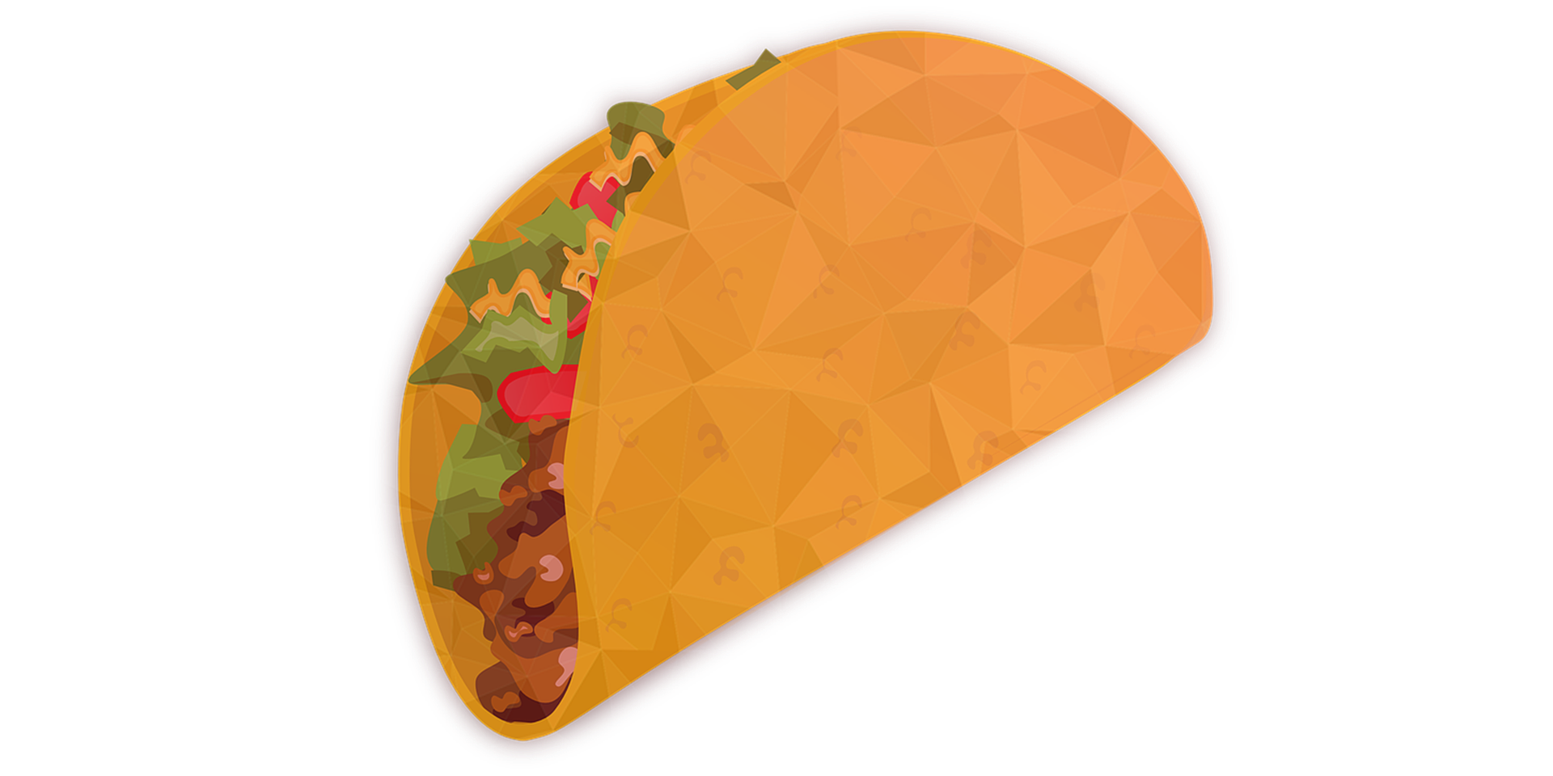
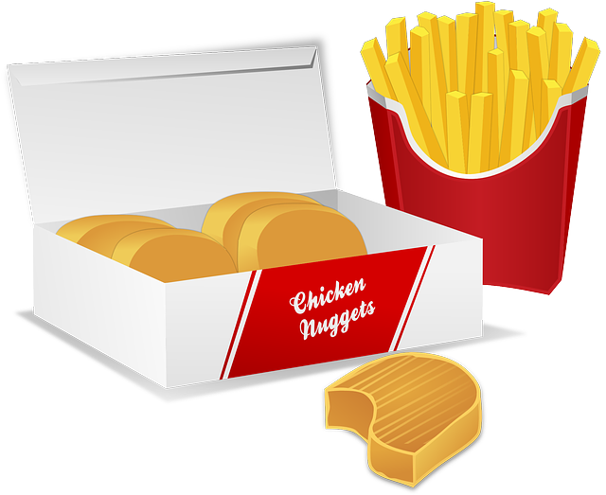
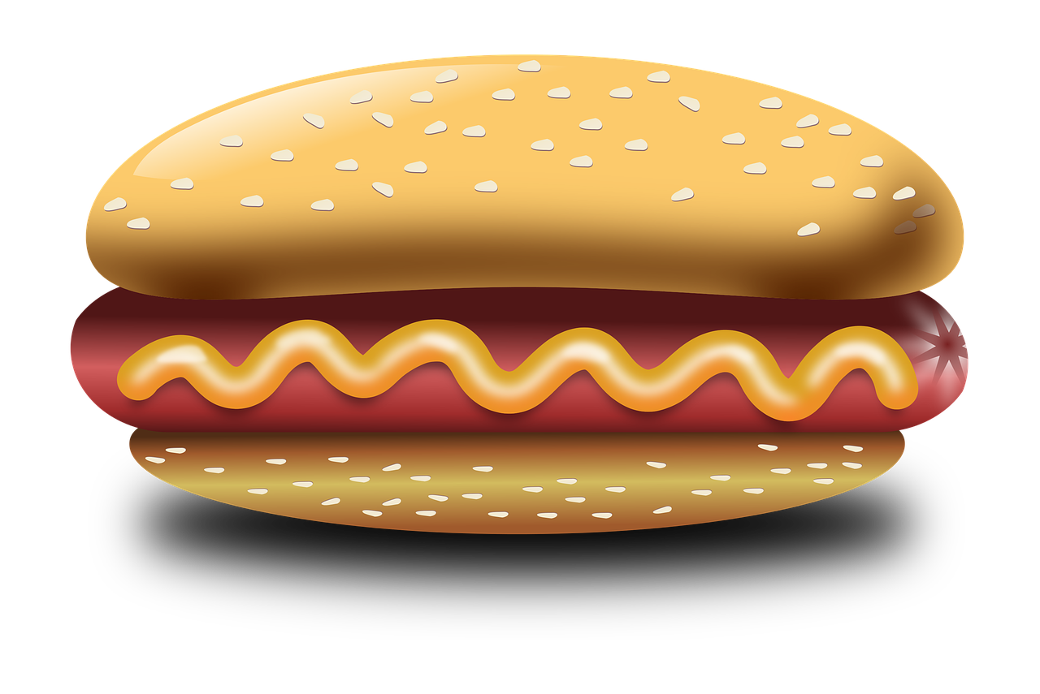
St Mary’s School mag
The food corner
Dear readers,
We all like fast food and we often eat this kind of food. But what do we really eat? Read this article and find out if you have balanced meals !
Did you know that the average daily quantity of calories for a teen is between 1,800 and 2,000 ?
Let’s check the calorie content in our favourite food!
You are what you eat!
266 calories for 100 gr of pizza
312 calories for 100 gr of French fries
310 calories for a burger
263 calories for a hot dog
205 calories for a burrito
291 calories for 100 gr of fried chicken
180 calories for a can of soda
160 calories for an orange juice
Take your calculators and check your calories amount!
Jason.K 8C

Slide 5
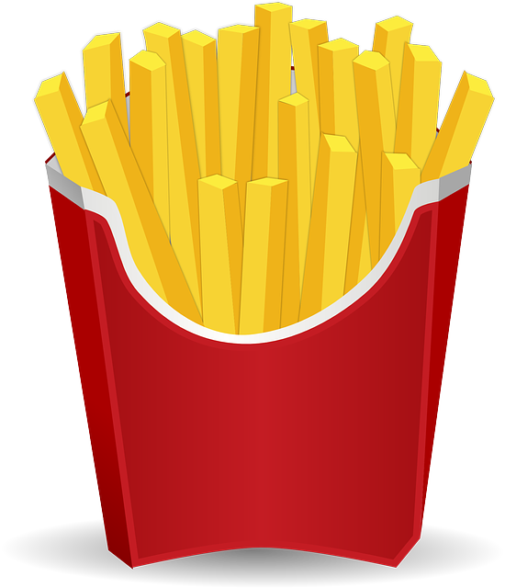
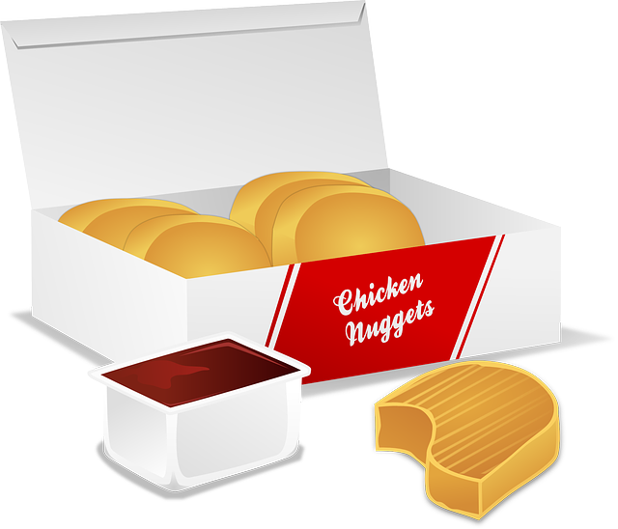
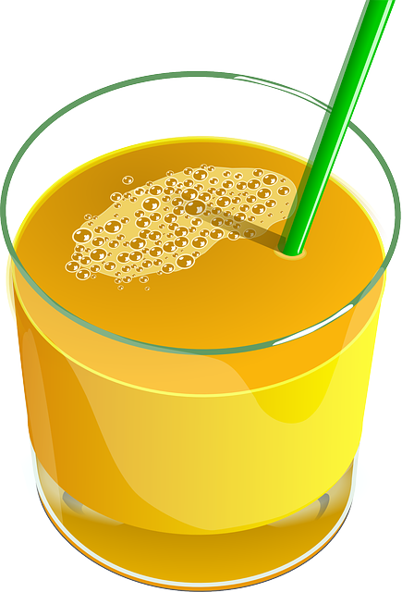
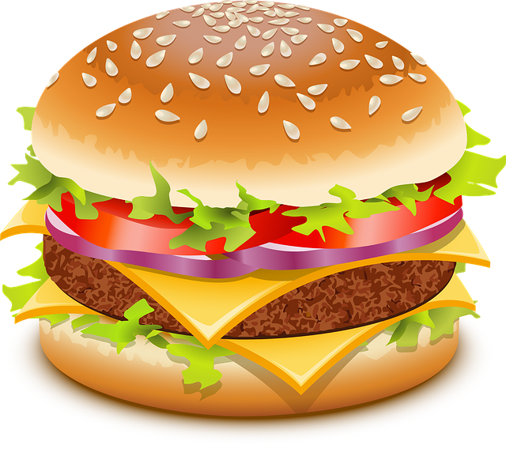
Put them into order!
- Calories +++
160
180
205
263
266
291
310
312

Slide 6
Recap on numbers
The tens end with a Y 30 vs 13 40 vs 14
53 : fifty-three
100 : one hundred
1,000 : one thousand 2 000 vs 2,000
2,5 vs 2.5
AND + UNIT AND + TENS

Slide 7
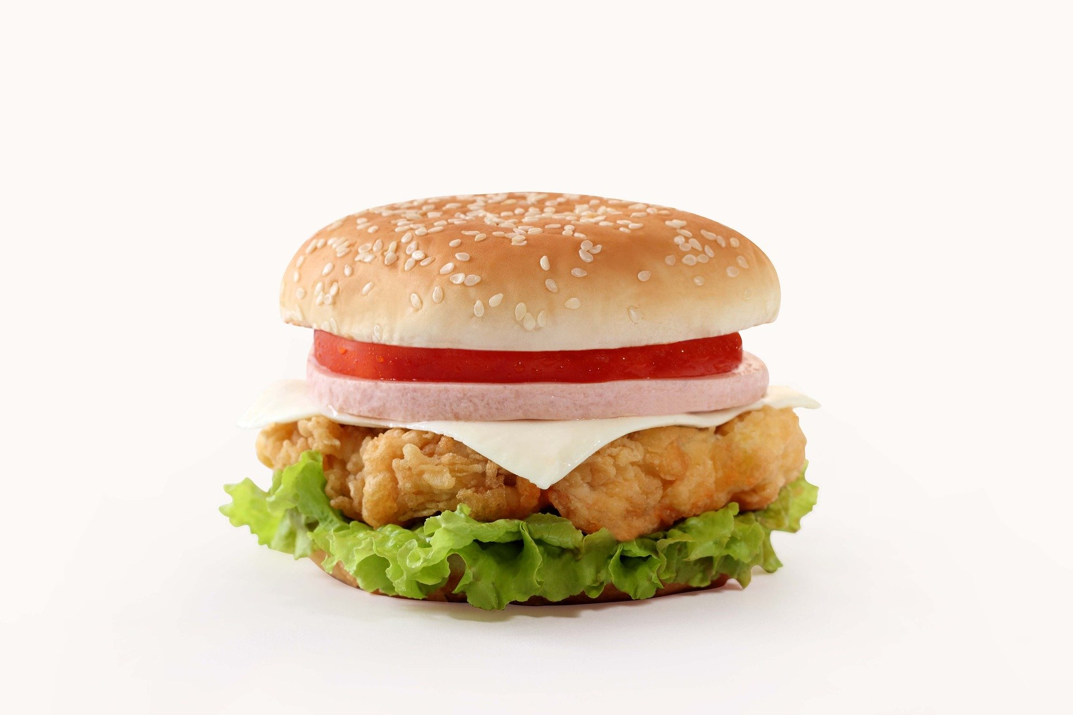
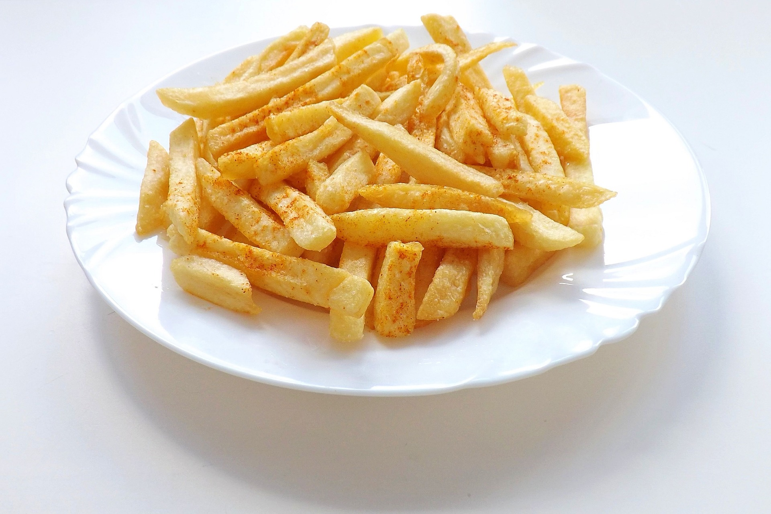
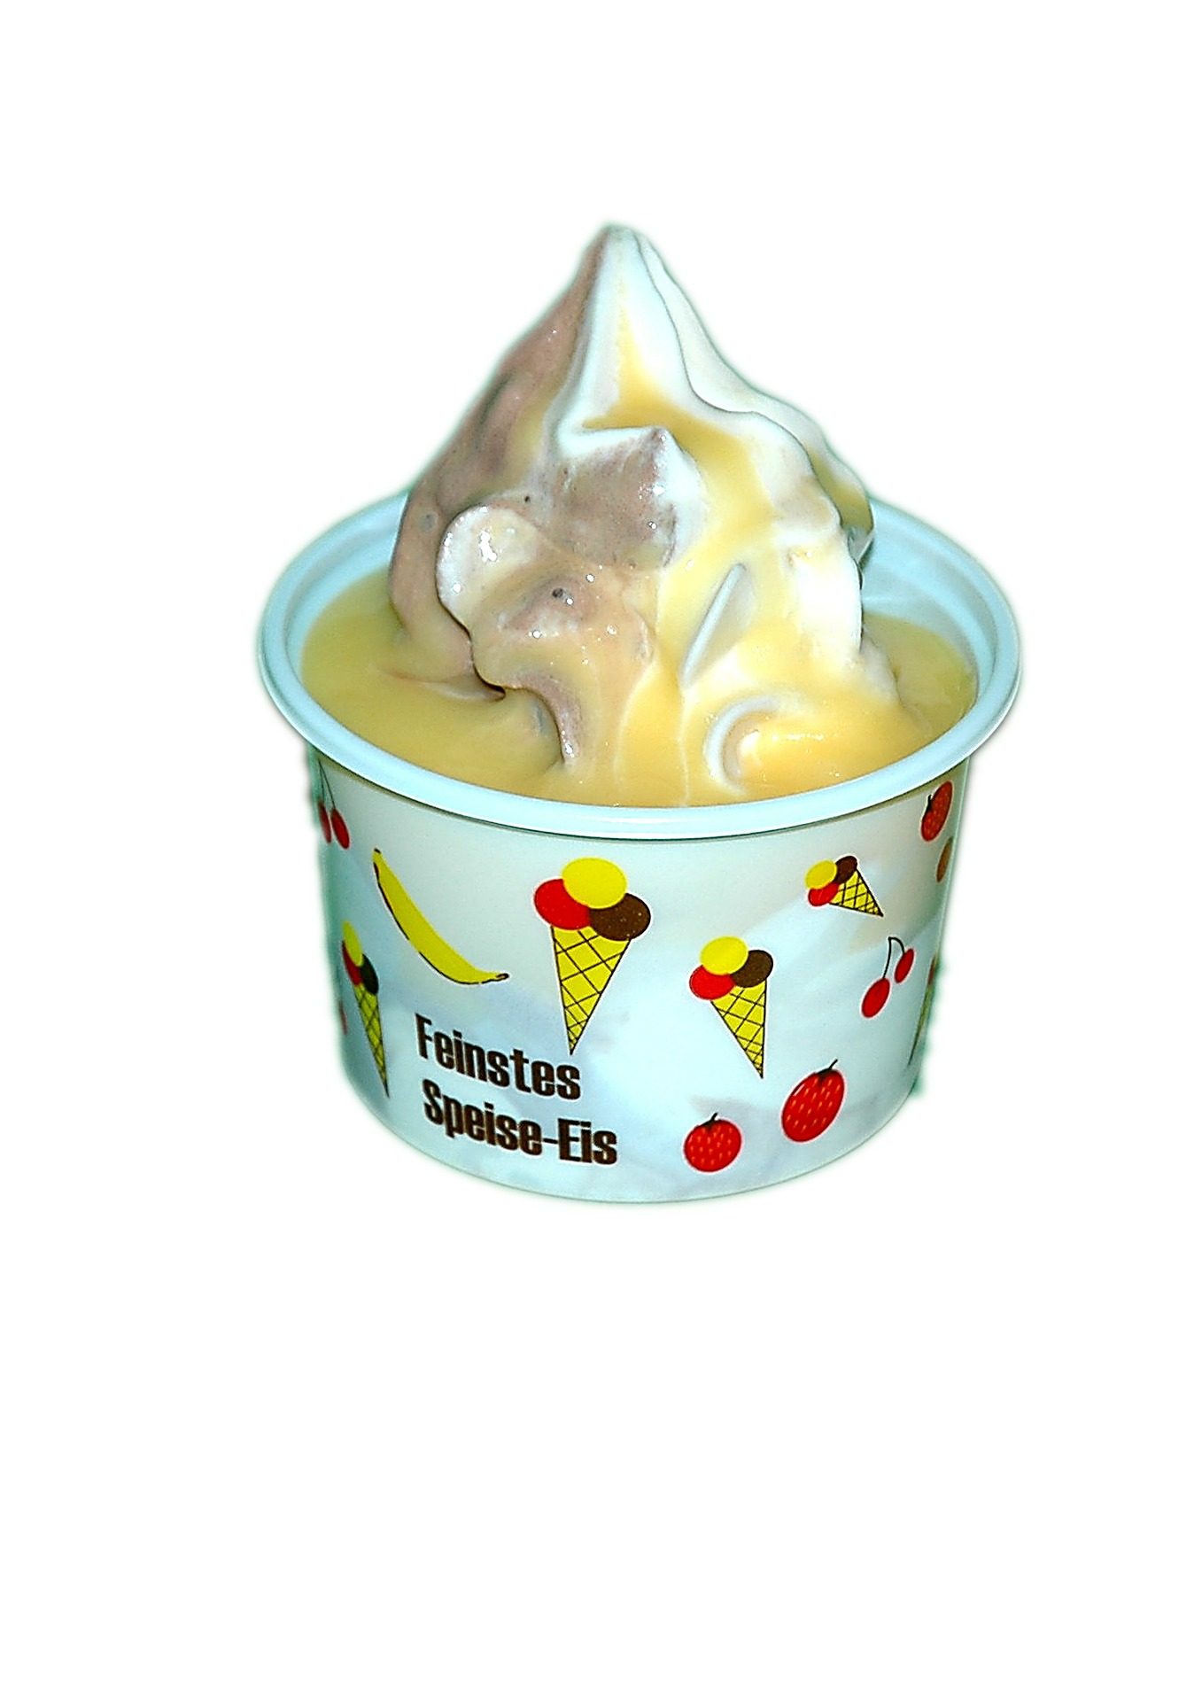
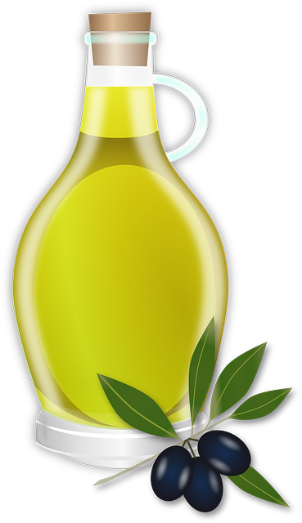
Count the calories: menu 1
+
+
+
=
992 calories !!!
310
312
180
190
Too many calories
Too much fat
Too much sugar

Slide 8
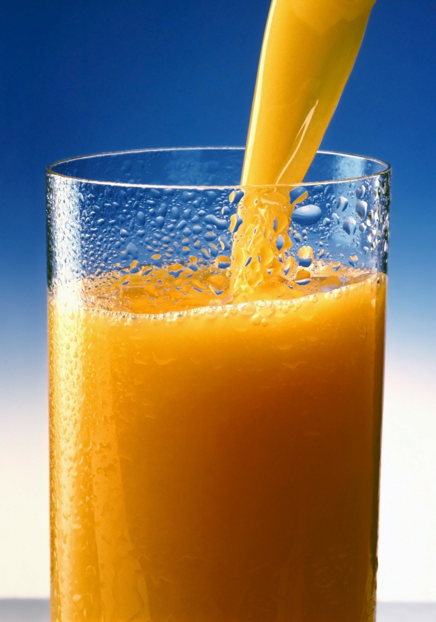
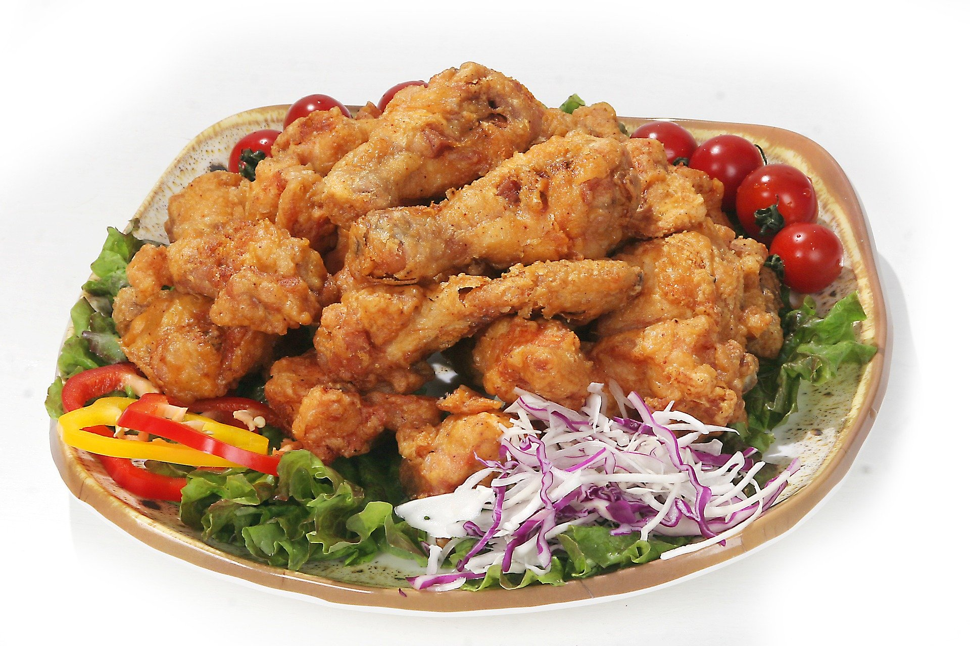
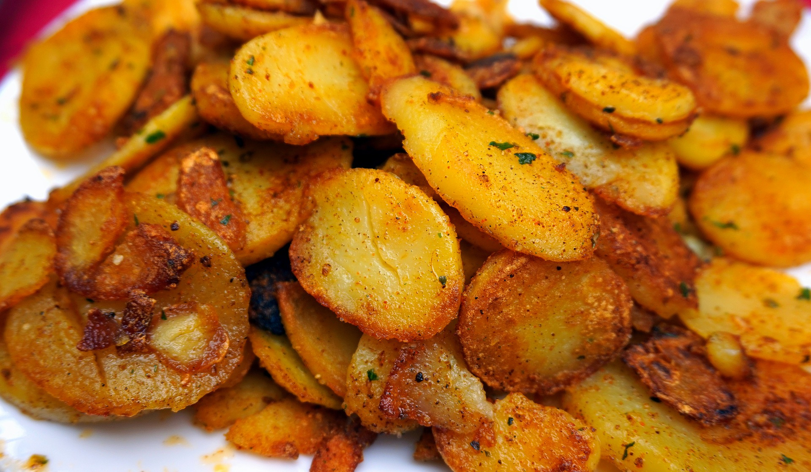
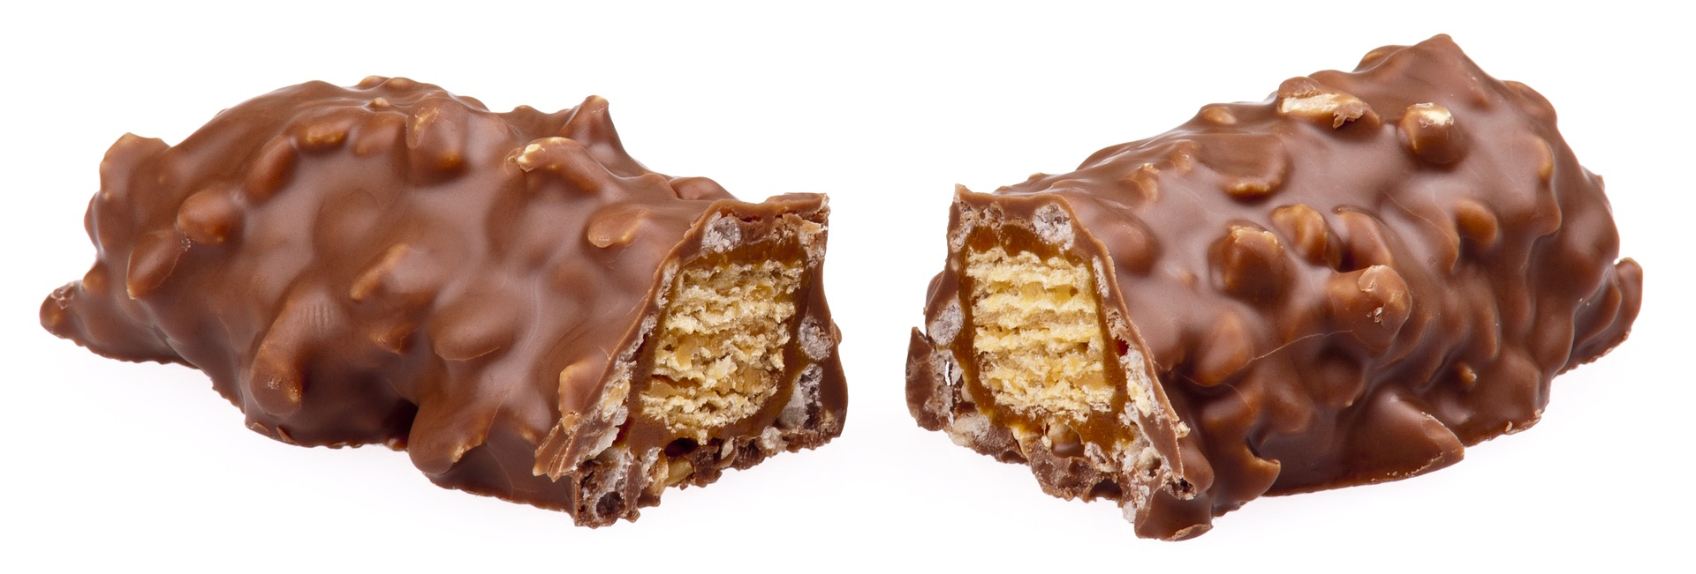
Count the calories: menu 2
+
+
+
=
1,161 calories !!!
291
230
160
480
Too many calories
Too much fat
Too much sugar

Slide 9
St Mary’s School mag
You are what you eat!
An answer from your mag!
The food corner
Dear readers,
After our last article, many students were a bit panicked and needed a little help!
Here we are with a few tips for you!
First, you shouldn’t eat too much junk food like burgers, fries and pizza.
You should cut on salt and sugar because too much salt and sugar is really bad for your health!
You can have many problems later!
You shouldn’t eat fries many times a week.
Drink a little water before eating, that’s very good!
You should always have a few fruit ready just in case you’re a bit hungry.
Do not have too many sugary drinks! And you should do a little exercise regularly!
Remember… You feel good for 5 minutes with junk food but you’ll feel good much longer with healthy food!
Jason.K 8C

Slide 10
Expressing good ideas and bad ideas
Pour donner un conseil à quelqu’un tu utilises:
should + un verbe
eg: You should eat more vegetables!
Pour déconseiller à quelqu’un de faire quelque chose , tu utilises:
shouldn’t + un verbe
eg: You shouldn’t drink too much soda!

Slide 11
Let’s practise!
?
?
Cook your own food
Drink soda for breakfast
Replace fries by vegetables
Eat cookies before going to bed
Use a lot of salt and sugar
Eat more fruit

Slide 12
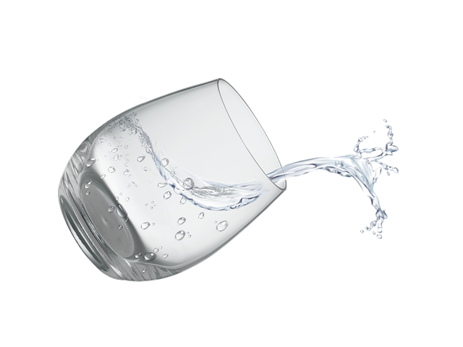
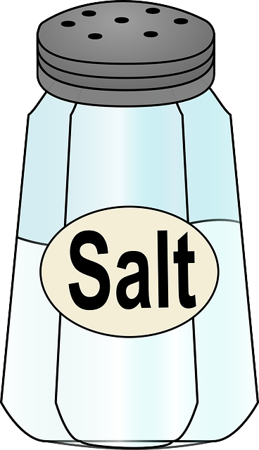
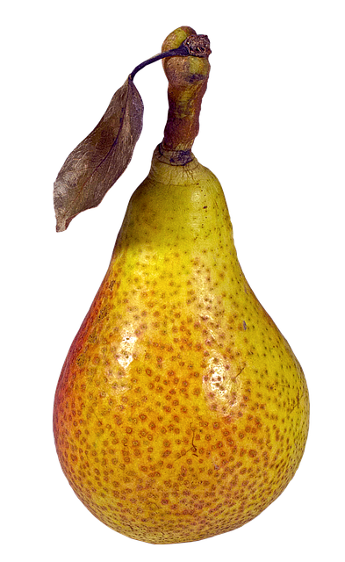
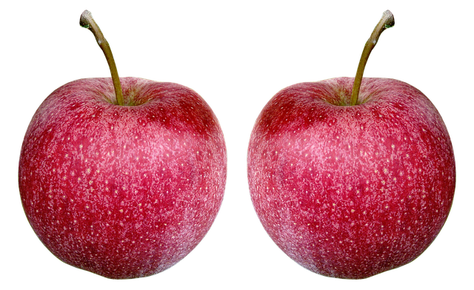
What we learned from the article:
Quantities
a large quantity
a small quantity
much junk food
a little water
1,2,3…
much salt
a little exercice
many sweet drinks
a few fruit
a few vegetables
1,2,3…
many problems
Our problems
Some solutions

Slide 13
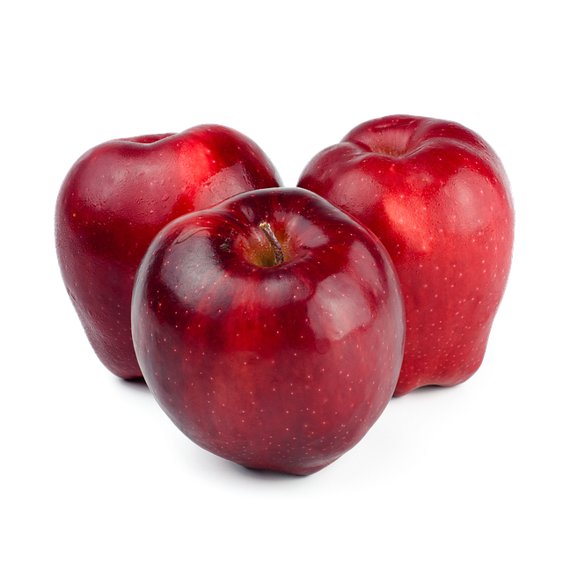
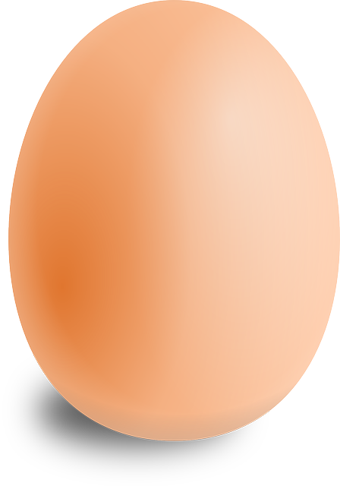
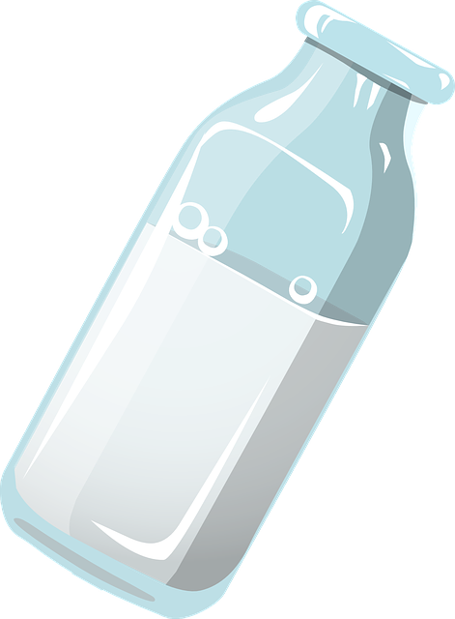
Let’s practise: what have I got in my fridge?
many apples
a little milk
much water
many bottles
a few eggs
a little cheese
Help Box | XXXXXXXXXXXXXXXX | XXX
1-2-3 | many | a few
1-2-3 | much | a little

Slide 14
FINAL CHALLENGE You’re the reporter!
Here’s a letter the mag received. Get ready to answer!
Hi dear Mag,
We’re going on a school trip next week and we need a packed lunch. I usually have crisps and mum buys one or two sandwiches at the supermarket for me. I always take a can of soda, some biscuits and sometimes a packet of sweets. Can you help me prepare a healthier packed lunch? Thx _{Ally 8B}
Ingredients (vocabulary) | Recipes (structures) | Justification
You should + V
You shouldn’t + V
You can + V
You must + V
much many
a few a little
because and but
healthy greasy
caloric
bad / good for you
delicious
crisps sandwiches
fruit vegetables
sweets carrots
water soda

Slide 15
An answer to Ally
Ingredients | Recipes | Justification
crisps sandwiches fruit vegetables sweets carrots water soda | You should + V You shouldn’t + V You must + V You can + V much many a few a little | because and but healthy greasy caloric bad / good for you delicious
Dear Ally,
Thank you for writing us. First, you shouldn’t take a soda but water instead because it’s better for you.
You should prepare your sandwiches at home because they will be healthier!
And you shouldn’t have crisps because they’re too greasy. You must take a few vegetables, like carrots, they’re delicious!
You can take a few sweets but you mustn’t eat too many! We hope you’ll enjoy your healthy trip!
The school Mag team

Slide 16
Méthodologie de la production écrite
Bien comprendre ce qui est attendu
Rassembler le vocabulaire + les structures utiles
Rédiger en justifiant et en utilisant des mots de liaison !

Slide 17
Dans ce cours tu as appris :
Du vocabulaire sur la nourriture
À utiliser des grands nombres en anglais
À donner des conseils
À exprimer des quantités
À te préparer à rédiger un texte

Slide 18
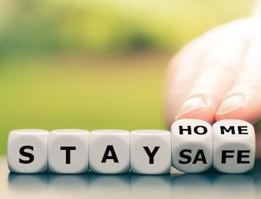
Thank you very much, see you soon!

