Slide 1
^{13th} trip around the English-speaking world!

Slide 2
Quel est le programme aujourd’hui?
Découvrir un aspect d’un pays anglophone.
Travailler l'expression du passé.
Apprendre à parler de personnages célèbres.
A la fin de cette séance , tu seras capable de fabriquer et jouer à un jeu de plateau….

Slide 3
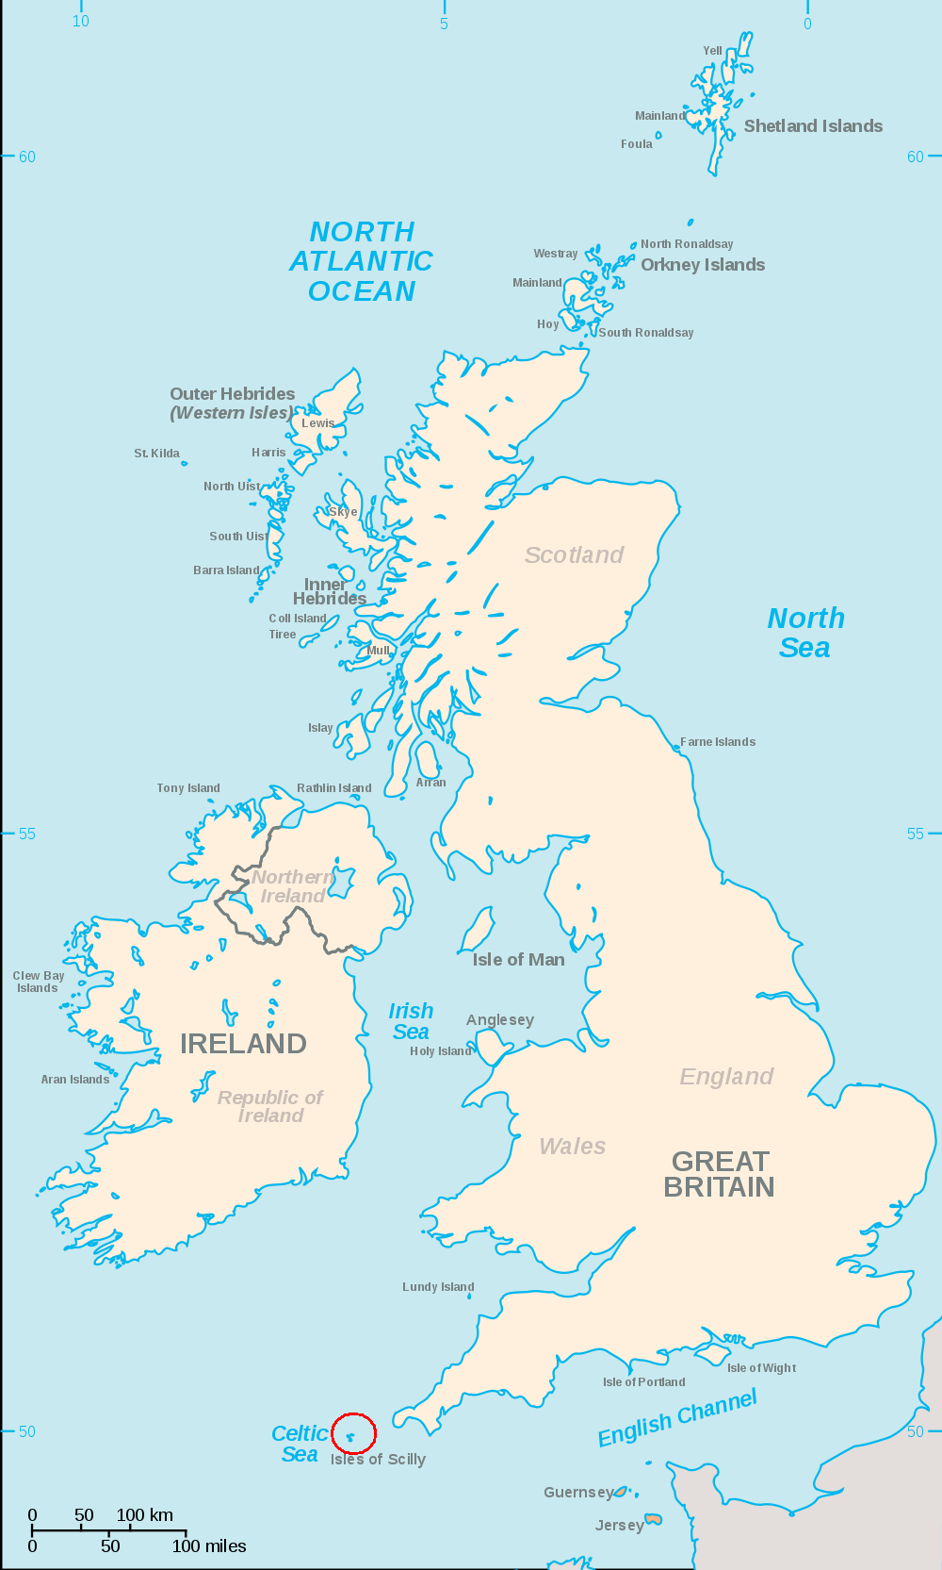
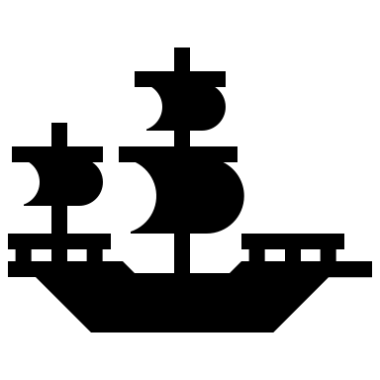
Today’s clues
The people we are going to talk about are from a big island.
This island is surrounded by 4 seas and 1 ocean in the Northern hemisphere.
We’re going back to the past between the 16th and 18th century.
Notes:
https://commons.wikimedia.org/wiki/File:Scilly_Isles_Locator_Map.png

Slide 4
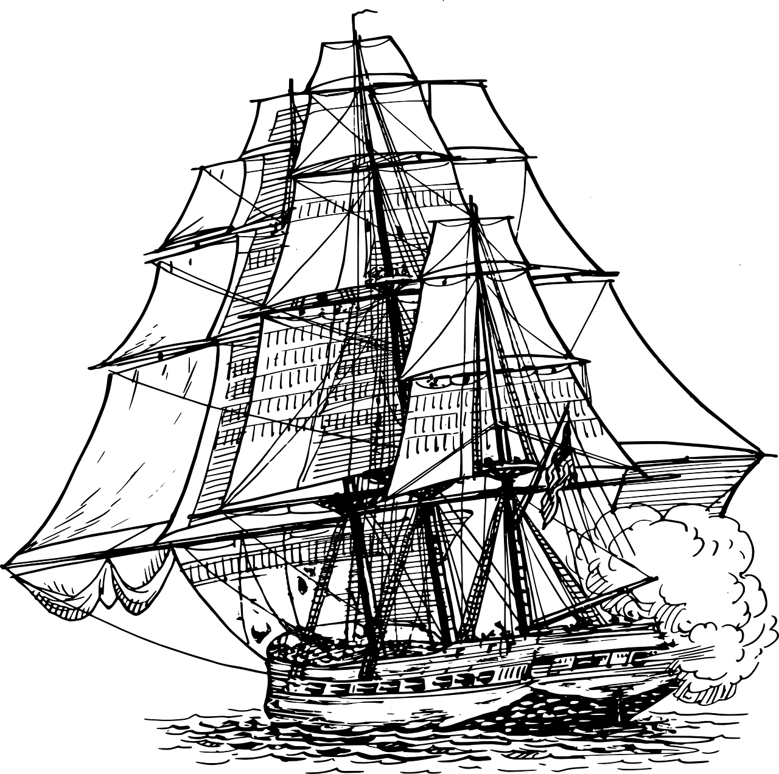
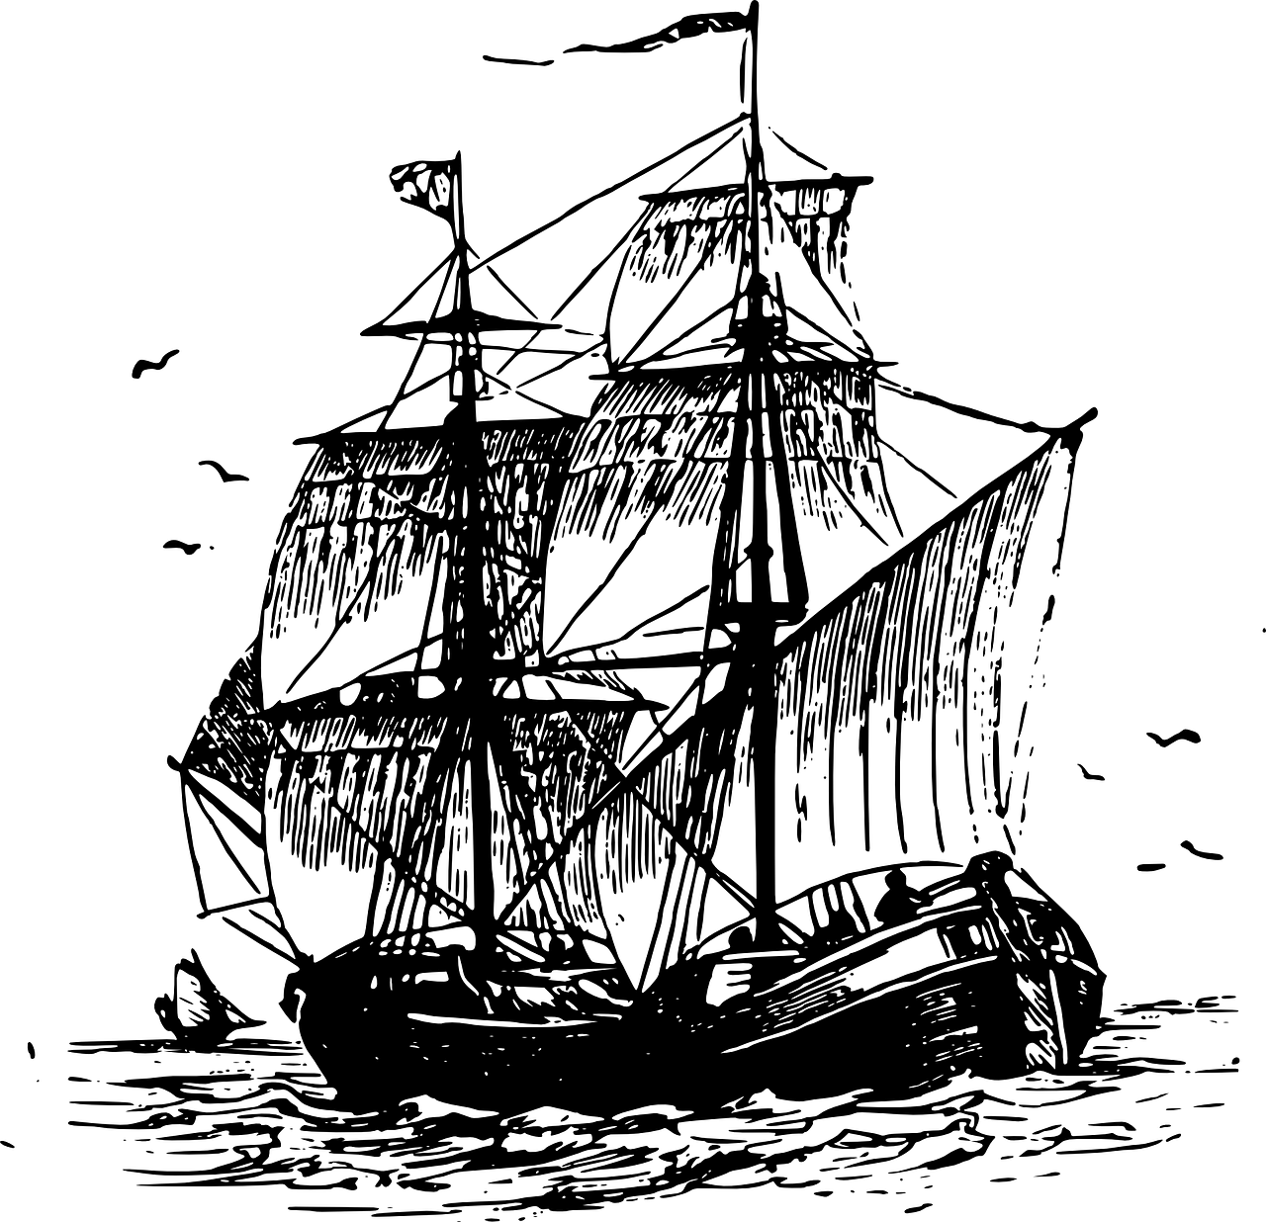
Can you guess today's topic?
_ _ _ _ _ _ _ _ _ _ _ _ _ _
Splash, Jumping, A.wav" by InspectorJ (www.jshaw.co.uk) of Freesound.org
Notes:
https://pixabay.com/fr/vectors/navire-voiles-guerre-canon-marine-309618/
https://pixabay.com/fr/vectors/voilier-navire-voile-pirate-oc%C3%A9an-37510/
https://freesound.org/people/pulswelle/sounds/339517/

Slide 5
Notes:
https://pixabay.com/fr/vectors/pirates-cr%C3%A2ne-os-crossbones-161803/

Slide 6
Pirates’ clothes and appearance
parrot
coat
leather boot
tricorn
beard
tattoo
hook
wooden leg
eyepatch
scar
Notes:
https://pixabay.com/fr/vectors/croix-cr%C3%A2ne-danger-crossbones-os-296395/
https://pixabay.com/fr/vectors/pirates-l-homme-femme-couple-oc%C3%A9an-296981/
https://pixabay.com/fr/vectors/pirate-col%C3%A8re-%C3%A9motic%C3%B4ne-smiley-149046/

Slide 7
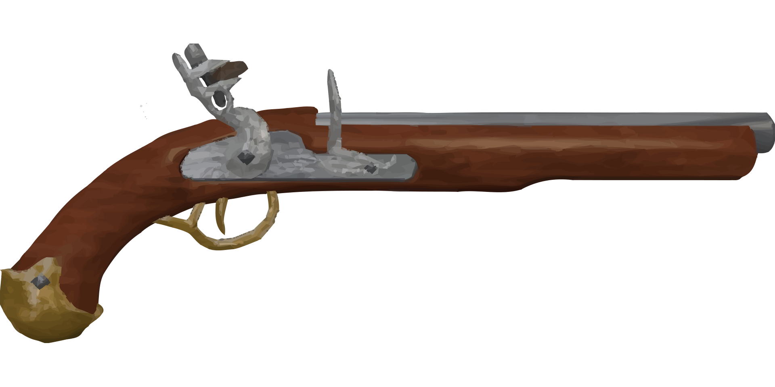
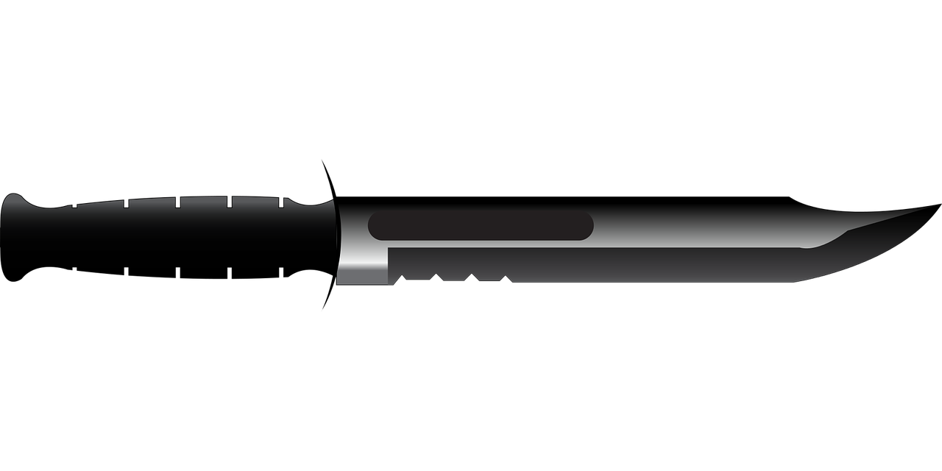
Pirates’ clothes and appearance
tricorn
parrot
scar
hook
coat
eyepatch
beard
tattoo
pistol
wooden leg
leather boot
dagger
Notes:
https://pixabay.com/fr/vectors/couteau-arm%C3%A9e-de-terre-la-chasse-1710292/
https://pixabay.com/fr/vectors/pirates-l-homme-femme-couple-oc%C3%A9an-296981/
https://pixabay.com/fr/vectors/pirate-col%C3%A8re-%C3%A9motic%C3%B4ne-smiley-149046/

Slide 8
Pirate’s clothes and appearance
1
Pirates’ clothes & accessories game
2
3
8
4
7
9
10
11
6
5
12
Notes:
https://pixabay.com/fr/vectors/couteau-arm%C3%A9e-de-terre-la-chasse-1710292/
https://pixabay.com/fr/vectors/pirates-l-homme-femme-couple-oc%C3%A9an-296981/
https://pixabay.com/fr/vectors/pirate-col%C3%A8re-%C3%A9motic%C3%B4ne-smiley-149046/

Slide 9
What did pirates eat and drink?
Pirate’s clothes and appearance
What else do you know about pirates?
Can you name famous pirates?
Why did they have parrots?
What do you know about pirates?
What did pirates do on board / on the boat?
What accessories did they have?

Slide 10
What do you remember?
5 questions for a champion
Question 1
What’s the title of the book by Robert Louis Stevenson?
1
2
3

Slide 11
What do you remember?
Question 2
What did pirates drink?
1
2
3

Slide 12
What do you remember?
Question 3
What did pirates do on board?
1
2
3

Slide 13
What do you remember?
Question 4
What did pirates wear on their heads?
1
2
3

Slide 14
What do you remember?
Question 5
What did they put on one of their eyes?
1
2
3

Slide 15
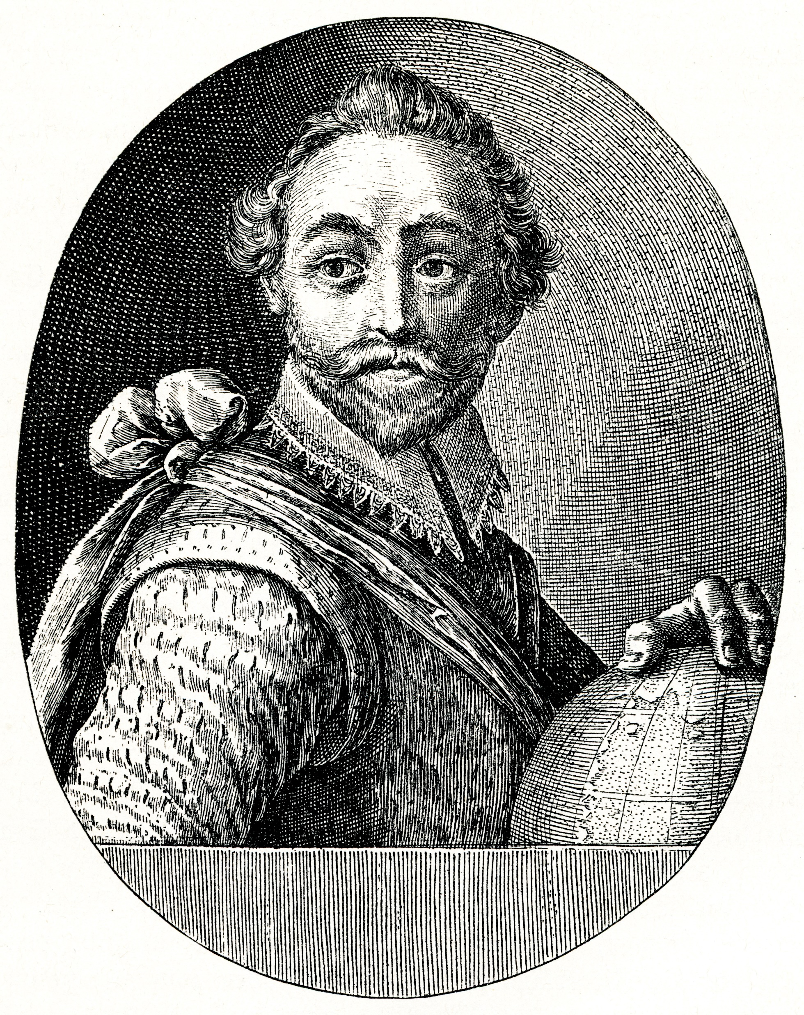
To become a pirate a man had to sign a contract or code. Every pirate was equal.
Privateers were « legal » pirates paid by kings or queens to attack ships from enemy countries! Francis Drake worked for the Queen of England!
Bartholomew Roberts
Edward Teach
« Blackbeard »
The privateer Francis Drake
Anne Bonny
© The New York Public Library, Astor, Lenox and Tilden Foundations
Notes:
https://fr.wikipedia.org/wiki/Fichier:General_History_of_the_Robberies_and_Murders_of_the_Most_Notorious_Pyrates_-_Captain_Bartholomew_Roberts_with_two_Ships.jpg
https://fr.wikipedia.org/wiki/Fichier:Teach_alias_Blackbeard,_colored.jpg
https://fr.m.wikipedia.org/wiki/Fichier:General_History_of_the_Pyrates_-_Ann_Bonny_and_Mary_Read_(coloured).jpg
https://commons.wikimedia.org/wiki/File:Francis_drake-antoine_maurin.png

Slide 16
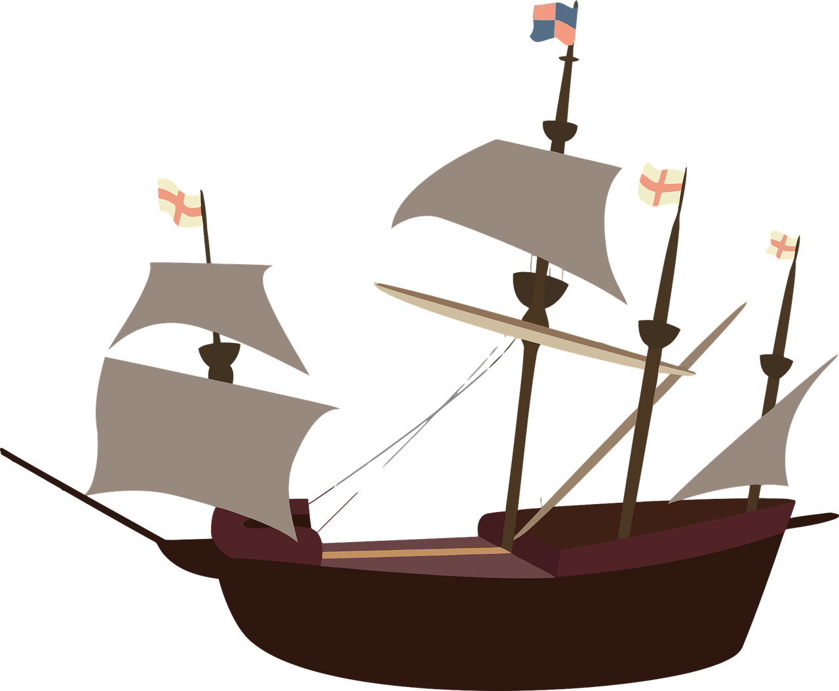
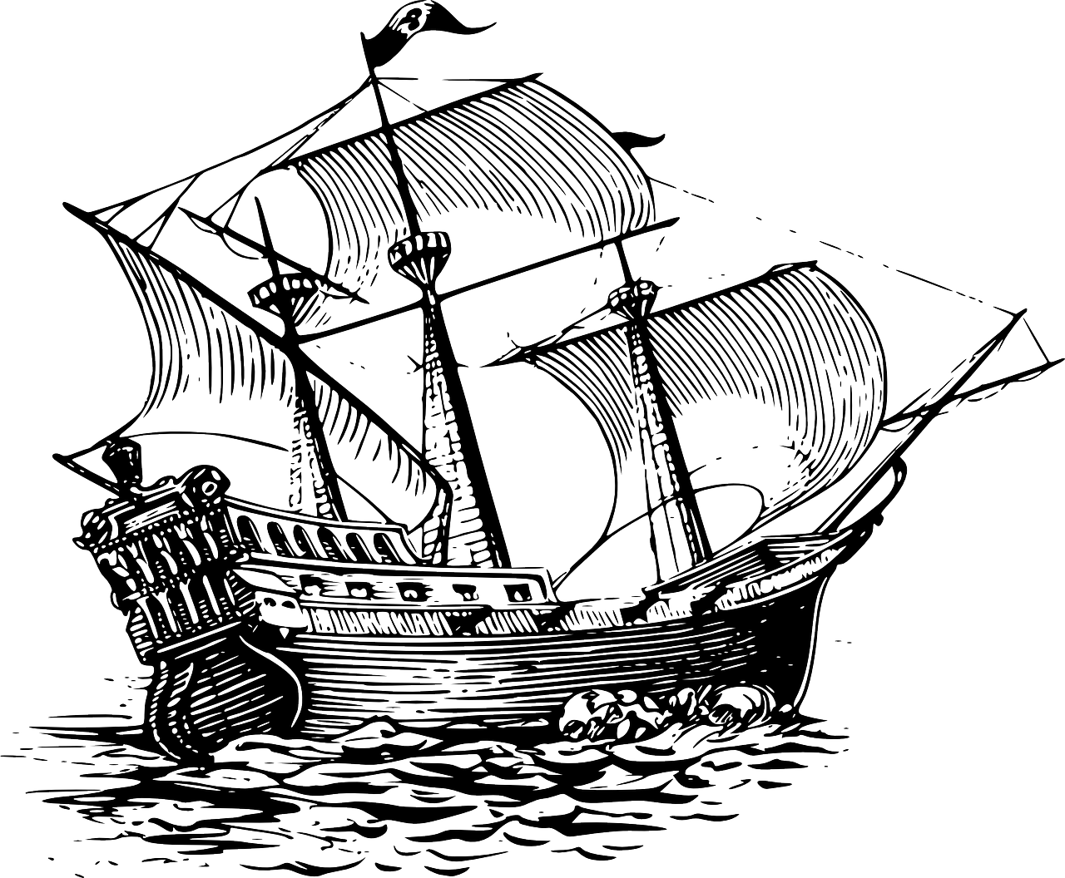
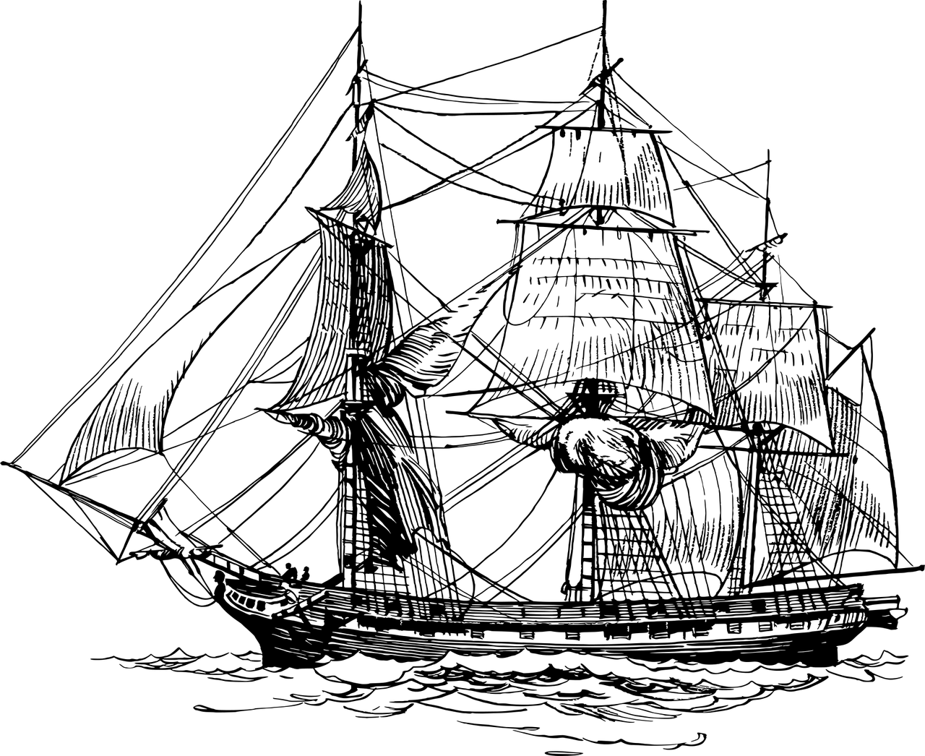
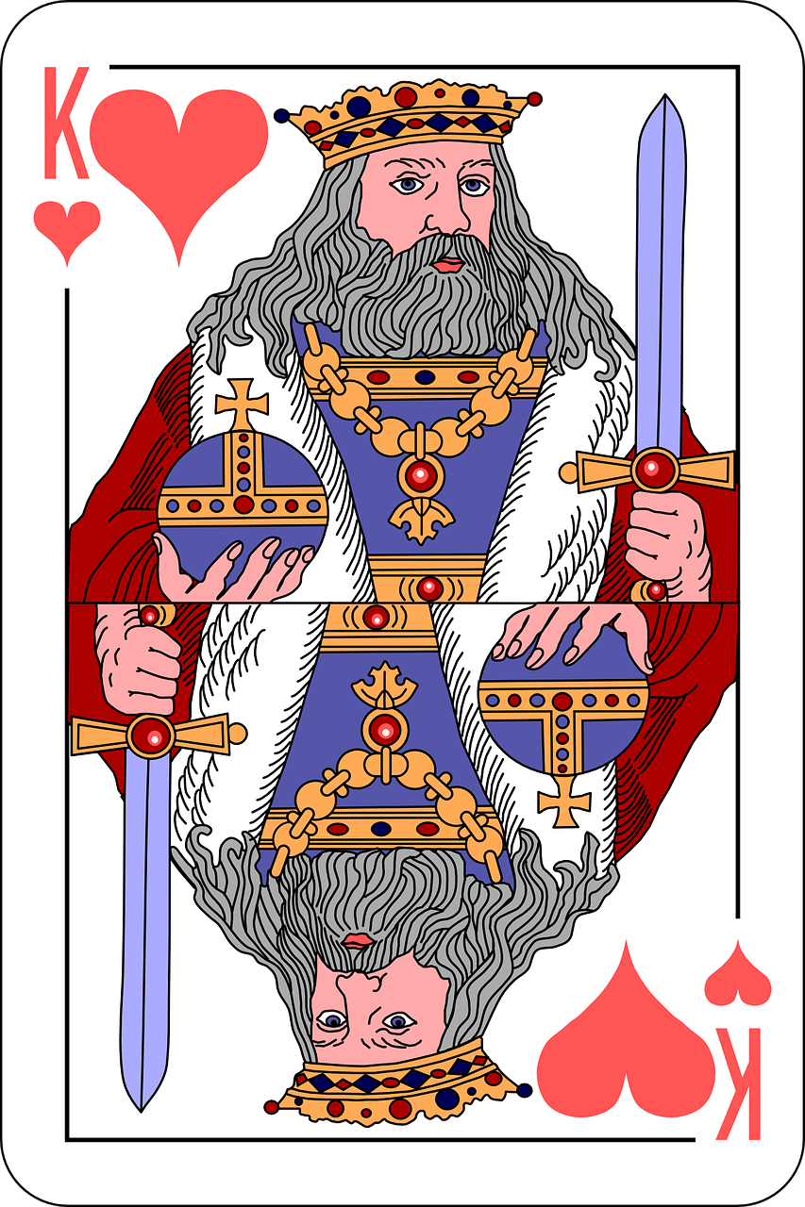
Pirates’ ships
mast
flag
sail
frigate
galleon
deck
Notes:
https://pixabay.com/fr/vectors/bateau-pirate-navire-pirates-voile-2028572/
https://pixabay.com/fr/vectors/galion-voilier-navire-de-voile-146994/
https://pixabay.com/fr/vectors/bateau-fr%C3%A9gate-oc%C3%A9an-mer-navire-2027454/

Slide 17
Pirates’ ships
sail
mast
flag
deck
Notes:
https://pixabay.com/fr/vectors/bateau-pirate-navire-pirates-voile-2028572/
https://pixabay.com/fr/vectors/galion-voilier-navire-de-voile-146994/
https://pixabay.com/fr/vectors/bateau-fr%C3%A9gate-oc%C3%A9an-mer-navire-2027454/

Slide 18
Pirates’ ships
mast
flag
sail
deck
Notes:
https://pixabay.com/fr/vectors/bateau-pirate-navire-pirates-voile-2028572/
https://pixabay.com/fr/vectors/galion-voilier-navire-de-voile-146994/
https://pixabay.com/fr/vectors/bateau-fr%C3%A9gate-oc%C3%A9an-mer-navire-2027454/

Slide 19
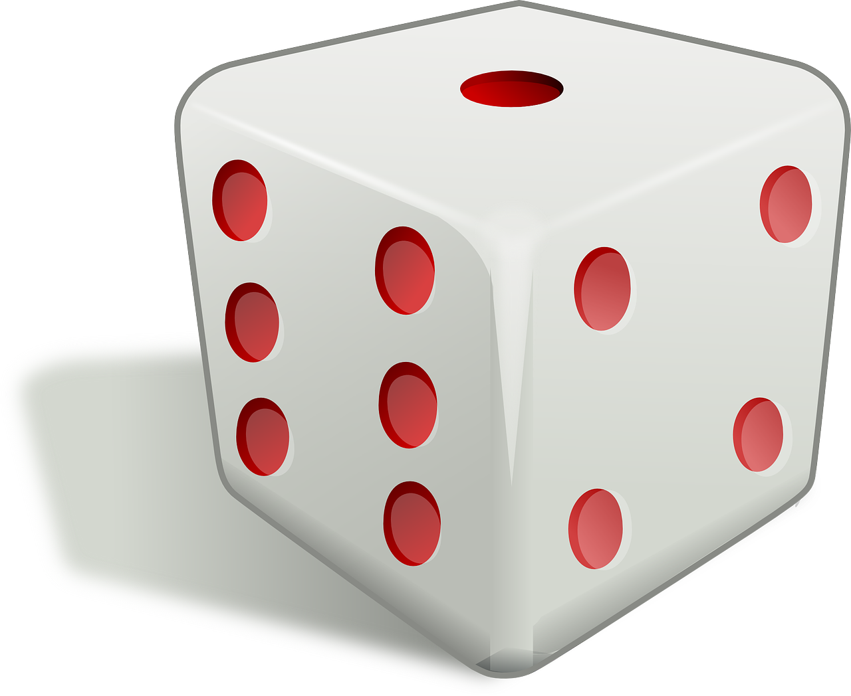
Activities on board!
keep watch
clean pistol/dagger
Chores
Fun activities
do combat training
smoke
play/listen to music
fish
Train for combat
clean deck
play cards or dice
look after the sails
Notes:
Https://pixabay.com/fr/vectors/coeurs-king-le-pont-cartes-%C3%A0-jouer-884196/
https://pixabay.com/fr/vectors/d%C3%A9s-cube-die-jeu-jeux-de-hasard-152179/

Slide 20
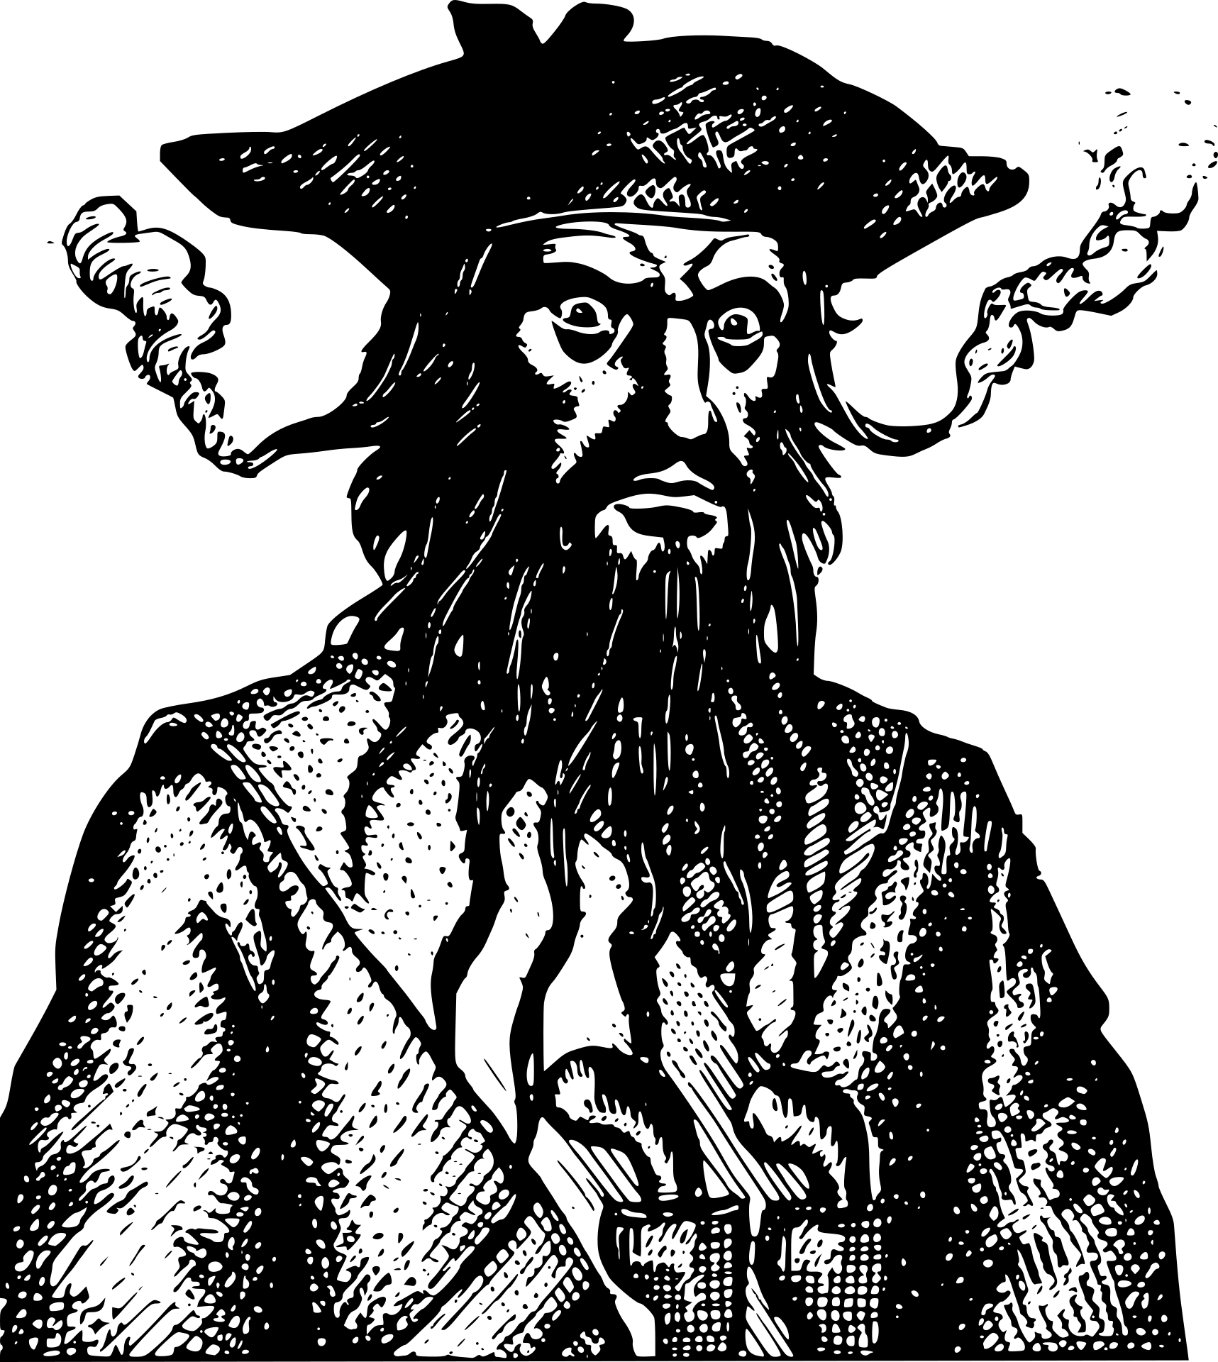
Discover Blackbeard!
Blackbeard was born around 1680 in Bristol, England.
Pirates used nicknames, so nobody really knows his real
name but historians think it was Edward Teach.
He was one of history's most famous pirates!
First, he was a privateer for the British and then he became a pirate in 1716. He captured a French ship and named it "Queen Anne's revenge". In 1718, he established his base in North Carolina in America. He captured many ships and stole their treasure (food, rum, gold, tobacco....). He was killed on November 22, 1718 by British soldiers. He was decapitated.
Adapted from Britanica.com
Notes:
https://commons.wikimedia.org/wiki/File:Capture-of-Blackbeard_(cropped).jpg
Adapted from: https://www.britannica.com/biography/Blackbeard
https://commons.wikimedia.org/wiki/File:Pirate_Flag_of_Blackbeard_(Edward_Teach).svg

Slide 21
Blackbeard was born around 1680 in Bristol, England.
Pirates used nicknames, so nobody really knows his real
name but historians think it was Edward Teach.
He was one of history's most famous pirates!
First, he was a privateer for the British and then he became a pirate in 1716. He captured a French ship and named it "Queen Anne's revenge". In 1718, he established his base in North Carolina in America. He captured many ships and stole their treasure (food, rum, gold, tobacco....). He was killed on November 22, 1718 by British soldiers. He was decapitated.
Adapted from Britanica.com
Real name
Nickname
Date of birth
Place of birth
Name of his ship
Job /occupation

Slide 22
Let’s think: questions.

Slide 23
Questions Matching
How
La manière
Where
L’identité
When
La raison
Who
Un lieu / destination
What
La nature
Why
Le moment

Slide 24
Questions
raison
identité
manière
?
?
?
lieu
nature
moment
?
?
?

Slide 25
Questions: complete!
………. were their names? Edward and Ann.
……….. did he go? To America.
…………. was he nervous? No reason!
………… was he feeling? Excited!
………….. did he come back? In 1718.
…………. was his friend? Francis.

Slide 26
Regarde l’auxiliaire et classe les questions
Where did he go?
When did he come back?
Who was his friend?
Why was he nervous?
What were their names?
How was he feeling?
WAS/WERE | DID
Wh- + was/were + sujet + …
Wh- + did + sujet + verbe + …

Slide 27
Jumbled questions
Wh- + did + sujet + verbe + …
Wh- + was/were + sujet + …
was
Who
?
Stevenson
did
?
What
wear
she
Why
they
?
did
earrings
wear
they
did
What
eat
?

Slide 28
Prepare questions
eat
How
he
wear
Where
DID
drink
When
she
WAS
do
Who
they
WERE
go
What
pirates
attack
Why
have

Slide 29
Edward Teach /Blackbeard
English
1680
Bristol
Pirate
Queen Anne’s revenge
1718

Slide 30
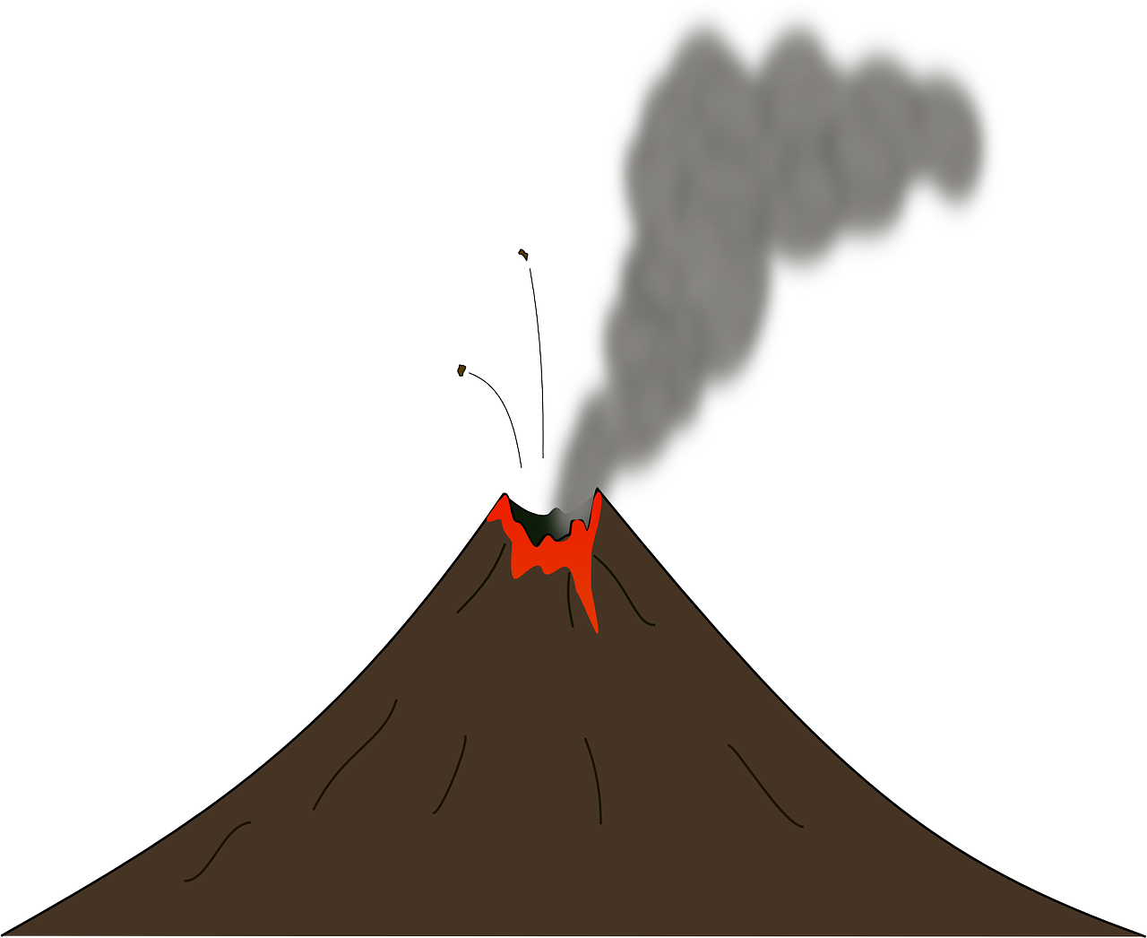
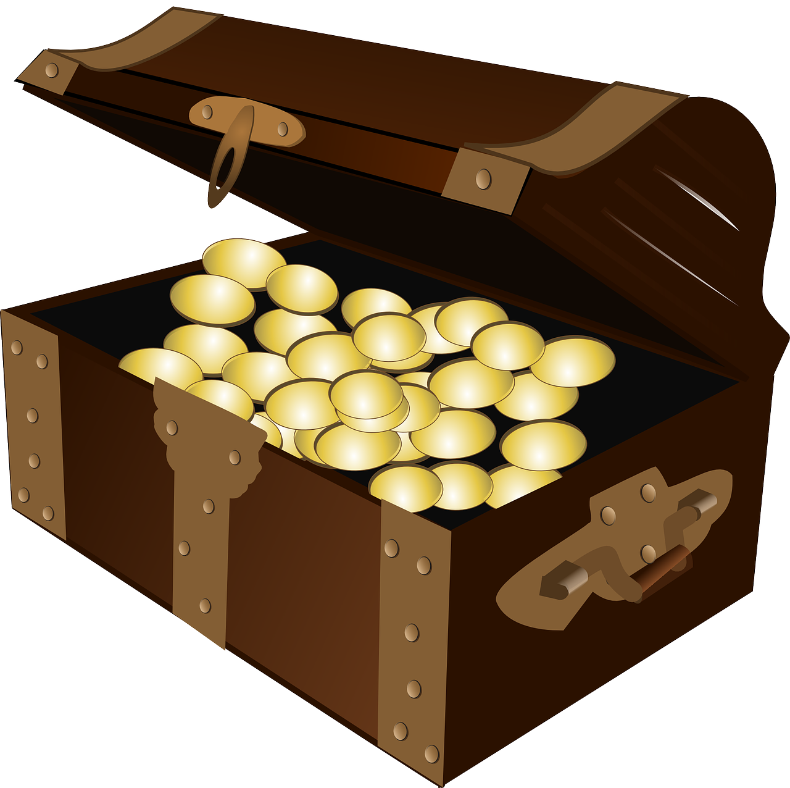
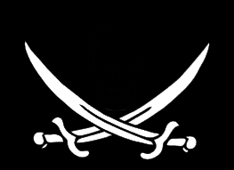
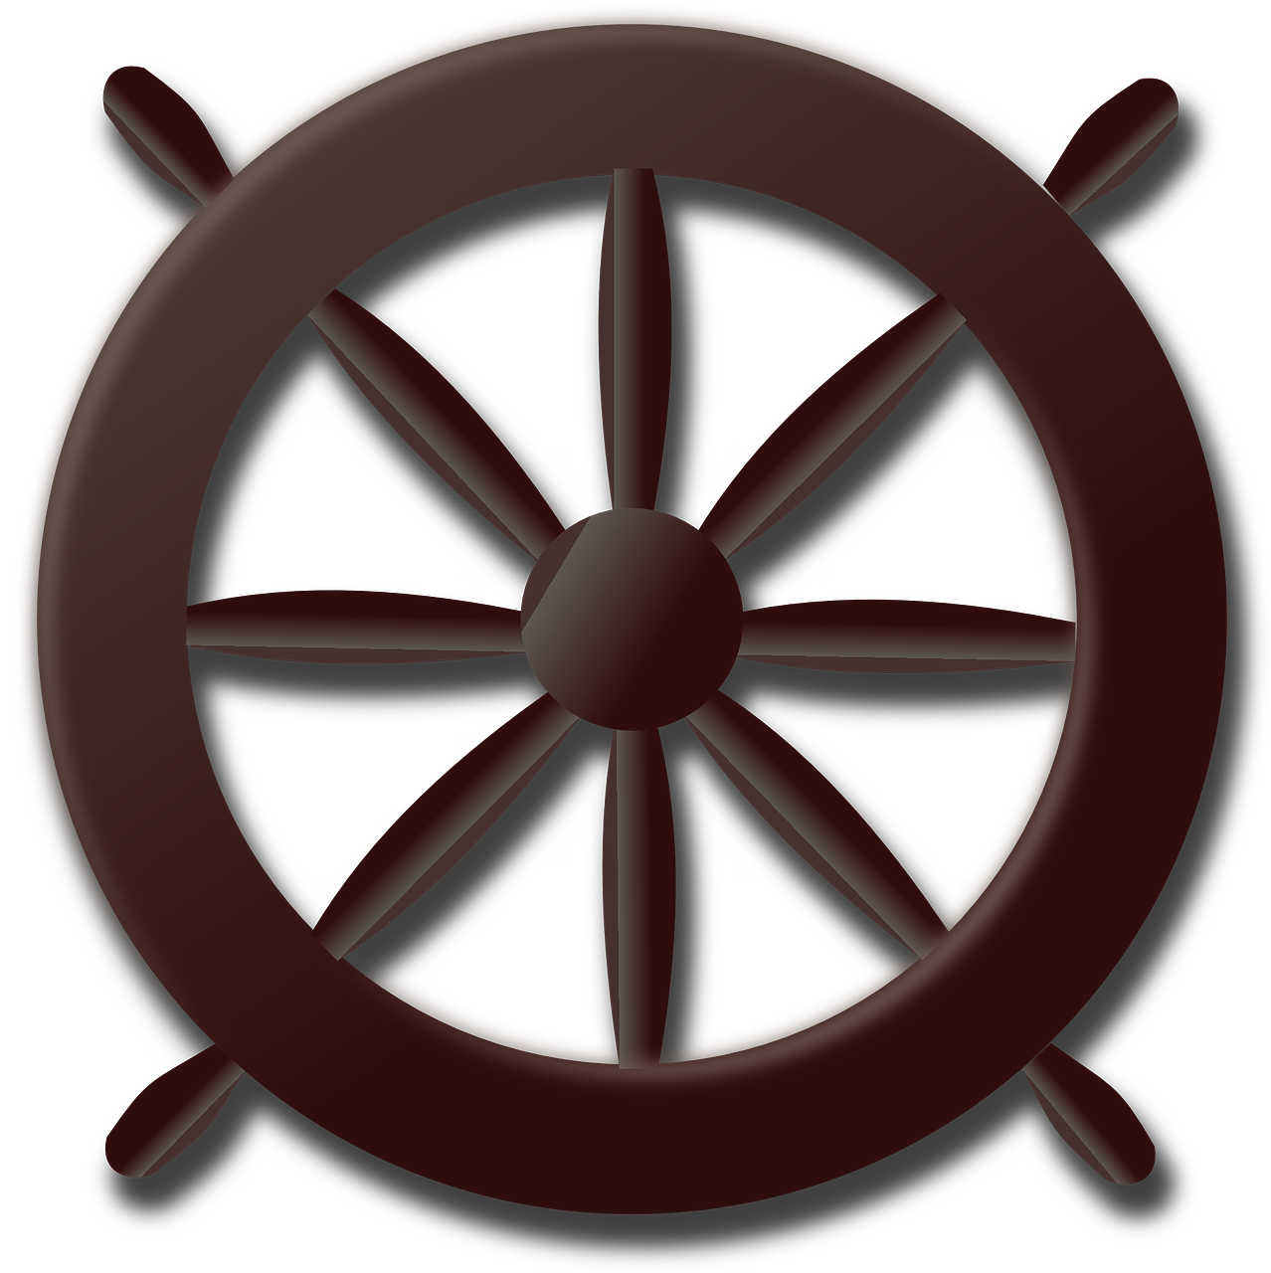
Treasure island
A
?
?
A
A
A
?
A
?
A
A
?
?
?
Start
A
?
?
A
Notes:
https://pixabay.com/fr/illustrations/autocollant-pirate-perroquet-2983914/

Slide 31
Récapitulons! Qu’avons-nous appris aujourd’hui? De quoi es-tu capable à présent?

Slide 32
Stay safe, wear a mask, and practise your English!
Notes:
https://pixabay.com/fr/vectors/pirate-crossbones-cr%C3%A2ne-drapeau-os-47705/

Slide 33
The end

