Slide 1
First trip around the English-speaking world!

Slide 2
Quel programme pour aujourd’hui?
Parcourir une ville célèbre
Apprendre à demander son chemin
Etre capable de situer quelques monuments.

Slide 3
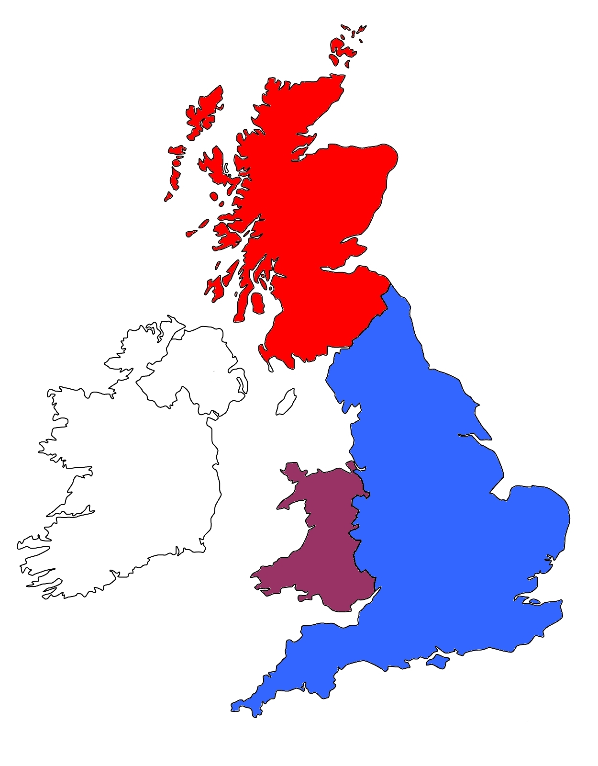
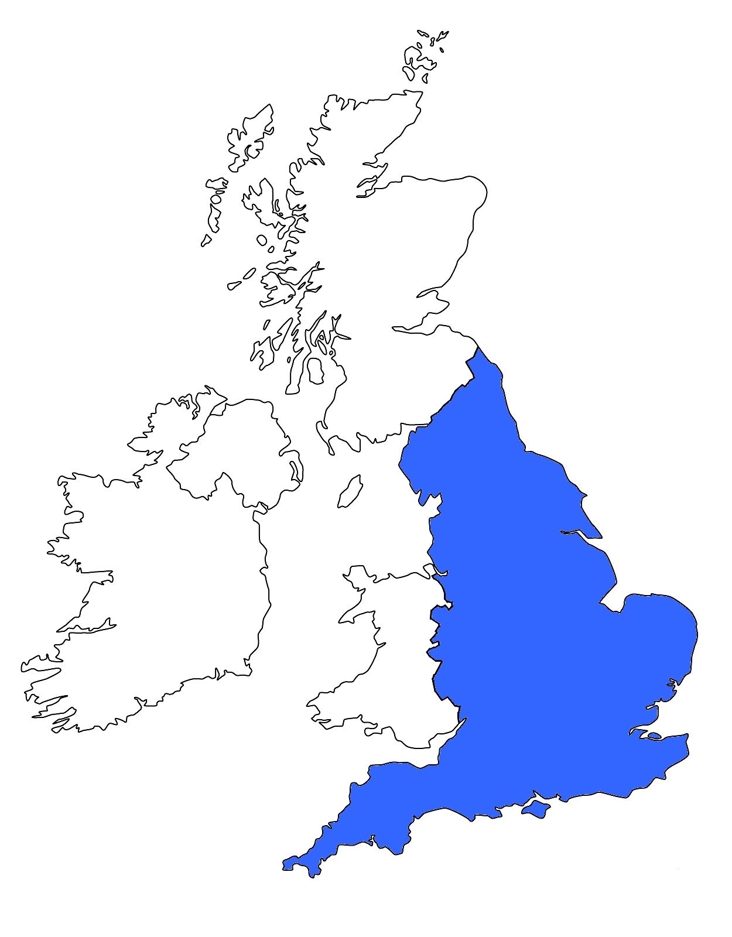
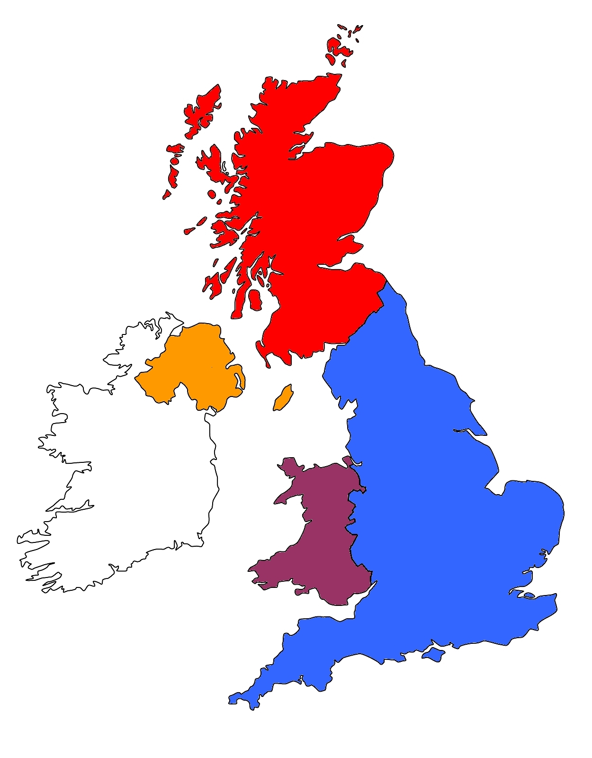
The United Kingdom
Great Britain
England

Slide 5
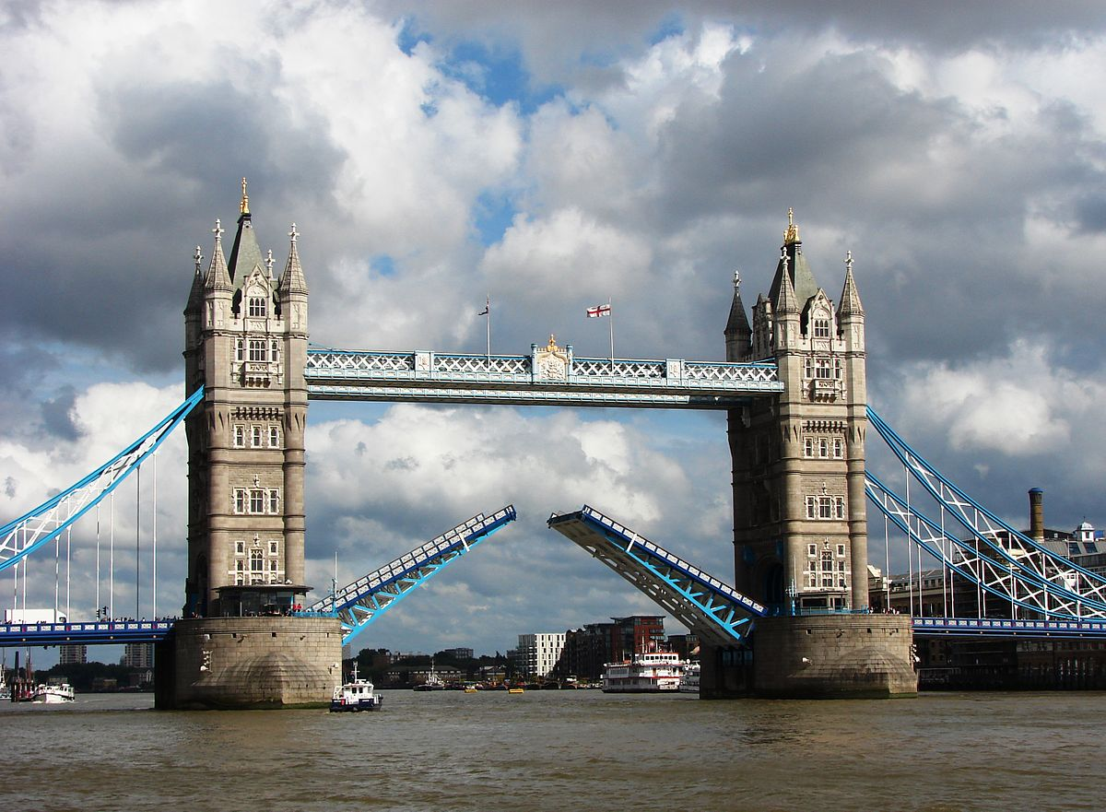
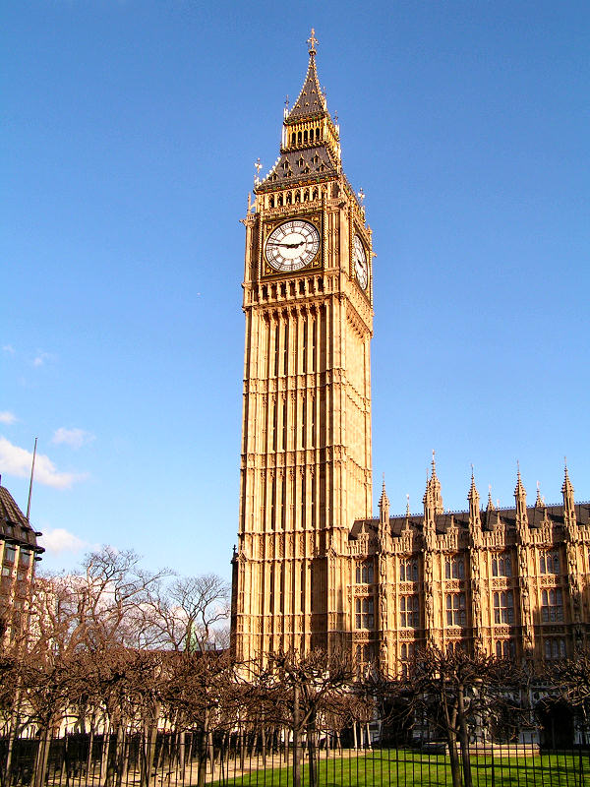
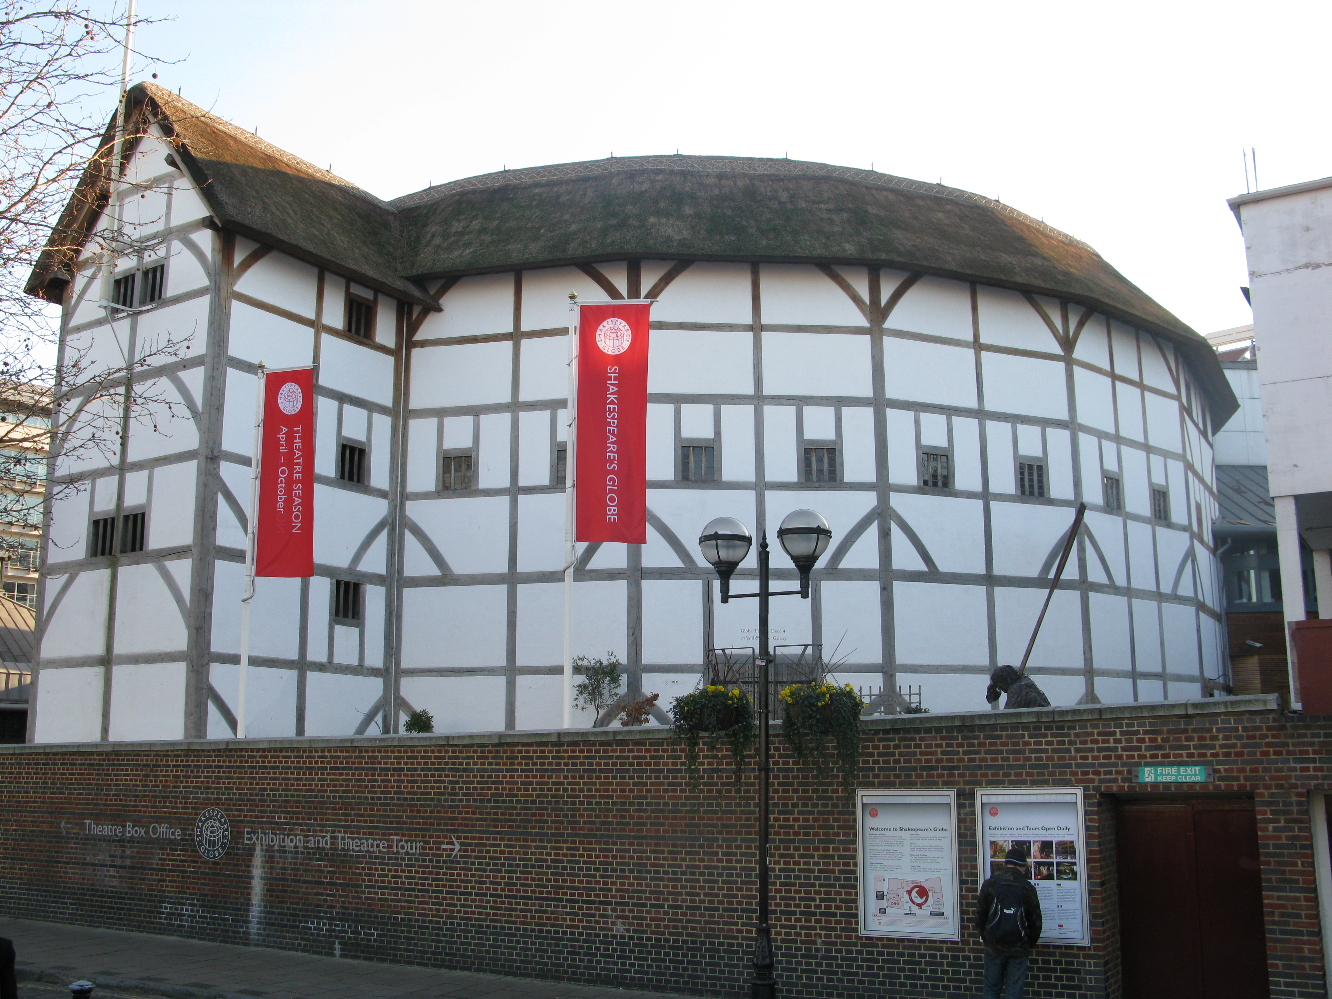
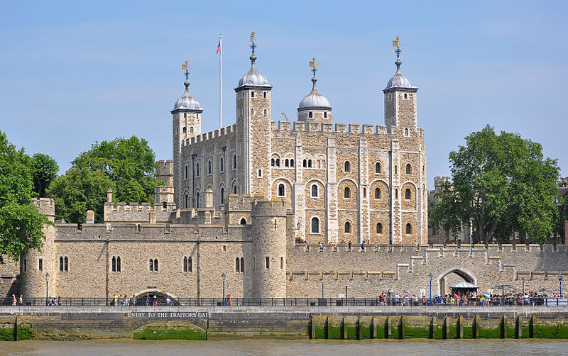
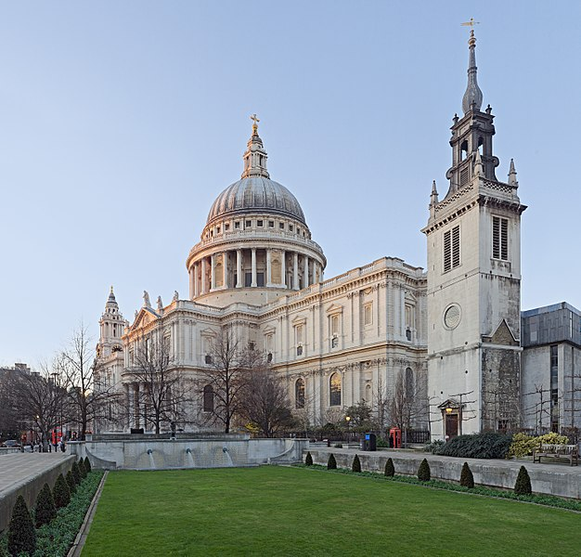
Tower Bridge
The Globe (theater)
Big Ben
The tower of London
St Paul’s cathedral

Slide 6
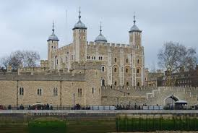
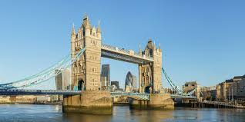
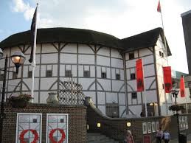
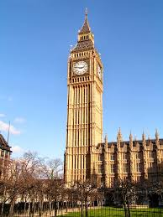
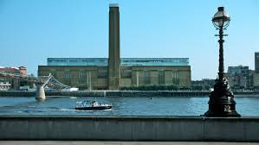
Big Ben
The Tate Modern
Tower Bridge
The Globe
St Paul’s cathedral
The Tower of London

Slide 7
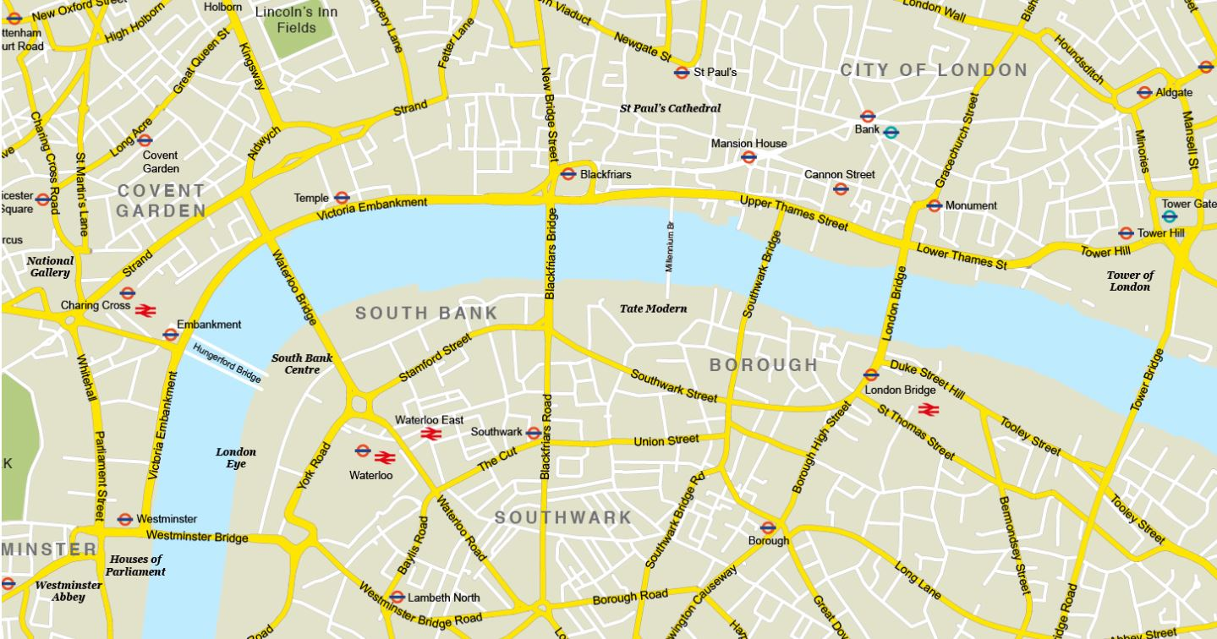
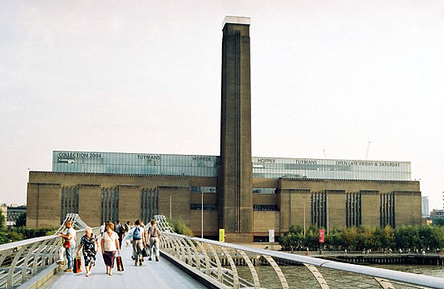

Slide 8
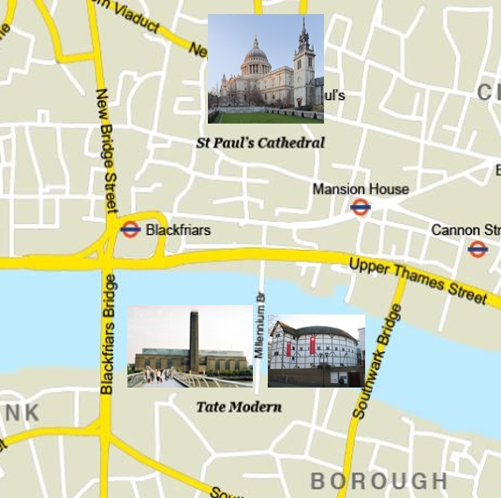
Let’s have a look
The Globe is next to the Tate modern.
The Globe is opposite St Paul’s Cathedral.
The Millenium Bridge is between The tate modern and Tower Bridge

Slide 9
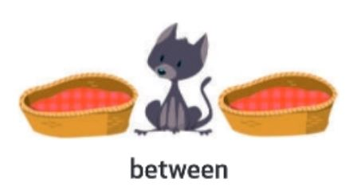
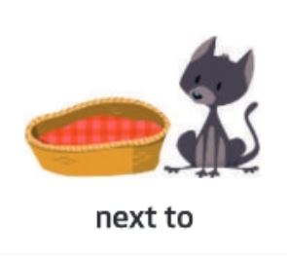
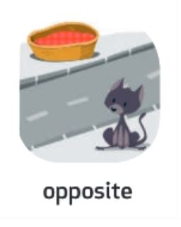
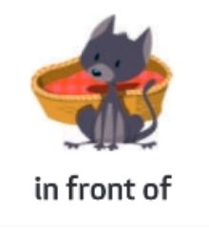
Let’s memorise prepositions!
on

Slide 11
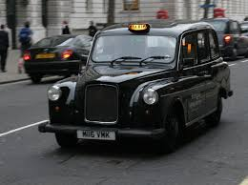
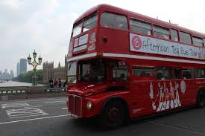
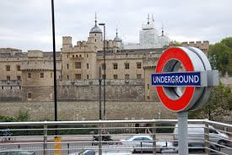
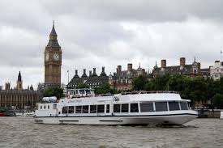
How can you get around London ?
By double decker
By tube
By cab
By boat

Slide 13
How can I go to ……
cross the street
Go straight on
turn right
turn left
cross a bridge
walk until….

Slide 14
Let’s play!
go straight on
turn left
cross …..
turn right
walk until….

Slide 15
Let’s memorise!
D
A
B
C
F
E

Slide 16
Let’s memorise!
D
A
B
C
F
E

Slide 18
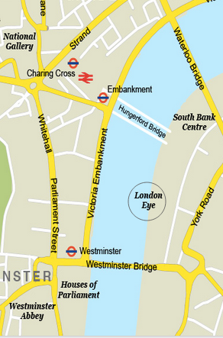
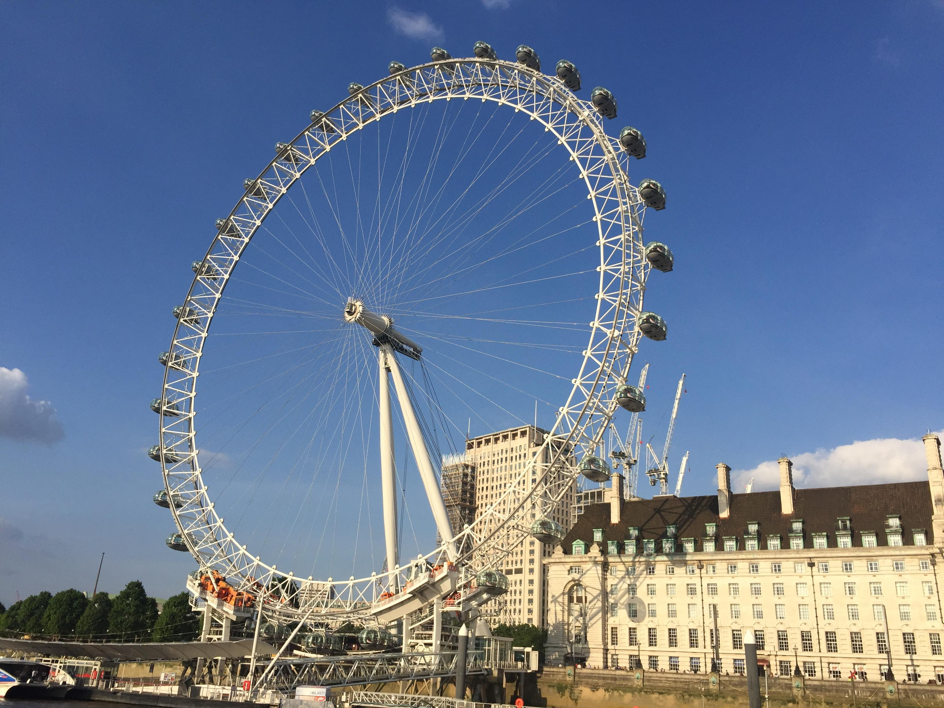
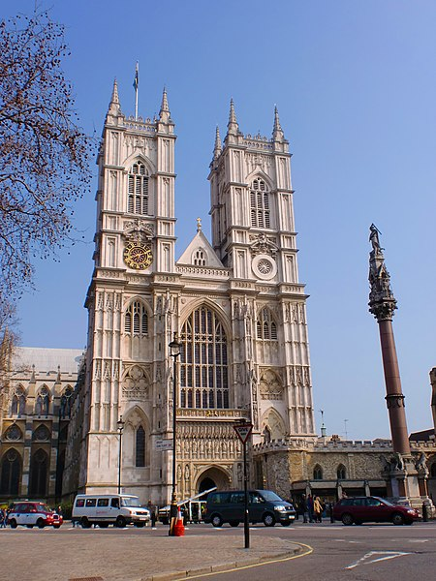

Slide 19
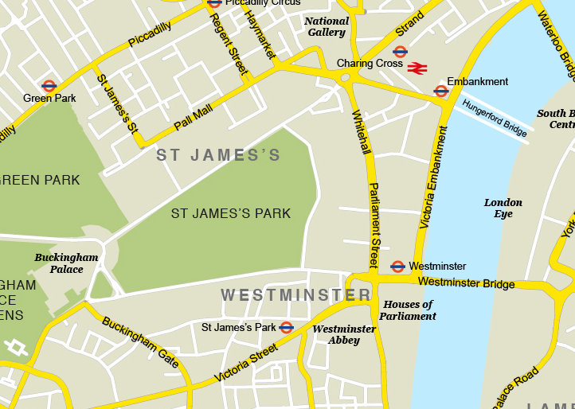

Slide 21
Now, recap!

Slide 23
How can I go to ……
turn left
Go straight on
turn right
cross the street
cross a bridge
walk until….

Slide 24
Récapitulons!

Slide 25
Stay home,
Stay safe….
and practice your English

