Slide 1
Third trip around the English-speaking world!

Slide 2
Quel est le programme?
Découvrir un pays anglophone
1
Revoir les saisons et les mois de l'année
2
Apprendre à parler de la météo
3

Slide 3
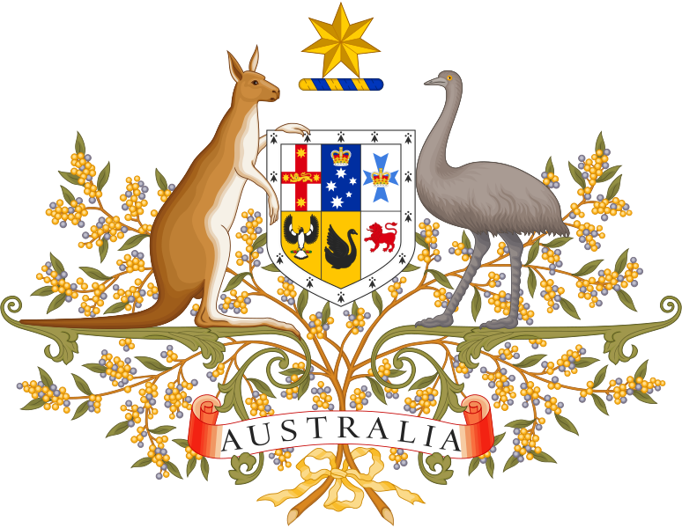
Today’s clue
4
2
1
3
5
Notes:
- Look at this picture and try to guess where we are going today. SO, first clue! What can you see?
I can see feathers and long bird’s legs… It’s a bird! Is it a heron?
No, look closer! It’s legs are grey!
Maybe it is that giant bird that lives in Africa: it is an ostrich!
Not bad! They’re the same family! But it is not an ostrich! Look at the second clue now!
It looks like a strange pigeon but with a long neck…
So, what’s your answer?
Honestly, I don’t know…
It is an emu
A what? I don’t know that bird…
It is the second-largest bird in the world after the ostrich. But where does it live?
I don’t know: I told u, I don’t know that bird!
OK: third clue then!
A long brown tail , strange long feet… I think I know: it’s a kangaroo!
That is correct Good job! So, which country are we going to?
To Australiaaaa!
- Yes, we’re going to Australia! But where is Australia? Let’s have a look together!

Slide 4
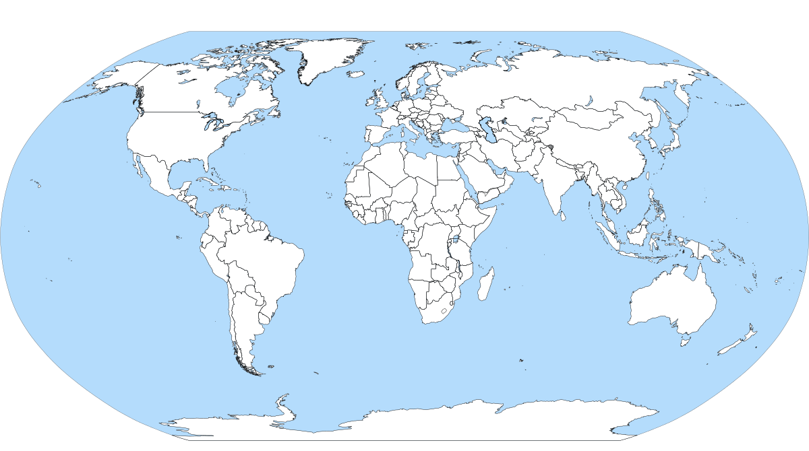
North
Northern hemisphere
West
East
Equator
Southern hemisphere
South
Notes:
Look, it's down here! It’s Down Under.
Look at his map of the world, listen and repeat: North – northern / South – southern
We are in the northern hemisphere but Australia is in the Southern Hemisphere, so the time is different and the seasons are not the same. It's the opposite!
So today, We are in April so it's spring here, today but in Australia, it's Autumn, is that right?
Exactly! Let’s revise seasons!

Slide 5
The four Seasons
Winter
Summer
Spring
Autumn
Notes:
Revenir sur les saisons : pictogrammes / répétitions
Les prononcer puis faire apparaître le mot

Slide 6
Let's memorise!
Summer
Spring
Autumn
Winter
Notes:
Revenir sur les saisons : matching game

Slide 7
Spot the seasons!
A
C
B
D
Notes:
Listen to the season and say if it's season A B C or D

Slide 8
Find the missing season
Notes:
Which one is missing?
A la fin on les écrit sous chaque dessin

Slide 9
Do you know the months and seasons of the year?
March
April
May
June
July
August
March
April
May
June
July
August
December
January
February
September
October
November
September
October
November
December
January
February
Notes:
When it's April in Paris, what season is it?
It's Spring! and when it's April in Australia, it's..... Autumn
Let's do it again: when it's December in Paris, it's …...............winter but it's Summer in Australia
Yes, well done!

Slide 10
Can you complete the months....
January
…..........
March
…...........
May
….........`
July
………….........
October
December
September
….........
Notes:
Now, let's see if you remember the months of the year....
Don't forget that in English they all start with a capital letter.

Slide 11
Let's pronounce them properly!
January / February / March / April /
May / June / July / August/
September / October/ November /
December

Slide 12
Notes:
We’re in April and it’s Spring time here , but it’s still cold.
But if the season are the opposite, what's the weather like in Australia today?

Slide 13
Notes:
Prononcer les villes
Look, we're going to work on the weather forecast for Australia, look at this map.
The capital city is Canberra and it's partly cloudy.
In the South west, in Perth, it's hot: 29° and partly cloudy.
It's stormy in the North in Darwin.
By the way, do you know your numbers?

Slide 14
Let’s revise numbers!
10
12
16
17
19
20
22
24
26
28
29
30
40
50
60
Notes:
Can you complete?

Slide 15
Number dictation
Notes:
Listen and write the numbers : we’re going to do a number dictation.
Are you ready?
10 – 13 – 15 – 20 – 17 – 29 – 30 – 32 – 40

Slide 16
Let’s revise numbers!
13
30
14
40
15
50
16
60
Notes:
Some are tricky : make sure you get them right (gestures)

Slide 17
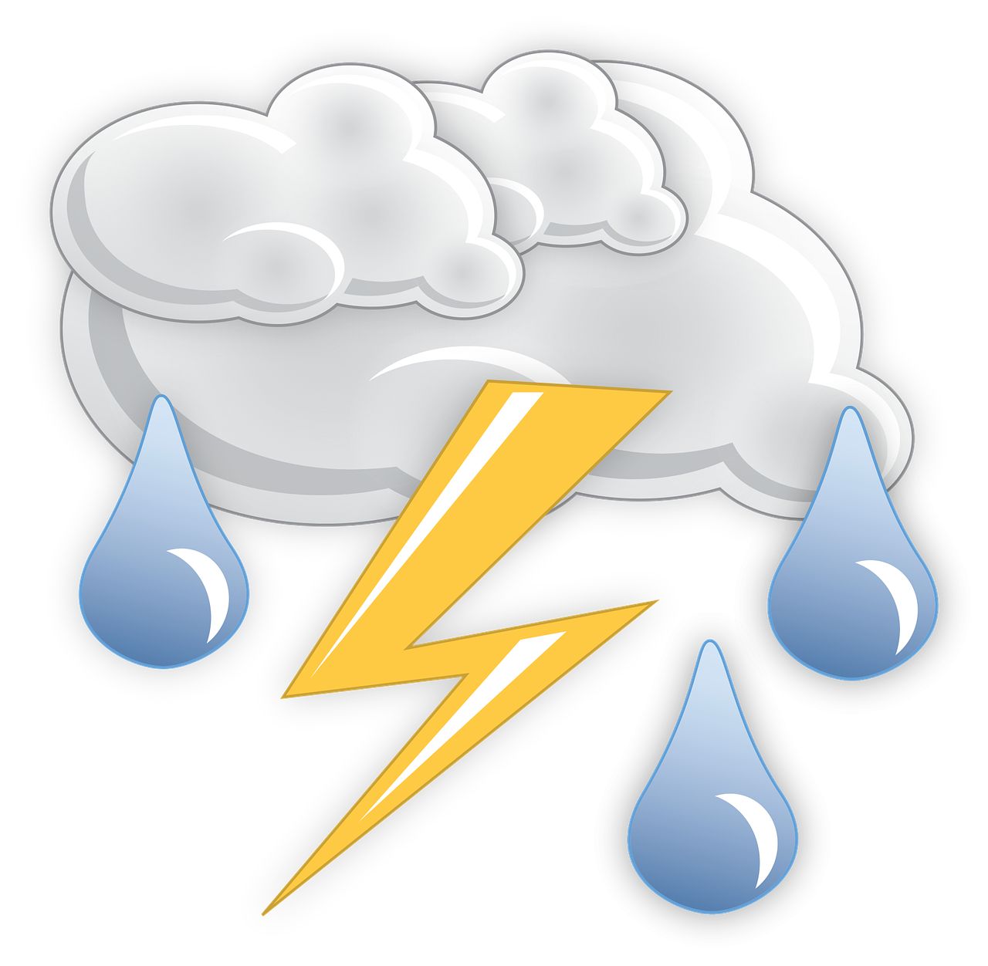
Weather
sunny
partly cloudy
cloudy
raining
snowing
windy
stormy
foggy
Notes:
To talk about the weather forecast you need to know weather conditions
Have you noticed the words in red?
Let’s try and memorise them all!

Slide 18
Weather
A
B
C
D
E
F
G
H
Notes:
Let’s play a game
What letter is sunny, tec
Dire les pictos, ils retrouvent la lettre.

Slide 19
Temperature
It’s hot!
It’s warm!
It’s cool!
It’s cold!
Notes:
Let’s talk about temperature

Slide 20
Weather forecast
In Sydney, it's
It's 24°. It’s
In Alice Springs, it's
It's 40°. It’s
It's in Darwin
but it's 31°. It’s
Notes:
Let's read and complete.
To pronounce the temperature, you need to know your numbers.

Slide 21
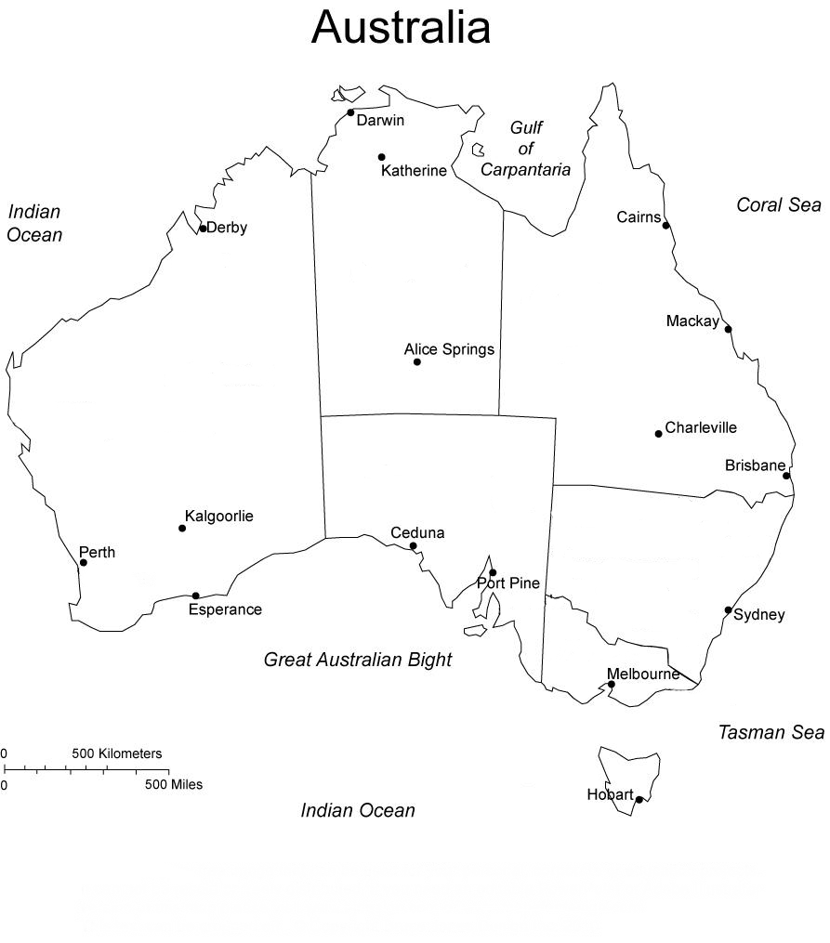
The weather forecast
Notes:
Ok, let's listen to the weather forecast.
Petite parenthèse en français. Nous allons écouter un audio qui s'intitule" weather forecast". Que penses-tu entendre? A quoi t'attends-tu? Anticipe toujours avec le titre.
1ere écoute on se concentre sur les villes entendues ( Il y en a 6) puis 2nde écoute on fera des pauses pour dessiner les situations météo à côté de chaque ville. → on les surligne
Now let’s listen
Now let’s listen again with some pauses so you have time to write

Slide 22
The weather forecast
Notes:
Now it’s your turn: let’s listen to tomorrow’s weather forecast

Slide 23
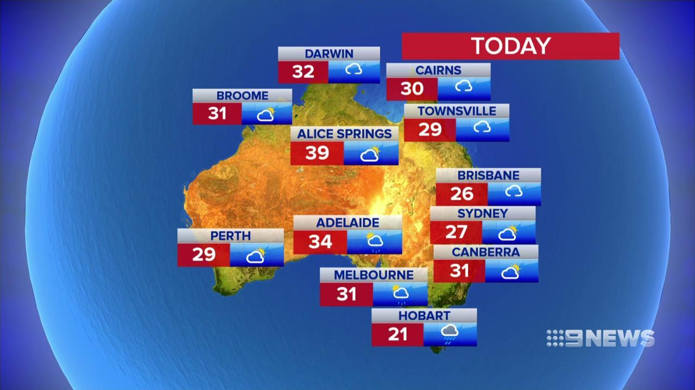
Now it’s your turn!
Notes:
Ok, can you prepare a weather forecast bulletin?

Slide 24
Récapitulons
Notes:
Aujourd'hui, nous avons revu les saisons, les mois, les nombres.
Nous avons découvert l'Australie et travaillé sur des situations météo.
Lorsque tu apprends du vocabulaire, nous avons vu qu'il était important de le lire, de le prononcer, de l'entendre, même de le mimer si possible.
Une autre astuce consiste à l'apprendre dans un ordre logique.
Lorsque tu écoutes un document , il y a toujours des mots que tu ne connais pas, mais fais toi confiance, tu n'as pas besoin de tout comprendre pour te débrouiller. Anticipe puis appuie toi sur ce que tu comprends.

Slide 25
Stay home,
stay safe and…
practise your English!

Slide 26
THE END

Slide 27
Exercices supplémentaires possibles

Slide 28
Spelling game
What letters are missing?
JA..ARY
SE.TE.BER
FE.R.AR.
J.NE
M.R.H
MA.
AU.U.ST
JUL.
.PR.L
D.C.MB.R
.CT.BER
.OV.M.ER
Notes:
Jeu d’orthographe: écrire des mois avec des lettres manquantes, à eux de retrouver

Slide 29
Temperature
Notes:
Observe these thermometers. One is going to disappear: Can you guess which one?

Slide 30
Temperature
1
2
3
Notes:
Observe these thermometers. One is going to disappear: Can you guess which one?

Slide 31
Listen
Hello, I’m Fleur Nittolo for today’s weather Forecast .
Autumn has arrived in Australia, but the temperatures are still nice and warm on the whole.
Today, It’s sunny and cloudy in Perth. The temperature is about 25°. It’s really hot in the north of the country with 34° up in Darwin. It’s going to be sunny all day! There is a chance of rain in Brisbane, so don’t forget your umbrella. In Sydney the temperature is around 23° and it’s going to be cloudy and sunny …. so no rain! It will be windy in Hobart, Tasmania. In our capital city, Canberra, it’s cloudy and sunny and the temperature is around 25°.
Tomorrow, it won’t be as nice. It will be rainy in the south-west in Perth. It will be very hot in Darwin with temperature around 35°. It will be rainy and windy in Sydney and partly cloudy in Canberra. The wind will blow in Hobart, so be careful!
That’s all for today!
Notes:
Transcription de la CO

Slide 32
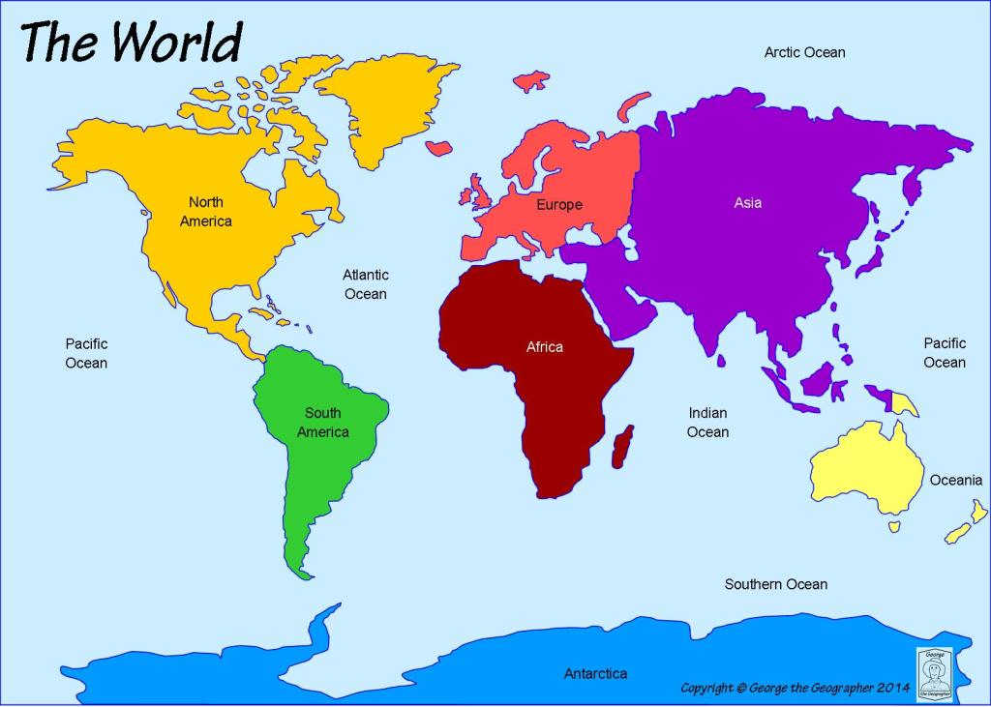
Notes:
Extra: pour faire apprendre/réviser les continents au passage.
How many continents are there?
Some people say 4, some say 5, some say 6.
But British people consider there are 7 continents: NA – SA – Afr. – Europe – Asia – Oceania and Antartica

Slide 33
Notes:
Give the names of the continents

