Slide 1
Fourth trip around the English-speaking world!

Slide 2
Quel programme pour aujourd’hui?
Parcourir une grande ville du monde anglophone
Apprendre à parler des animaux
Acquérir des méthodes pour comprendre et apprendre

Slide 3
Today’s clues
It’s a very big country in the southern hemisphere
We are going to visit a very busy and big city but it’s not the capital
The name of the city starts with an « s »
It’s famous for its opera house
1
2
3
4
5

Slide 4
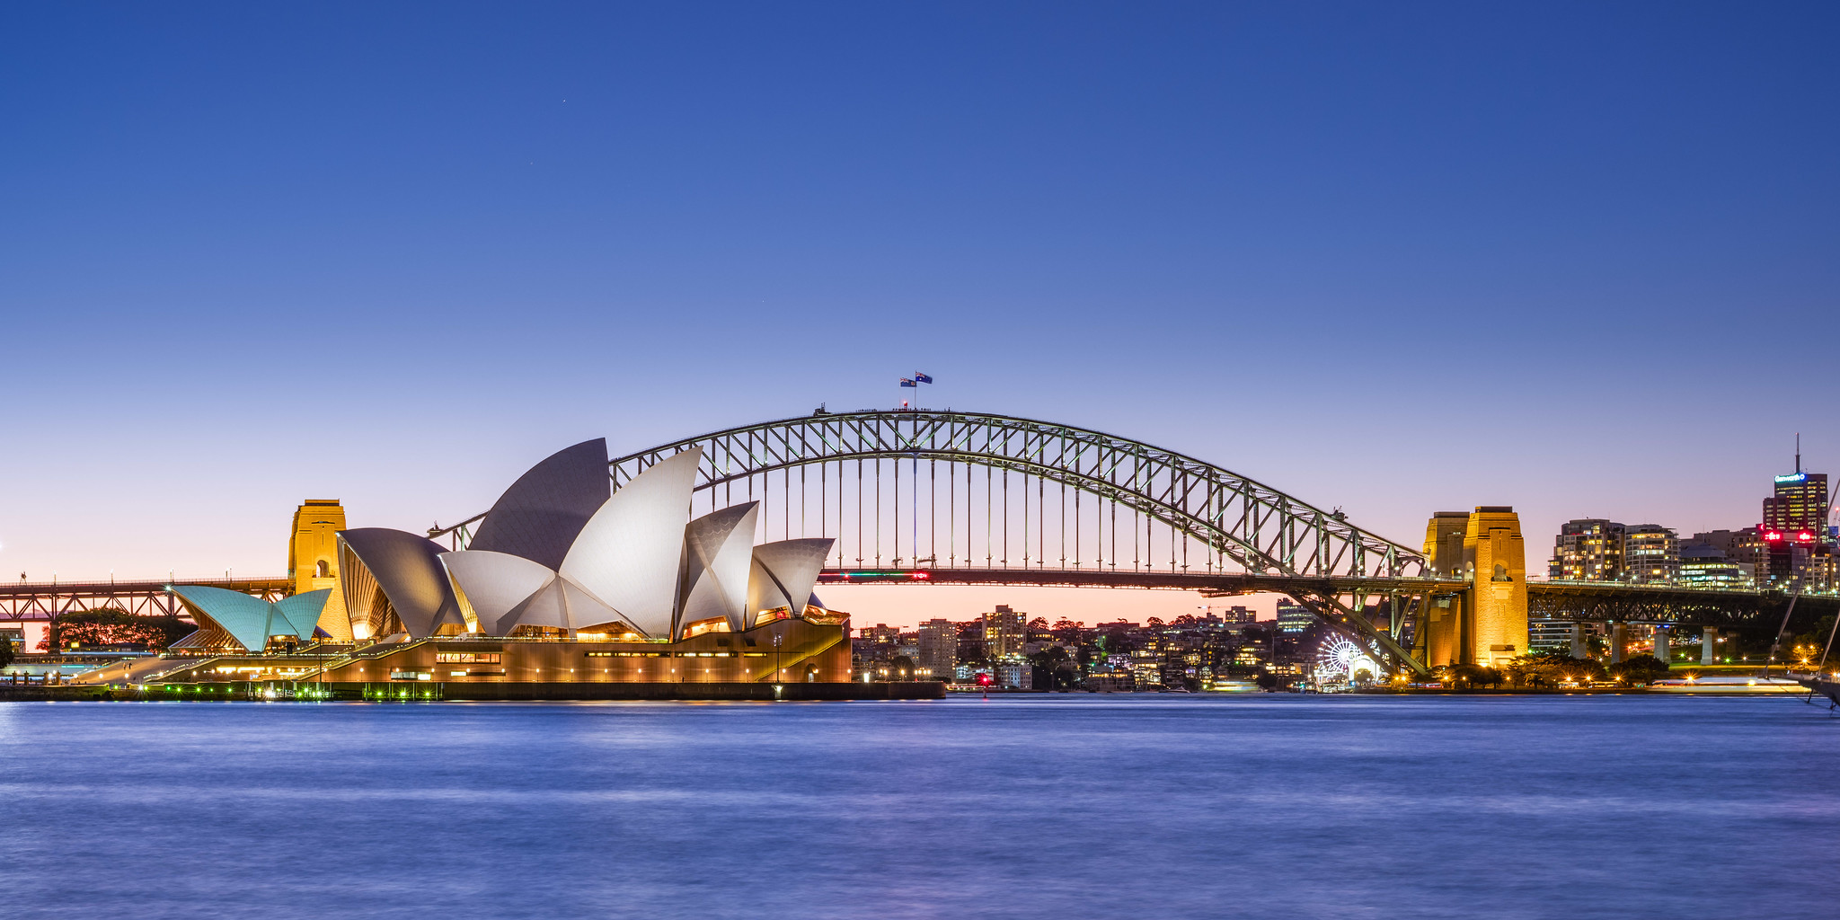
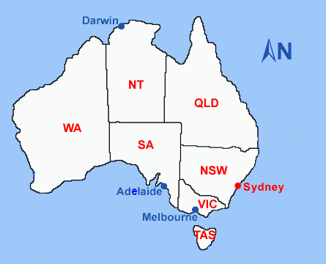
Sydney

Slide 5
My favourite places and activities in Sydney …..
Strategies?
Notes:
We're going to listen to someone talking about her favourite places and activities in Sydney.
Petite parenthèse en français sur un point de méthodologie, avant de continuer.
Nous allons entendre une jeune femme parler. Le titre est "my favourite places and activities in Sydney".
Comment vas-tu t'y prendre? Essaie de t'appuyer sur que tu comprends, les mots qui seront peut-être pus accentués, donc qui ressortiront . Entraîne toi: prends une feuille et note les mots que tu comprends. Emmanuel, si on part du titre, a quoi t'attends tu? Cinema? Beach? Volleyball? Surf? Restaurant? Café? Park? Friends...
My / favourite / Sydney / activities / places? Mes places préférées à Sydney? Non, mes lieux? Ok, so now, let's listen – focus on places 1ere écoute: On écoute et on essaie de repérer ce qu'on peut.
Are you ready? Let's go!

Slide 6
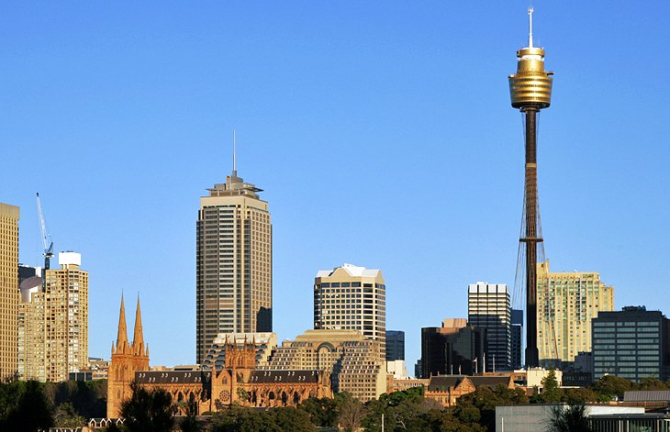
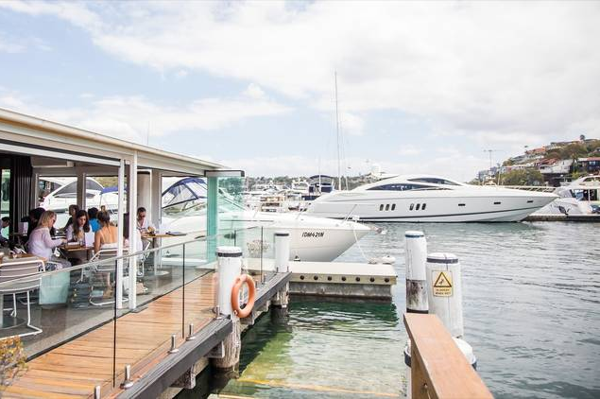
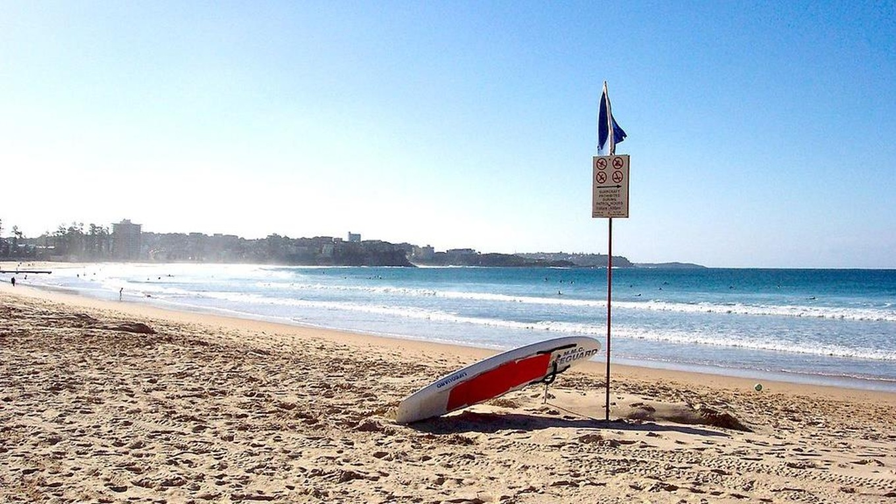
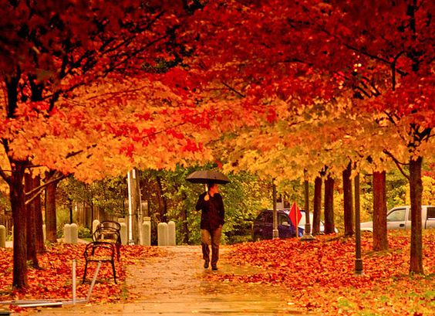
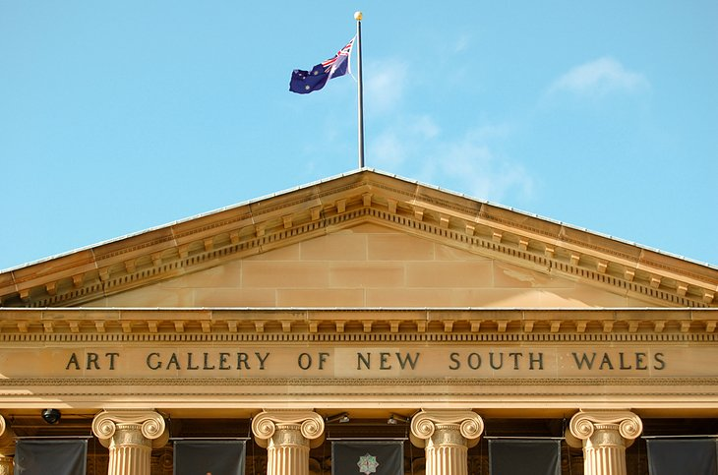
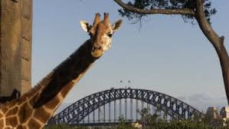
❑
❑
Tower eye
The Opera House
❑
The Harbour
❑
Bondi beach
❑
Royal Botanic Garden
❑
Art Gallery of New South Wales
❑
Taronga zoo
Notes:
Ok, so now let's listen – focus on places
tick the places mentionned in the audio

Slide 7
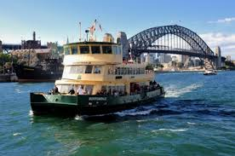
Let's recap
walk …
eating
surf
take the ferry
visit
favourite animals
the Opera House
on the harbour
Bondi beach
the zoo
in the Royal
Botanic Garden
ferry
Notes:
Ok, so now let’s check! She likes to take a ferry to go to Taronga zoo. So let's go and visit too.

Slide 8
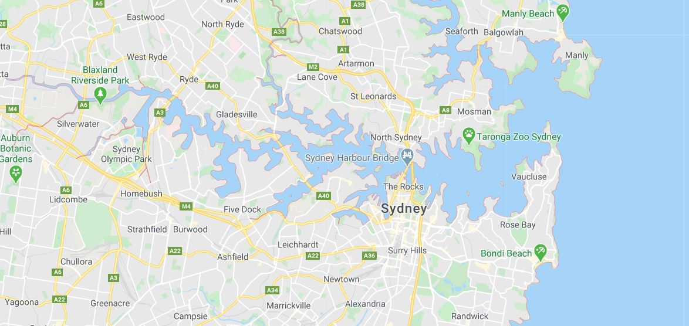
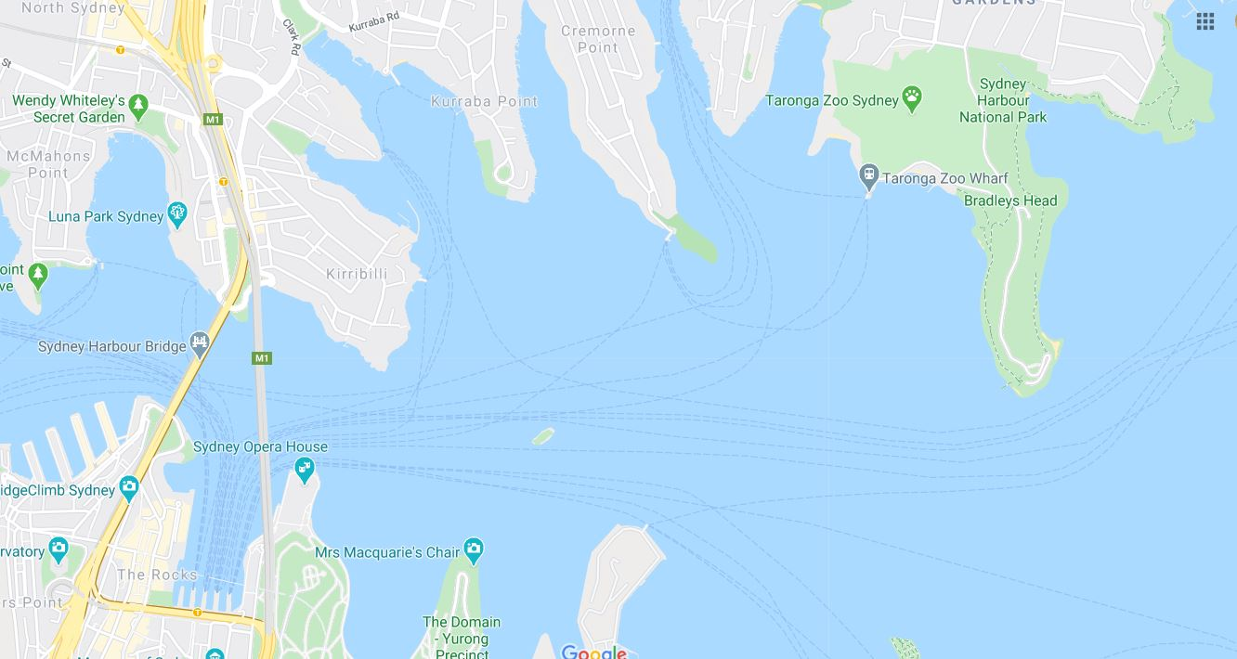
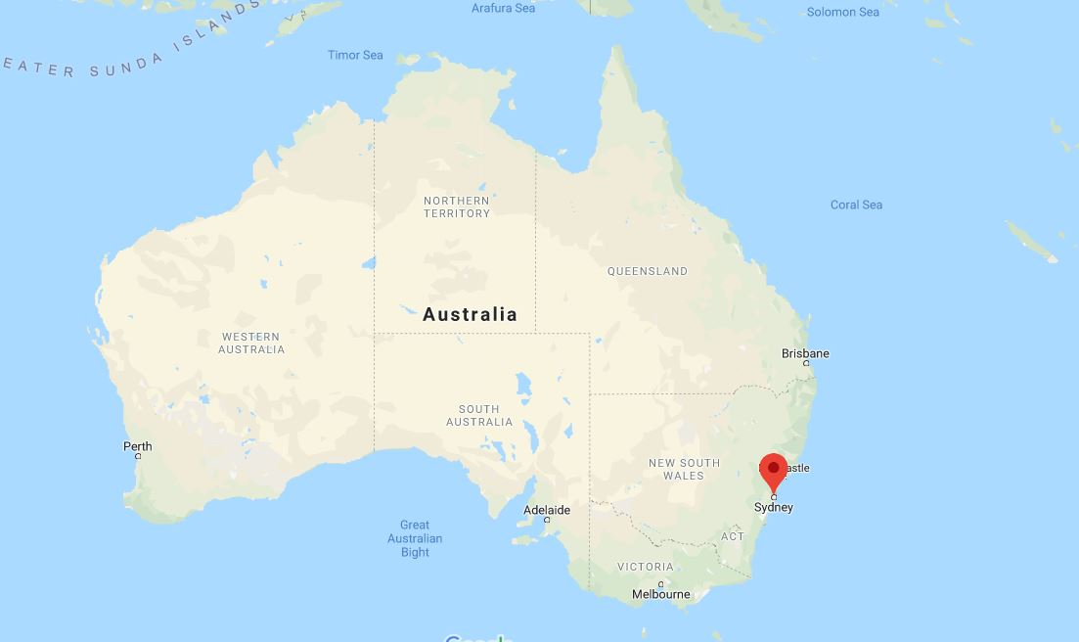
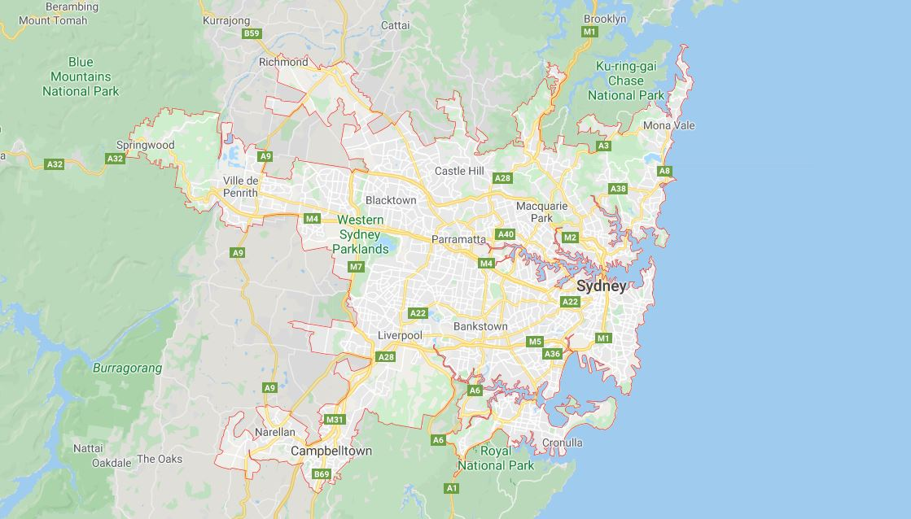
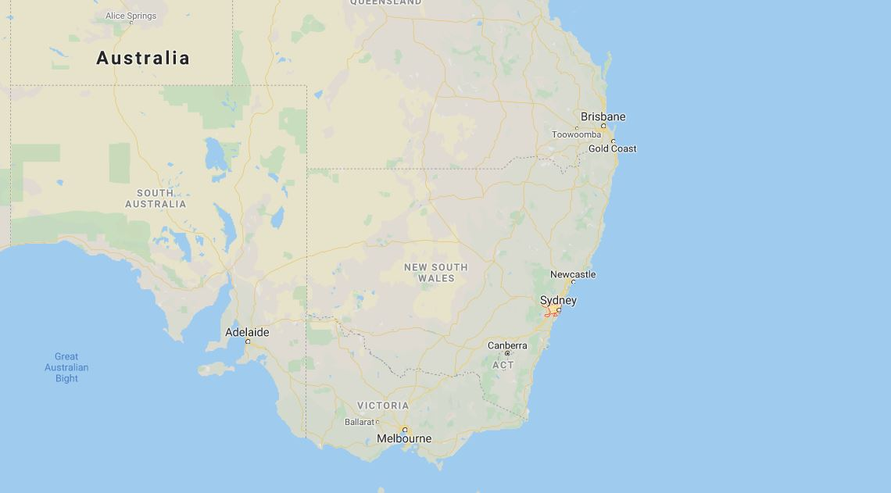
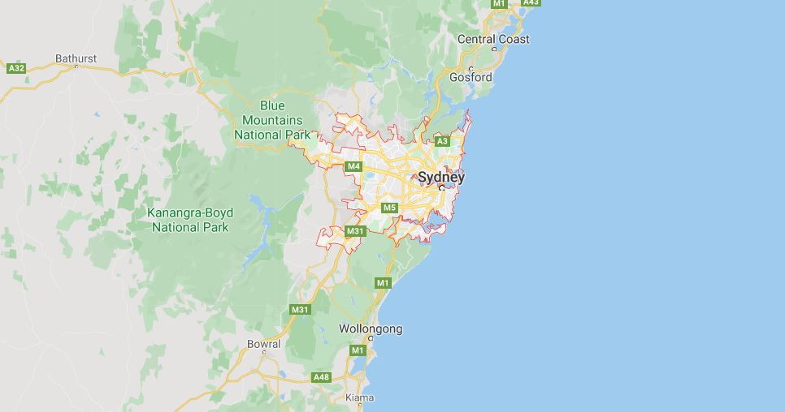
The Circular Quay
Notes:
But first, let’s try and understand why our friend from Sydney wants to take the ferry!
In Paris you don’t say: let’s take the ferry!
So why? Let’s have a look at those maps:
Sydney is in the South east of A as we have seen.
It’s a big city but Sydney is a little bit like Venice: there is water everywhere!
So, as you can see, the best way to go to Taronga Zoo from the harbour called the Circular Quay is to take the ferry

Slide 9
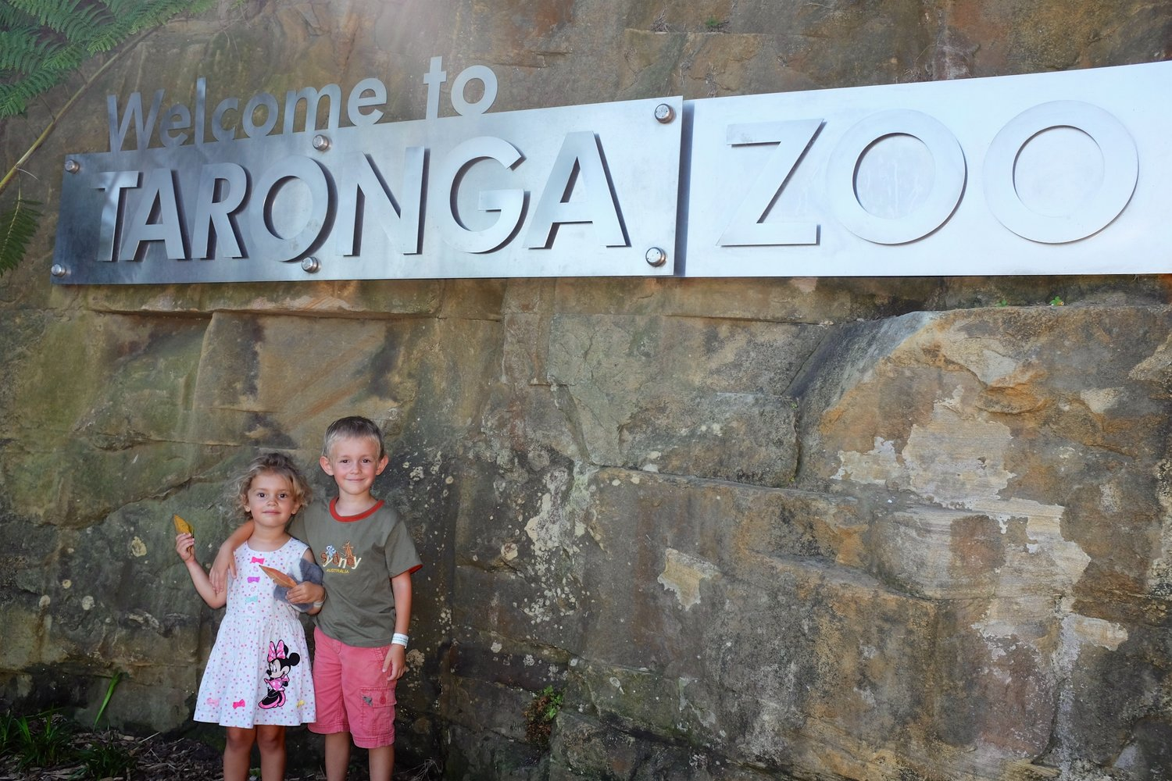
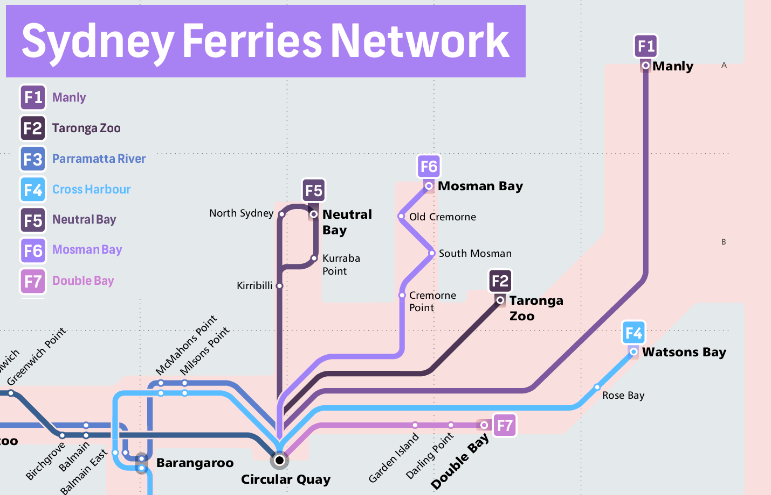
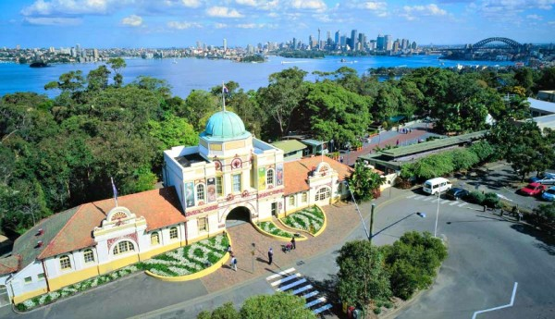
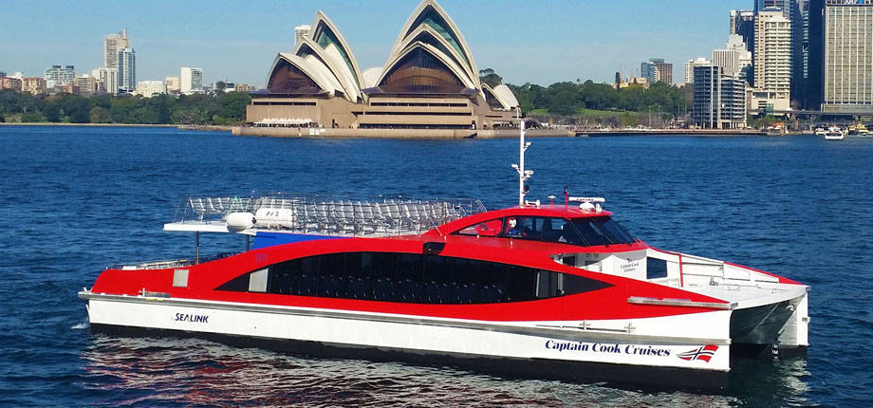
Notes:
But which ferry can you take?
Have a look at this map: The circular Quay is here. But where is TZ? Did you find it? It’s to the north east!
So, you must take line F2, let's go!

Slide 10
Zoo entry
Notes:
So, we are here in TZ! I’d like to go and see the kangaroos, how can I do?
OK, you must find the Australian walkabout.
Take the first left and walk until the pelicans. Go straight on and turn left.
You will walk by the emus and you'll see the kangoroos at the end.

Slide 11
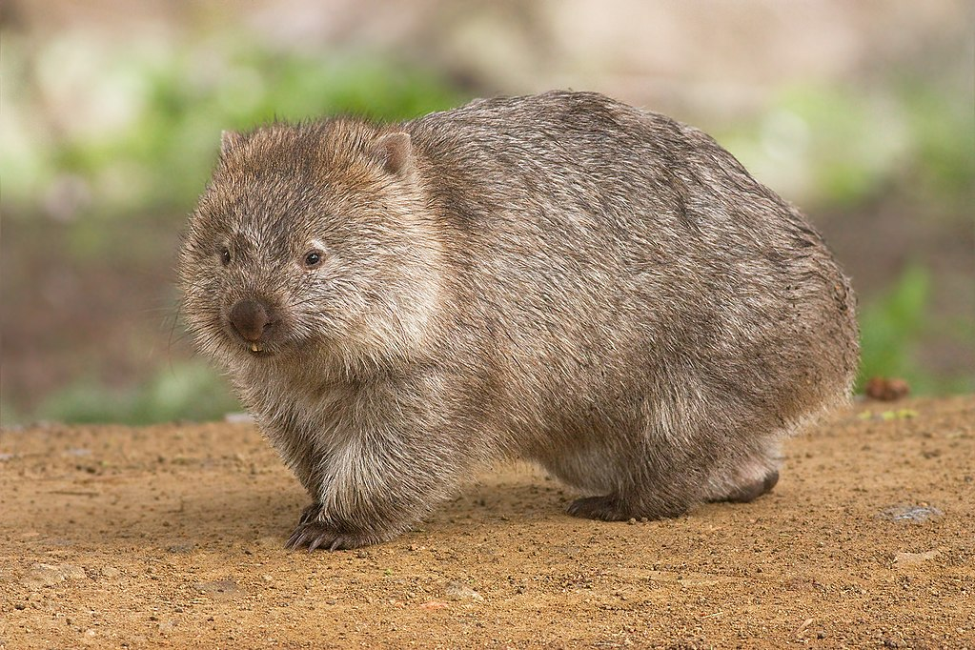
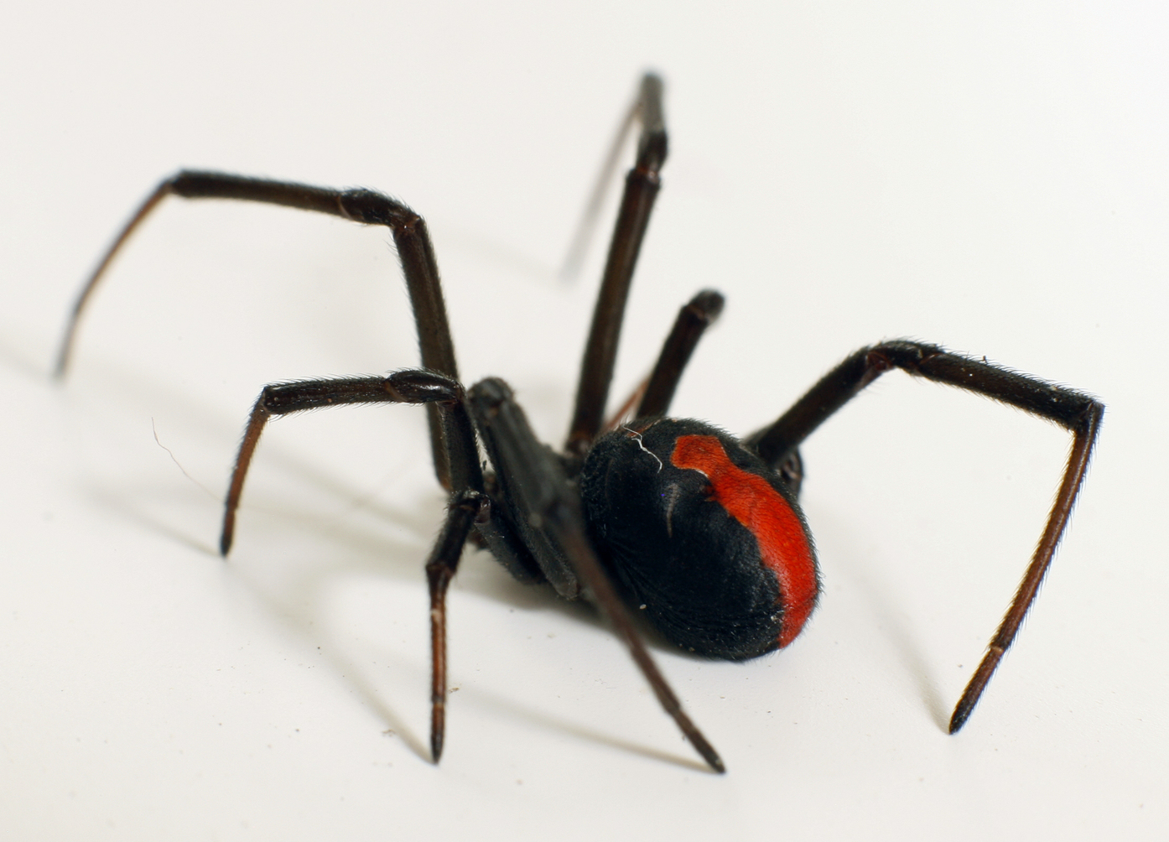
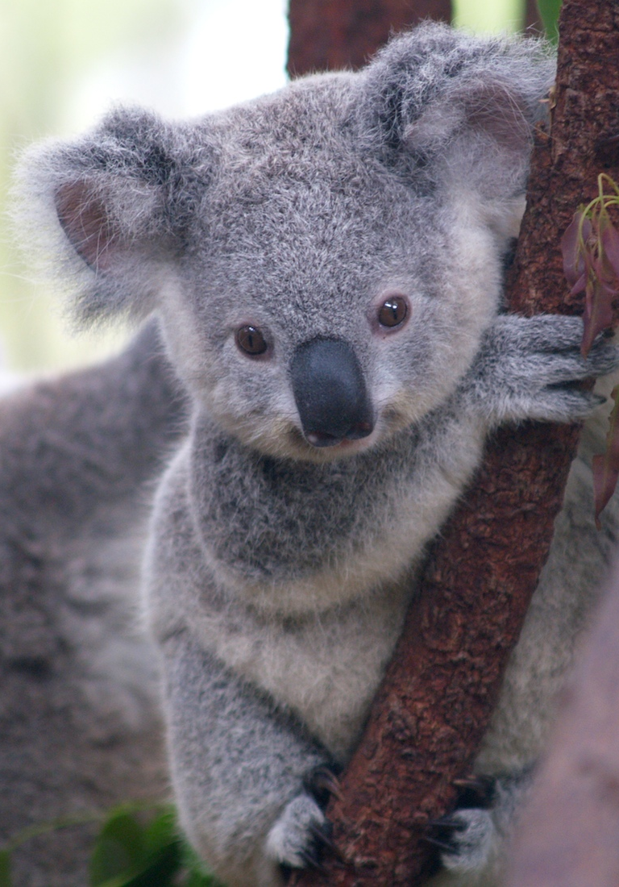
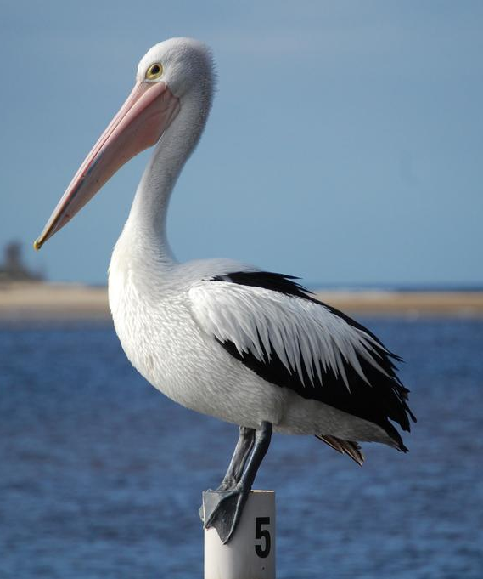
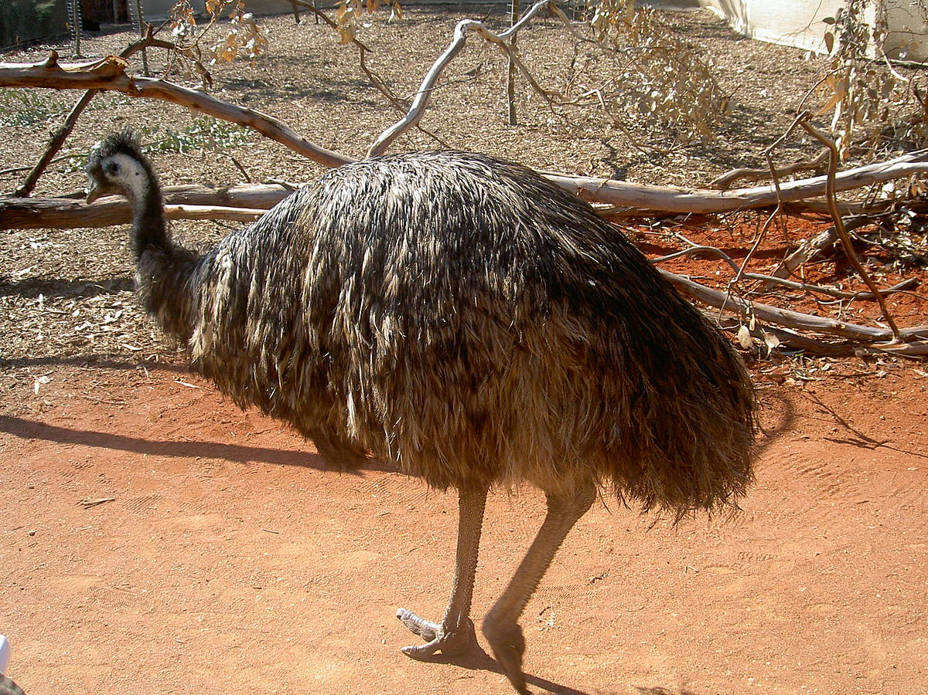
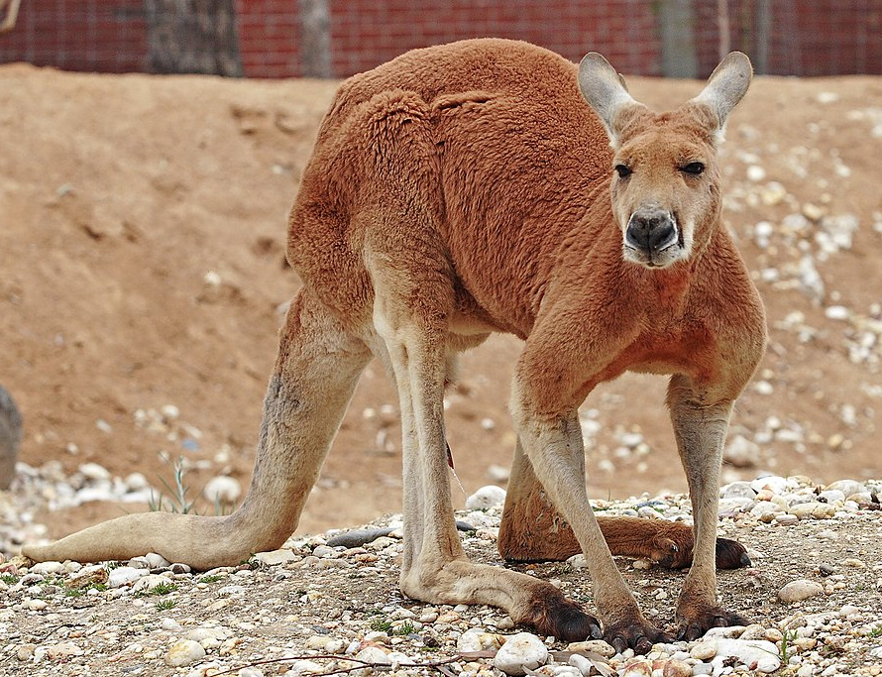
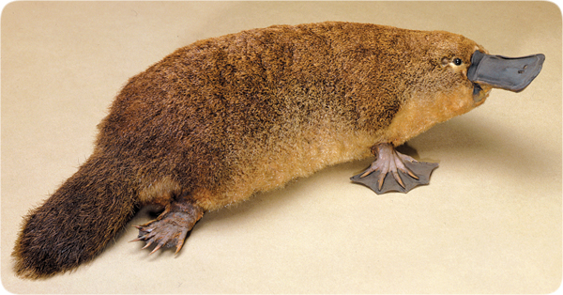
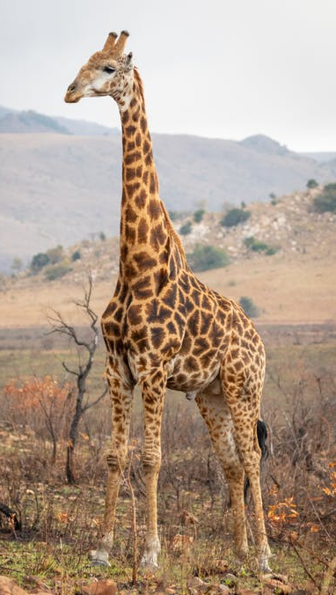
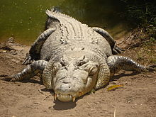
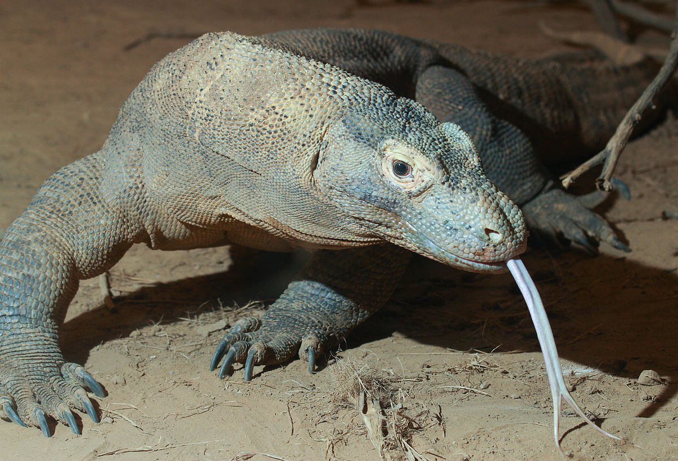
Australian animals
Spiders
Mammals
Birds
Pelican
Wombat
red-back spider
Emu
Koala
Reptiles
Platypus
Non-Australian animals
Red kangaroo
Saltwater crocodile
Diamond python/snake
Giraffe
Komodo dragon
Notes:
Wow, there are lots of animals around here!
It’s a big zoo , there are a lot animals from all over the world! Let's see if you know some of them.
But before repeating them, take your time to memorise them; Here is a technique: a lot of the words are transparent: they’re similar in French and English ; but sometimes the pronunciation is different. Your job is to memorise their pronunciation! SO now, let’s repeat!
Let’s play a game now!

Slide 12
Notes:
Which one's missing?
Are you ready to play? Look carefully to find the missing one.

Slide 13
1
2
3
4
5
Notes:
Which one's missing?
Are you ready to play? Look carefully to find the missing one.

Slide 14
1
2
3
4
5

Slide 15
1
2
3
4
5

Slide 16
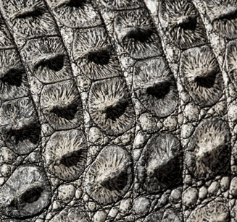
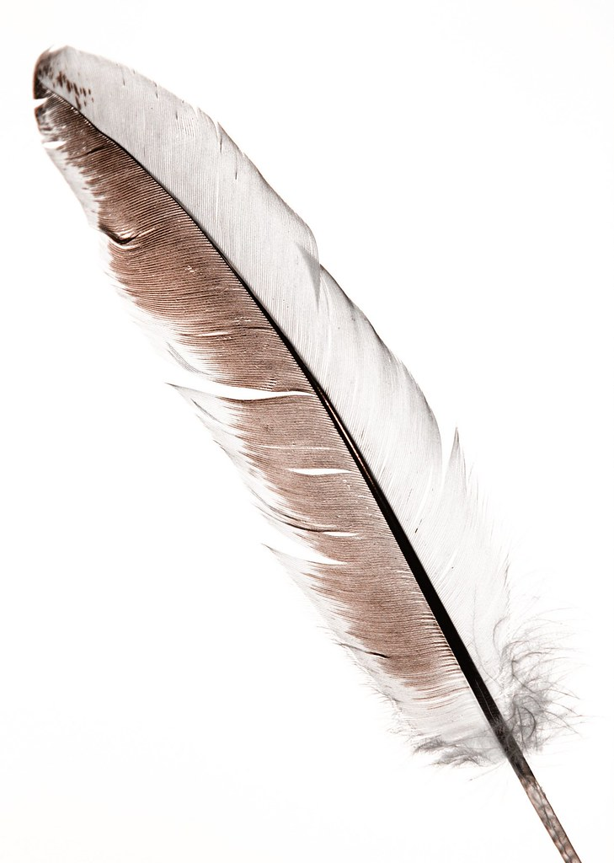
Let’s describe animals....
ear
wing
tail
beak
mouth
back
teeth
claws
leg
fur/furry
scales
feather
Cette photo par Auteur inconnu est soumise à la licence CC BY-SA
Notes:
Good, let's move on and see how to describe animals.
Let's repeat them.
Comments to remember some of them

Slide 17
Let’s describe animals....
Cette photo par Auteur inconnu est soumise à la licence CC BY-SA

Slide 18
Guessing game: which animal is it?
It has a furry body and a big tail
It has a very large nose/beak.
It lives and swims in the water .

Slide 19
Guessing game: which animal is it?
It has 4 legs, it's small and it comes from Australia.
It has grey or brown fur.
It has very long claws because it likes to dig tunnels.

Slide 20
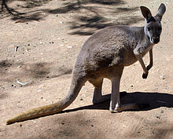
Guessing game: which animal is it?
It is generally brown or red and it is furry.
It jumps all the time and moves on 2 or 4 legs.
It has a long tail and it carries its baby in a pouch (pocket).
Notes:
Brilliant, it’s a kangaroo!
Now, let’s and learn more information by looking at signs in the zoo.

Slide 21
They have fur, round bodies, fluffy ears, and large oval-shaped noses. Their fur is usually grey or grey-brown in color.
The vast majority of their diet consists of eucalyptus leaves. A single animal usually eats about a pound of leaves in a day. It spends up to 18 hours per day sleeping!
They live up in the branches of the trees, rarely climbing down.
1 pound = 0,45kg
Adapted from https://animals.net
Notes:
Let’s try and guess from the description which animal it is.
…
Recap all the information we have about this animal.
Now let’s use some techniques to try and get more information
Bravo! Tu t’en es très bien sorti . Grâce à fur, nose, et aux verbes eat and sleep tu as compris qu’il s’agissait d’un koala. Les mots juste avant sont des adjectifs qui te permettent d’apporter une précision sur le nom: le nez est oval et les oreilles sont douces comme celles d’une peluche. Mais ils sont important si tu veux faire des phrases plus complexes

Slide 22
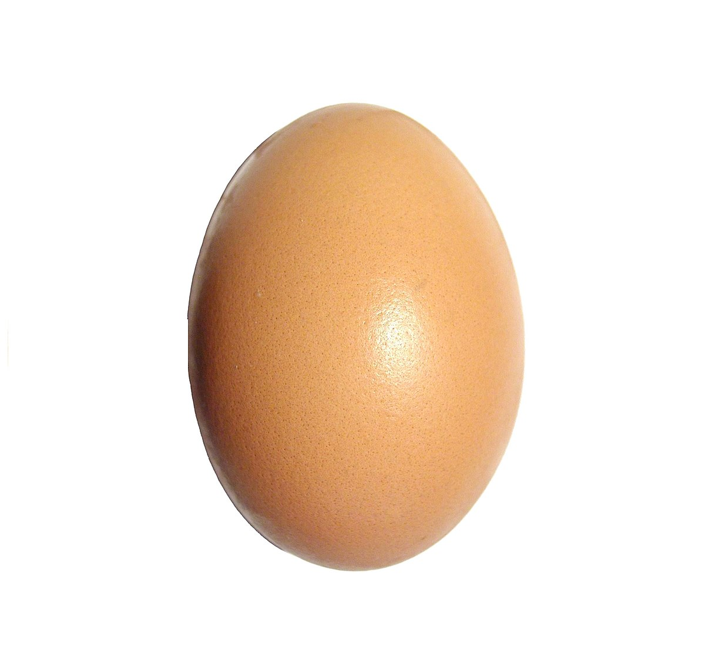
Saltwater crocodiles
Saltwater crocodiles are really big: 6 they are 6 meters long! They can run and crawl.
They live in the sea and near rivers in the forest. They lay their eggs in the ground.
They kill their preys under water.
Notes:
Essayons maintenant d’utiliser certaines techniques avec un autre exemple pour voir si nous pouvons aussi essayer de deviner certains mots.

Slide 23
Mots transparents ou semi-transparents: mots qui ressemblent au français car ils ont une étymologie commune.
Ex: Giraffe – Crocodile – Koala – pelican - dragon
Ex: Beak (bec) – nose (nez) – mammal (mammifère)
Méthodologie
Références personnelles
Ex: wings → chicken wings
Ex: tail → manga Fairy Tail
Décomposition: on découpe le mot en parties qui ont du sens
Ex: saltwater crocodiles = crocodiles (transparent)
+ water (eau) crocodiles d’eau de mer (salée)
+ salt (sel)
Co-texte: on utilise les mots à côté de celui qu’on cherche pour déduire le sens de ce mot
Ex: they lay their eggs

Slide 24
Description
small / tall / long
large / wide / flat
furry / grey /red
Body parts
scales / feathers
teeth / noses / beaks
wings / legs / claws
Actions
jump
crawl
walk / run
live
carry
eat
kill
sleep
Animals
Koalas
Emus
Crocodiles
Pelicans
Giraffes
Etc.
Food
prey / animals / eggs
Insects / leaves
Habitats
in the … water / river sea / forest / tree / desert / ground
Make sentences to describe an Australian animal...
are / have
IT'S YOUR TURN!
Notes:
Now it’s your turn.
Pick and choose words from each box to create sentences
Make sentences to describe an australian animal...

Slide 25
Récapitulons
Notes:
Nous avons découvert la ville de Sydney
Lorsque tu écoutes un document , il y a toujours des mots que tu ne connais pas, mais fais toi confiance, tu n'as pas besoin de tout comprendre pour te débrouiller. Anticipe puis appuie toi sur ce que tu comprends.
Pour deviner ou retenir du vocabulaire tu peux utiliser 4 techniques: tr / décomp / co-t / références perso
Bref, appuie-toi sur ce que tu sais et essaye de deviner ce qui te manque!

Slide 26
Stay home,
stay safe and…
practise your English!

Slide 27
THE END

Slide 28
Activités supplémentaires possibles

Slide 29
How can I go to ……
turn left
go straight on
cross the street
turn right
cross a bridge
walk until….

Slide 30
Zoo entry

Slide 31
1
2
3
4
5
Notes:
Which one's missing?
Are you ready to play? Look carefully to find the missing one.

