Slide 1
17th trip around the English-speaking world!

Slide 2
Quel est le programme aujourd’hui?
Découvrir un aspect d’un pays anglophone.
Travailler l'expression du futur.
Découvrir les vacances à l’anglo-saxonne.
A la fin de cette séance , tu seras capable d’écrire un e-mail…

Slide 3
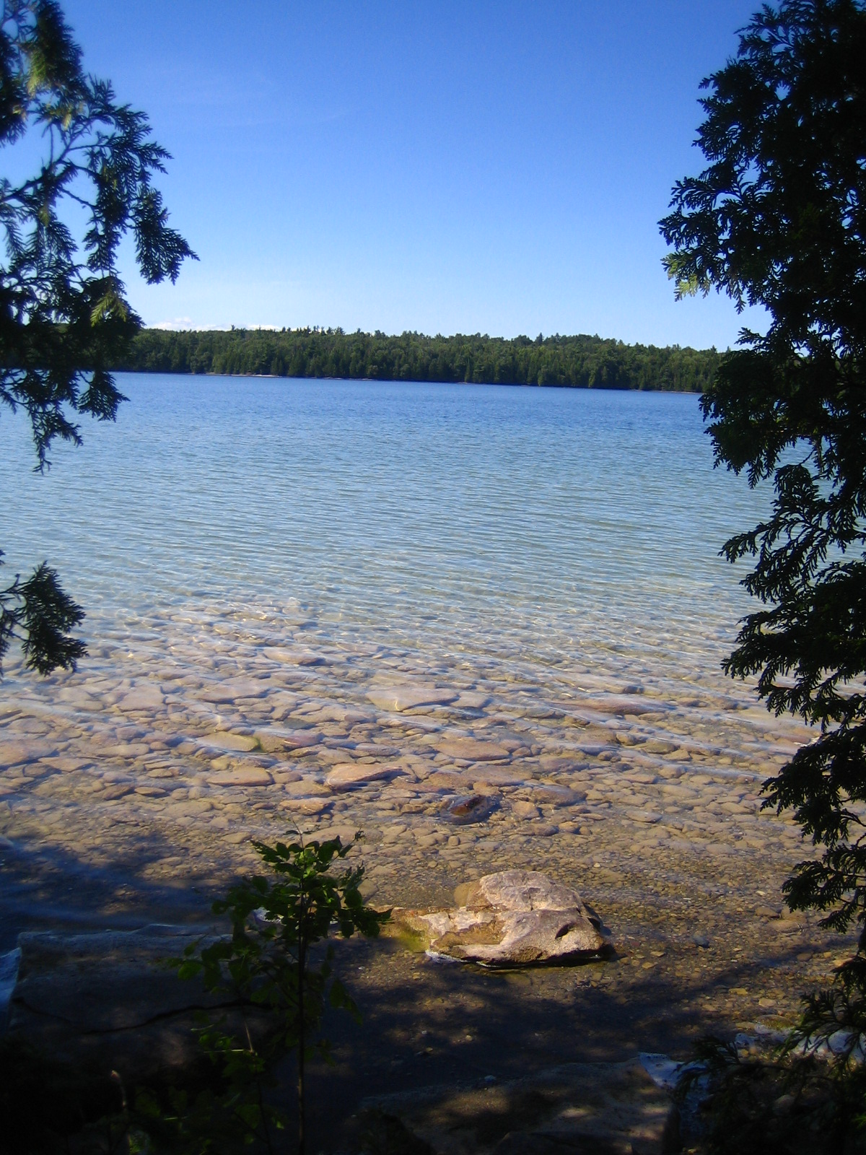
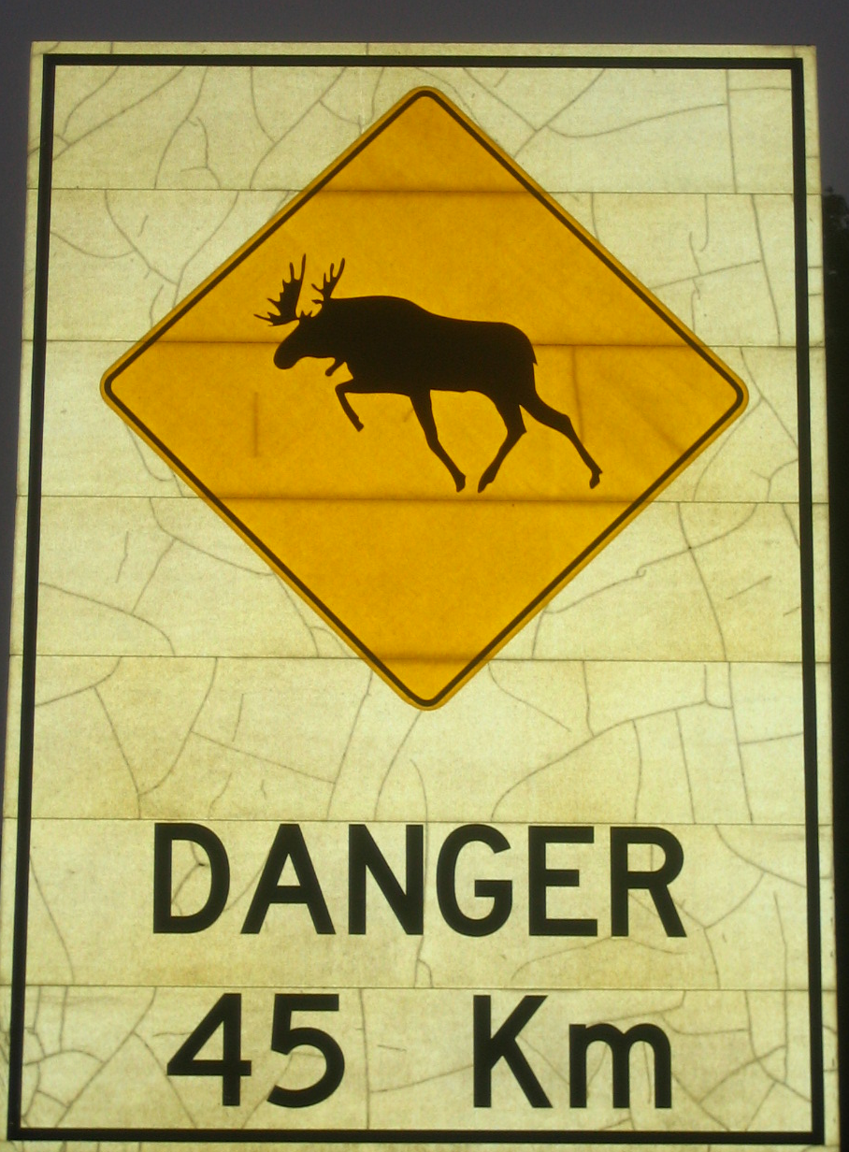
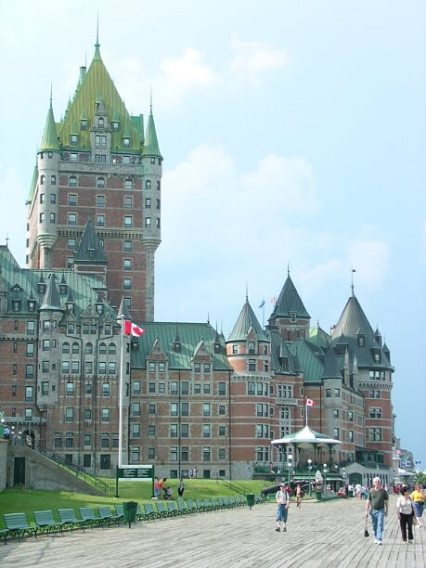
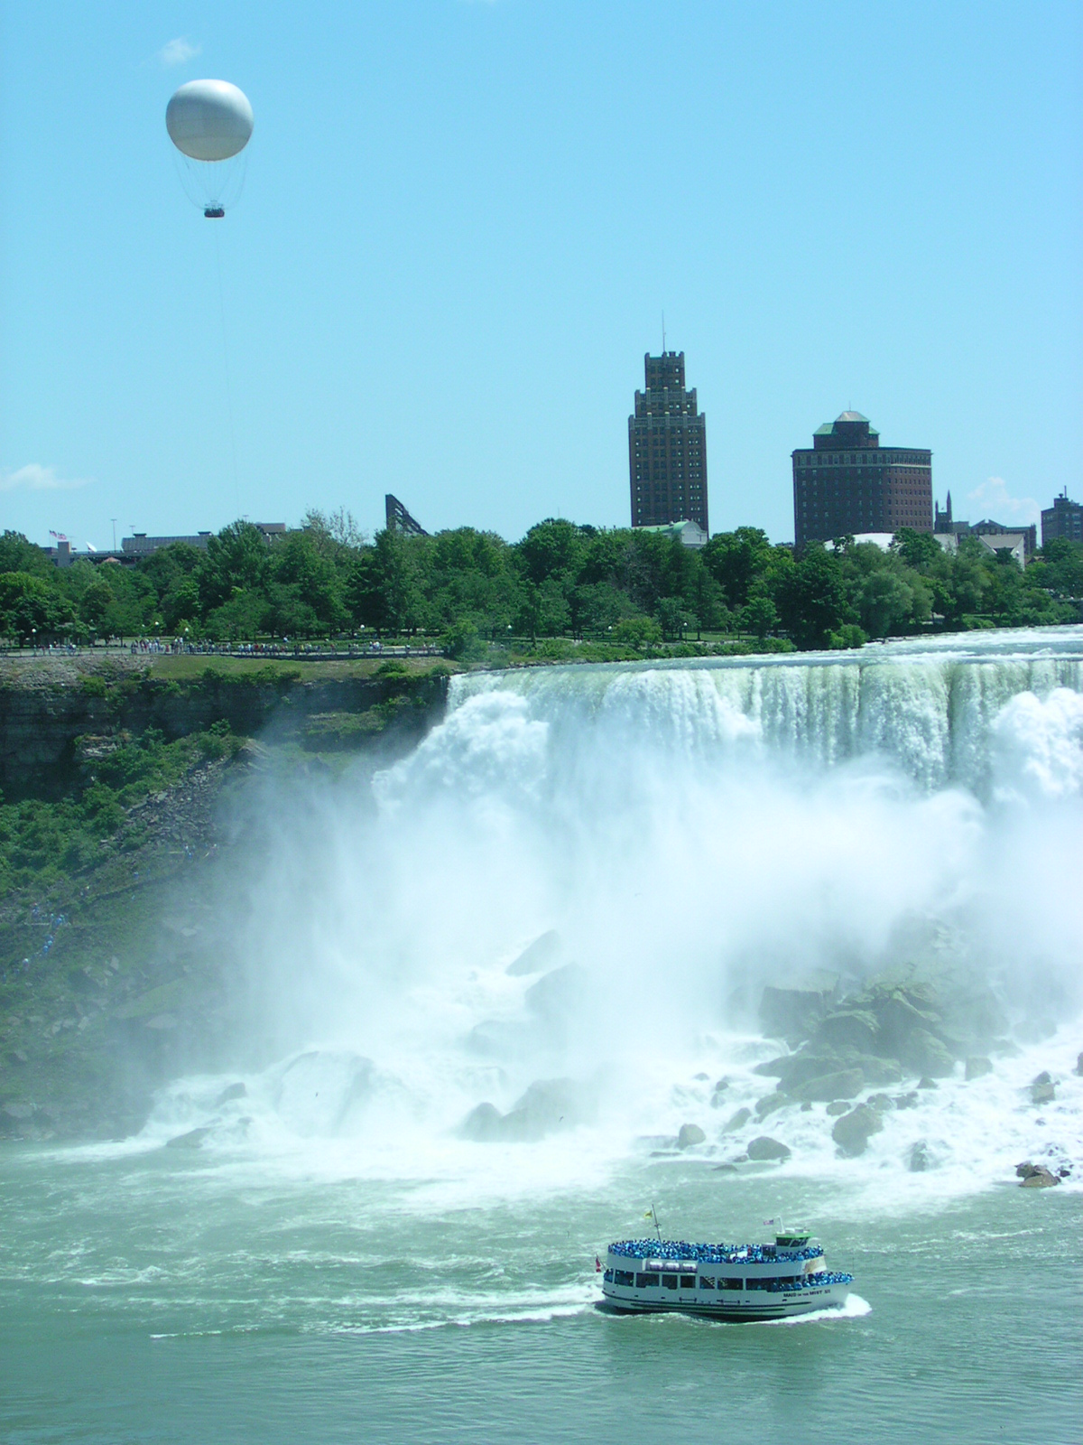

Slide 4
Today’s clues
We’re going to visit a big country: it’s the 2nd largest country in the world!
There are a lot of bears there!
The capital city is Ottawa.

Slide 5
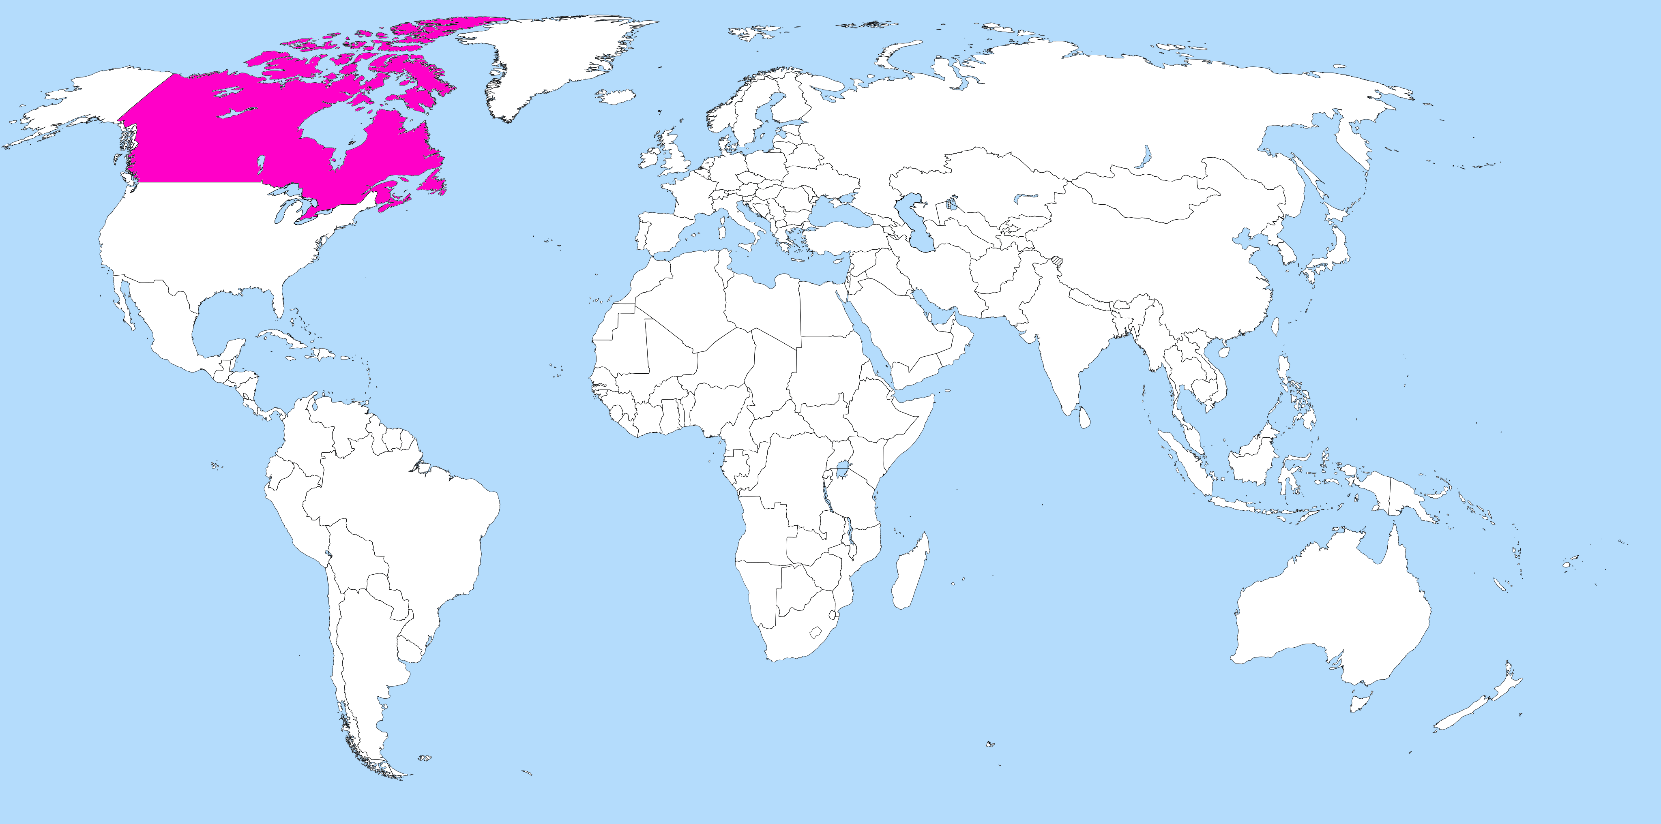
So let’s visit Canada!
Notes:
800px-Flag_of_Canada.svg.png
https://commons.wikimedia.org/wiki/File:A_large_blank_world_map_with_oceans_marked_in_blue.svg

Slide 6
O Canada / Ô Canada
French version
Ô Canada!
Terre de nos aïeux, Ton front est ceint de fleurons glorieux!
Car ton bras sait porter l'épée, Il sait porter la croix!
Ton histoire est une épopée Des plus brillants exploits.
Et ta valeur, de foi trempée, Protégera nos foyers et nos droits.
Protégera nos foyers et nos droits.
O Canada!
Our home and native land! True patriot love in all of us command,
Car ton bras sait porter l'épée, Il sait porter la croix!
Ton histoire est une épopée Des plus brillants exploits,
God keep our land glorious and free! O Canada, we stand on guard for thee.
O Canada, we stand on guard for thee.
English version
O Canada! Our home and native land! True patriot love in all of us command.
With glowing hearts we see thee rise, The True North strong and free!
From far and wide, O Canada, we stand on guard for thee.
God keep our land glorious and free! O Canada, we stand on guard for thee.
O Canada, we stand on guard for thee.
Notes:
https://www.canada.ca/en/canadian-heritage/services/anthems-canada.html
https://www.canada.ca/content/dam/pch/documents/services/anthems-canada/oCanadaPoster_1492621184610_eng.pdf

Slide 7
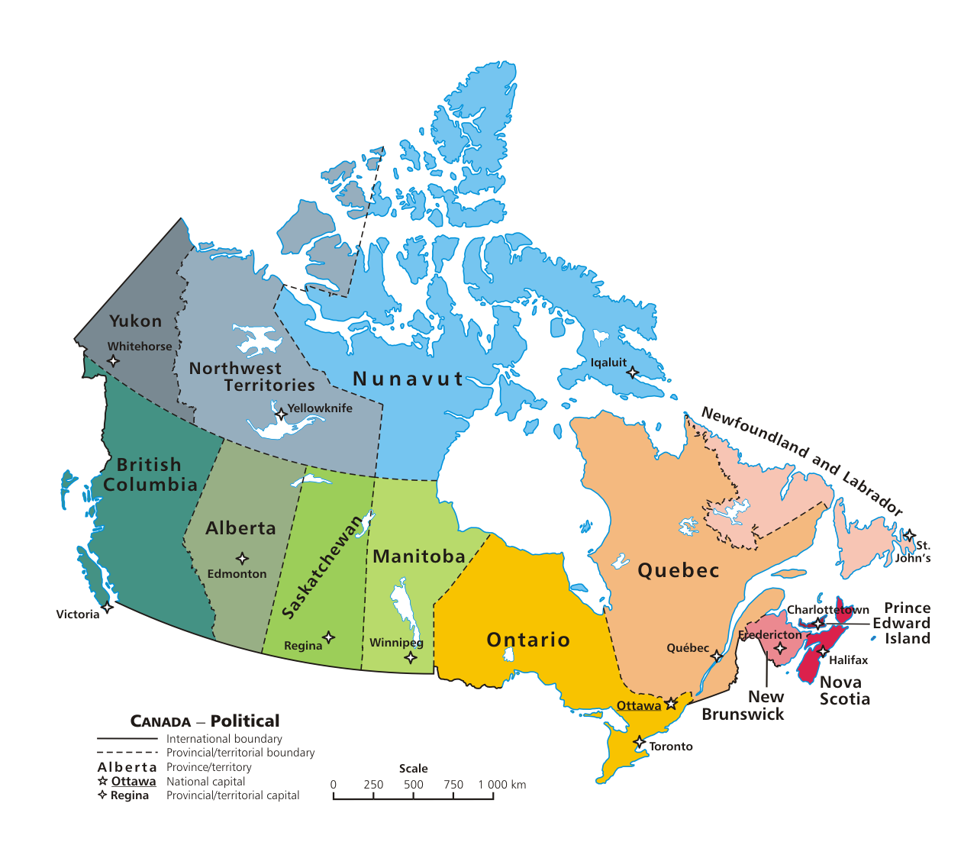
Hello! / Bonjour!/ 9 other languages
Hello! / Bonjour!
Hello! / Bonjour!
Bonjour!
Hello!
Hello!
Hello!
Hello!
Hello!
Hello!
Hello!
Hello!
Hello! / Bonjour!
Notes:
https://commons.wikimedia.org/wiki/File:Political_map_of_Canada.png

Slide 8
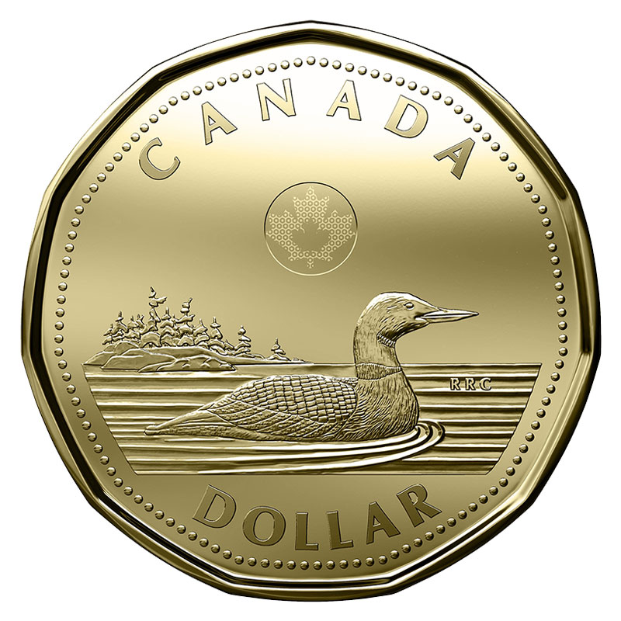
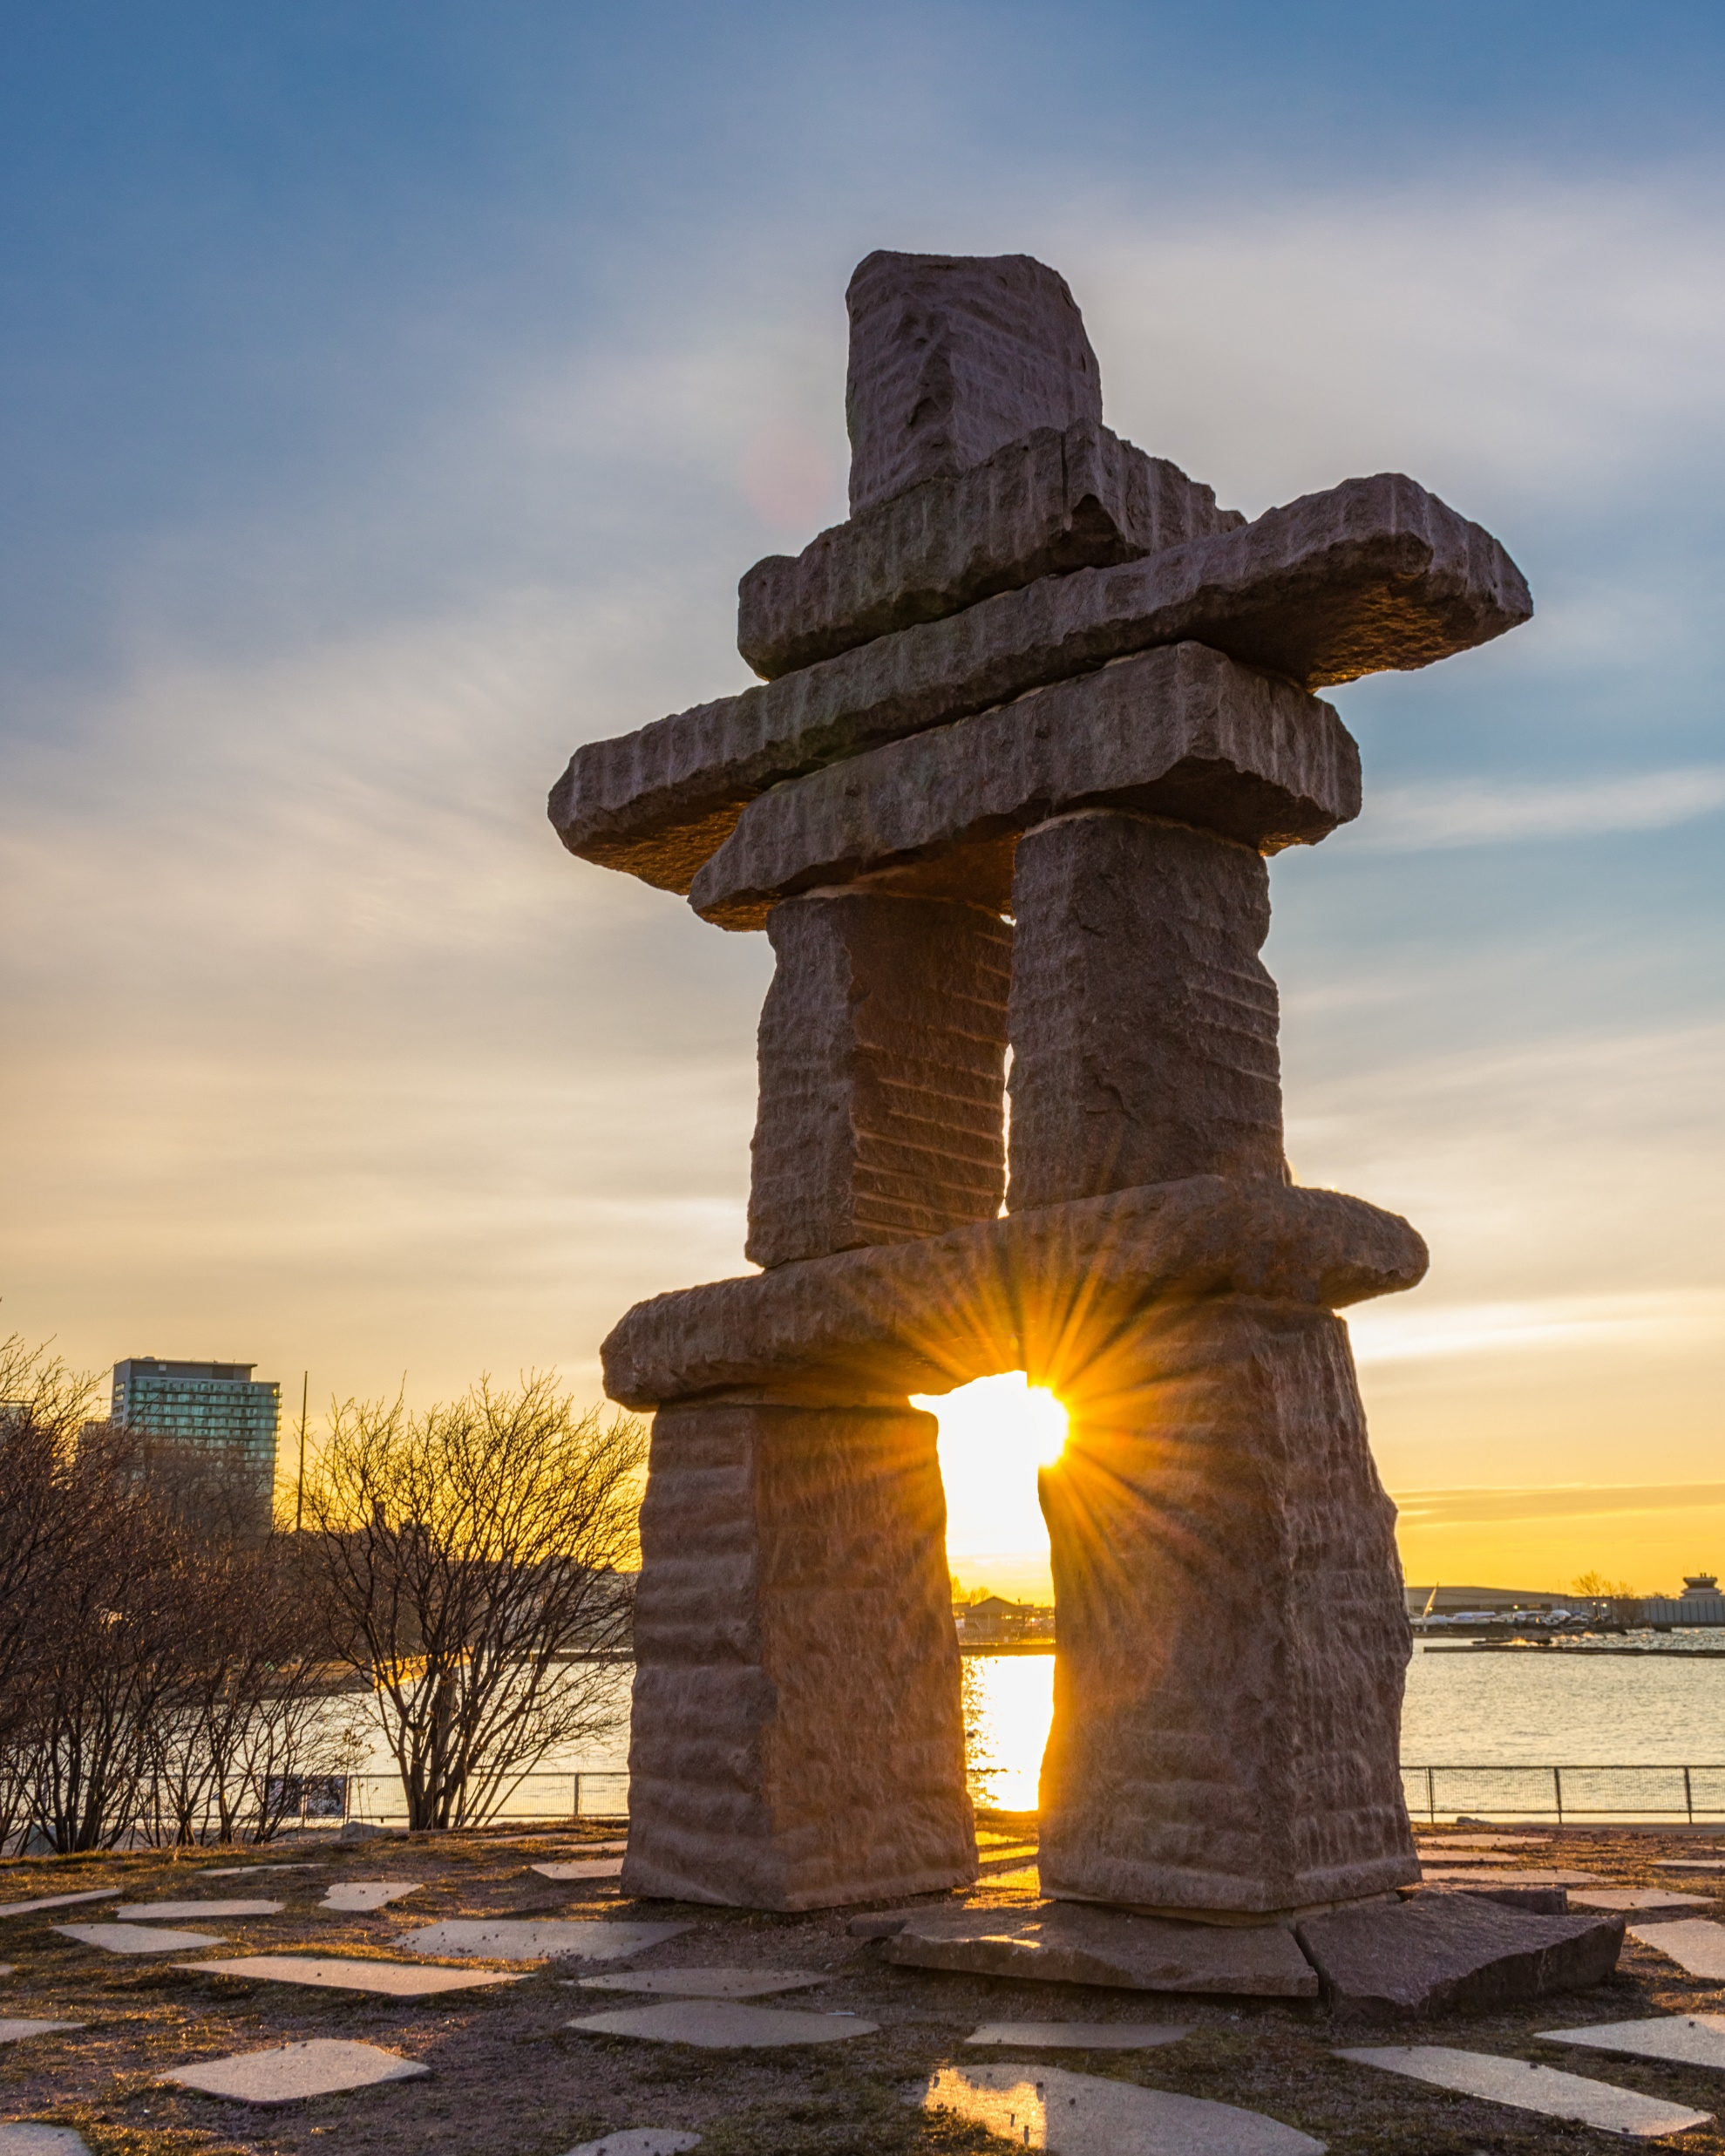
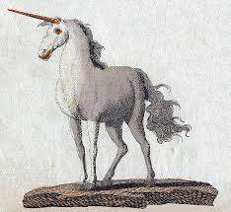
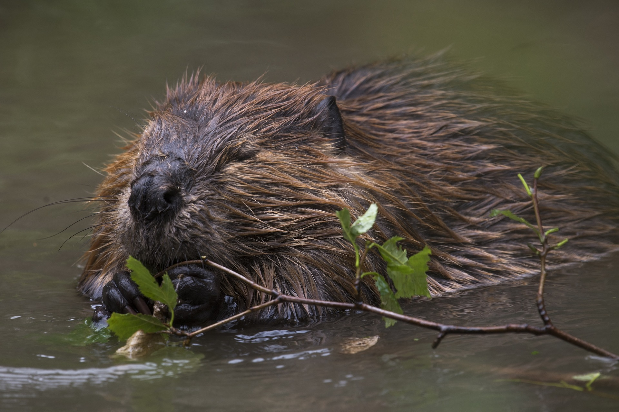
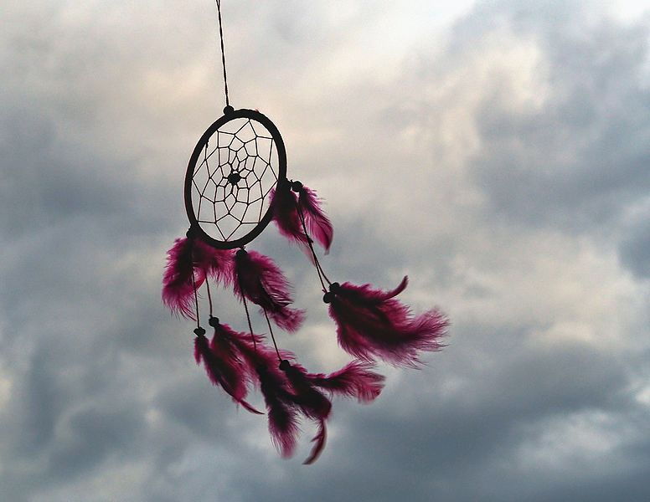
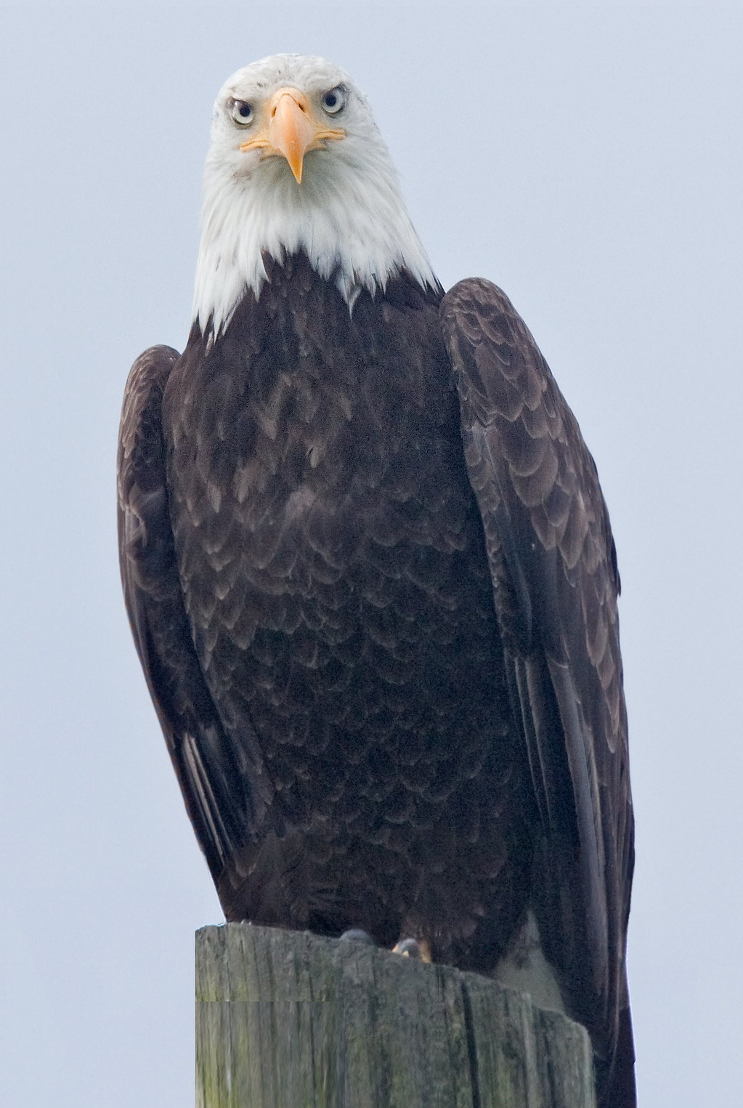
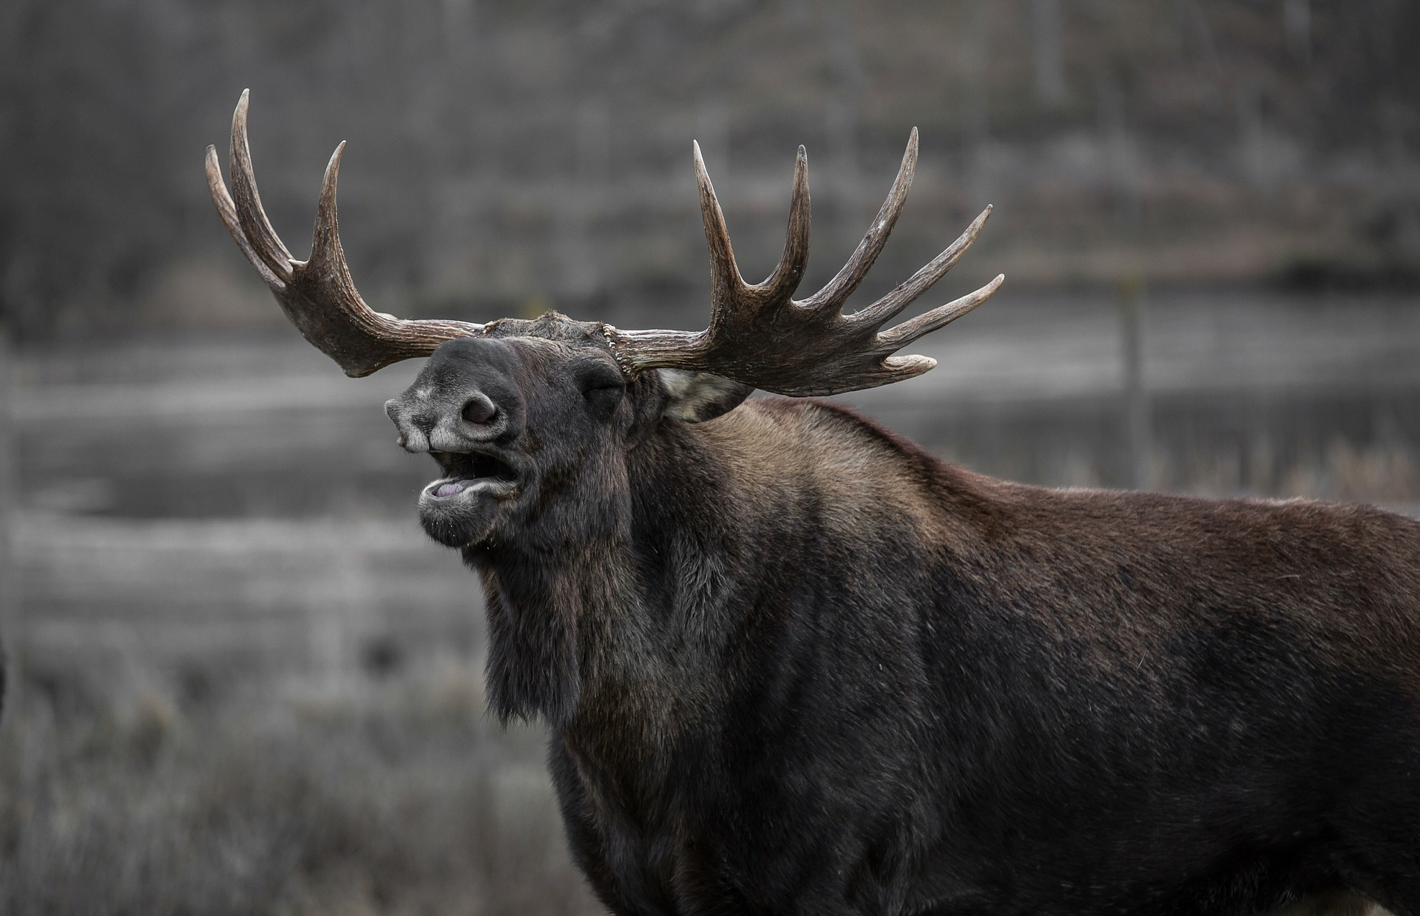
Canadian symbols! Listen and cross the odd ones out.
goose
unicorn
beaver
maple leaf
inukshuk
dreamcatcher
totem
moose
eagle
Notes:
https://pixabay.com/fr/photos/orignal-bull-elk-b%C3%A2illements-602659/
https://pixabay.com/fr/photos/aigle-%C3%A0-t%C3%AAte-blanche-oiseaux-2645344/
https://pixabay.com/fr/photos/castor-rongeurs-des-animaux-3709599/
https://pixabay.com/fr/photos/khahtsahlano-colombie-britannique-1184526/
https://pixabay.com/fr/photos/capteur-de-r%C3%AAves-plume-sunset-3299832/
https://commons.wikimedia.org/wiki/File:Bertuch-Unicorn.png
https://commons.wikimedia.org/wiki/File:Sunset_on_the_inuksuk_at_English_Bay.jpg
https://www.kids-world-travel-guide.com/canada-facts.html

Slide 9
Notes:
https://commons.wikimedia.org/wiki/File:American_Beaver.jpg
https://commons.wikimedia.org/wiki/File:Close_up_shot_of_bull_moose.jpg
https://commons.wikimedia.org/wiki/File:2019-canadian-1-dollar-common-loon-coin-1-800x800.jpg
https://commons.wikimedia.org/wiki/File:Dreamcatcher_in_the_sky.jpg
https://commons.wikimedia.org/wiki/File:Wakas_House_and_Pole_at_the_Canadian_Museum_of_Civilization.jpg
https://commons.wikimedia.org/wiki/File:Sunset_on_the_inuksuk_at_English_Bay.jpg
https://www.kids-world-travel-guide.com/canada-facts.html

Slide 10
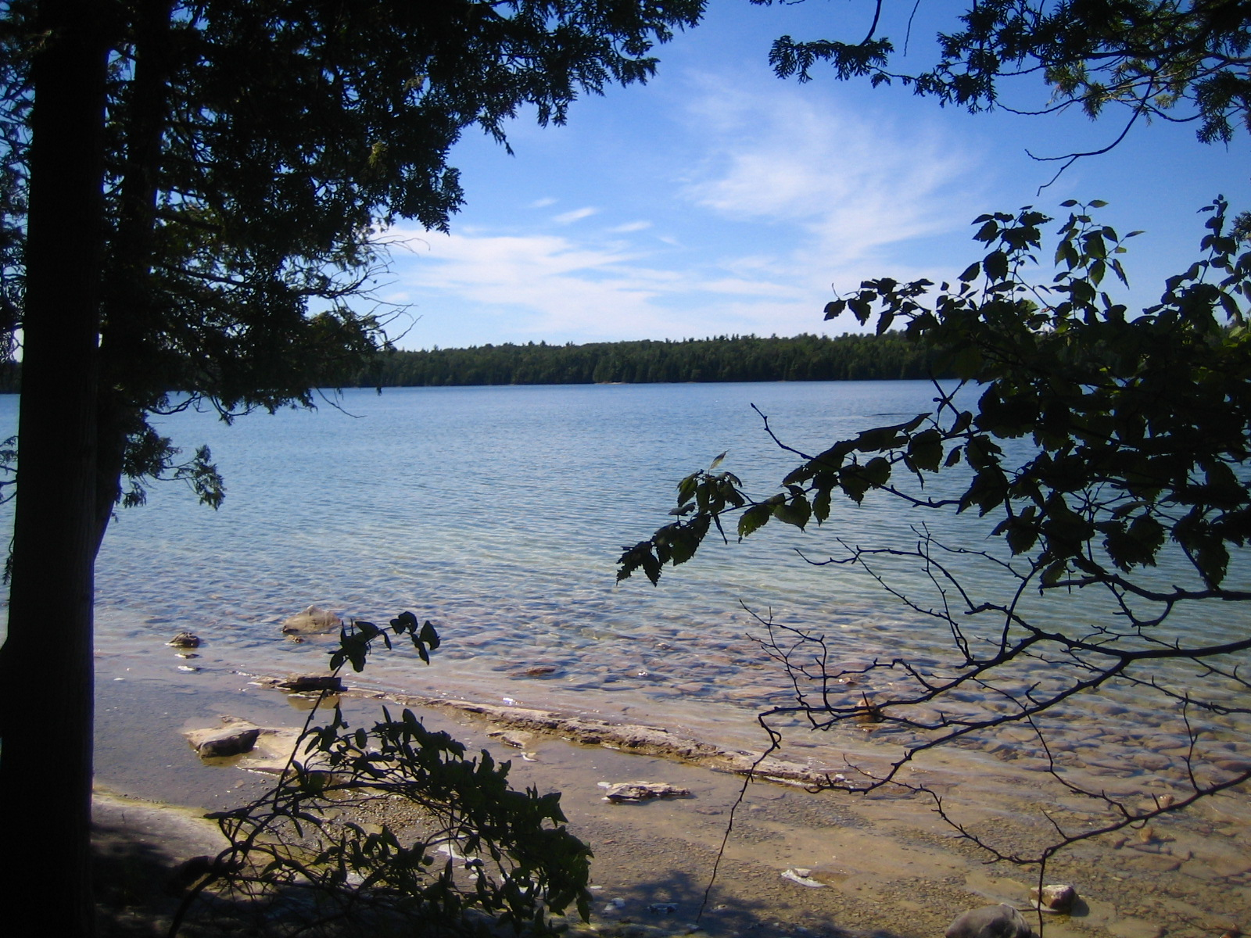
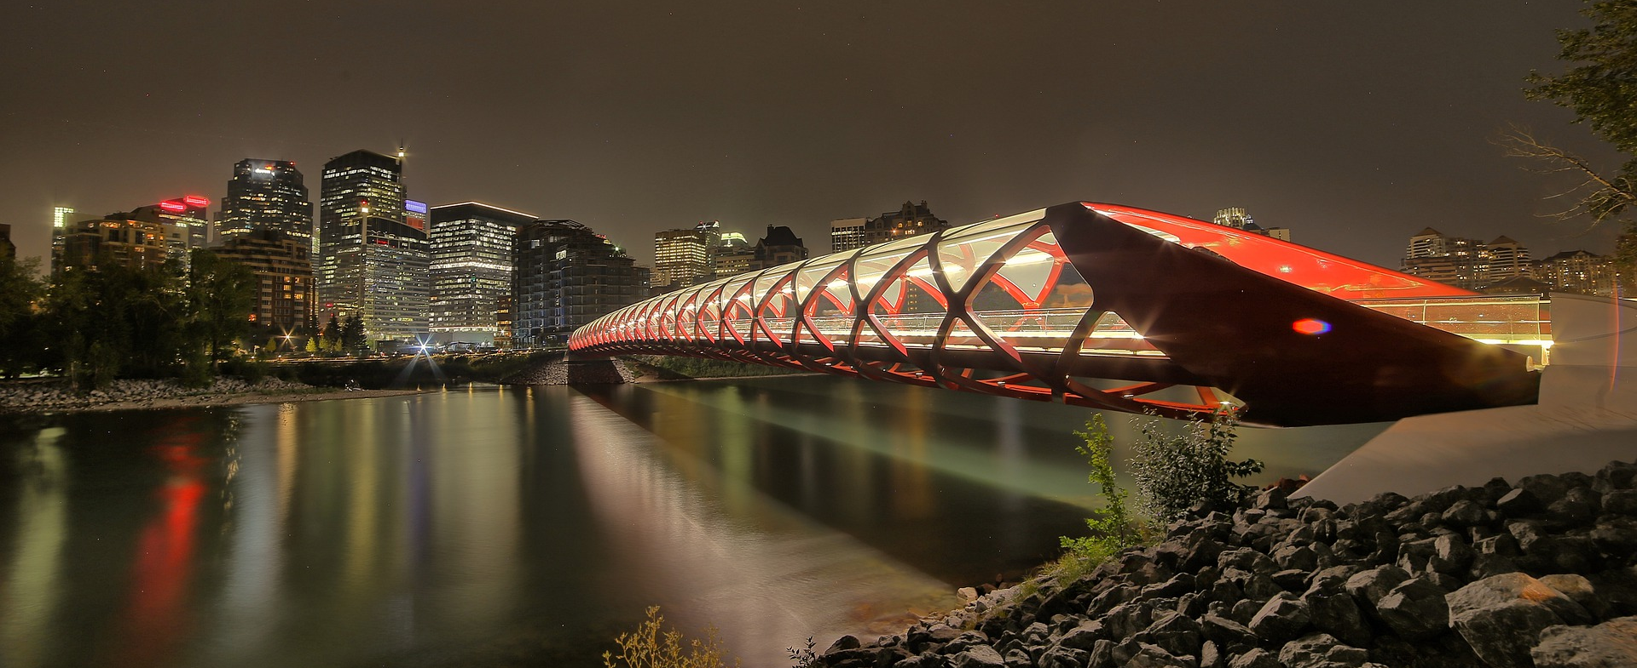
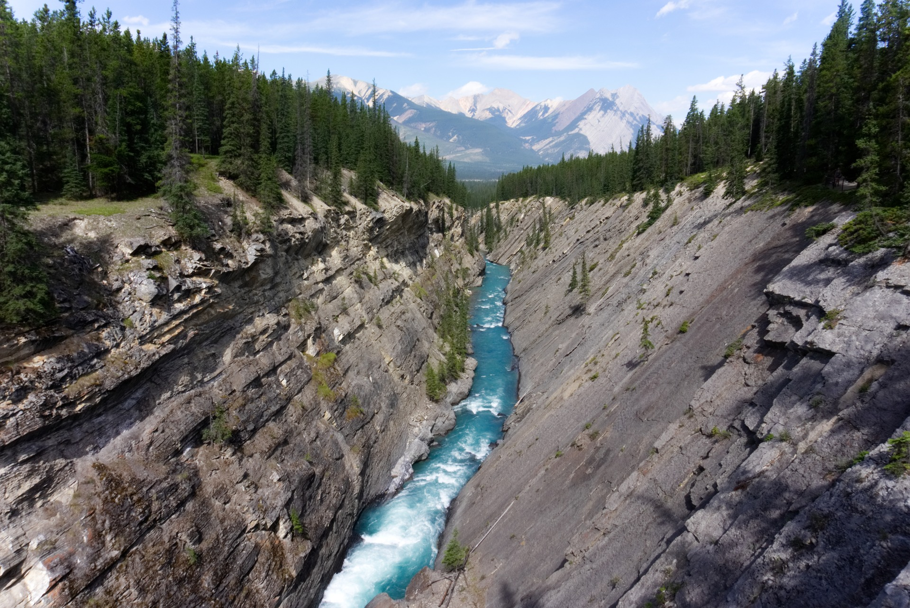
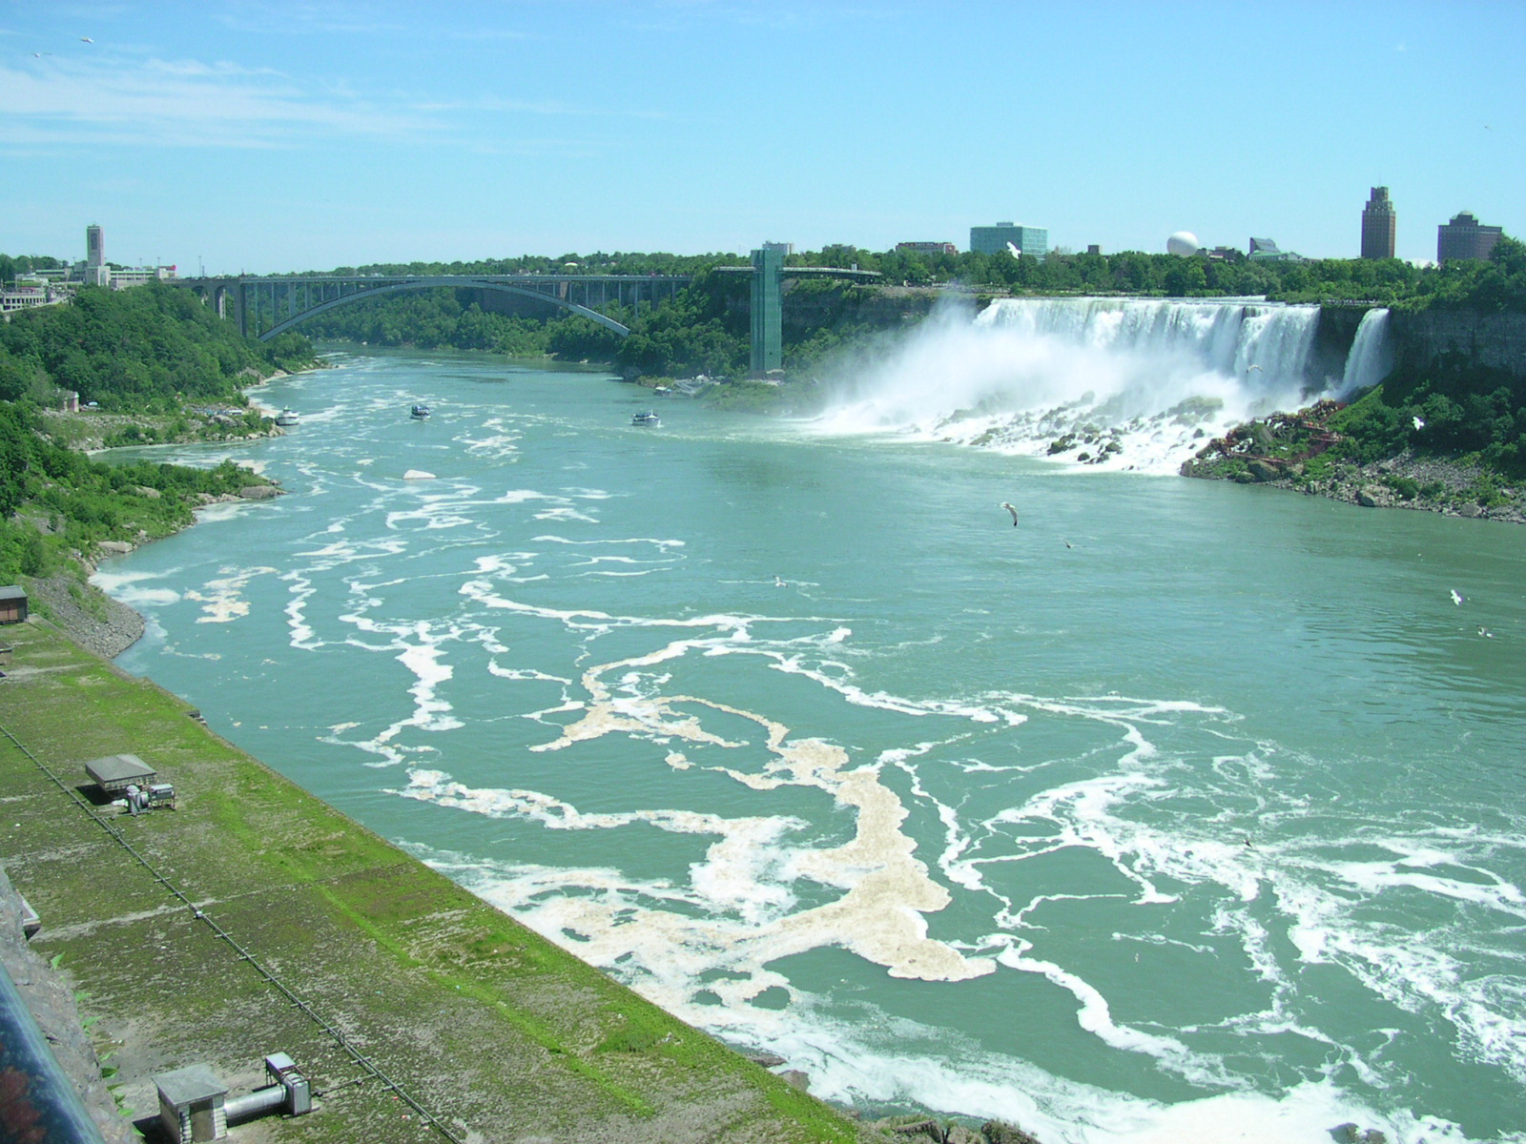
city/town
skyline
lake
bridge
forest
mountain
Landscapes
river
waterfall
canyon
Notes:
https://pixabay.com/fr/photos/nature-canyon-paysage-3696693/
https://pixabay.com/fr/photos/la-paix-pont-calgary-canada-5248859/

Slide 11
6
8
1
7
3
2
Landscapes
4
9
5
Notes:
https://pixabay.com/fr/photos/nature-canyon-paysage-3696693/
https://pixabay.com/fr/photos/la-paix-pont-calgary-canada-5248859/

Slide 12
The Canadian quiz!
Question 1 – The capital city is……
A. Toronto.
B. Vancouver.
1
2
3
C. Ottawa.

Slide 13
The Canadian quiz!
Question 2- Canada is…..
A. North of the USA .
B. South of the USA.
1
2
3

Slide 14
The Canadian quiz!
Question 3- The two main official languages are….
A. English and Spanish.
B. English and French.
1
2
3
C. English and Italian.

Slide 15
The Canadian quiz!
Question 4 The Niagara falls are….
A. In the USA .
B. In Canada.
1
2
3
C. In Canada and the USA.

Slide 16
The Canadian quiz!
Question 5- The Canadian flag is….
A. Red and white.
B. Red and blue.
1
2
3
C. Red, blue and white.

Slide 17
Guess today’s topic
_ _ _ _ _ _ _ _ _ _ _
Notes:
E – I – O – A
T L G N F K R
Faire un pendu pour deviner: On pourrait avoir un chevalier avec une épée qui se rapproche au fur et à mesure? En guise de pendu?
The legend of King Arthur
https://pixabay.com/fr/vectors/bataille-lame-%C3%A9p%C3%A9e-guerre-arme-2024415/
https://pixabay.com/fr/vectors/des-animaux-armure-jeu-actif-appel-1296949/

Slide 18
What activities can you do on a summer camp?
archery
surfing
water-skiing
horse riding
sailing
climbing
playing
music
cycling
playing
tennis
canoeing
swimming
painting
Notes:
https://commons.wikimedia.org/wiki/File:Horseback_Riding_in_Oahu.jpg
https://upload.wikimedia.org/wikipedia/commons/b/ba/First_day_of_Archery_2018_YOG_%28243%29.jpg
https://commons.wikimedia.org/wiki/File:Backcountry_canoe_trip_on_Malign_Lake.jpg
https://pixabay.com/fr/photos/grimper-escalade-gratuite-sun-rock-2296308/
https://fr.wikipedia.org/wiki/Fichier:SailingCanoe.jpg
https://fr.wikipedia.org/wiki/Fichier:Wakeboard_Tailbone.jpg

Slide 19
What activities can you do on a summer camp?
1
2
3
4
5
Notes:
https://commons.wikimedia.org/wiki/File:Horseback_Riding_in_Oahu.jpg
https://upload.wikimedia.org/wikipedia/commons/b/ba/First_day_of_Archery_2018_YOG_%28243%29.jpg
https://commons.wikimedia.org/wiki/File:Backcountry_canoe_trip_on_Malign_Lake.jpg
https://pixabay.com/fr/photos/grimper-escalade-gratuite-sun-rock-2296308/
https://fr.wikipedia.org/wiki/Fichier:SailingCanoe.jpg
https://fr.wikipedia.org/wiki/Fichier:Wakeboard_Tailbone.jpg

Slide 20
What activities can you do on a Summer camp?
1
2
3
4
5
Notes:
https://commons.wikimedia.org/wiki/File:Horseback_Riding_in_Oahu.jpg
https://upload.wikimedia.org/wikipedia/commons/b/ba/First_day_of_Archery_2018_YOG_%28243%29.jpg
https://commons.wikimedia.org/wiki/File:Backcountry_canoe_trip_on_Malign_Lake.jpg
https://pixabay.com/fr/photos/grimper-escalade-gratuite-sun-rock-2296308/
https://fr.wikipedia.org/wiki/Fichier:SailingCanoe.jpg
https://fr.wikipedia.org/wiki/Fichier:Wakeboard_Tailbone.jpg

Slide 21
1
2
3
4
5
Notes:
https://commons.wikimedia.org/wiki/File:Horseback_Riding_in_Oahu.jpg
https://upload.wikimedia.org/wikipedia/commons/b/ba/First_day_of_Archery_2018_YOG_%28243%29.jpg
https://commons.wikimedia.org/wiki/File:Backcountry_canoe_trip_on_Malign_Lake.jpg
https://pixabay.com/fr/photos/grimper-escalade-gratuite-sun-rock-2296308/
https://fr.wikipedia.org/wiki/Fichier:SailingCanoe.jpg
https://fr.wikipedia.org/wiki/Fichier:Wakeboard_Tailbone.jpg

Slide 22
What activities can you do on a Summer camp?
Notes:
https://commons.wikimedia.org/wiki/File:Horseback_Riding_in_Oahu.jpg
https://upload.wikimedia.org/wikipedia/commons/b/ba/First_day_of_Archery_2018_YOG_%28243%29.jpg
https://commons.wikimedia.org/wiki/File:Backcountry_canoe_trip_on_Malign_Lake.jpg
https://pixabay.com/fr/photos/grimper-escalade-gratuite-sun-rock-2296308/
https://fr.wikipedia.org/wiki/Fichier:SailingCanoe.jpg
https://fr.wikipedia.org/wiki/Fichier:Wakeboard_Tailbone.jpg

Slide 23
1
Martial arts
camp
Sports
camp
4
Science
camp
2
Nature
camp
3
Musical
camp
5
Notes:
Audios
#1 I am crazy about sports. I love playing basketball, football, any sports game!
#2 For my birthday, I got a drone and I want to learn how to use it properly.
#3 In my free time, I practise Taekwondo. I love it, I Am trying to get better so I need to practise over the summer.

Slide 24
Activities include:
Registration now open for Spring &
SUMMER CAMP
Skating
Lake fishing
Kayaking
Arts & Crafts
Mini Golf
Drama
Horseriding
Build fires
Sleep in tents
Rafting
Cooperative Games
Canyoning
Sportball
at City Center Garden for ages 5-15
2020 dates available:
PRE REGISTER: $ 178,35/WEEK
2 OR MORE WEEKS: $ 167,50/WEEK
DROP IN: $ 189,30/WEEK
Jun 29 - Jul 3
Jul 6 - 10
Jul 13 - 17
Jul 20 - 24
Jul 27 - Jul 31
Aug 4 - 7
Aug 10 - 14
Aug 17 - 21
Regular Camp Hours: 9am-3pm
www.citycentregarden.ca / 250.394.1863
Notes:
https://pixabay.com/fr/vectors/camp-camping-tente-nature-aventure-4363073/

Slide 25
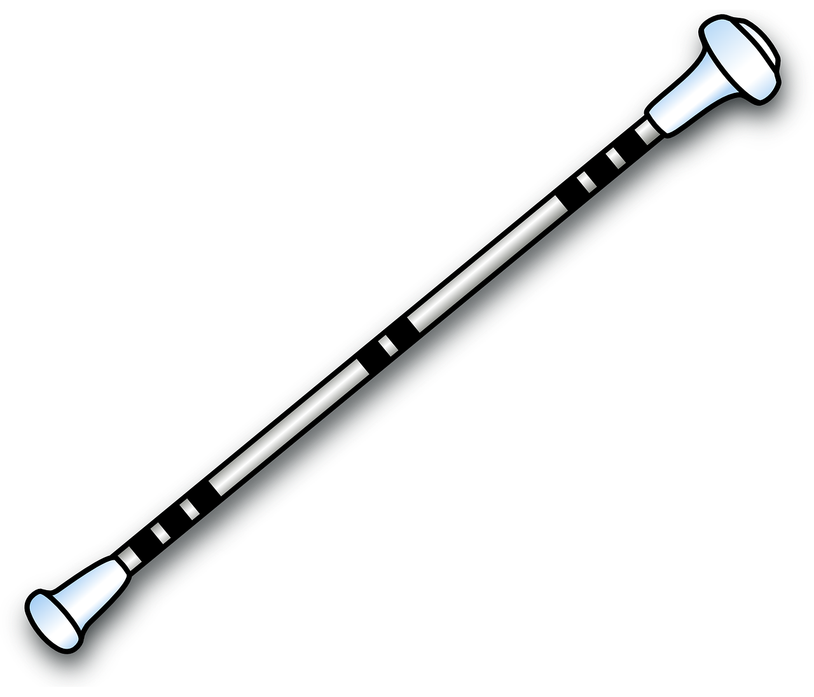
Cheermadisons – 9275 Rue Thimon
Pierrefonds – H8Y 0A1 – 514.333.8555
INSCRIPTION / REGISTRATION
sur/on www.cheermadisons.ca
Notes:
https://pixabay.com/fr/vectors/baguette-instrument-tourbillon-41317/
https://pixabay.com/fr/vectors/cheerleading-cheer-pom-pom-girl-4916621/
https://pixabay.com/fr/illustrations/silhouette-pom-pom-girls-black-4233622/

Slide 26
Release your kid’s inner genius!
Drones
Kodu Game design
Virtual reality
Video editing
Internet of things
3D game designing
Photography
Leadership
TECH REVOLUTION SUMMER CAMP
REGISTER NOW !
CODING
6:1 teaching ratio
Canada’s largest Tech Camp
One device per kid
ELECTRONICS
ROBOTICS
C - STEM
Weekly camps run from Jul 9th – Aug 30th 2020
9am – 2 pm
868-275-0188/89/90
Pine College
May avenue
Lekki Phase 1
info@pineschool.ca
www.pineschools.ca
Notes:
https://pixabay.com/fr/vectors/moniteur-%C3%A9cran-ordinateur-1143202/

Slide 27
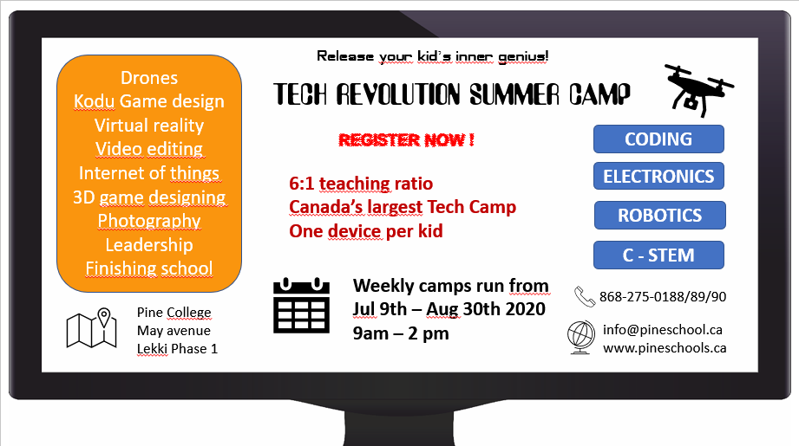
Where will they go and why?

Slide 28
Let’s think: « will » et « be going to »
Observe ces 2 phrases:
I hope I will go to Canada. I’m going to choose a Summer camp where we can do lots of outdoor activities because I love nature.
Ces 2 phrases ont un sens futur puisqu’Andrea explique ce qu’elle va faire cet été.
Pourtant, il y a 2 formes différentes pour exprimer ce futur. Mais pourquoi?
WILL
BE GOING TO
Décision sur le moment
Planifié
Résolution
Si elle y va, parce qu’elle aime la nature, Andrea a déjà prévu d’aller dans un camp où il y a des activités de plein air.
Andrea espère, a envie au moment où elle parle, d’aller au Canada mais cela n’aura peut-être pas lieu.

Slide 29
Now, it’s your turn!
I am going to play minigolf this afternoon with my sister like every Tuesday.
I will call my friend now to know if she is ok with this summer camp.
I know what we can do tomorrow: we will play football with Paul.
Andrea is going to choose a camp in Canada because she loves the country.
Décision sur le moment | Planifié

Slide 30
Structure
Will | Be going to
I
He/ she
We
You
They
am
is
are
are
are
I
He/ she
We
You
They
will
+ verbe
going to
+ verbe
I will eat I am going to eat

Slide 31
Answers
Will | Be going to
I
He/ she
We
You
They
am
is
are
are
are
Sujet +
will
+ verbe
going to
+ verbe
Will | Be going to
Am
Is Are
Are
Are
I
he/ she
we
you
they
Questions
will
+ sujet
+ verbe
going to
+ verbe

Slide 32
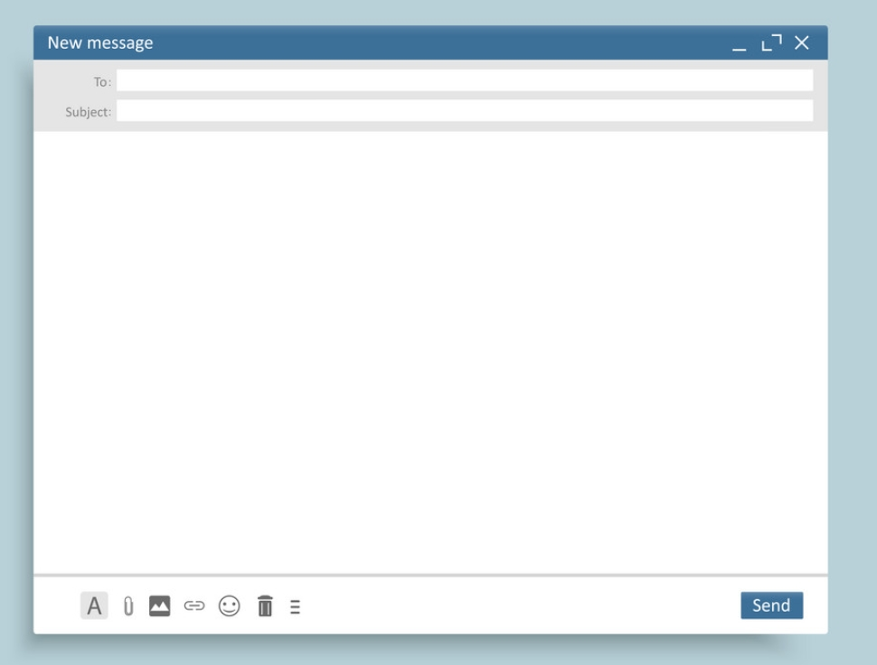
Sender
From :
ellie.mitch@bmail.com
To :
info@pineschool.ca
Recipient
Subject:
Questions about the summer camp
Subject
Dear Madam/Sir,
I am very interested in your summer camp. I love technology and video games. But I have some questions.
First I can see there is a 3D game designing workshop. Which apps are we going to use?
I can see there is a photography workshop too: are we going to use apps on our mobiles? Is it necessary to download any apps?
Best regards,
Ellie Mitch
Greetings
Body
Closing
Signature
Attachments

Slide 33
Sender
From :
ellie.mitch@bmail.com
To :
info@citygarden.ca
Recipient
Subject:
Questions about the summer camp
Subject
Dear Madam/Sir,
I am very interested in your summer camp. I love technology and video games. But I have some questions.
First I can see there is a 3D game designing workshop. Which apps ………………………………….use?
I can see there is a photography workshop too: …………………
…………….to use apps on our mobiles? Is it necessary to download any apps?
Best regards,
Ellie Mitch
Greetings
Body
Closing
Signature
Attachments

Slide 34
Sender
From :
ellie.mitch@bmail.com
To :
info@citygarden.ca
Recipient
Subject:
Questions about the summer camp
Subject
Dear Madam/Sir,
Greetings
I am very interested in your summer camp. I love technology and video games. But I have some questions.
Will we sleep in tents ?
Body
Are we going to kayak every day ?
Do I need to buy some sunscreen?
Best regards,
Closing
Ellie Mitch
Signature

Slide 35
From :
To :
Subject:
Greetings
Body
Closing
Signature

Slide 36
Récapitulons! Qu’avons-nous appris aujourd’hui? De quoi es-tu capable à présent?

Slide 37
Wear a mask and practise your English!
Not on your horns Tony! On your mouth, silly!

Slide 38
The end

Slide 39
Extra activities

Slide 40
Let’s play! Can you find the word?
H rse ridi g
Cano ing
F s ing
ikin
R ck cli bing

Slide 41
It’s your turn!
Workshops start at 9am
& finish at 4pm
Monday – Drones
Tuesday – 3D Game design
Wednesday – Sportsball
Thursday – Photography
Friday – Virtual reality

Slide 42
Ellie’s resolutions
Workshops start at 9am
& finish at 4pm
Monday – Drones
Tuesday – 3D Game design
Wednesday – Sportsball
Thursday – Photography
Friday – Virtual reality
I ……… get up at 8am every morning to be on time for the first workshop.
I ………. attend each workshop.
I ………………… make efforts to work in groups.

Slide 43
Question time!
On Monday, she ………………………… attend the Drone workshop.
On Tuesday, it …………………………. be 3D Game design.
I ……… get up at 8am every morning to be on time for the first workshop.
I ………. attend each workshop.
I ………………… make efforts to work in groups to make firends.

Slide 44
camera
mic/mike
leggings
flask
mosquito repellent
hiking shoes
cap
ball
swimsuit
flip-flops
camcorder
sunscreen
Notes:
Carte postale avec étiquettes pour

Slide 45
Where are they going to?
Science camp
Nature camp
Martial arts camp
Musical camp
Sports camp
Jack
Tina
Notes:
https://fr.freepik.com/icones-gratuites/creme-solaire-bouteille_771944.htm
https://www.pngwave.com/png-clip-art-afwyp/download
https://publicdomainvectors.org/en/free-clipart/Vector-image-of-black-rubber-boot-on-grey-background/32926.html

