Slide 1

KEEP CALM
AND SPEAK
ENGLISH

Slide 2
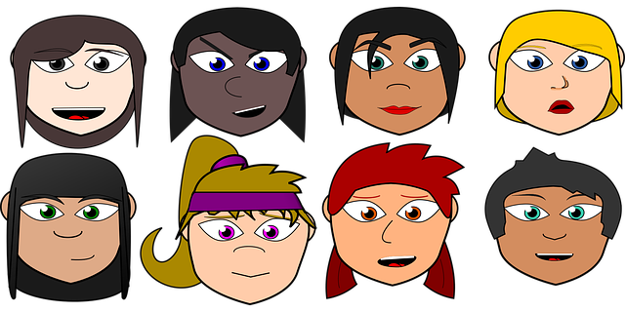
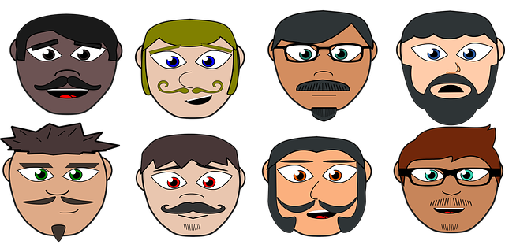
Physical description

Slide 3
Dans ce cours,
tu vas revoir:
Du vocabulaire pour décrire une personne
Les déterminants possessifs
tu vas t’entraîner à:
Décrire quelqu’un
Comprendre une description

Slide 4
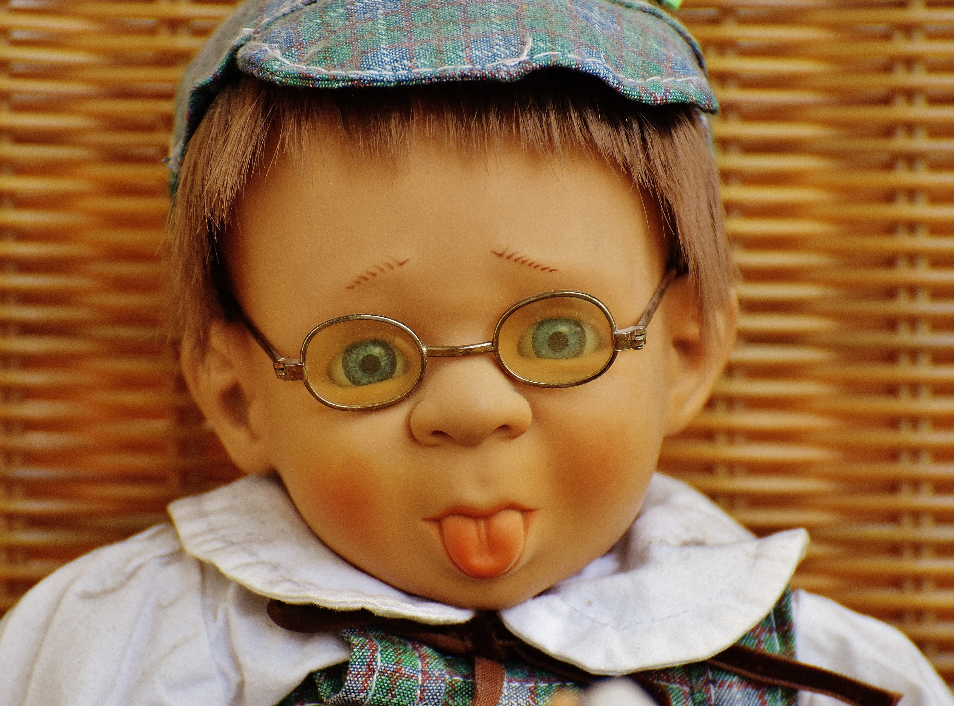
Tim
eyes
hair
glasses
nose
tongue
mouth
face

Slide 5








EYES
GLASSES
NOSE
HAIR
/aΙ/
/IZ/
MOUTH
TONGUE
FACE

Slide 6






Listen and draw!

Slide 7


Singular or plural?
2
1

Slide 8
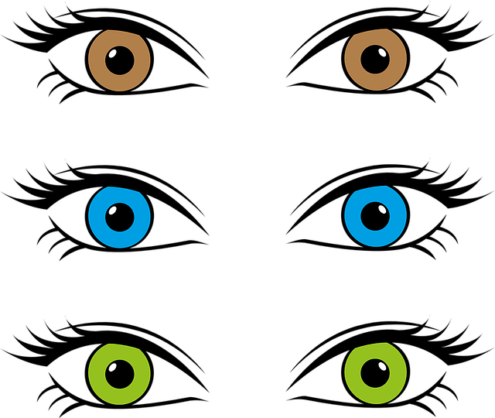
COLOURS
I’ve got brown eyes.
He has got blue eyes.
She’s got green eyes.

Slide 9
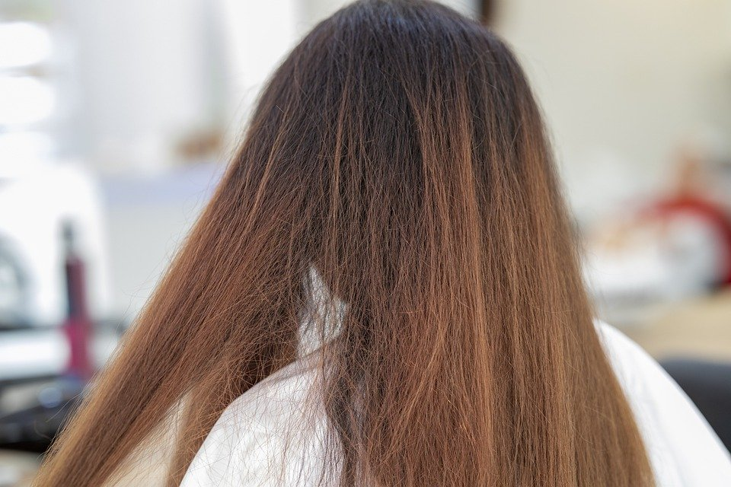
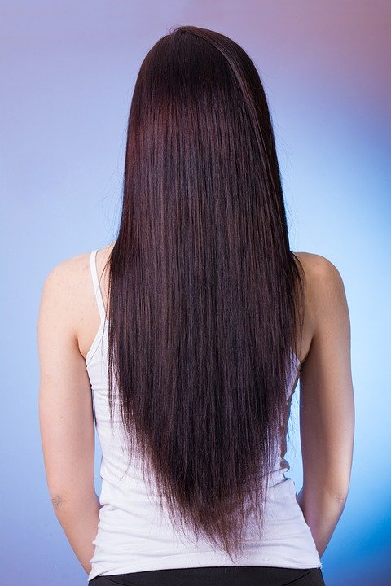
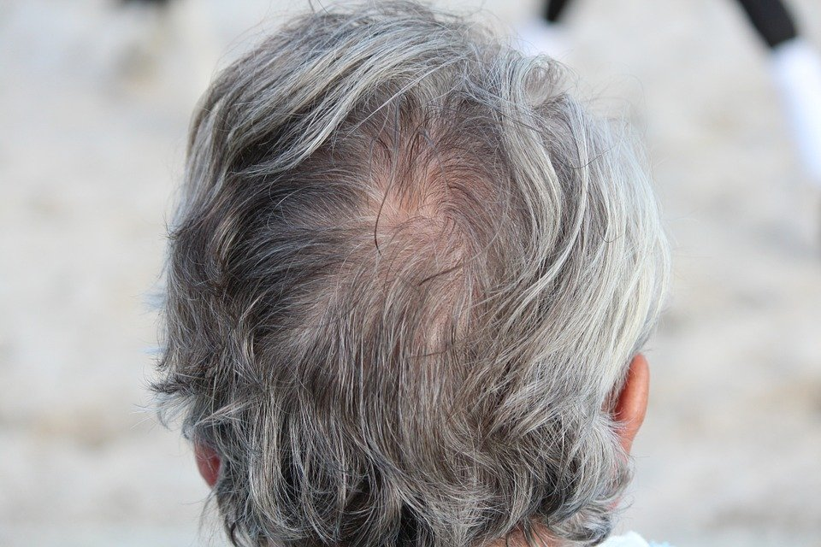

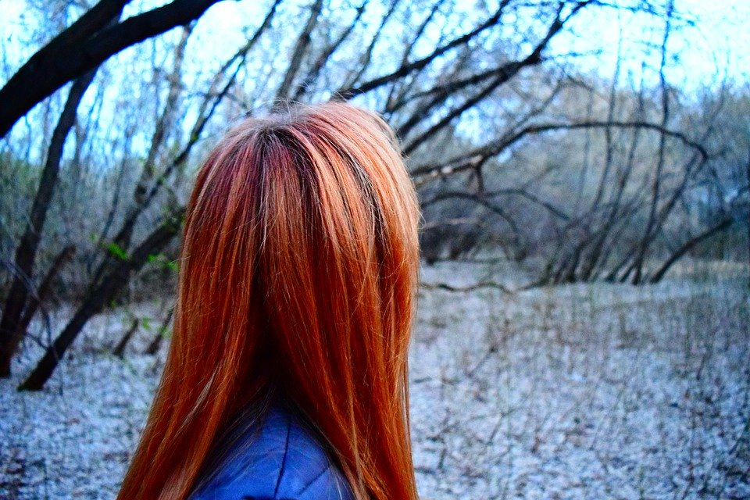
COLOURS
BLACK
DARK/BROWN
RED
GREY
BLOND/ FAIR
I have got dark hair. She has got red hair.

Slide 10
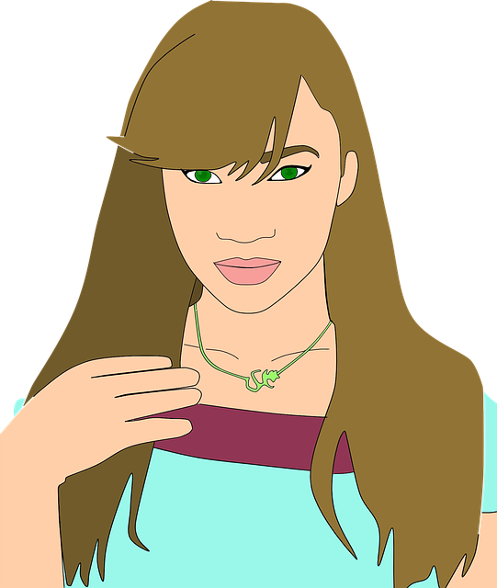
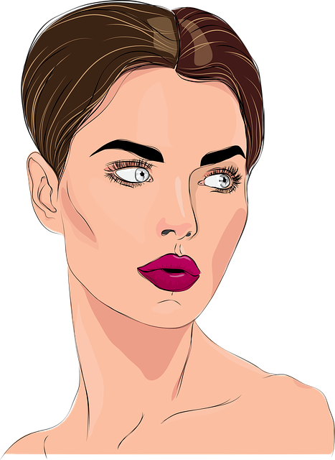
LENGTHS
SHORT
VS
LONG
I’ve got long hair.
She has got short dark hair..

Slide 11


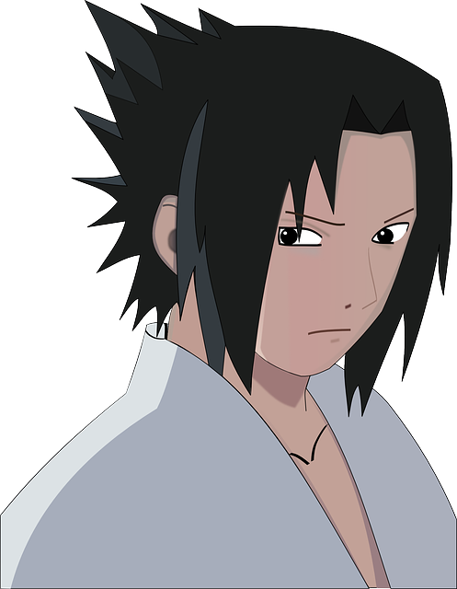
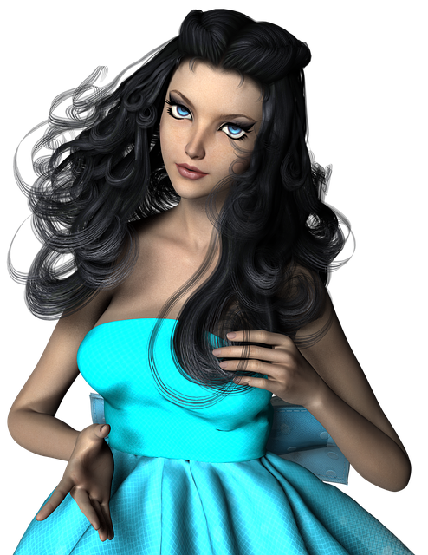
SHAPES
FRIZZY
SPIKY
STRAIGHT
CURLY
I’ve got straight hair.
She’s got long curly hair.
He’s got short spiky black hair..

Slide 12
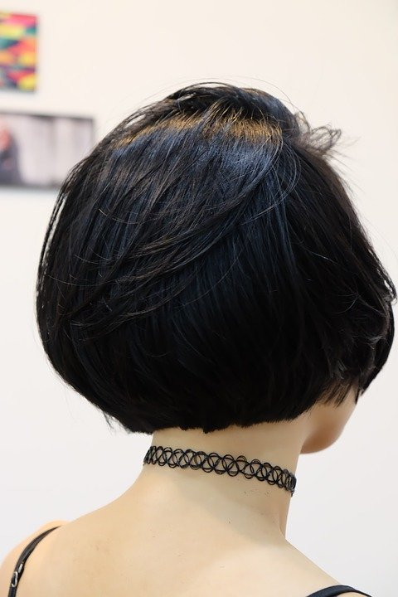
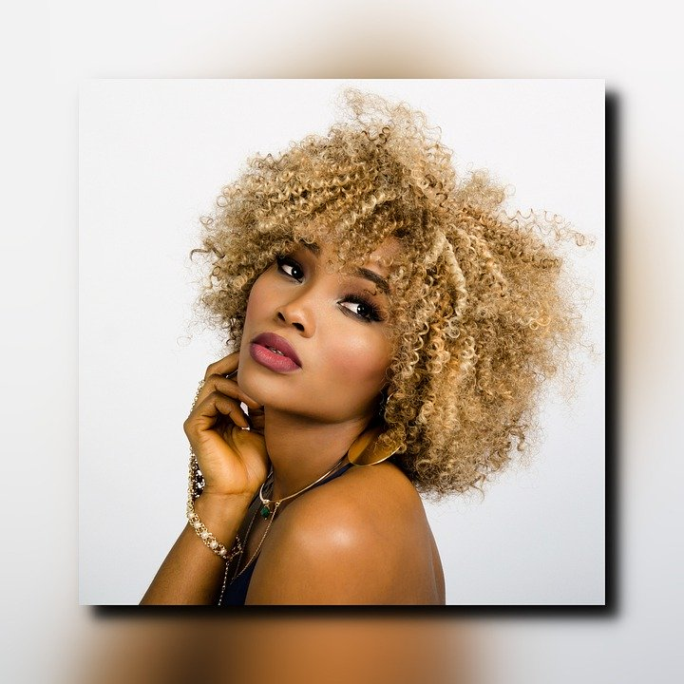
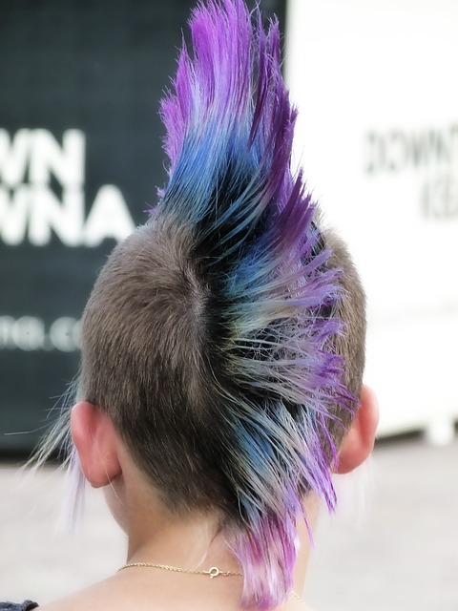
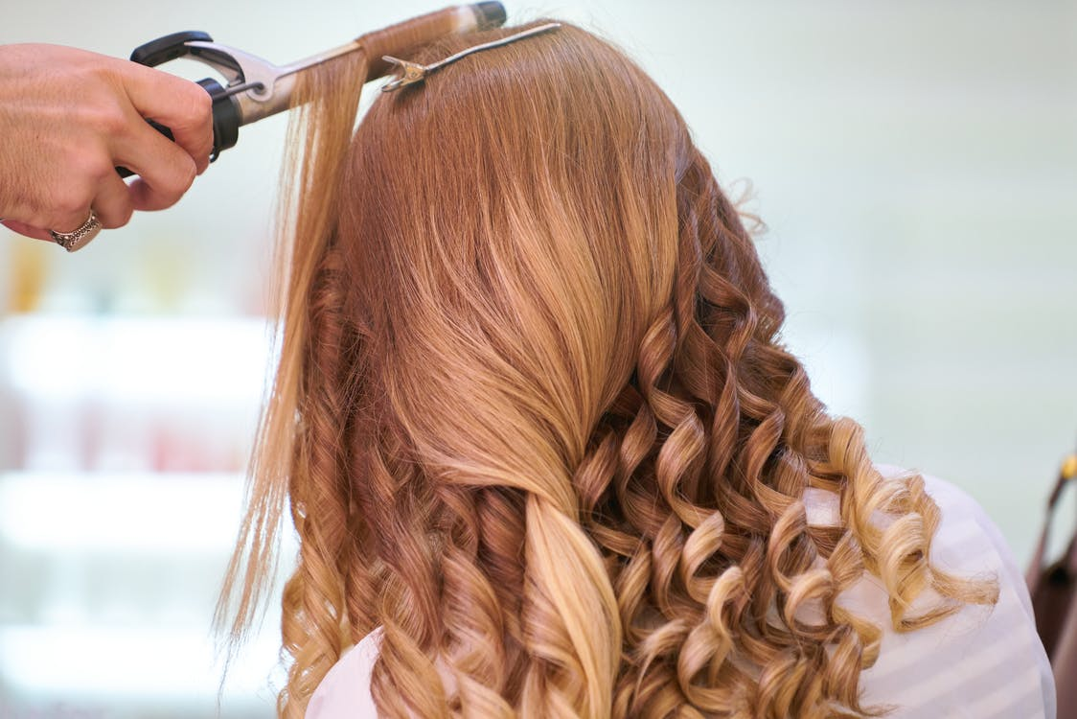
CHECK YOUR ADJECTIVES
STRAIGHT
SPIKY
FRIZZY
CURLY
SHORT
LONG

Slide 13

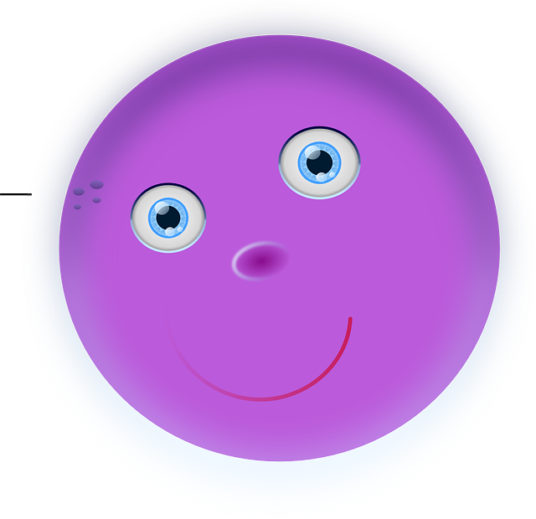

SHAPES
round
square
LONG
SHORT/ SMALL
BIG
I’ve got a long nose.
He’s got an orange square face.
He’s got a big round nose!

Slide 14
LET’S OBSERVE
I’ve got a small nose and big blue eyes.
small
big blue
L’adjectif se place devant le nom qu’il qualifie!
Devant un nom au singulier on utilise a (ou an devant une voyelle) mais on en met pas de déterminant avec un nom pluriel!

Slide 15
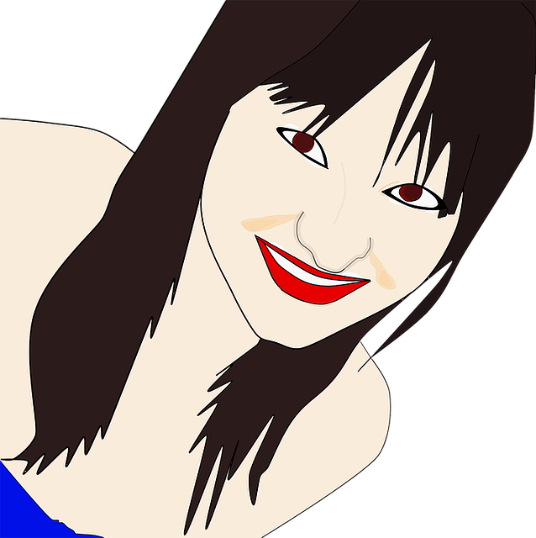
My name’s Rebecca.
REBECCA
I’ve got long straight black hair,
and brown eyes.
I’ve got a big nose and a big mouth.
My glasses are big and black!

Slide 16
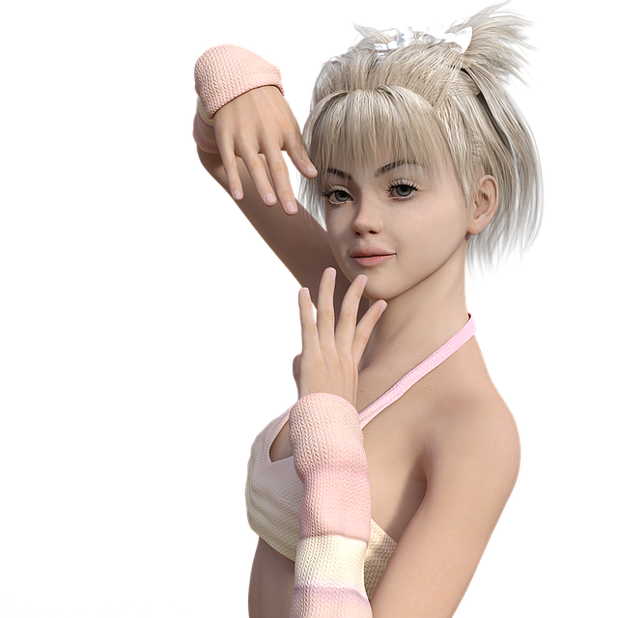
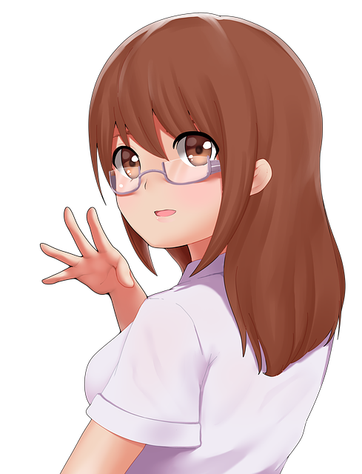
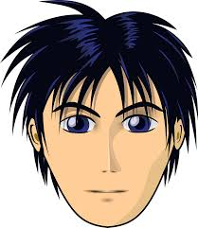
Whose hair?
Her hair is fair.
Their hair is black and spiky.
Their hair is long and brown.
His hair is black.

Slide 17
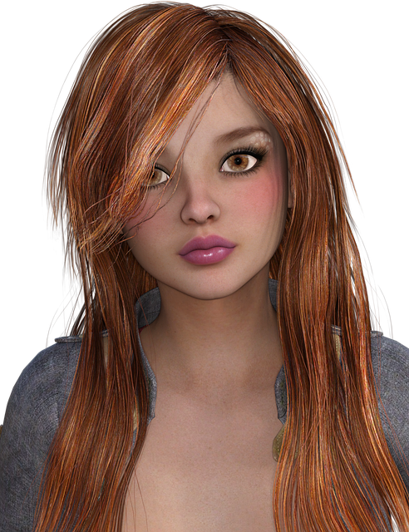
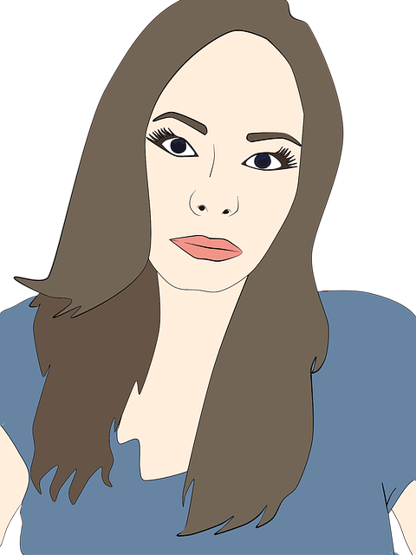
My hair is long,
straight and brown..
Our hair is long and straight..

Slide 18

Let’s recap! A qui ça appartient?
my eyes
à moi:
à toi ou à vous:
à lui:
à elle:
à nous:
à eux ou à elles:
your hair
his tongue
her glasses
À qui?
our face
their nose

Slide 19
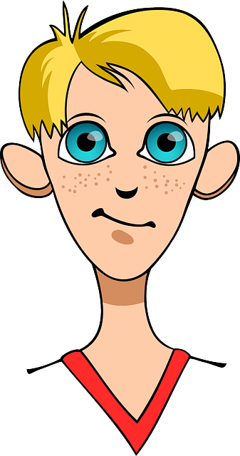
Let’s practise!
“ eyes are blue, I love them!”
This is a photo of my sister, hair is long and dark.
“I look like my father, we’ve got the same hair, hair is red and curly.”
Tom has got a small nose but nose is all red!
“Stop eating these sweets!!! tongue is all blue now!”
My brothers are twins, eyes are blue.
My
her
our
his
Your
their

Slide 20

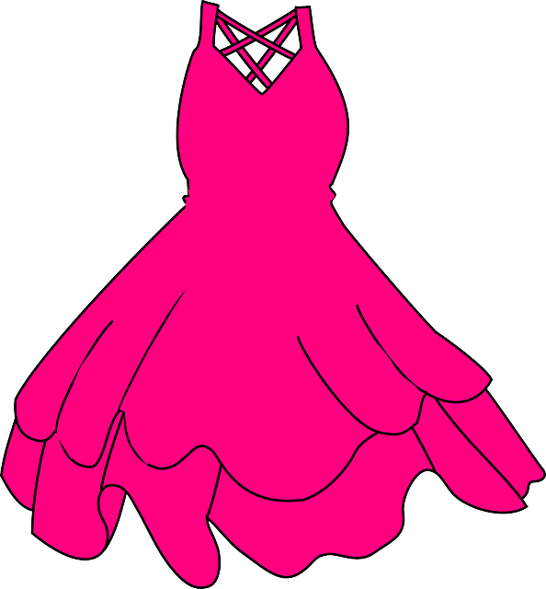
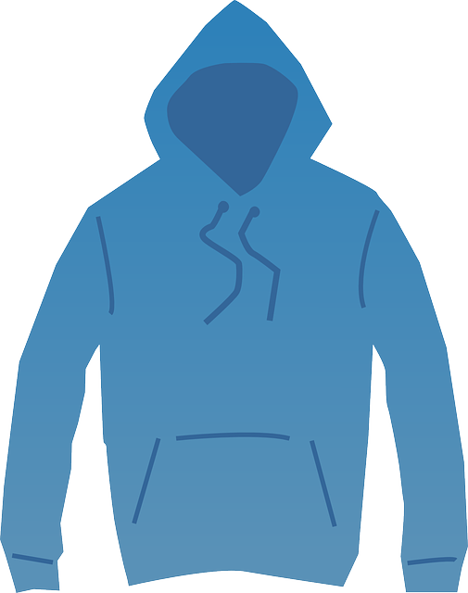
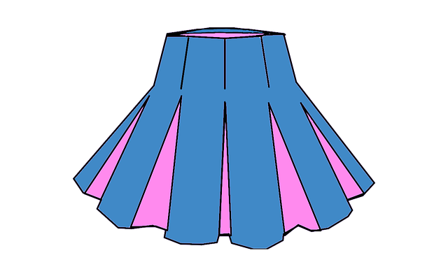
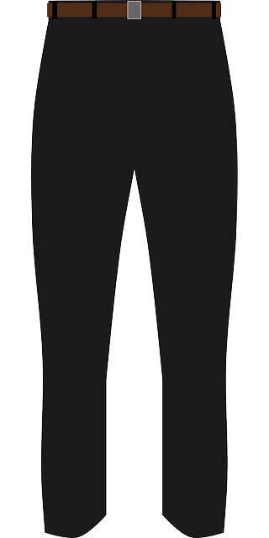




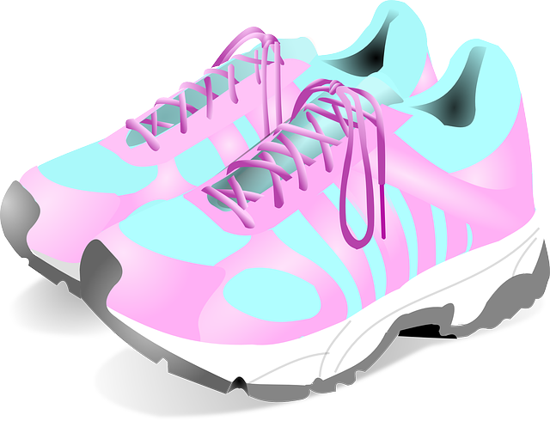
Clothes and accessories
DRESS
SKIRT
SHIRT
SWEATER
SHOES
TROUSERS
CAP
HAT
HANDBAG
TRAINERS

Slide 21
Colour memory!
HAT
SHIRT
SKIRT
HANDBAG
DRESS
CAP
SWEATER
SHOES
TROUSERS
TRAINERS

Slide 22
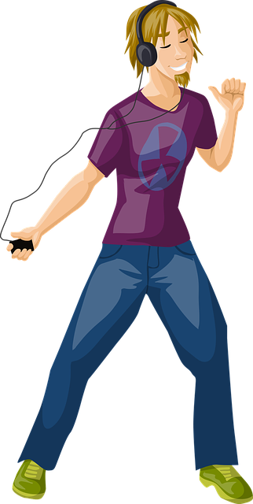
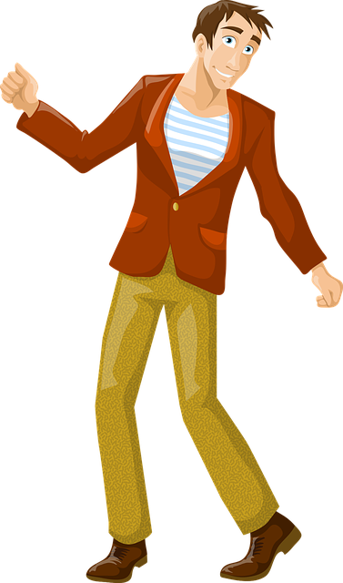
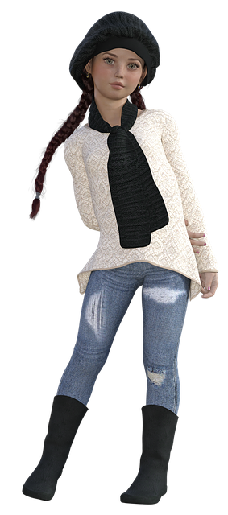
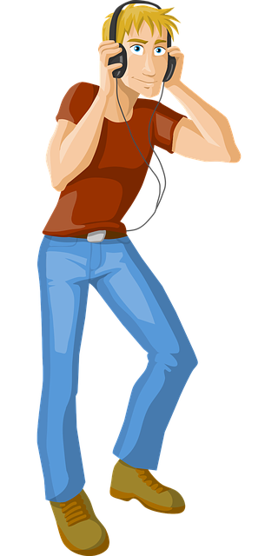
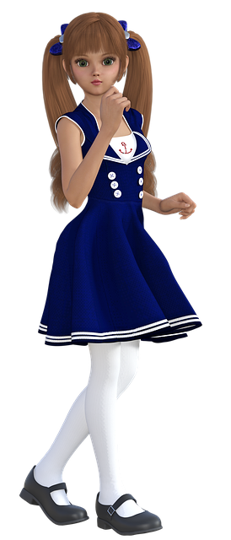

Listen and spot
Alan

Slide 23
Listen and spot
Amy

Slide 24
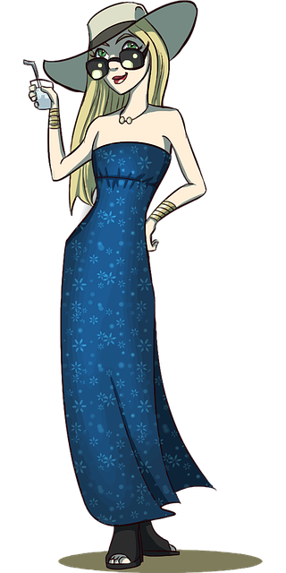
Describe Rebecca
Her name is Rebecca.
Her hat is big and grey.
Her eyes are green. (She’s got green eyes.)
Her glasses are big, black and square.
Her hair is long straight and fair (blond).
She’s got a long blue dress.
Her shoes are black.
She’s got a purple handbag.

Slide 25
Do you remember Tim, the terror?

Slide 26
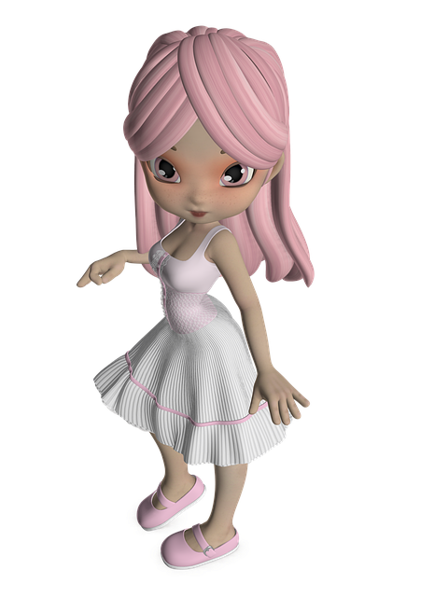
Discover Ellie and Ella.
Their hair is pink, their eyes are brown. They’ve got a white dress and their shoes are pink!
They’re cute!

Slide 27
Dans ce cours tu as appris :
Du vocabulaire pour décrire quelqu’un
Les déterminants possessifs
À faire et à comprendre la description d’une personne

Slide 28

Thank you very much, see you soon!
STAY SAFE
AND
Practise your English

Slide 29
À imprimer format photo qui rentre dans une enveloppe
Toutes les images sont issues de PIXABAY libres de droits et usage commercial autorisé
Toutes les images sont issues de PIXABAY libres de droits et usage commercial autorisé

