Slide 1
KEEP CALM AND SPEAK ENGLISH

Slide 2
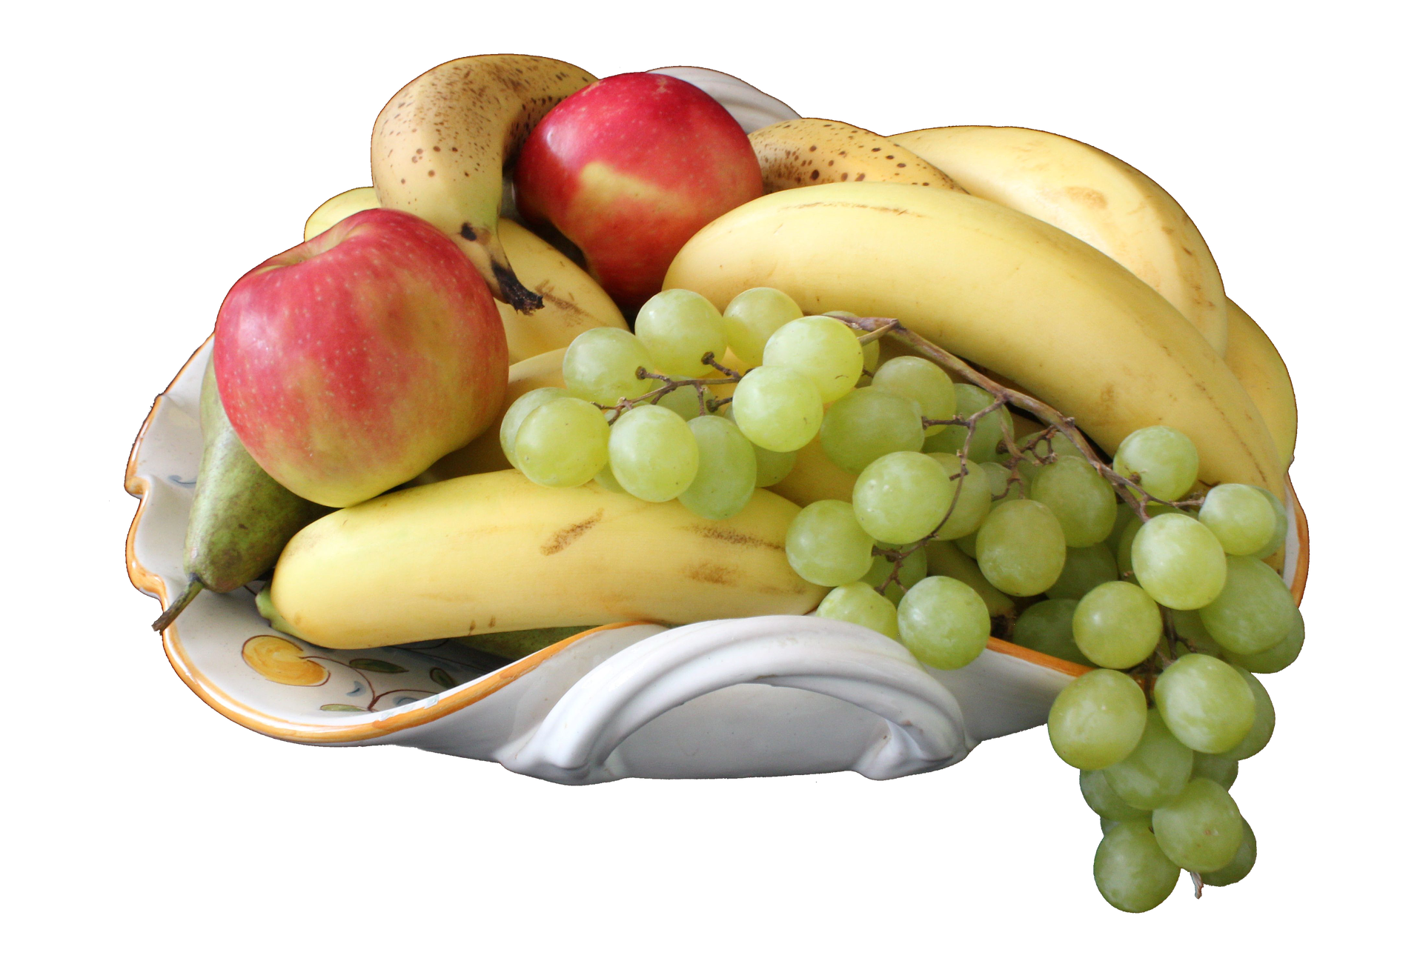
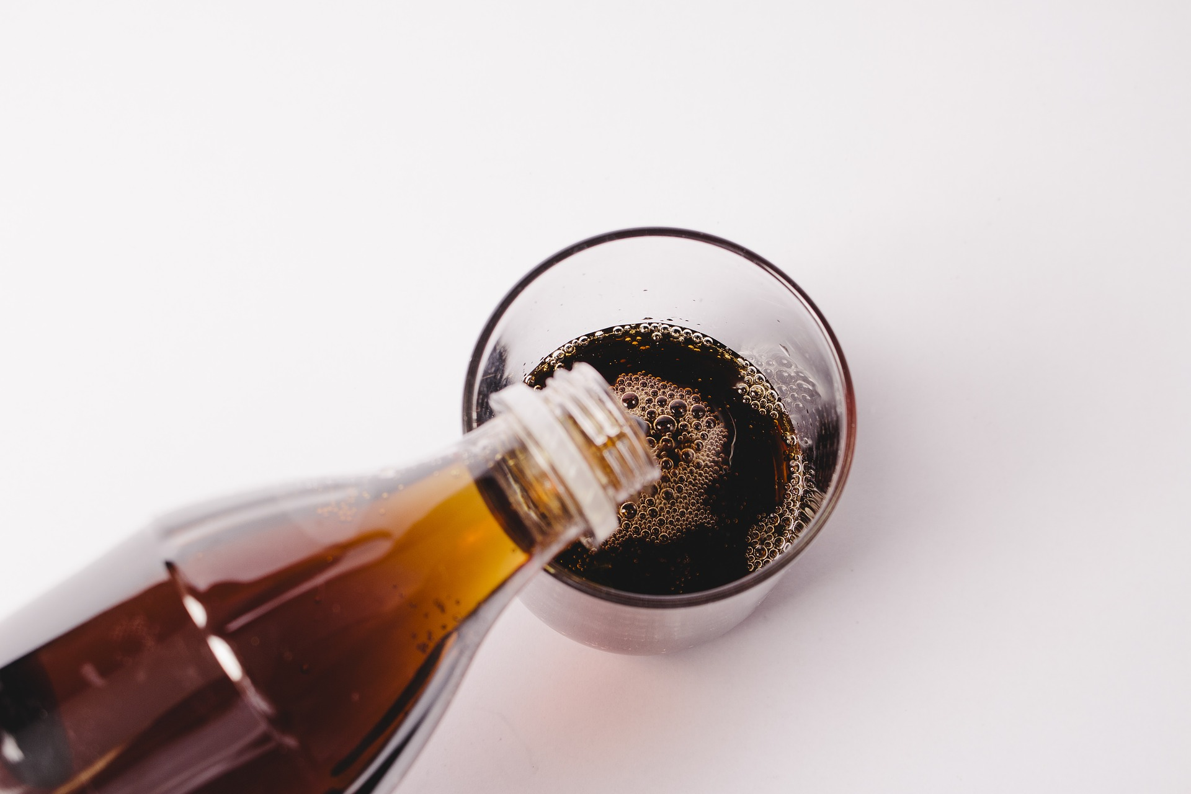
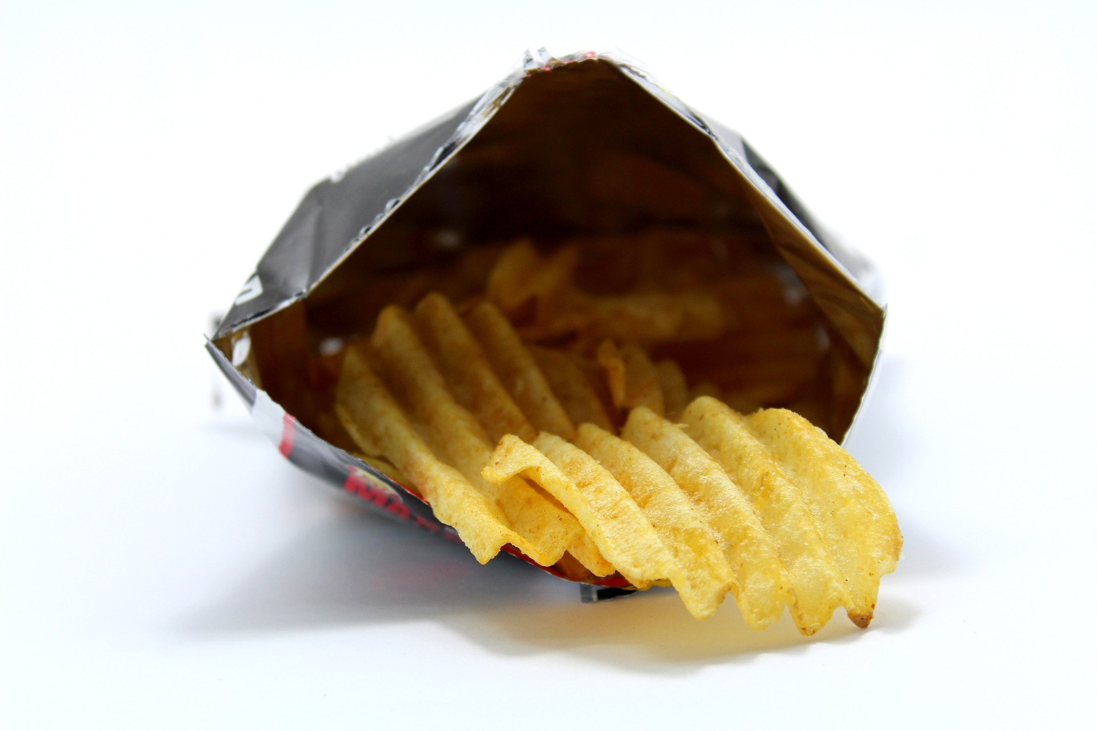
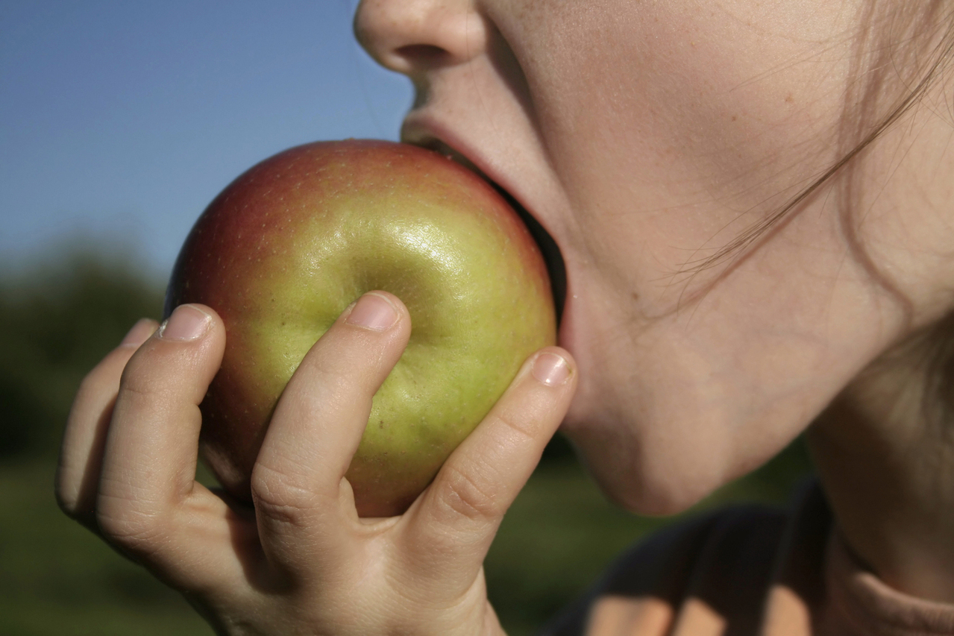
Food and health:
snacking

Slide 3
Dans ce cours tu vas revoir:
Du vocabulaire sur la nourriture
Quelques proverbes anglais
Comment faire des comparaisons
Comment exprimer des quantités

Slide 4
SNACK TIME
“A hungry man is an angry man...”
What do you have for snack time?

Slide 5
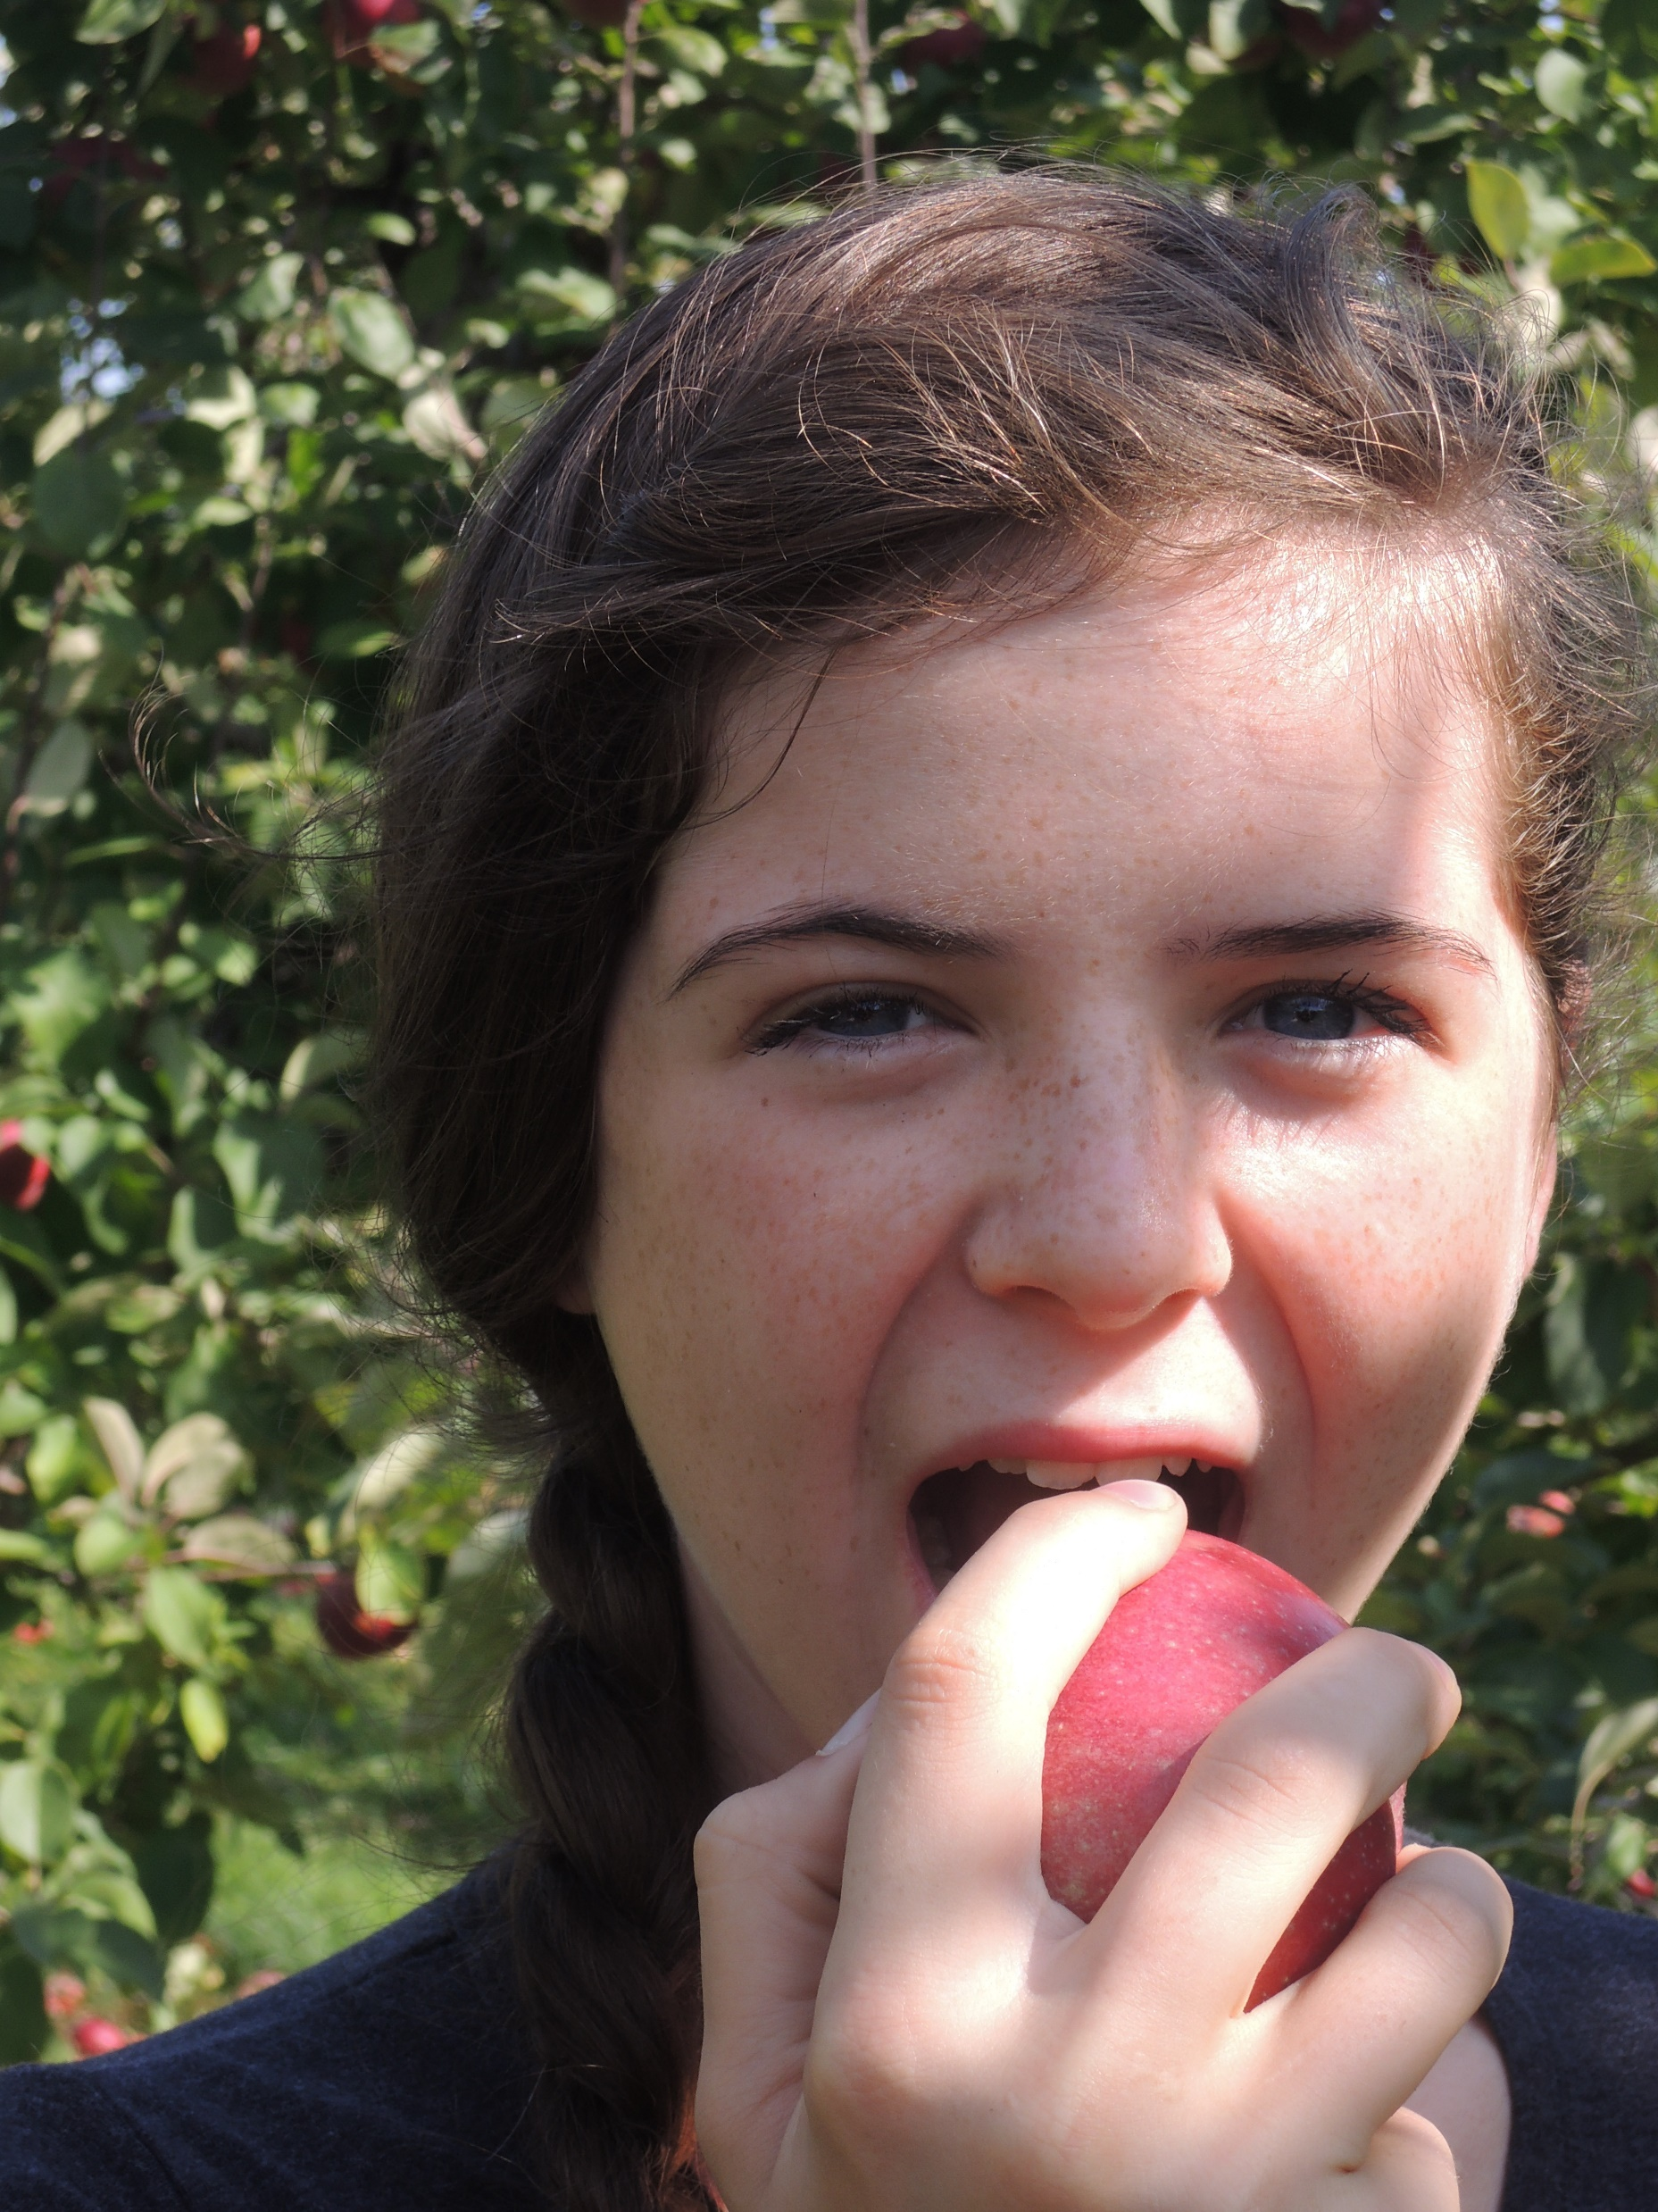
An apple a day
keeps the doctor away !
Notes:
https://fotomelia.com/files/?did=40191&file=0 libre de droit
Free doctor apple Images and Royalty-free Stock Photos

Slide 6
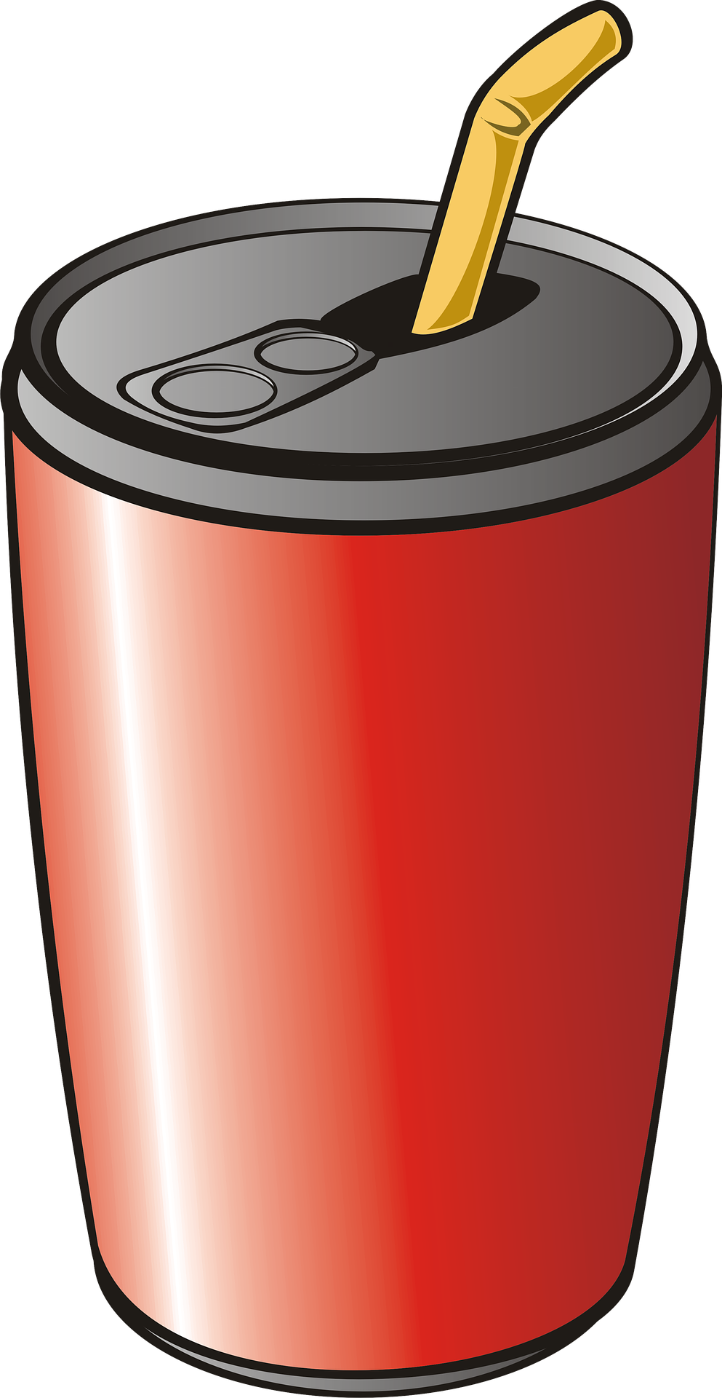
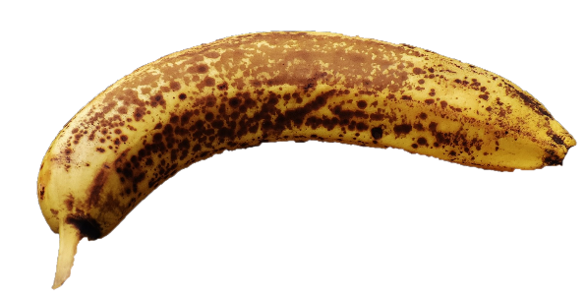
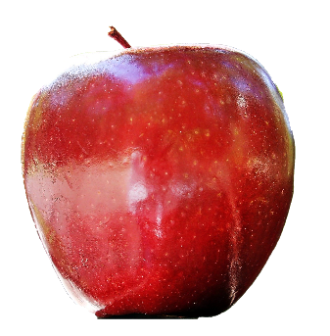
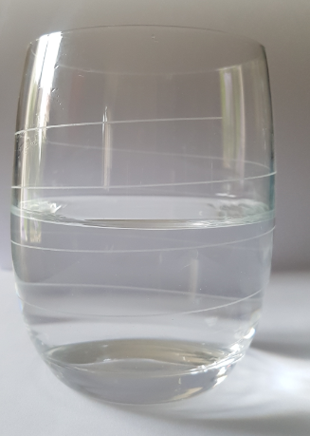
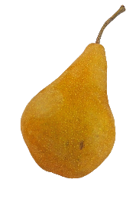
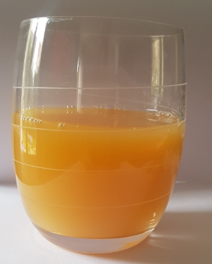
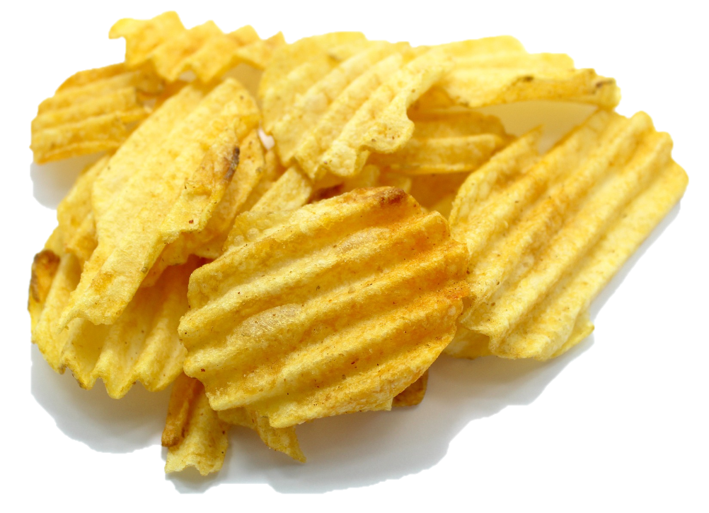
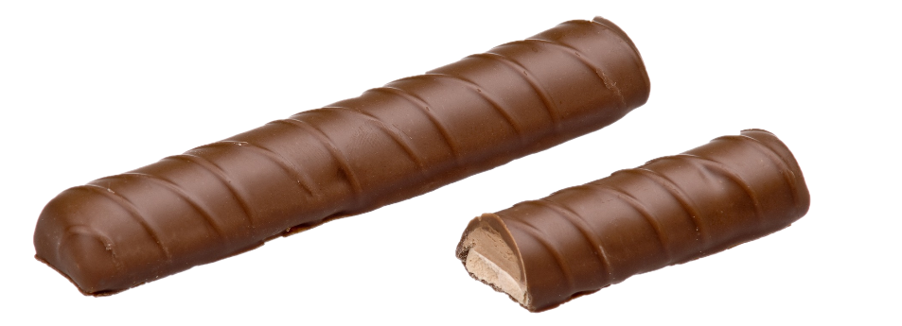
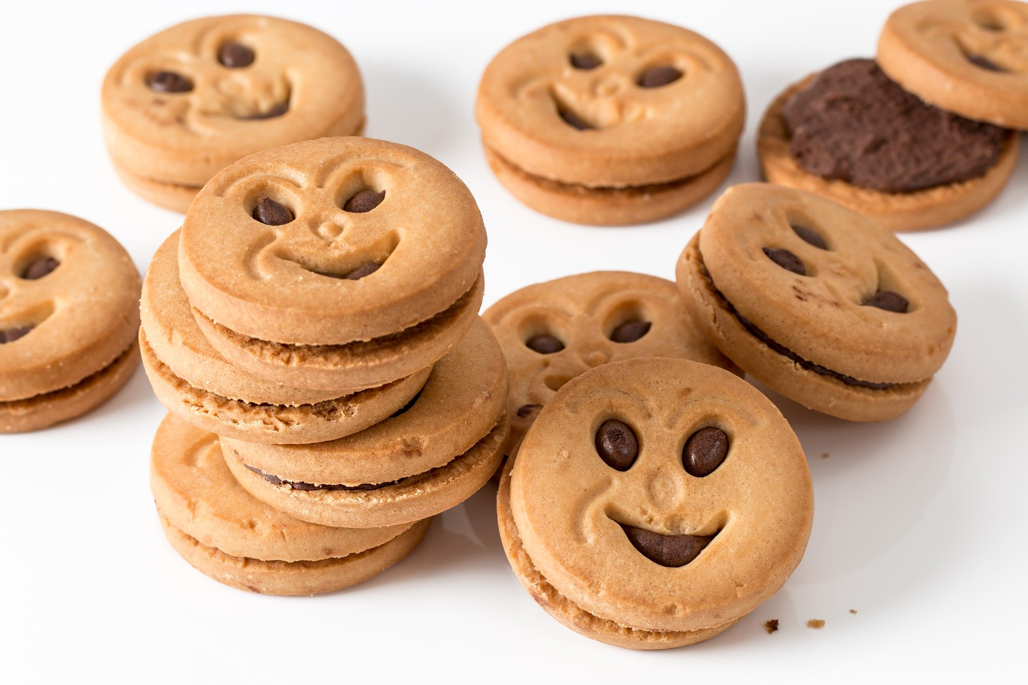
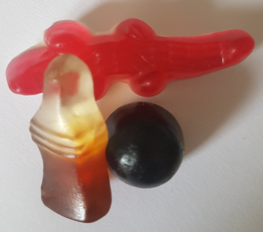
Drinks
Fruit
a banana
an apple
water
soda
A pear
fruit juice
Snacks
crisps
biscuits/cookies
sweets
A chocolate bar

Slide 7
Now check your vocabulary!
water
fruit juice
soda
a banana
an apple
a pear
a chocolate bar
biscuits/cookies
crisps
sweets

Slide 8
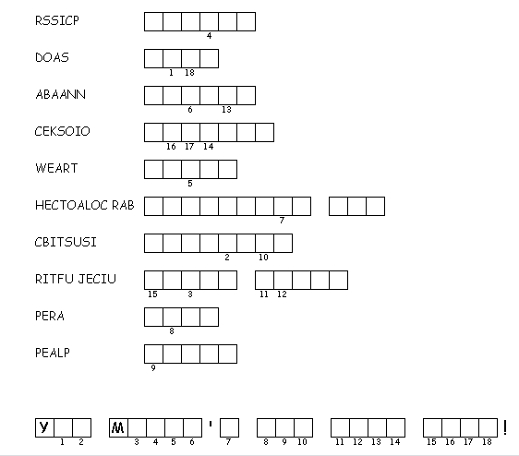
CRISPS
SODA
BANANA
COOKIES
WATER
CHOCOLATE
BAR
BISCUITS
FRUIT
JUICE
PEAR
APPLE
OU USTN T EAT JUNK FOOD

Slide 9
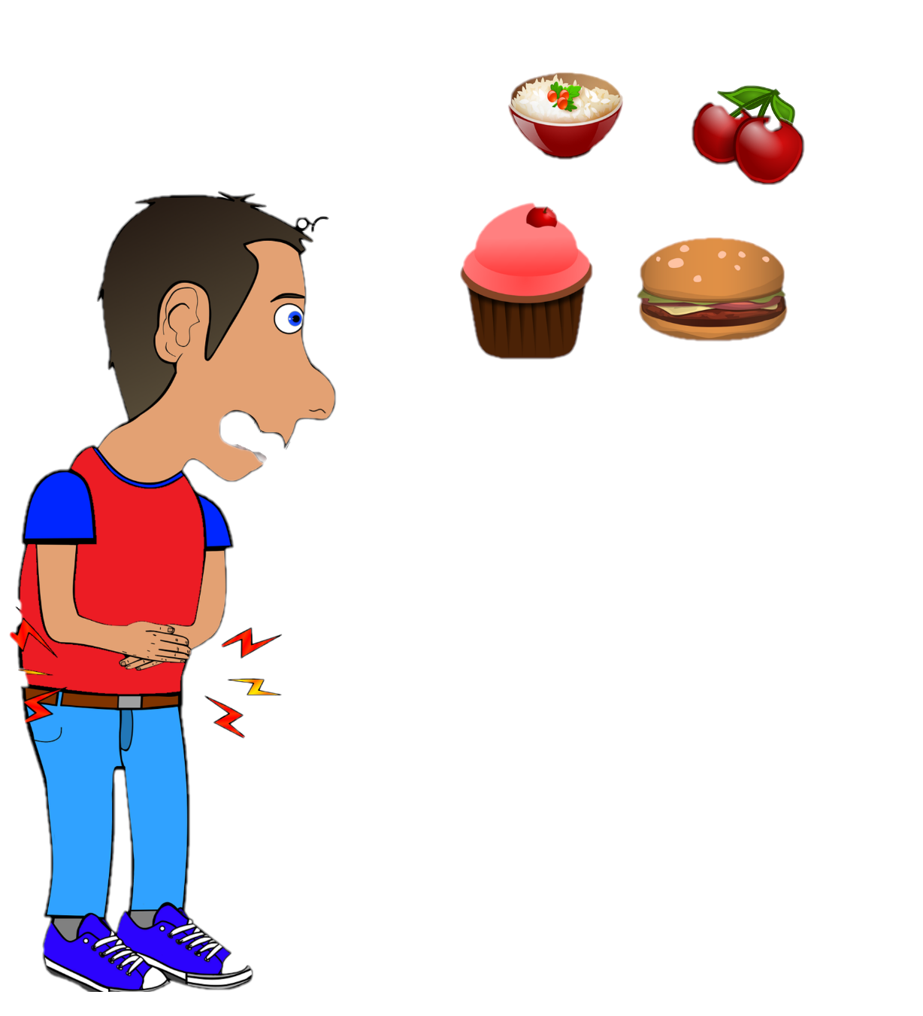
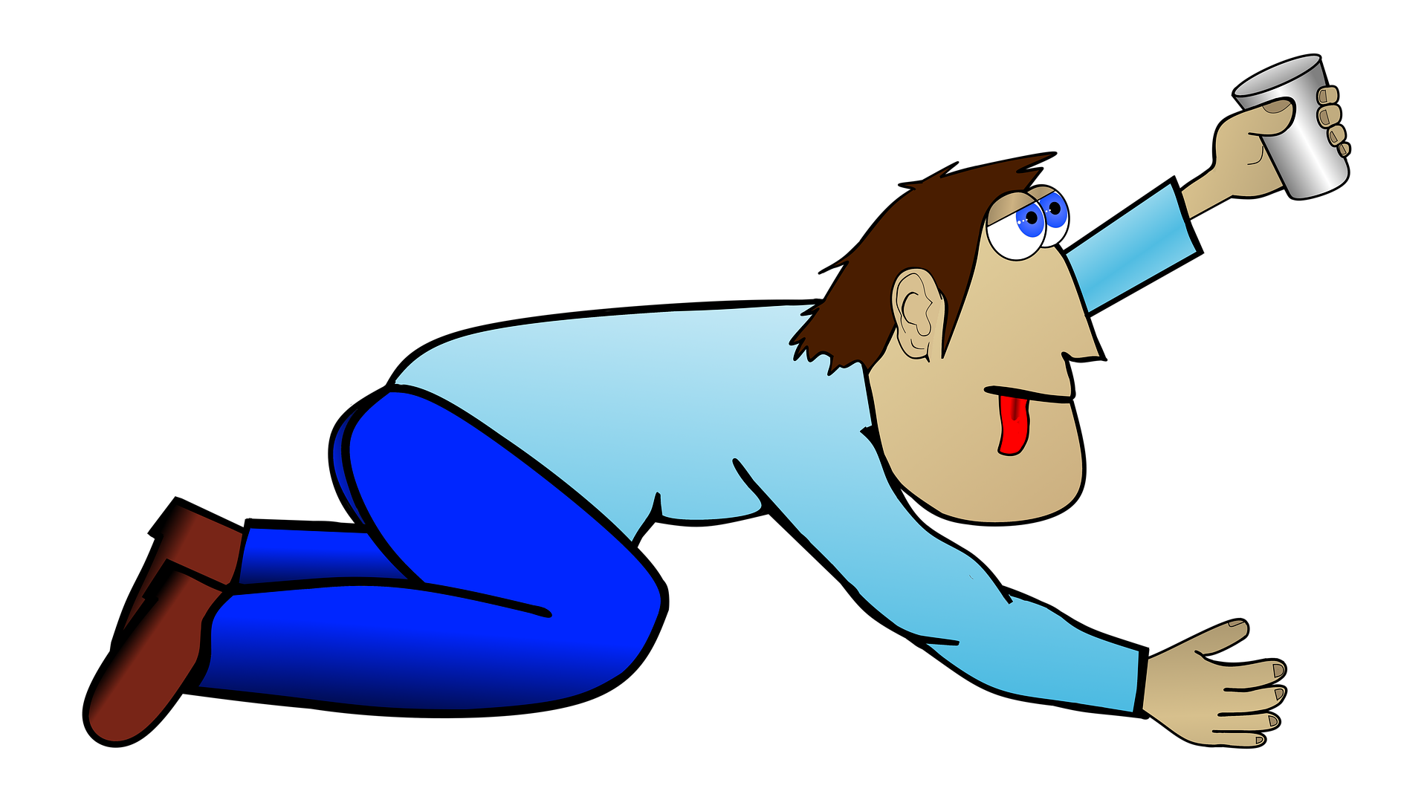
SNACK TIME:
choose a better life in the hotter days!
It’s 4 pm, and you’re a little hungry?
Fruit are more colourful and better than crisps!
Fruit are tastier and better than biscuits!
You’re thirsty?
Soda vs juice ?
Juice vs water ?
Water is the winner ! ☺
It’s better and healthier! 
Sodas are worse for you, ☹
They’re more caloric!
Juices are lighter!

Slide 10
The message of the poster
Is this a message for winter time or for spring time?
The days are in April than in December!
Can good snacks make your life better or worse?
Is junk food healthier or more caloric?
hotter
better
more caloric

Slide 11
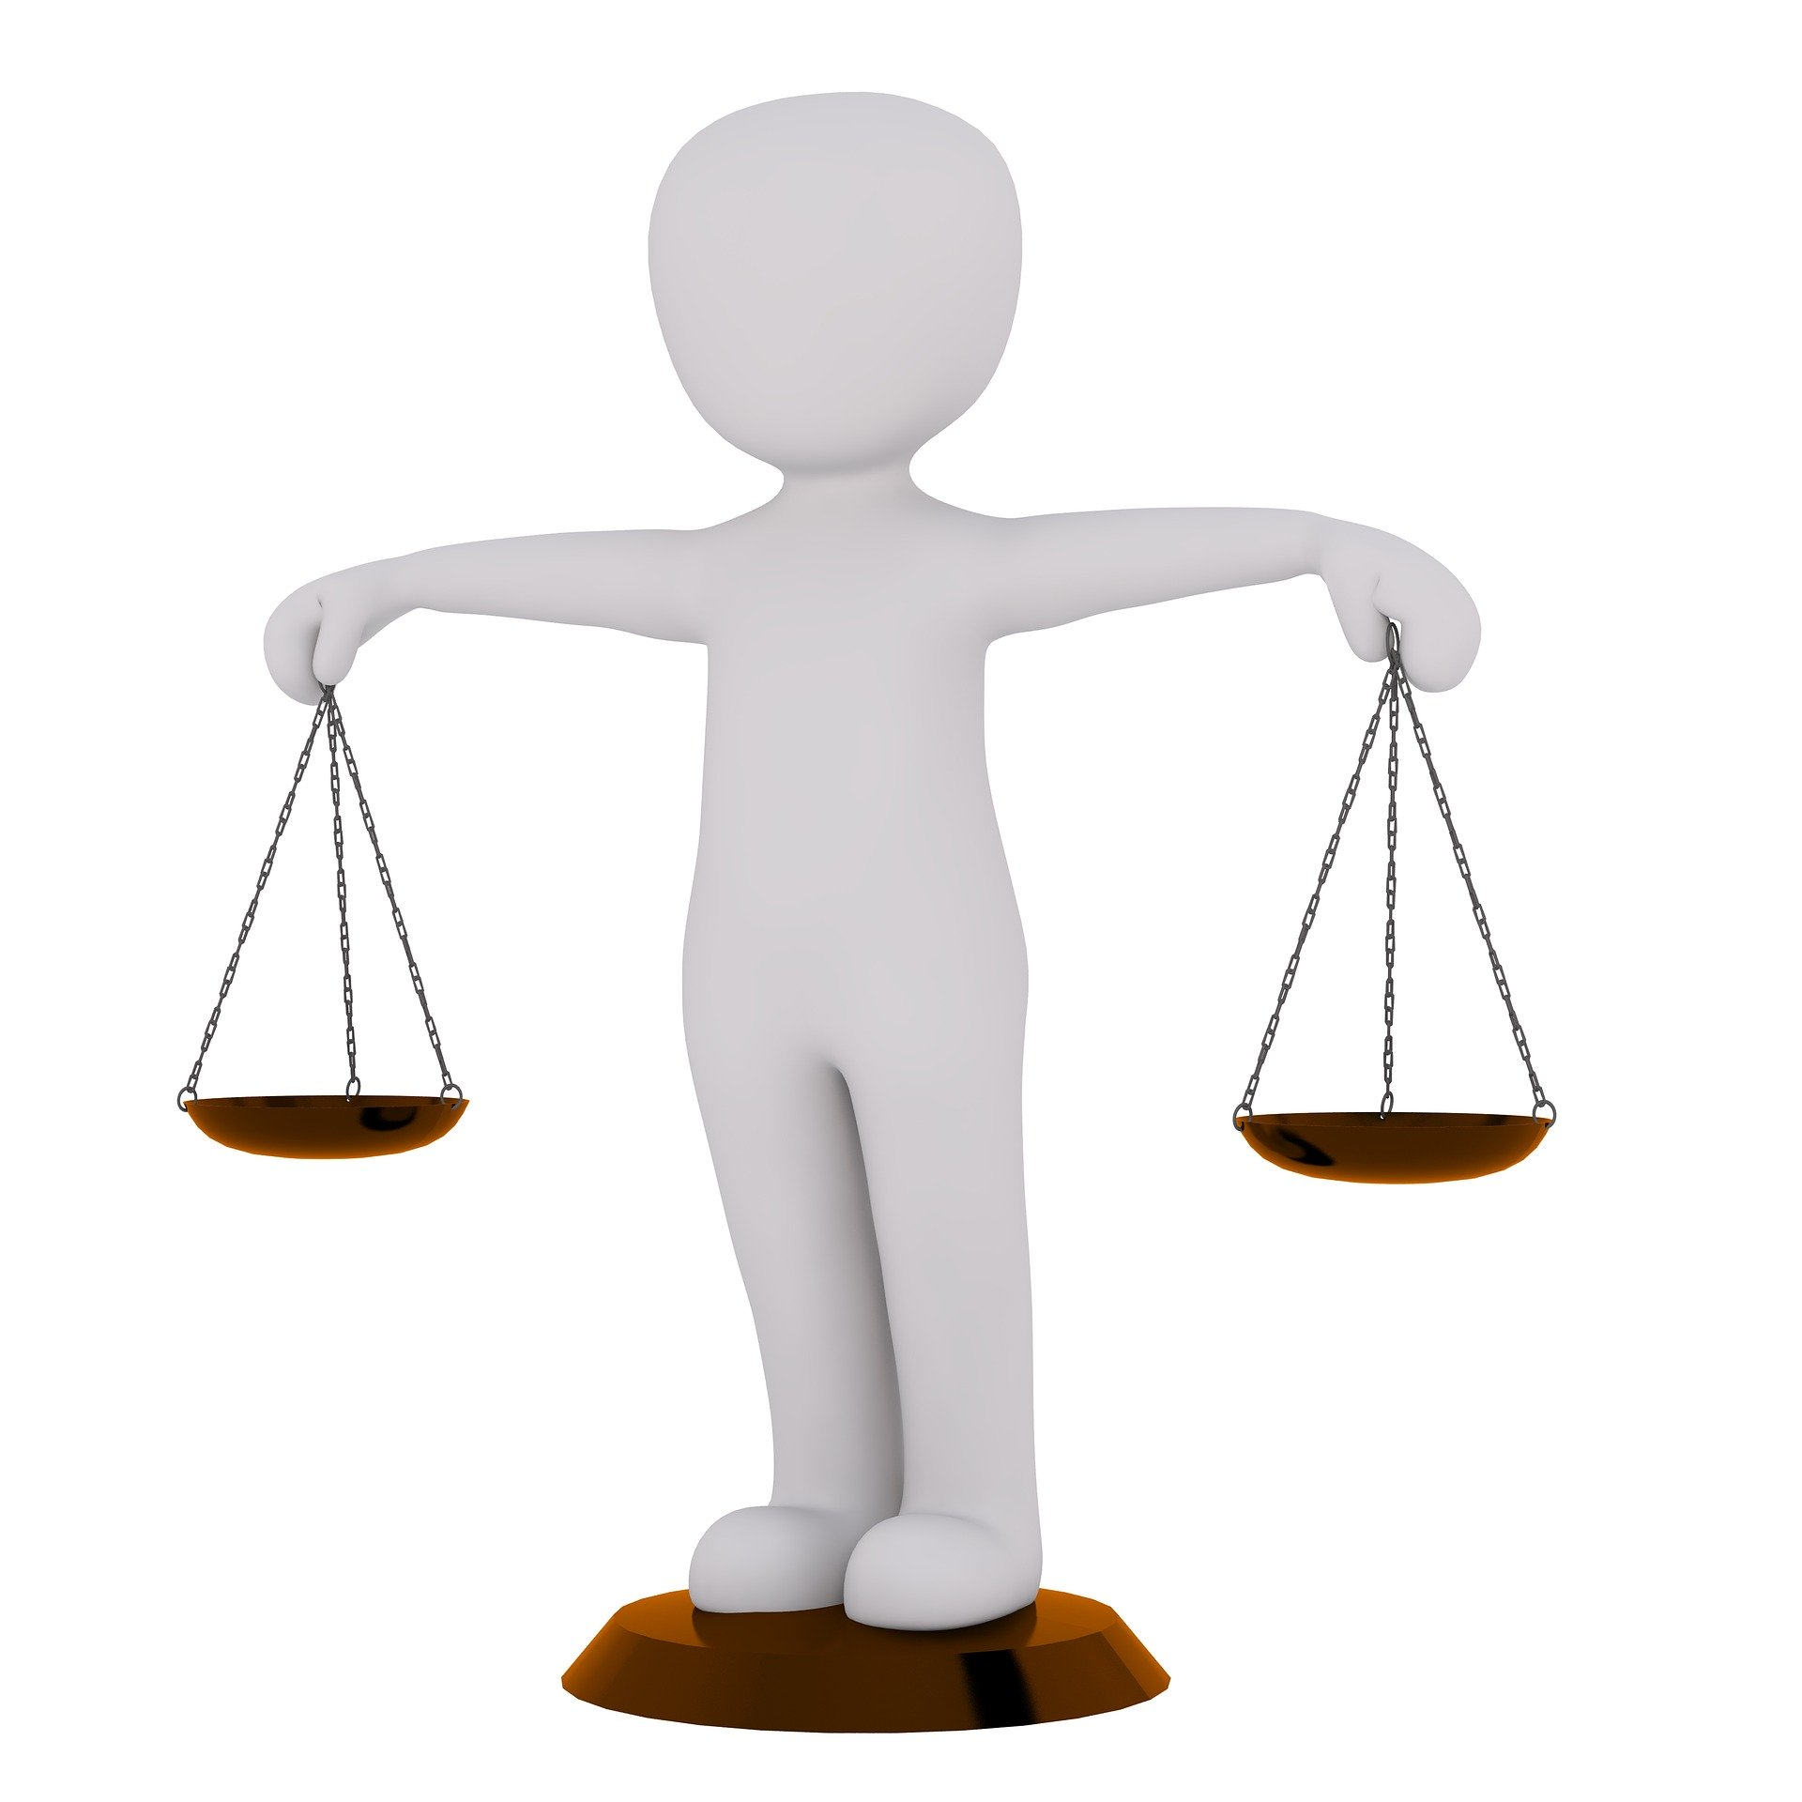
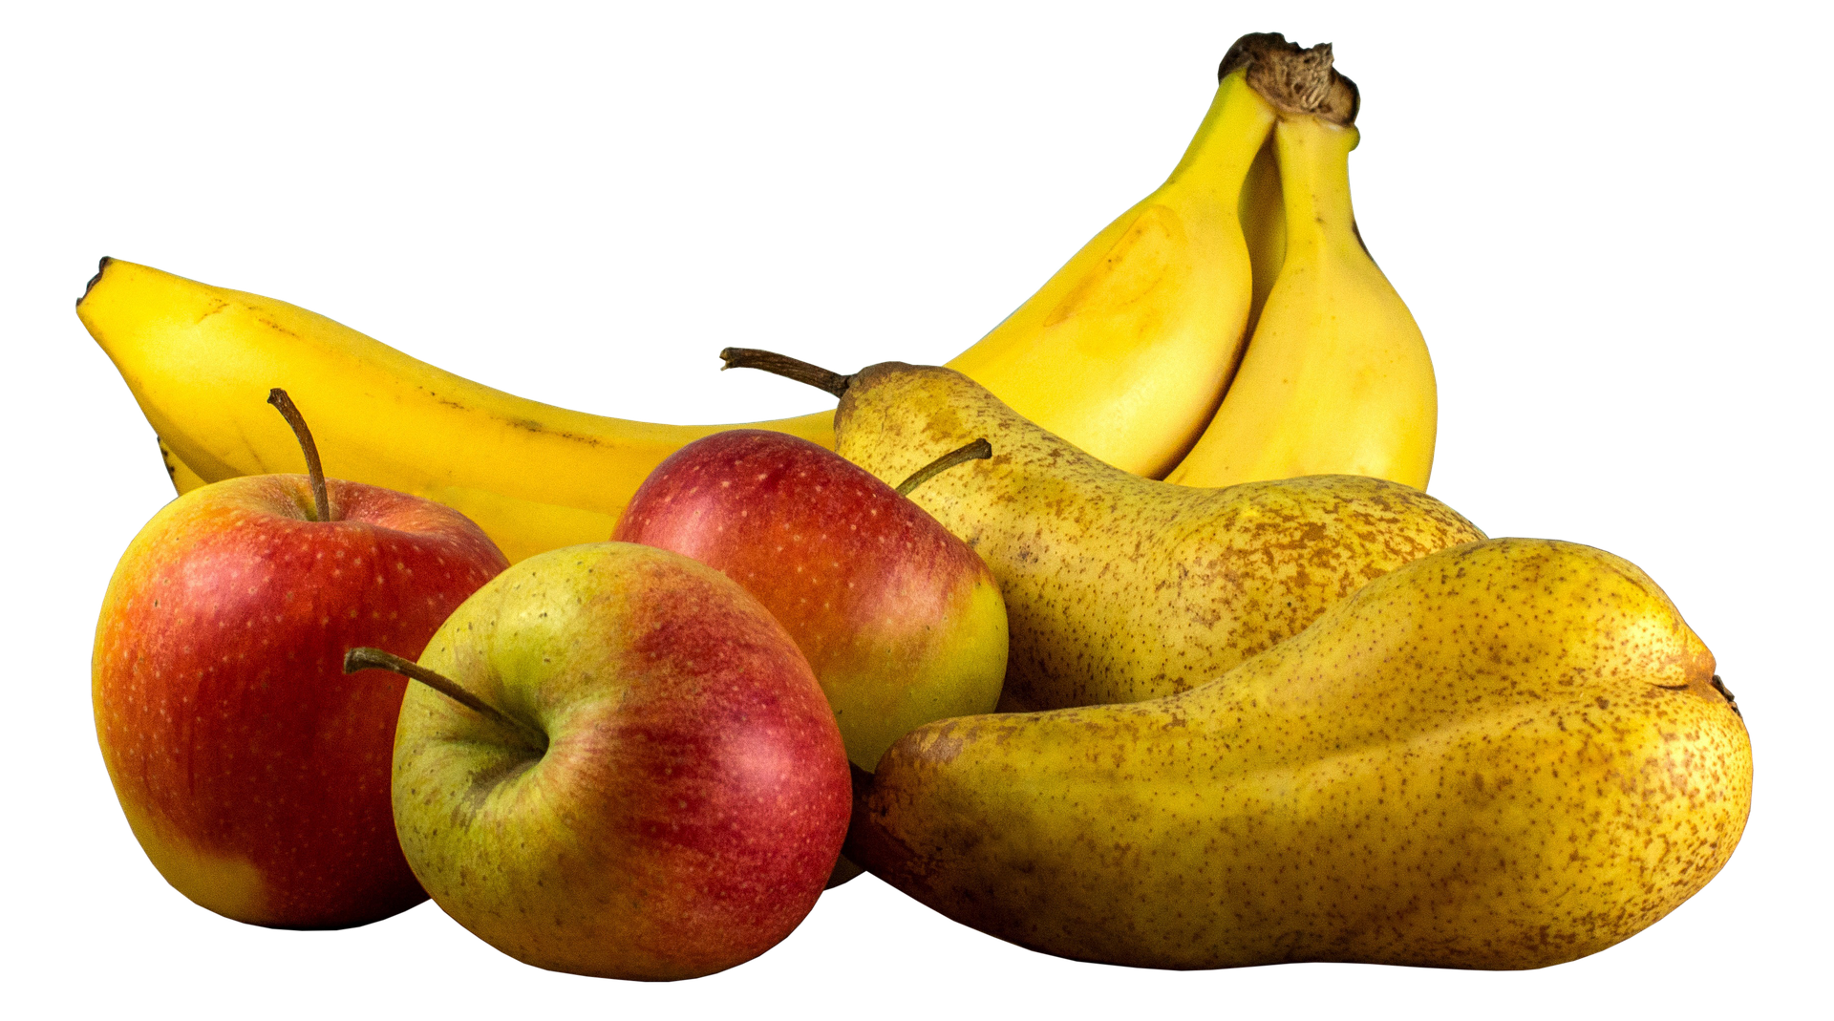
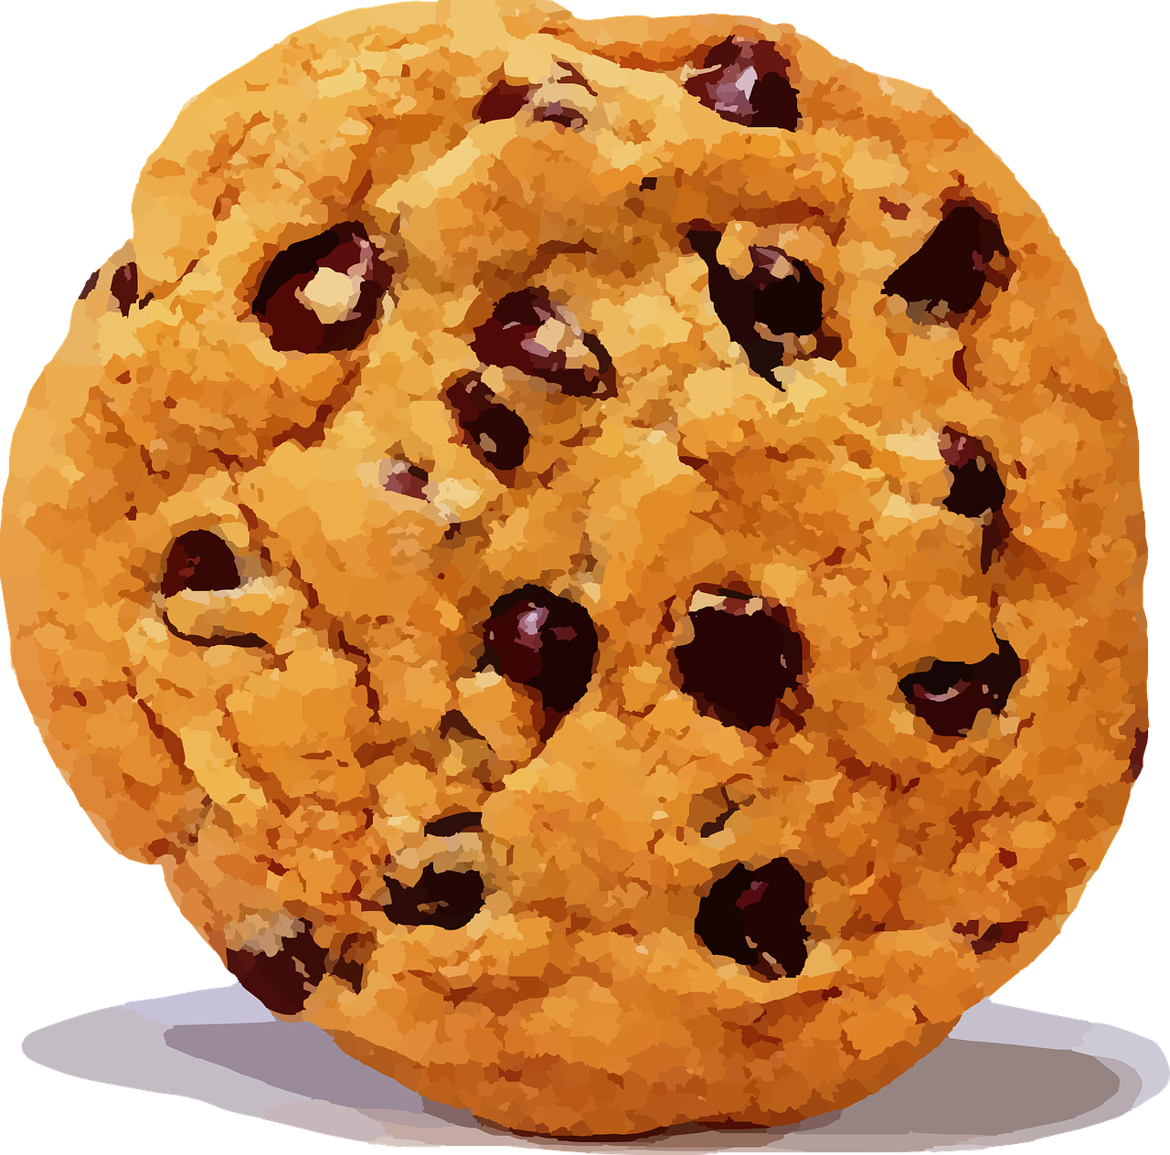
Matches and winners
TASTY GOOD CALORIC
Match 1
tastier
Yummy!!!
VS
better
more caloric
THAN

Slide 12
Matches and winners
HEALTHY SWEET FAT/GREASY
Match 2
healthier
VS
sweeter
fatter =
greasier
THAN

Slide 13
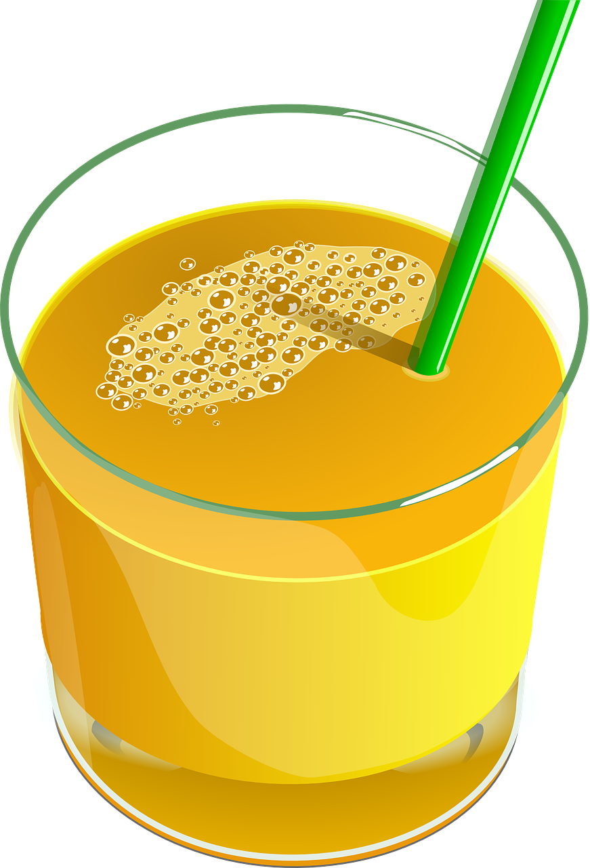
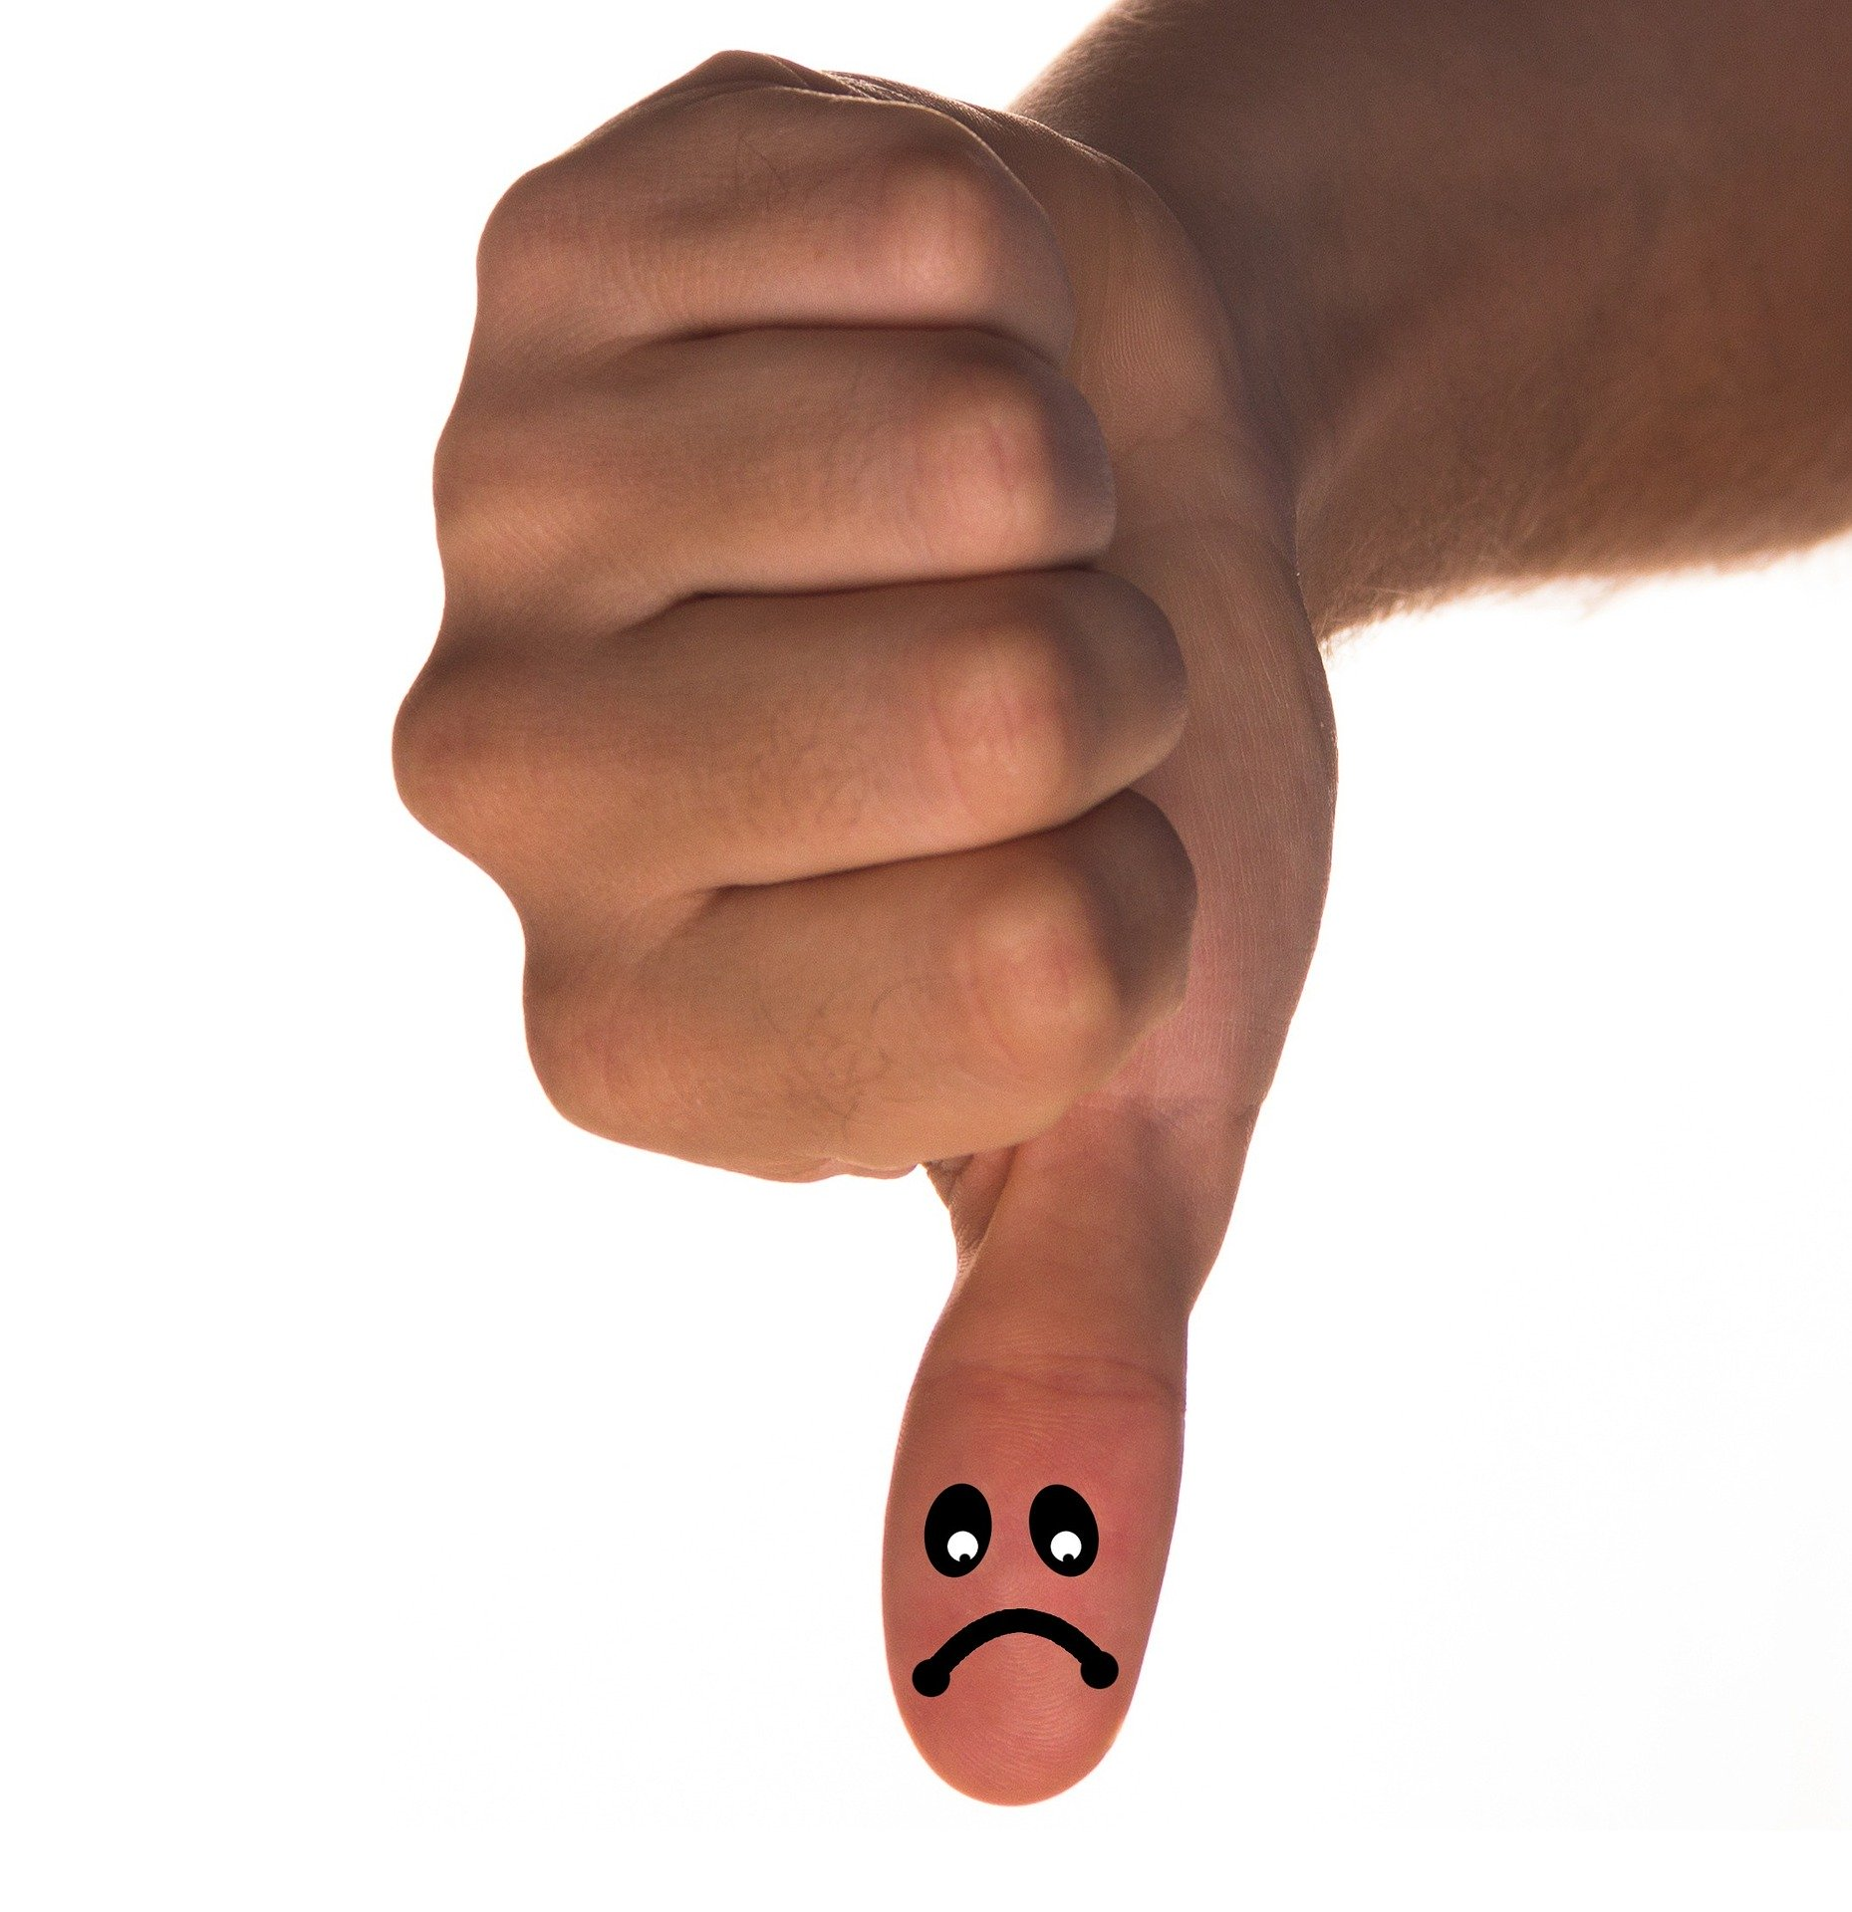
Matches and winners
CALORIC BAD LIGHT
more caloric
Match 3
VS
worse
lighter
THAN

Slide 14
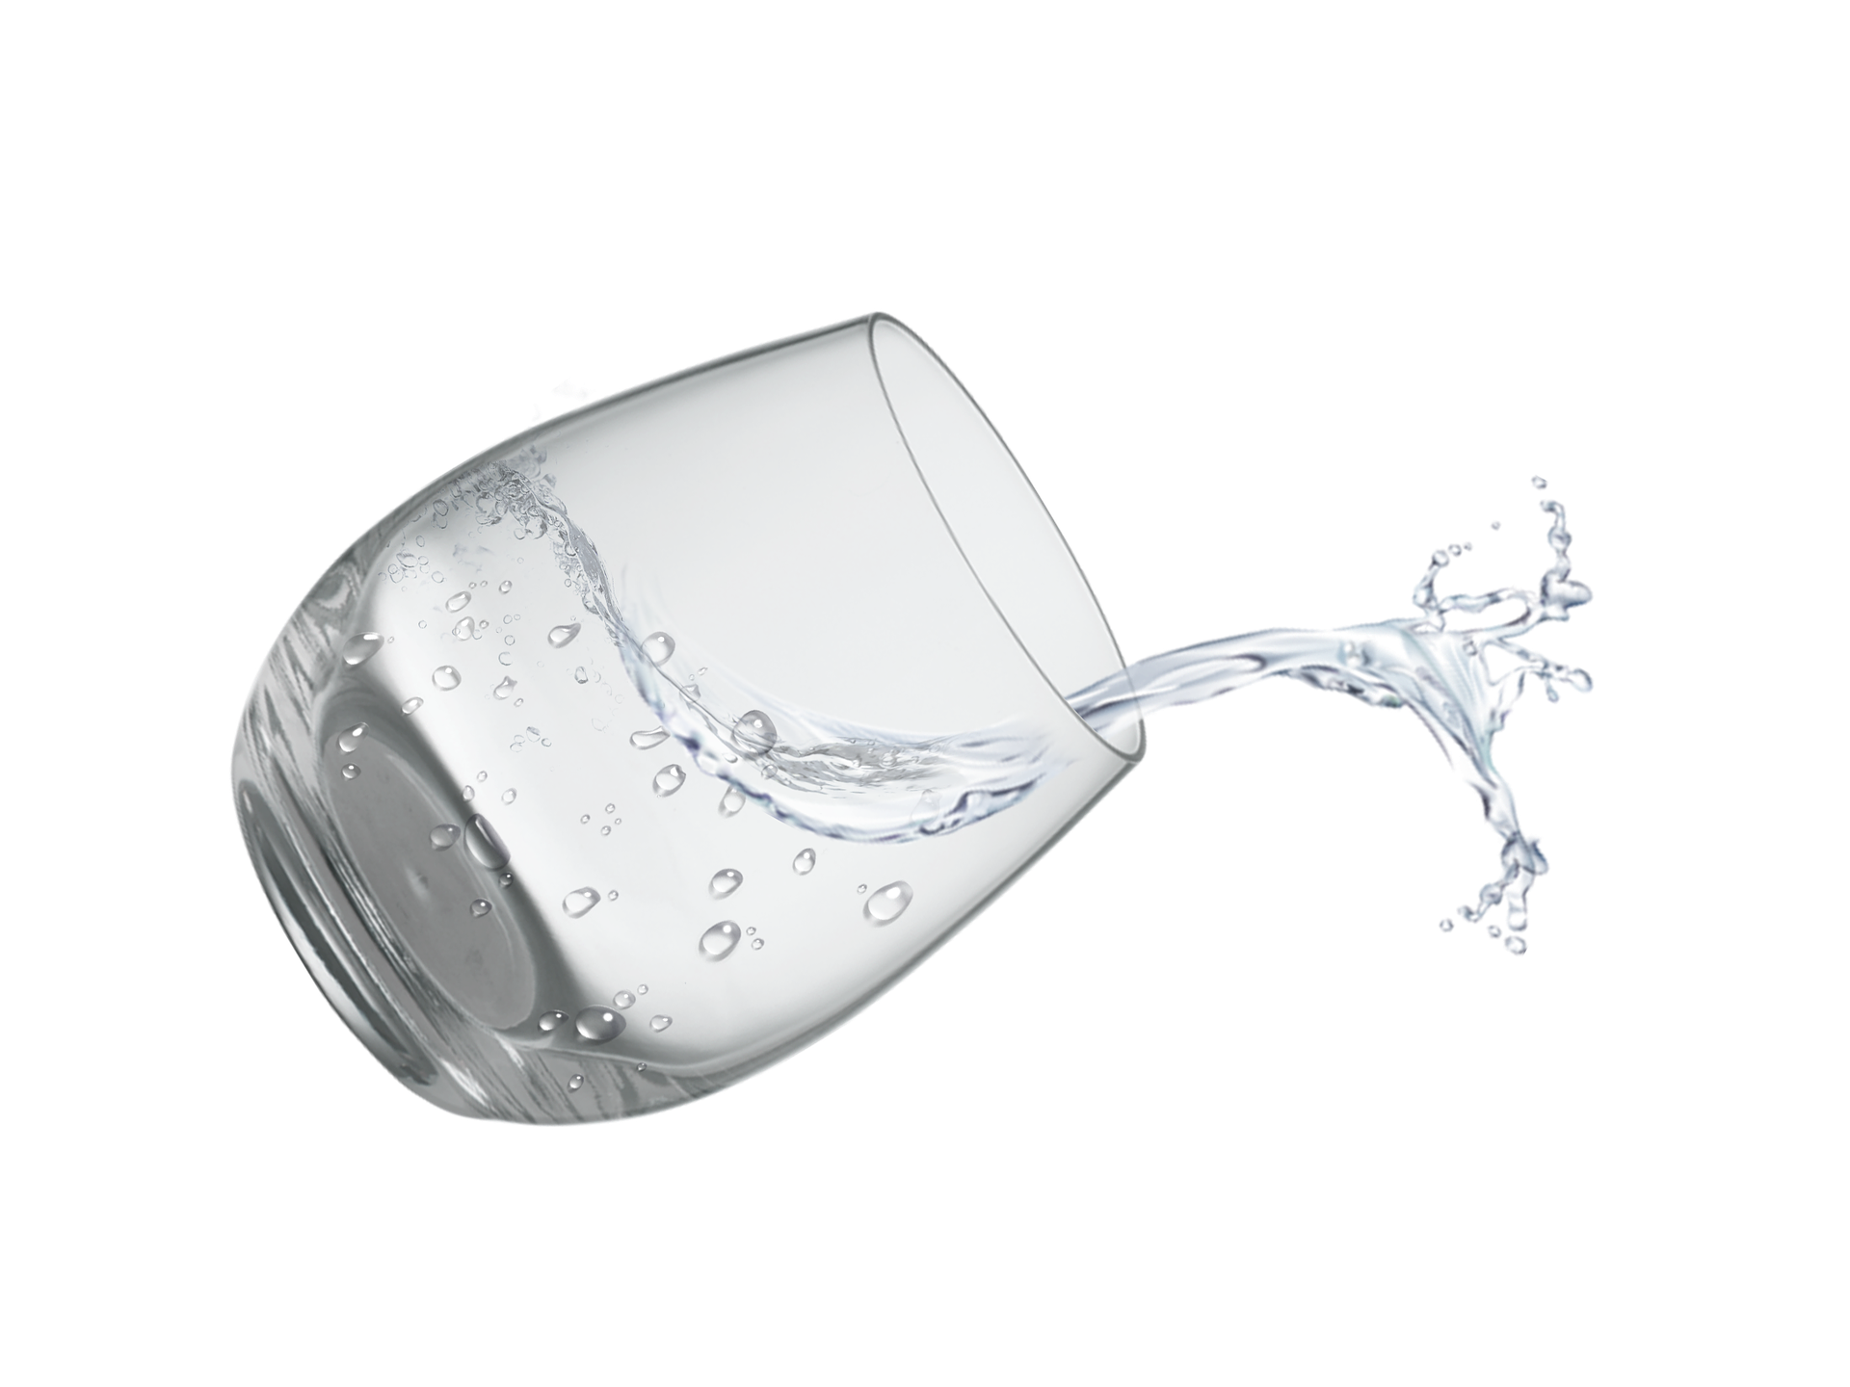
Matches and winners
GOOD HEALTHY
better
Match 4
VS
healthier
THAN

Slide 15
Fruit are more colourful and better than crisps.
Fruit are tastier and sweeter than sweets.
Crisps are fatter and worse than fruit.
Comparing
more colourful
better
tastier
sweeter
fatter
worse
bad
tasty
colourful
good
sweet
fat

Slide 16
Let’s observe
Short adjectives
Long adjectives
light  lighter
delicious  more delicious
present  more present
big bigger
tasty tastier
Exceptions 
good  better
bad  worse

Slide 17
Let’s recap
Pour comparer deux choses (+…que):
Regarde si l’adjectif est court, long ou irrégulier.
ADJECTIF
Court Long Irrégulier
+ ER MORE + ADJ Par 
Y ier
BIG: 2 consonnes

Slide 18
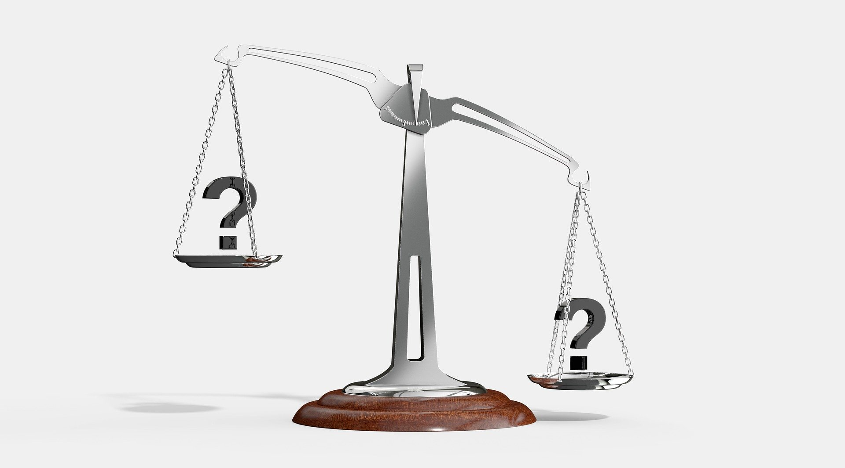
Let’s practice
light
A chocolate bar
vs
an apple
delicious
bad
caloric

Slide 19
Let’s practice
sugary
sweets
vs
a pear
good
bad

Slide 20
Let’s practice
light
greasy
An orange
vs
crisps
bad
caloric

Slide 21
“You mustn’t eat any sweets and you mustn’t drink any soda all day.
You can eat some biscuits for snack but brush your teeth afterwards!
You must drink some water instead of soda.
Don’t eat any crisps or any chocolate bars, choose some fruit instead!”
A visit to the dentist’s
n’t
any
n’t
any
some
some
sweets / soda / crisps
chocolate bars
water biscuits fruit
n’t
any
any
some

Slide 22
Let’s recap: parler de quantités indéfinies
Pour dire que l’on doit ou peut en prendre:
Some + un nom dans une phrase affirmative
You must / can eat some vegetables.
Pour dire que l’on ne doit pas en prendre.
Any + un nom dans une phrase négative
You can’t / mustn’t drink any soda all day.

Slide 23
Let’s practise!
Fill in the text using: « some », « any » or « no ».
Your cat is too fat! From now on, don’t give him chocolate ! And he must do exercise. It’s really important!
You mustn’t give him sugar and he mustn’t drink milk all day.
You can give him water!
any
some
any
any
some

Slide 24
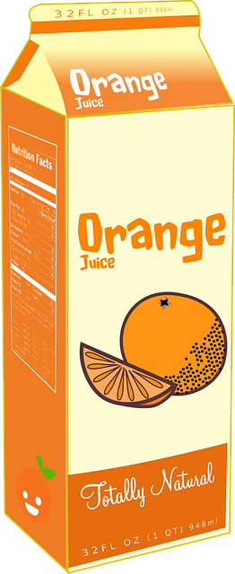
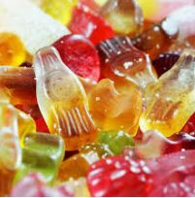
Let’s go shopping! Tell your Mum what you’ve got and what you haven’t got.

Slide 25
Dans ce cours tu as appris :
À parler à parler du goûter
À faire des comparaisons
À exprimer des quantités indéfinies
À manger plus équilibré!

Slide 26
“Eat to live but do not live to eat!”
So, be reasonable!
So now, is comparing easier?
I hope your snacks will be healthier!
Life will be easier and funnier when we go back to school!
But, before that, you’ll be more protected and safer at home!

Slide 27
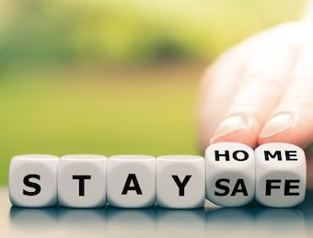
Thank you very much, see you soon!

