Slide 1
KEEP CALM AND SPEAK ENGLISH

Slide 2
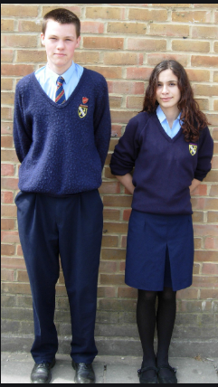
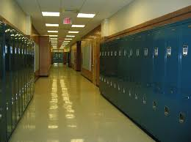
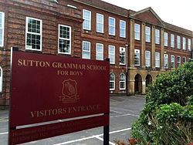
School in England
Cette photo par Auteur inconnu est soumise à la licence CC BY-SA
Notes:
Hi, my name's Natalie. I'm a teacher in collège Beau Soleil in Chelles and today's lesson is about school in England. But remember no school these days! You must stay at home it's very important for you for your friends and for your family

Slide 3
Dans ce cours tu vas apprendre à mieux connaître:
L’emploi du temps d’un élève britannique
Les différentes matières
Les spécificités britanniques
Et tu vas apprendre à parler
de ton emploi du temps
Notes:
Partie en français pour annoncer les objectifs

Slide 4
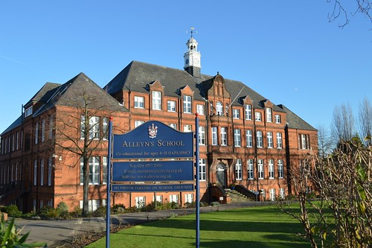
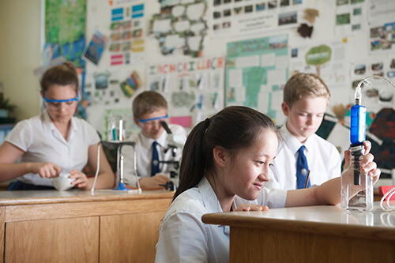
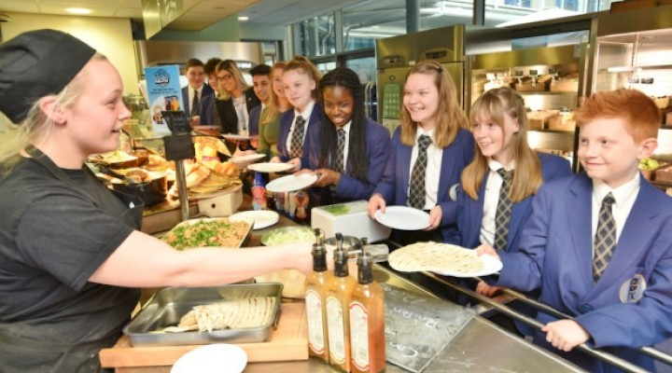

Slide 5
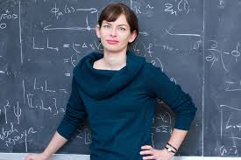
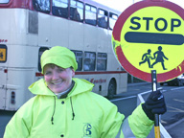
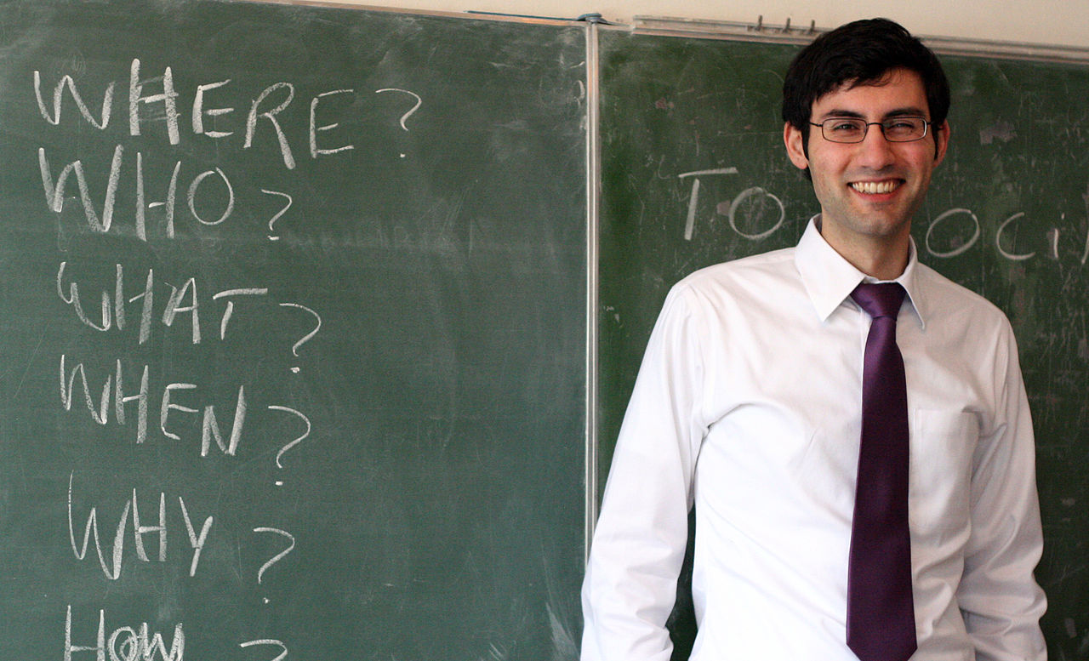
The people in a school
The headmaster
The Maths teacher
The lollypop lady
The nurse
The English teacher

Slide 6
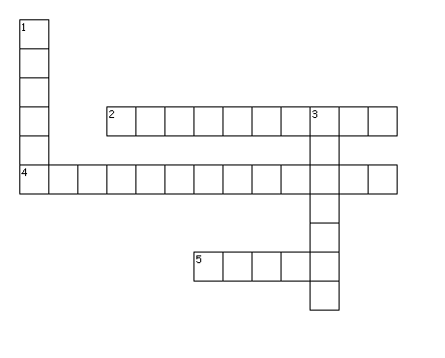
Across
S
C
H
O
O
2.
4.
HEADMASTER
E
C
H
R
5.
LOLLIPOP LADY
Down
1.
NURSE
3.

Slide 7
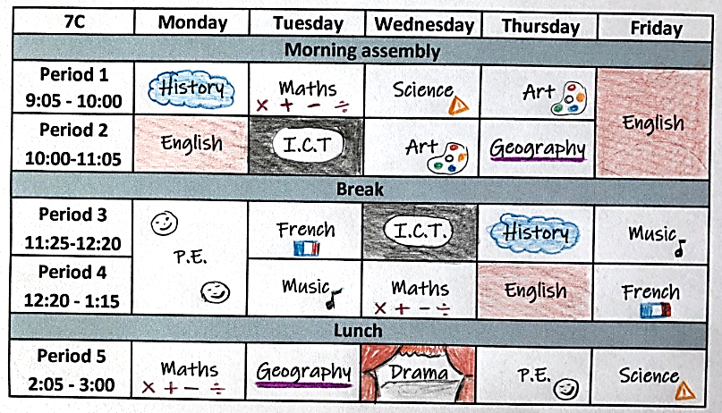
Year 7C
My timetable
Physical Education
Information
Communication
Technology
Notes:
Projection de l'emploi du temps "seul" So you know this document....but what is it in English? click : it's my timetable! Now what form are you in? in sixième? in 5ème? And what about this time table? a sixieme's timetable? a cibquieme's timetable? wheres the class? click pour faire apparaitre la flèche : 7C strange isn't it??? click year 7C is the class! When you are in year 7 in England, you are in 6ème in France...So when you are in 5ème in France...in England you are... yes you're right in year 8! Very good So year 7 is 6ème in France and year 8 is 5ème in France. School is a little different in England . Let's discover the subjects now....They have got...on...at... faire apparaitre les matières à chaque fois. Avec pause what about you? when have you got History... Puis Focus sur les horaires: what time do they start? Yes they start at 9:05 it's ok :-) Now what time do they finish...They finish ....at 3! yes at three click smiley! They're lucky ! Oh wait a minute...they finish at 3 on Mondays...on Tuesdays...and click they finish at 3 on Wednesdays too! Un recap en Français à ce stade?

Slide 8
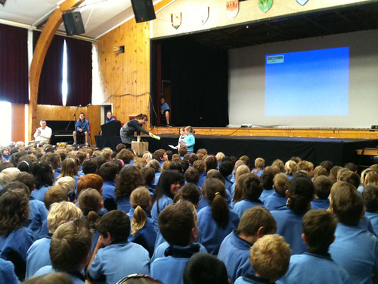
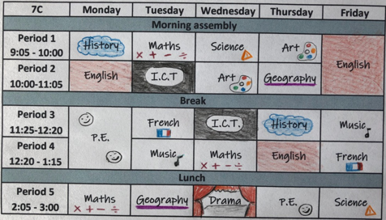
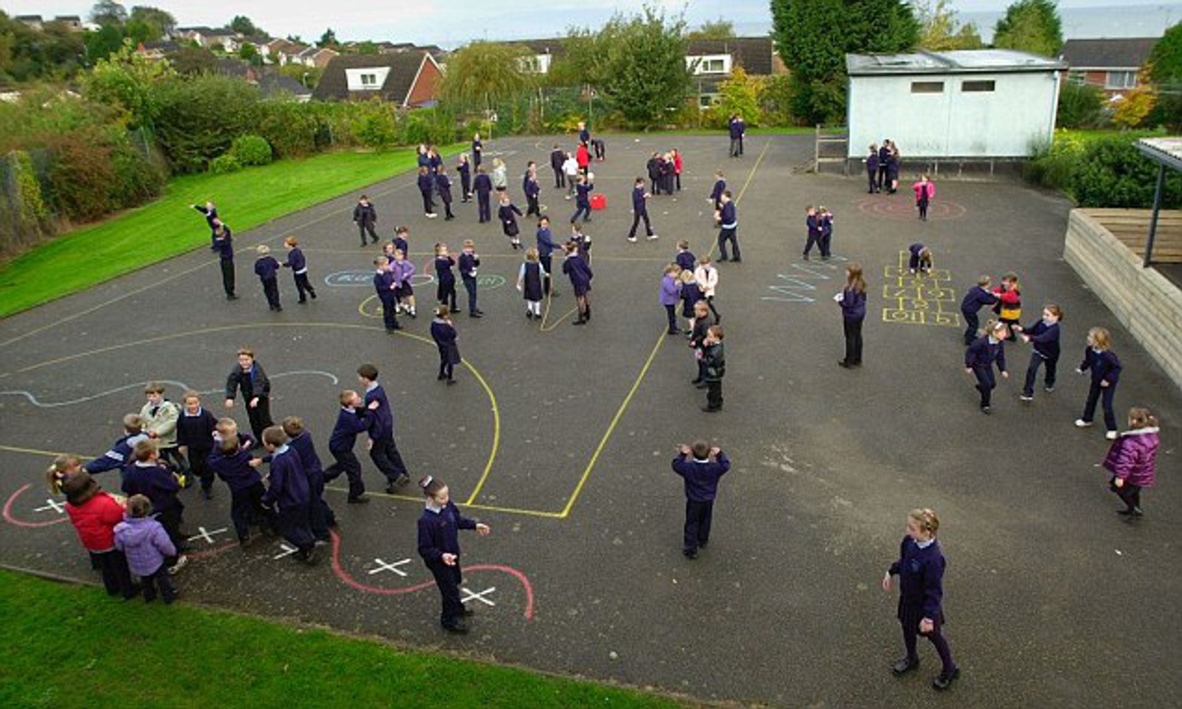
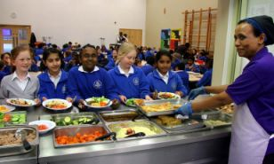
Moments of the day

Slide 9
Let’s recap our school subjects now!

Slide 10
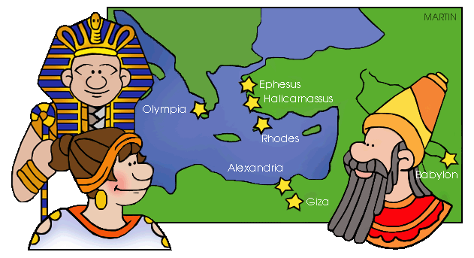
History
English
French
P.E.
Drama
Geography
Science
Music
I.C.T.
Art

Slide 11
School in England quiz!
QUESTION 1
If I am in cinquième in France, in England I am in…
year 5
year 6
year 7
year 8

Slide 12
School in England quiz!
QUESTION 2
What is the first moment of the day in an English school?
Assembly
Break
Lunch
I.C.T.
Notes:
Projection de l'emploi du temps "seul" So you know this document....but what is it in English? click : it's my timetable! Now what form are you in? in sixième? in 5ème? And what about this time table? a sixieme's timetable? a cibquieme's timetable? wheres the class? click pour faire apparaitre la flèche : 7C strange isn't it??? click year 7C is the class! When you are in year 7 in England, you are in 6ème in France...So when you are in 5ème in France...in England you are... yes you're right in year 8! Very good So year 7 is 6ème in France and year 8 is 5ème in France. School is a little different in England . Let's discover the subjects now....They have got...on...at... faire apparaitre les matières à chaque fois. Avec pause what about you? when have you got History... Puis Focus sur les horaires: what time do they start? Yes they start at 9:05 it's ok :-) Now what time do they finish...They finish ....at 3! yes at three click smiley! They're lucky ! Oh wiat a minute...they finsih at 3 on Mondays...on Tuesdays...and click they finish at 3 on Wednesdays too! Un recap en Français à ce stade?

Slide 13
School in England quiz!
QUESTION 3
What day is different for English and French pupils?
Monday
Wednesday
Thursday
Tuesday

Slide 14
Do you know your school subjects now?
You can wear a mask or a costume in …
DRAMA
SCIENCE
You do experiments, study animals and plants in…
P.E.
You practice sport in …
ART
You can draw and paint in …
I.C.T.
You work on computers in …
You study dates monuments and cities in…
HISTORY and GEOGRAPHY
You can sing in …
MUSIC

Slide 15
Speak about a timetable
I’m in year7C, year 8D…
We’ve got…. I’ve got….they’ve got…
Science, P.E., Art, I.C.T. ….
Telling the time
Hours : 0 - 12
Minutes : 0 - 55
on Mondays, on Tuesdays…
14:15
at 2:15 , at 12:20 !
1:45 10:20 11:05 9:45 12:30
9:05 10:15 11:20 1:50

Slide 16
Let’s practise!
7A
Break
Lunch
Assembly
I’m in year 7A.
On Mondays, I’ve got Assembly at 9 am.
I’ve got Maths at 9:15 and Science at 10:15.
I’ve got Geography at 11:30, after break.
And, I’ve got PE in the afternoon, at 2pm!

Slide 17
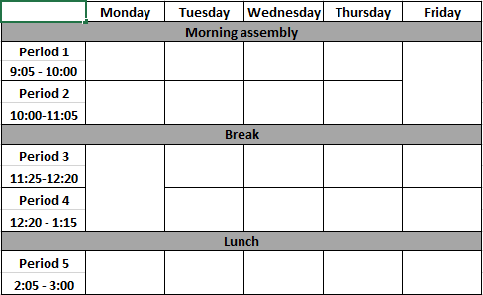
Now check your comprehension
Year 8A
What year is Ashley in?
Spot and place the subjects in the timetable.
Recap
En quelle classe serait Ashley en France?
Quel jour préfère-t-elle et pourquoi?

Slide 18
Dans ce cours tu as :
découvert les lieux et les personnes dans une école britannique.
découvert les spécificités d’un emploi du temps anglais.
appris le vocabulaire des matières scolaires.
appris à parler de ton emploi du temps.

Slide 19
Thank you very much, see you soon!

