Slide 1
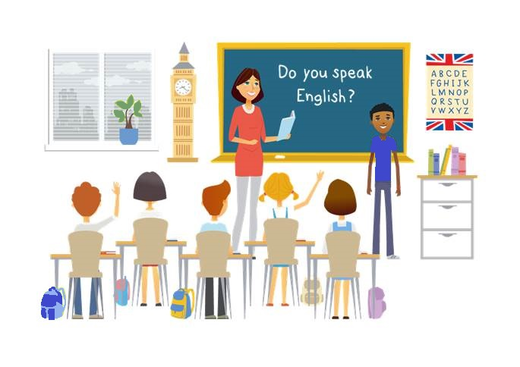
CLIL
CM2 - Year 6
Music
in English

Slide 2
Hello song

Slide 3
CLIL
CM2 - Year 6
Music
in English
by Mathilde and Sandrine

Slide 4
Weather and feelings
Let’s mime !

Slide 5
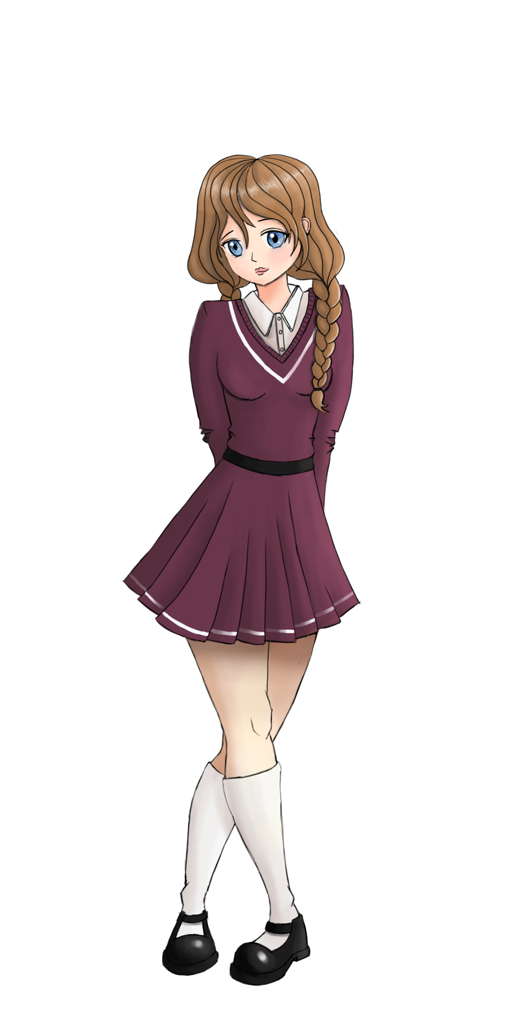
Special day!

Slide 6
Music in English
Matériel et instructions
Musique
Styles musicaux
Récapitulons
Défi

Slide 7
You need…
your hands
your feet
your voice

Slide 8
Orders
clap
stomp
stomp
sing
clap
tap
tap
sing

Slide 9
Pulsation
slow
fast

Slide 10
Tempo
largo / lento
adagio / moderato
allegreto / vivace
presto / prestissimo
slow
medium
medium up
up
Classical
Jazz
pulsation

Slide 11
Let’s listen and play!
4
2
1
3
5
4
1
2
3
slow
fast
slow
fast

Slide 12
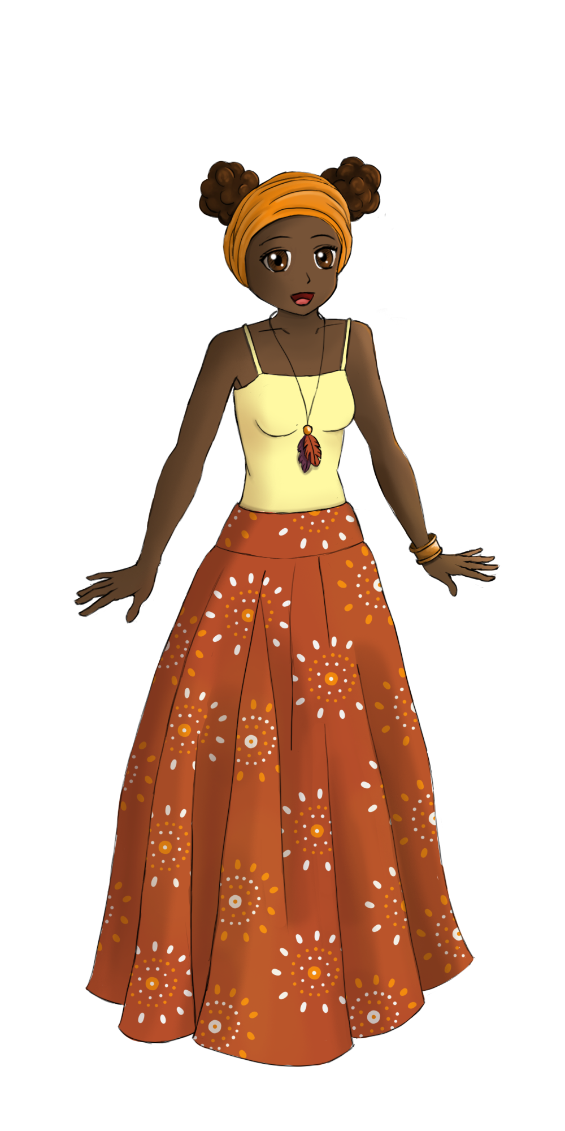
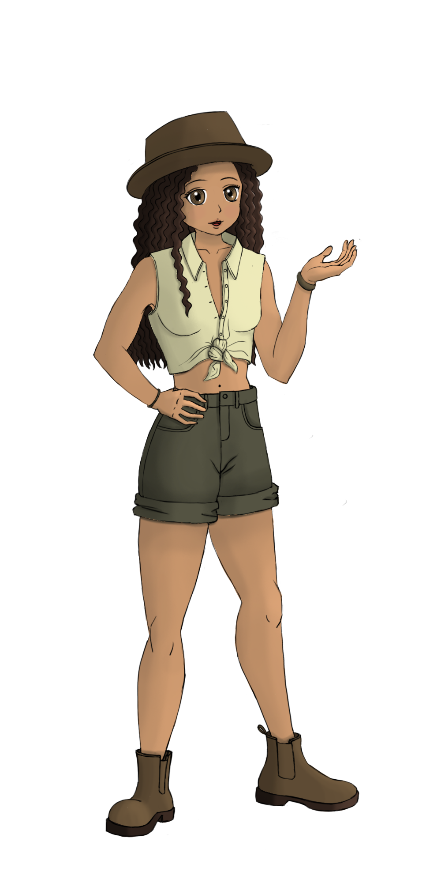
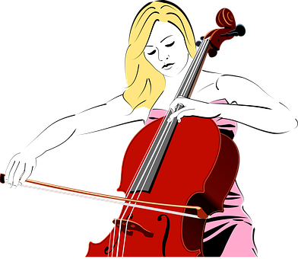
Tone

Slide 13
Height
high pitch

Slide 14
Height
low pitch
or deep

Slide 15
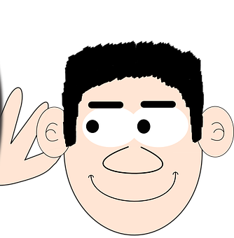
Intensity
quiet

Slide 16
Intensity
loud

Slide 17
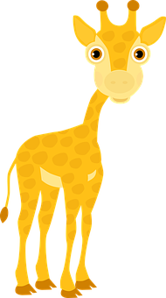
Length
long
I am mute...
short

Slide 18
Let’s play!
short
long
loud
high pitch
low pitch
or deep
quiet

Slide 19
Musical styles
STOP !!!
Rock
Zouk
Country
Classical
Pop
Bossa
Gospel
Indian music
Metal
Electro
Funk
Raï
Punk
Jazz
Blues
Afican music
Reggae
R’n’B
Slam
Disco
Hard Rock
Flamenco
Rap

Slide 20
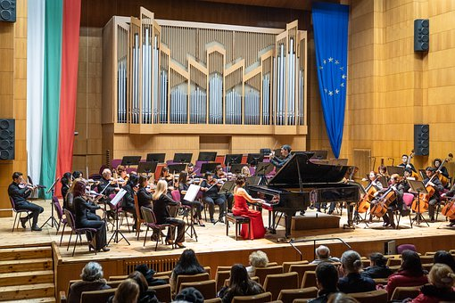
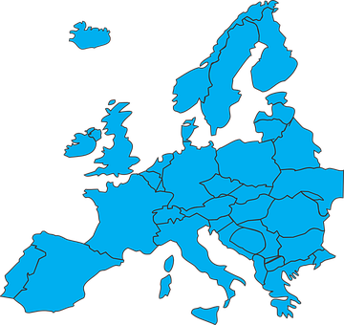
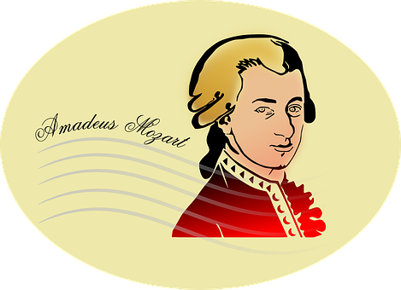
Classical

Slide 21
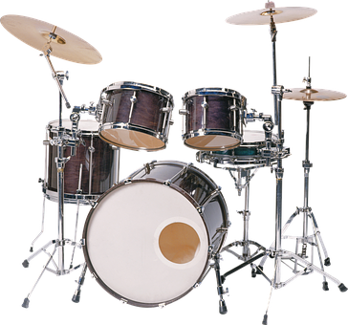
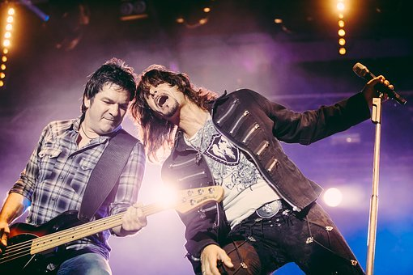
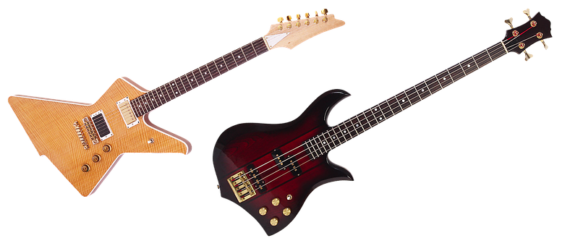
Rock and roll

Slide 22
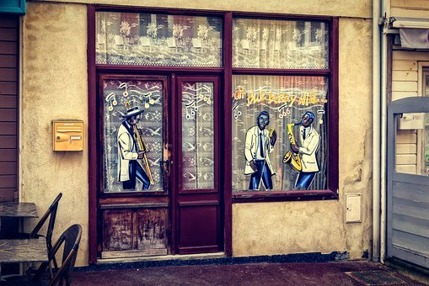
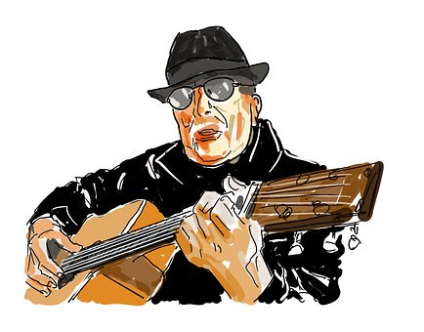
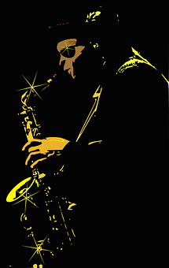
Blues

Slide 23
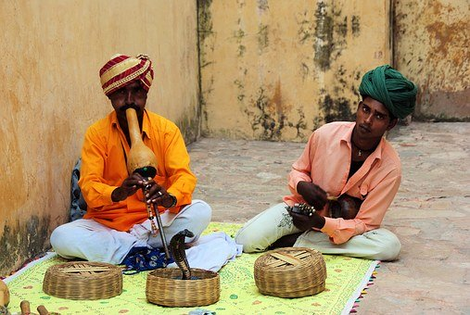
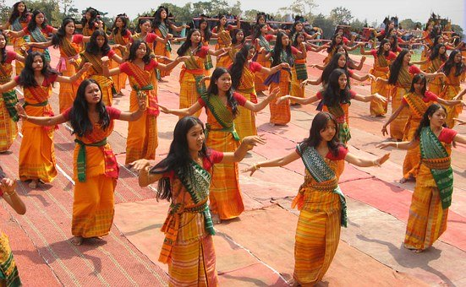
Indian music

Slide 24
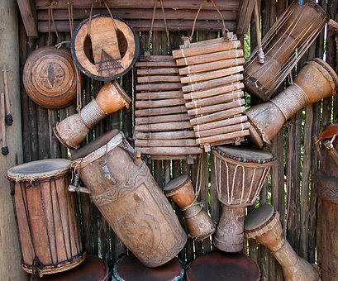
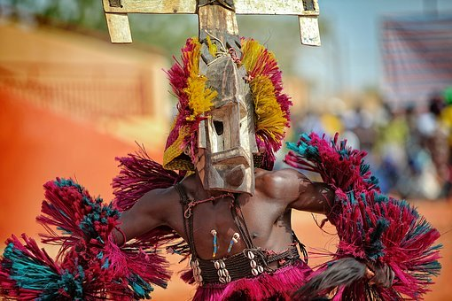
African music

Slide 25
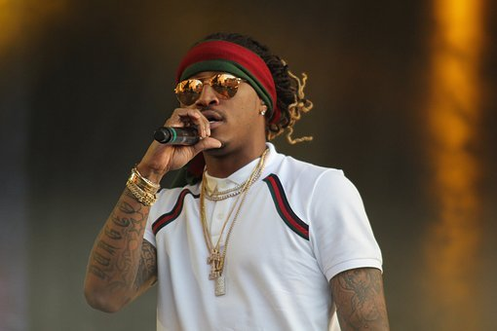
Rap

Slide 26
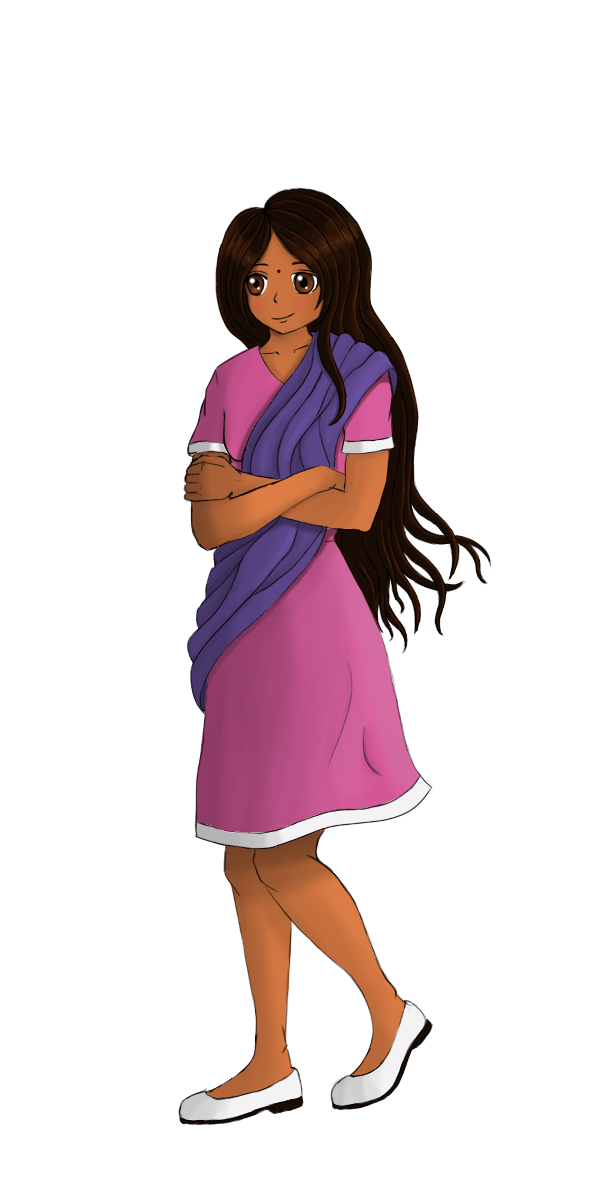
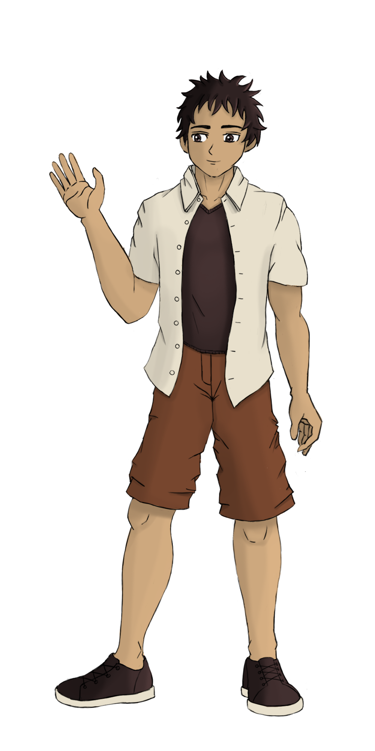
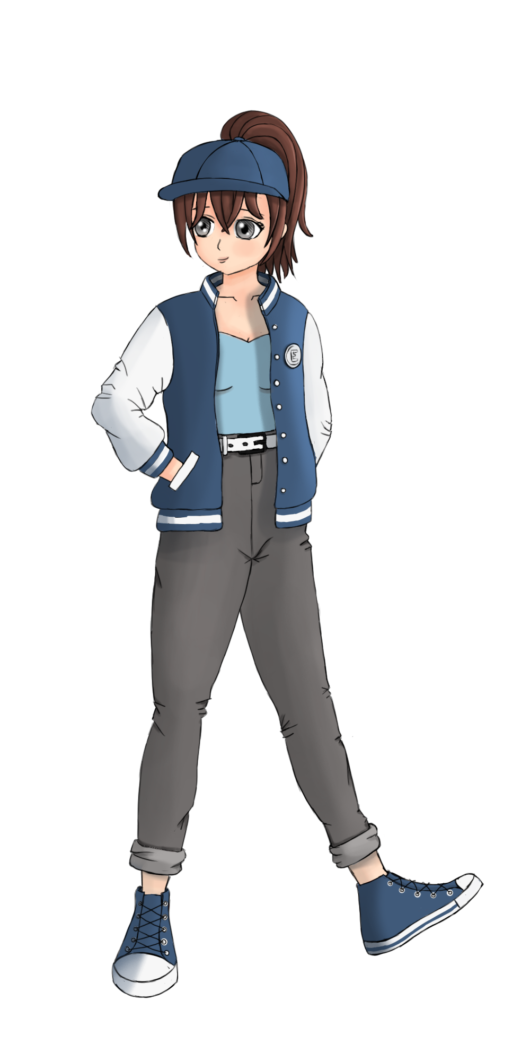
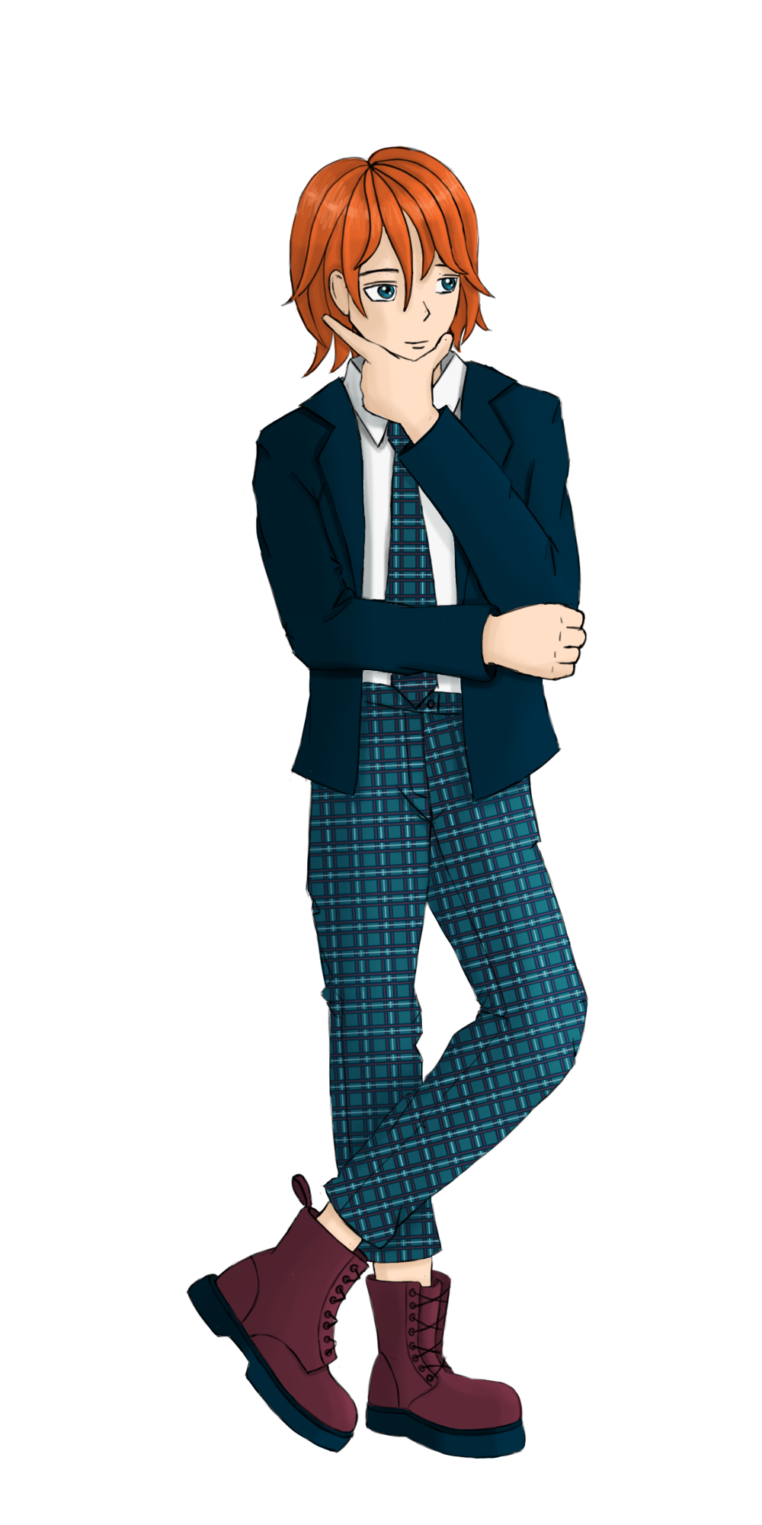
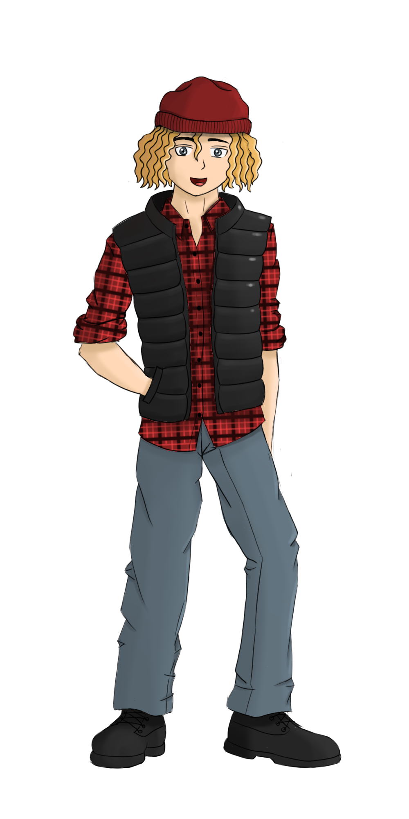
Let’s play!
Mansi
Immanuel
Emma
Oliver
Jacky
Jenna
Jamie

Slide 27
Let’s recap!
Tempo/Height/Length/Intensity
Musical styles
Happy birthday Sam!

Slide 28
Challenge!
Play with your voice
Choose a song
Choose a musical style

Slide 29
Music in English
Timbre, intensité, hauteur, longueur
Styles musicaux
Joyeux anniversaire Sam!
Défi

Slide 30
Goodbye song

Slide 31
CLIL
CM2 - Year 6
Goodbye
from Mathilde and Sandrine

Slide 32
Ressources and contributions
Pictures
https://stock.adobe.com/ https://pixabay.com/fr/
https://www.flaticon.com/ https://www.clipart.com/fr/index
Personal photos
Characters
Sam Lumni and her friends drawn by Manon
Audio recordings
Voices : Tess, Mansi, Lukas, Immanuel, Emily, Eddie, Sydny, Jacklyn, Richard, Dain, Erin
Music, melody and lyrics by Stephane and François
Conception
Anna, Anne-Valérie, Mathilde, Sabrina et Sandrine

