Slide 1
CLIL
CM2 - Year 6
Physical Education
in English

Slide 2
Hello song

Slide 3
CLIL
CM2 - Year 6
Physical Education
in English
by Mathilde and Sandrine

Slide 4
How are you today?
Relax… let’s travel to India.
I’m stressed!!!

Slide 5
Today’s lesson
Matériel et instructions
Découvrons l’Inde
Yoga
Récapitulons
Défi

Slide 6
Let’s revise the continents!
Europe
Asia
1
3
7
North America
Africa
4
2
6
Oceania
South America
5
Antarctica

Slide 7
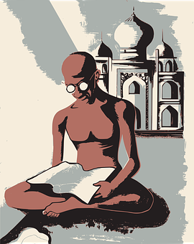
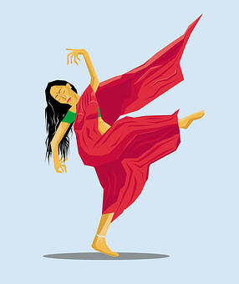
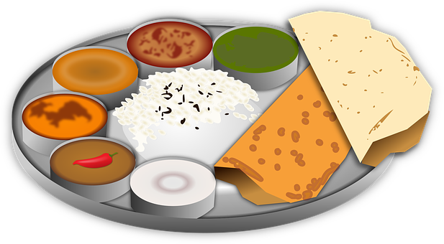
Let’s discover India!

Slide 8
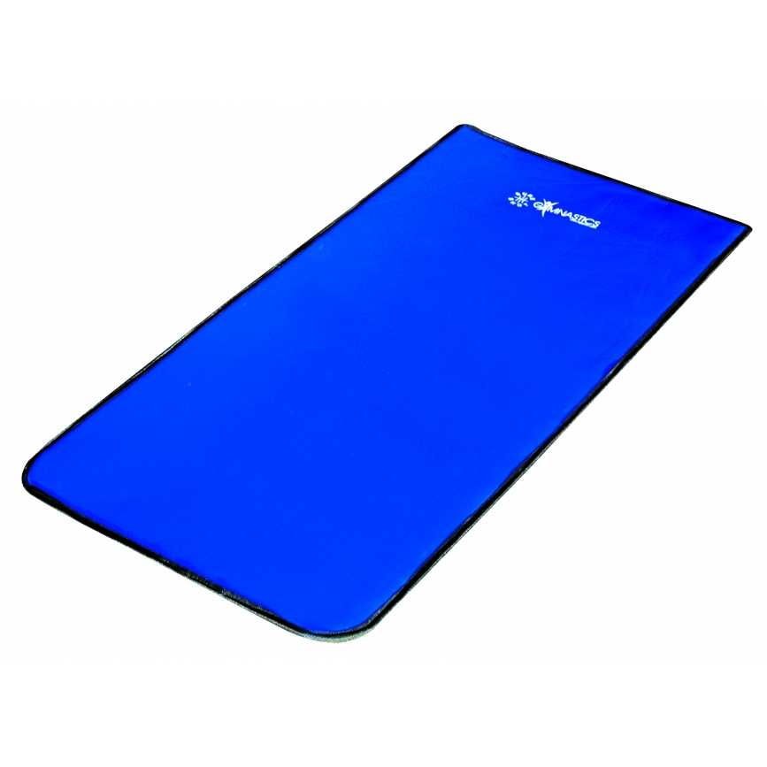
You need….
comfortable clothes
a gym mat
a chair

Slide 9
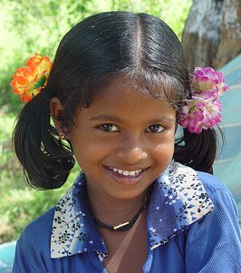
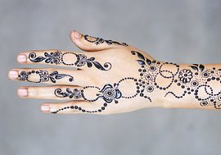
Let’s revise!
?
head
thumb
shoulder
?
chest
?
finger
stomach
?
?
?
arm
?
?
?
?
leg
?
?
eye
knee
toe
hand
?
foot

Slide 10
Orders
look
put your hands down
bend
listen
stretch
put your hands up
breathe
stand up
close your eyes
concentrate

Slide 11
Orders
put your hands down
sit down
stretch
stand up
breathe
look
listen
bend
put your hands up
close your eyes

Slide 12
Recommandations
Be calm
Listen to your body
Hold the position for 3 breaths
It’s not a competition

Slide 13
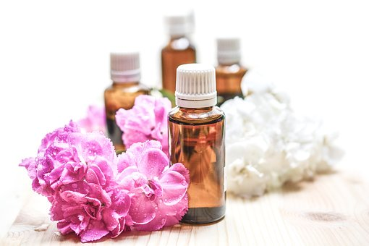
Let’s reduce your stress!
rub
auto massage

Slide 14
Let’s get ready!
stressed
excited
focused
concentrated
calm
How do you feel ?

Slide 15
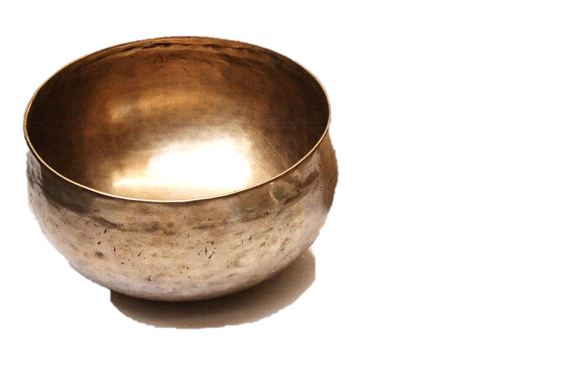
Let’s get ready!
MMMM
OOOOO
AAAAA

Slide 16
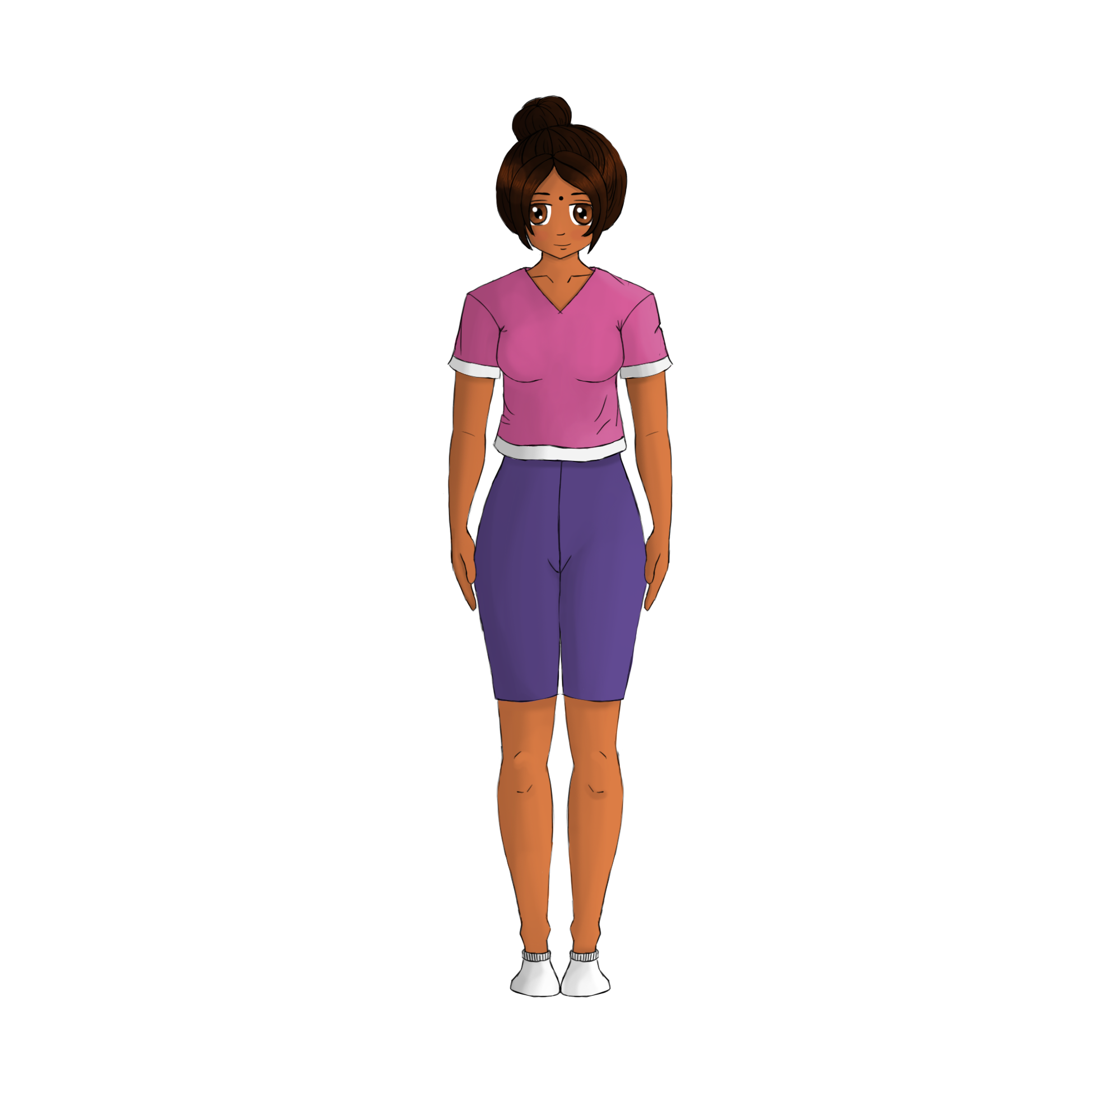
The moutain pose
How do you feel?
stressed
excited
focused
concentrated
calm

Slide 17
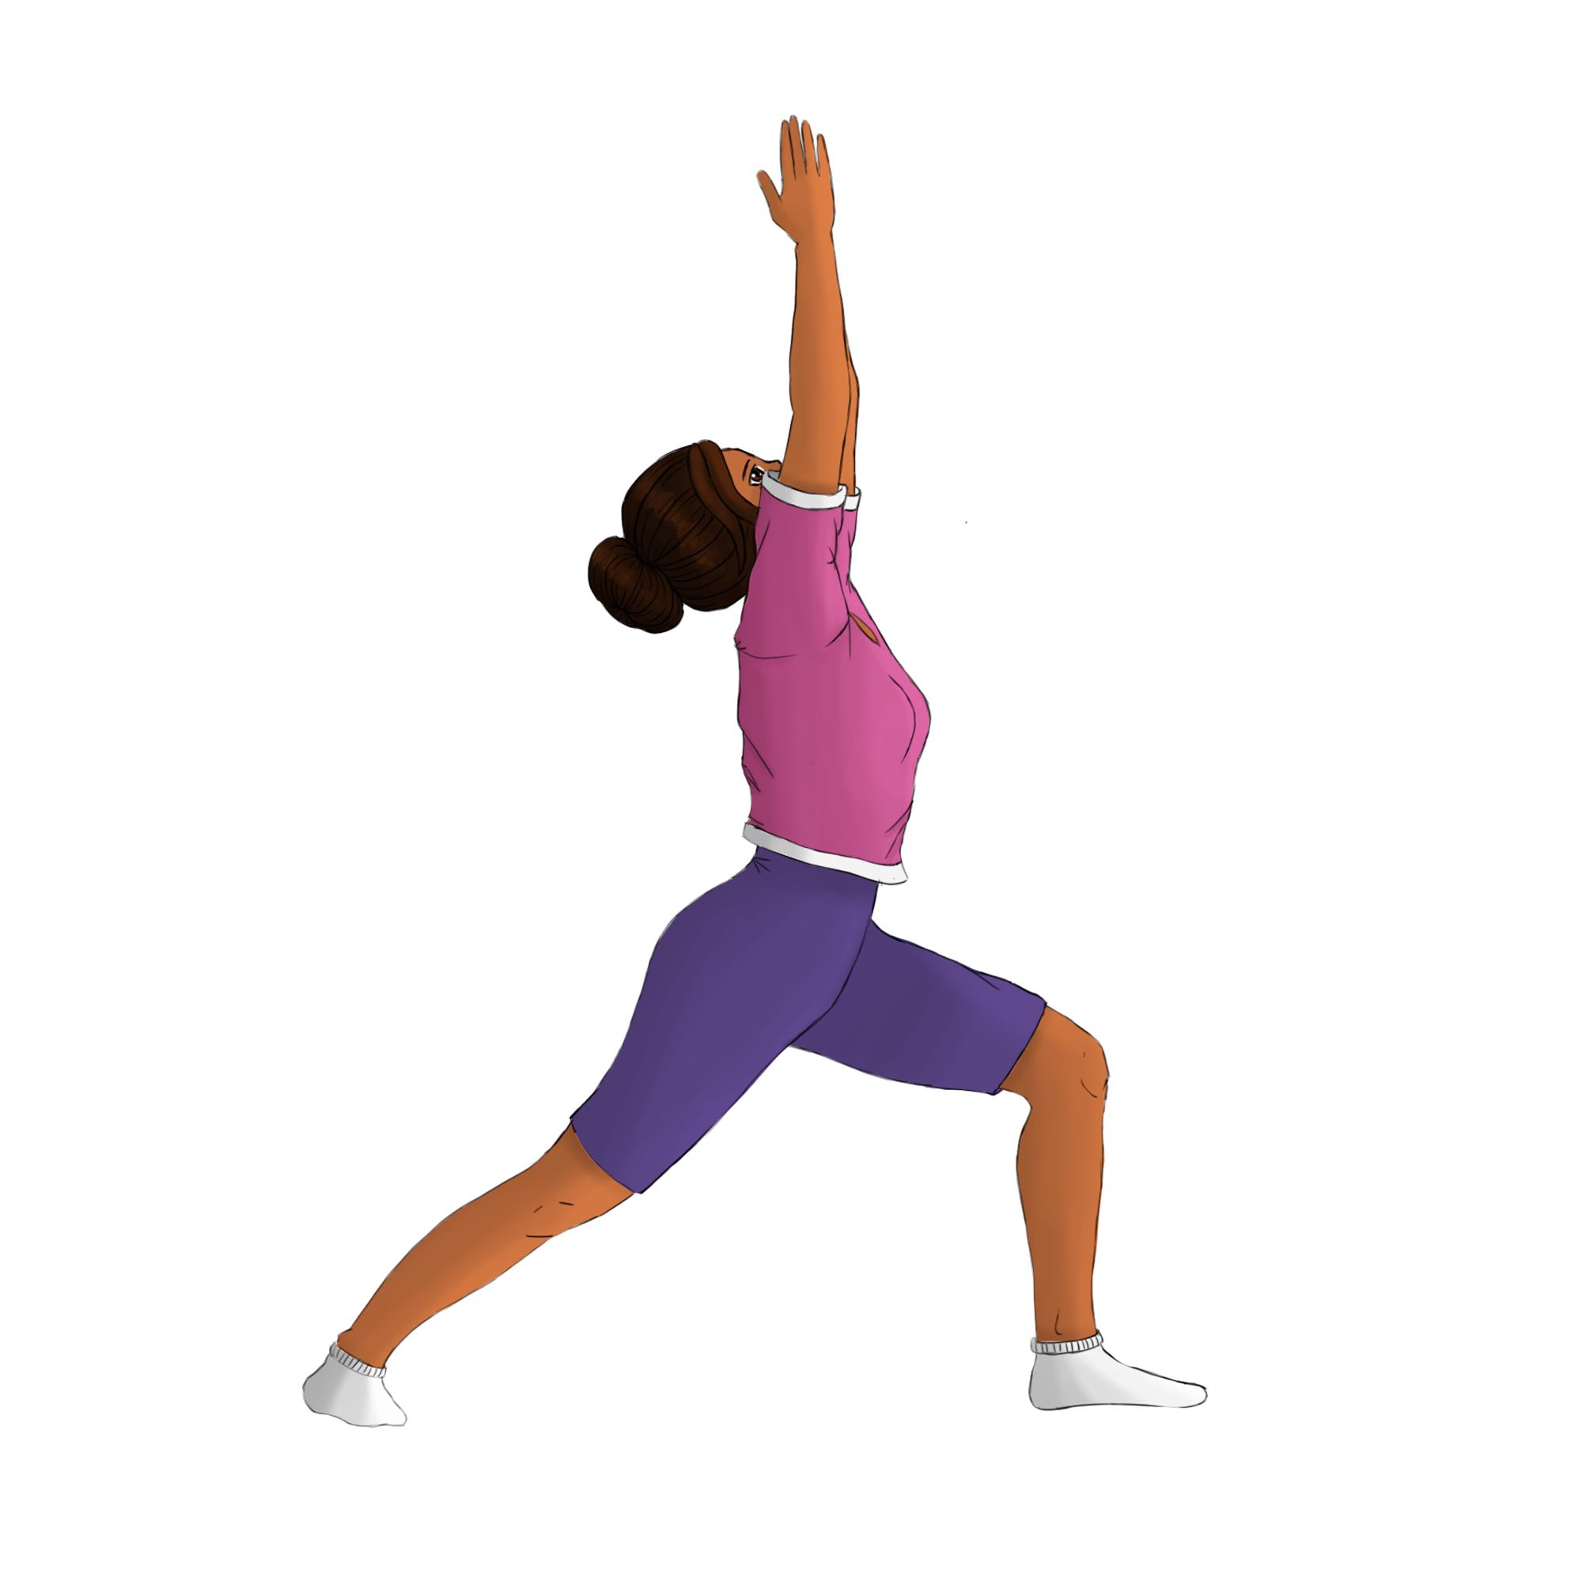
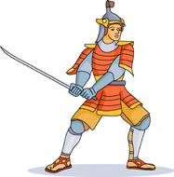
The warrior pose
How do you feel?
stressed
excited
focused
concentrated
calm

Slide 18
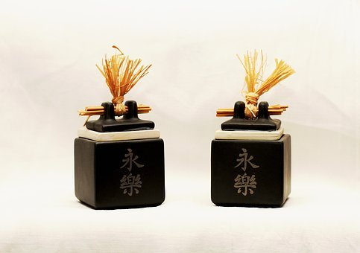
The chair pose
How do you feel?
stressed
excited
focused
concentrated
calm

Slide 19
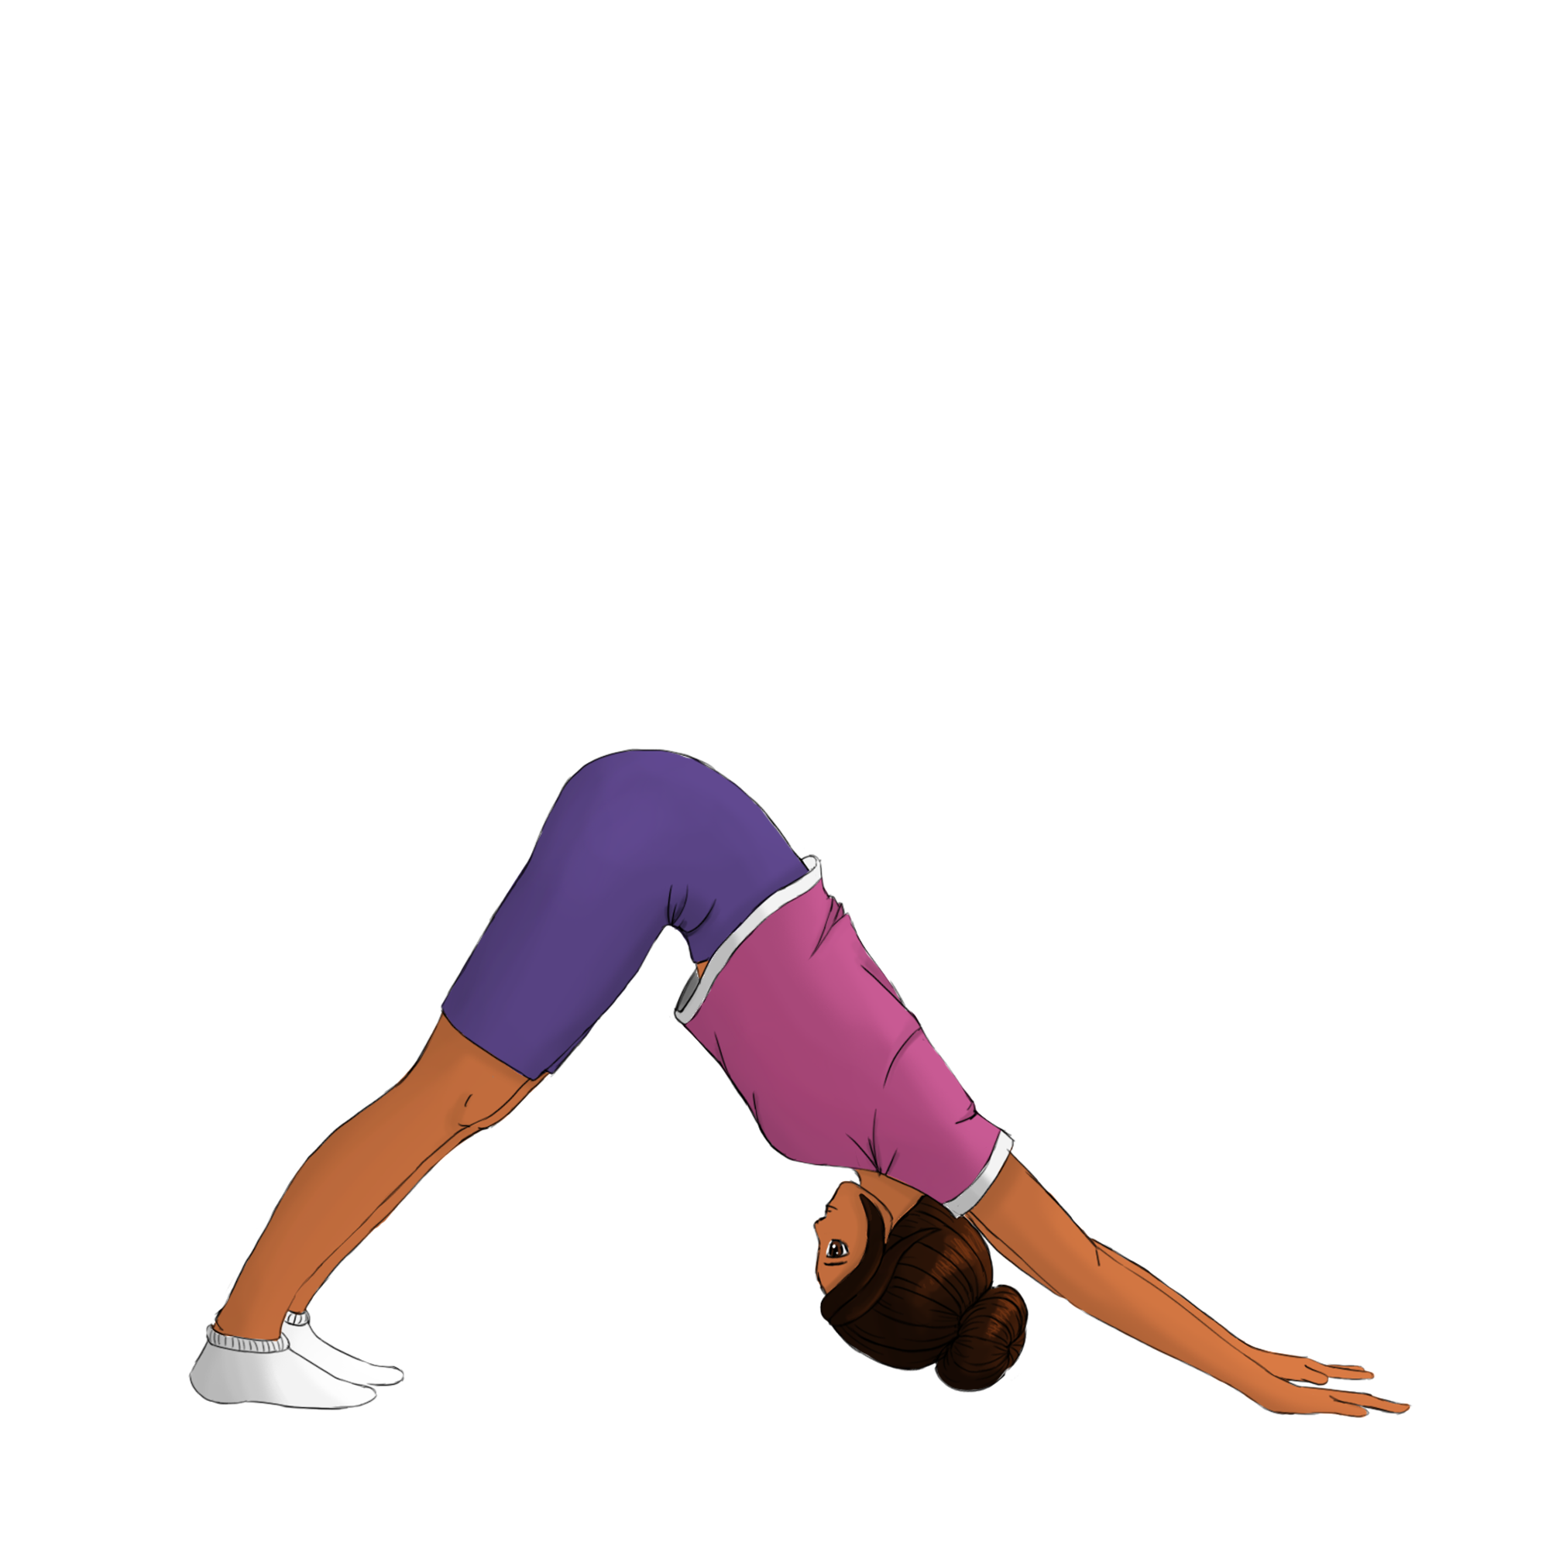
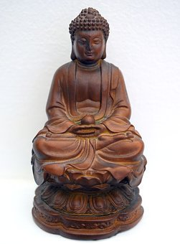
The downward dog pose
How do you feel?
stressed
excited
focused
concentrated
calm

Slide 20
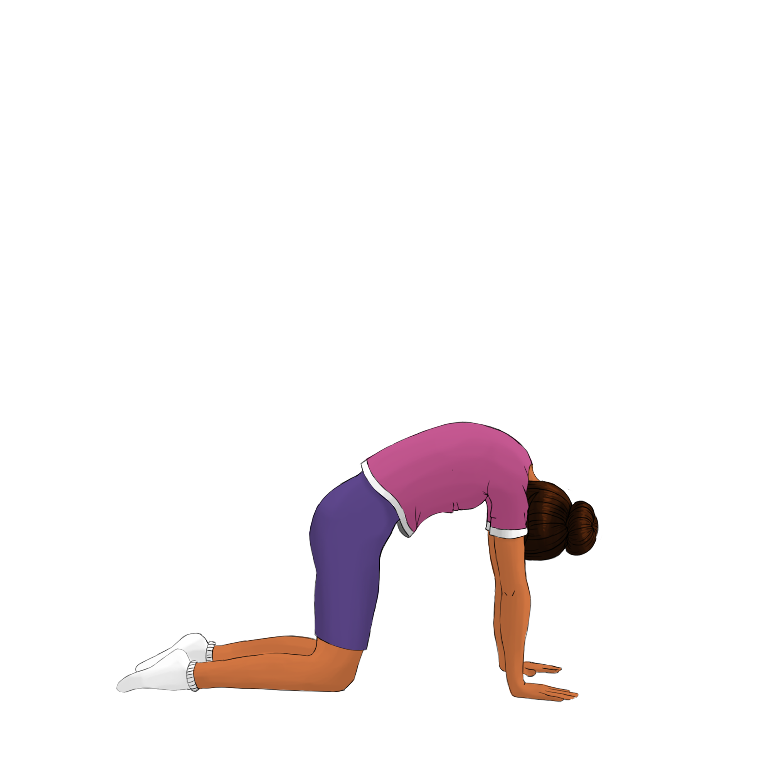
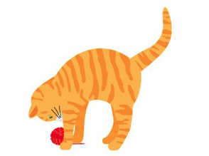
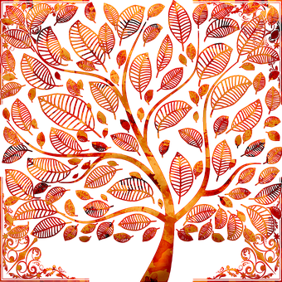
The cat pose
How do you feel?
stressed
excited
focused
concentrated
calm

Slide 21
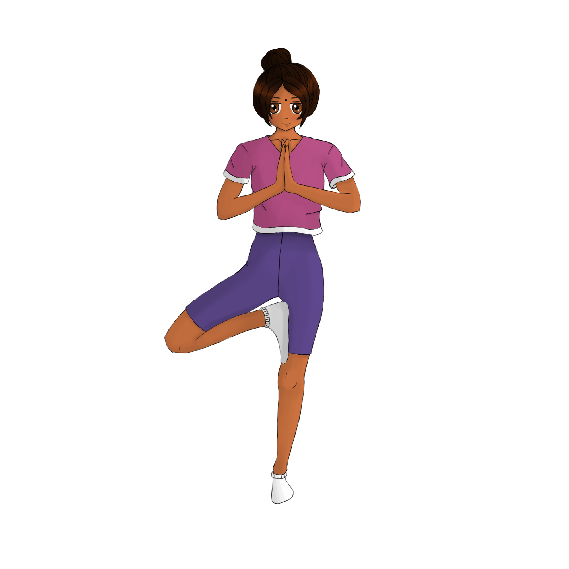
The tree pose
How do you feel?
stressed
excited
focused
concentrated
calm

Slide 22
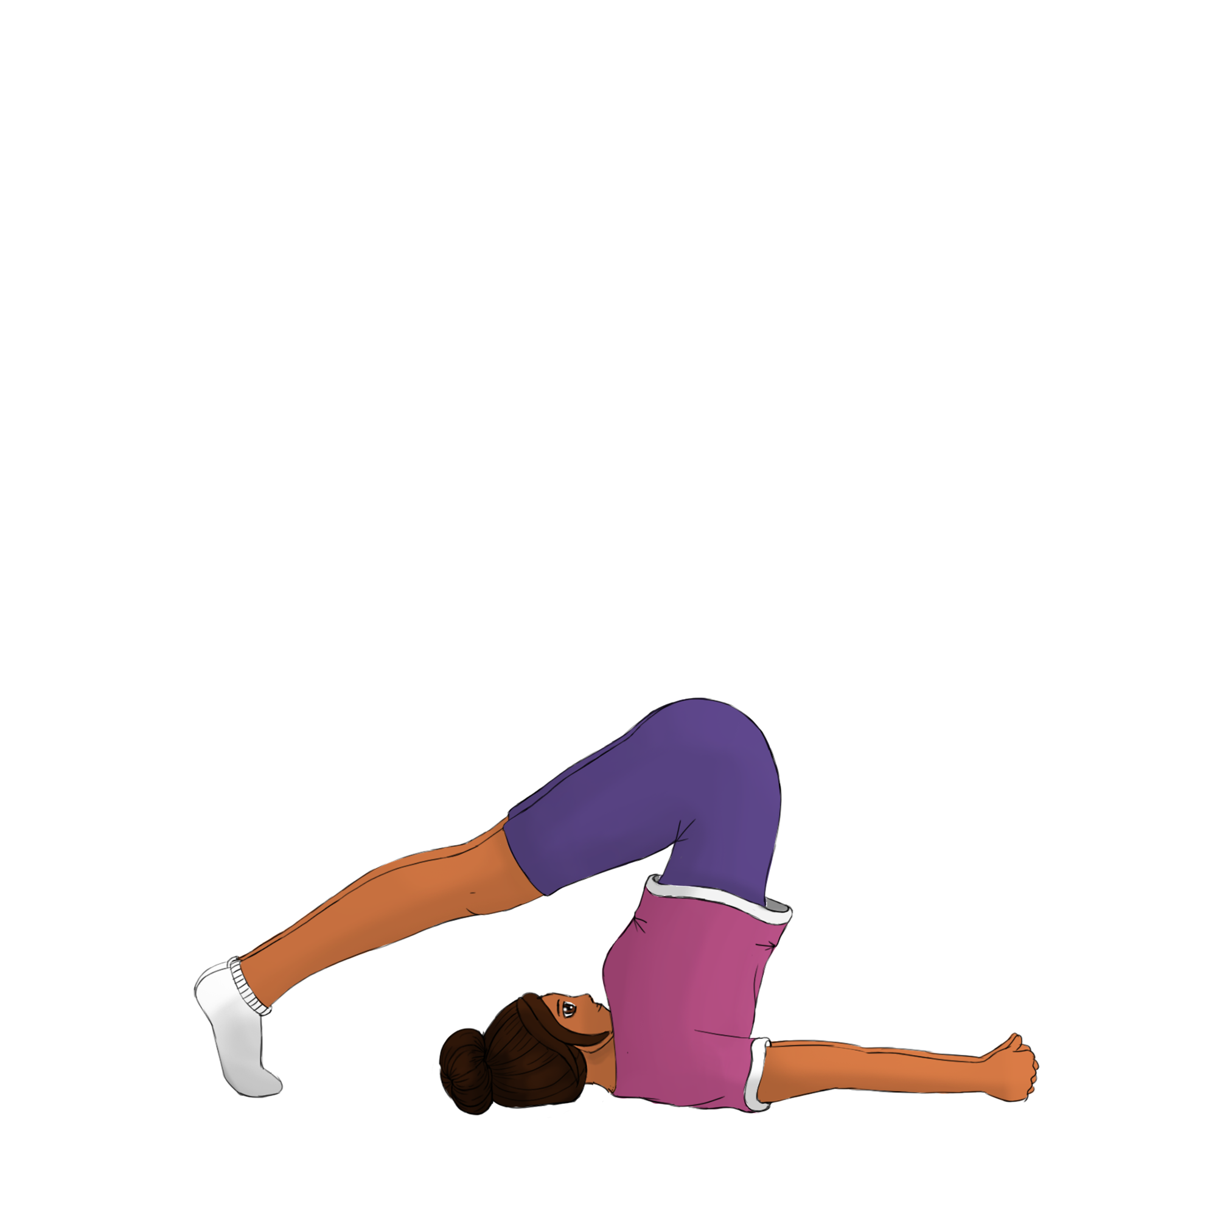
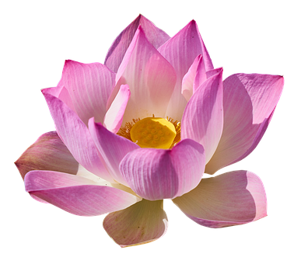
The snail pose
How do you feel?
stressed
excited
focused
concentrated
calm

Slide 23
Let’s relax your head!
How do you feel?
stressed
excited
focused
concentrated
calm

Slide 24
How do you feel?
excited
calm

Slide 25
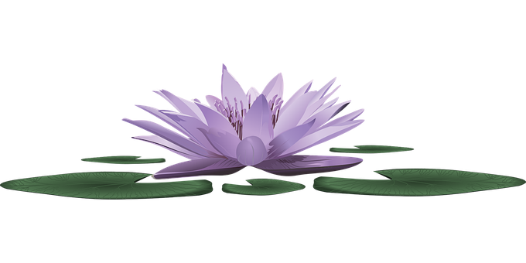
Challenge!
Practise yoga at home
Draw your favourite pose
Ask an adult to post it on
#Englishlumni

Slide 26
Today’s lesson
Matériel et instructions
Découvrir l’Inde
Pratiquer le yoga
Récapituler
Défi

Slide 27
Goodbye song

Slide 28
CLIL
CM2 - Year 6
Goodbye
by Mathilde and Sandrine
Notes:
Rituel:
Enseignant 1: se présente
Enseignant 2: se présente
Enseignants 1 et 2: Welcome to our English class!!
https://pixabay.com/fr/illustrations/insigne-flair-anglais-langue-1093968/

Slide 29
Ressources and contributions
Pictures
https://stock.adobe.com/ https://pixabay.com/fr/
https://www.flaticon.com/ https://www.clipart.com/fr/index
Personal photos
Characters
Sam Lumni and her friends drawn by Manon
Audio recordings
Voices : Tess, Mansi, Lukas, Immanuel, Emily, Eddie, Sydny, Jacklyn, Richard, Dain, Erin
Music, melody and lyrics by Stephane and François
Conception
Anna, Anne-Valérie, Mathilde, Sabrina et Sandrine

