Slide 1
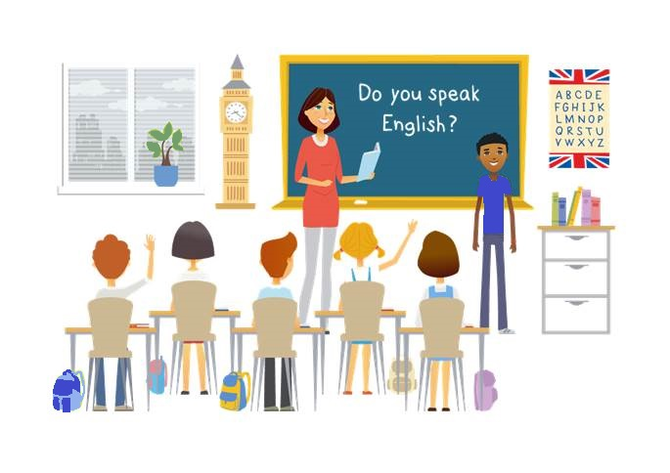
CM2 - Year 6
English
Class

Slide 2
Hello song

Slide 3
CM2 - Year 6
English
Class
from Mathilde and Sandrine

Slide 4
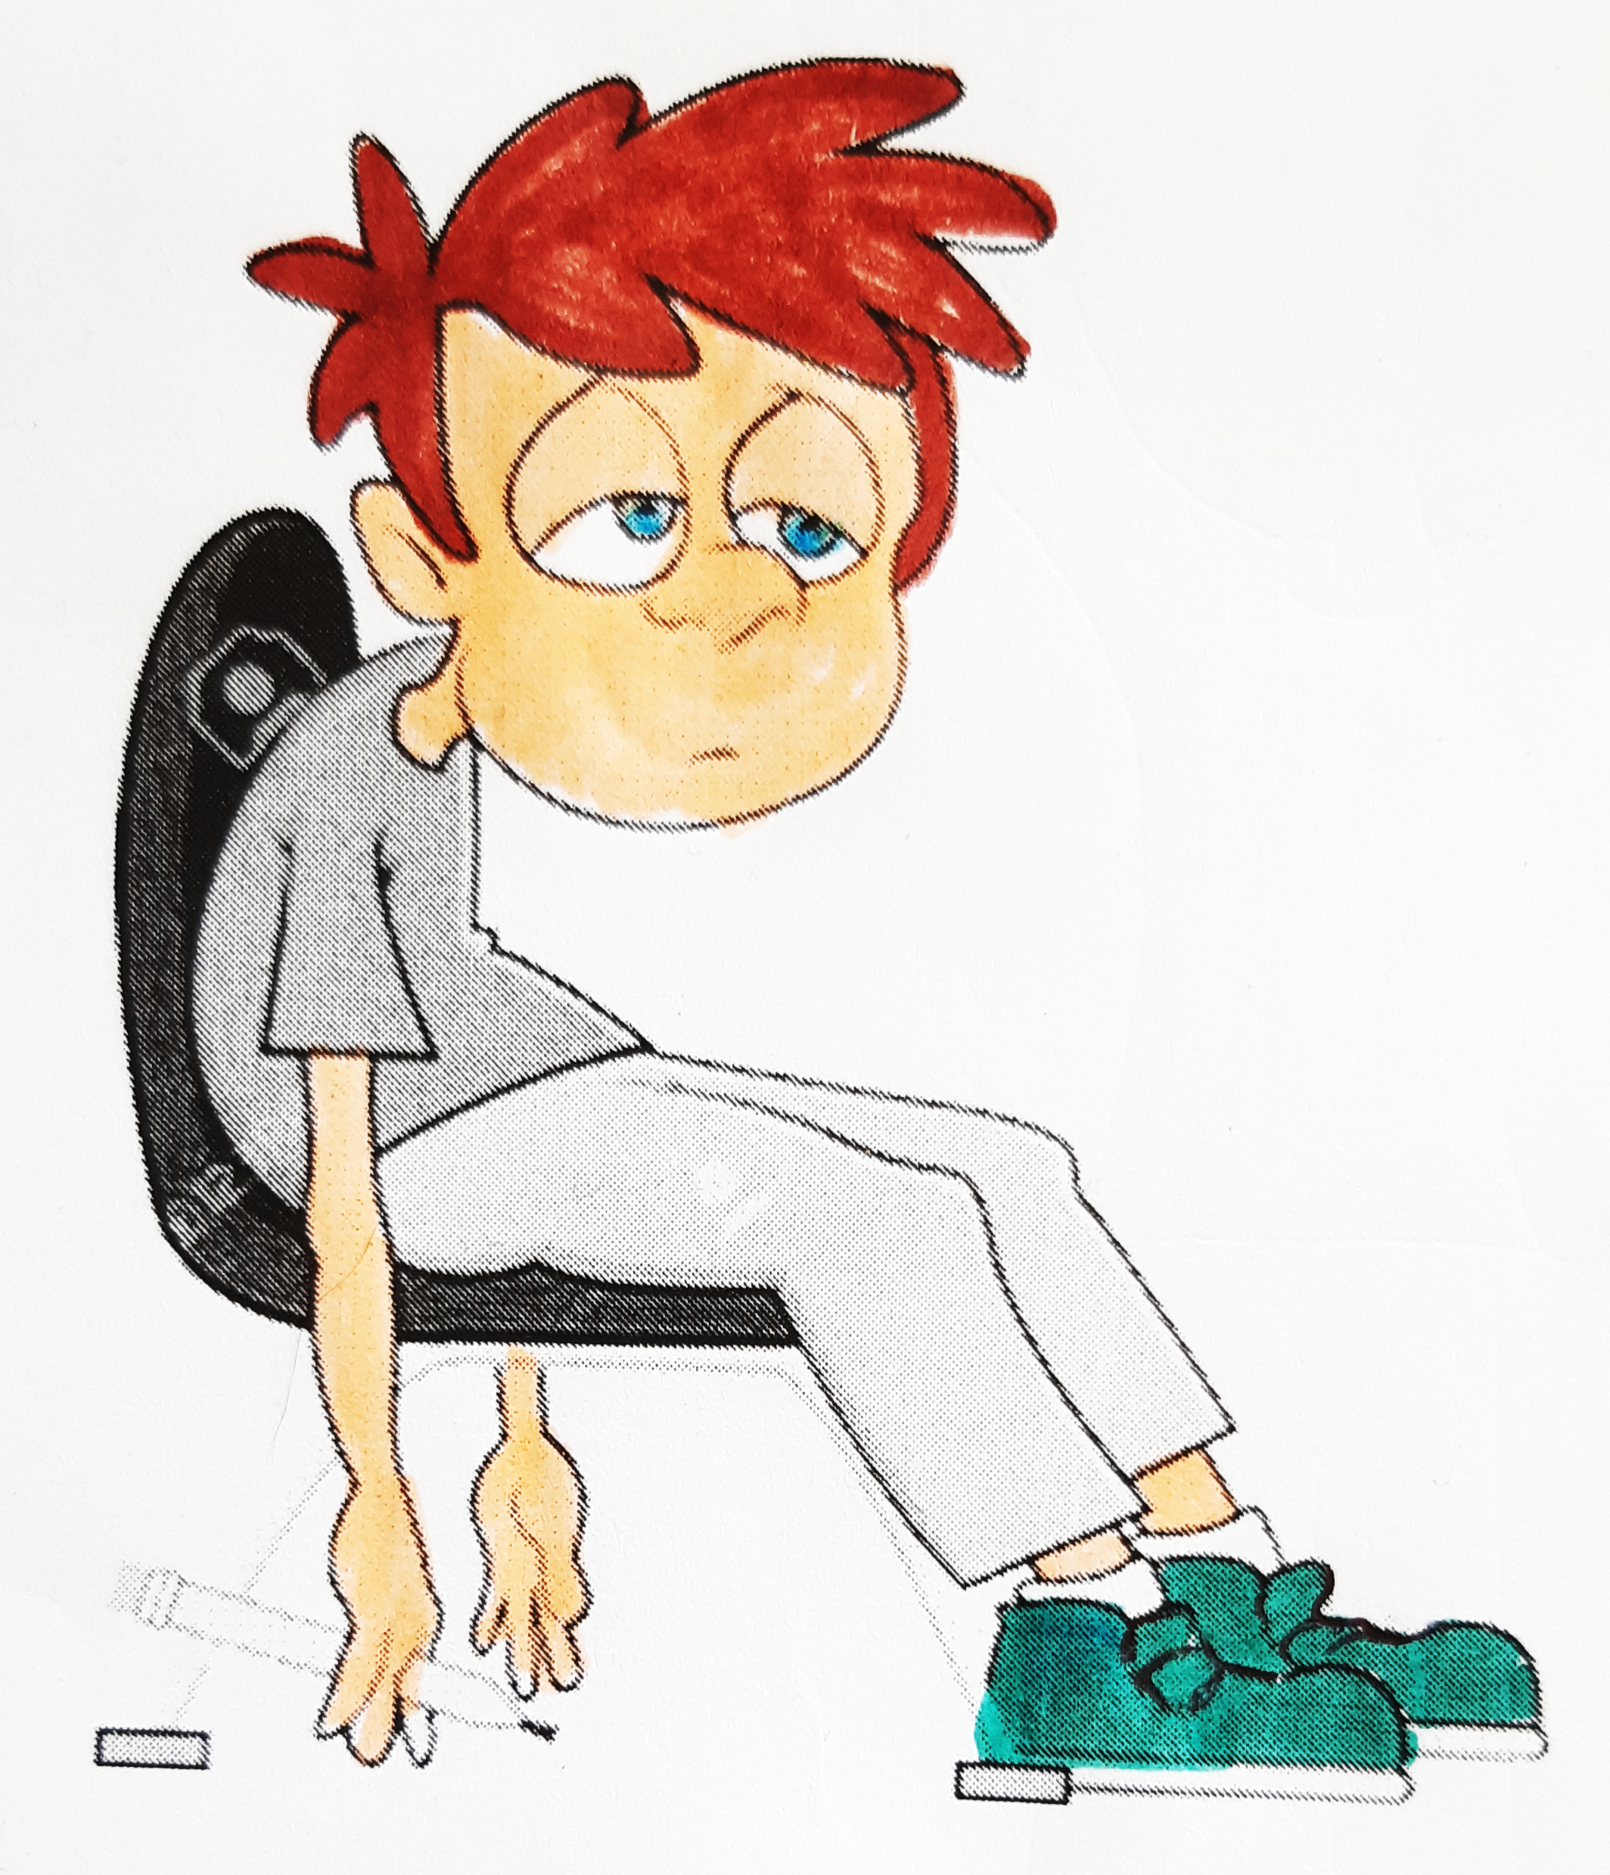
How are you?
I’m...
tired.
Notes:
.

Slide 5
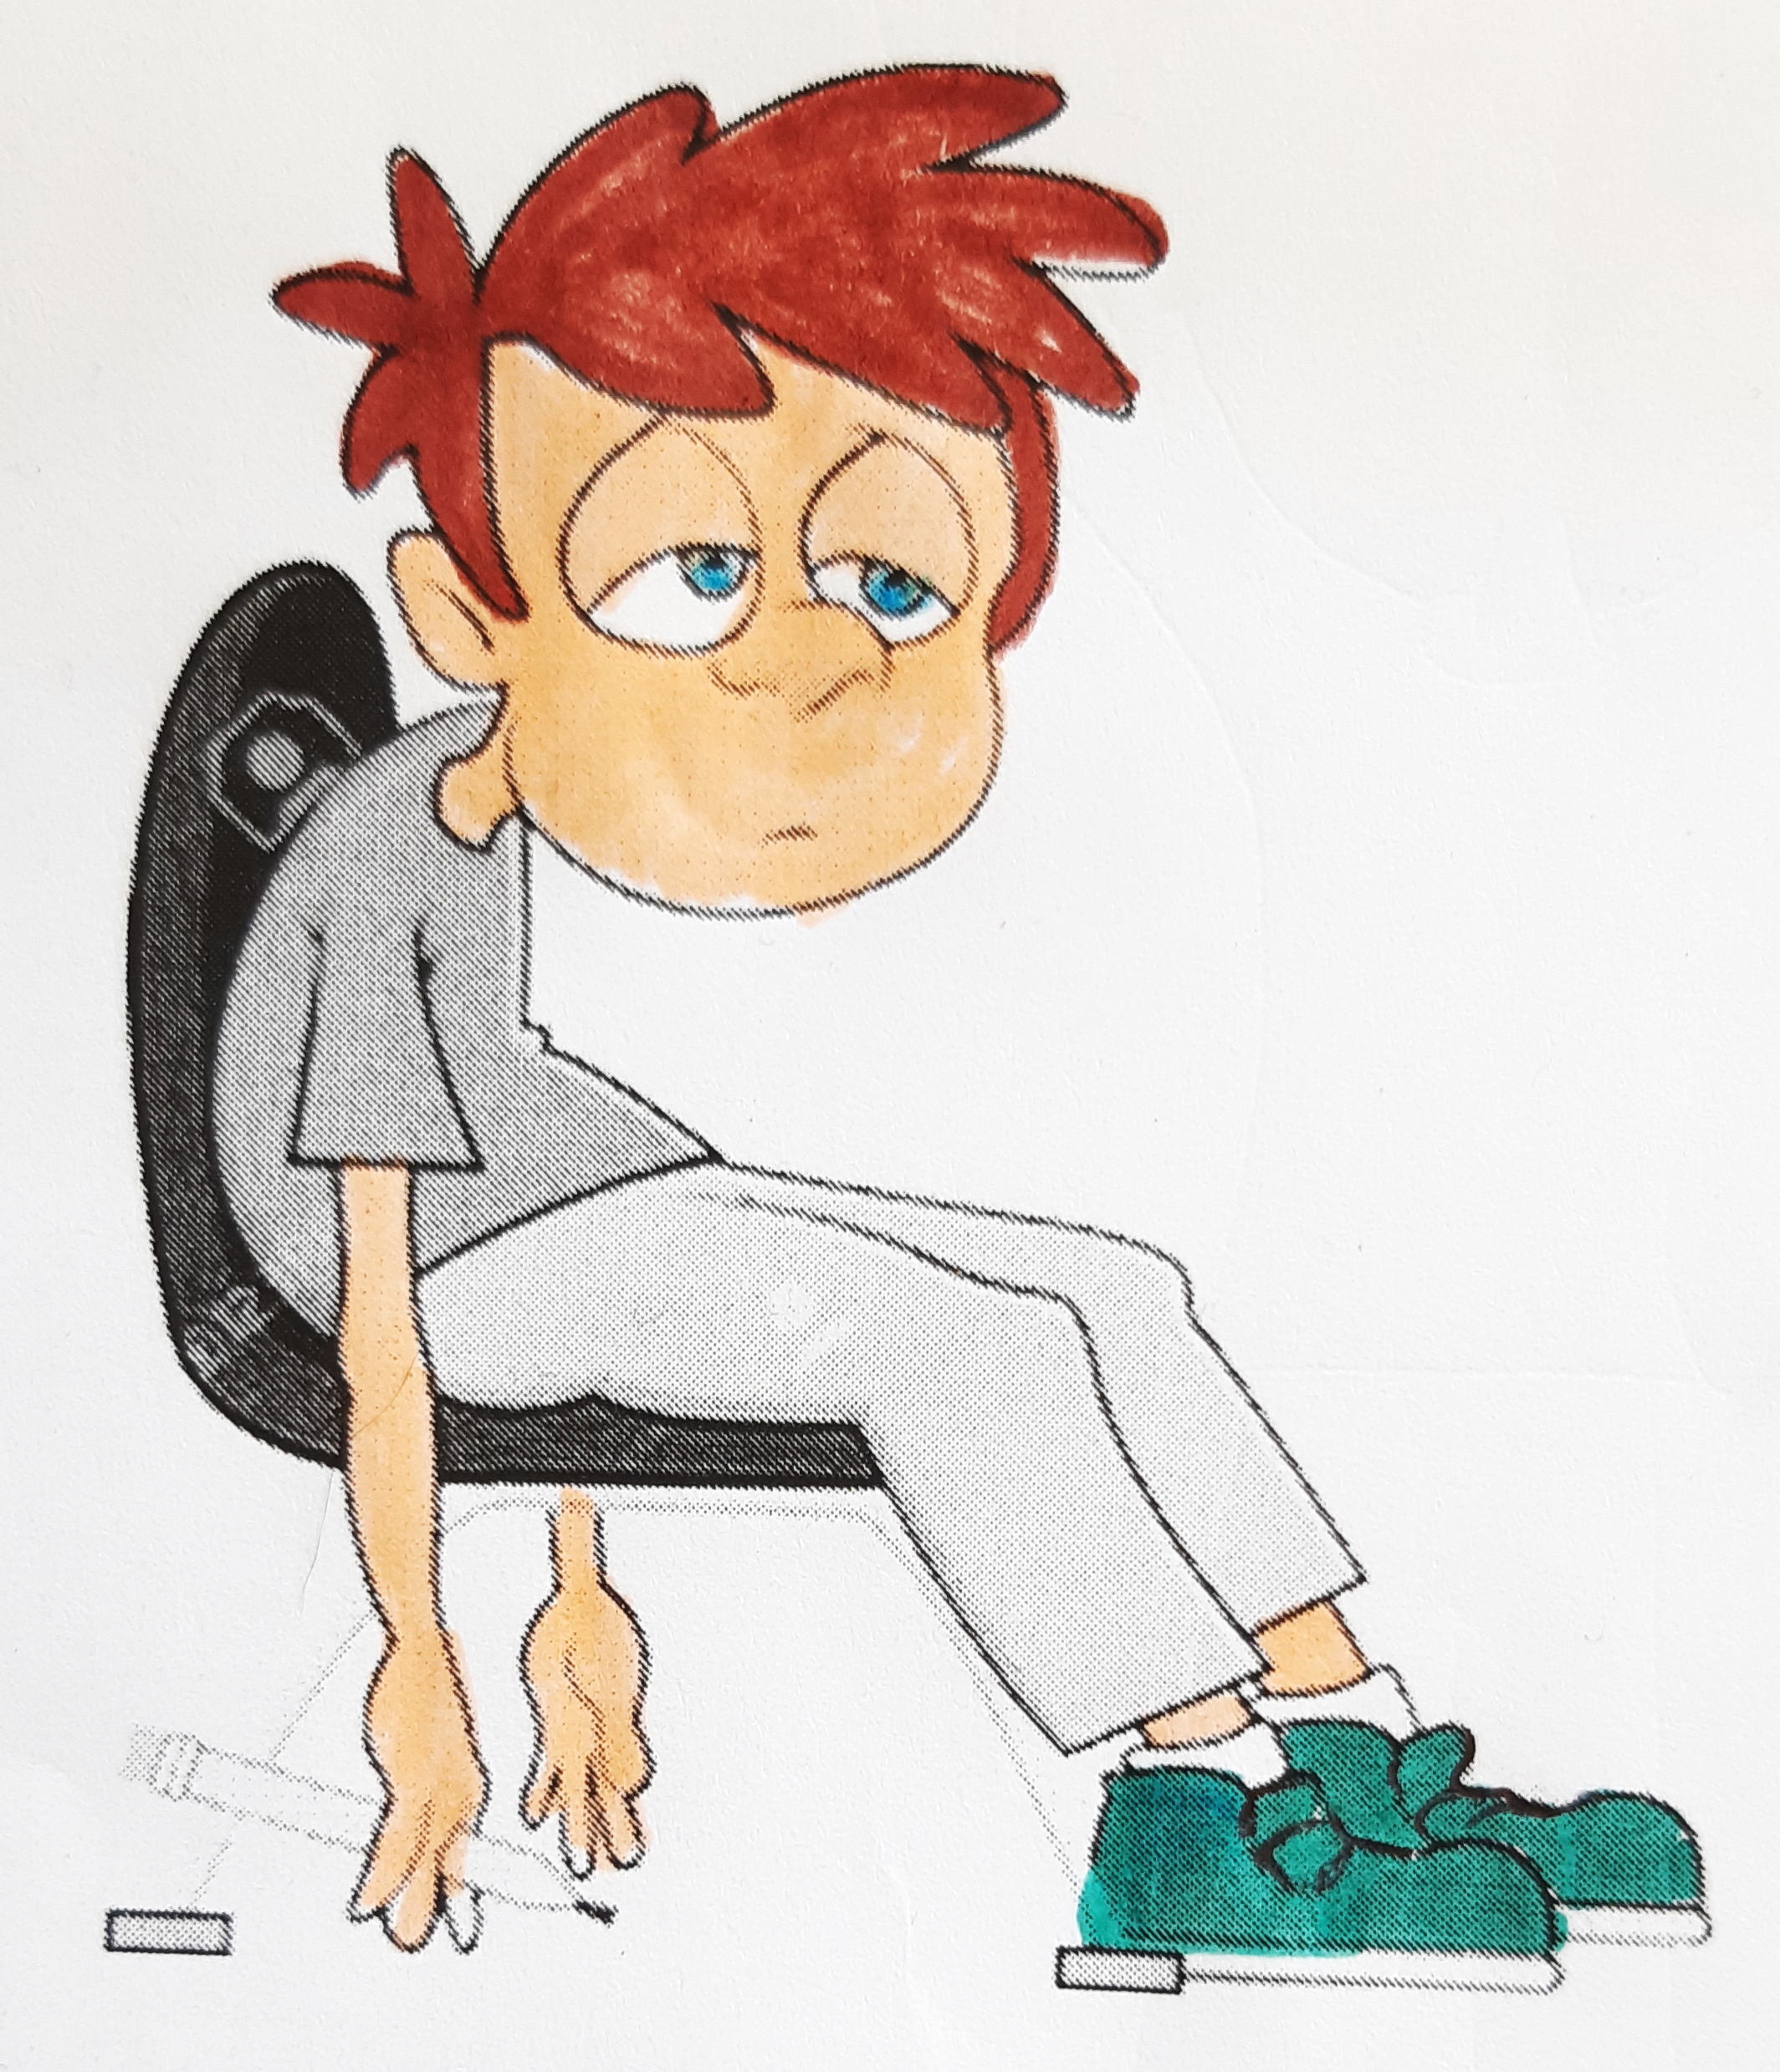
How are you?
Don’t shake your head!
Don’t sit down!
Stand up!
fffffff
Move your
body!
Turn around!

Slide 6
Today’s lesson
Parties du corps: dedans et dehors
Chanson et jeux
Comparaisons
Récapitulons

Slide 7
You need…
a pen
a whiteboard
a whiteboard marker
a pencil

Slide 8
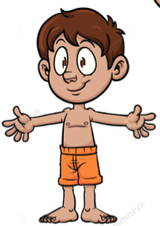
Let’s play: ‘I spy...’
“I spy with my little eye something beginning with…”
Arm
T
L
A
F
Finger
Leg
Thumb

Slide 9
Action song
1
finger
1
thumb
1
arm
1
leg
1
nod of the head
Keep Moving

Slide 10
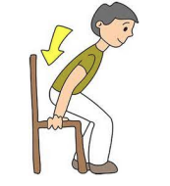
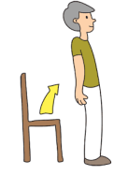
Action song
1
finger
1
thumb
1
arm
1
leg
1
nod of the head
Sit
down
Stand up
Keep Moving

Slide 11
Action song
1
finger
1
thumb
1
arm
1
leg
1
nod of the head
Sit
down
Stand up
Turn
around
Keep Moving

Slide 12
Action song
1 finger
1
leg
Sit
down
Turn
around
Keep Moving
1
arm
Stand up
1
thumb
1
nod of the head

Slide 13
Action song
One finger
One thumb
One arm
One leg
One nod of the head
Sit down
Stand up
Turn around
“ We’ll all be happy and bright “
KEEP
MOVING!

Slide 14
Let’s look outside your body!
skin
muscles

Slide 15
Let’s look inside your body!
skeleton
bones

Slide 16
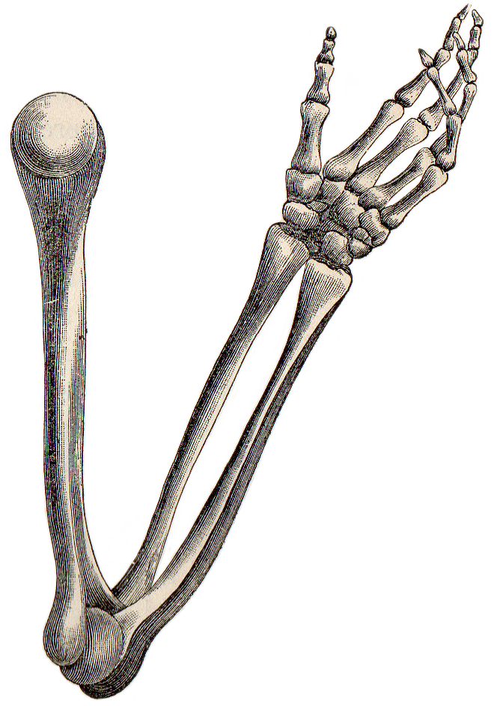
Let’s measure the bones!
arm bone
thumb bone
longer than

Slide 17
Let’s compare sizes!
leg bone
toe bone
smaller than

Slide 18
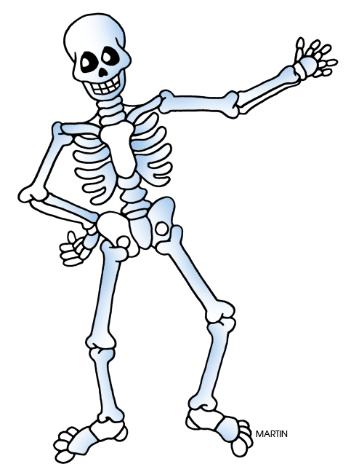
Let’s measure the bones!
arm
bone
finger
bone
leg
bone
toe
bone

Slide 19
Let’s compare sizes!
leg
bone
arm
bone
finger
bone
toe
bone

Slide 20
Matching game
The
is
than
the
bone
arm
thumb
bone
longer

Slide 21
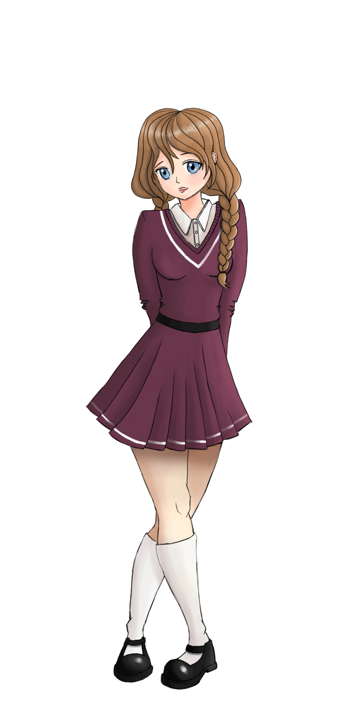
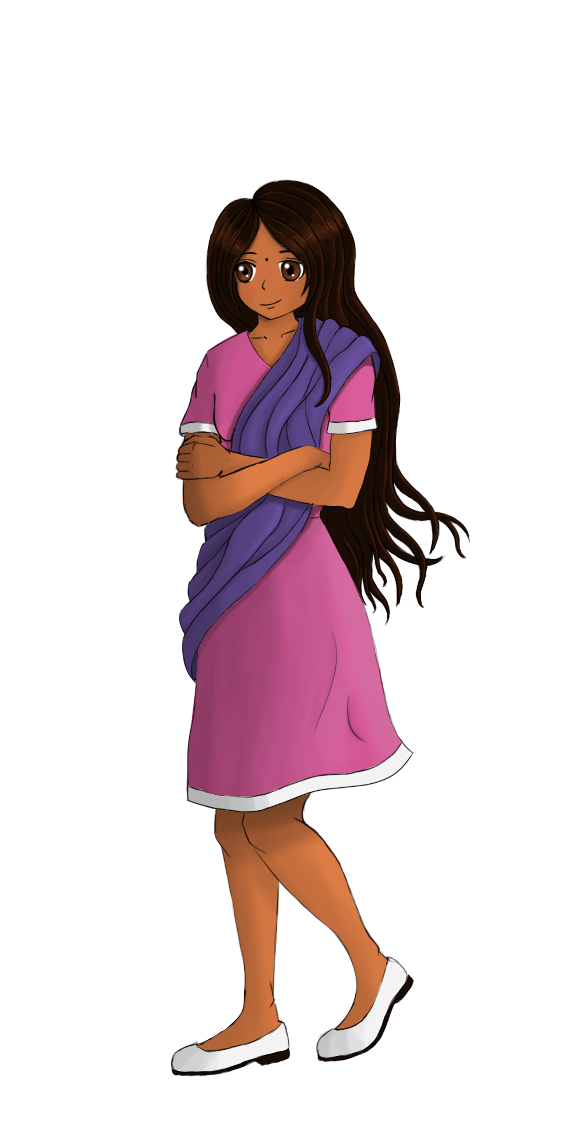
Let’s discover different body sizes!
fat
thin

Slide 22
Let’s compare!
I am thinner than Sam.
I am fatter than Mansi .

Slide 23
Let’s discover different body sizes!
tall
small

Slide 24
Let’s compare!
I am taller than Sam.
I am smaller than Mansi .

Slide 25
Let’s think!
longer
smaller
thinner
fatter
taller
Remember :
short adjective + er

Slide 26
Let’s play!
tall
+
er
=
taller
+
=
smaller
stronger
+
=

Slide 27
Sentence building
than
I
am
Sandrine.
taller
I
am
taller
than
Sandrine.

Slide 28
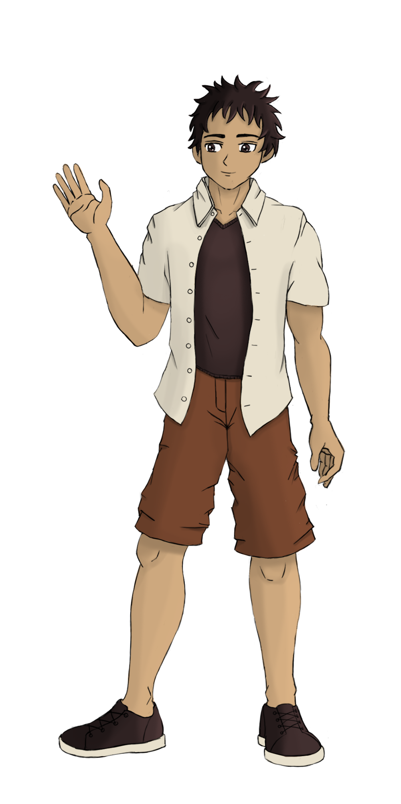
Different bodies...
muscular
athletic

Slide 29
Let’s compare!
I am more muscular than Mansi.
I am more athletic than Immanuel.

Slide 30
Let’s think!
more muscular
more athletic
Remember :
more + long adjective

Slide 31
Let’s create adjectives!
more
+
muscular
=
more muscular
=
more athletic
=
more intelligent

Slide 32
Sentence building
am
than
I
Sandrine.
more
athletic
I
am
more
athletic
than
Sandrine.

Slide 33
Let’s think and play!
athletic
thin
more +
+ er
tall
big
intelligent
fast
more muscular
darker
dark
faster
muscular
more
intelligent
thinner
bigger
more
athletic
taller

Slide 34
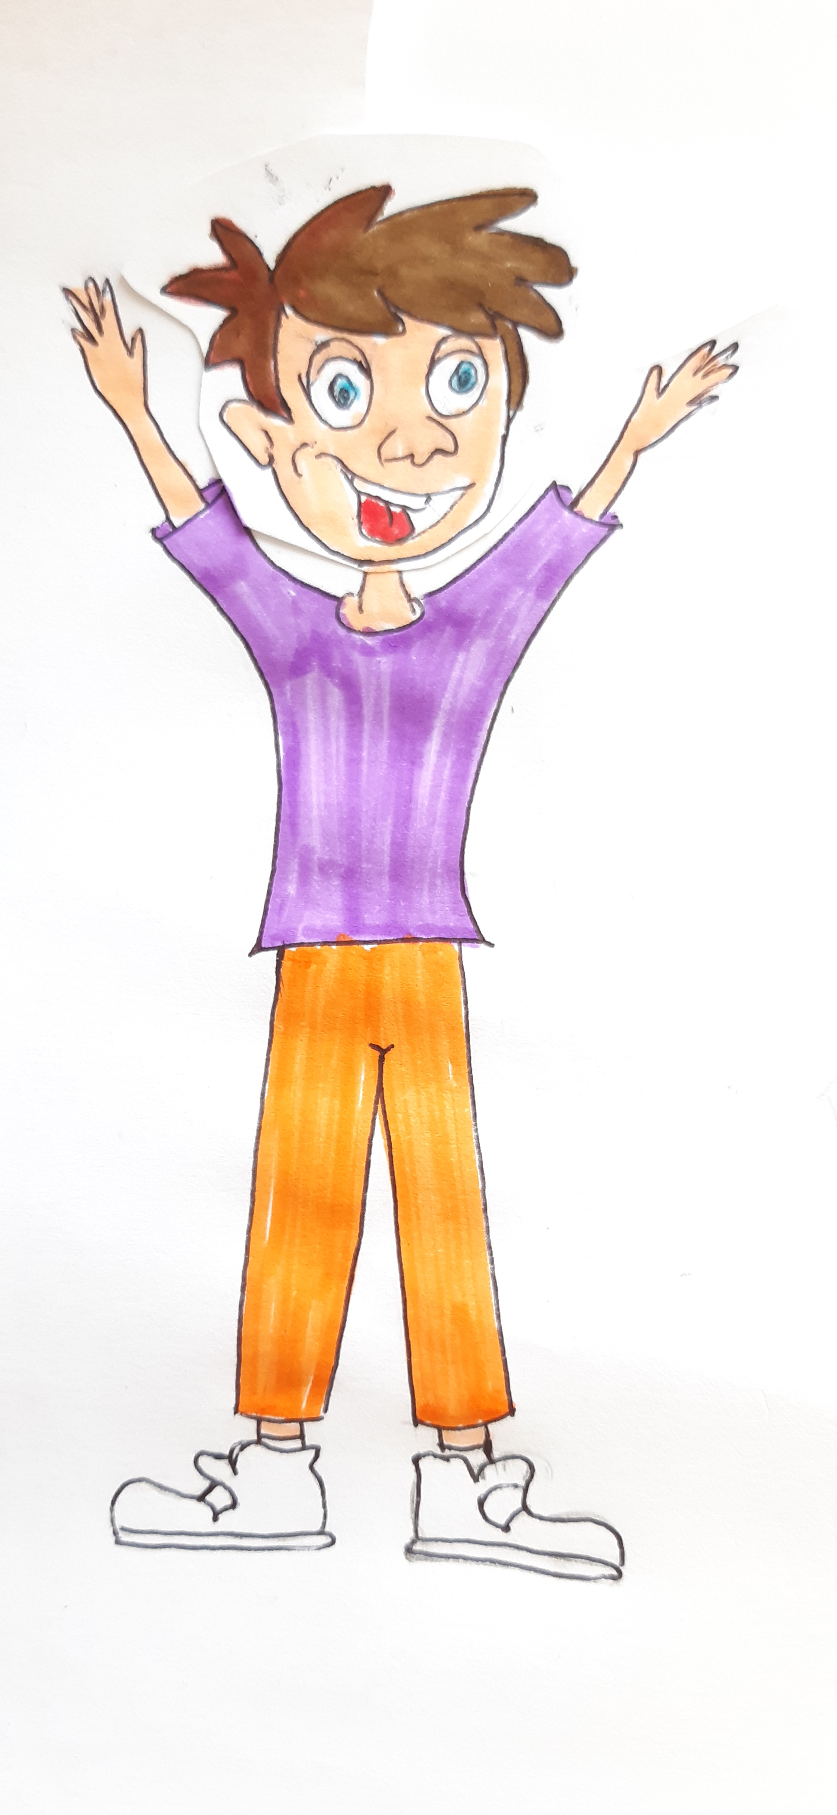
How are you?
stronger!
more muscular!
I’m ….
faster!
happier!
more athletic!

Slide 35
Today’s lesson
Parties du corps: dedans et dehors
Chanson et jeux
Comparaisons
Récapitulons

Slide 36
Goodbye song

Slide 37
CM2 - Year 6
Goodbye
from Mathilde and Sandrine

Slide 38
Ressources and contributions
Pictures
https://stock.adobe.com/ https://pixabay.com/fr/
https://www.flaticon.com/ https://www.clipart.com/fr/index
Personal photos
Characters
Sam Lumni and her friends drawn by Manon
Audio recordings
Voices : Tess, Mansi, Lukas, Immanuel, Emily, Eddie, Sydny, Jacklyn, Richard, Dain, Erin
Music, melody and lyrics by Stephane and François
Conception
Anna, Anne-Valérie, Mathilde, Sabrina et Sandrine

