Slide 1
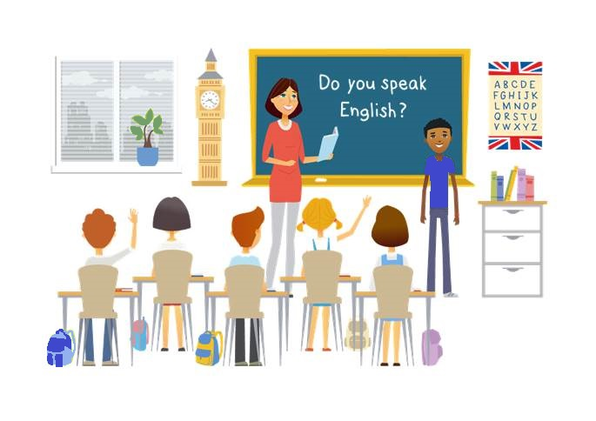
CM2 - Year 6
English
Class

Slide 2
Hello song

Slide 3
CM2 - Year 6
English
Class
by Mathilde and Sandrine

Slide 4
Today’s lesson
Sentiments
L’alimentation
J’aime / je n’aime pas
Sain ou non?
Exprimer ses goûts
Récapitulons
Challenge

Slide 5
You need …
a mark_r
a cop_bo_k
a penc_l
a whitebo_rd

Slide 6
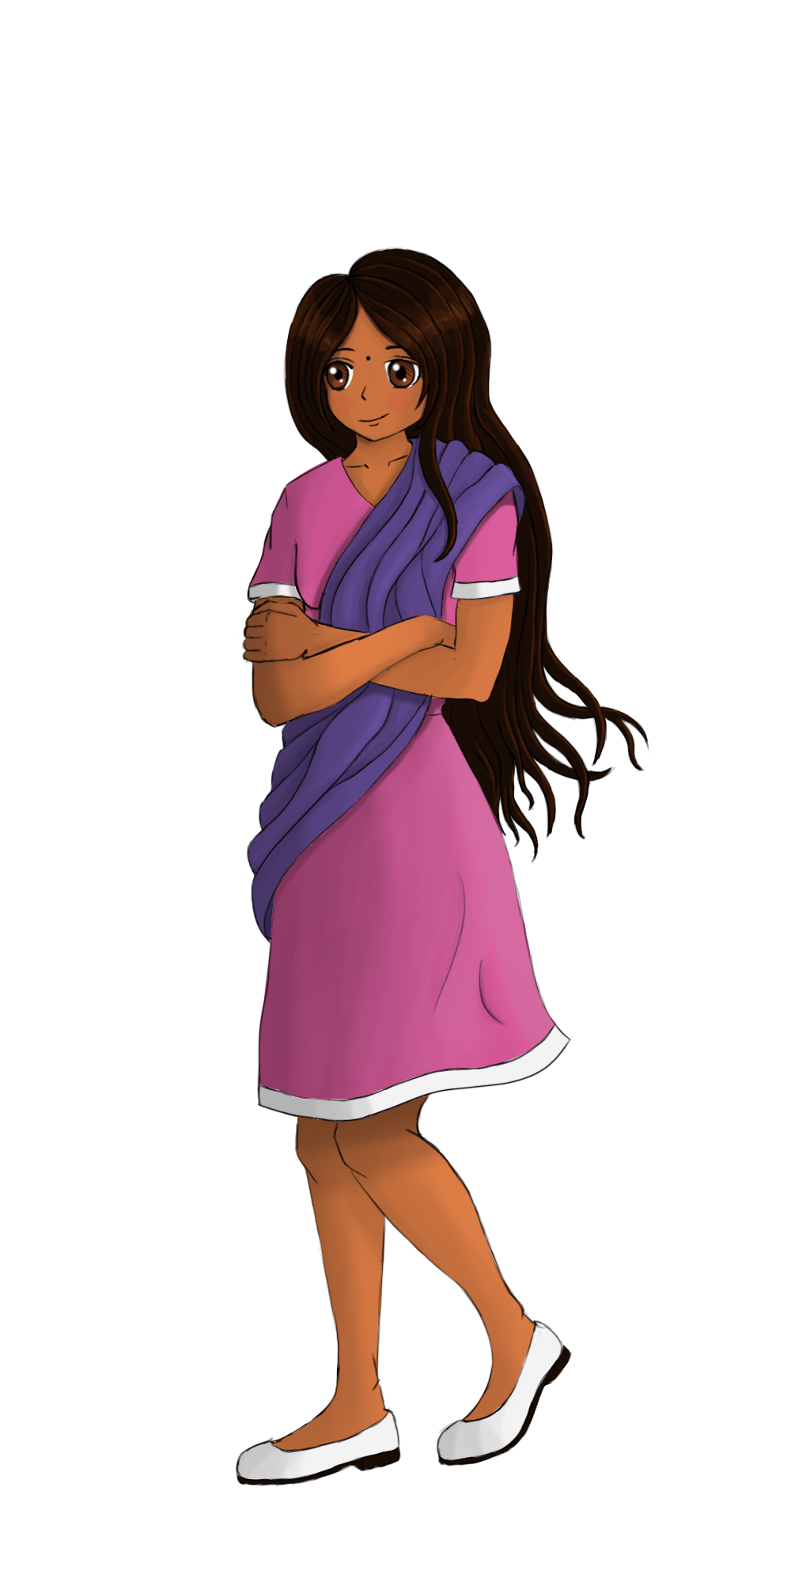
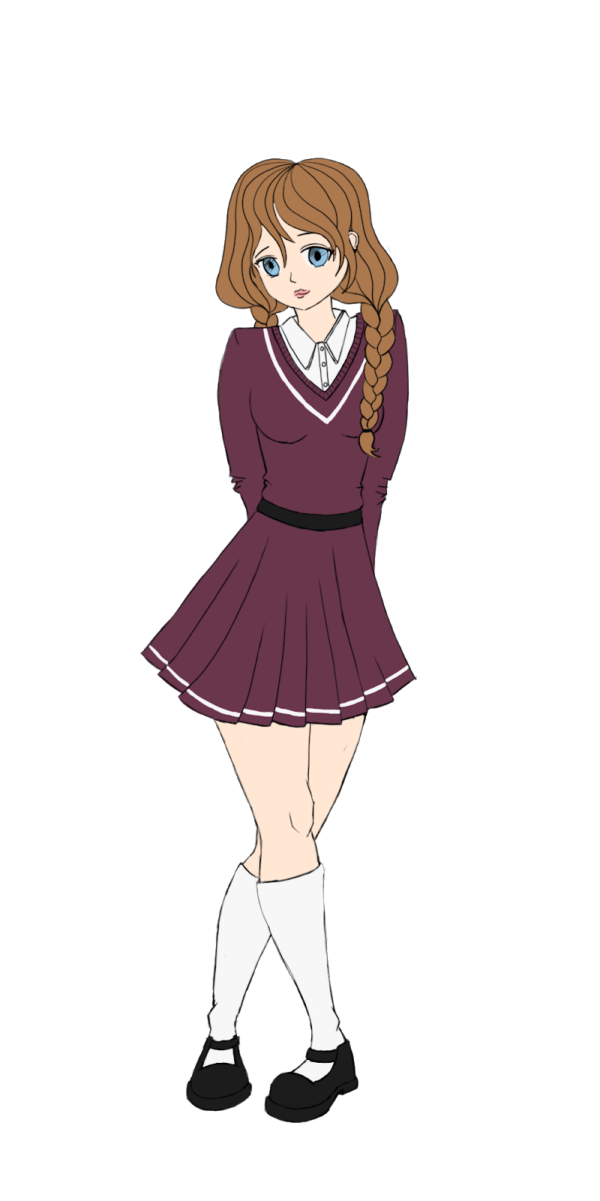
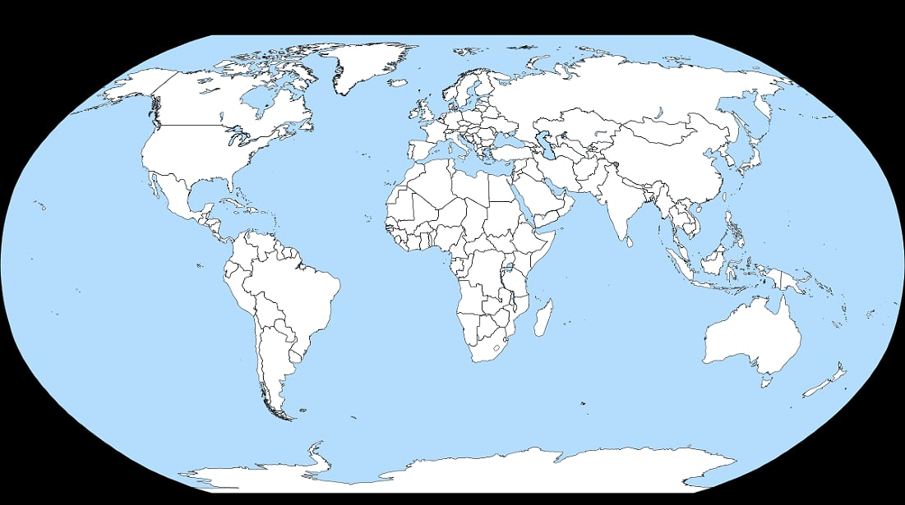
Let’s travel!

Slide 7
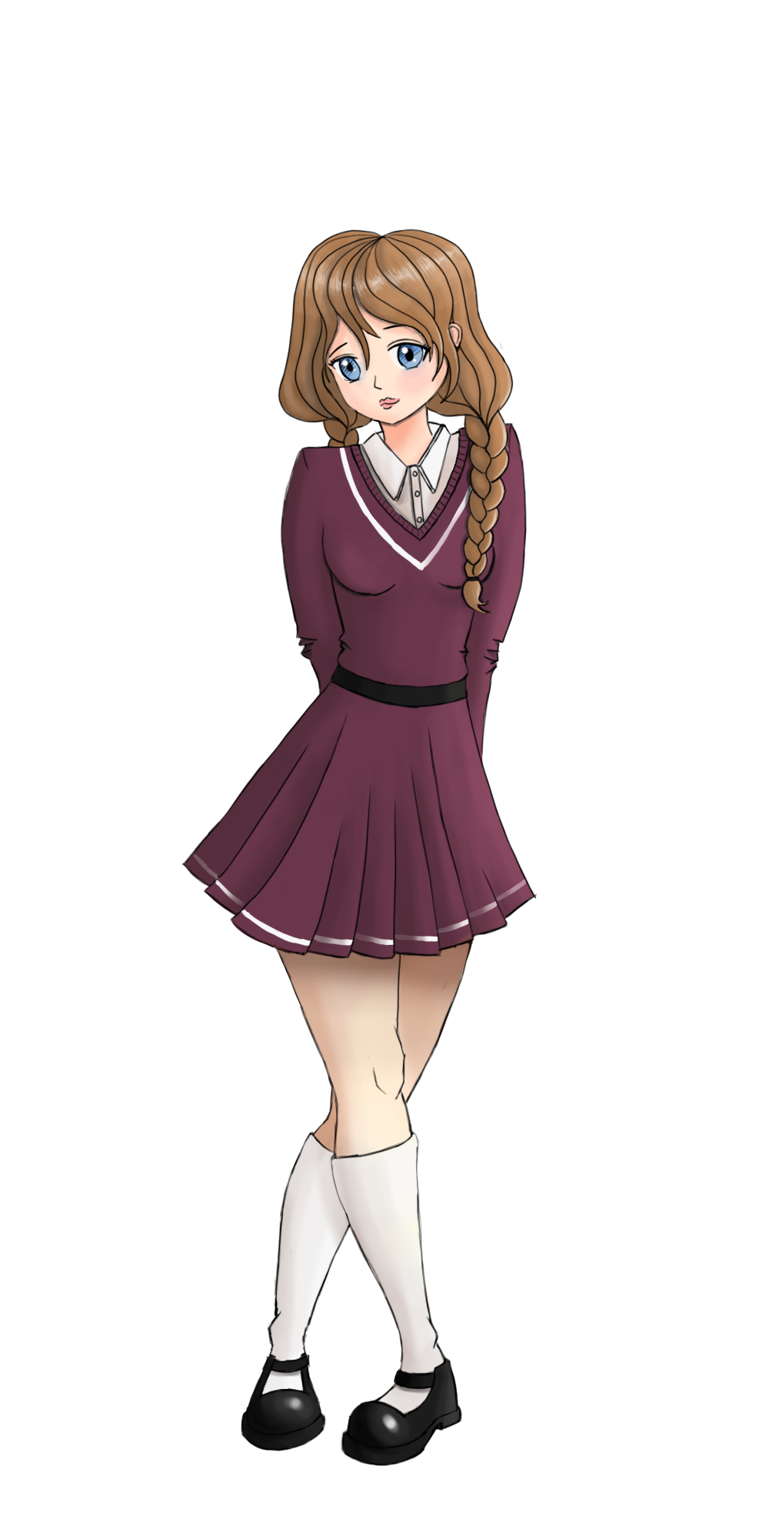
Greetings
Hi Mansi!
Hello Sam!
I’m hungry!
How are you?
I’m cool

Slide 8
Feelings
NEW!
I’m...
hungry!

Slide 9
Let’s listen!
hungry?
or
angry?

Slide 10
Feelings
NEW!
thirsty
I’m...
or
thirty?

Slide 11
Feelings
Are you ?
No, I’m not!

Slide 12
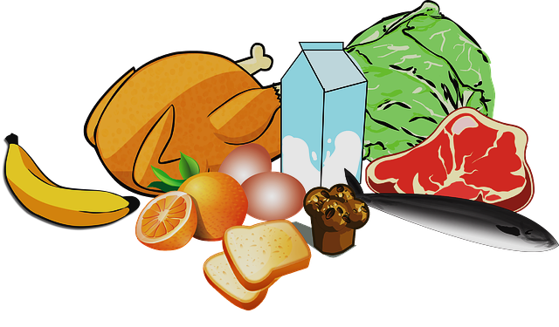
Feelings
Are you ?
Yes I am!

Slide 13
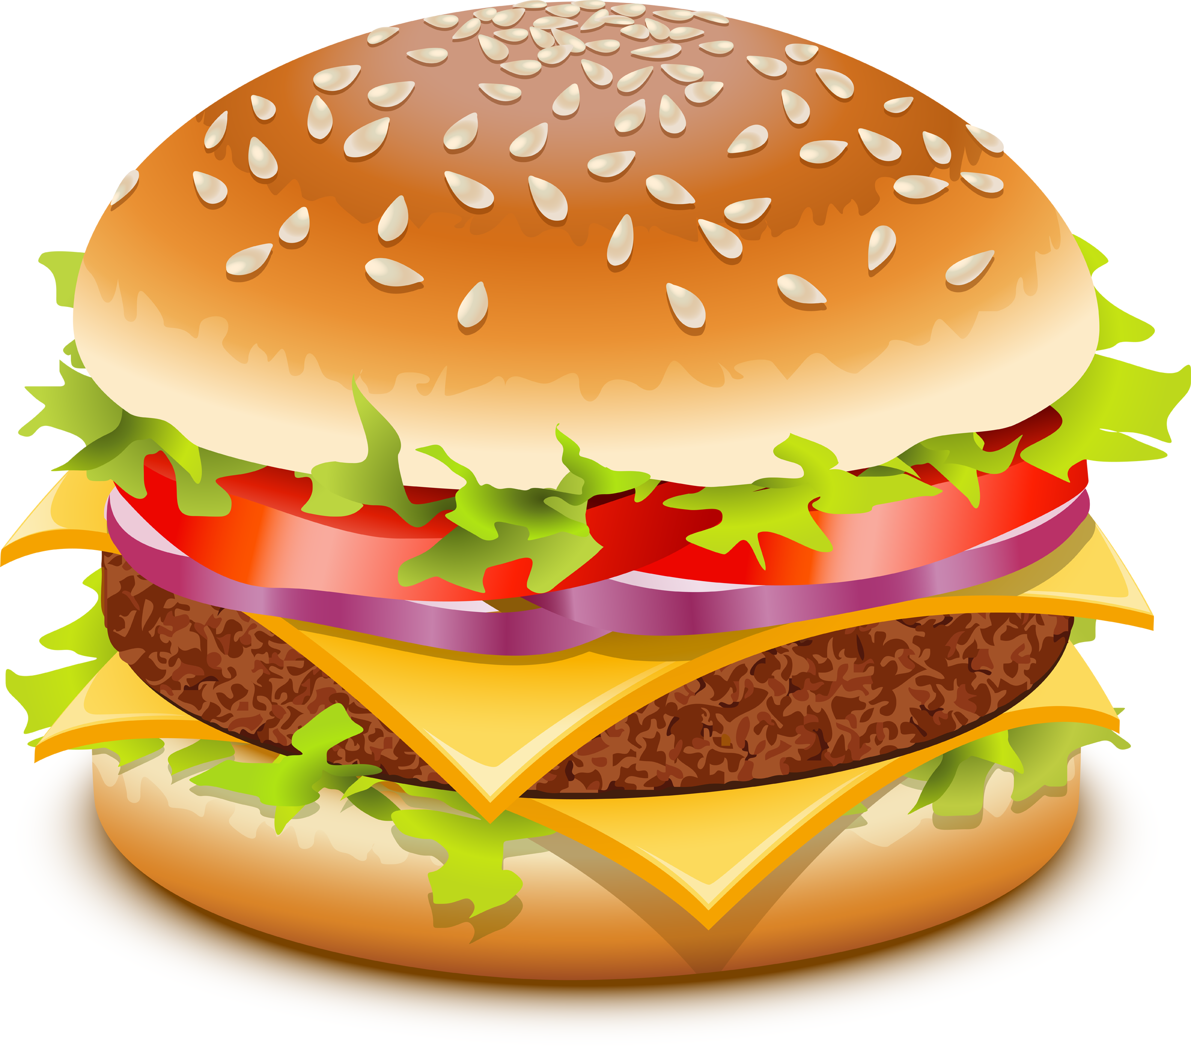
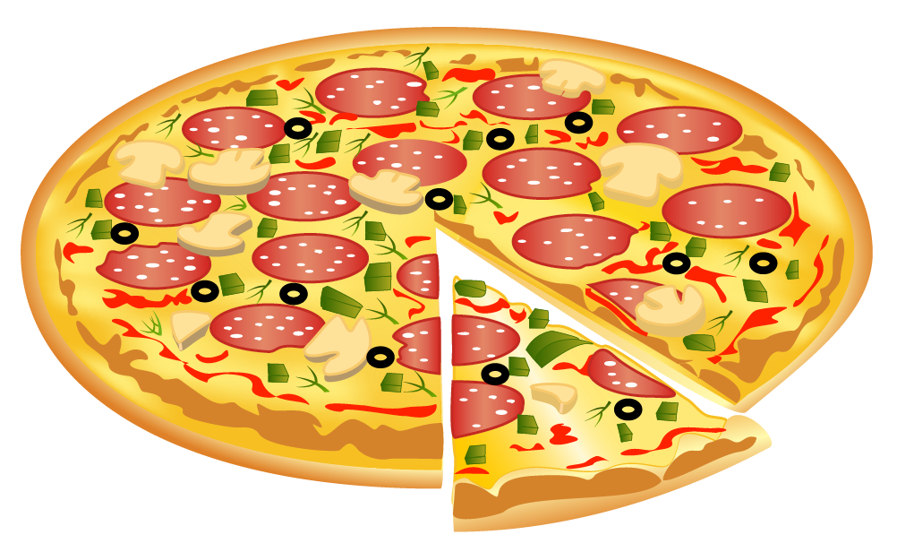
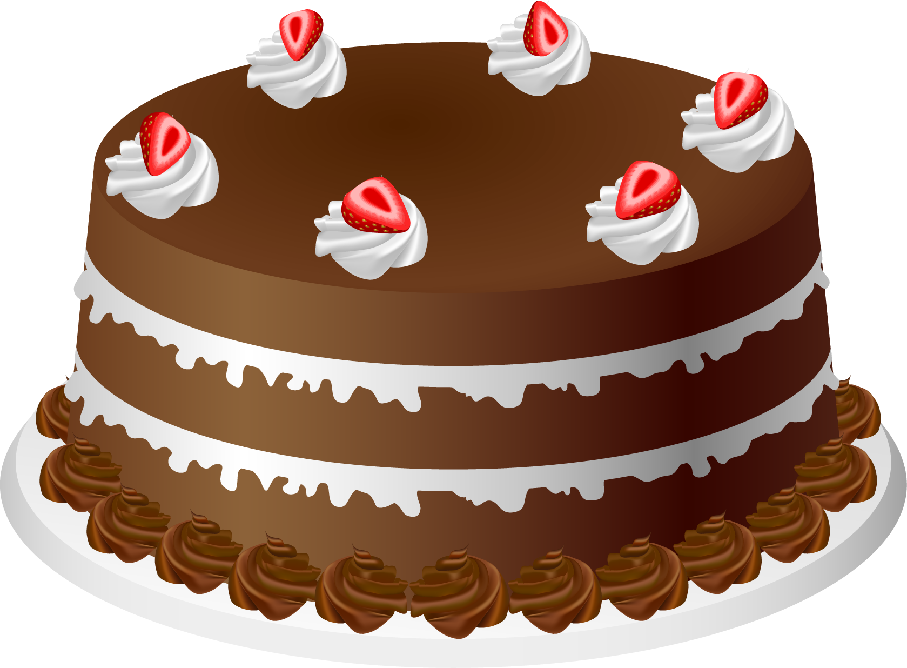
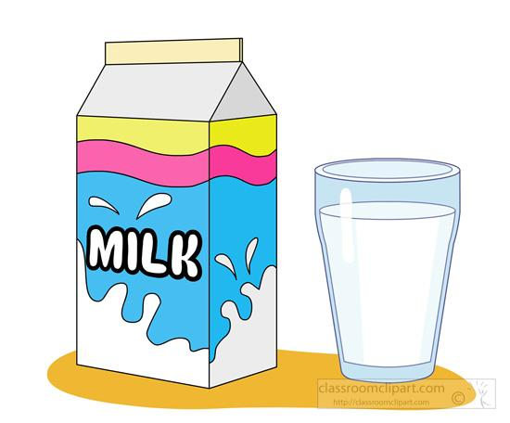
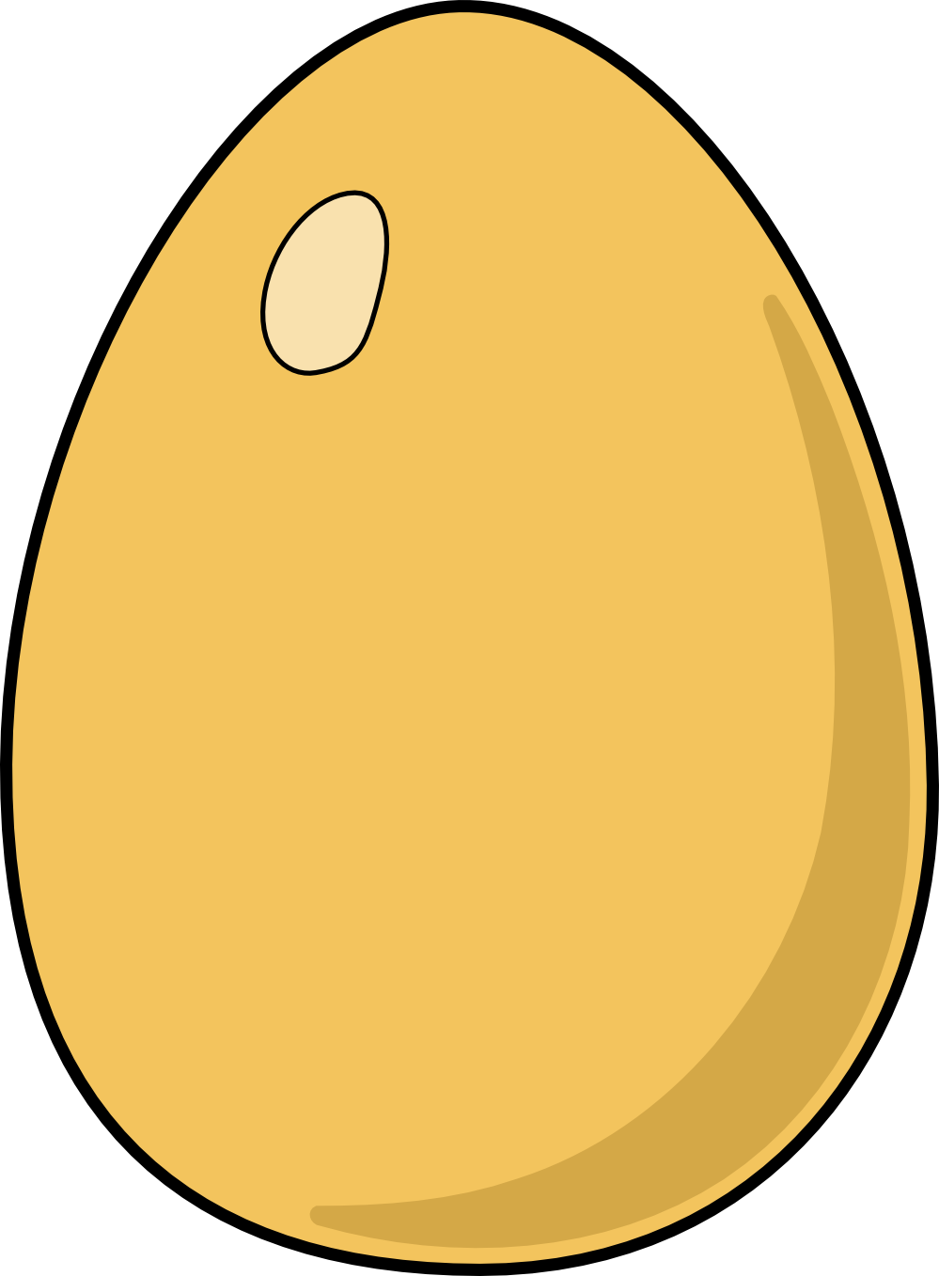
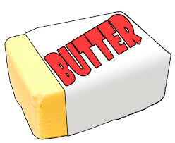
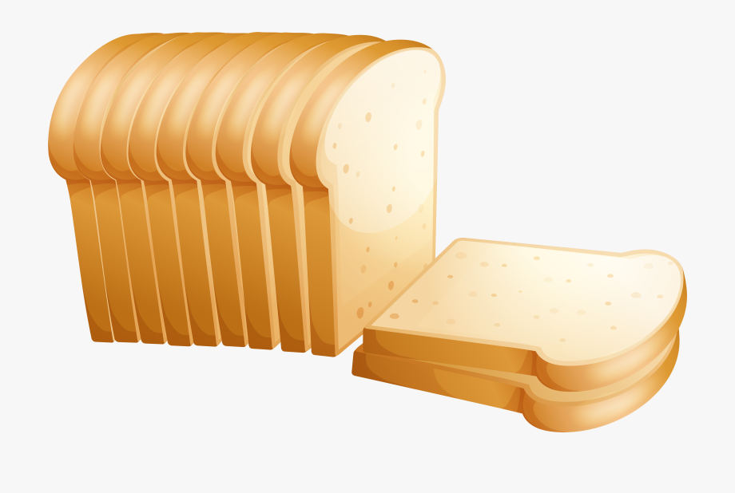
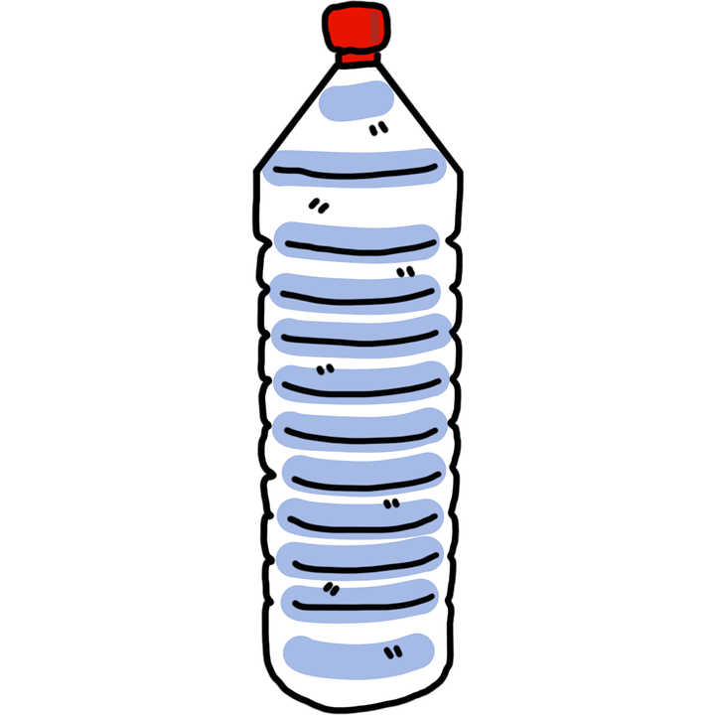
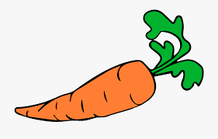
Let’s revise food and drinks!
What’s this?
It’s ...
an egg
water
juice
soda
bread
milk
a yoghurt
a fish
a carrot
a sweet
meat
an apple
butter
a hamburger
a cake
a banana
a pizza
an egg
a cake

Slide 14
Let’s complete!
an egg
a cake
egg
fish
an
a
vowels
consonants
apple
pizza
egg
fish
apple
pizza

Slide 15
I like
I like…
YUMMY!
What do you like?

Slide 16
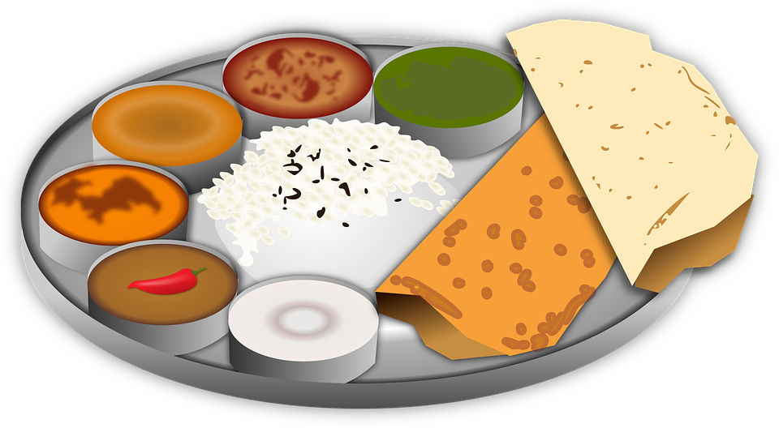
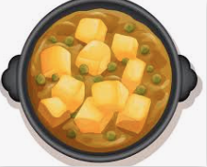
I like
NEW!
I like...
YUMMY!
INDIAN FOOD
What do you like?

Slide 17
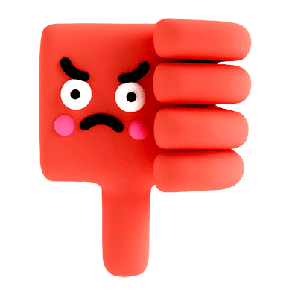
I don’t like…
I don’t like…
I like junk food.

Slide 18
Junk food
Yummy!

Slide 19
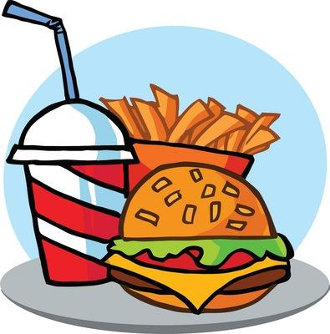
I don’t like…
I don’t like…
I like healthy food.

Slide 20
Healthy food
Yummy!

Slide 21
Healthy or junk food?
Healthy food
Junk food

Slide 22
Sentence building
I
I
like
cake.
I
I
like
fish.
fish
cake

Slide 23
Sentence building
I like cake.
+
and
I like fish.
I like cake and fish.

Slide 24
Sentence building
I
I
don’t
like
meat.
I
I
don’t
like
hamburgers.
hamburgers
meat

Slide 25
Sentence building
I
but
I
/
I like fish.
but
I don’t like meat.
I like fish but I don’t like meat.

Slide 26
Question?
Yes I do!
No I don’t!
but
Do you like...
my favourite food is...

Slide 27
Your turn!
And you? What is your favorite food?
Do you like .... ?
but
my favourite food is...
Yes I do.....

Slide 28
Let’s listen!

Slide 29
Let’s recap!
I’m hungry / I’m thirsty
healthy food / junk food
I like …. / I don’t like….
And / but
Do you like?
Favourite food

Slide 30
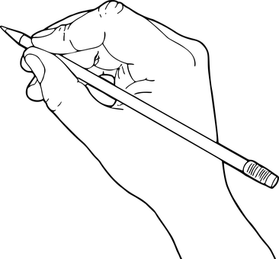
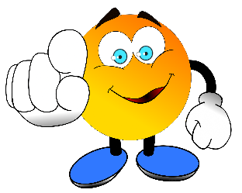
Challenge!
Ask an adult to post it on
#Englishlumni
Draw your
ideal plate
or drink

Slide 31
Today’s lesson
Sentiments
L’alimentation
J’aime / je n’aime pas
Sain ou non?
Exprimer ses goûts
Récapitulons
Challenge

Slide 32
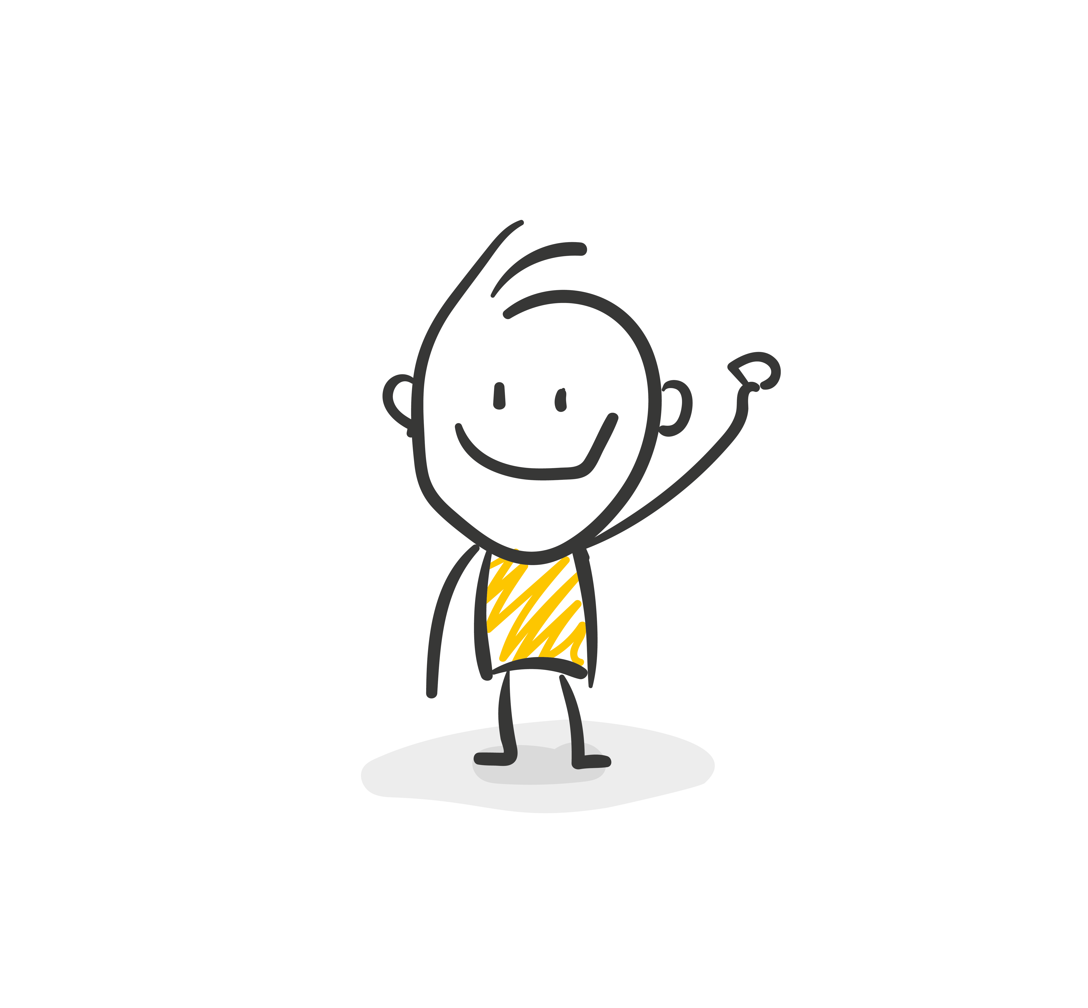
Goodbye song

Slide 33
CM2 - Year 6
Goodbye
from Mathilde and Sandrine

Slide 34
Ressources and contributions
Pictures
https://stock.adobe.com/ https://pixabay.com/fr/
https://www.flaticon.com/ https://www.clipart.com/fr/index
Personal photos
Characters
Sam Lumni and her friends drawn by Manon
Audio recordings
Voices : Tess, Mansi, Lukas, Immanuel, Emily, Eddie, Sydny, Jacklyn, Richard, Dain, Erin
Music, melody and lyrics by Stephane and François
Conception
Anna, Anne-Valérie, Mathilde, Sabrina et Sandrine

