Slide 1
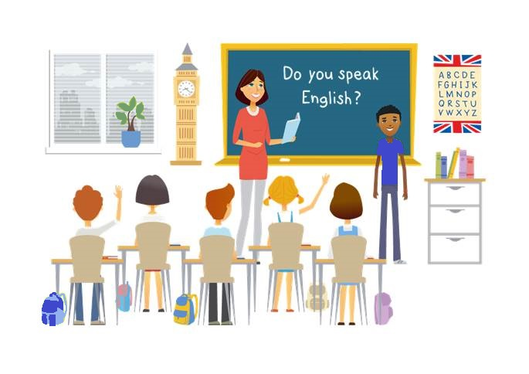
CM2 - Year 6
English
Class

Slide 2
Hello song

Slide 3
CM2 - Year 6
English
Class
by Anne-Valérie and Anna

Slide 4
How are you today?
tired
sick
happy
sad
angry

Slide 5
Today’s lesson
Présenter quelqu’un
Réviser les nombres 0 - 20
Prononcer la lettre H
Découvrir quelques pays
Découvrir des accents

Slide 6
You need….
a pencil
a whiteboard marker
a copybook
a whiteboard

Slide 7
Let’s revise numbers!
1
3
5
7
9
2
4
6
8
10
11
13
15
17
19
12
14
16
18
20

Slide 8
Number challenge!
1
2
4
6
7
10
11
14
15
17
19

Slide 9
Challenge, yes, you can!

Slide 10
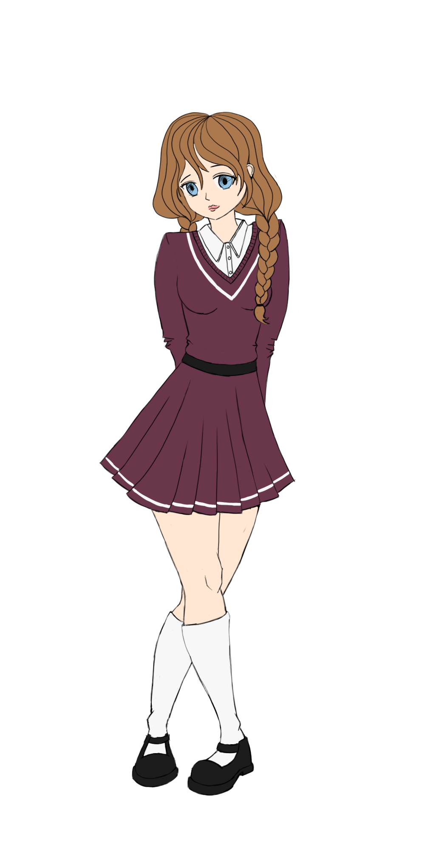
This is …
Sam Lumni
11
Manchester
England

Slide 11
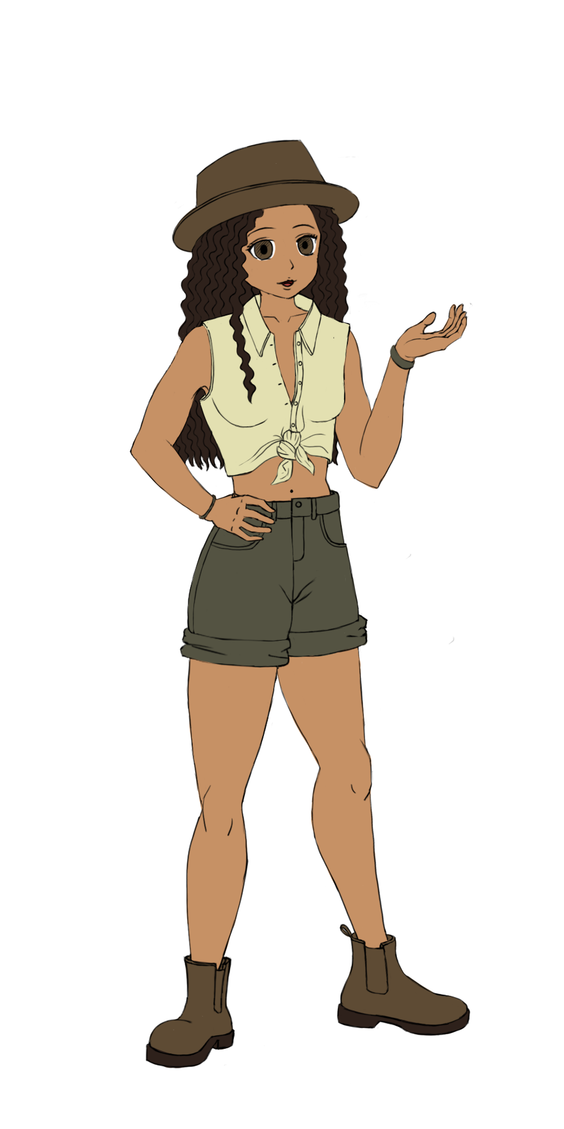
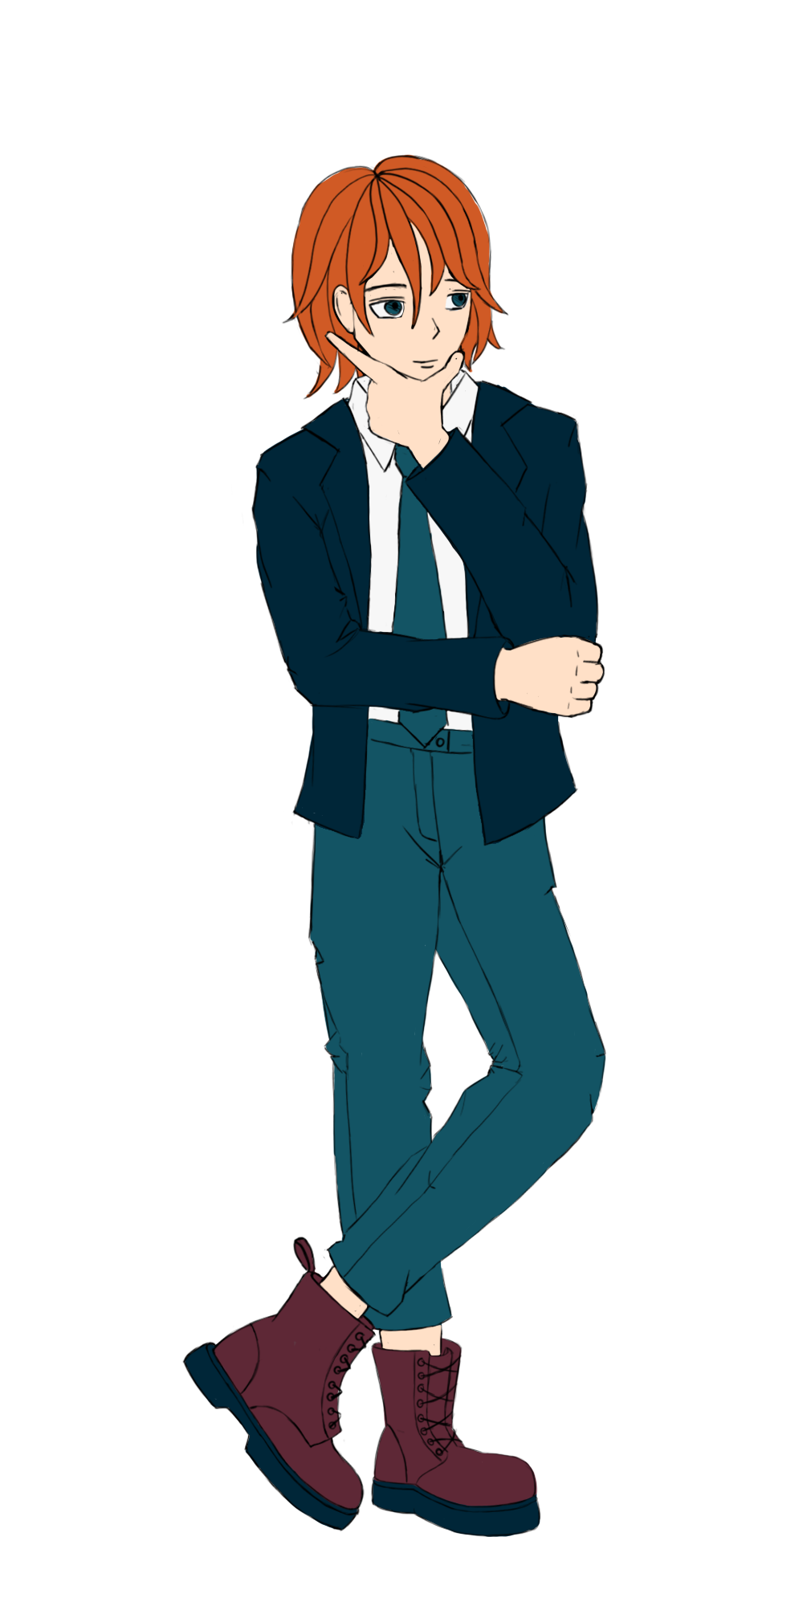
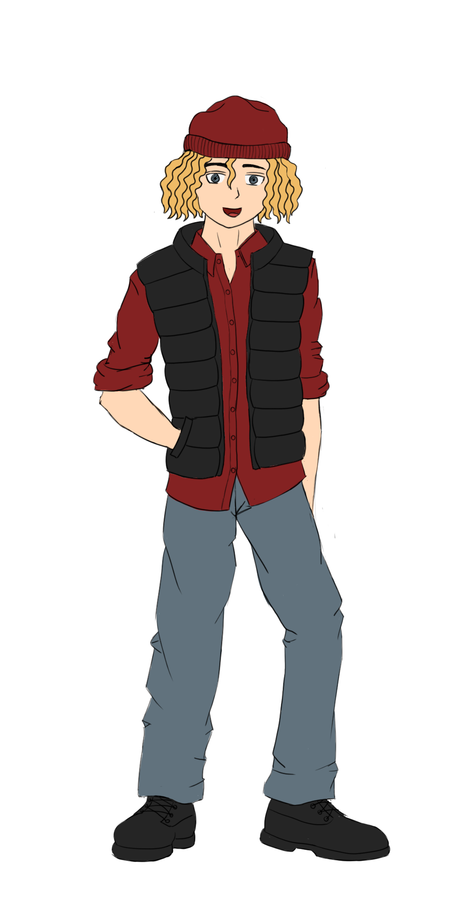
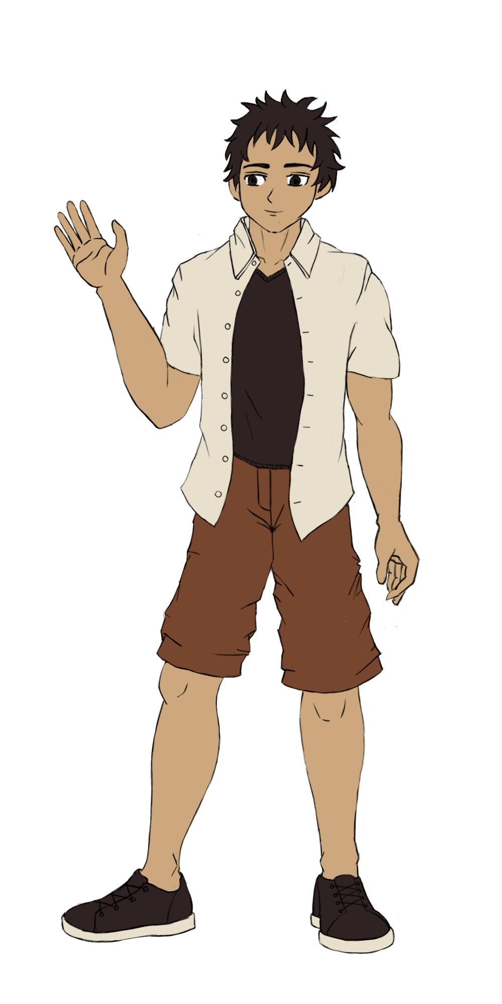
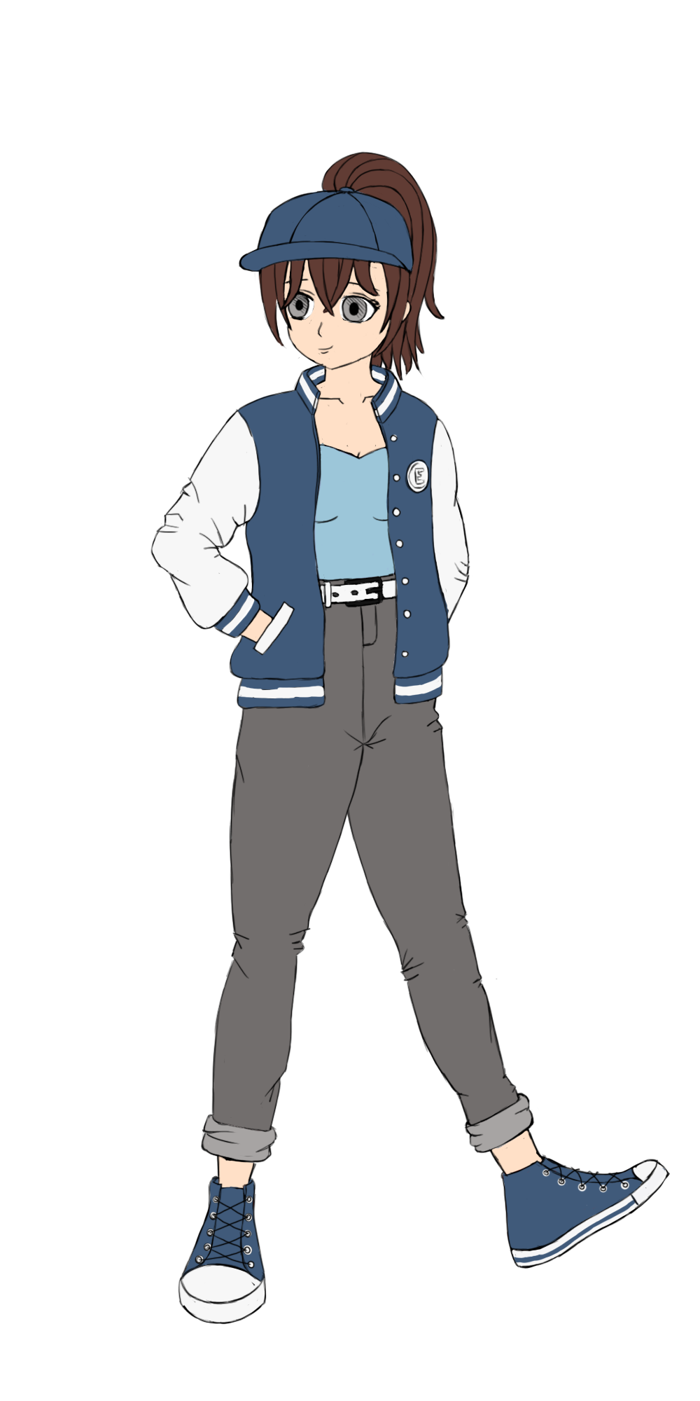
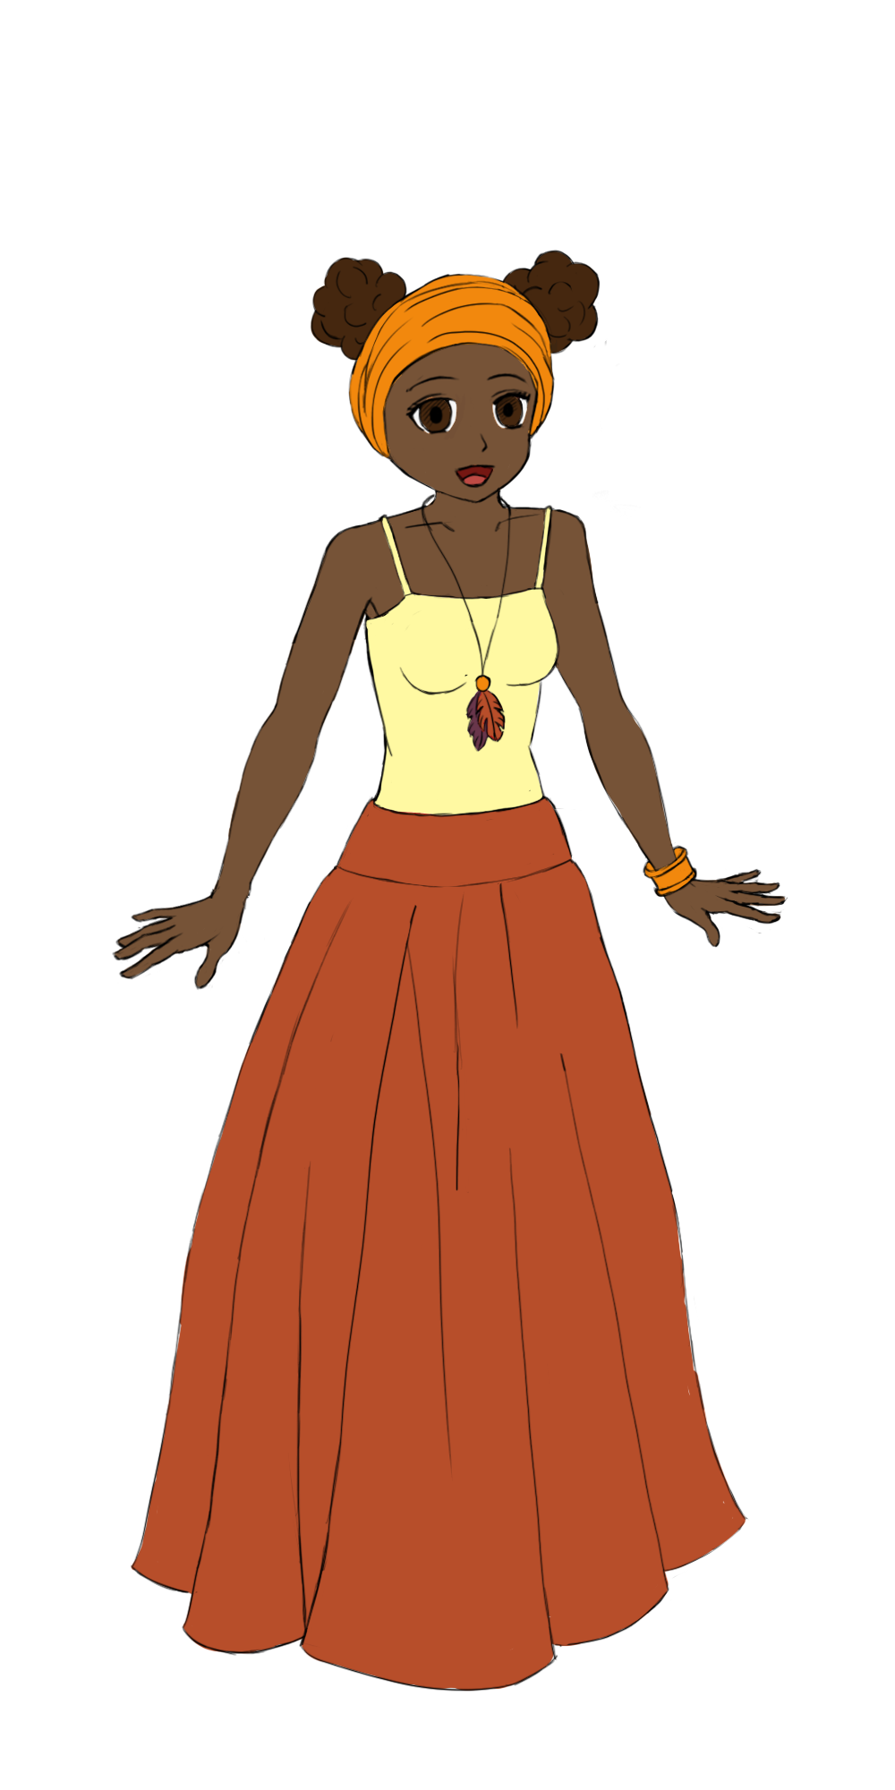
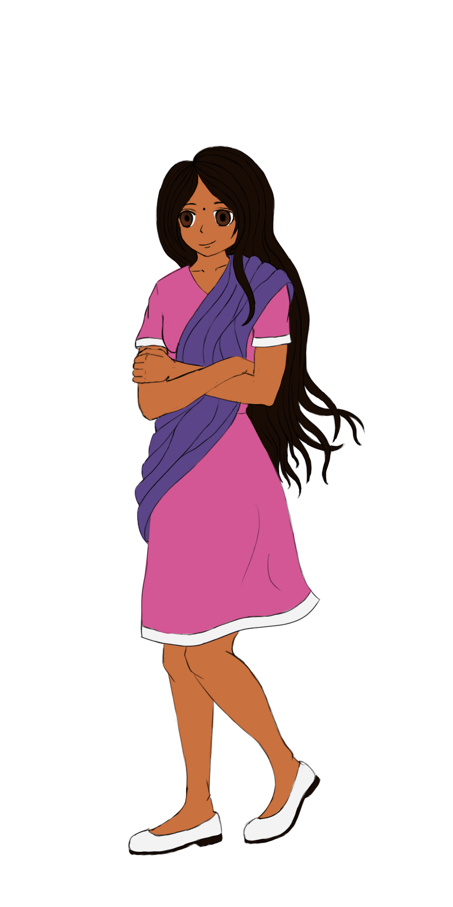
Sam’s friends
Jamie
Jackie
Emma
Oliver
Mansi
Immanuel
Jenna

Slide 12
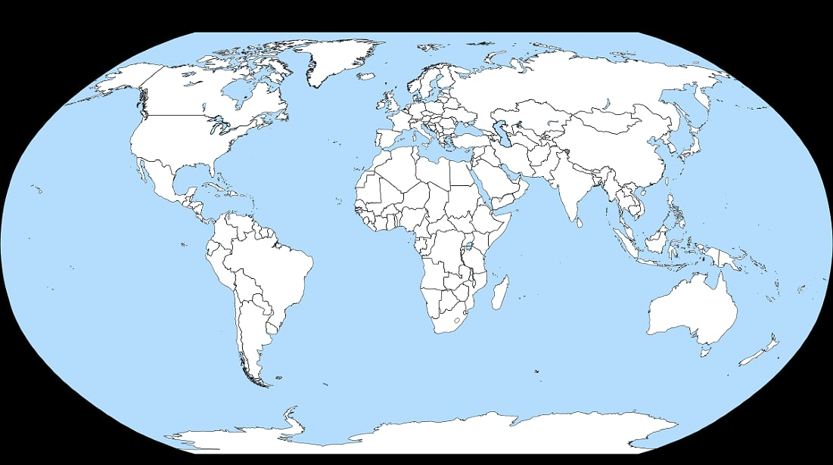
Jamie
Scotland
Oliver
Canada
Sam
England
Jackie
Australia
Mansi
India
Emma
USA
Immanuel
Singapore
Jenna
South Africa

Slide 13
England
Scotland

Slide 14
The USA
Canada

Slide 15
India
Singapore

Slide 16
South Africa
Australia

Slide 17
Let’s recap!
America (USA)
Australia
American
Australian
South Africa
India
South African
Indian

Slide 18
Let’s recap!
Singapore
Canada
Singaporean
Canadian
England
Scotland
English
Scottish

Slide 19
country quiz

Slide 20
nationality quiz

Slide 21
Question time!
What’s her name?
Her name is Jackie.
Where does she come from?
She comes from Australia. She is Australian.
How old is she?
She is 12.

Slide 22
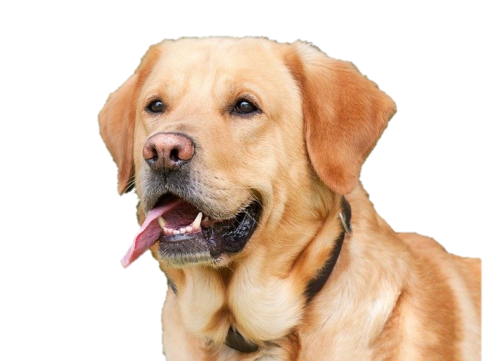
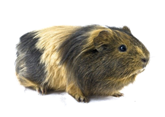
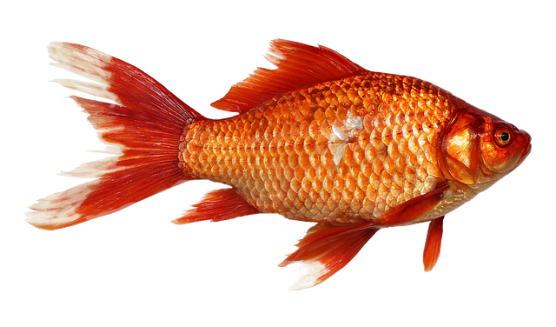
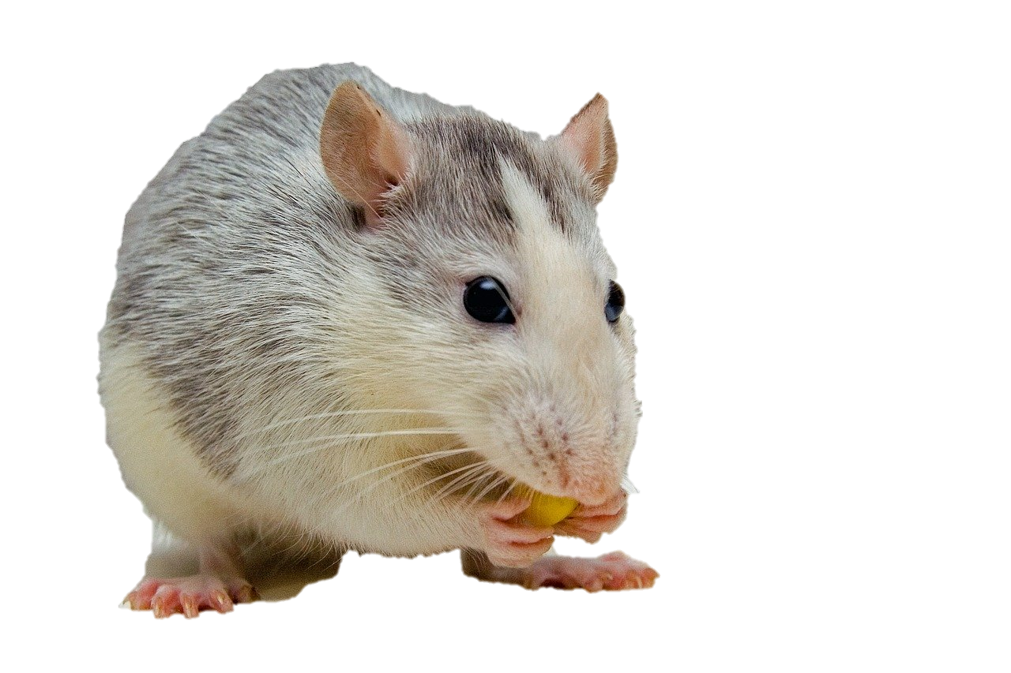
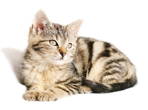
Jamie’s pets

Slide 23
Hobbies

Slide 24
Hobbies
1
2
3
4
5

Slide 25
Hobbies
1
2
3
4
5

Slide 26
Hobbies
1
2
3
4
5

Slide 27
Mansi’s hobbies

Slide 28
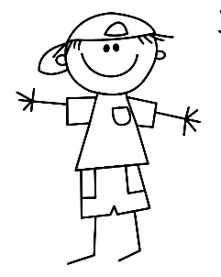
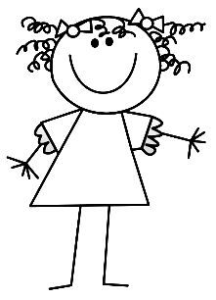
Let’s recap!
she
he
her
his

Slide 29
Sentence building
her
is
……
she
is
she
in

Slide 30
Sentence building
his
is
……
he
in
he
is

Slide 31
Sentence building
she
5
has
he
1
has

she
and

Slide 32
Challenge!
he
her
his
is
she
in

has
and

Slide 33
Today’s lesson
Présenter quelqu’un
Réviser les nombres 0 - 20
Prononcer la lettre H
Connaître quelques pays
Découvrir des accents

Slide 34
Goodbye song

Slide 35
CM2 - Year 6
Goodbye
from Anne-Valérie and Anna

Slide 36
Ressources and contributions
Pictures
https://stock.adobe.com/ https://pixabay.com/fr/
https://www.flaticon.com/ https://www.clipart.com/fr/index
Personal photos
Characters
Sam Lumni and her friends drawn by Manon
Audio recordings
Voices : Tess, Mansi, Lukas, Immanuel, Emily, Eddie, Sydny, Jacklyn, Richard, Dain, Erin
Music, melody and lyrics by Stephane and François
Conception
Anna, Anne-Valérie, Mathilde, Sabrina et Sandrine

