Slide 1
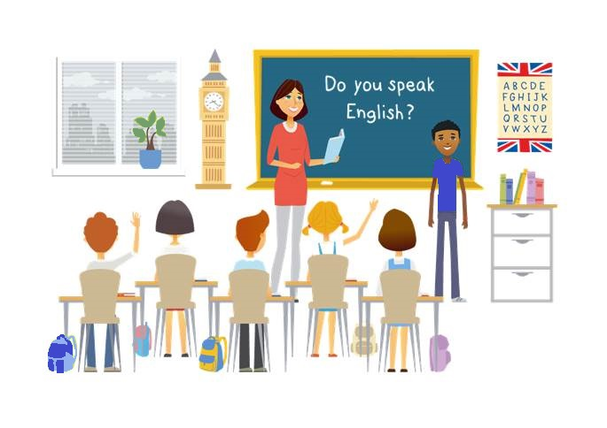
CM2 - Year 6
English
Class

Slide 2
Hello song

Slide 3
CM2 - Year 6
English
Class
by Anne-Valérie and Anna

Slide 4
Today’s lesson
Réviser l’écriture de la date
Se rendre à l’école
Écouter des anglophones
Apprendre le nom des vêtements
Décrire l’habillement d’un élève
Parler de sa routine

Slide 5
You need….
a pencil
a whiteboard marker
a copybook
a whiteboard

Slide 6
Let’s write the date
Pick a day
Pick a month
Pick a number
Wednesday
April
3rd
1st
31st
Thursday
July
17th
2nd
22nd
Tuesday
August
11th
30th
Thursday
,
August
2nd
,

Slide 7
Let’s recap!
Thursday
2nd
July
Thursday
,
July
2nd

Slide 8
Remember: what time is it?
It’s 8 o’clock.

Slide 9
Remember: what time is it?
to
past
Notes:
Dessiner les aiguilles
Insister sur to=before

Slide 10
Remember: what time is it?
It’s half past 8.

Slide 11
What time is it ?
quarter
quarter
to
past
Notes:
Dessiner les aiguilles
Insister sur to=before

Slide 12
Remember: what time is it?
It’s quater to 6.

Slide 13
Remember: what time is it?
Notes:
Ecouter et dessiner l’heure.
2 o’clock
11 o’clock
midnight

Slide 14
My morning routine
wake up
get up
make my bed

Slide 15
My morning routine
have a shower
brush my teeth
brush my hair
have breakfast
Notes:
Enseignante 1 présente sa routine
Enseignante 2 présente sa routine en changeant l’ordre

Slide 16
Memorise!
Notes:
Repeat in the right order

Slide 17
Memorise!
Notes:
The routines are all mixed up
Can you point to ……

Slide 18
Plan the day!
B
C
D
A
F
E
G
Notes:
Enseignantes 1 et 2
Write the letters in the right order

Slide 19
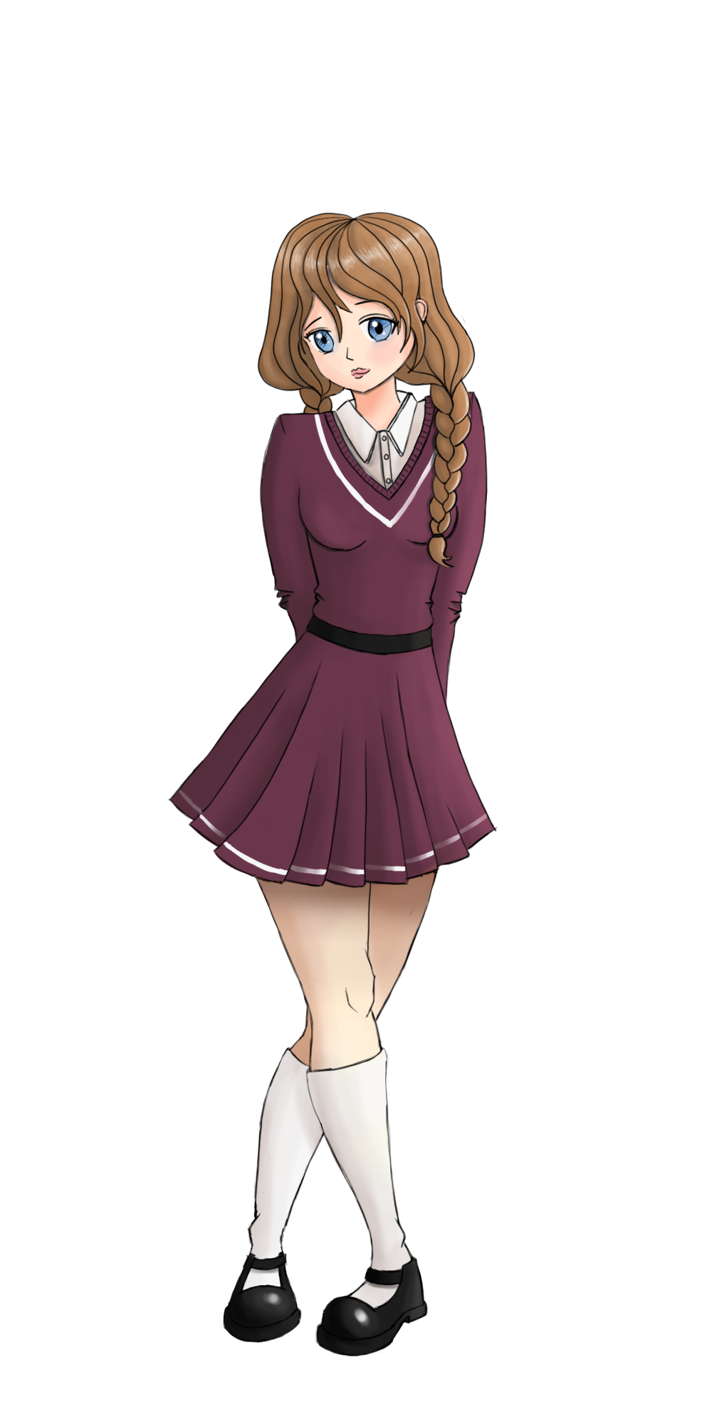
Sam’s morning routine
1
2
3
4
5
6
7
Notes:
Enseignantes 1 et 2 donnent les indications de la morning routine de Sam.
She wakes up.
Shower before Breakfastcf slide 18
Faire la correction en reliant.

Slide 20
Challenge!
Sam has a shower.
Sam gets up.
Sam has breakfast.
Notes:
Enseignante 1 et 2 font les dialogues

Slide 21
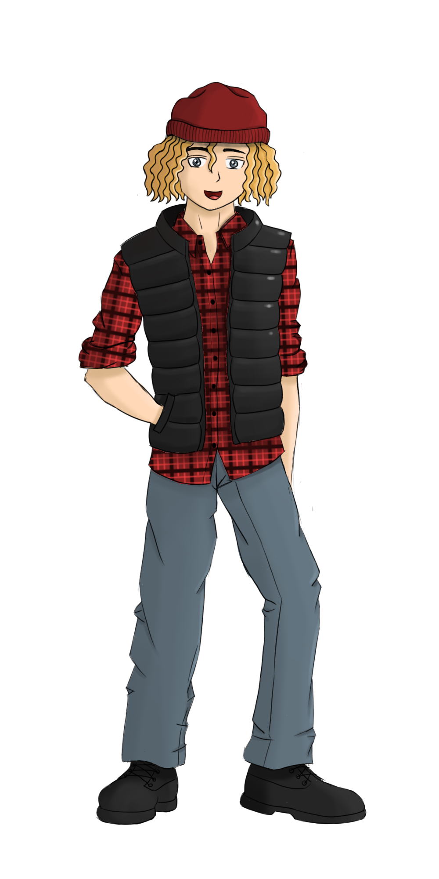
Oliver’s morning routine
?
?
?

Slide 22
Remember: the colours
Notes:
On a déjà travaillé les émotions
On peut rajouter la météo
I’m happy because it’s warm and sunny today

Slide 23
Remember: the colours
blue
light blue
dark blue
Notes:
On a déjà travaillé les émotions
On peut rajouter la météo
I’m happy because it’s warm and sunny today

Slide 24
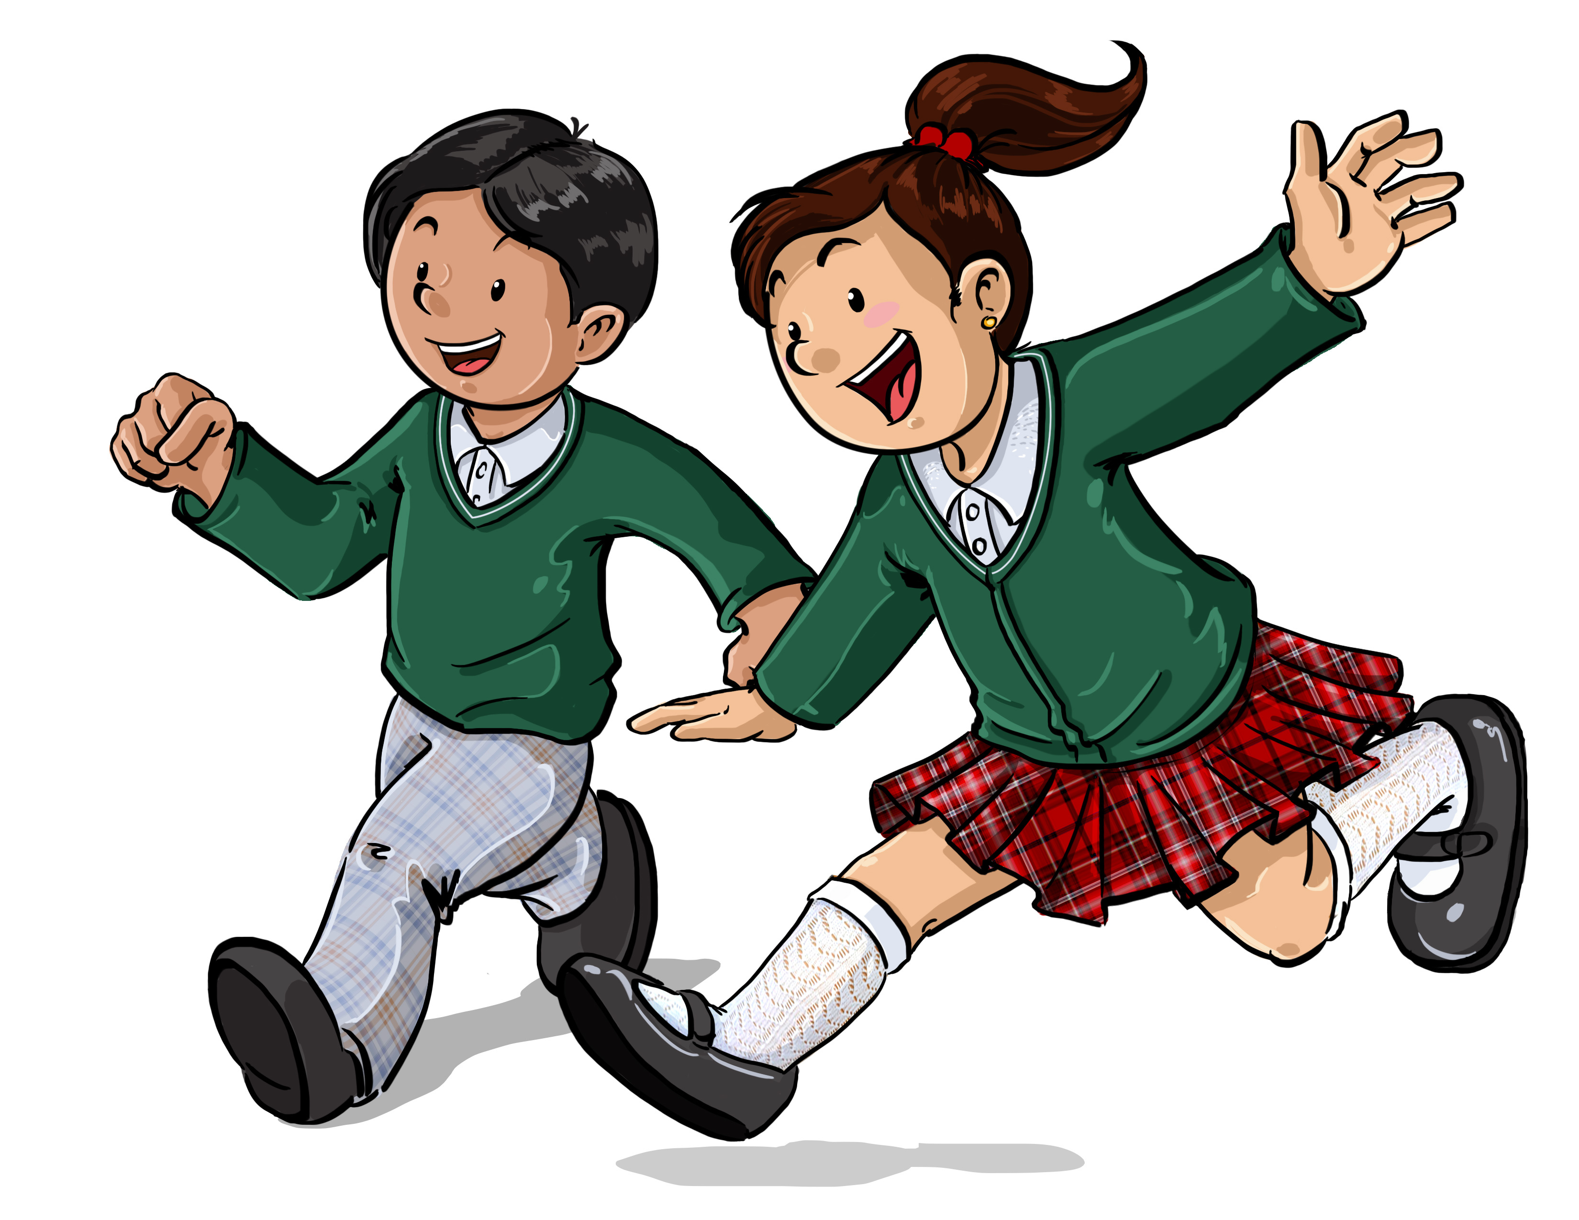
school uniform
Notes:
Présentation des vrais uniformes qui sortent d’un sac à dos
Le voc est vu à l’oral: short sleeves/long sleeves, summer dress/winter dress
Trousers, skirt, shirt, jumper, cardigan, tie, school emblem,

Slide 25
school uniform
tie
shirt
jumper
cardigan
dress
trousers
Skirt
shoes
socks
Notes:
Présentation des vrais uniformes qui sortent d’un sac à dos
Le voc est vu à l’oral:
Trousers, skirt, shirt, jumper, cardigan, tie, school emblem, dress
Correction en faisant les flèches
Introduire la notion de pluriel

Slide 26
Let’s recap !
shoe
shoes
trousers
Notes:
This is Sam.
What is she wearing?

Slide 27
she
is
wearing …
school uniform
a
?
a
singular
plural
+
Notes:
This is Sam.
What is she wearing?
Enseignantes 1 et 2 production orale avec etayage

Slide 28
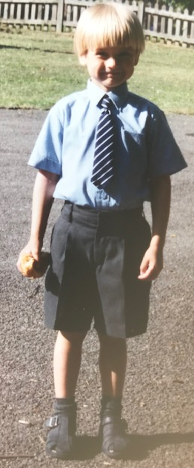
he
is
wearing …
school uniform
a
?
a
singular
plural
+
Notes:
This is my son.
What is he wearing?
What season is it ?
What is missing for the winter uniform ?
Montrer les éléments qui vont s’ajouter

Slide 29
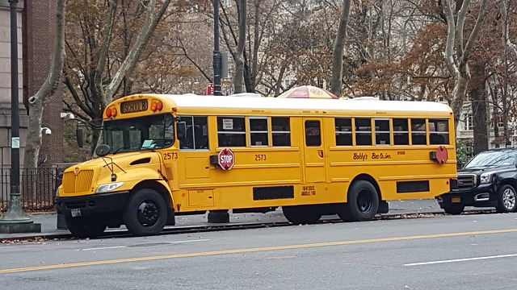
How do they go to school?
Notes:
On: partie du corps
By: avec un moyen de transport

Slide 30
How do you go to school?
on foot
by bus
by train
by bicycle
by car
Notes:
On: partie du corps
By: avec un moyen de transport

Slide 31
Sentence building
to
train
I
to
I
by
go
by
go
train
bus
to
by
bus
Oliver
goes
to
by
Oliver
goes
foot
to
on
foot
Sam
goes
to
on
Sam
goes

Slide 32
Challenge !
Create, colour and describe your school uniform.
Explain how you go to school.
Post it with help of an adult on:
#Englishlumni

Slide 33
Today’s lesson
Réviser l’écriture de la date
Se rendre à l’école
Écouter des anglophones
Apprendre le nom des vêtements
Décrire l’habillement d’un élève
Parler de sa routine

Slide 34
Goodbye song

Slide 35
CM2 - Year 6
Goodbye
by Anne-Valérie and Anna
Notes:
Rituel:
Enseignant 1: se présente
Enseignant 2: se présente
Enseignants 1 et 2: Welcome to our English class!!
https://pixabay.com/fr/illustrations/insigne-flair-anglais-langue-1093968/

Slide 36
Ressources and contributions
Pictures
https://stock.adobe.com/ https://pixabay.com/fr/
https://www.flaticon.com/ https://www.clipart.com/fr/index
Personal photos
Characters
Sam Lumni and her friends drawn by Manon
Audio recordings
Voices : Tess, Mansi, Lukas, Immanuel, Emily, Eddie, Sydny, Jacklyn, Richard, Dain, Erin
Music, melody and lyrics by Stephane and François
Conception
Anna, Anne-Valérie, Mathilde, Sabrina et Sandrine

