Slide 1
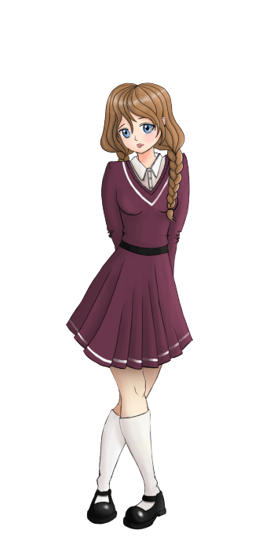
English with
Ionna
and
Anne
Sam

Slide 2
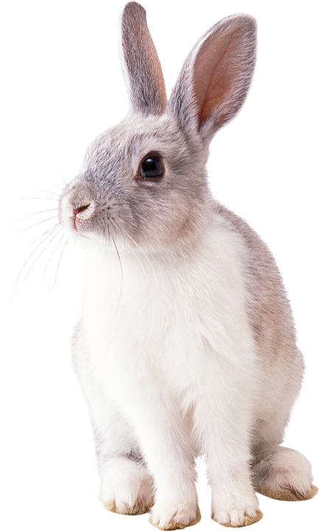
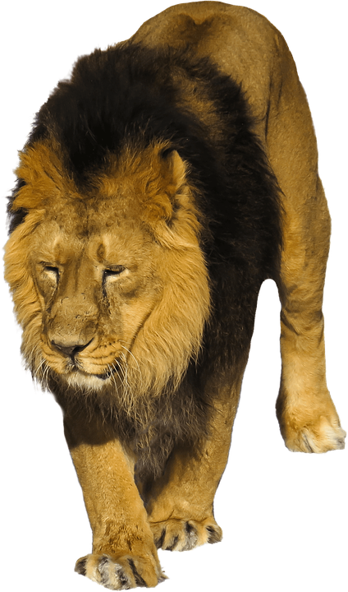
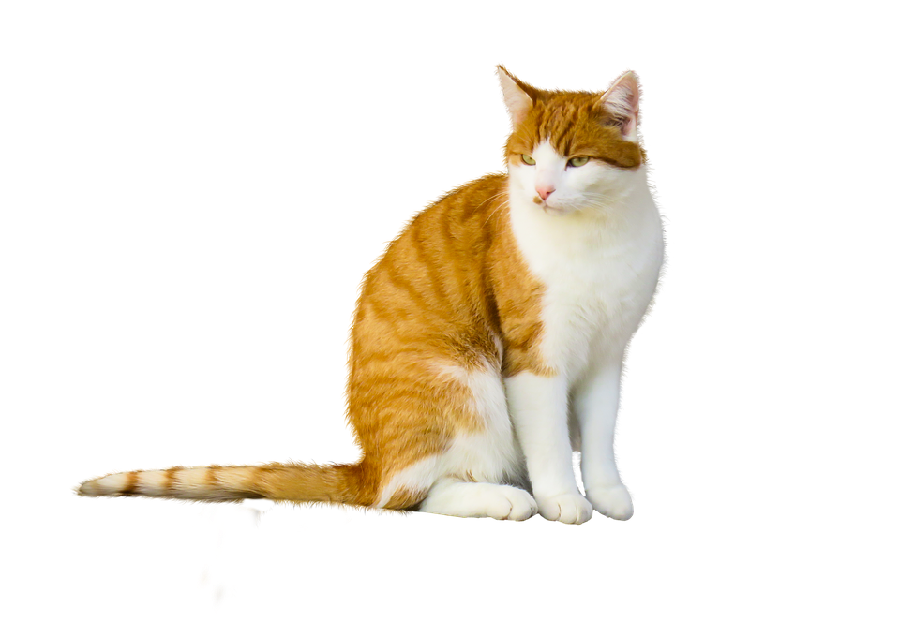
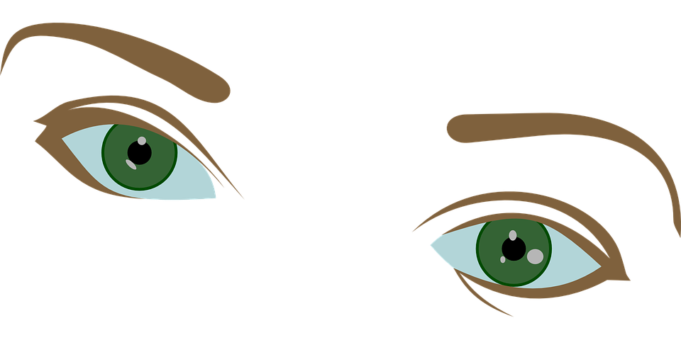
Dans ce cours, tu vas :
A
B
C
D
E
F
chanter
découvrir des animaux sauvages et domestiques
découvrir l’alphabet
nommer quelques parties du corps

Slide 3
The Hello song !
Let’s sing!

Slide 4
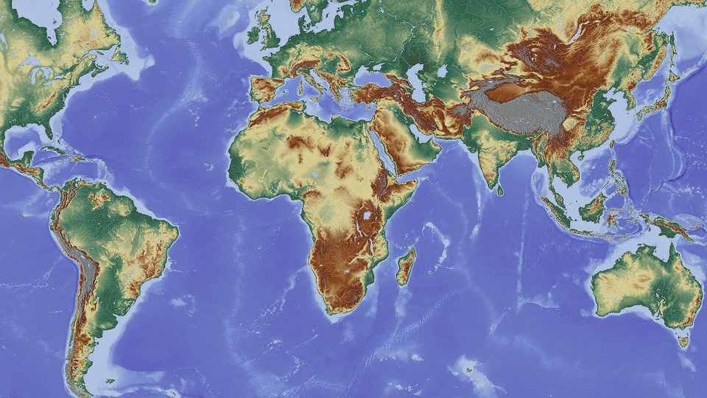
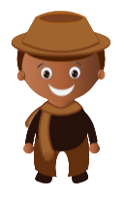
AFRICA
SOUTH
AFRICA
CAPE TOWN

Slide 5
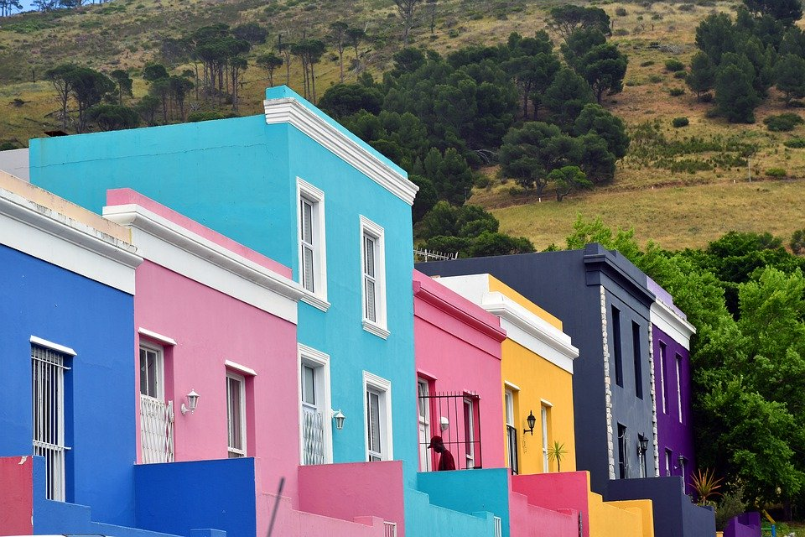
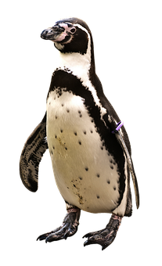
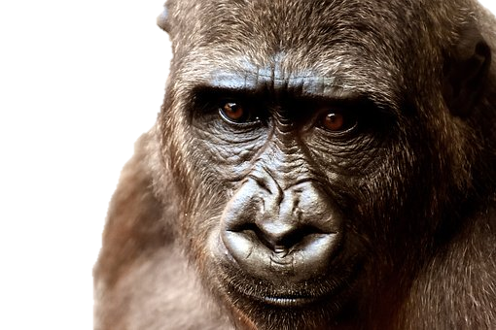
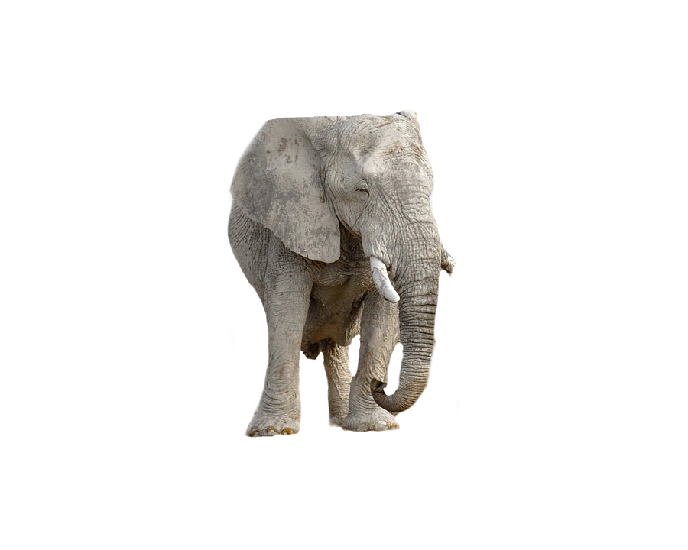
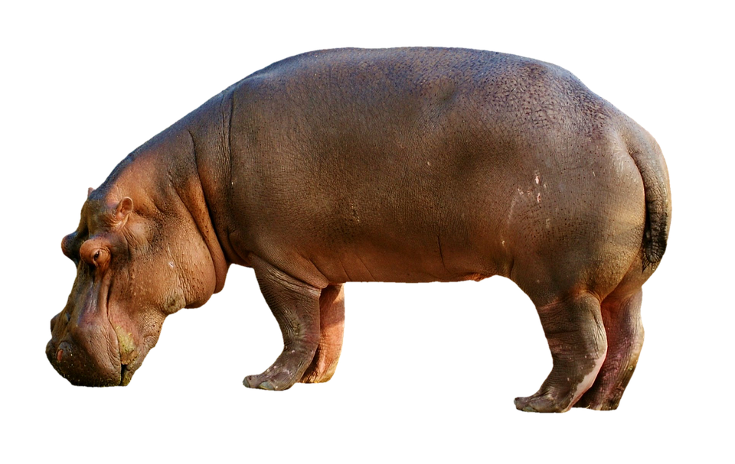
Welcome !

Slide 6
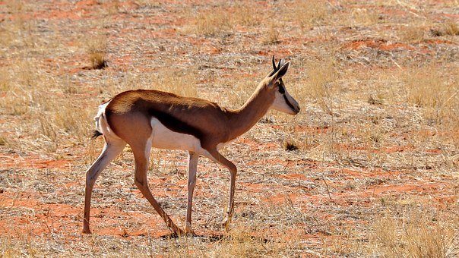
A SPRINGBOK

Slide 7
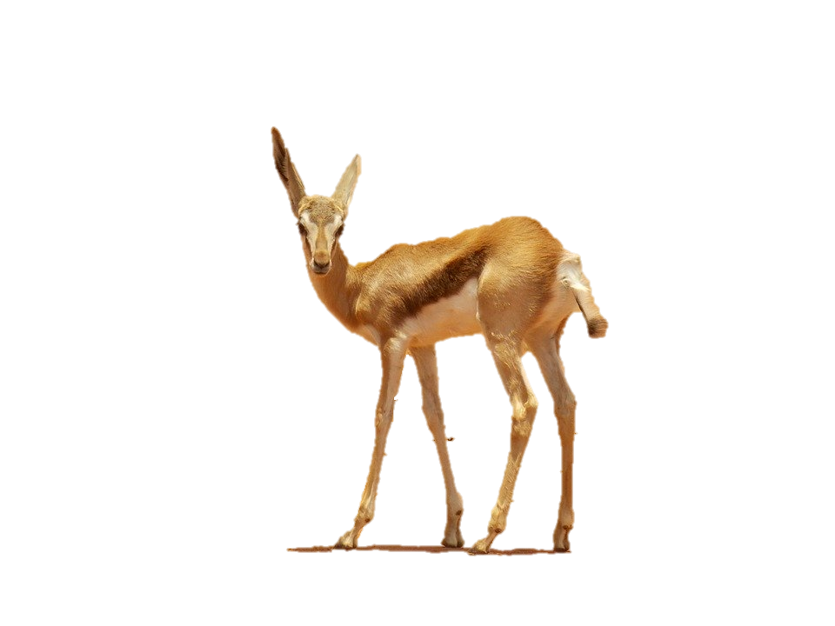
3
2
1
6
5
4

Slide 8
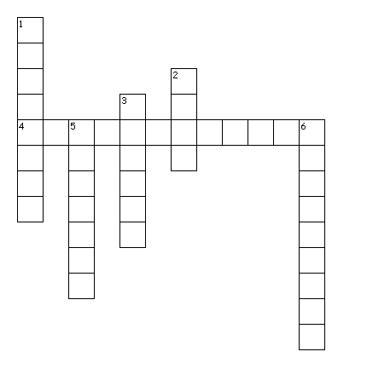
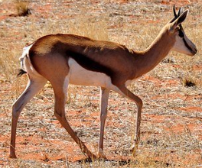
E
L
E
P
Across
4.
Down
1.
2.
3.
5.
6.
L
I
N
M
NKEY
HIPPOPOTAMUS
A
N
T
E
N
G
U
I
N
P
R
I
N
G
B
O
K

Slide 9
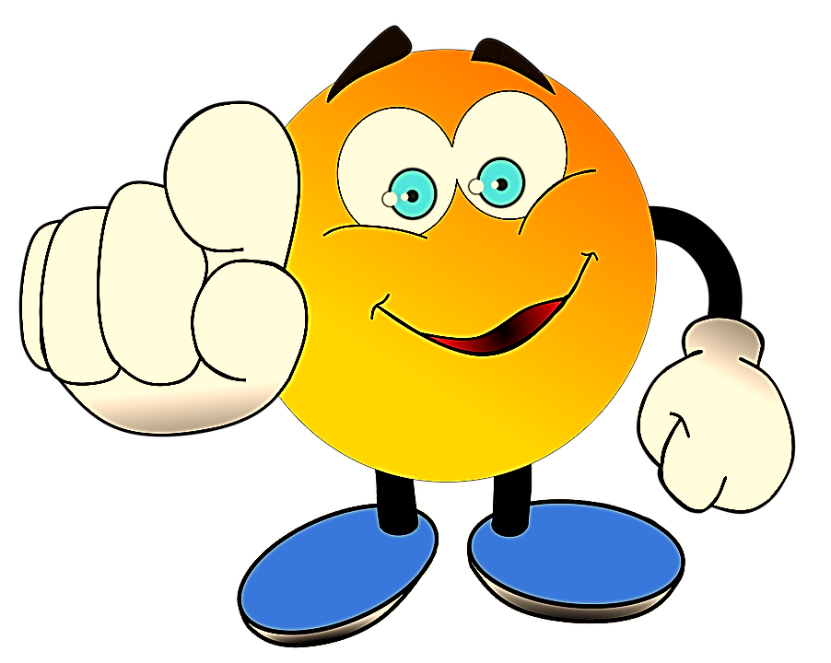
A
B
C
D
E
F
G
H
I
J
K
L
M
N
O
P
Q
R
S
T
U
V
W
X
Y
Z

Slide 10
B
C
D
E
F
G
I
L
M
N
O
P
Q
R
S
T
U
V
W
X
Y
Z
A
H
J
K

Slide 11
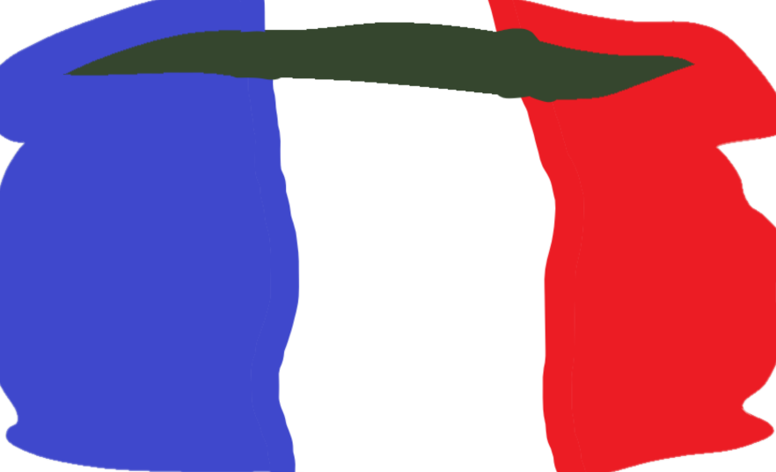
F
I
L
M
N
O
Q
S
W
R
U
X
Y
Z
B
C
D
E
A
H
G
P
T
V
J
K

Slide 12
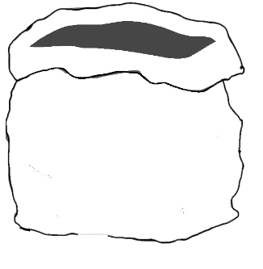
Y
F
L
M
I
N
S
Z
O
Q
U
W
B
C
D
E
A
H
R
X
G
P
T
V
J
K

Slide 13
F
L
M
I
N
S
Y
O
Z
Q
U
W
B
C
D
E
A
H
G
P
T
V
J
K
R
X

Slide 14
F
L
M
Q
U
A
H
B
C
D
E
O
I
Y
J
K
N
Z
G
P
T
V
S
W
R
X
LION

Slide 15
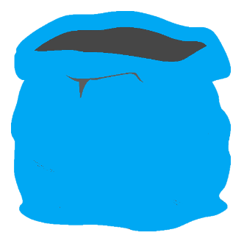
Q
U
F
L
M
A
H
B
C
D
E
O
I
Y
J
K
N
Z
G
P
T
V
S
W
R
X
MONKEY

Slide 16
Q
U
F
L
M
A
H
B
C
D
E
O
I
Y
J
K
N
Z
G
P
V
N
S
T
W
R
X

Slide 17
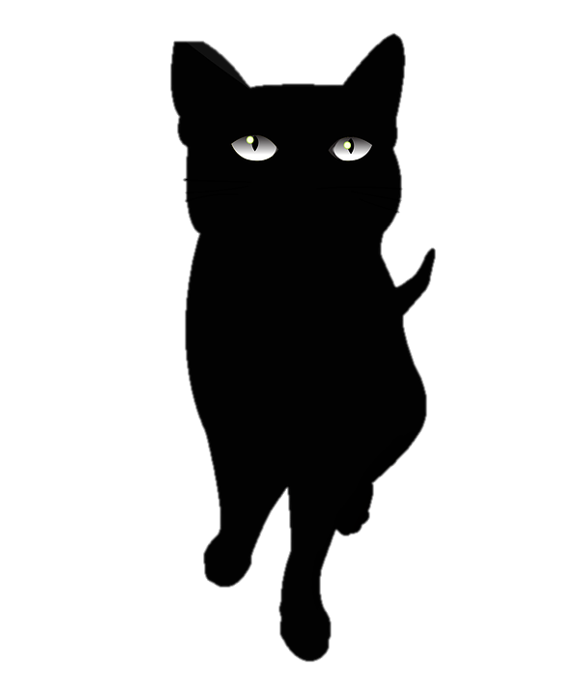
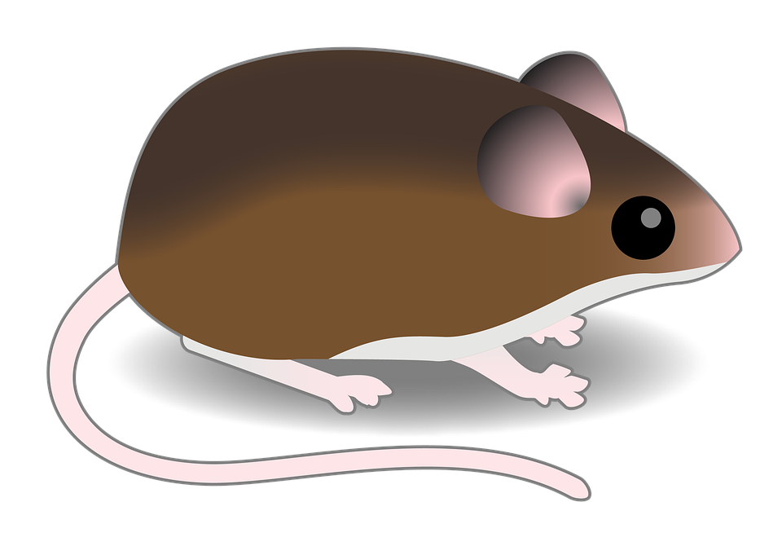
A black cat,
a brown mouse
and a purple bird.

Slide 18
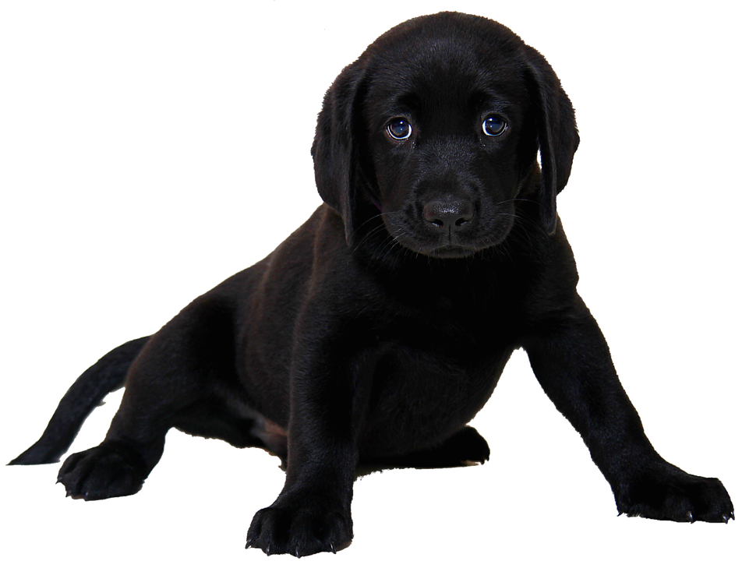
?

Slide 19
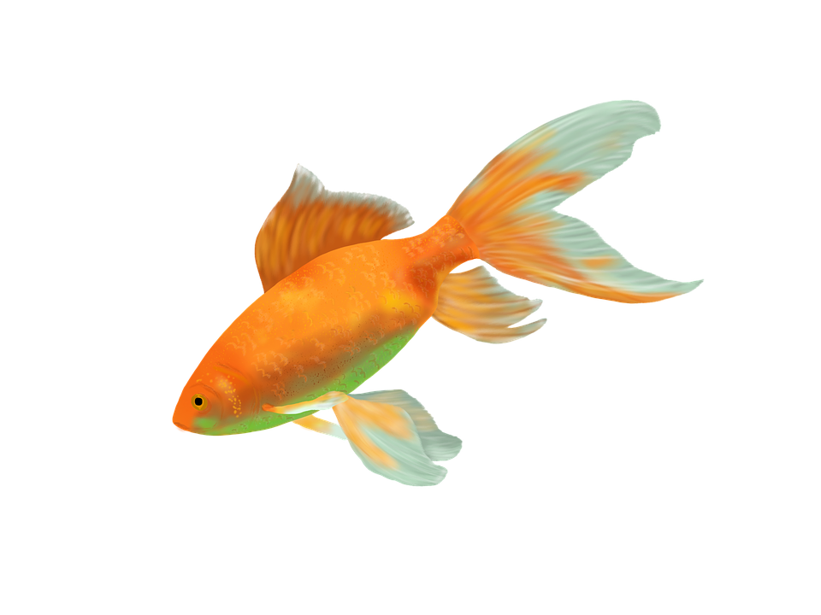
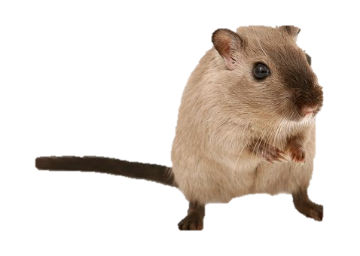
?
Notes:
Tu me demande Have you got a pet? Je dis no, I haven’t.
Je te demande Have you got a pet. Yes, I’ve got a goldfish, a bird and a hamster. On fait s’afficher tes animaux

Slide 20
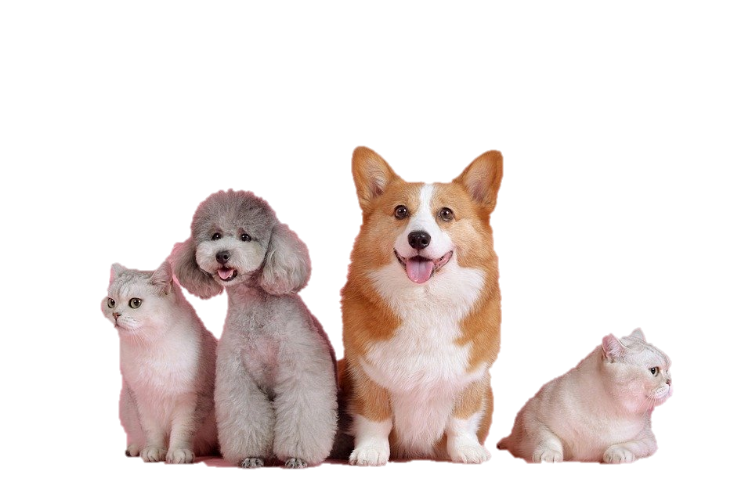
?

Slide 21
Yes, I have.
No, I haven’t.

Slide 22
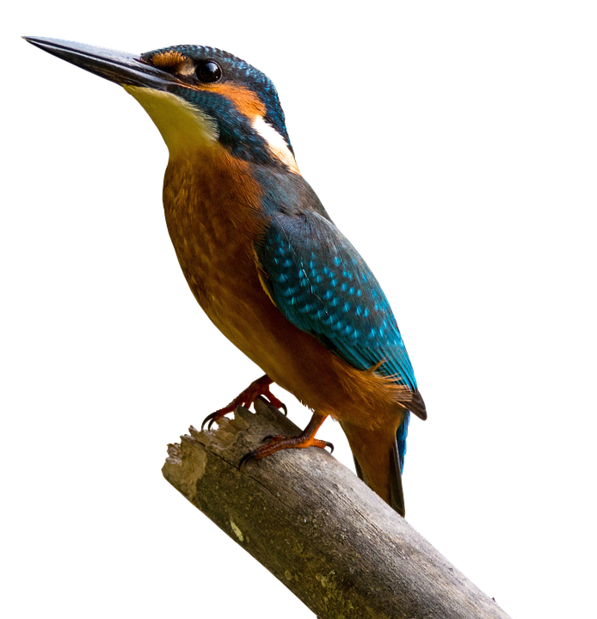
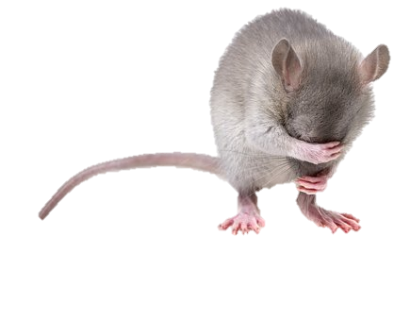
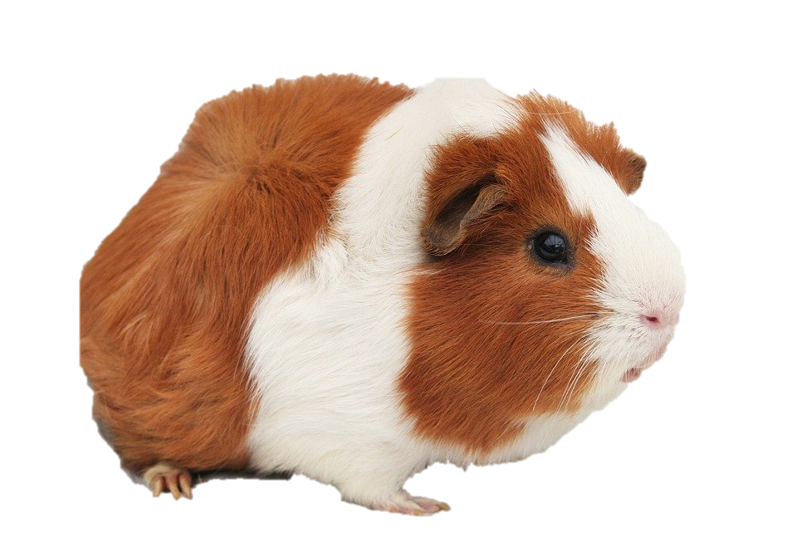
4
2
3
1
7
6
5

Slide 23
goldfish
7
rabbit
1
cat
mouse
hamster
2
6
bird
dog
3
5
4

Slide 24
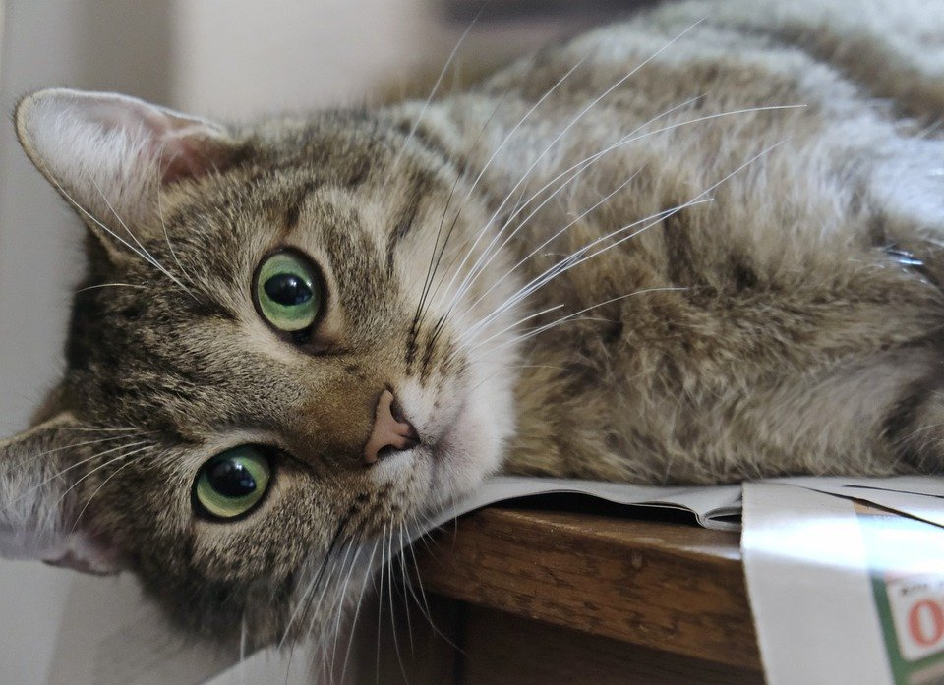
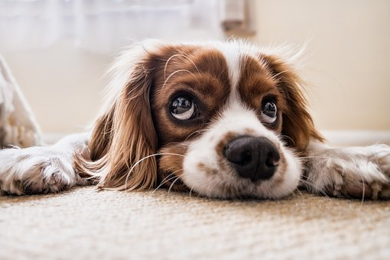
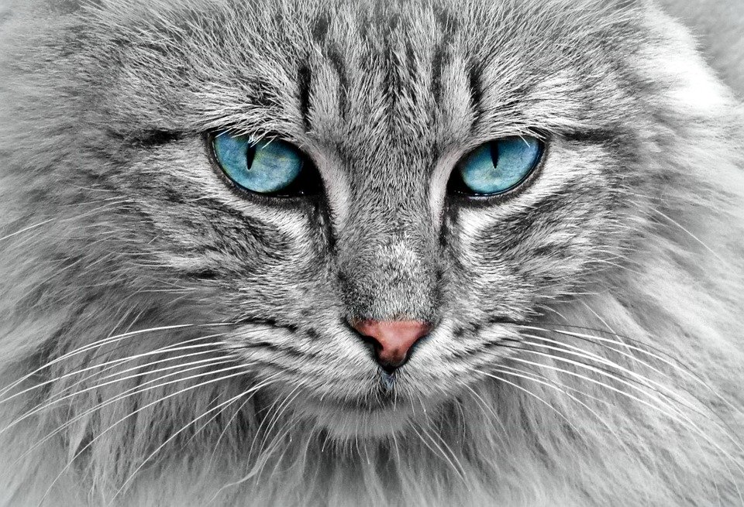
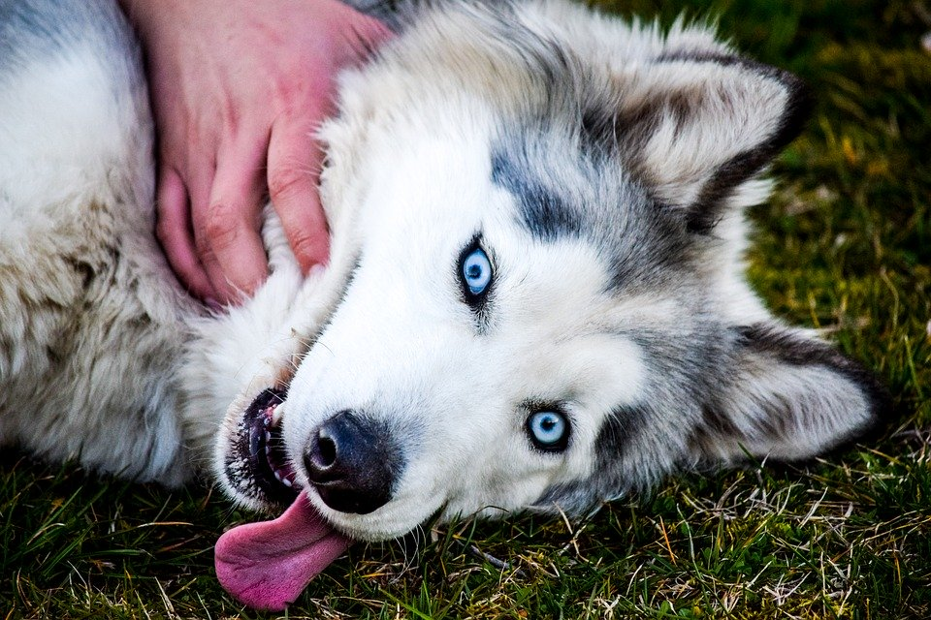
1
1
2
2
Notes:
my cat has got green eyes and my dog has got blue eyes

Slide 25
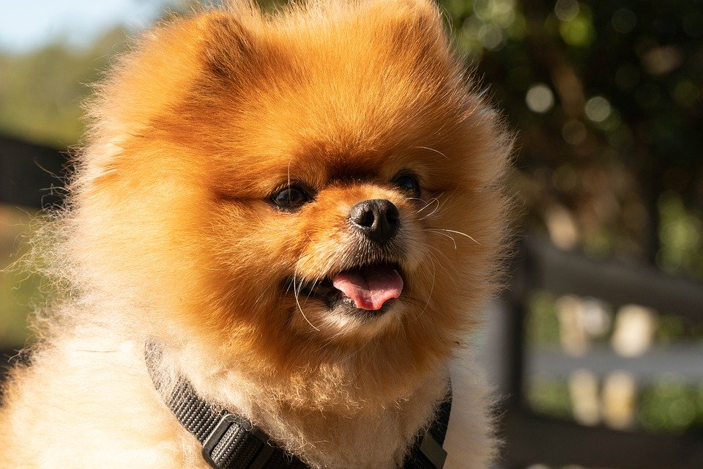
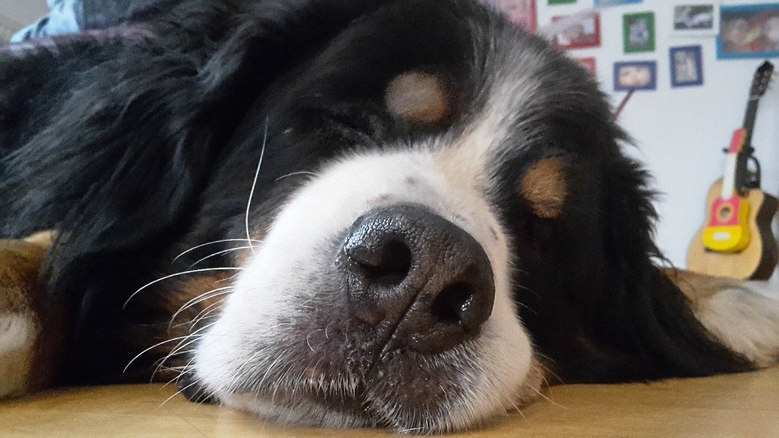
1
2
Tommy
Roxy
Notes:
Tommy has got a big nose. Roxy has got a small nose.

Slide 26
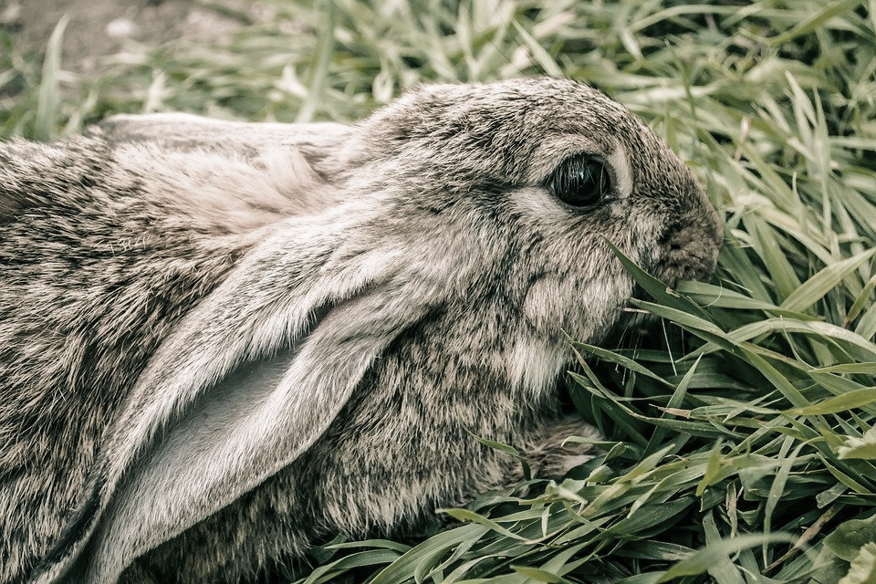
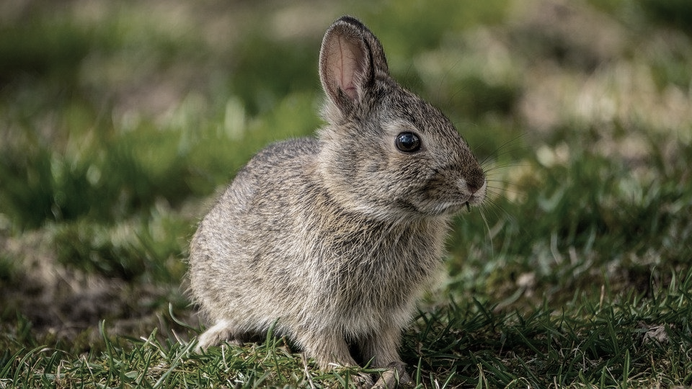
1
2
Amy
Tom
Notes:
Tom has got small ears and Amy has got long ears.

Slide 27
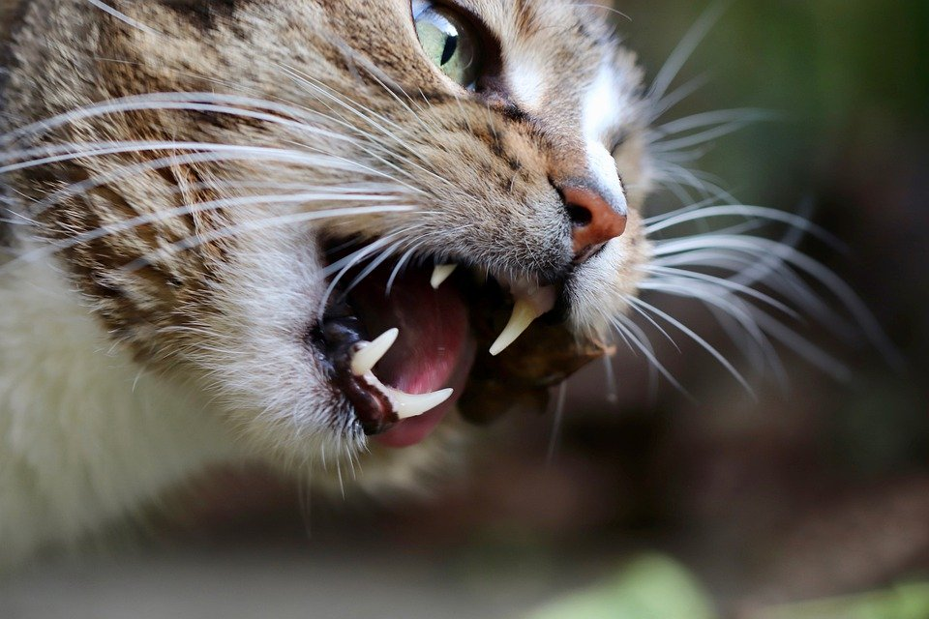
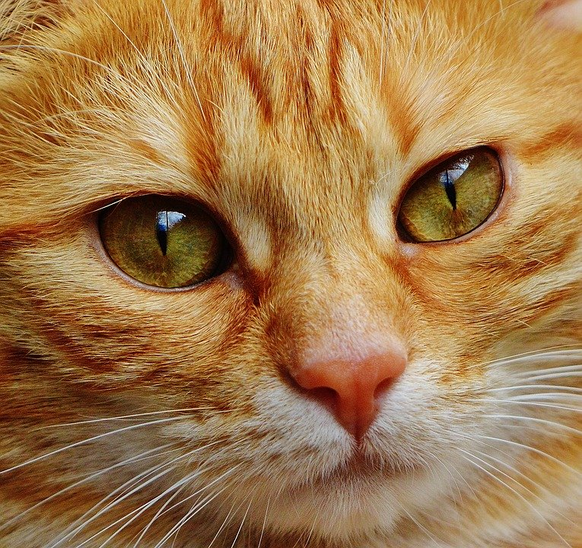
1
2
My cat
Notes:
My cat has got green eyes, a small nose and a big mouth!

Slide 28
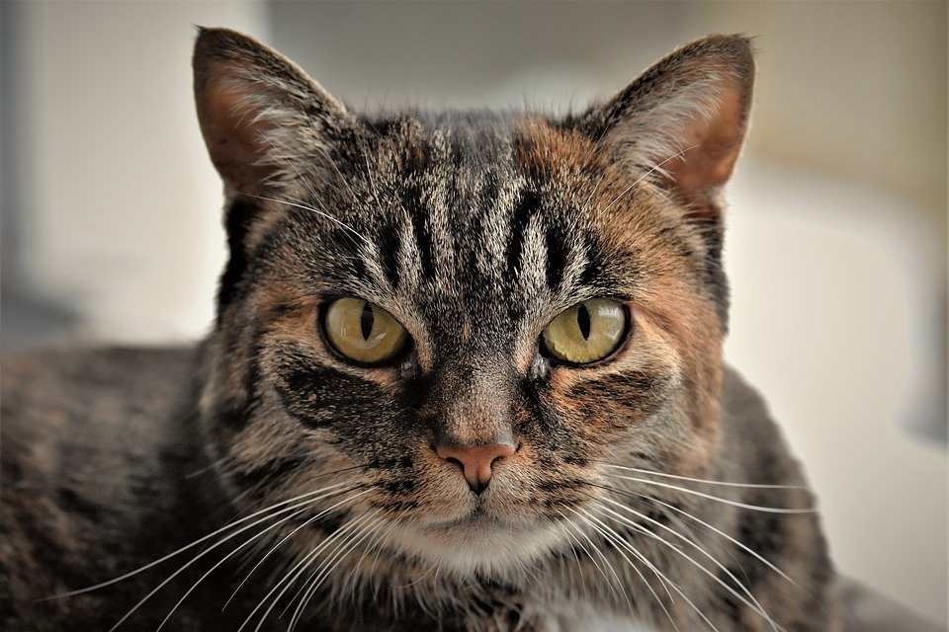
1
3
2
4

Slide 29
eyes
nose
ears
mouth

Slide 30
Q
U
F
L
M
A
H
B
C
D
E
E
O
I
Y
J
K
N
Z
G
P
T
V
S
W
R
X
EYES

Slide 31
Q
U
F
L
M
A
H
B
C
D
E
O
I
Y
J
K
N
Z
G
P
T
V
S
W
R
X
Notes:
On épèle E A R S

Slide 32
Q
U
F
L
M
A
H
B
C
D
E
O
I
Y
J
K
N
Z
G
P
T
V
S
W
R
X
MOUTH

Slide 33
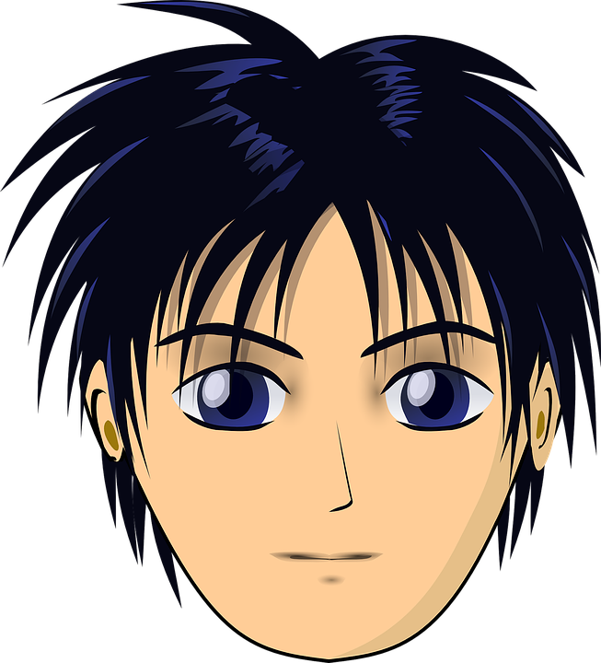
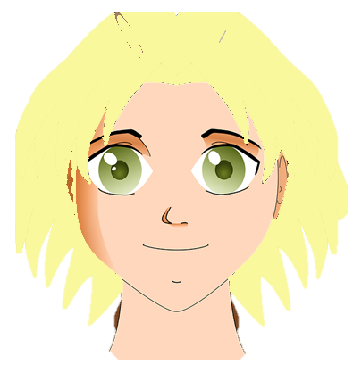
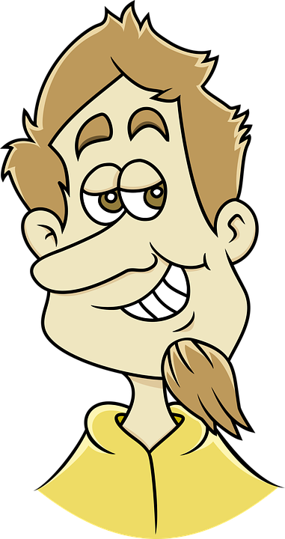
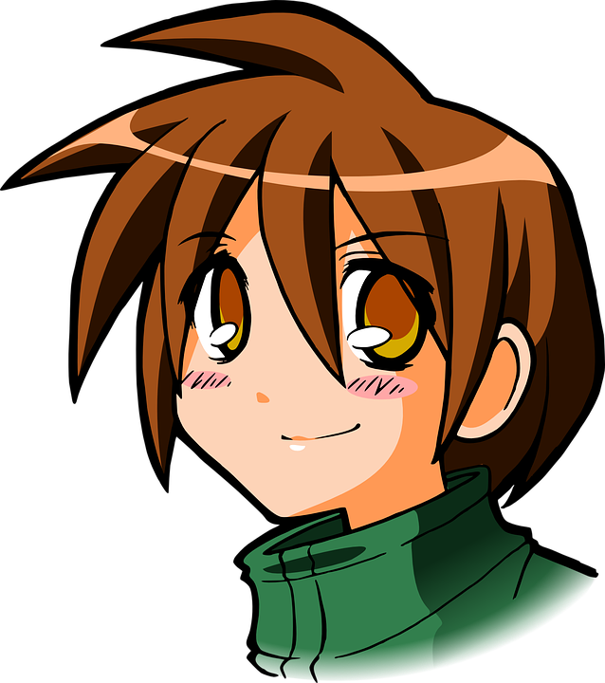
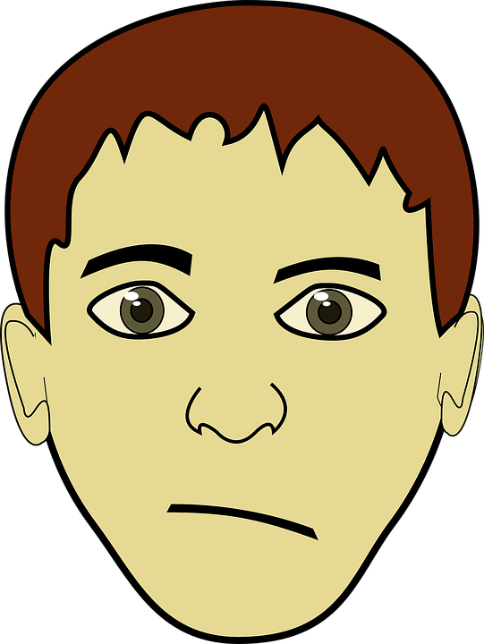
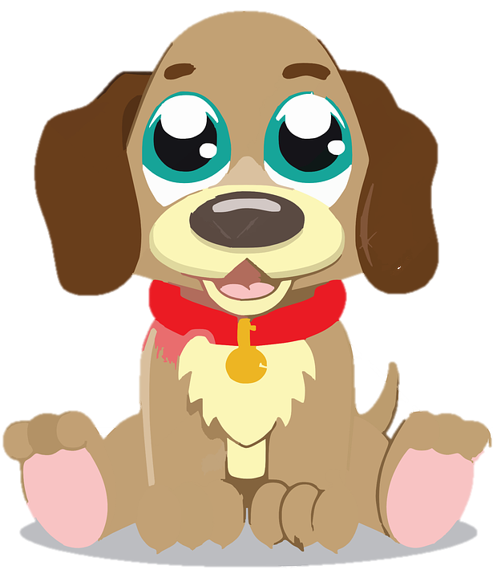
Kevin
3
2
3
2
4
5
1
4
1
Notes:
Rex lives with Kevin. Kevin has got a small nose. He has got green eyes and blond hair.

Slide 34
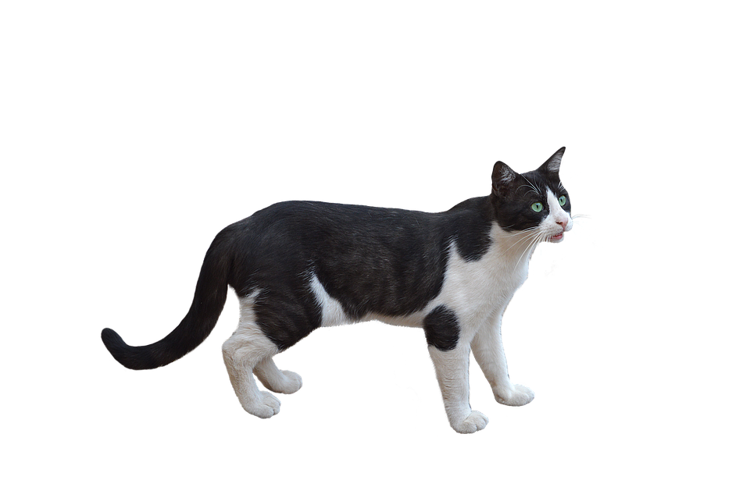
Tom
2
3
5
1
4
Notes:
Rex lives with Tom. Tom has got brown hair, brown eyes and a long nose

Slide 35
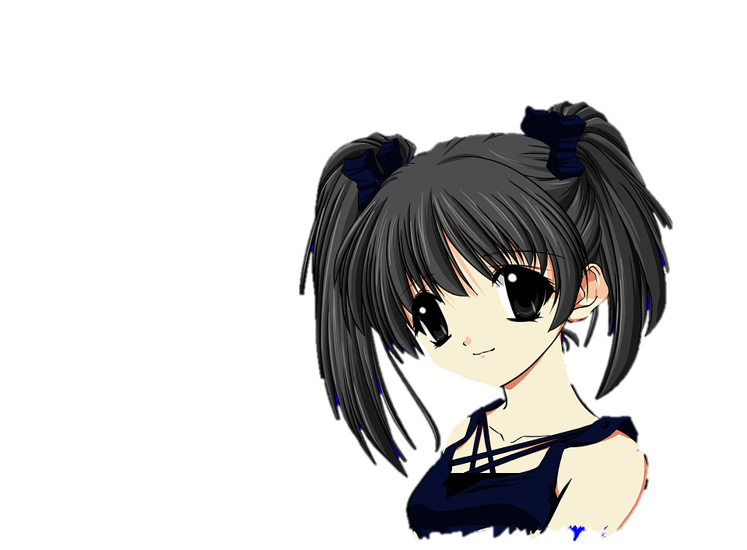
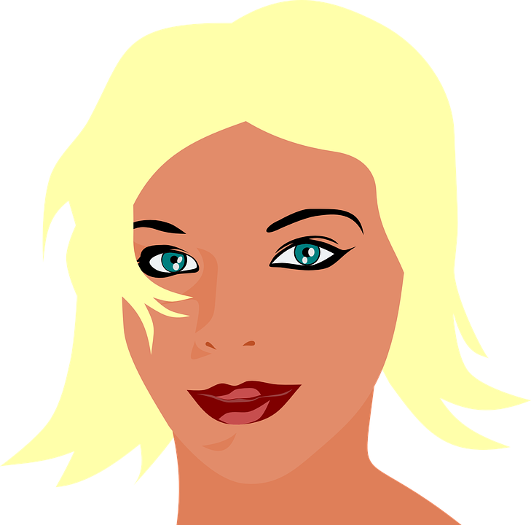
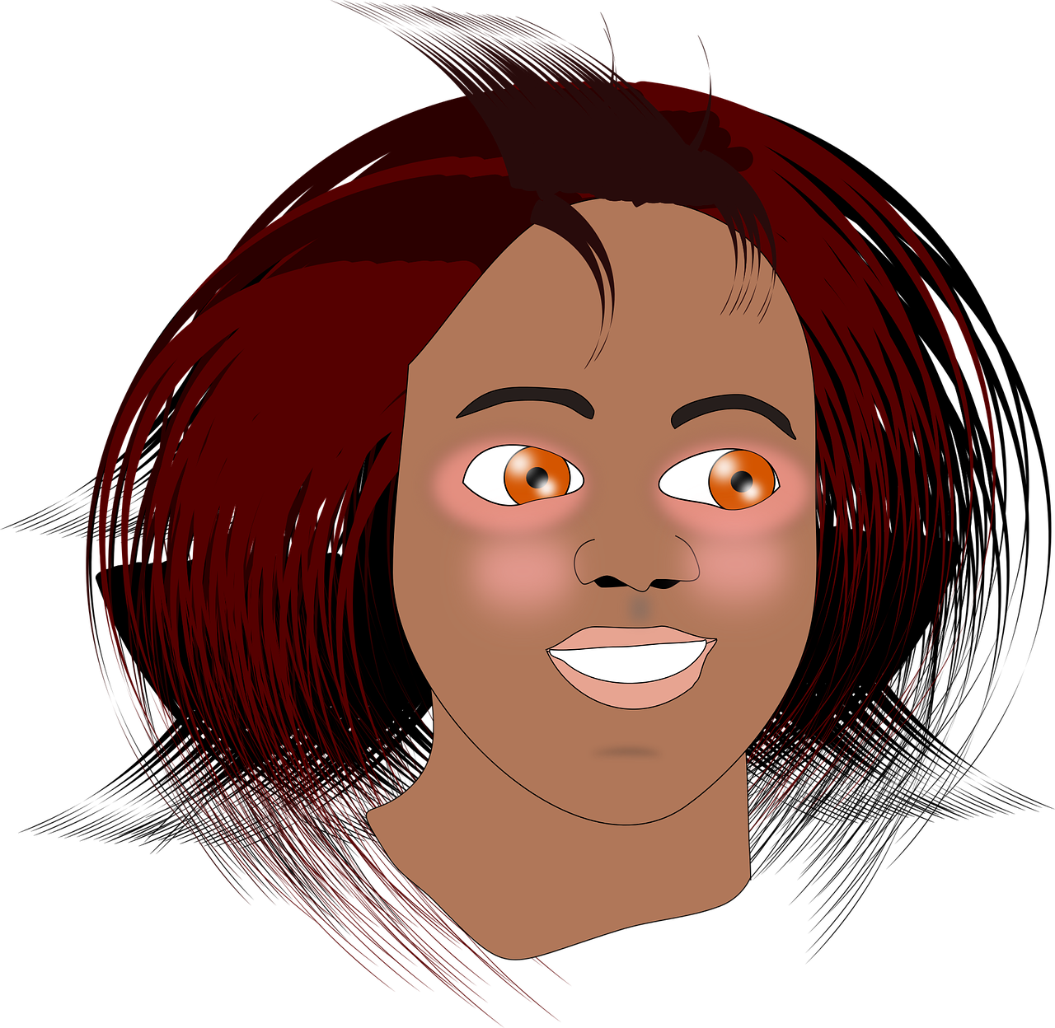
Sonia
2
3
4
5
1
Notes:
Sonia has got long brown hair, a big nose and brown eyes. She has got a big mouth. She has got a mouse!

Slide 36
Kate
2
3
4
5
1
Notes:
Kate has got blue eyes, brown hair, a small nose and she has got a bird

Slide 37
5
1
4
2
3

Slide 38
5
1
4
2
3
eyes
ears
hair
nose
mouth

Slide 39
Describe me!

Slide 40
Draw!

Slide 41
Head and shoulders song!
Notes:
listen

Slide 42
Head and shoulders song!
Let’s sing!
Head and shoulders knees and toes, knees and toes, knees and toes
Eyes, ears, mouth and nose!
Notes:
Sing avec mouvements

Slide 43
Dans ce cours, tu as :
découvert des animaux sauvages et domestiques
appris à nommer des parties du visage
H
M
appris les sons de l’alphabet en anglais
B

Slide 44
Goodbye song
Let’s sing!

Slide 45
Q
U
F
L
M
A
H
B
C
D
E
O
I
Y
J
K
N
Z
G
P
T
V
S
W
R
X

Slide 46
Q
U
F
L
M
A
H
C
E
B
D
E
O
I
Y
J
K
N
Z
G
P
T
V
S
W
R
X

Slide 47
Q
U
F
L
M
A
H
C
E
B
D
E
O
I
Y
J
K
N
Z
G
P
T
V
S
W
R
X

Slide 48
Q
U
F
L
M
A
H
C
E
B
D
E
O
I
Y
J
K
N
Z
G
P
T
V
S
W
R
X

