Slide 1
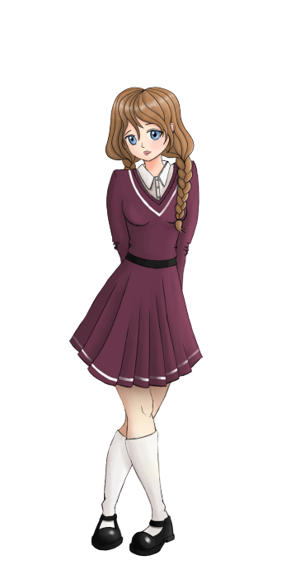
English with
Ionna
and
Anne
Sam

Slide 2
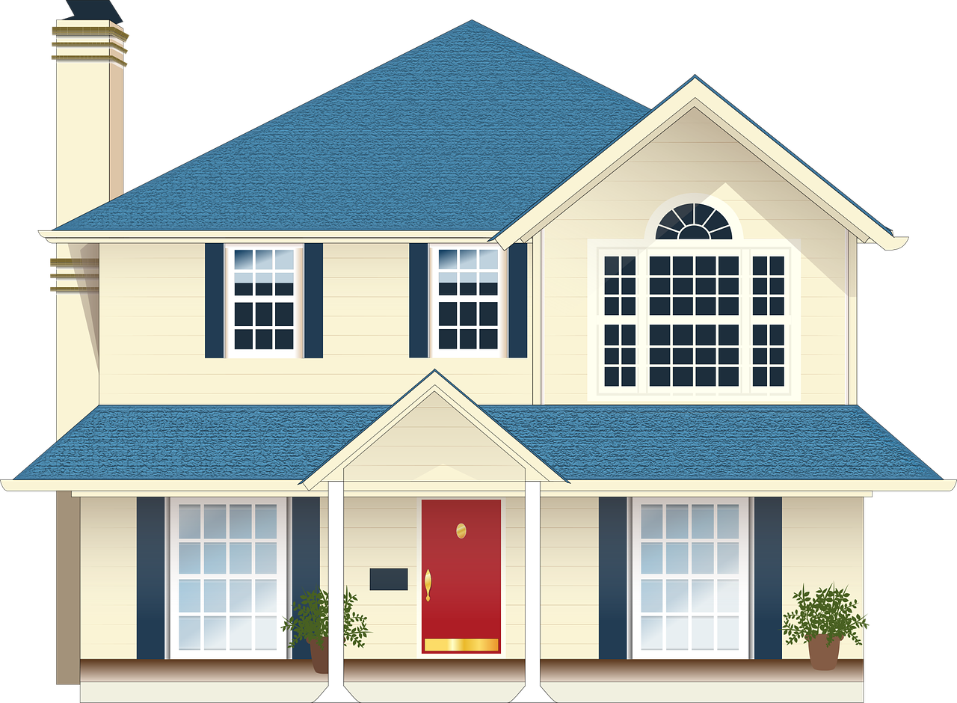
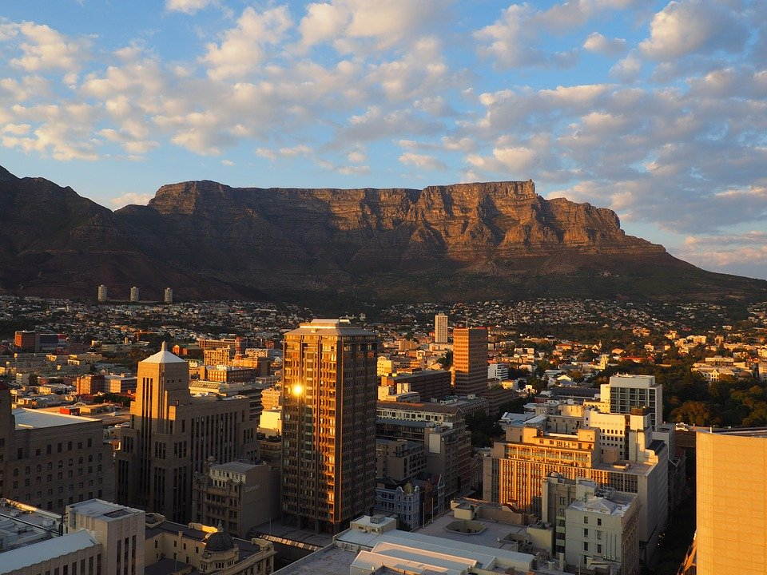
Dans ce cours tu vas
découvrir l’Afrique du Sud
apprendre le vocabulaire des pièces de la maison et de l’ameublement
découvrir les paysages de Cape Town

Slide 3
The Hello song !
Let’s sing!

Slide 4
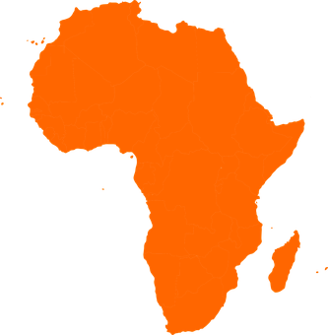
Let’s go to South Africa
AFRICA
HARRY
SAM
SOUTH AFRICA

Slide 5
Let’s go to South Africa
North
SOUTH AFRICA
South
Notes:
South Africa is the country that is the most on the South of the African continent

Slide 6
South African flag
6
1
4
3
5
2
Notes:
Dire de bien observer le drapeau

Slide 7
South African flag
1
4
5
3
2
Notes:
Dire de bien observer le drapeau
1 red
2 blue
3 green
4 yellow
5 black

Slide 8
South African flag
rainbow flag
Rainbow of people
Notes:
The flag of South Africa is, green , red, blue, black, yellow, and white.
(The "Y" on the flag symbolizes the union of many groups of people in South Africa). The many colors represent the rainbow of people in South Africa.
Enlever le Y????????

Slide 9
Rainbow nation
Rainbow nation
11 languages
Different cultural traditions
Notes:
-South Africa is also called the 'Rainbow Nation', because there are so many different languages and different cultural traditions

Slide 10
Quiz
1 -What colours are in this flag?
A –orange, black, blue, red, green, white
B –white, black, yellow, blue, red, green
Notes:
Listen
FACE ÉLÈVE

Slide 11
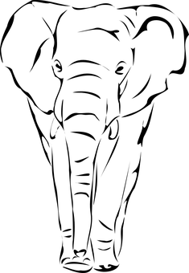
Quiz
2 - What do the many colours in the flag represent?
A –The different animals of South Africa
B – The rainbow of people in South Africa
Notes:
Listen

Slide 12
Quiz
3 – How many languages are there in South Africa?
A –8 languages
B – 11 languages
Notes:
Listen

Slide 13
Let’s go to South Africa
SOUTH AFRICA
CAPE TOWN
HARRY
Notes:
This is Harry, he lives in Cape town in South Africa

Slide 14
Cape Town
A big city

Slide 15
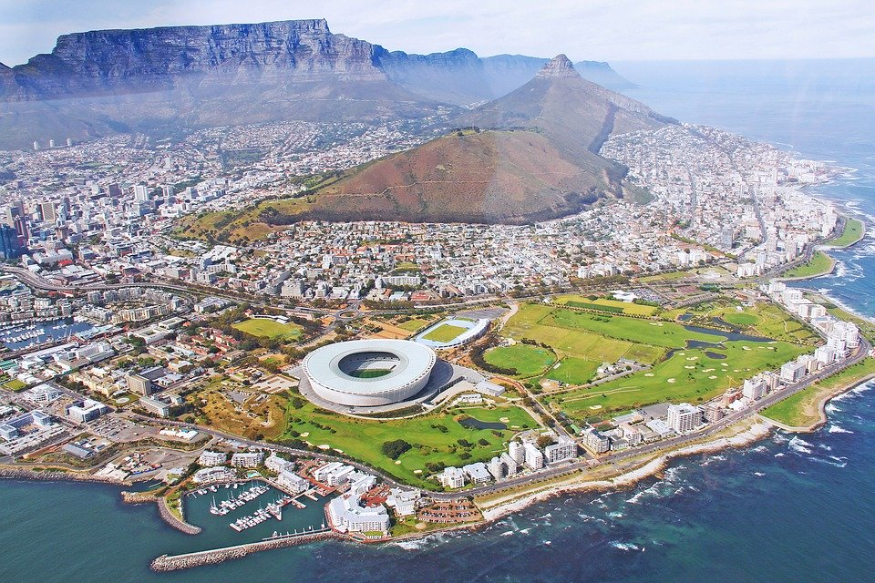
Cape Town
mountains
the sea
the city
Notes:
This is a city -
I see moutains
I see the sea

Slide 16
Cape Town
buildings
the city
Notes:
This is a city -
I see moutains

Slide 17
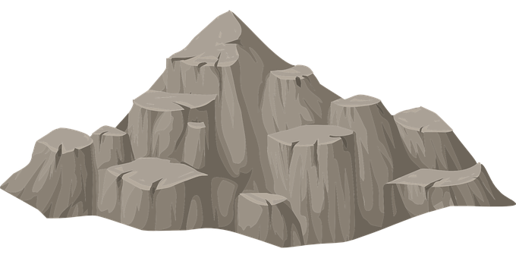
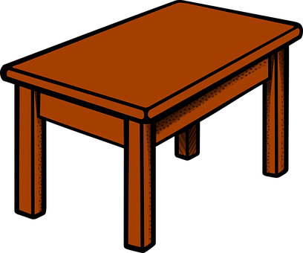
Cape Town
Table Mountain
mountains
Notes:
I see mountains

Slide 18
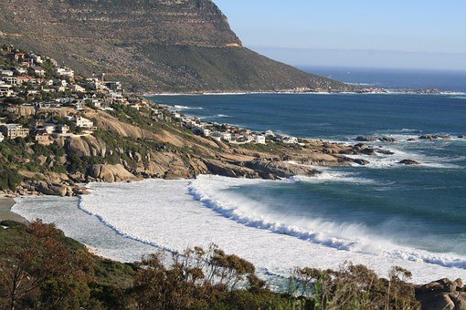
Cape Town
the sea
a beach
Notes:
I see the sea, and there is the beach

Slide 19
Let’s recap
buildings
the city
2
3
1
the sea
a beach
4
mountains
5
Notes:
A beach

Slide 20
buildings
city
beach
the sea
mountains

Slide 21
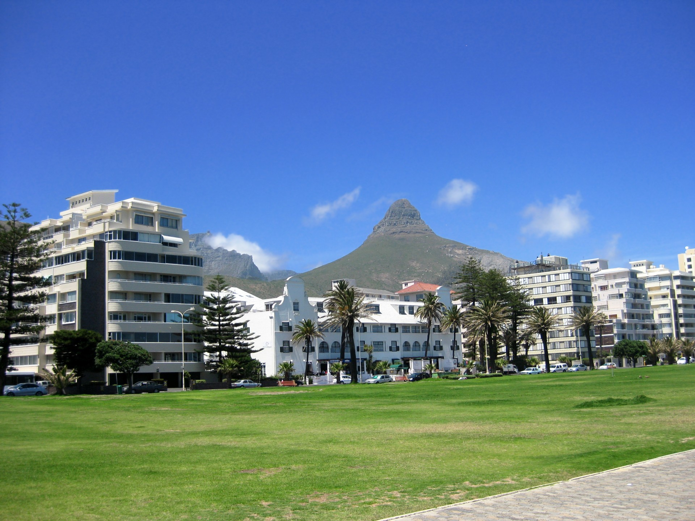
My house
This is my house.

Slide 22
Come in !

Slide 23
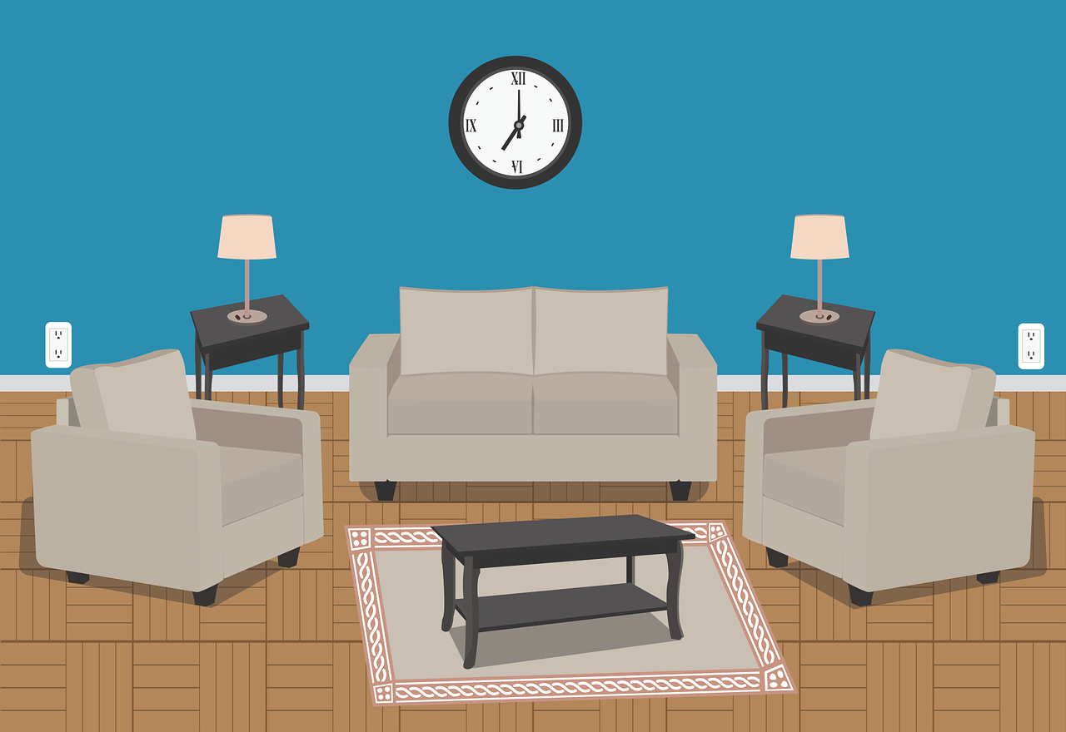
The living room

Slide 24
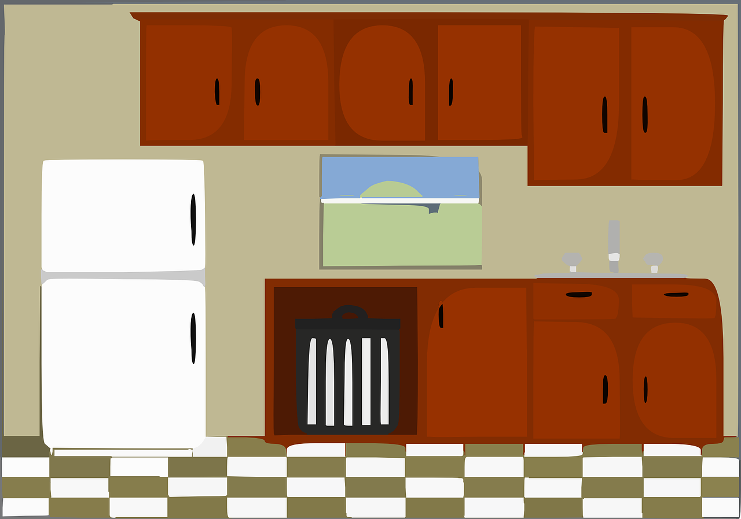
The kitchen

Slide 25
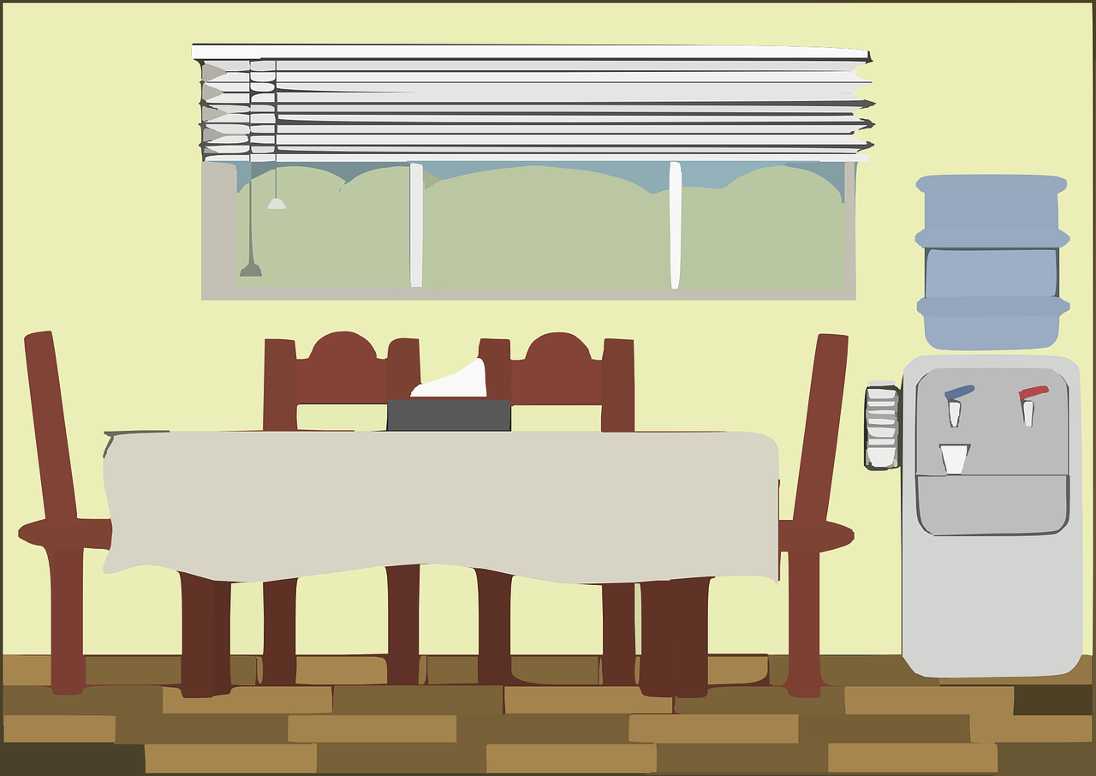
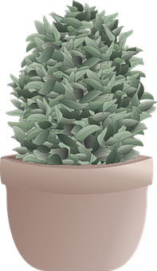
The dining room

Slide 26
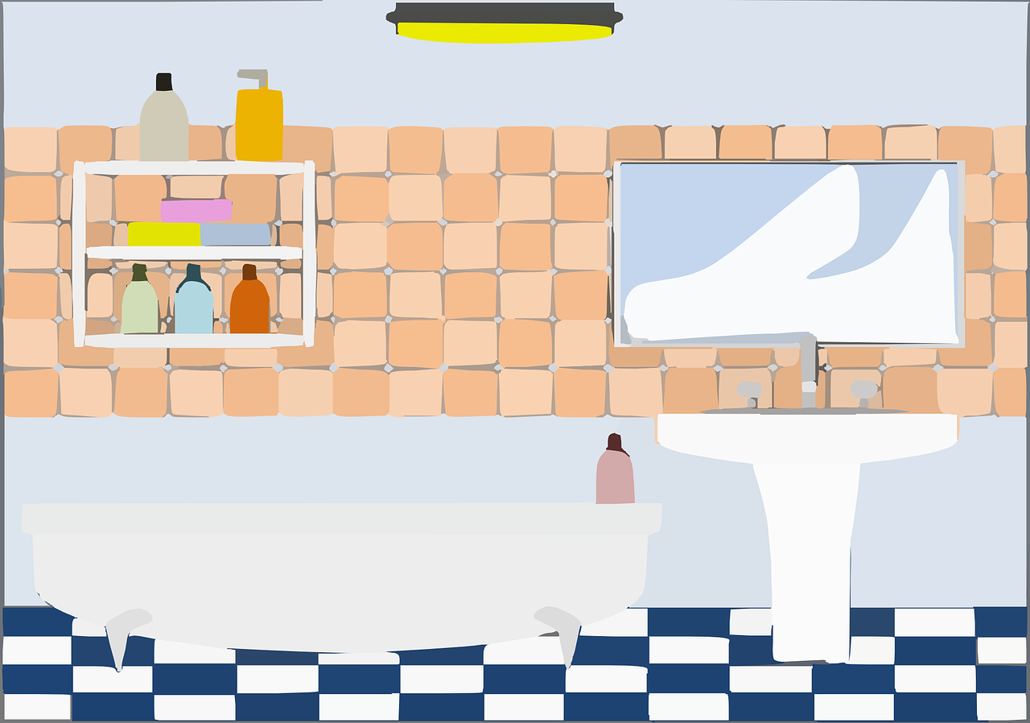
The bathroom
Notes:
Au niveau des couleurs, est-ce qu’elles passent bien à l’écran…..??

Slide 27
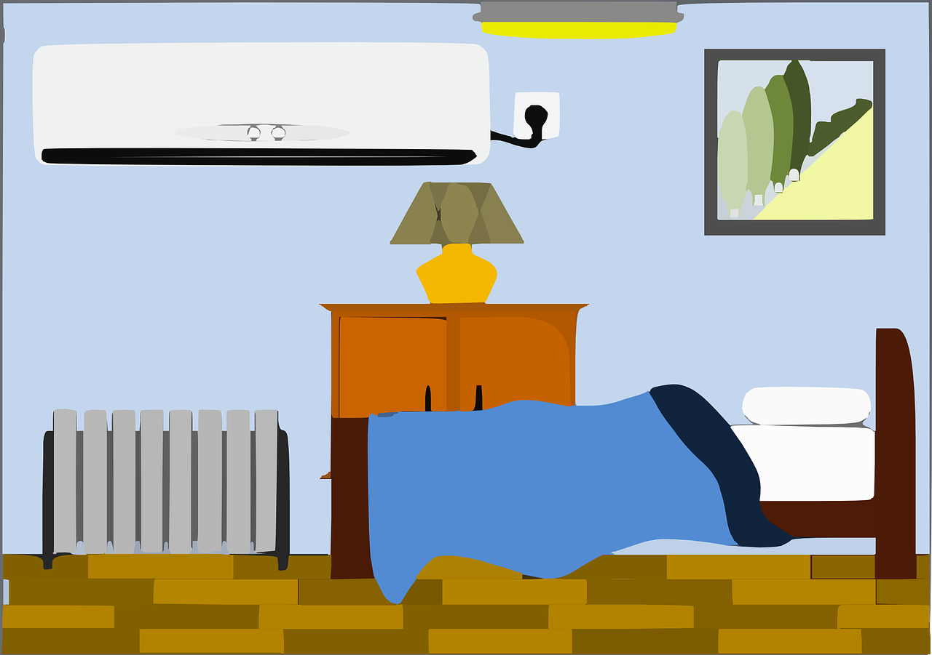
The bedroom

Slide 28
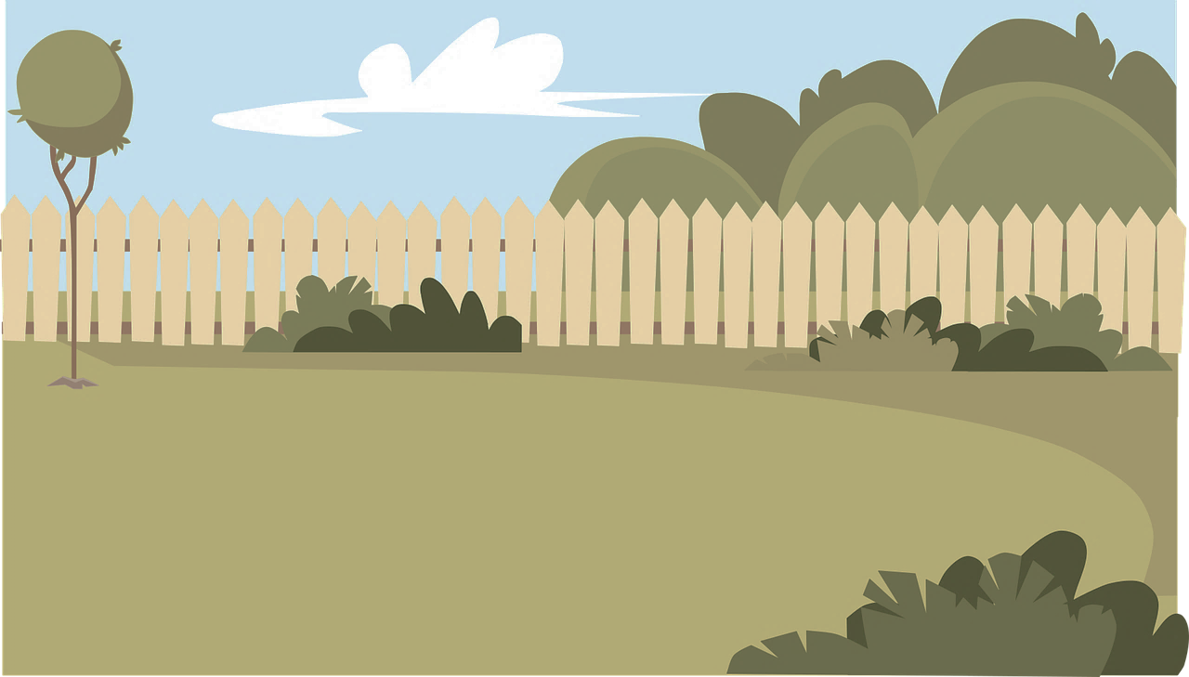
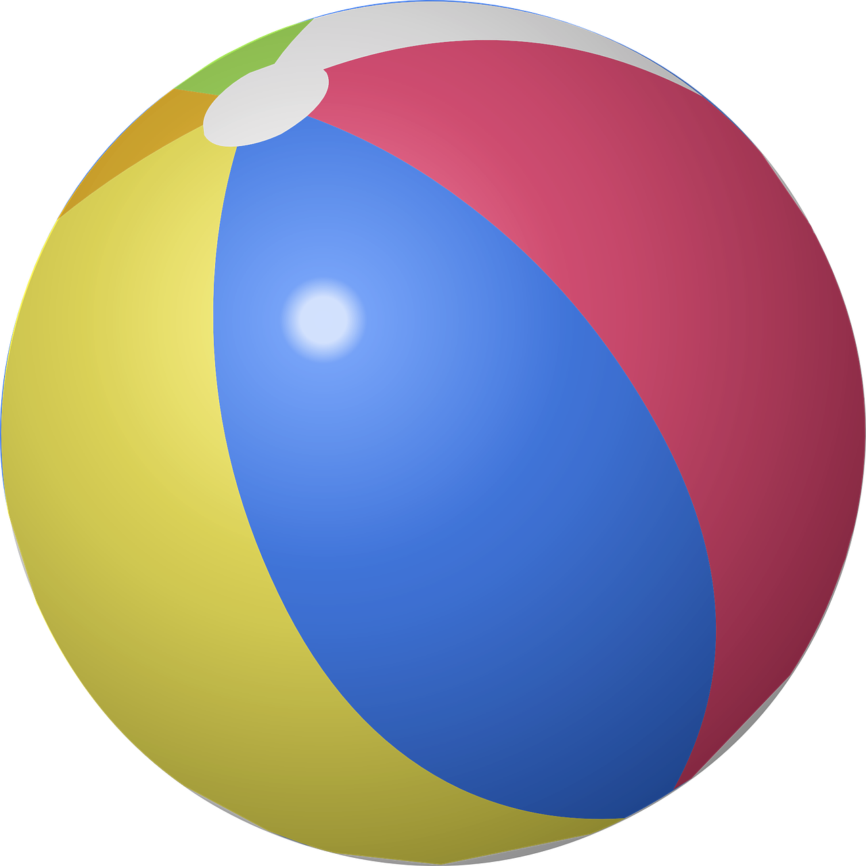
The garden
Notes:
Changer vers un vert sombre pour écran

Slide 29
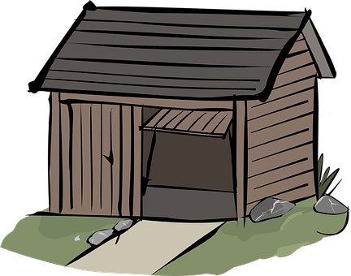
The garage

Slide 30
1
2
3
4
5
6

Slide 31
The garden
The living room
The dining room
The bathroom
The kitchen
The bedroom

Slide 32
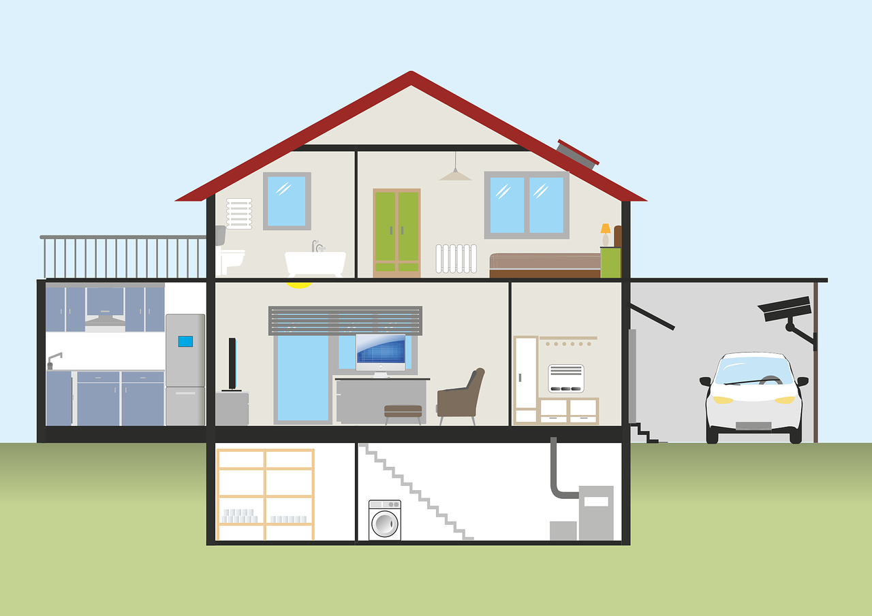
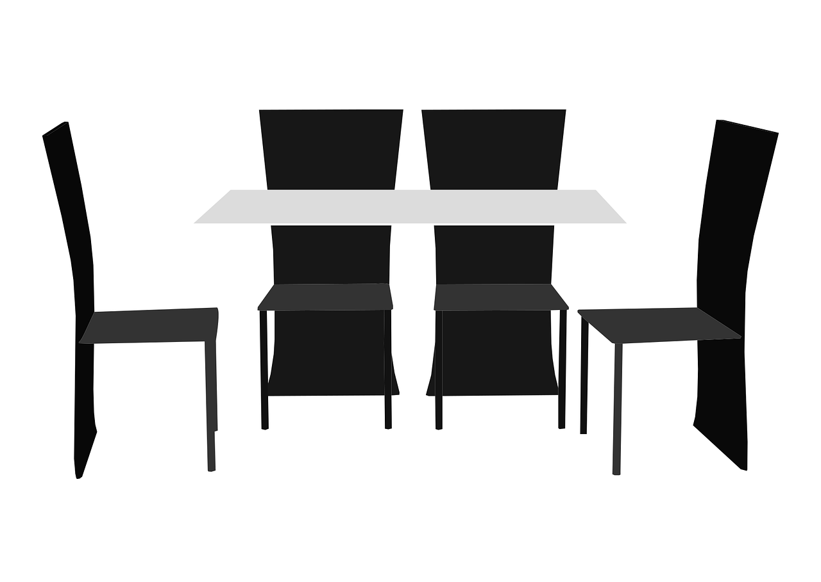
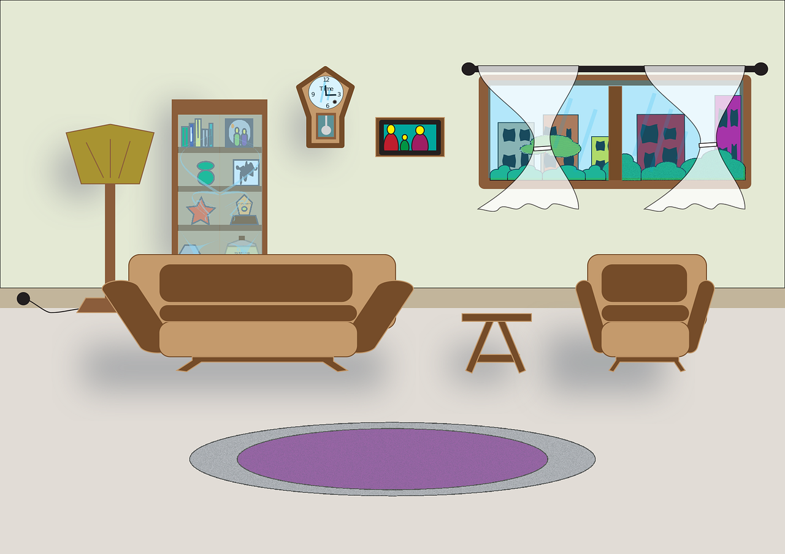
He
is in
the bathroom.
She
is in
the living room.

Slide 33
He
is in
the kitchen.
She
is in
the garage.

Slide 34
He
is in
the bedroom.
She
is in
the dining room.

Slide 35
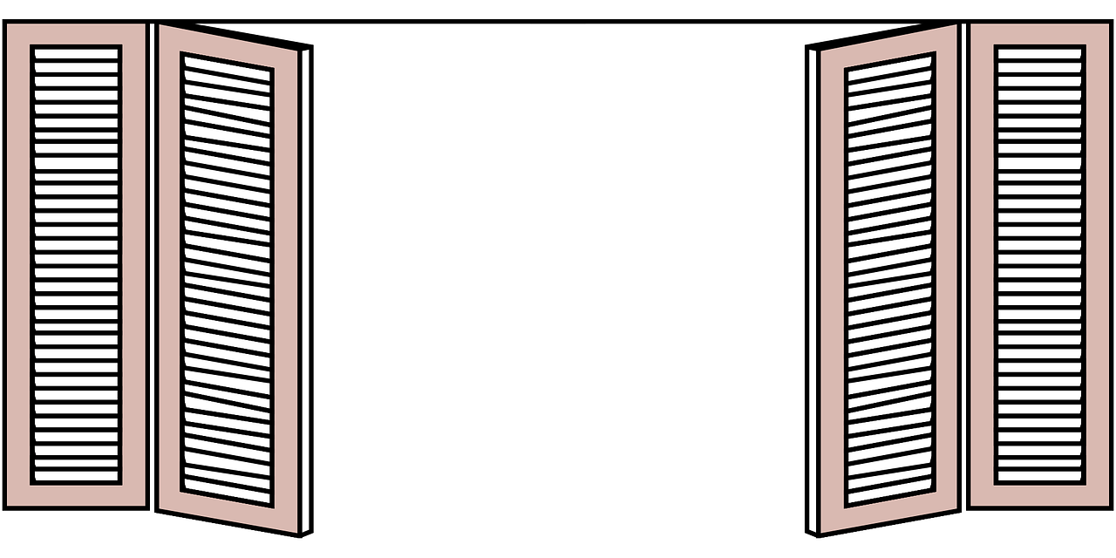
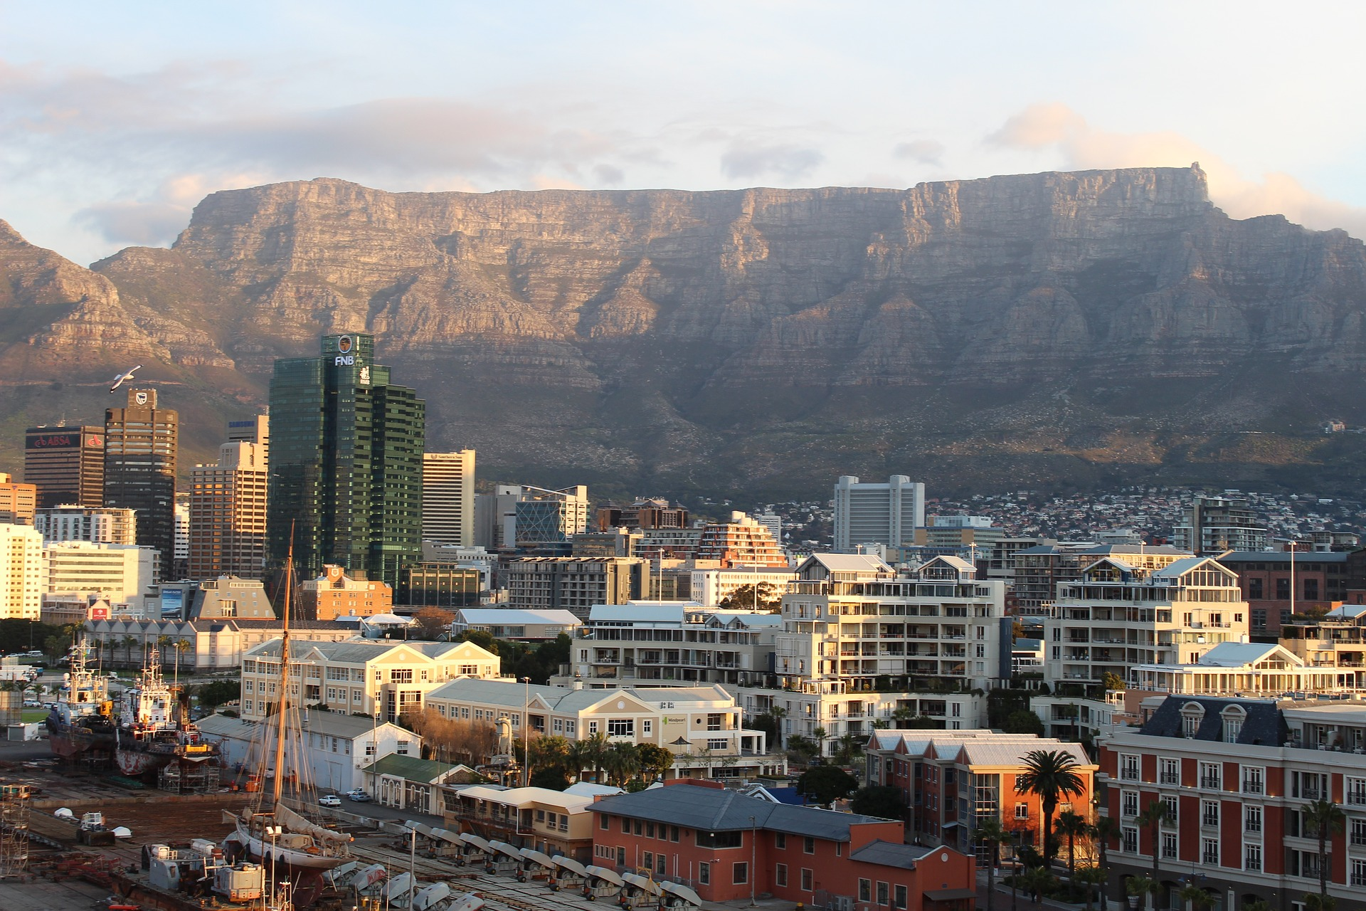
From my window, I can see Table mountain!
Notes:
C’est bien Table Mountain sans le the

Slide 36
a table

Slide 37
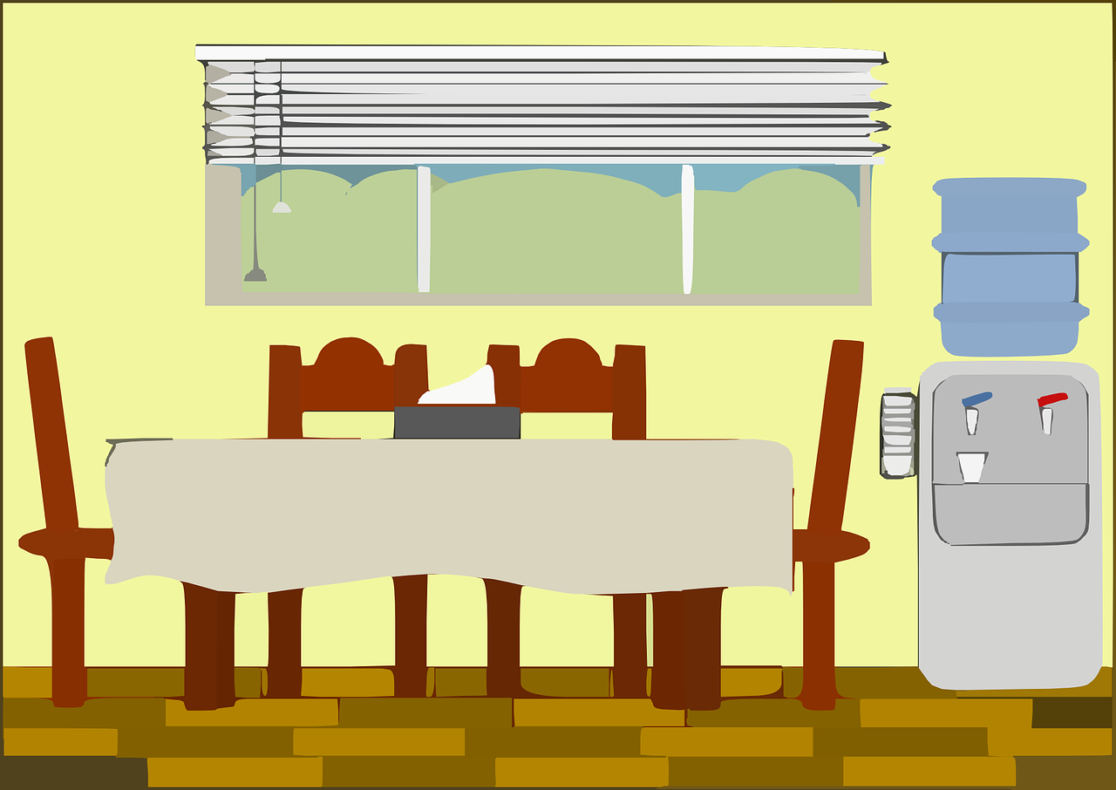
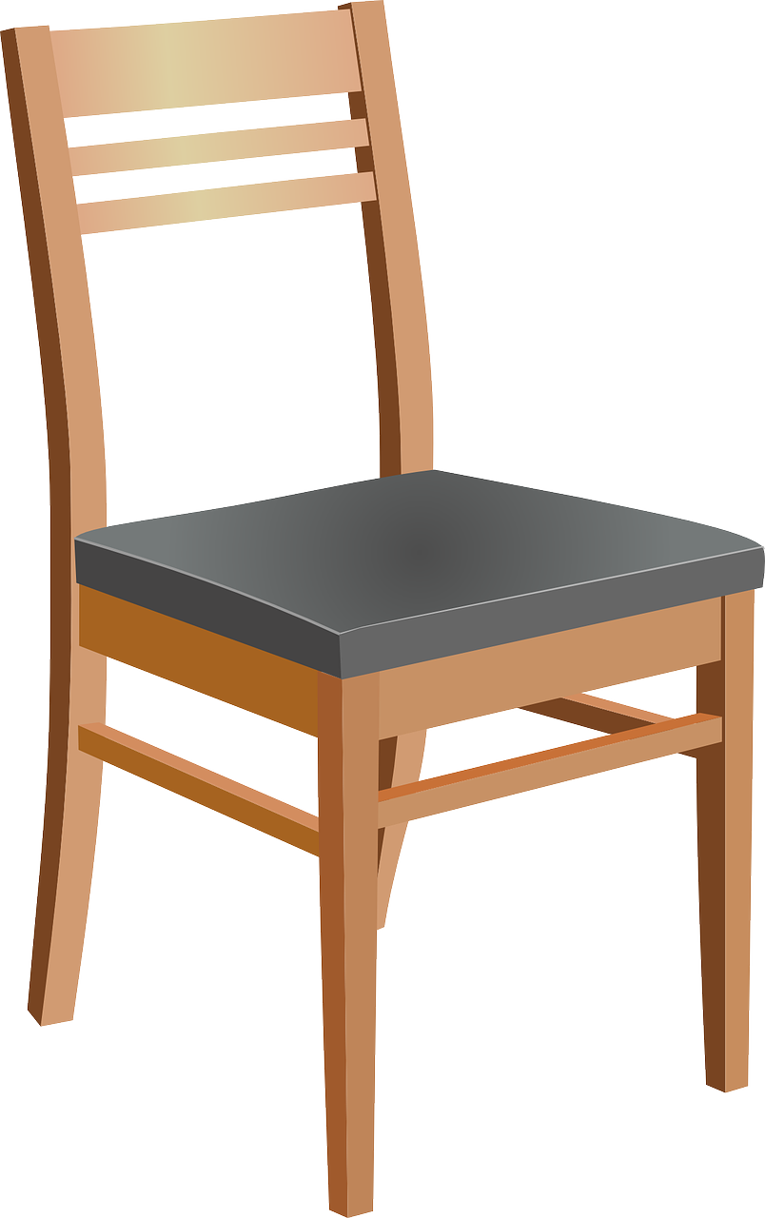
a chair
a table
a dining room
Notes:
La transition est intéressante, un peu poussée mais …..
Harry peut de nouveau investir les diapositives
In his kitchen there is a chair and there is a table

Slide 38
a bedroom
a bed
Notes:
In his bedroom there is a bed

Slide 39
a bathroom
a bath

Slide 40
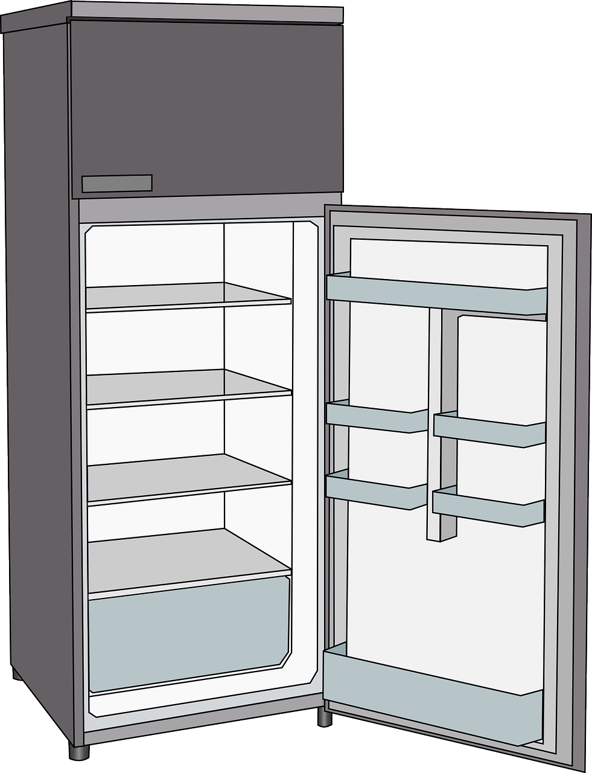
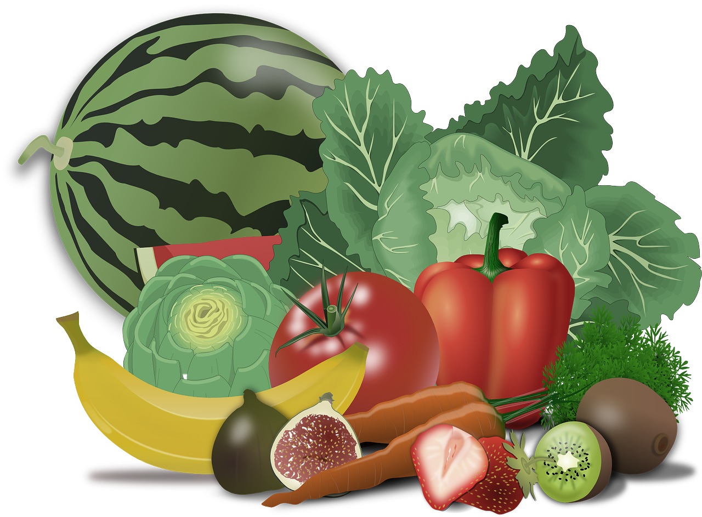
a fridge
a kitchen

Slide 41
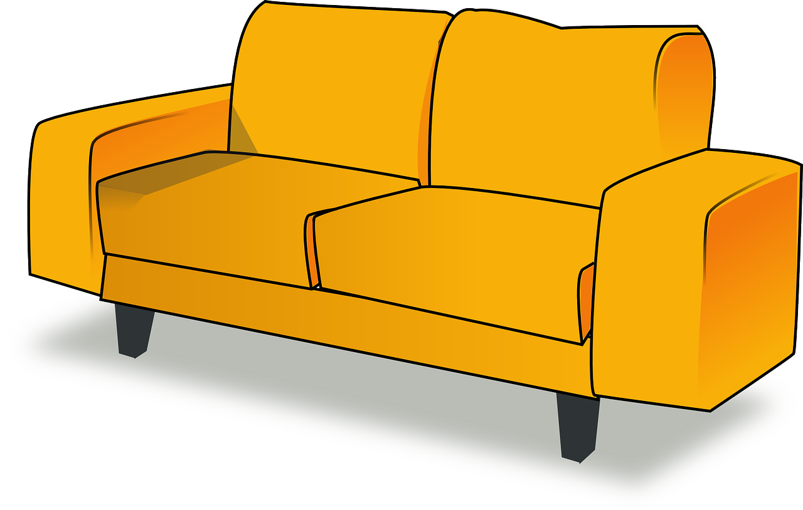
a living room
a sofa

Slide 42
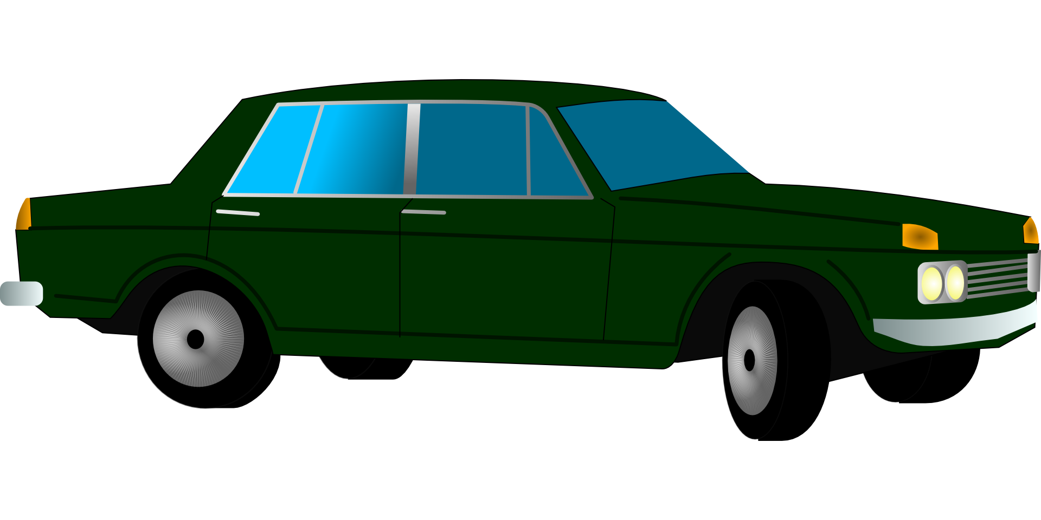
a garage
a car

Slide 43
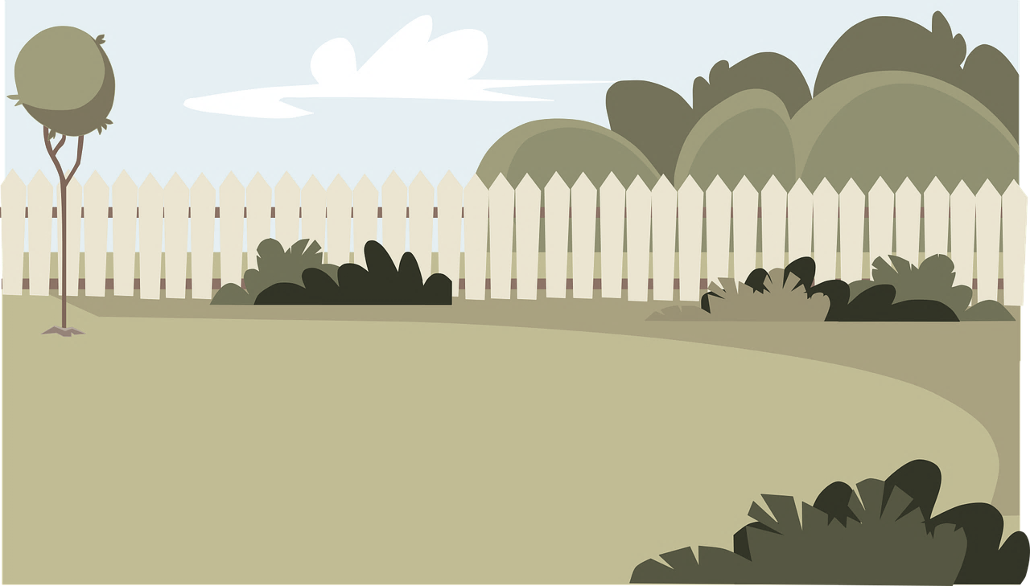
a garden
a bike

Slide 44
1
2
3
4
5
6
7

Slide 45
a table
a bath
a bike
a bed
a car
a fridge
a sofa

Slide 46
 | 1 | 2 | 3 | 4 | 5
A
B
C
D
E
(A ; 1)
(D ; 4)
(B ; 2)
(E ; 3)
( ; )
E
5
( ; )
D
1
( ; )
C
5
( ; )
A
4
Notes:
On peut faire un jeu dans ce style.
-un coup on demande la case
- un coup on fait placer
Et si on veut aller encore plus loin, on peut réfléchir à une manière de placer les objets pour ensuite demander où est la cuisine…..
Style bataille navale

Slide 47
 | 1 | 2 | 3 | 4 | 5
A
B
C
D
Notes:
On peut faire un jeu dans ce style.
-un coup on demande la case
- un coup on fait placer
Et si on veut aller encore plus loin, on peut réfléchir à une manière de placer les objets pour ensuite demander où est la cuisine…..
Style bataille navale

Slide 48
Challenge

Slide 49
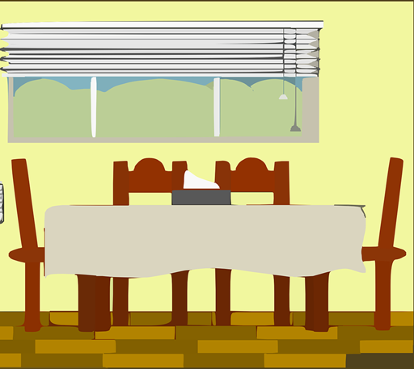
Challenge

Slide 50
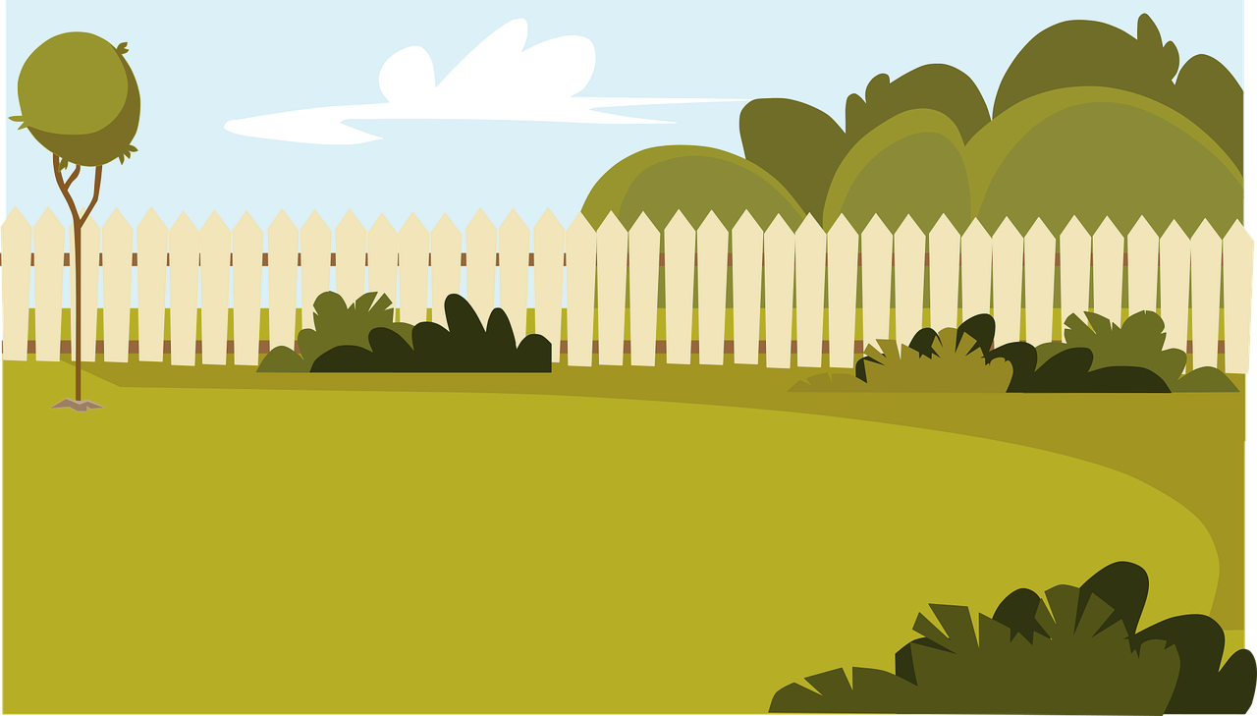
Challenge

Slide 51
Tongue twister
Clap on the back and click on the clock

Slide 53
Dans ce cours tu as
découvert l’Afrique du Sud
appris le vocabulaire des pièces de la maison et de l’ameublement
découvert les paysages de Cape Town

Slide 54
Goodbye song
Let’s sing!

