Slide 1
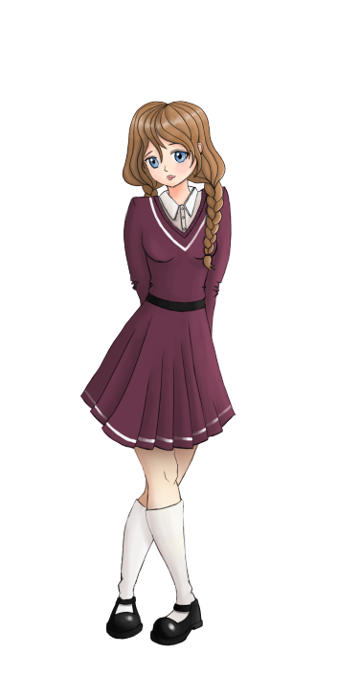
English with
Ionna
and
Anne
Sam

Slide 2
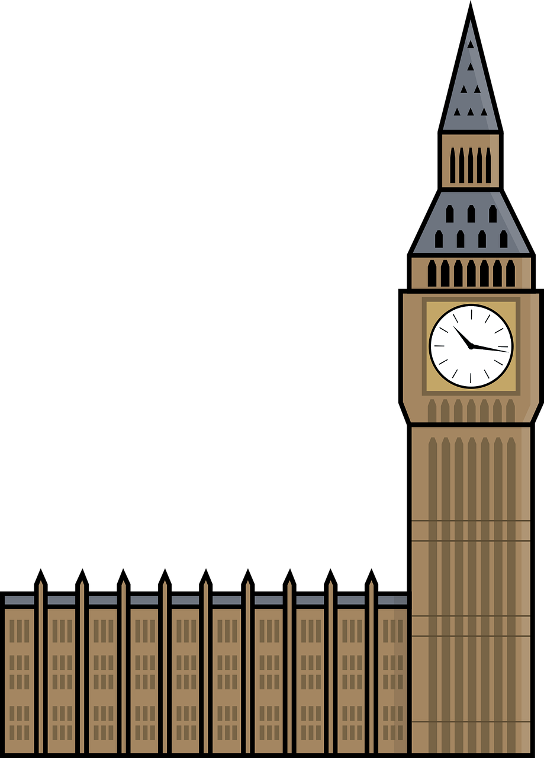
Dans ce cours tu vas
chanter
découvrir la ville de Londres
apprendre à nommer les membres de ta famille
nommer les couleurs

Slide 3
_{Hello Song}
Let’s sing!

Slide 4
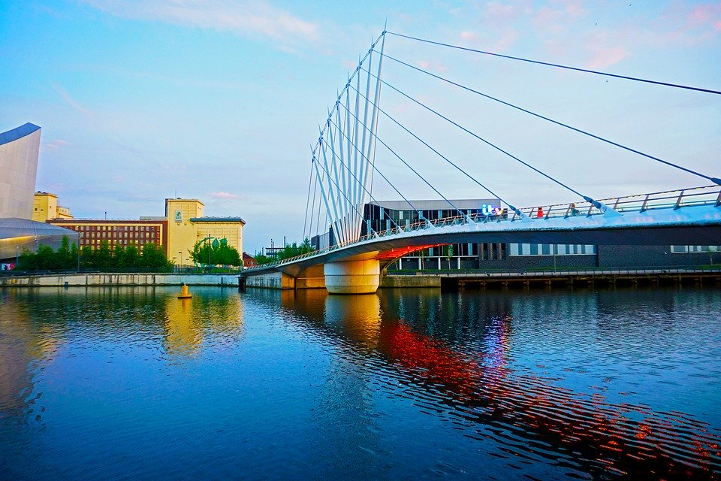
Hello
Hello!
MANCHESTER
The United Kingdom
Notes:
Sam enregistrée : Hello, my name’s Sam!
Anne / ionna : My name’s Anne Nice to meet you
Ionna : My name’s ionna, nice to meet you too!

Slide 5
United Kingdom flag
18
19
17
11
10
10
11
14
13
19
12
13
12
15
16

Slide 6
Capital ?
U
N
I
T
E
D
K
I
N
G
D
O
M
L
O
N
D
O
N

Slide 7
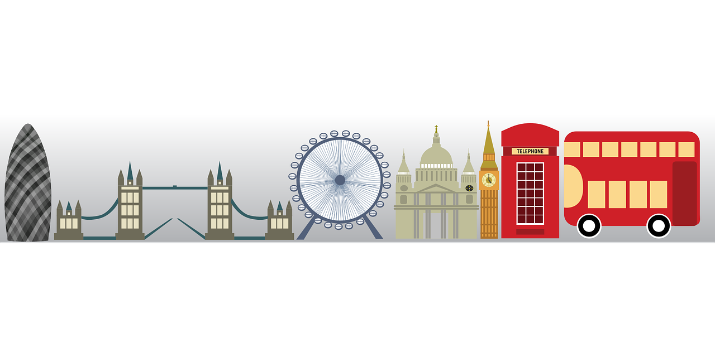
Visit London
London!
Notes:
Sam : Let’s go to London
Anne : let’s go to London
Ionna – Yes, let’s visit London

Slide 8
Visit London
Notes:
Anne let’s take the Bus
Ionna : It’s a red Bus !
Anne : Yes, red, black white, – une fleche et un rond de la couleur apparaissent à chaque fois
Faire répéter

Slide 9
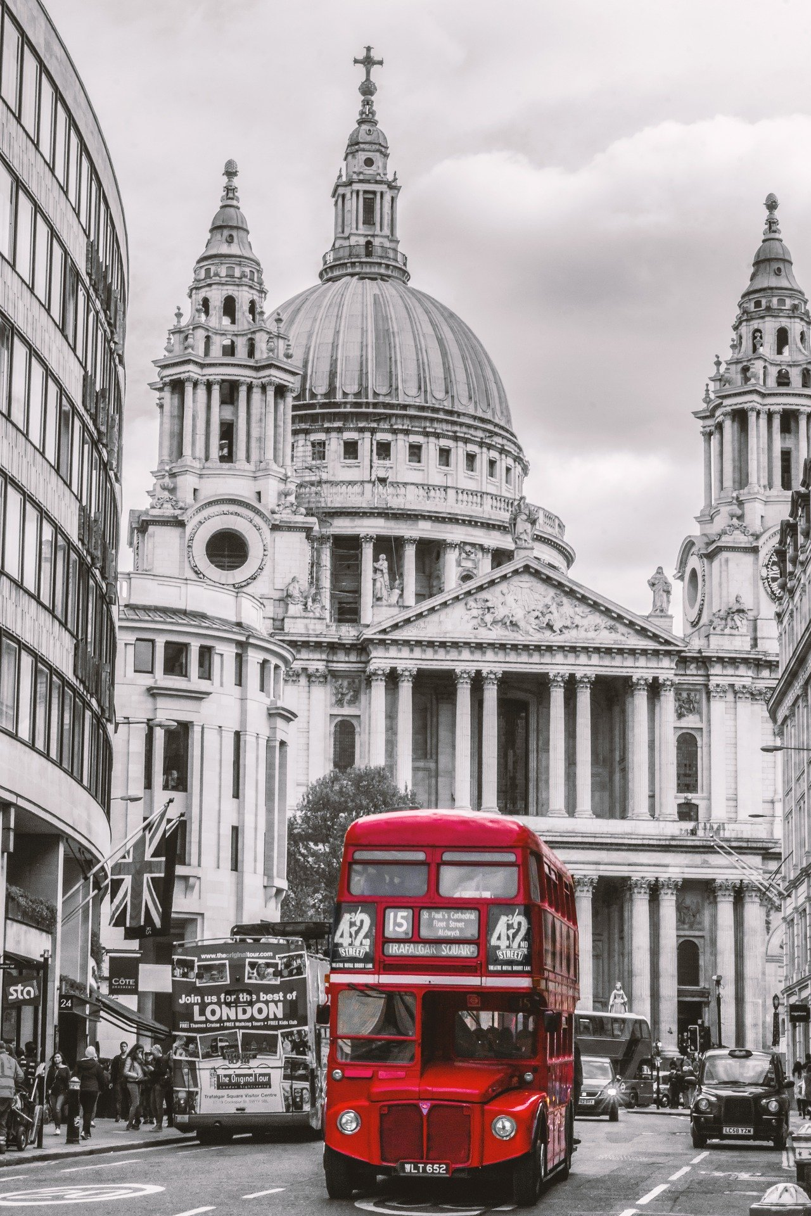
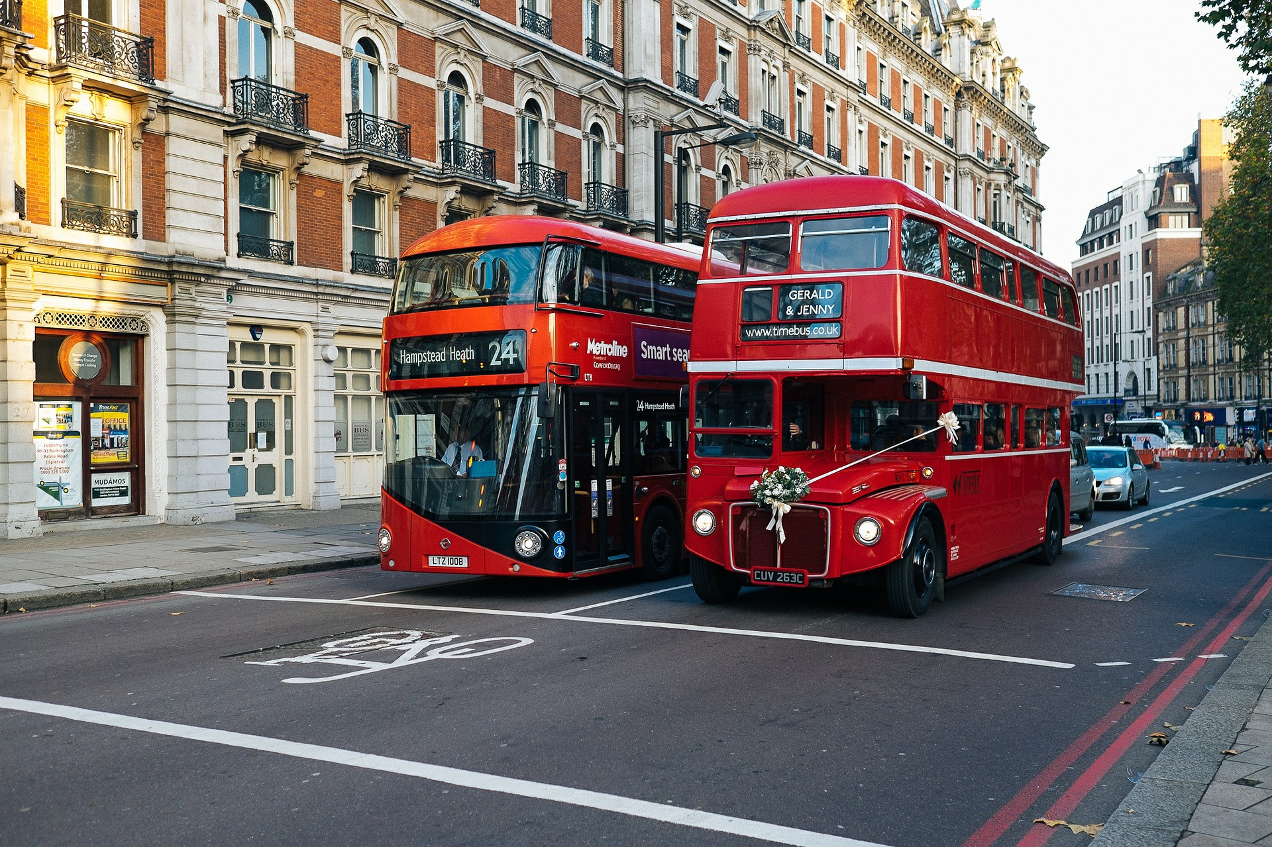
Visit London
new
old
Notes:
Bus that is red called a double-decker
Red Buses :
It’s and old bus
It’s a new Bus
Old + new apparaissent écran
Faire répéter

Slide 10
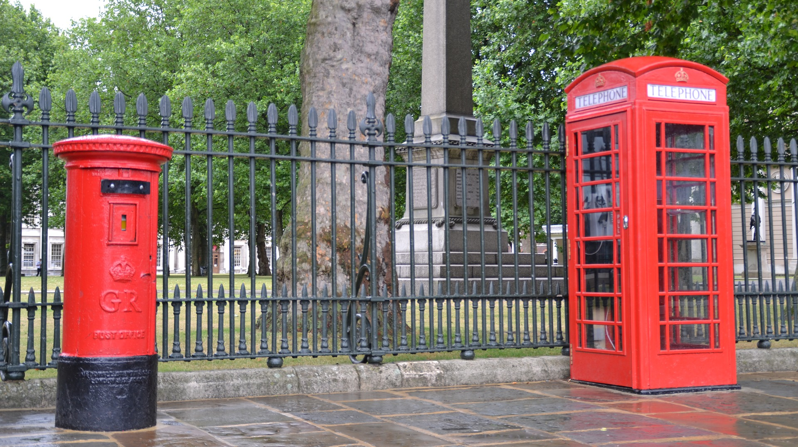
Notes:
This is a mailbox –
Répéter et montrer
This is a telephone box
Répéter et montrer
There are / there is a red letterbox and a red telephone box ??

Slide 11
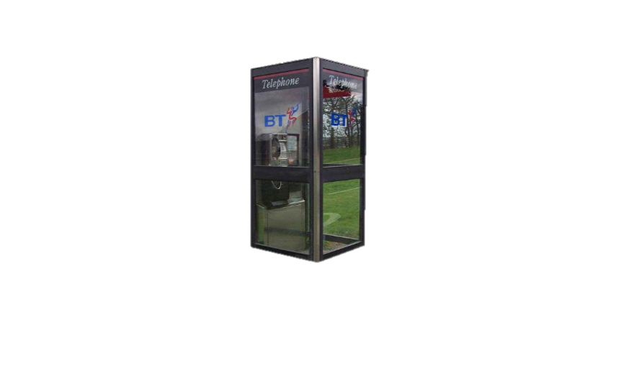
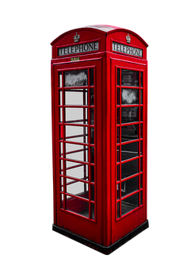
old
new

Slide 12
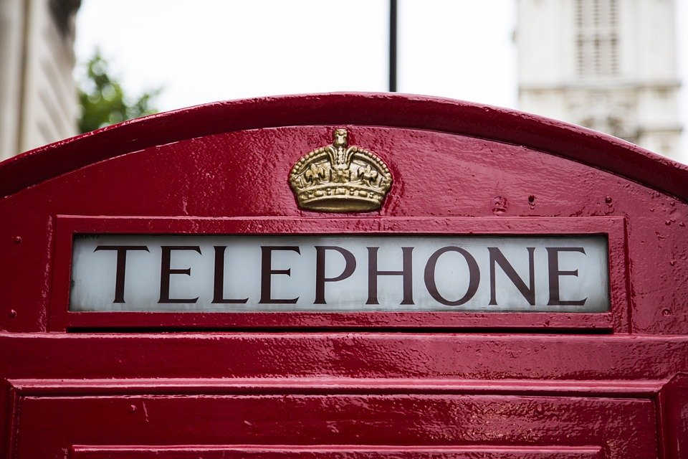
Visit London
Notes:
Oh look ! There is a yellow crown on the red telephone box
Faire répéter
Yes, a crown ! queen Elizabeth II has a crown !! / ou gold crown?

Slide 13
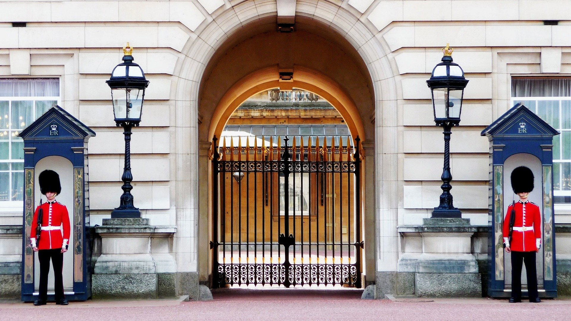
Notes:
Red gards
Blue boxes
Black streelights

Slide 14
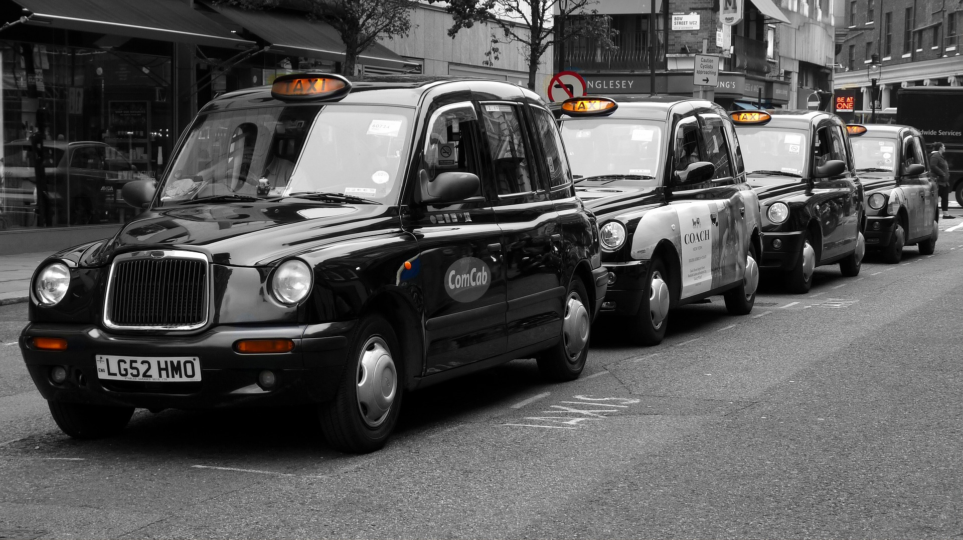
Notes:
There is a black taxi
There are black taxis

Slide 15
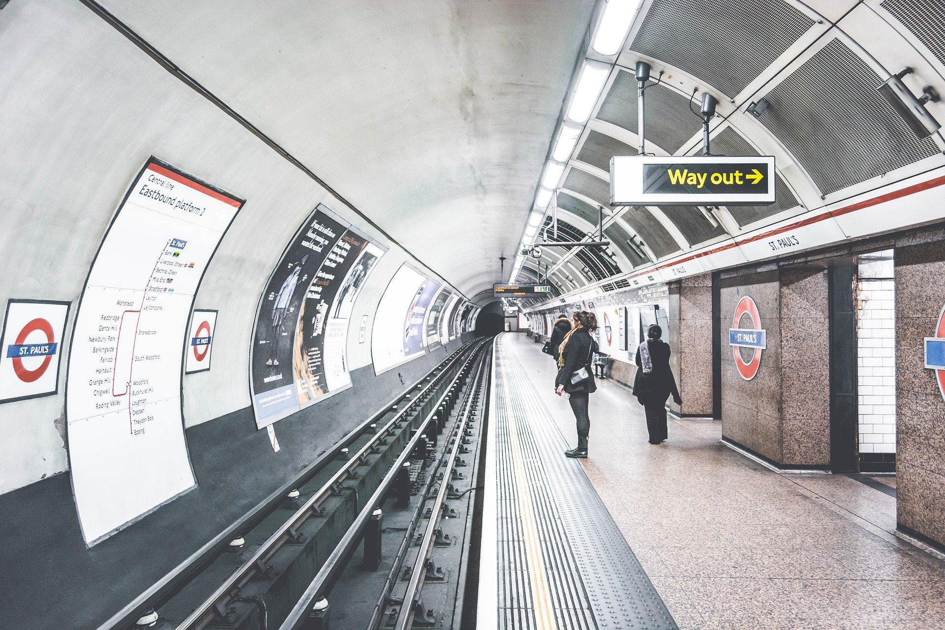
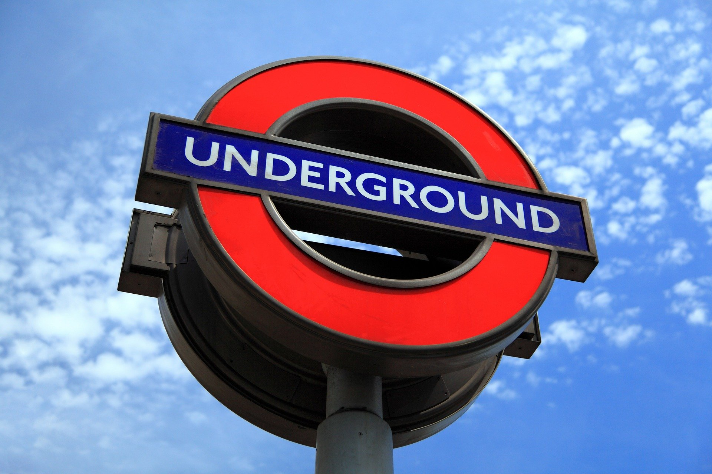
The tube
Notes:
This is the tube – or the underground
It’s a public transportation in London, like the Decker buses
Faire répéter
Les couleurs (blue, red, white)

Slide 16
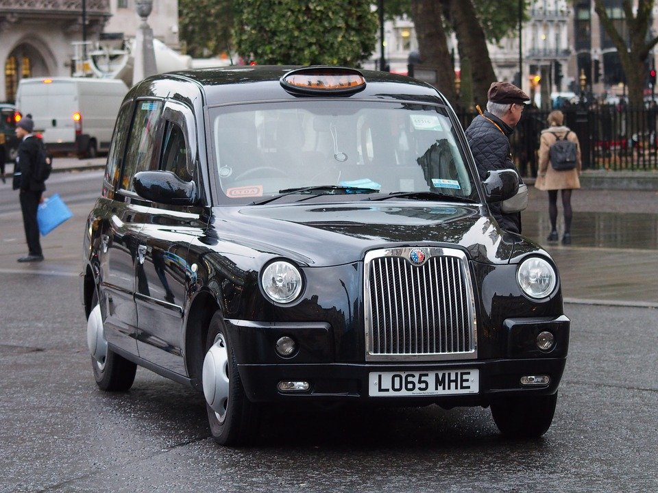
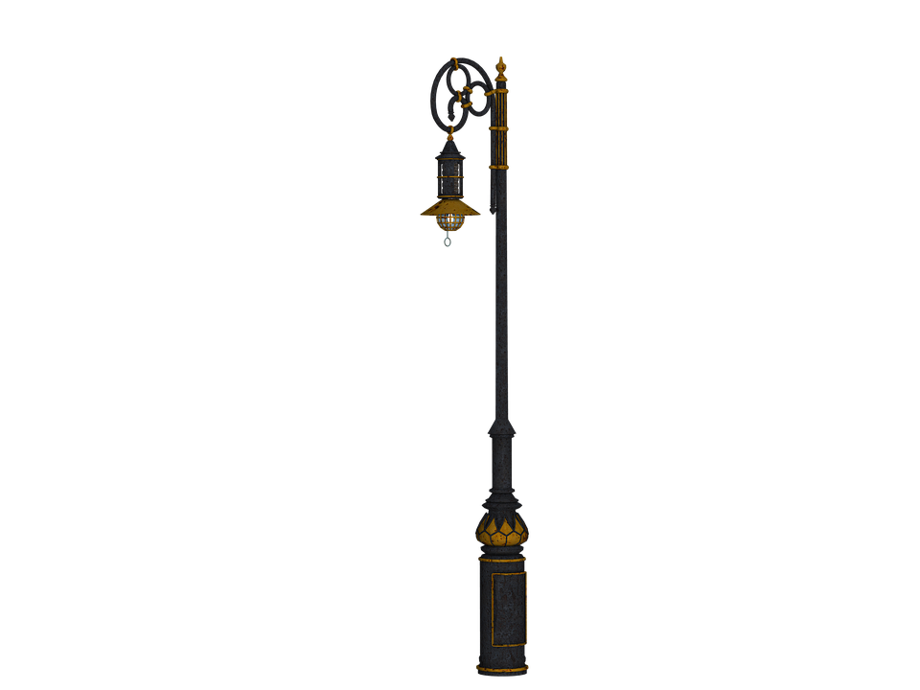
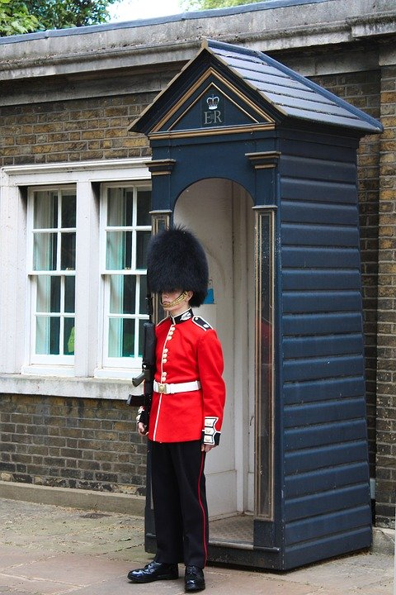
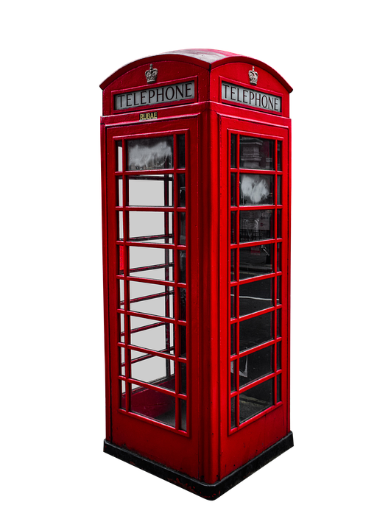
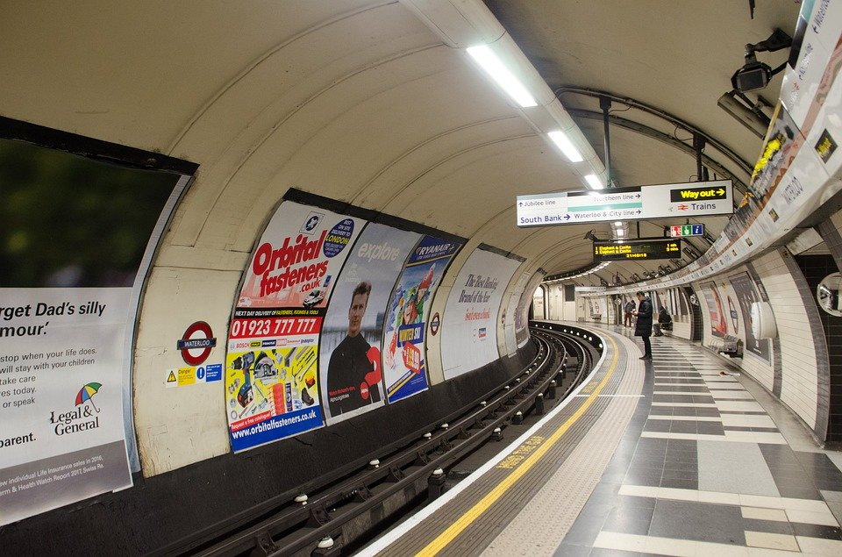
Recap!
4
2
6
5
1
3
Notes:
What number is the streetlight…. ? The royal guard? The underground?
Puis what’s number 5? Number2? Number 4?

Slide 17
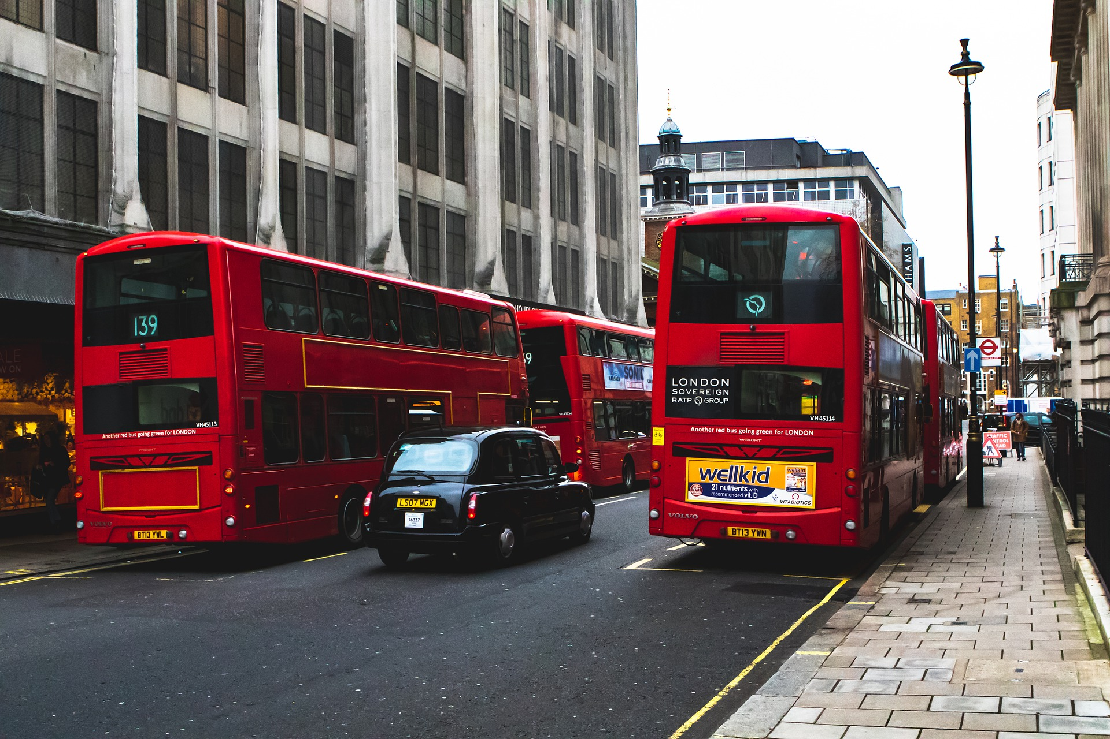
London streets challenge
Notes:
Look at the picture and concentrate

Slide 18
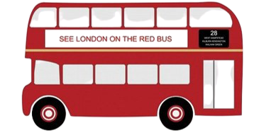
London streets challenge
4
Notes:
Who is Kelizabeth II ?
Is she my granmother
Is she my motherr
Is she my great grandmother?
Réponse
She is my great grandmother – she is the Queen

Slide 19
London streets challenge
1

Slide 20
London streets challenge
2

Slide 21
London streets challenge
Notes:
Let’s check!

Slide 22
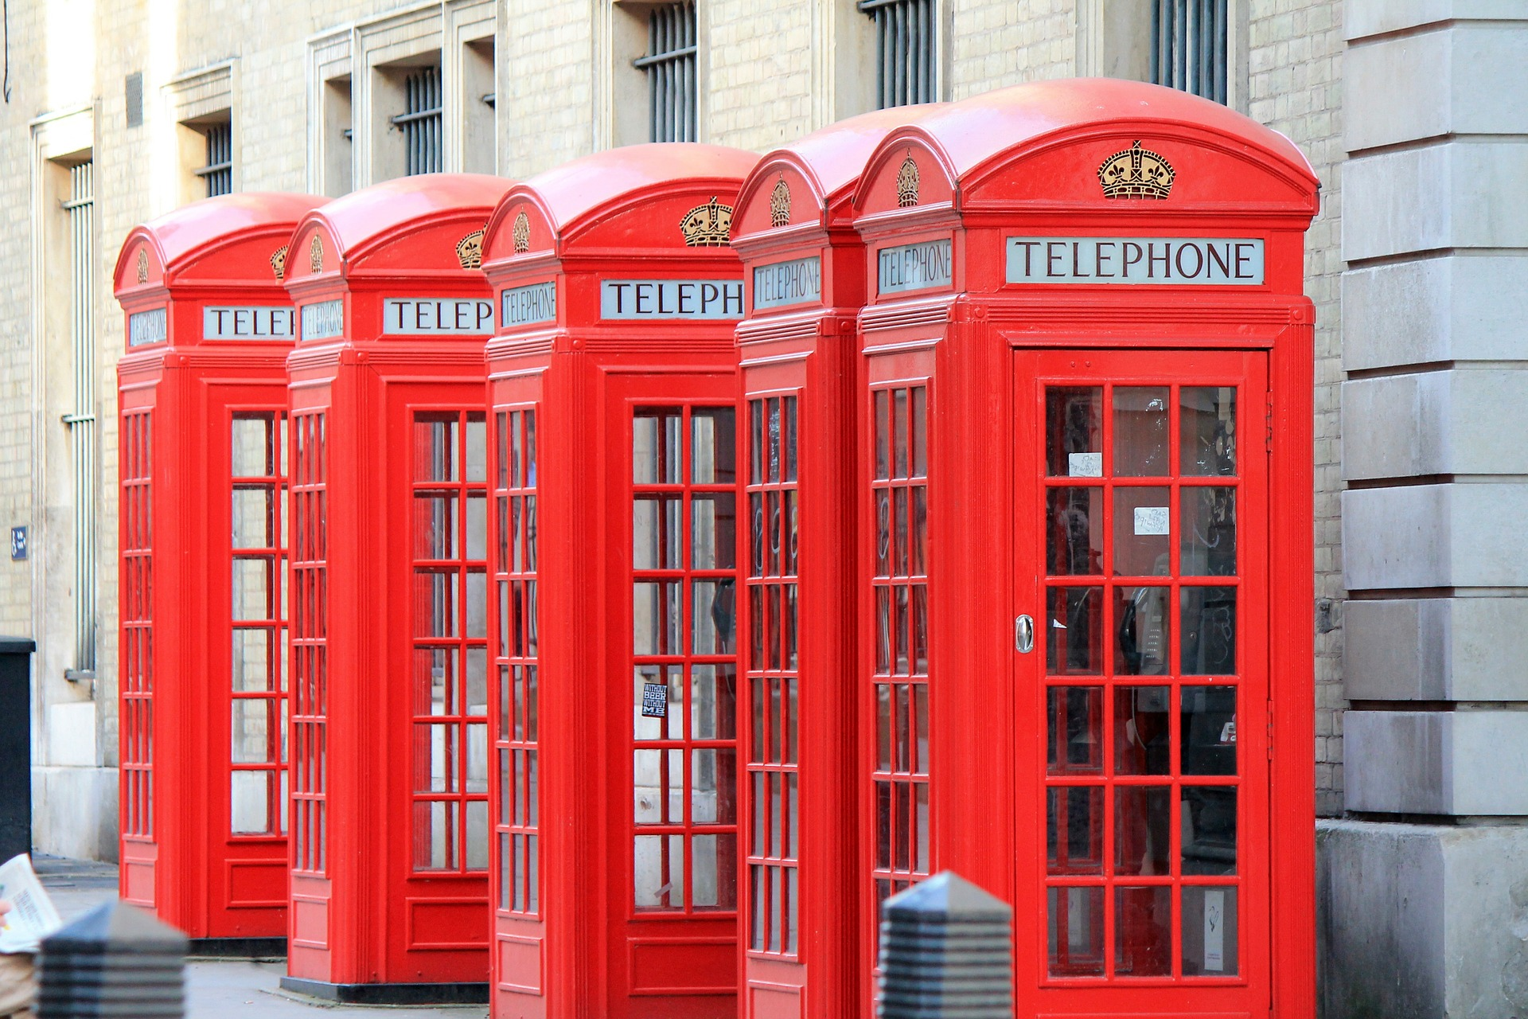
London streets challenge

Slide 23
London streets challenge
5
9

Slide 24
London streets challenge

Slide 25
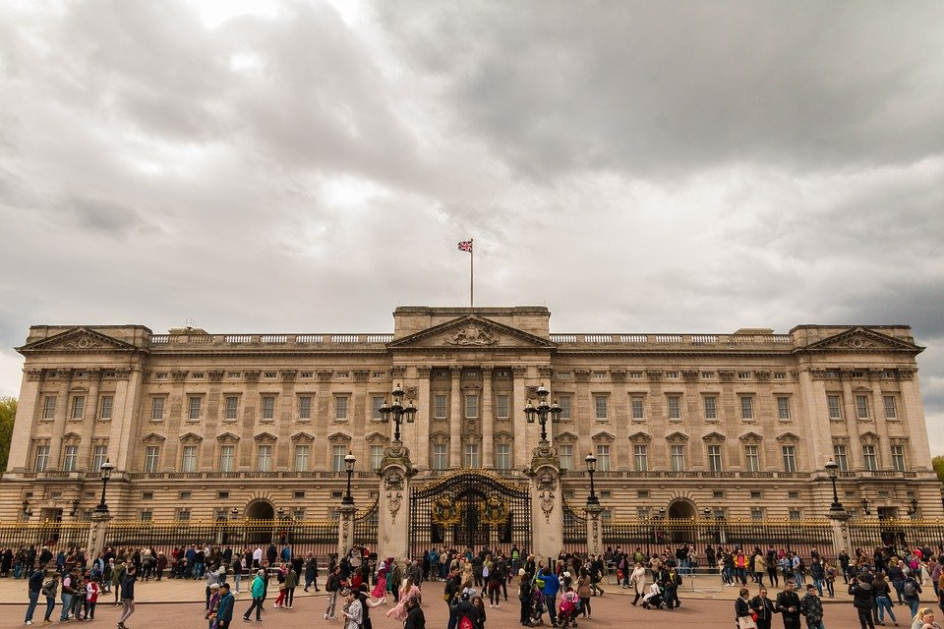
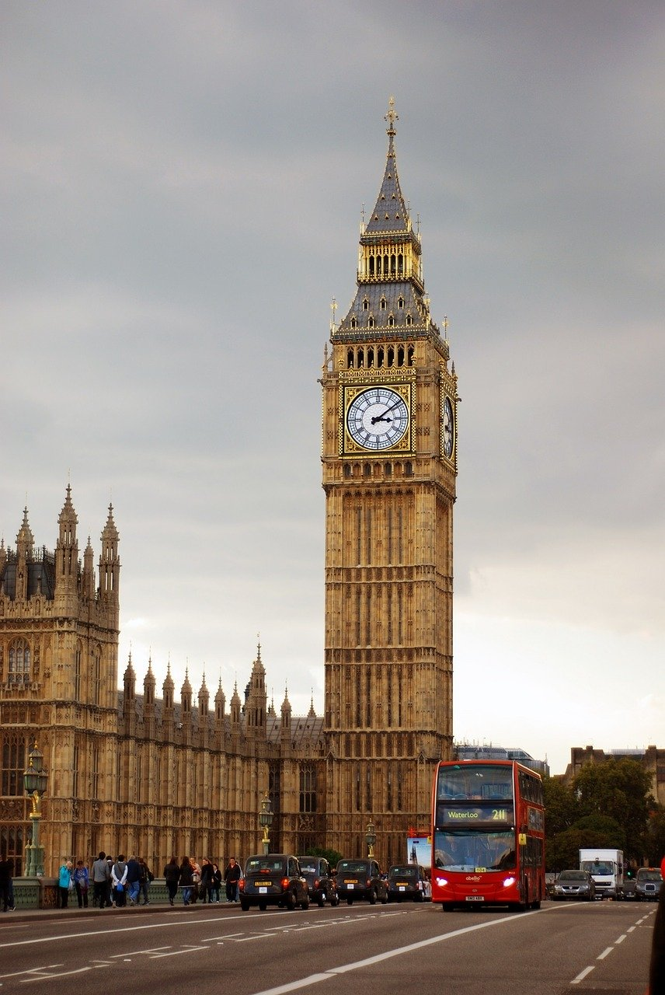
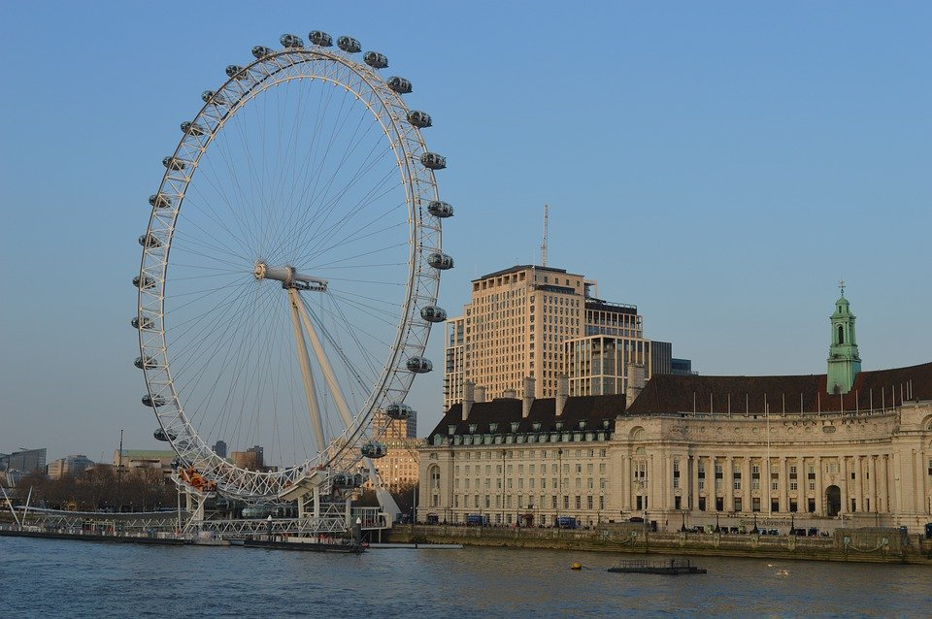
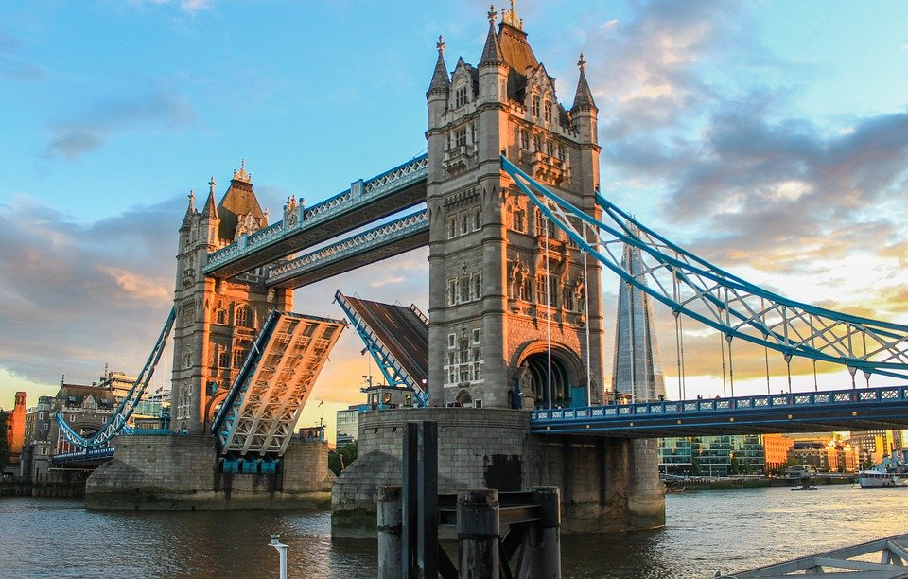
Buckingham Palace
Big Ben
Monuments
Of London
London Eye
Tower Bridge
River Thames

Slide 26
Monuments
Of London
London Eye
Buckingham Palace
Tower Bridge
Big Ben
River Thames

Slide 27
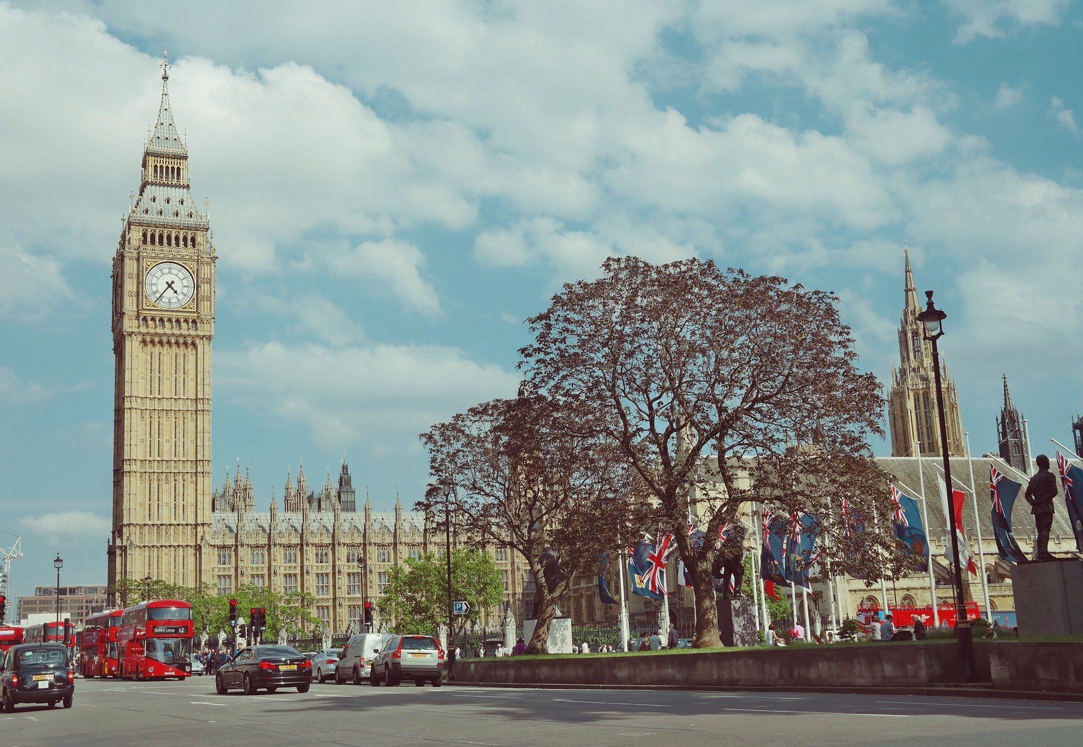
Challenge
Buckingham Palace
London Eye
Big Ben
Tower Bridge
River Thames
Notes:
Anne What is it?
Laisser le temps de répondre..
Ionna : It’s Big Ben !

Slide 28
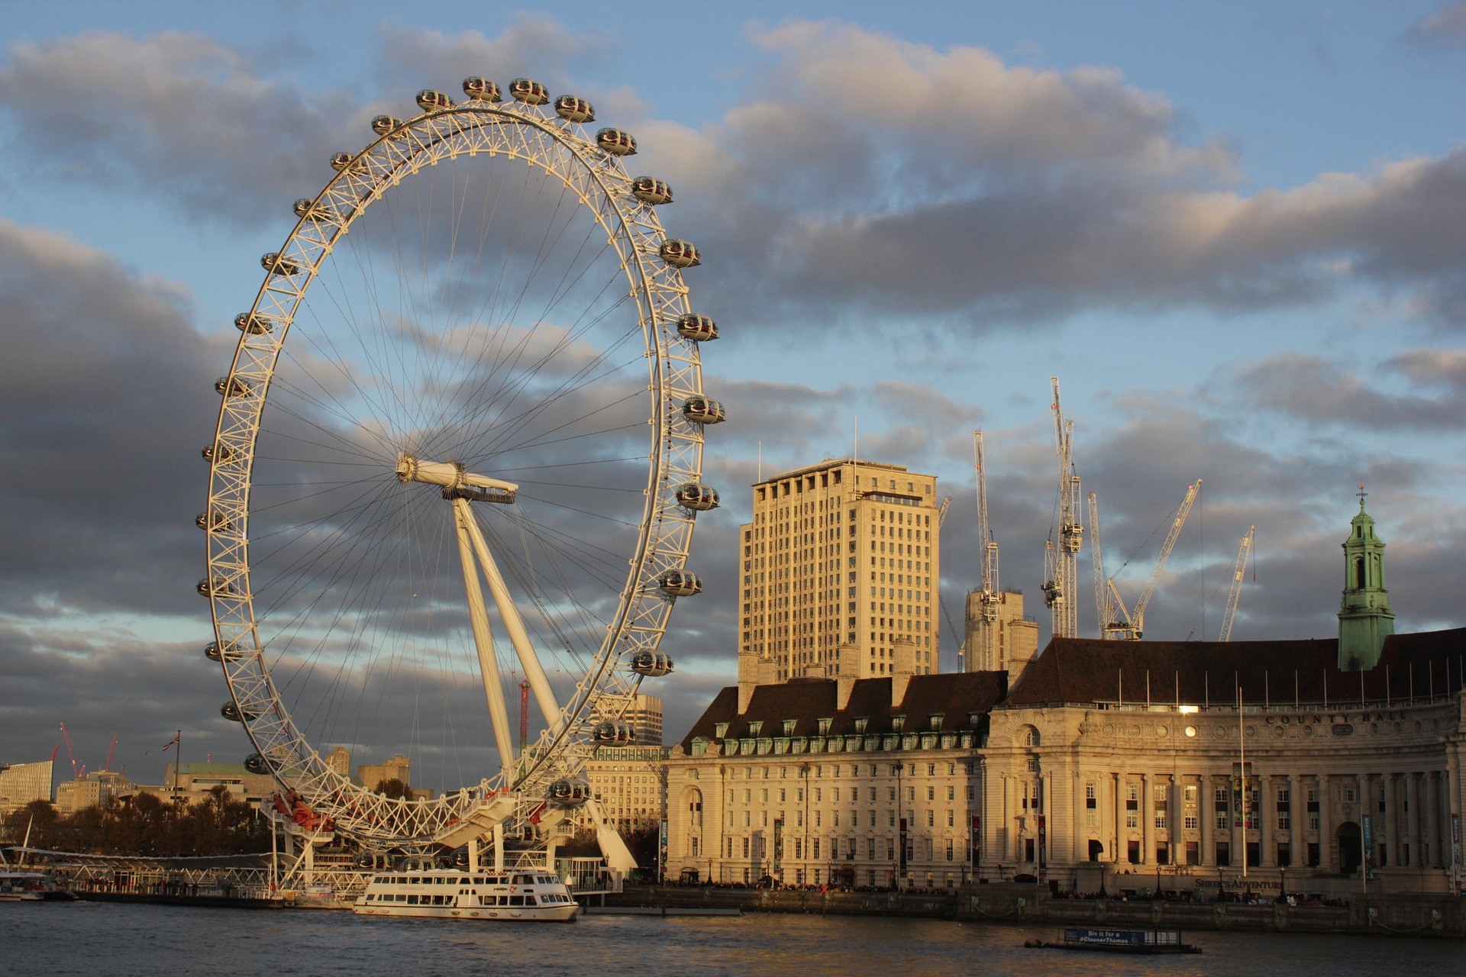
Challenge
London Eye
River Thames
Big Ben
Tower Bridge
Buckingham Palace
Notes:
Anne What is it?
Laisser le temps de répondre..
Ionna : It’s Buckingham Palace !

Slide 29
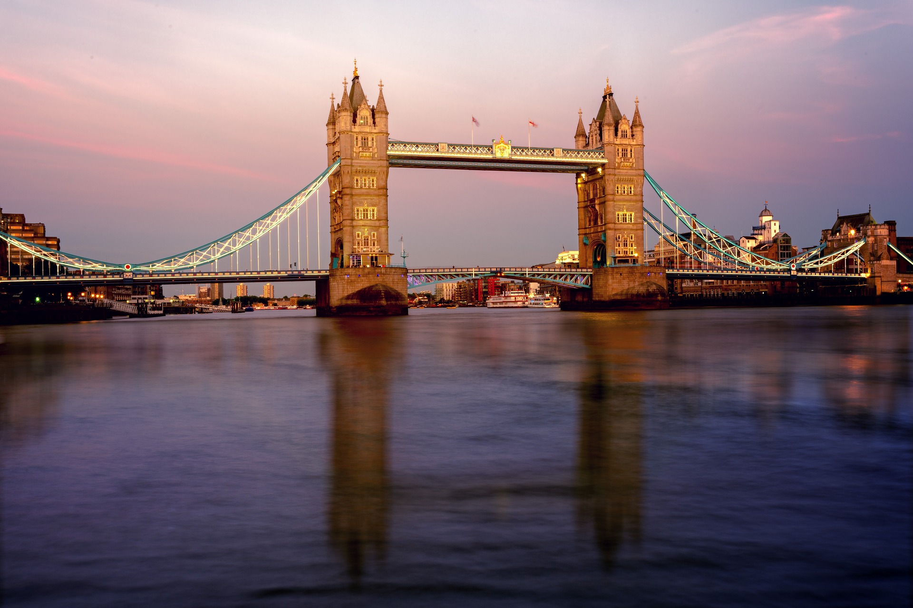
Challenge
Buckingham Palace
London Eye
Big Ben
Tower Bridge
River Thames
Notes:
Anne What is it?
Laisser le temps de répondre..
Ionna : It’s Buckingham Palace !

Slide 30
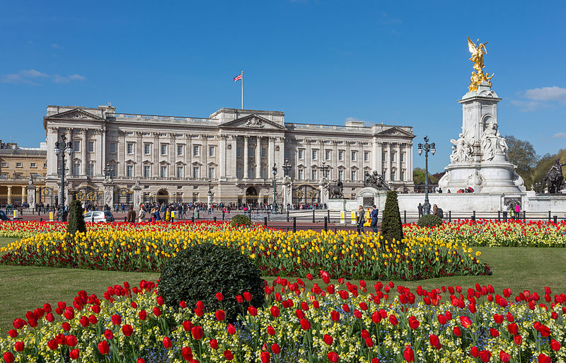
Challenge
Tower Bridge
London Eye
Big Ben
Buckingham Palace
River Thames
Notes:
Anne What is it?
Laisser le temps de répondre..
Ionna : It’s Buckingham Palace !

Slide 31
Challenge
Buckingham Palace
London Eye
Big Ben
Tower Bridge
River Thames
Notes:
Anne What is it?
Laisser le temps de répondre..
Ionna : It’s Buckingham Palace !

Slide 32
Let’s sing
Let’s sing!
London Bridge is falling down, falling down, my fair Lady

Slide 33
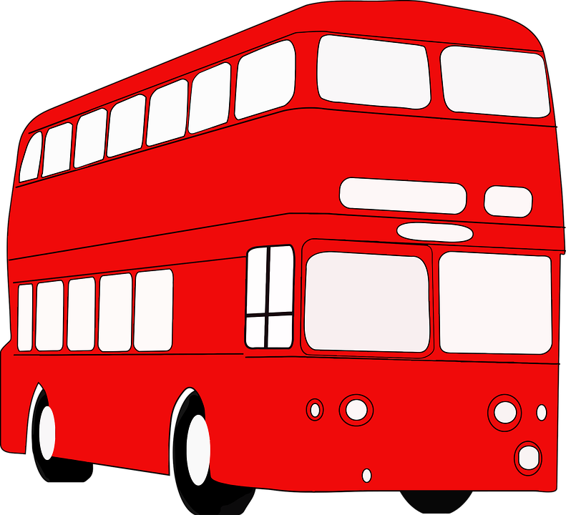
Let’s visit London!

Slide 34
11 lines
Bakerloo line
District line
Metropolitan line
Central line
Hammersmith and city line
Victoria line
Cercle line
Jubilee line
Northern line
Piccadilly line
Waterloo and city line

Slide 35
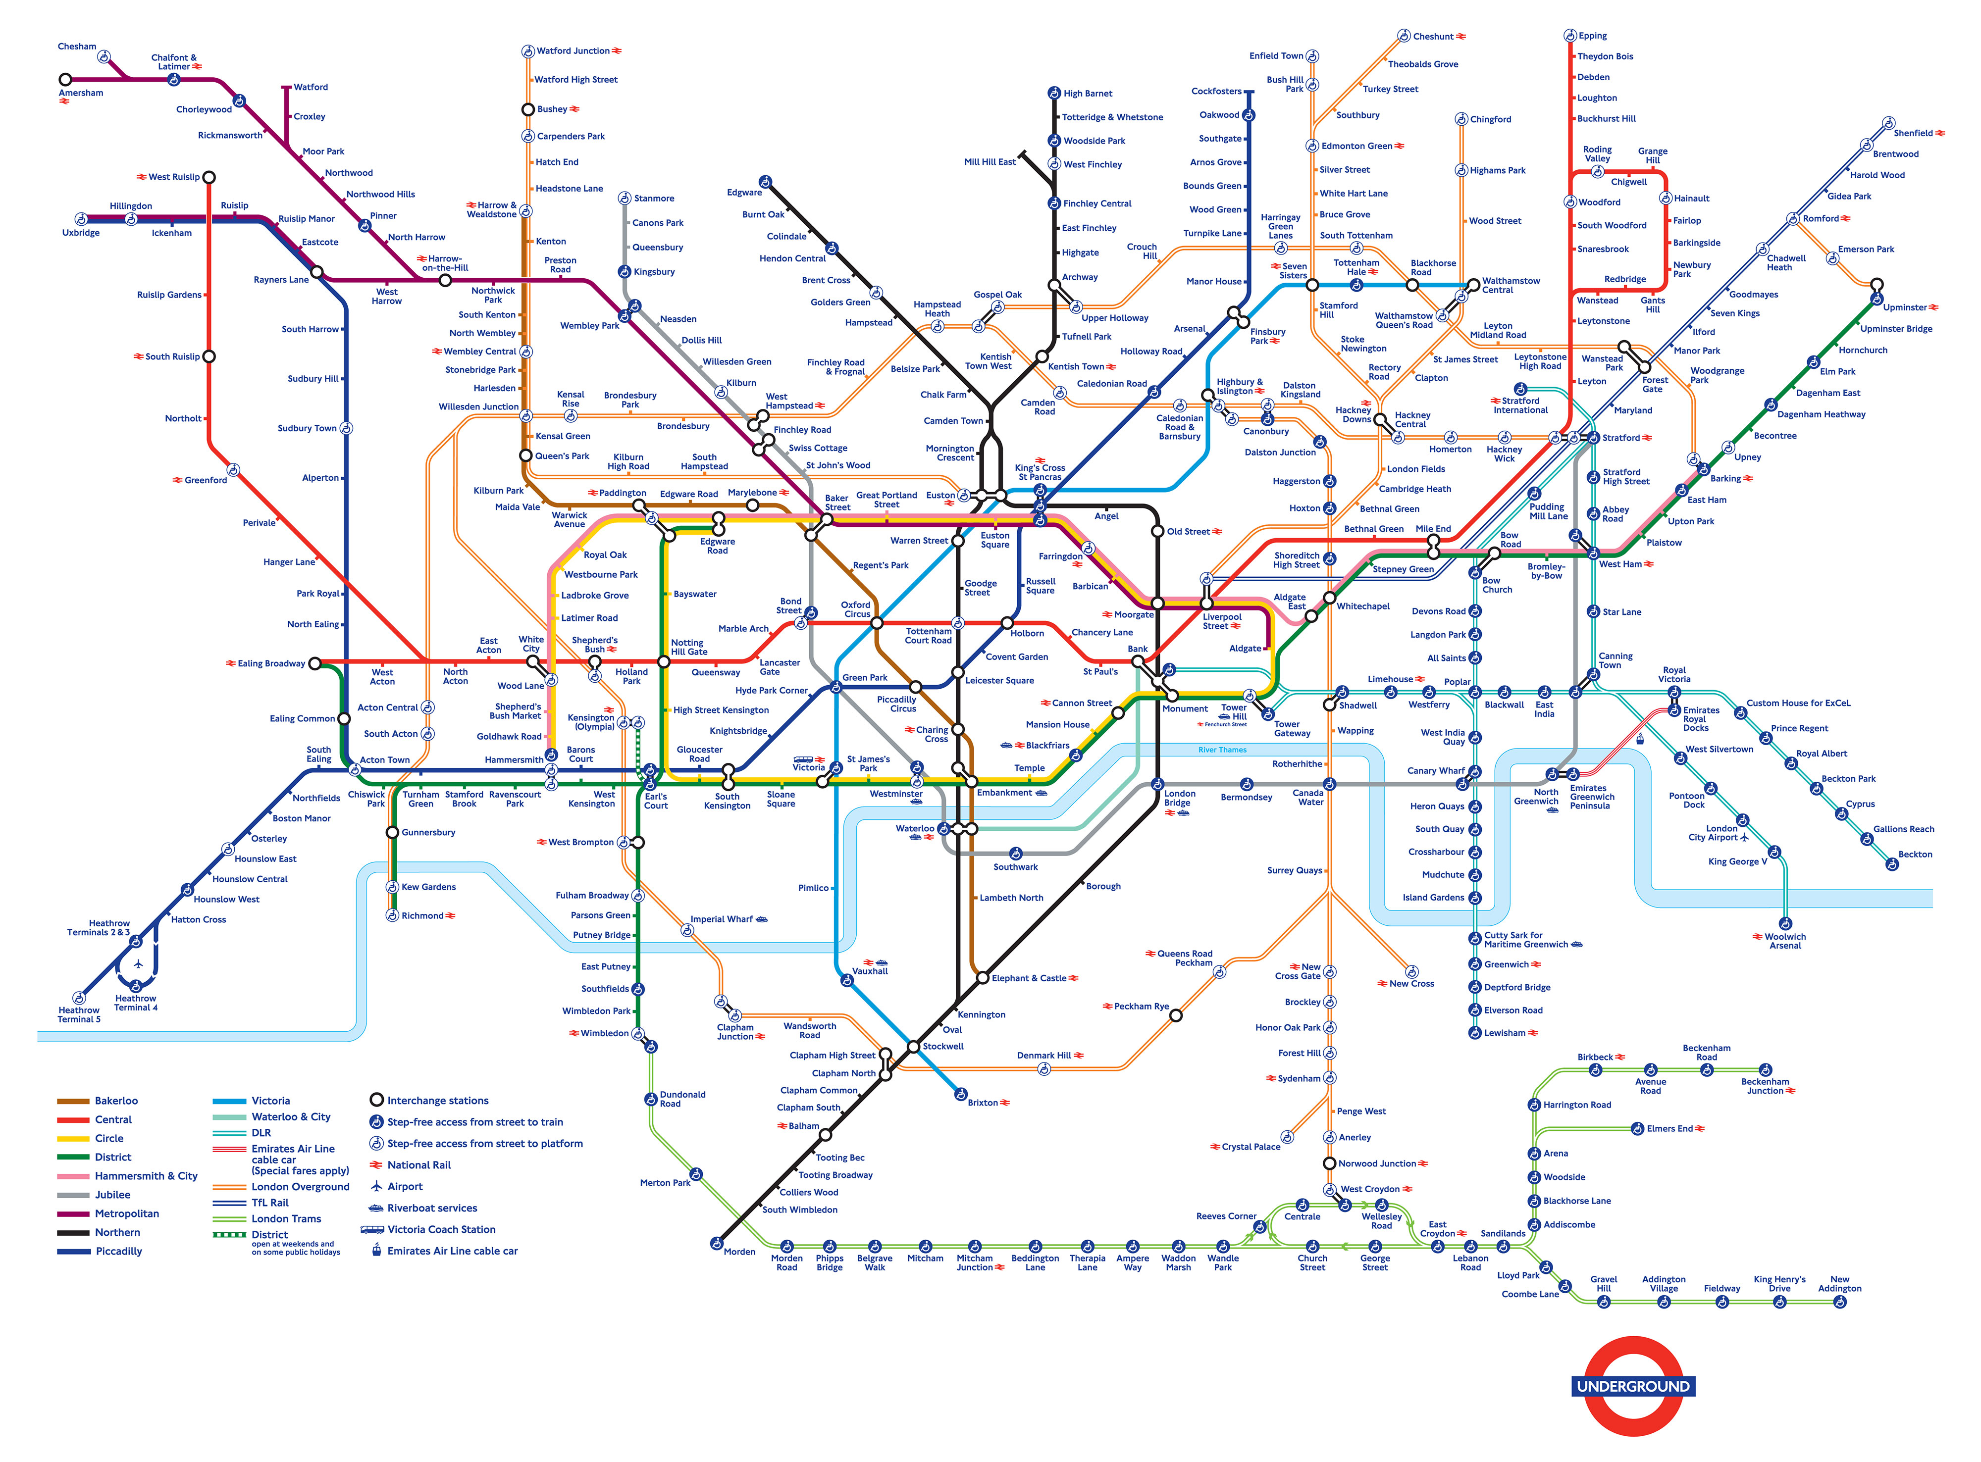

Slide 36
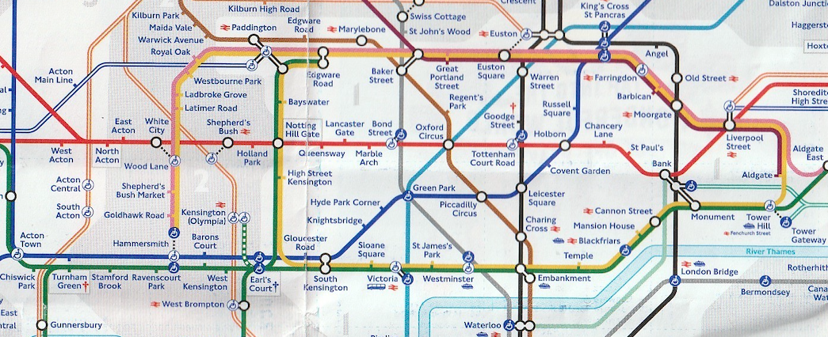
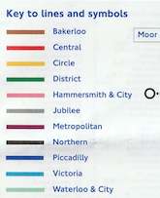
The tube map
Notes:
Jeu :
I want to go from Oxford Circus to Nothing hill gate
What line is it? It’s the Red line
Et nous yes and look at the Key
It’s the red line / Central line

Slide 37
The tube map
Notes:
Jeu :
I want to go from Picadilly Circus to Paddington
What line is it? It’s the brown line
Et nous yes and look at the Key
It’s the brown line / Bakerloo line

Slide 38
The tube map
Notes:
Jeu :
I want to go from Saint James Park to Bond Street
What line is it? It’s dark green line / or the yellow line / there are 2 lines
Et nous yes and look at the Key
It’s the yellow line / the Circle line –
Or it’s the green line / the district line
And..
You have to take another line
You have to take the… red line – at Nothing hill -
The red line is Central line

Slide 39
The tube map
Notes:
Si on a encore du temps : je – Entourer un endroit et dire : I want to go from XXX to XXX
What is the line ? What color?
How many stops?

Slide 40
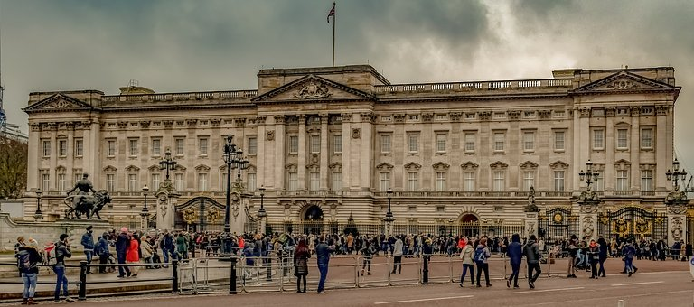
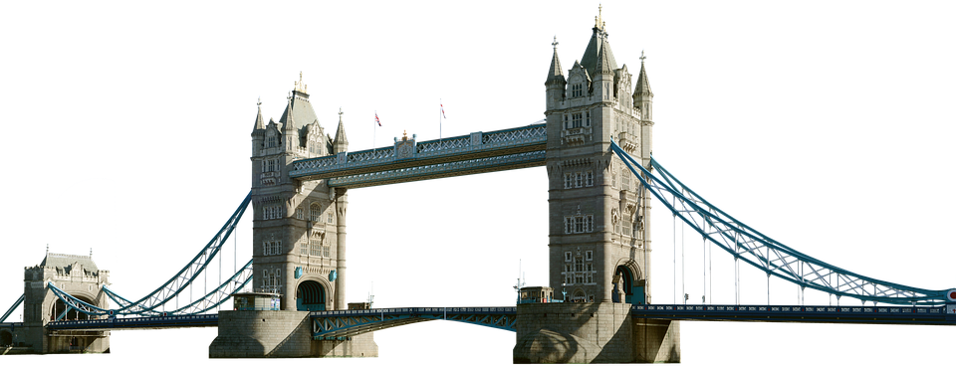
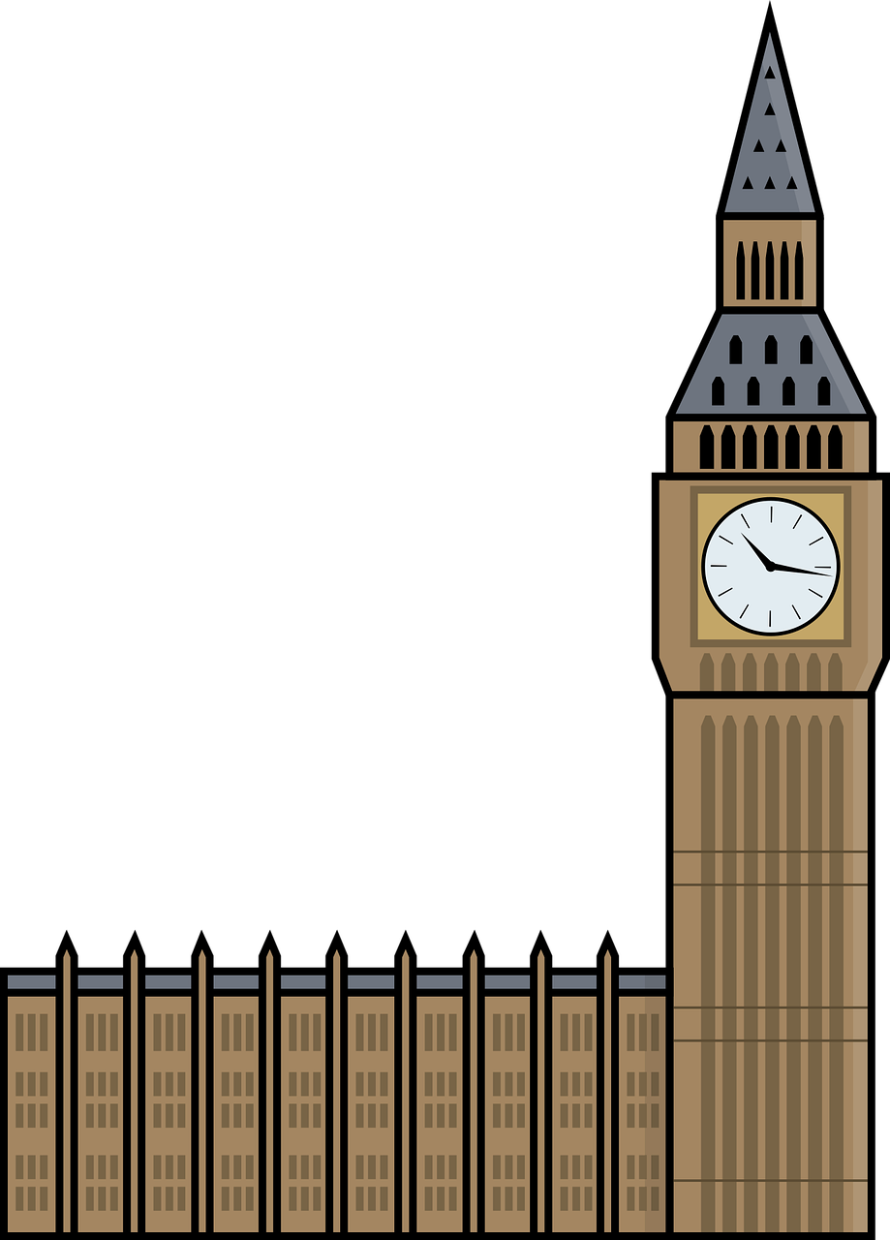
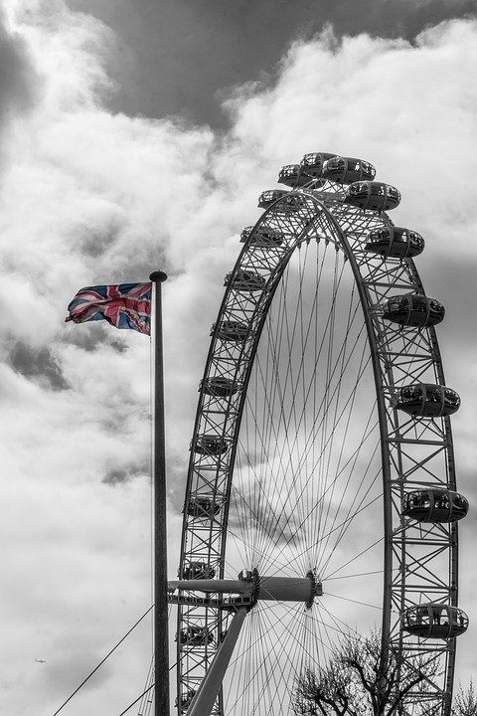
Notes:
Where is Buckingham palace? Il apparait etc…

Slide 41
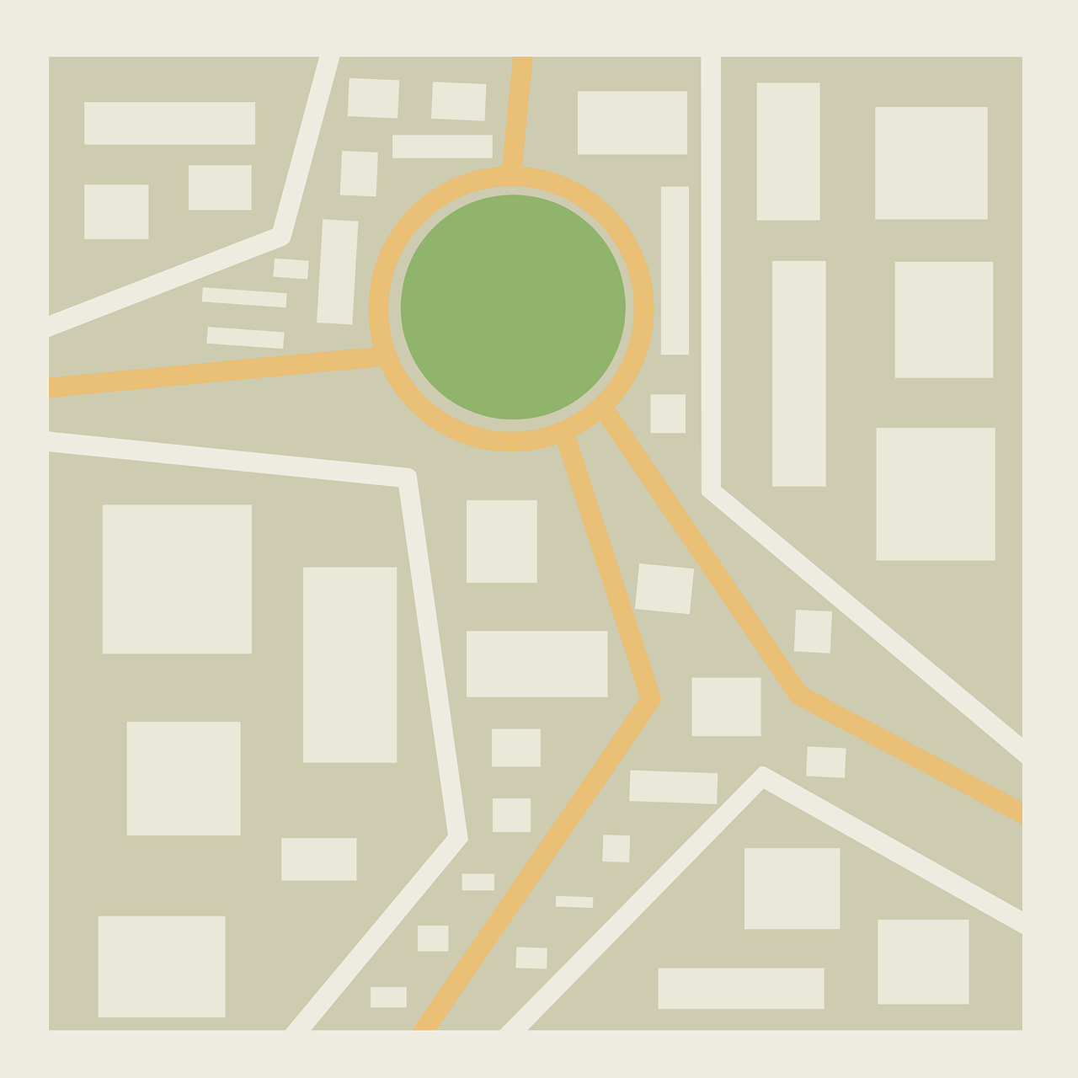
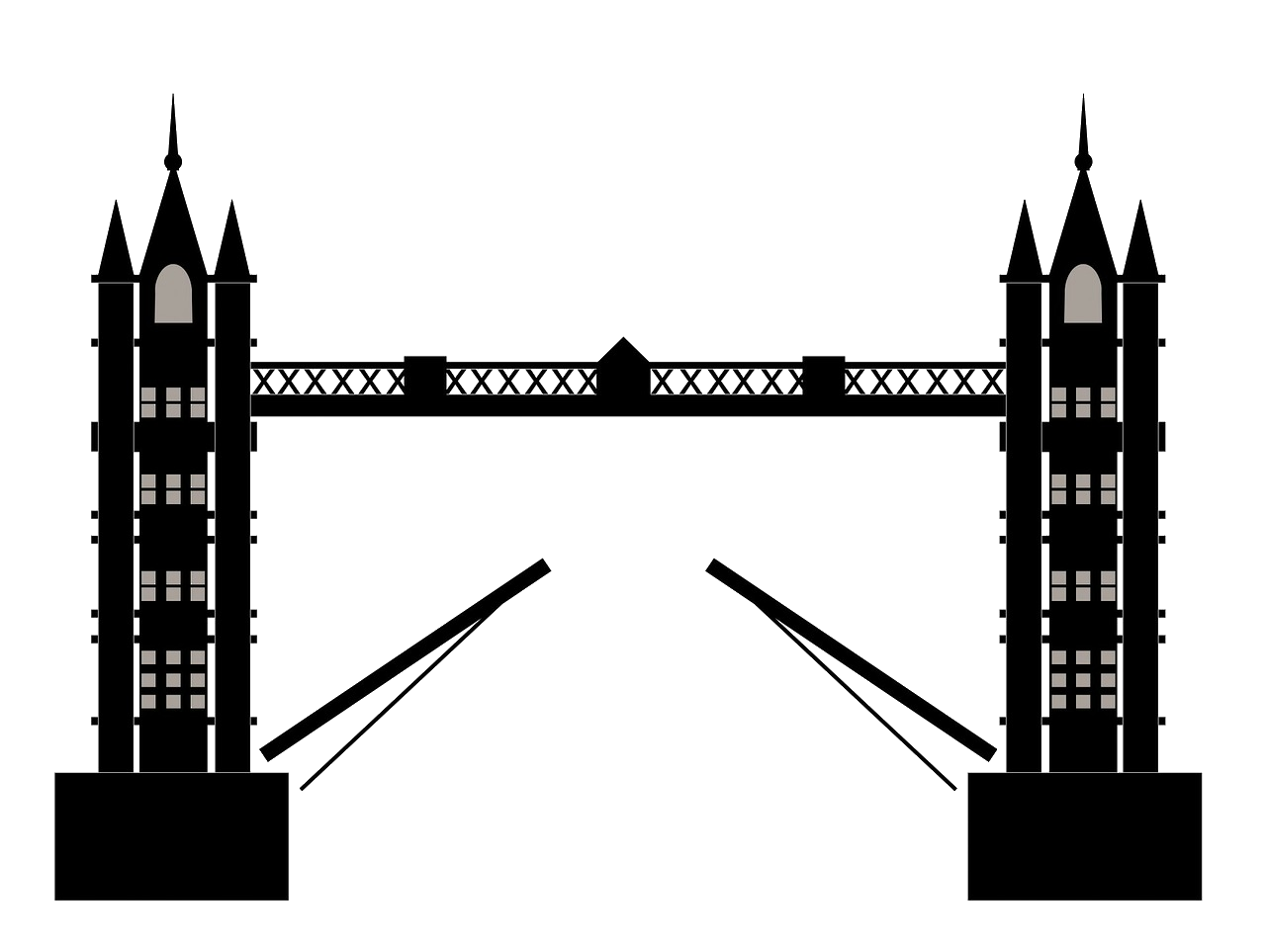
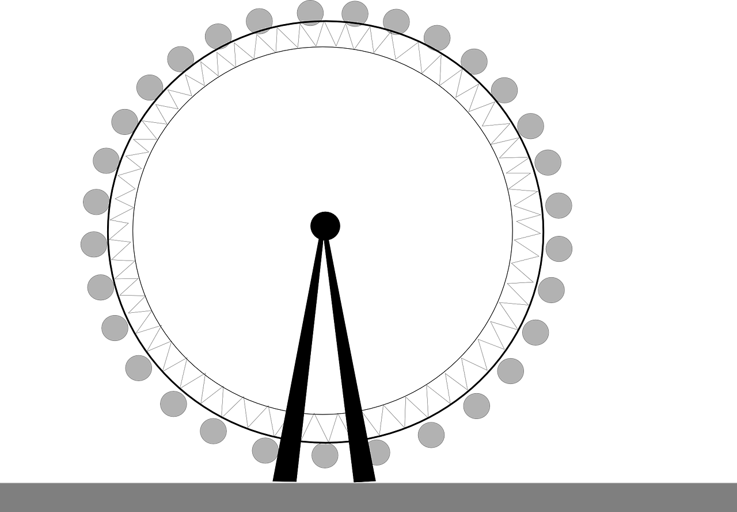
Visit London
River Thames
Buckingham Palace
Tower Bridge
London Eye
Big Ben
Notes:
Ionna : It’s London! A map of London
Anne : a map – montrer la carte
Ionna : What do you see?
Anne : I see Big Ben – cliquer et le mot Big Ben apparaît
What do you see?
Ionna : I see the London Eye – cliquer et le mot London Eye apparaît
What do you see?
Anne : I see the Tower Bridge– cliquer et le mot Tower apparaît
What do you see?
Ionna : I see Buckingham Palace – cliquer et le mot Buckigham Palace apparaît
Puis River Thame

Slide 43
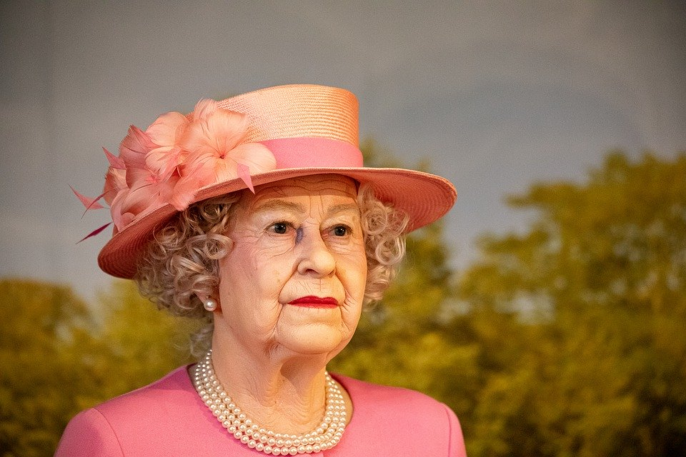
Visit London
Notes:
Anne What is it?
Laisser le temps de répondre..
Ionna : It’s Buckingham Palace! Cliquer et le Palace apparaît
Anne I Spy with my little eye… something Green
Ionna montre et répète Green (herbe)
I spy with my little eye something… red and Yellow
Répéter red and yellow et montrer les fleurs

Slide 44
Royal Family
George!
Notes:
Ionna / Anne : Hello, who are you?
Prince George répond : Hello, I’m Georges. I live in London
Anne : Hello Prince Georges
Ionna : Hello Prince Georges. Let’s see your family

Slide 45
Royal Family
Notes:
This is my family
Let’s discover who is in my family!
On lui répond

Slide 46
Royal Family
Queen Elizabeth II
Charles
Diana
Kate
William
Charlotte
Louis
Harry
Notes:
This is my family
On lui répond

Slide 47
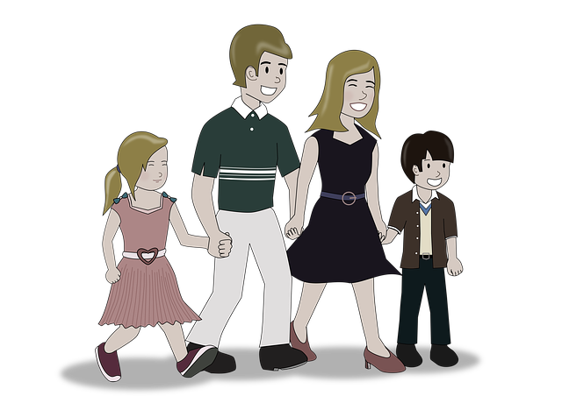
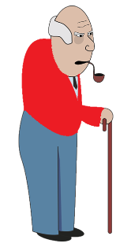
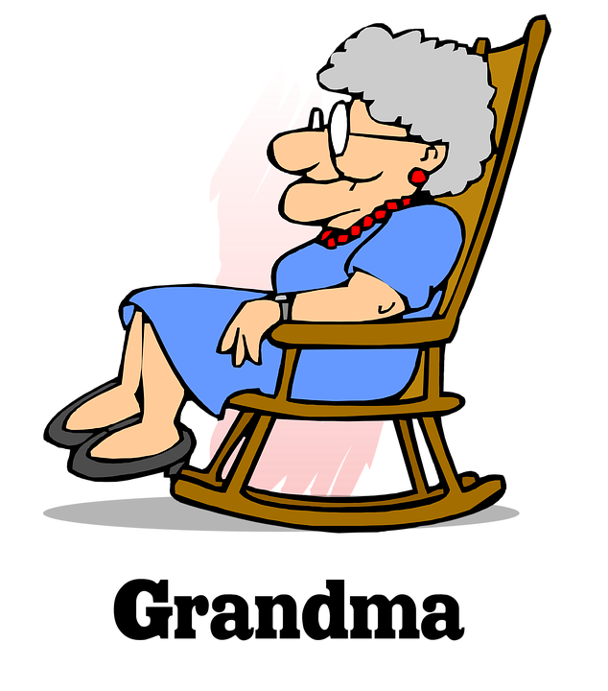
This is my family
my father
my grandfather
my grandpa
my mother
my grandmother
my grandma
my sister
my brother

Slide 48
Check your vocabulary

Slide 49
Royal Family
Louis
Notes:
Who is Louis?
Is he my brother
Is he my sister
Is he my father
Réponse
He is my father

Slide 50
Royal Family
Kate
Notes:
Who is Kate ?
Is she my granmother
Is she my grandfather
Is she my mother?
Réponse
She is my mother

Slide 51
Royal Family
YES
Charlotte
Notes:
Have you got a sister?
Yes I have

Slide 52
Royal Family
NO
Notes:
Have you got a sister?
Yes I have

Slide 53
Royal Family
YES
Notes:
Have you got a sister?
Yes I have

Slide 54
Royal Family
NO
Notes:
Have you got a sister?
Yes I have

Slide 55
Tongue twister
Harry is a happy cat with a hat.
Notes:
Poser la question au public
And you, have you got a sister?
Yes I do - No I don’t
Have you got a brother
Yes I do - No I don’t
Have you got a cat?
Have you got a dog?

Slide 56
Anne

Slide 57
Family
Notes:
Poser la question au public
And you, have you got a sister?
Yes I have / No I haven’t
Have you got a dog?
Yes I have / No I haven’t
Have you got a brother
Yes I do - No I don’t
Have you got a cat?
Have you got a dog?

Slide 58
Family
Notes:
Poser la question au public
And you, have you got a sister?
Yes I have / No I haven’t
Have you got a dog?
Yes I have / No I haven’t
Have you got a brother
Yes I do - No I don’t
Have you got a cat?
Have you got a dog?

Slide 59
Family
Notes:
Poser la question au public
And you, have you got a sister?
Yes I have / No I haven’t
Have you got a dog?
Yes I have / No I haven’t
Have you got a brother
Yes I do - No I don’t
Have you got a cat?
Have you got a dog?

Slide 60
Family
Notes:
Poser la question au public
And you, have you got a sister?
Yes I have / No I haven’t
Have you got a dog?
Yes I have / No I haven’t
Have you got a brother
Yes I do - No I don’t
Have you got a cat?
Have you got a dog?

Slide 61
Notes:
Where is your father? He’s in the phonebox
Where is your sister she’s on the bus
Where’s your grandmother? She’s in front of Big Ben
Where’s your mother? She’s in the tube
Where’s your brother? He’s at the London Eye
Where’s your grandfather? He’s at the Tower Bridge
And where’s the Queen? She’s in BP

Slide 62
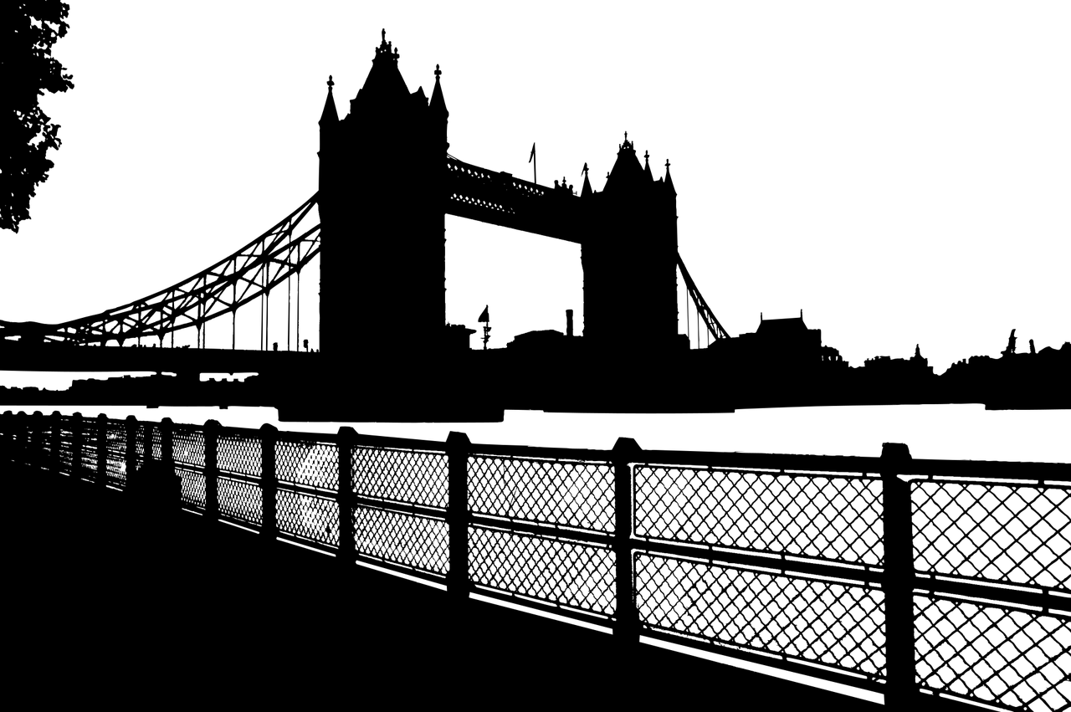
Who’s hiding?
Notes:
Anne What is it?
Laisser le temps de répondre..
Ionna : It’s Buckingham Palace !

Slide 63
Dans ce cours tu as appris à
chanter
découvrir la ville de Londres
apprendre à nommer les membres de ta famille
nommer les couleurs

Slide 64
_{Goodbye Song}
Let’s sing!
Notes:
Écouter et chanter la Hello Song par dessus

