Slide 1
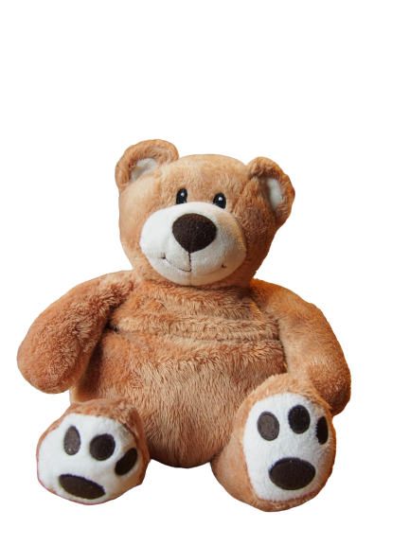
English with
Teddy,
Anne and Natalie

Slide 2
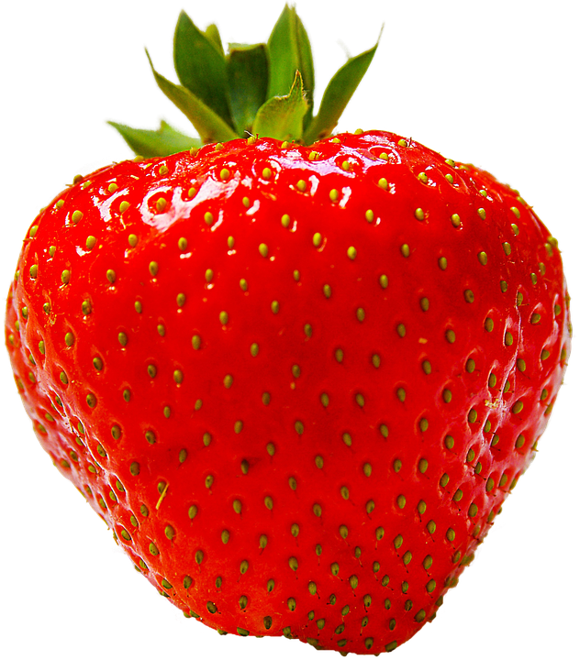
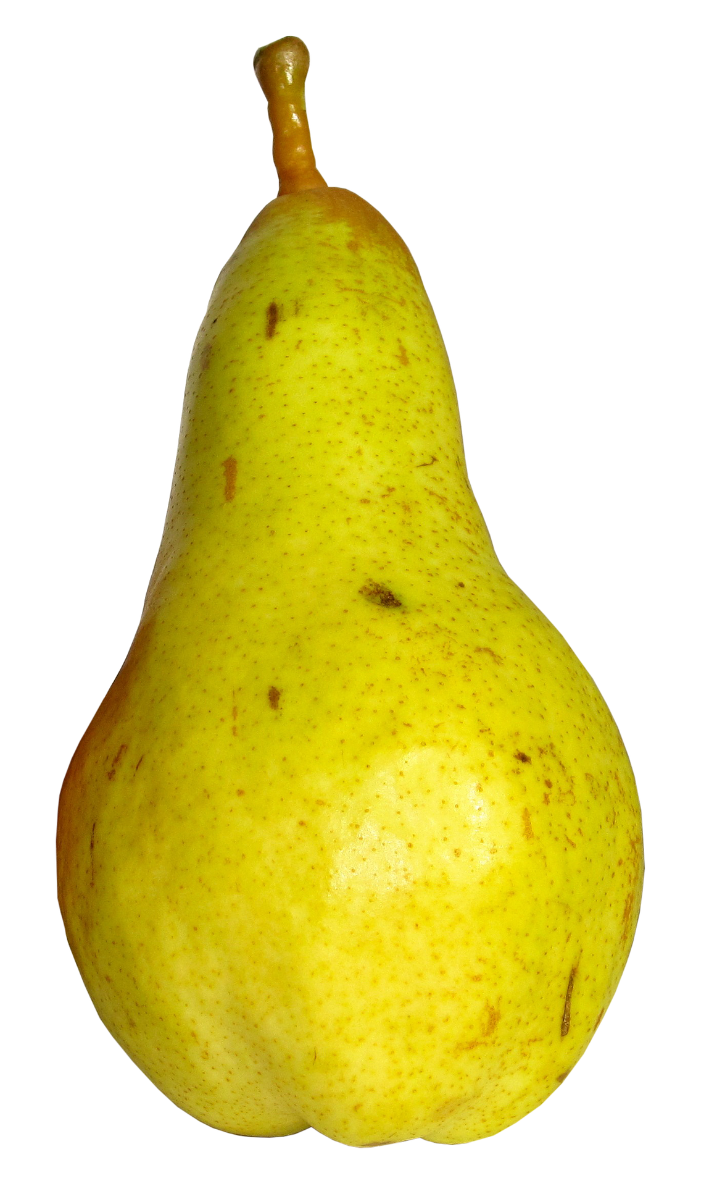
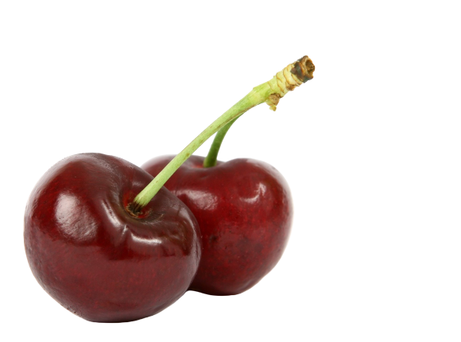
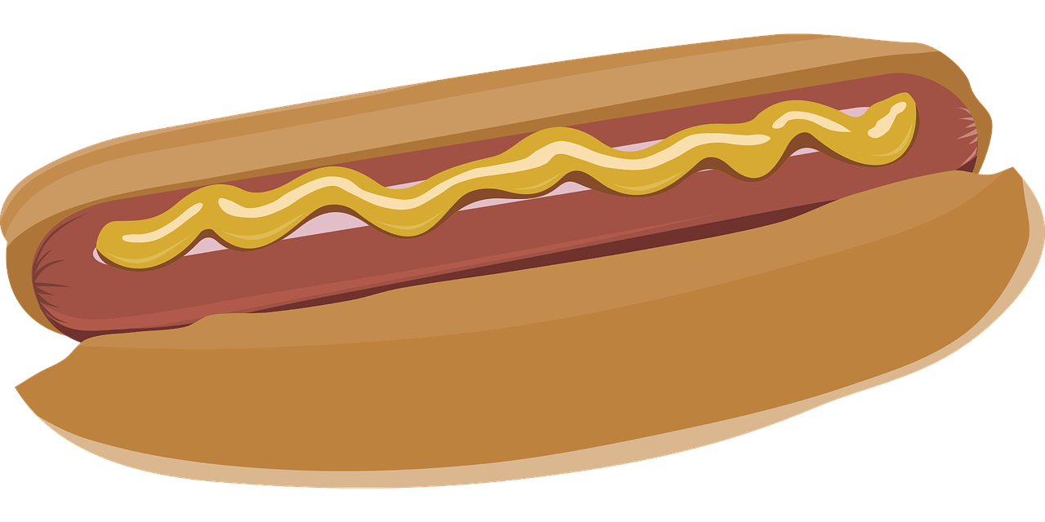
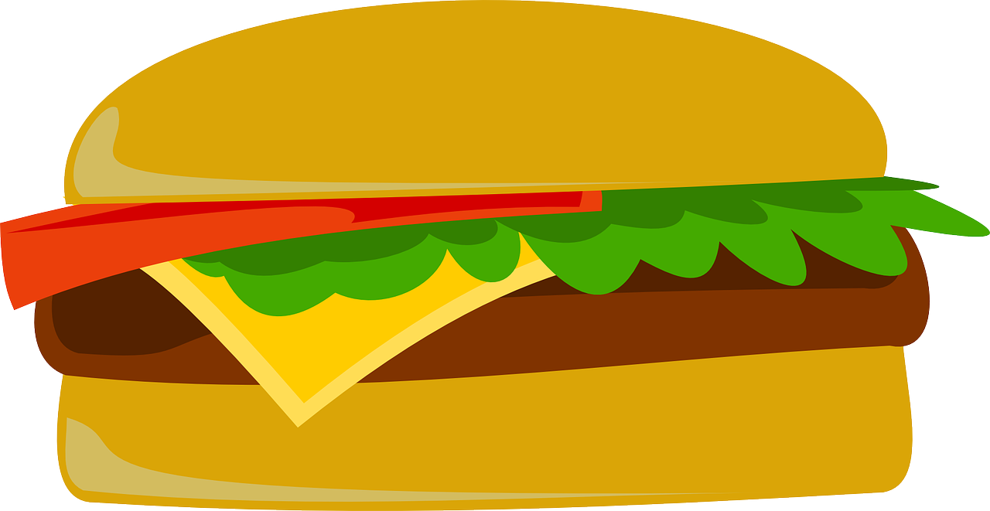
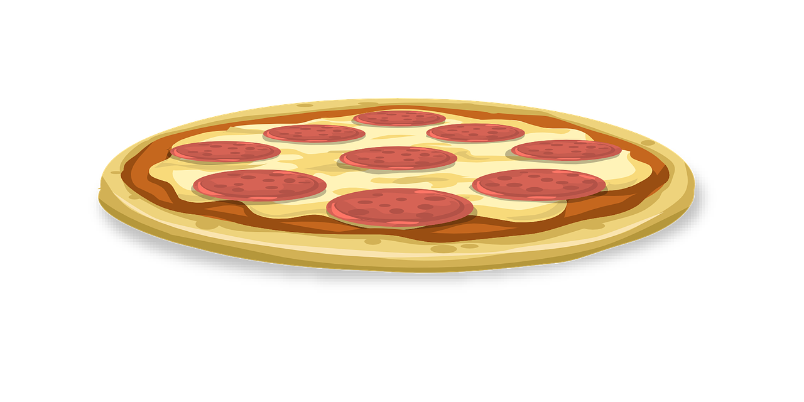
Dans ce cours, tu vas :
découvrir des aliments
découvrir les fruits
chanter
dire ce que tu aimes ou non

Slide 3
Let’s sing!
The hello song!

Slide 5
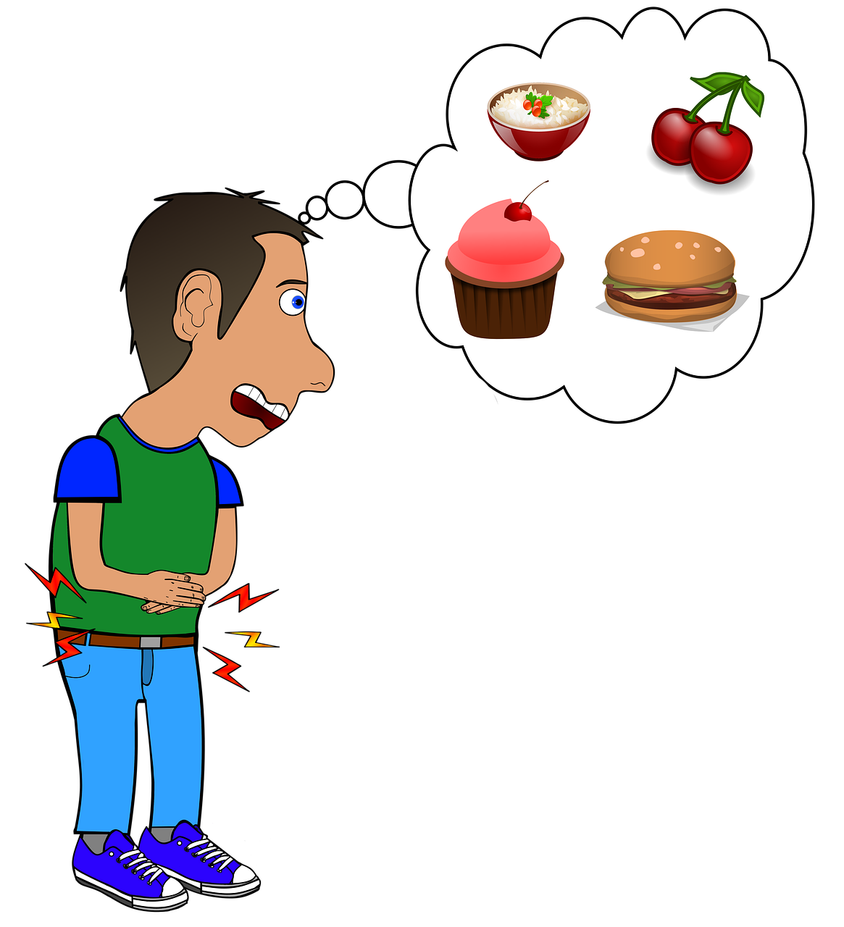

Slide 6
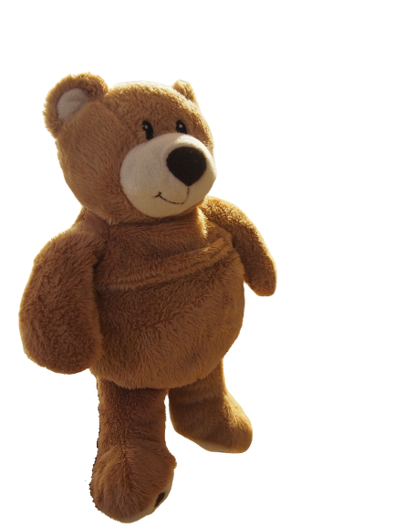
Notes:
Teddy dit I’m happy …
Ou Kate ???
I’m happy because I go to school.

Slide 7
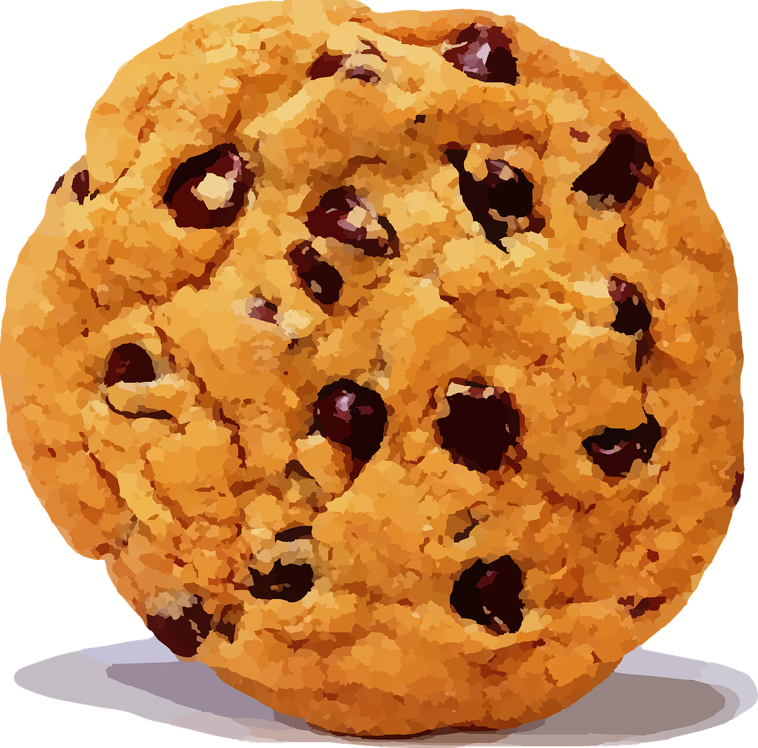
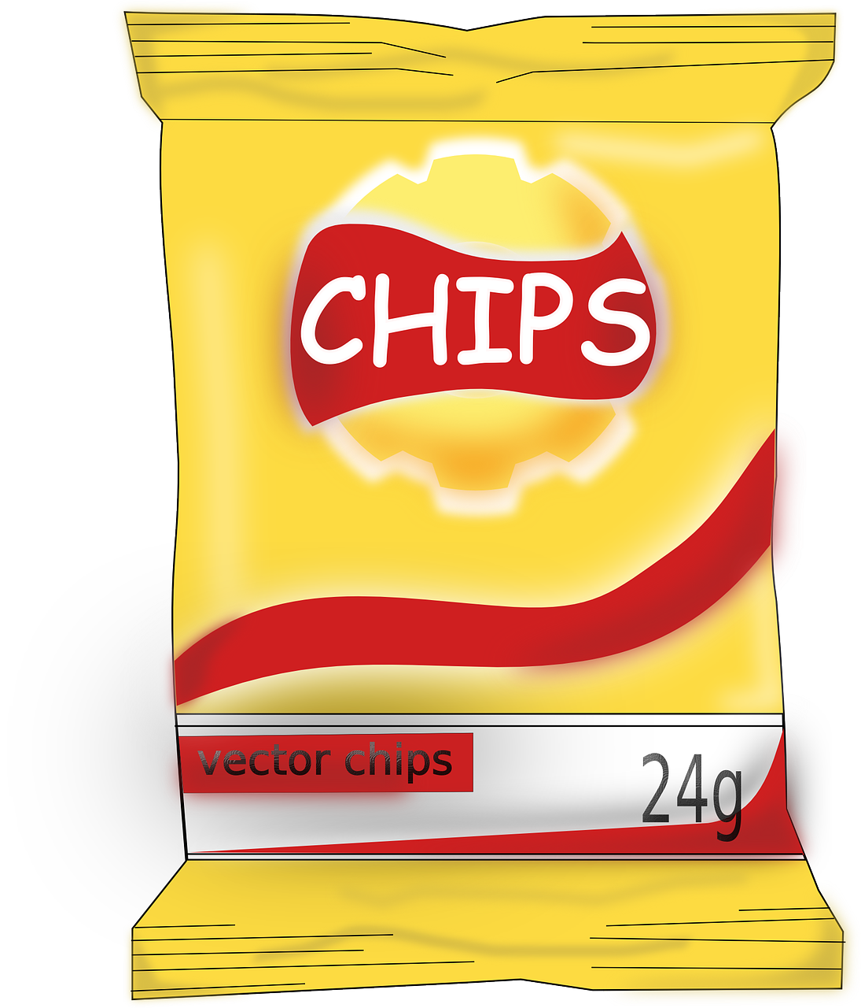
FOOD
DRINKS
DESSERTS
soda
Notes:
What’s in my favourite restaurant?

Slide 8
FOOD
DRINKS
DESSERTS
1
2
6
9
3
10
7
soda
11
12
5
4
8
Notes:
What’s in my favourite restaurant?

Slide 9
FOOD
DRINKS
DESSERTS
soda
Notes:
Can you spot something pink?

Slide 14
Notes:
Anne : My name’s Anne.
Natalie: Hello Anne!

Slide 15
Notes:
Anne : My name’s Anne.
Natalie: Hello Anne!

Slide 16
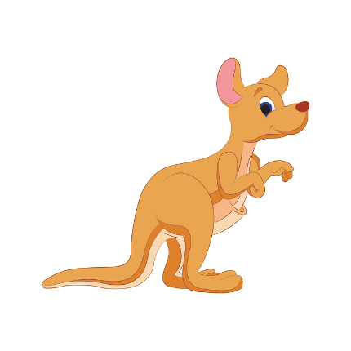
Notes:
Anne : My name’s Anne.
Natalie: Hello Anne!

Slide 17
Notes:
Anne : My name’s Anne.
Natalie: Hello Anne!

Slide 18
Yummy!
Notes:
Anne : My name’s Anne.
Natalie: Hello Anne!

Slide 19
Yuck!!!
Notes:
Anne : My name’s Anne.
Natalie: Hello Anne!

Slide 20
Notes:
Anne : My name’s Anne.
Natalie: Hello Anne!

Slide 21
soda
Notes:
Anne : My name’s Anne.
Natalie: Hello Anne!

Slide 22
soda

Slide 23
FOOD
DRINKS
$3
soda
$2
$7
$2
Notes:
Audio : Hello, I’d like a hot dog, chips and a soda please!

Slide 24
FOOD
DRINKS
$4
$1
soda
$1
$6
Notes:
Audio : Hello, I’d like a hot dog, chips and a soda please!

Slide 25
$5
FOOD
DRINKS
DESETS
DESSERTS
$4
$1
$3
$1
$2
$5
$2
soda
$1
$2
$3
$2
$2
Notes:
Natalie : Anne I’ve got 5 dollars: I’d like a hot dog, an apple juice and a cookie. Is it possible?

Slide 26
$7
FOOD
DRINKS
DESETS
DESSERTS
$4
$1
$3
$1
$2
$5
$2
soda
$1
$2
$3
$2
$2
Notes:
Anne : Natalie I’ve got 7 dollars: I’d like a pizza , a soda and an icecream. Is it possible?

Slide 27
DESSERTS
?

Slide 28
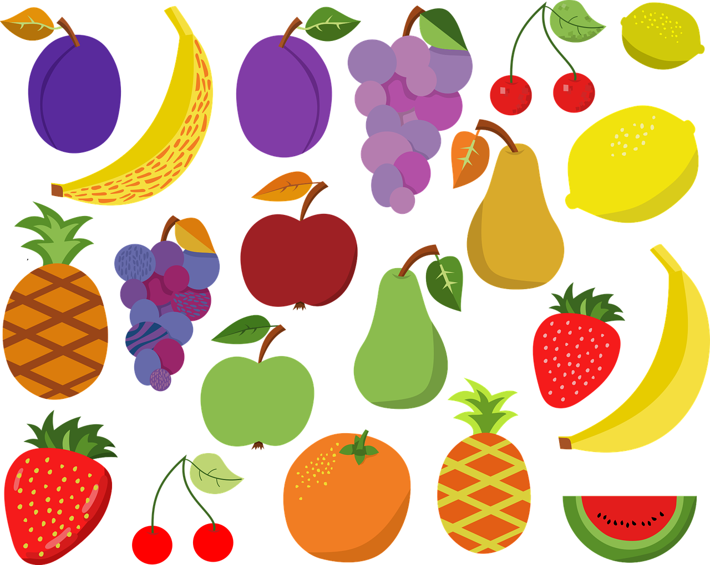
Notes:
Anne : My name’s Anne.
Natalie: Hello Anne!

Slide 29
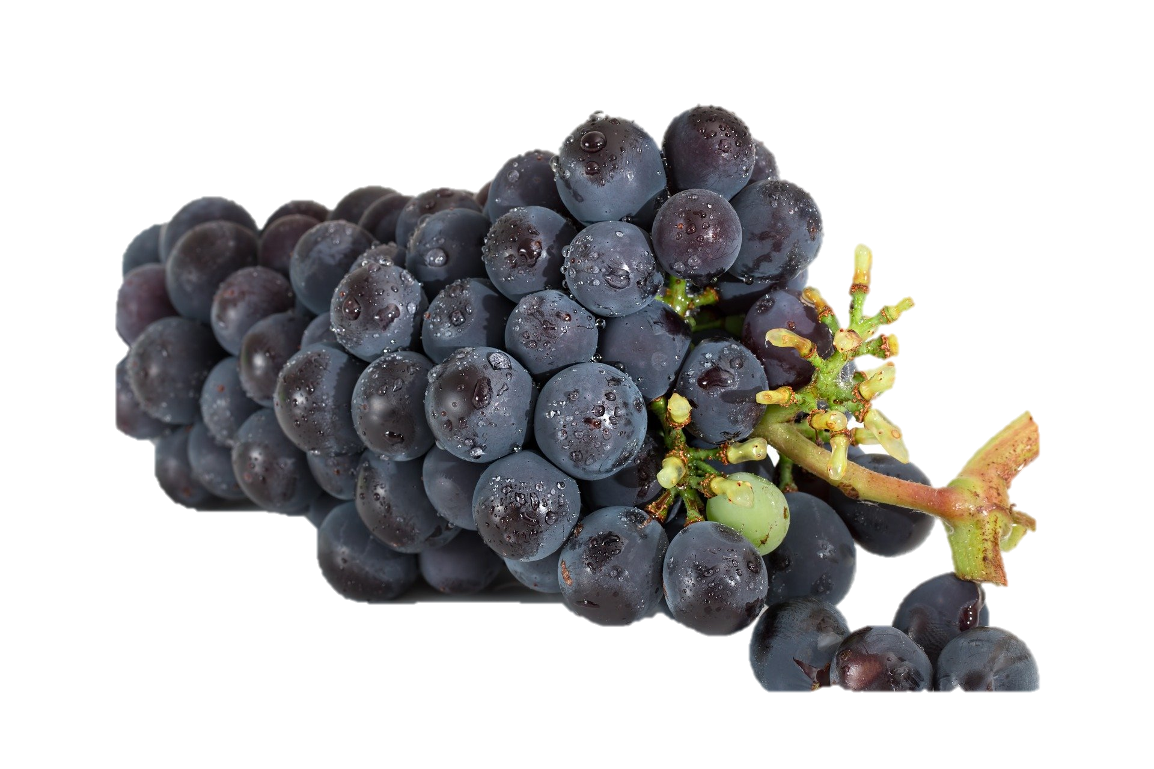
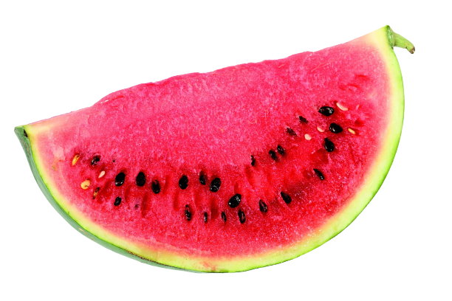
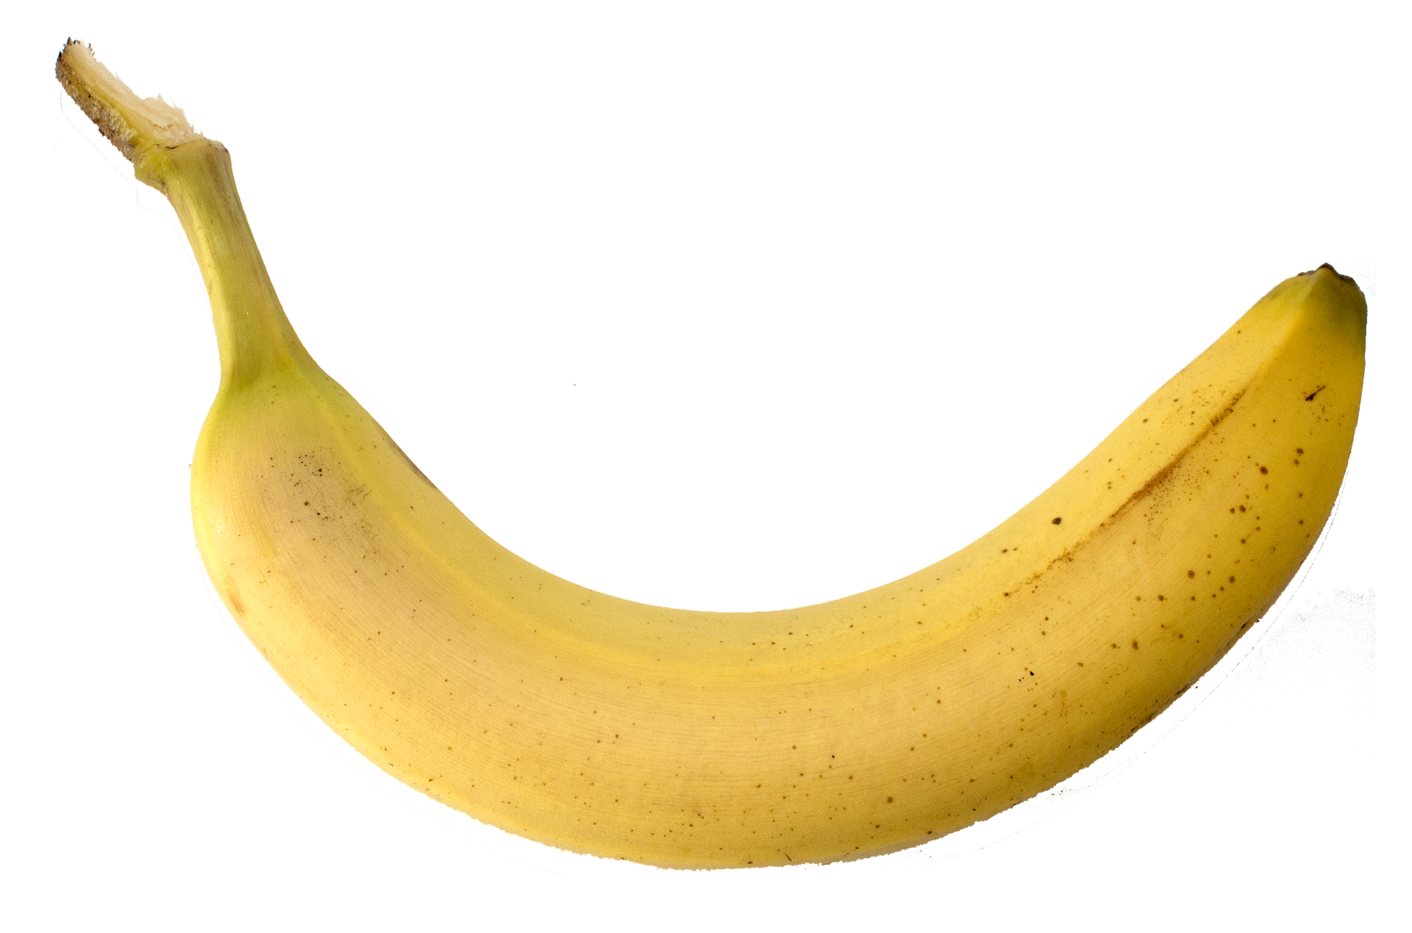
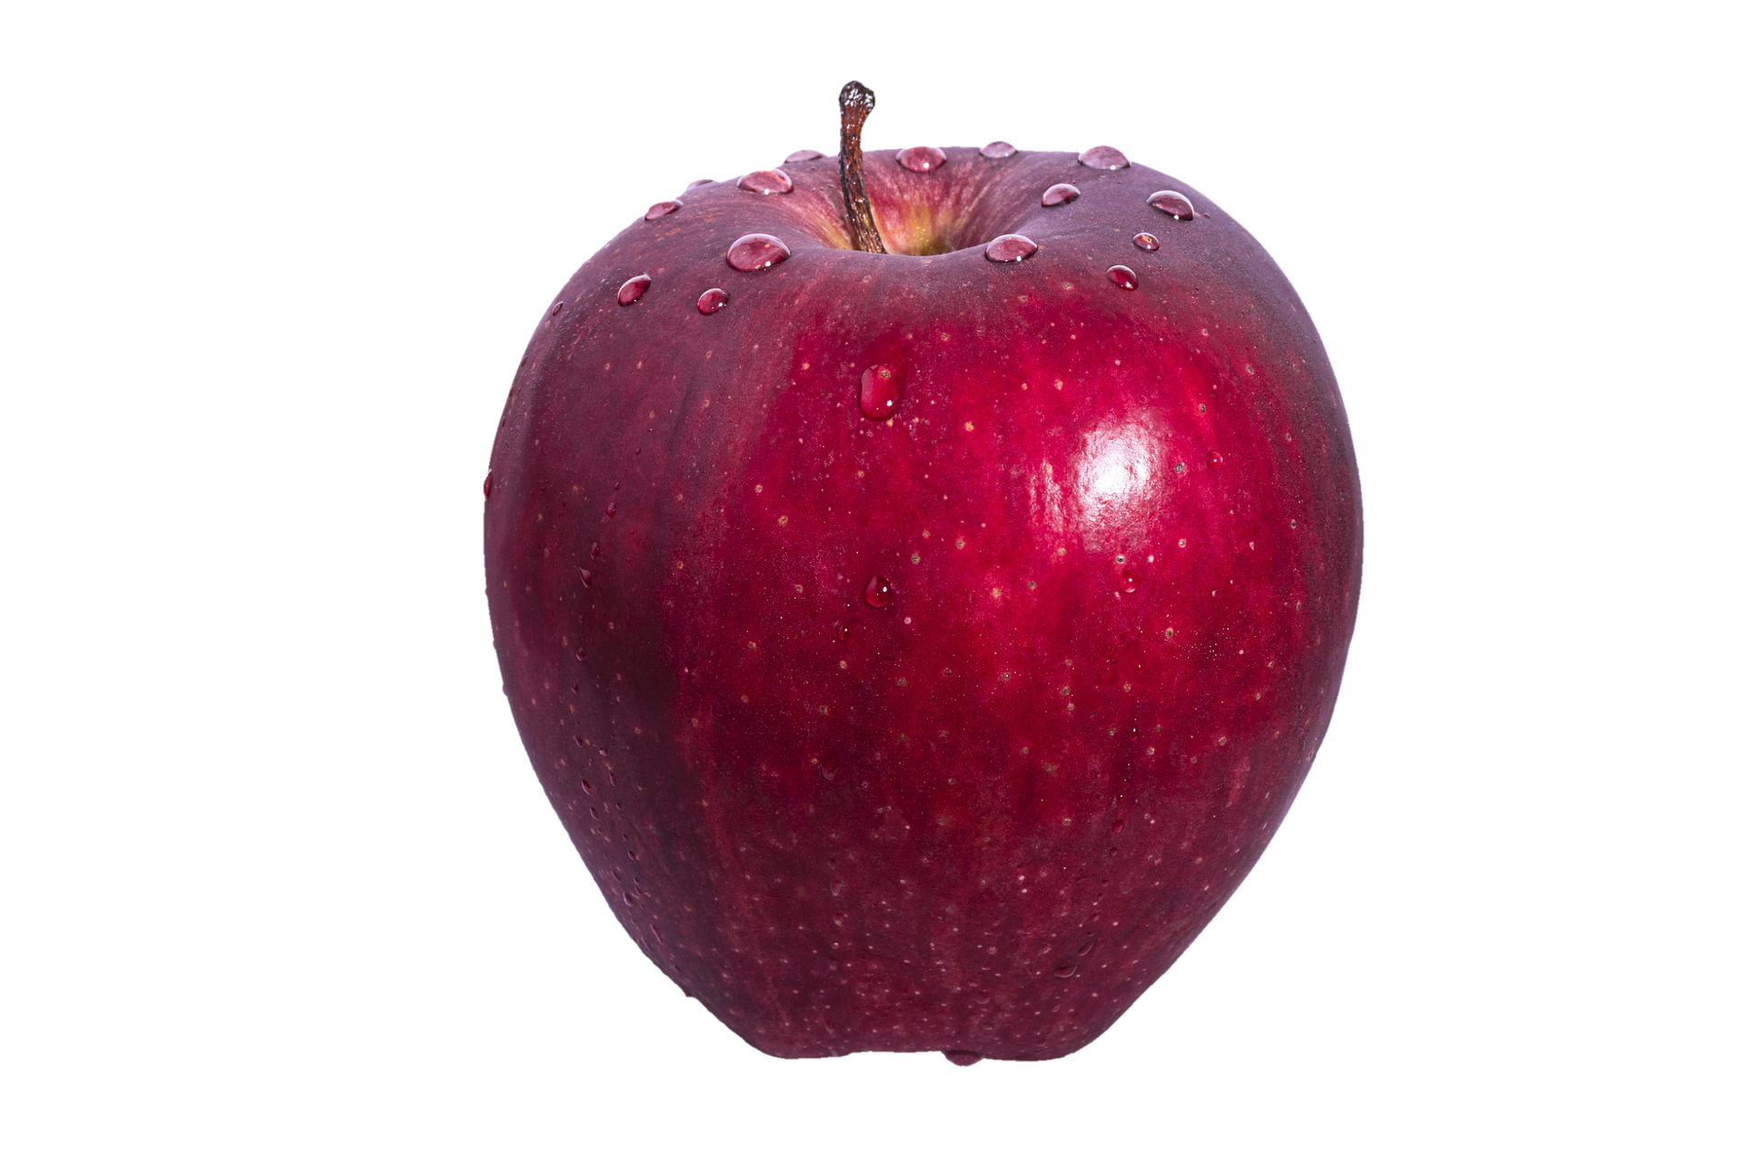

Slide 30
Spot!

Slide 31
Speak!

Slide 32
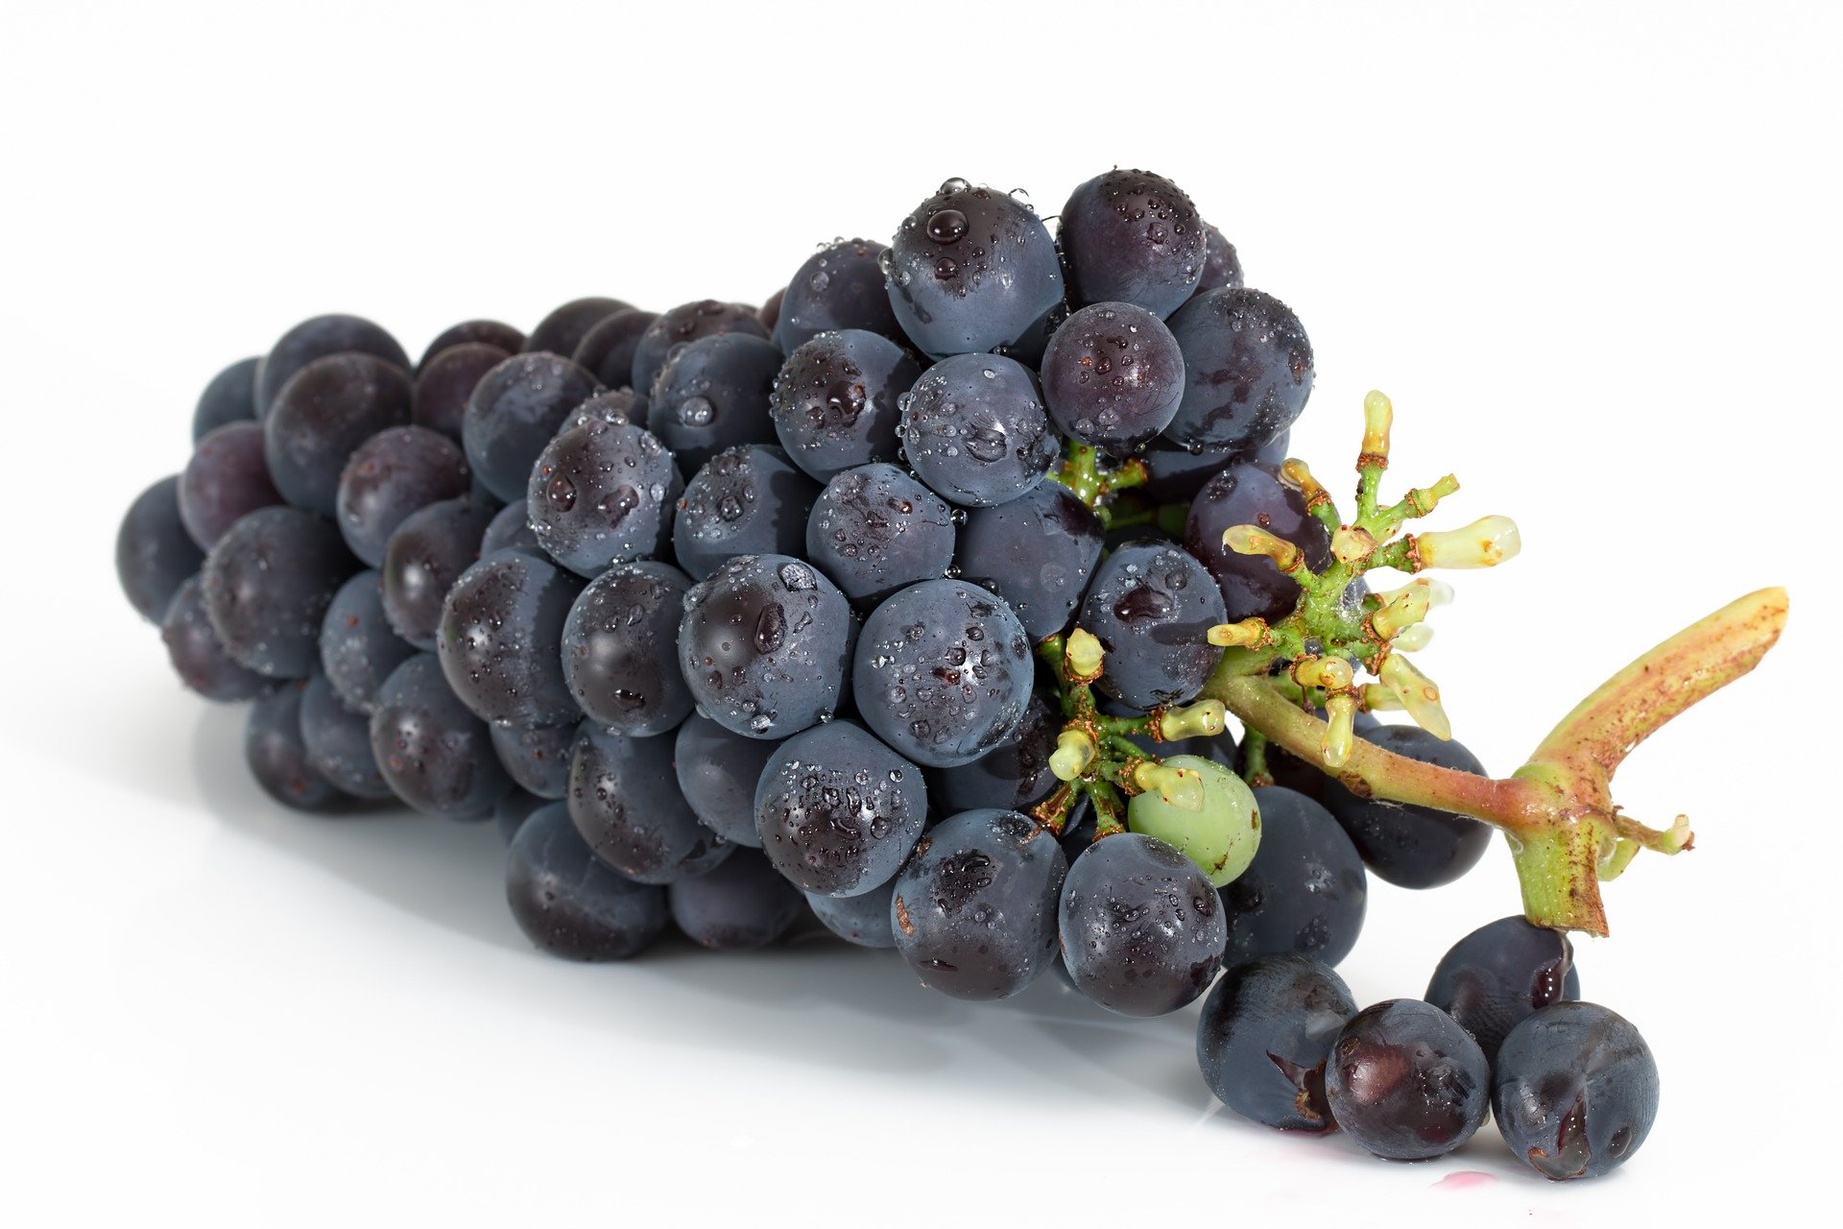
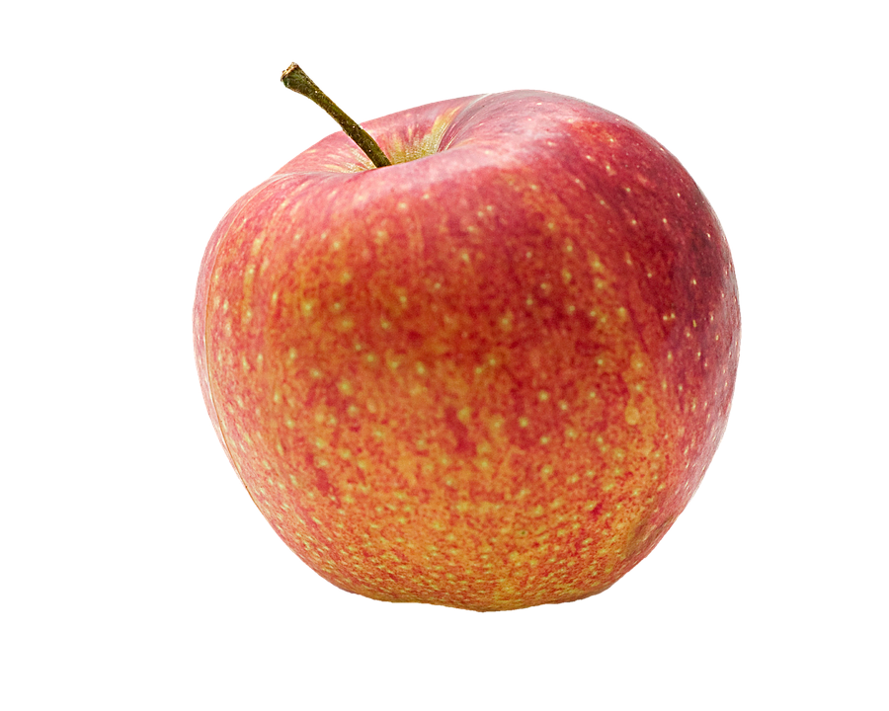
8
1
2
7
3
6
5
4
Dominos!

Slide 33
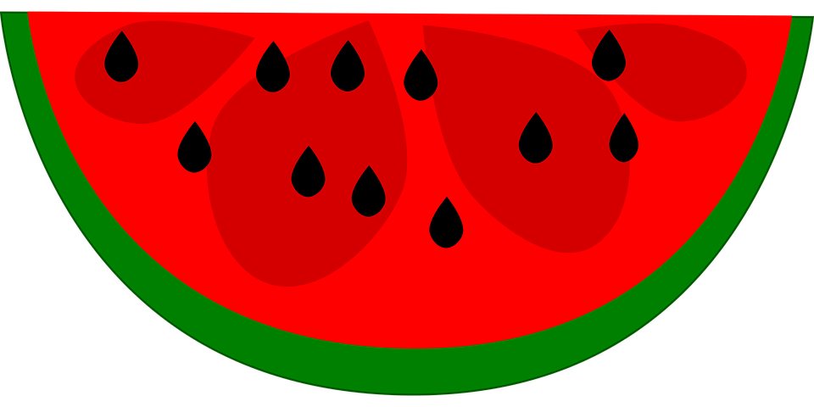
Challenge1

Slide 34
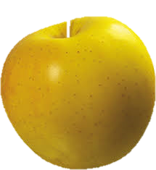
Challenge 2

Slide 35
NY
=

Slide 37
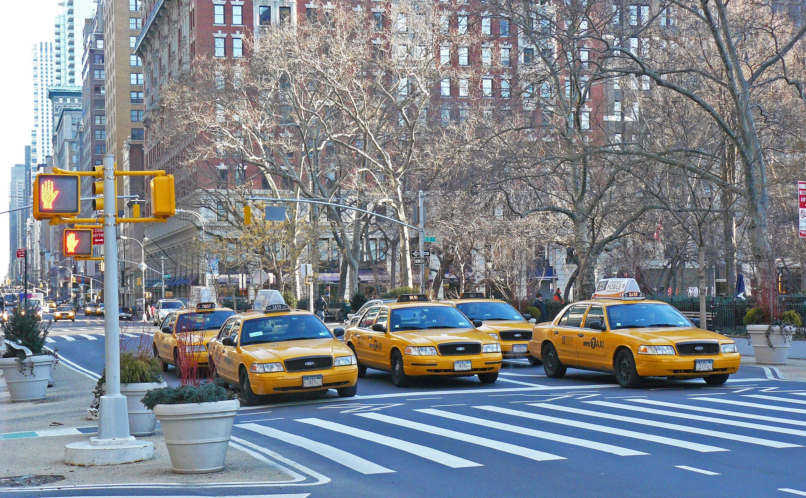
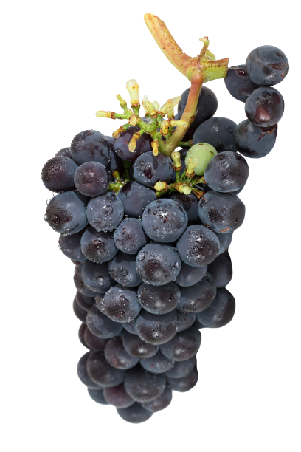

Slide 38
Let’s sing!
I like apples

Slide 43
Yummy!

Slide 45
Yuck!

Slide 49
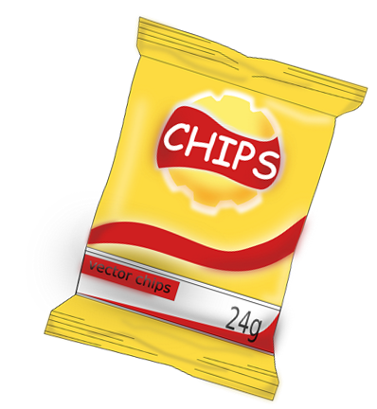

Slide 51
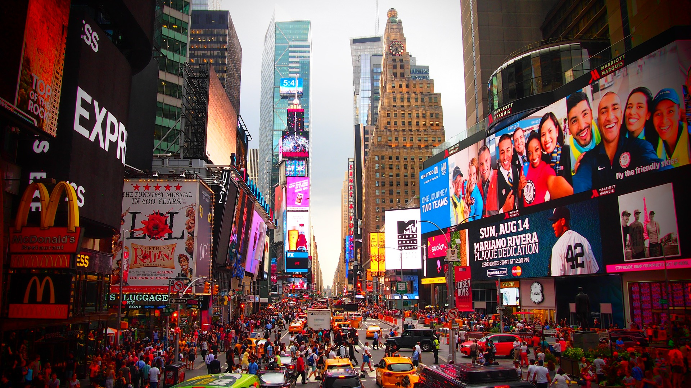
Dans ce cours tu as appris à
découvrir les fruits
découvrir des aliments
dire ce que tu aimes ou non
chanter

Slide 52
Let’s sing!
The goodbye song!

Slide 53
Challenge fruit

Slide 54
Challenge fruit

Slide 55
Challenge fruit

Slide 56
Challenge fruit

Slide 57
Challenge fruit

Slide 58
Challenge fruit

Slide 59
Challenge fruit

Slide 60
Challenge fruit

Slide 61
Challenge fruit

Slide 62
Challenge fruit

Slide 63
Challenge fruit

Slide 64
Challenge fruit

